Slide 1
LAB11
2015/06/09

Slide 2
Template
Template allows function or class to work on different data types without being rewritten
Function template
void sort(int* number){
……
}
void sort(double* number){
……
}
template <class T>
void sort(T* number){
……
}

Slide 3
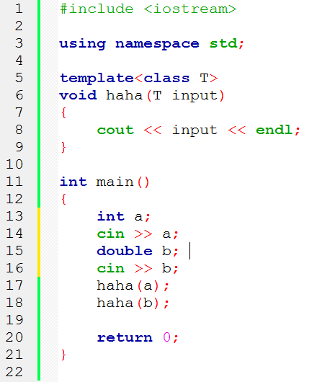
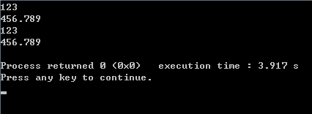
Template - example

Slide 4
Class template
Template parameters can be
Type template parameters
Non-type template parameters
Template template parameters
template <template_parameter_list>
class class_template_name{
……
}

Slide 5
Class template
Example
template <class T>
class A{
private:
T *ptr;
public:
FunctionA(T *a){……}
FunctionB(T *b);
}
template <class T>
A<T>::FunctionB(T *b){
…… }

Slide 6
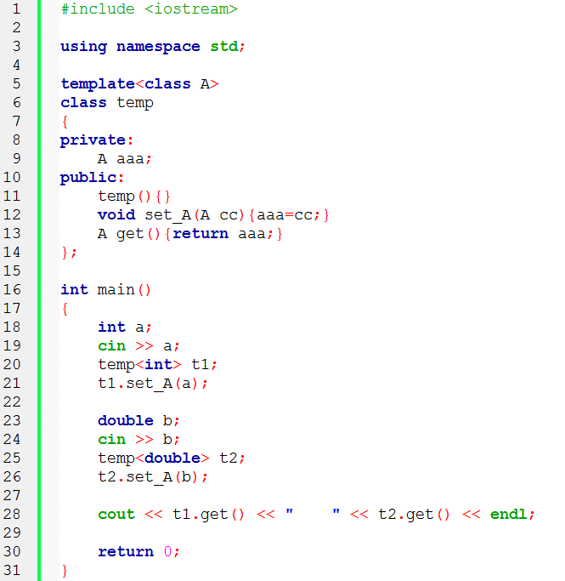
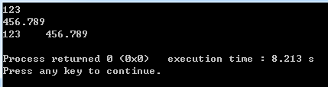

Slide 7
Container
Container used for storing objects in an organized way following specific access rules
Template type parameter can be used to specify type of
objects contained in a container
Types of container: vector, list, map, set……
vector
defined in vector header file
objects are stored in contiguous memory locations
Member functions of vector class template- size(), begin(), end(), push_back(), insert()……
C++ reference - vector
http://www.cplusplus.com/reference/vector/vector/?kw=vector

Slide 8
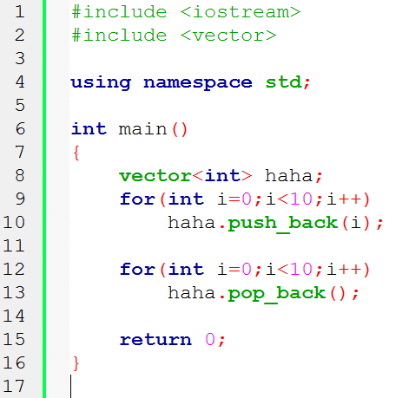
example

Slide 9
Iterator
Iterator is an object that enables a programmer to traverse a cotainer
Int main(){
vector<int> a;
a.push_back(100);
a.push_back(200);
a.push_back(300);
vector<int>::iterator it;
for(it = a.begin();it != a.end();it++)
cout<<*it<<“ “;
return 0;
}

Slide 10
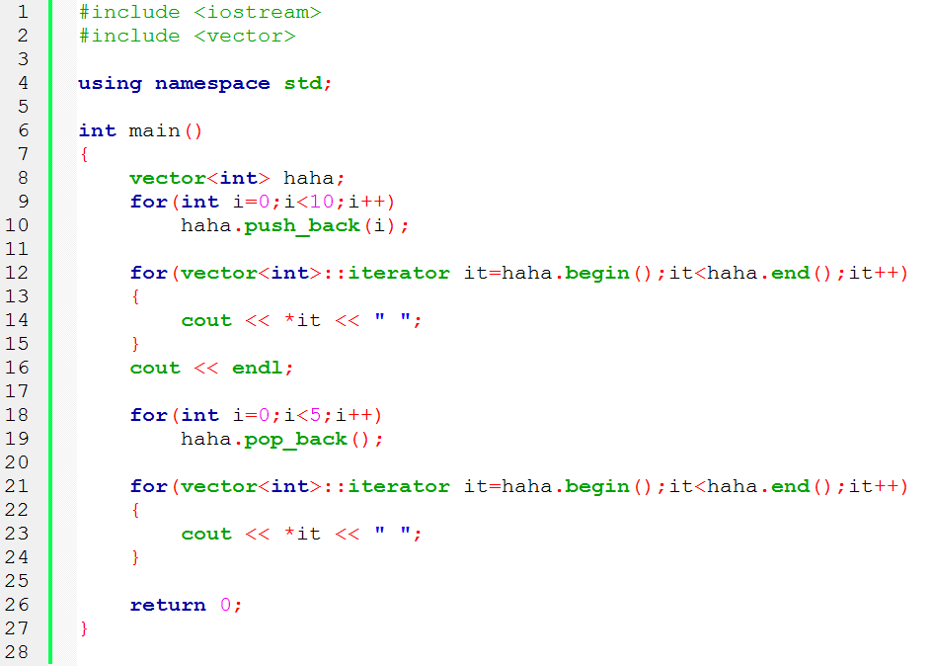

example

Slide 11
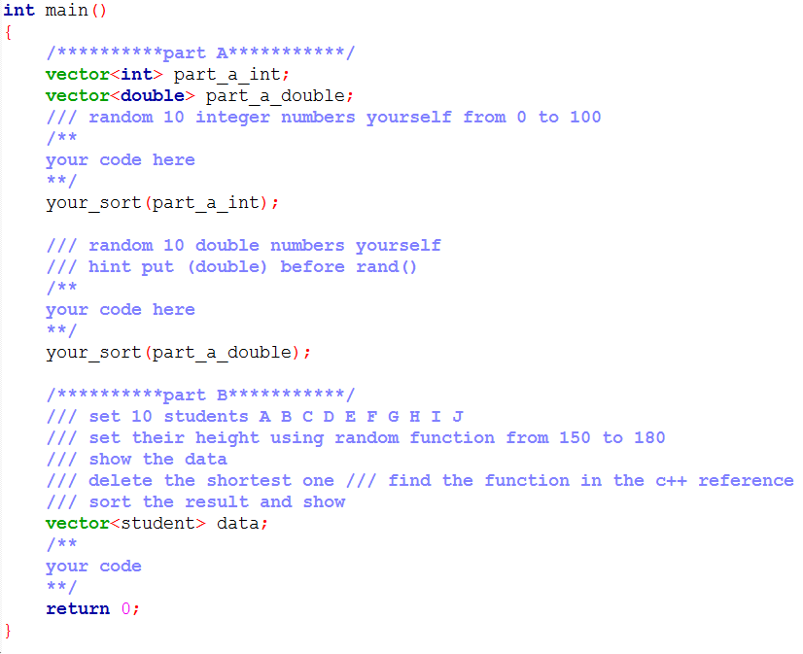
assignment

