Slide 1
LAB 7
Inheritance

Slide 2
Introduction
Inheritance is convenient for reusing code.
By implementing inheritance, a class(derived class) can inherit data members and member functions of another class(base class).
Inherited class is called base class.
Inheriting class is called derived class.

Slide 3
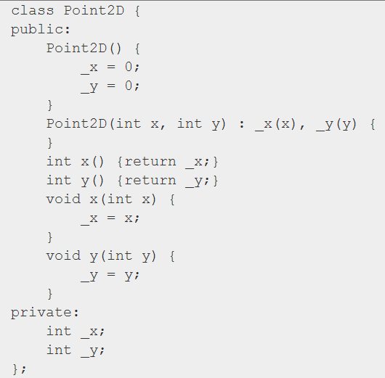
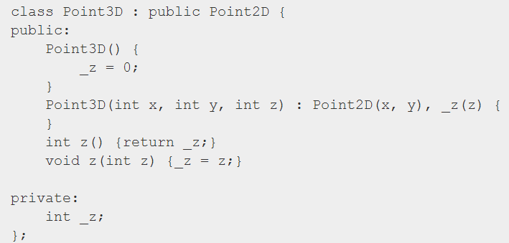
Introduction(cont.)

Slide 4
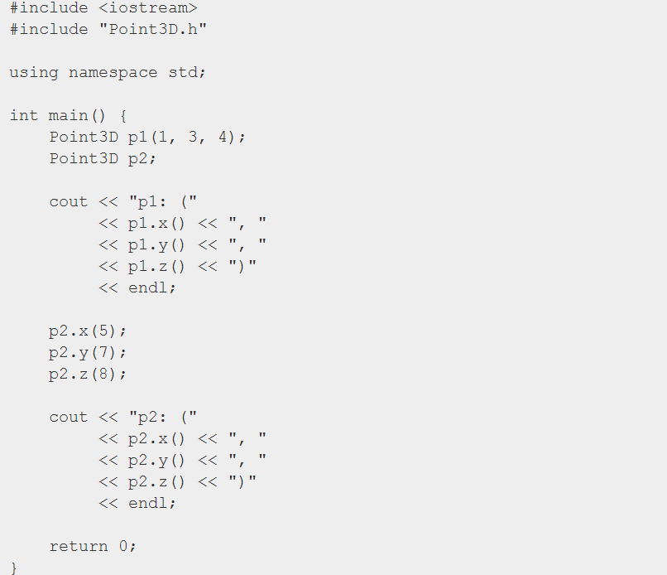

Introduction(cont.)

Slide 5
Introduction(cont.)
Public Inheritent
Base Class
Point2D
Data Member
Member Function
Derived Class
Point3D
Data Member
Member Function
int _x
int _y
int getx()
int gety()
void setx(int x)
void sety(int y)
int _z
int getz()
void setz(int z)
int _x
int _y
int getx()
int gety()
void setx(int x)
void sety(int y)
Data Member
Member Function

Slide 6
Class Declaration
Declaration
class <derived-class> : Access-level <base-class>
{
// derived-class body
// specific data members and member functions
}
Access-level could be
public
protected
private

Slide 7
Class Declaration(cont.)
Vehicle
Bike
Truck
Car
For example
Class Declaration
class Vehicle { … };
class Car : public Vehicle { … };
class Truck : public Vehicle { … };
class Bike : public Vehicle { … };

Slide 8

Member Access
Public members can be used
anywhere
Protected members can be used only by
member functions
friends
member functions of derived classes
friends of derived classes
Private members can be used only by
member functions
friends

Slide 9
Member Access(cont.)
class Book {
public:
string title;
Book() {
title = "OOP";
SN = "123-456-789";
price = 500;
}
void show() {
cout << "Book's title : " << title << endl; // OK
cout << "Book's SN : " << SN << endl; // OK
cout << "Book's price : " << price << endl; // OK
}
protected:
string SN;
private:
int price;
};

Slide 10
Member access(cont.)
class CSBook : public Book {
public:
void show() {
cout << "Book's title : " << title << endl; // OK
cout << "Book's SN : " << SN << endl; // OK
// Error: Since price is private in class Book
cout << "Book's price : " << price << end
}
};

Slide 11
Member access(cont.)
int main() {
Book B1;
cout << "Book's title : " << B1.title << endl; // OK
// Error: Since SN is protected in class Book
cout << "Book's SN : " << B1.SN << endl;
// Error: Since price is private in class Book
cout << "Book's price : " << B1.price << endl;
return 0;
}

Slide 12
Access Level
Public: Can be used by derived class
Private: Only can be used in class, even
the derived class can’t used
Protected: Let derived class can use
member of base class

Slide 13
Access Level(cont.)
Public Inheritance
Assume B is a public base
Class A : public B{ }
B’s private members will be hidden
B’s public and protected members’ access level unchange
Only public members can be accessed directly by the Derived object
Member in base class | Private | Protected | Public
Member in derived class | Hidden | Protected | Public

Slide 14
Access level(cont.)
Class A{
public:
int a;
protected:
int b;
private:
int c;
Class B{
public:
a, x;
protected:
b, y;
private:
z;
Class B : public A{
public:
int x;
protected:
int y;
private:
int z;

Slide 15
Access Level(cont.)
class Base //開始定義類別
{
private: //宣告private等級的成員
int pri_att;
void pri_show(){
cout << "Base::pri_show() is called!" << endl;
}
protected: //宣告protected等級的成員
int pro_att;
void pro_show(){
cout << "Base::pro_show() is called!" << endl;
}
public: //宣告public等級的成員
Base(): pri_att(1), pro_att(2), pub_att(3){}
int pub_att;
void pub_show()
{ cout << "Base::pub_show() is called!" << endl; }
};

Slide 16
Access Level(cont.)
class Derived : public Base
{
public: //宣告成員函數
void show_pro(){ cout << "Base::pro_att = " << pro_att << endl ; }
};
int main() //主程式開始
{
Derived A_Derived;
//cout << "A_Derived.pro_att = " << pro_att << endl; 無法直接存取
A_Derived.show_pro(); //需透過Derived物件成員函數才可存取
cout << A_Derived.pub_att << endl; //直接存取基本類別的資料成員
}

Slide 17
Access level(cont.)
Protected Inheritance
Assume B is a public base
Class A : protected B{ }
B’s private members will be hidden
B’s public members’ level will be set into protected
B’s protected members’ level unchange
Only public members can be accessed directly by the Derived object
Member in base class | Private | Protected | Public
Member in derived class | Hidden | Protected | Protected

Slide 18
Access level(cont.)
Class A{
public:
int a;
protected:
int b;
private:
int c;
Class B{
public:
x;
protected:
a, b, y;
private:
z;
Class B : protected A{
public:
int x;
protected:
int y;
private:
int z;

Slide 19
Access level(cont.)
class Derived : protected Base{
public: //宣告成員函數
void show();
};
void Derived::show(){
cout << endl;
cout << "Base::pub_att = " << pub_att << endl;
cout << "Base::pro_att = " << pro_att << endl;
//cout << "Base::pri_att = " << pri_att << endl;
}
int main() //主程式開始 {
Derived A_Derived;
//cout << "Derived::pub_att = " << A_Derived.pub_att << endl; 無法存取
//cout << "Derived::pro_att = " << A_Derived.pro_att << endl; 無法存取
//cout << "Derived::pri_att = " << A_Derived.pri_att << endl; 無法存取
A_Derived.show();//需透過Derived物件成員函數才可存取
}

Slide 20
Access level(cont.)
Private Inheritance
Assume B is a public base
Class A : protected B{ }
B’s private members will be hidden
B’s public and protected members’ level will be set into private
Only public members can be accessed directly by the Derived object
Member in base class | Private | Protected | Public
Member in derived class | Hidden | Private | Private

Slide 21
Access level(cont.)
Class A{
public:
int a;
protected:
int b;
private:
int c;
Class B{
public:
x;
protected:
y;
private:
a, b, z;
Class B : private A{
public:
int x;
protected:
int y;
private:
int z;

Slide 22
Access level(cont.)
class Derived : private Base
{
public: //宣告成員函數
void show();
};
void Derived::show()
{
cout << "Base::pub_att = " << pub_att << endl;//存取基本類別的資料成員
cout << "Base::pro_att = " << pro_att << endl;//存取基本類別的資料成員
//cout << "Base::pri_att = " << pri_att << endl; 因隱藏無法存取
}
int main() //主程式開始
{
Derived A_Derived;
A_Derived.show();//必須透過show函數存取基本類別的資料成員
}

Slide 23
Constructor and Destructor
Base and derived class should have their own constructor and destructor.
Base class constructor will be called before derived class constructor.
Derived class destructor will be called before base class destructor.

Slide 24
Constructor and Destructor(cont.)
Assume class CB derived from base class CA
CA
Constructor calls:
CA -> CB
Destructor calls:
CB -> CA
CB

Slide 25
Constructor and Destructor(cont.)
class CA {
public:
CA() {
cout << "CA constructor" << endl;
}
~CA() {
cout << "CA destructor" << endl;
}
};
class CB : public CA {
public:
CB() {
cout << "CB constructor" << endl;
}
~CB() {
cout << "CB destructor" << endl;
}
};

Slide 26
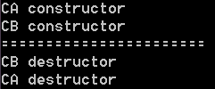
Constructor and Destructor(cont.)
int main() {
CB b;
cout << "=======================" << endl;
return 0;
}

Slide 27
Today Practice
Use the container in “vec.h” and class inheritance to implement Stack and Queue.
Please use the header file and main.cpp on E3.
You have to finish the definition of the public functions in “vec.h”.
You can’t add any new member function in “vec.h”.
There are two classes Queue and Stack in the next page.
You can only use the member functions in “vec.h” to implement the Queue and the Stack.

Slide 28
Hint
#include “vec.h”
class Queue : protected vec
{
private:
int front, rear;
public:
//your code here
};
class Stack : protected vec
{
private:
int top;
public:
//your code here
};

Slide 29
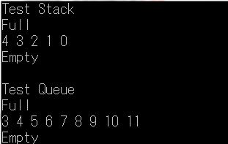
Smaple Output

