Slide 1
LAB10
Multiple Inheritance
Virtual Inheritance

Slide 2
Multiple Inheritance
Class B1
Class B2
Class C

Slide 3
Multiple Inheritance
Declaration
Class C: access-level base1_name, access-level base2_name{
…..
};
Example
Class B1{
…..
};
Class B2{
…..
};
Class C: public B1, public B2{
…..
};

Slide 4

Diamond Problem
Class A
int main(){
C c;
}
Class B1
Class B2
Result:
Class C

Slide 5

Virtual Inheritance
Use “ Virtual ” in inheritance to solve the problem.
Class A{
…..
};
Class B1: virtual public A{
…..
};
Class B2: virtual public A {
…..
};
Class C: public B1, public B2{
…..
};
Result:

Slide 6
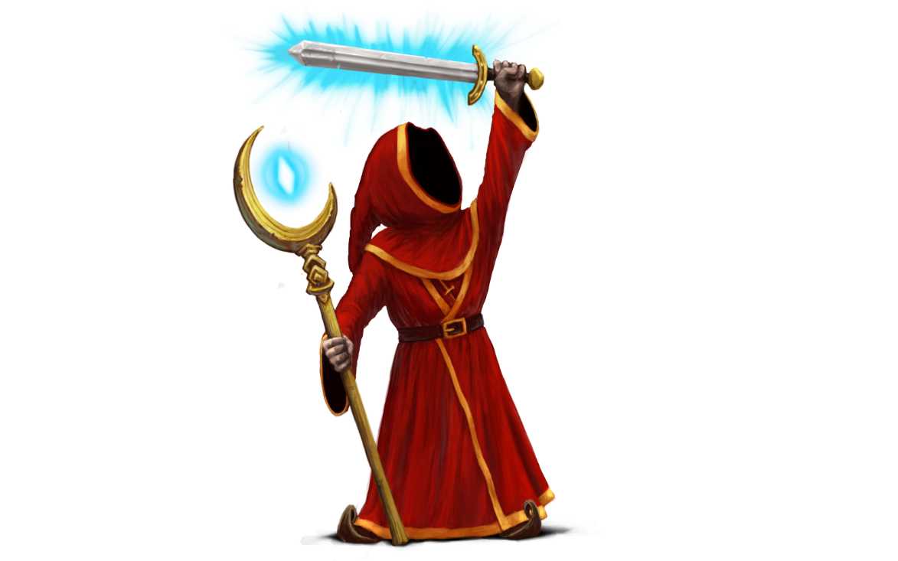
Requirement-Magicka!?
People
HP, Shield_HP
Swordsman
weapon
attack()
Wizard
wand
Spell_magic(skill)
Magicka

Slide 7
People class
People have HP and shield_HP member.
And your defined function.

Slide 8
Swordsman class
Inherited from People class
Swordsman has 3 kinds of weapon which one you can choose.
1). Sword → damage 10 to Boss.
2). M60 → damage 20 to Boss.
2). Excalibur → damage 100 to Boss.
Swordsman only attack by weapon.

Slide 9
Wizard class
Inherited from People class
Wizard has 3 kinds of wand which one you can choose.
1). Wood wand-> 1*damage to enemy.
2). Silver wand> 1.2 * damage to enemy.
2). Gold wand > 2 * damage to enemy.
Spell magic skill to attack enemy.
0). Shield → protected myself.
1). Fire/Water/Thunder → Use Fire/Water/Thunder and damage 50 blood to Boss.
2). Critical skill – Fire→Thunder→Fire→Fire→Water ,it damage 100 to Boss.

Slide 10
Magicka class
Magicka has 100 HP,and when Magicka spell shield magic, shield_HP = 100.
Inherited from Swordsman class and Wizard class
When magicka attack by weapon →
use Swordsman class’s method
When magicka attack by magic →
use Wizard class’s method
When you got damage from boss, your HP will decrease.
When you have shell to protect, you only get damage 40 on your shield_HP.
Notice NOT damage on your HP.

Slide 11
Boss class
Boss always attack you and damage 50 to you for each round.
Boss HP has 500 HP.

Slide 12
Requirement
You have to implement above 5 classes.
At Start, you need to choose weapon and wand to your magicka.
For each round,
0. Show magicka HP and Boss HP.
1.Boss attack your magicka. → show “ Boss attack!! ”.
2.You need to select attack or spell magic.
In magic mode,you have to spell skill
(Key in magic skill).
3. Show Boss and you what damage got.
4.Your HP got 0 →Show “Game Over”.
Boss HP got 0 →Show “You Win”.

Slide 13
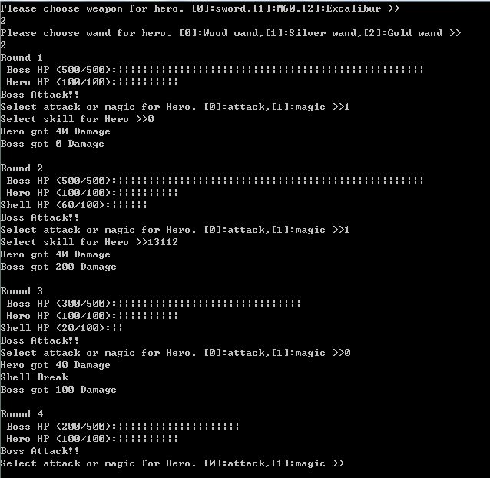
Shortcut
“|” represent 10 bloods
Spell Shield,
Next round need to show shield_HP
Spell critical magic
0 → Shield
1 → Fire
2 → Water
3 → Thunder
Shield_HP = = 0 Shell Break

