Slide 1
LAB8-Polymorphism

Slide 2
Binding
Binding:Binding the function’s name and the function’s address
Static binding:Binding at compile time.More efficiency but not flexible.
Dynamic binding:Binding at run time.Not efficiency but more flexible.

Slide 3
Polymorphism-pointer
C++ supports polymorphism through virtual methods and pointer
C++ allows a base class’s pointer pointing to either the bass class or derived class
int main()
{
Vector *vec; //Base class pointer
Stack s; //Derived class
vec = &s; //vec points to a Stack(derived class)
}

Slide 4
Polymorphism-pointer
It is not legal for a pointer form derived class pointing to a base class unless casting
int main() int main()
{ {
Vector vec; Vector vec;
Stack *s; Stack *s;
s = &vec; //error! s = (Stack*)&vec; //OK!
return 0; return 0;
} }

Slide 5
Polymorphism-virtual
class Vector{
public:
void show(){cout<<“I’m Vector!”<<endl;}
};
class Stack:public Vector{
public:
void show(){cout<<“I’m Stack!”<<endl;}
};
class Queue:public Vector{
public:
void show(){cout<<“I’m Queue!”<<endl;
};
int main(){
Vector vec;
Stack s;
Queue q;
Vector *vec1 = &vec;
Vector *vec2 = &s;
Vector *vec3 = &q;
vec1->show();
vec2->show();
vec3->show();
return 0;
}
Result: I’m Vector!
I’m Vector!
I’m Vector!

Slide 6
Polymorphism-virtual
class Vector{
public:
virtual void show(){cout<<“I’m Vector!”<<endl;}
};
class Stack:public Vector{
public:
virtual void show(){cout<<“I’m Stack!”<<endl;}
};
class Queue:public Vector{
public:
virtual void show(){cout<<“I’m Queue!”<<endl;}
};
int main(){
Vector vec;
Stack s;
Queue q;
Vector *vec1 = &vec;
Vector *vec2 = &s;
Vector *vec3 = &q;
vec1->show();
vec2->show();
vec3->show();
return 0;
}
Result: I’m Vector!
I’m Stack!
I’m Queue!

Slide 7
Polymorphism-virtual
If derived class is not redefined a virtual function, it is simply inherited in the usual way
If derived class redefined a virtual function in the base class, it must have the same prototype as the base class’s function, or it would hides the base class’s function
If the function in the base function is non virtual method, the derived class need to redefined all the function
class Vector{
public:
virtual void show();
virtual void show(int a);
virtual void show(double b);
};
class Stack:public Vector{
public:
virtual void show();
virtual void show(int a);
virtual void show(double b);
};

Slide 8
Requirement
Assume that there is a device controller in a computer named “Host”. The Host maintain a list of external storage devices.
Device can be a CD-ROM or a HardDisk. Each device is presented by it’s name(mount_Name) and a device number(mount_ID).
Device number(mount_ID) is decided by the mount order.Ex: CD-ROM A is the thrid mounted device in the Host, that is it’s number(mount_ID) is 3.
The device’s name can be renamed.
Class CD-ROM and class HardDisk is derived from base class named Device.
mount_ID and mount_Name only in class Device.
Class Host storage the mounted device’s name(mount_Name) and number(mount_ID). And you need to implement a function to mount device.
You need to implement a function to show information use polymorphism method.

Slide 9
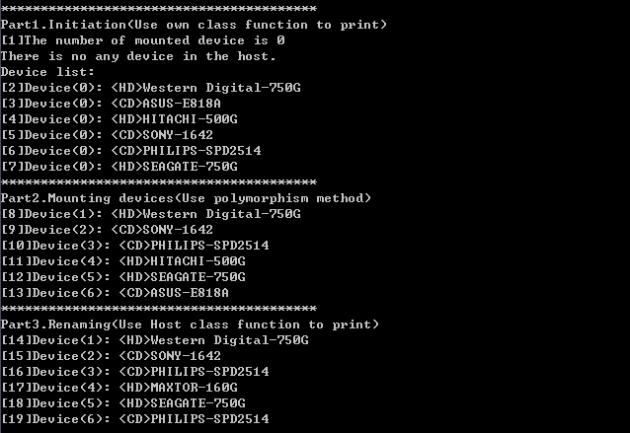
Requirement

