Slide 1
LAB3 - class
2015/03/17

Slide 2
outline
Introduction of class
Assignment

Slide 3
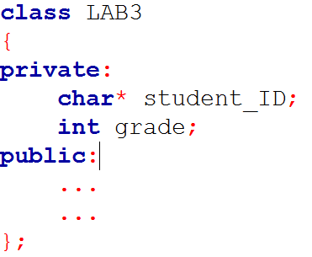
Class

Slide 4
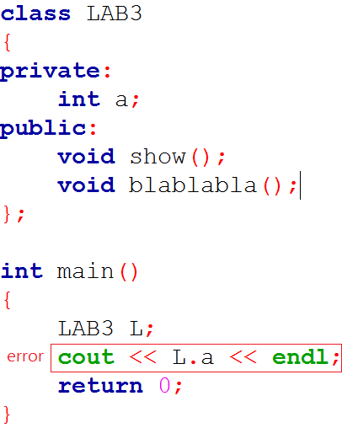
Class
Private
Public

Slide 5
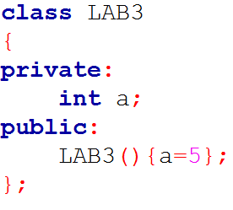
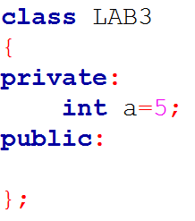
Constructor(1/3)

Slide 6
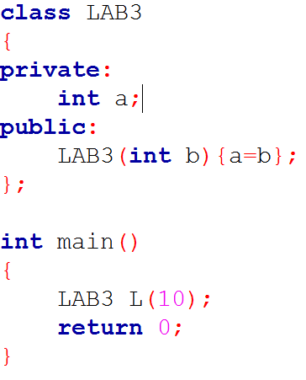
Constructor(2/3)

Slide 7
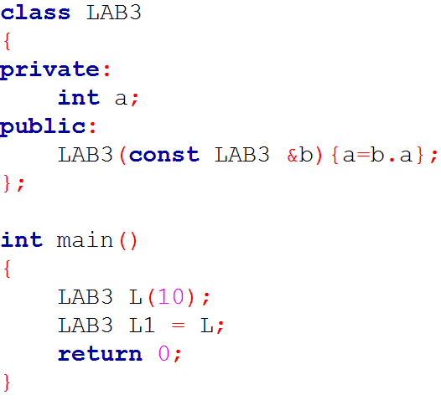
Constructor(3/3)
Copy constructor

Slide 8
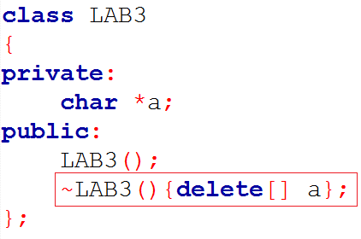
Destructor

Slide 9
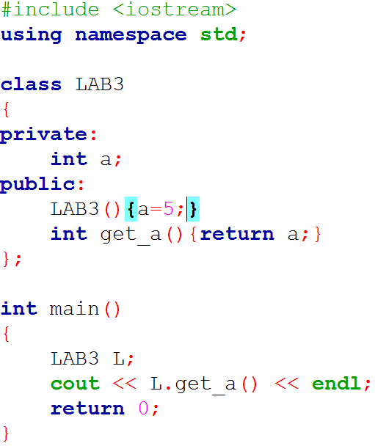
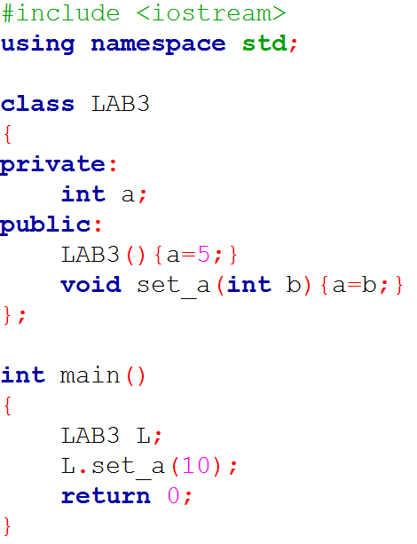
Private data

Slide 10
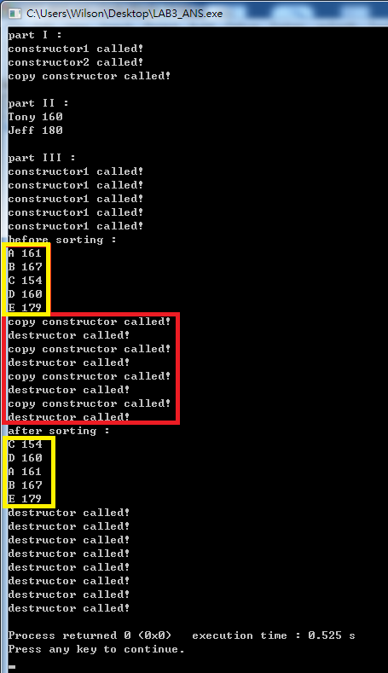
Assignment

