Slide 1

AIAP Tooling
Go to www.menti.com
and use the code 47 16 90

Slide 2
Contents
Python Conventions
Virtual Environments
Jupyter Tooling

Slide 3
PEP8
Documentation: https://pep8.org/
Main Points
Consistency
Be like English
“It’s just a guide”
-Me

Slide 4
Introduction
This document gives coding conventions for the Python code comprising the standard library in the main Python distribution. Please see the companion informational PEP describing style guidelines for the C code in the C implementation of Python. This document and PEP 257 (Docstring Conventions) were adapted from Guido’s original Python Style Guide essay, with some additions from Barry’s style guide. This style guide evolves over time as additional conventions are identified and past conventions are rendered obsolete by changes in the language itself. Many projects have their own coding style guidelines. In the event of any conflicts, such project-specific guides take precedence for that project.
Introduction
This document gives coding conventions for the Python code comprising the standard library in the main Python distribution. Please see the companion informational PEP describing style guidelines for the C code in the C implementation of Python.
This document and PEP 257 (Docstring Conventions) were adapted from Guido’s original Python Style Guide essay, with some additions from Barry’s style guide.
This style guide evolves over time as additional conventions are identified and past conventions are rendered obsolete by changes in the language itself.
Many projects have their own coding style guidelines. In the event of any conflicts, such project-specific guides take precedence for that project.

Slide 5
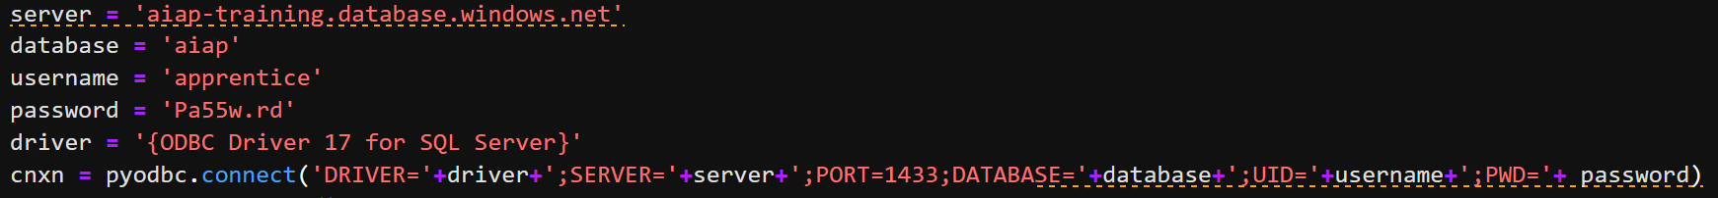
Line Length

Slide 6
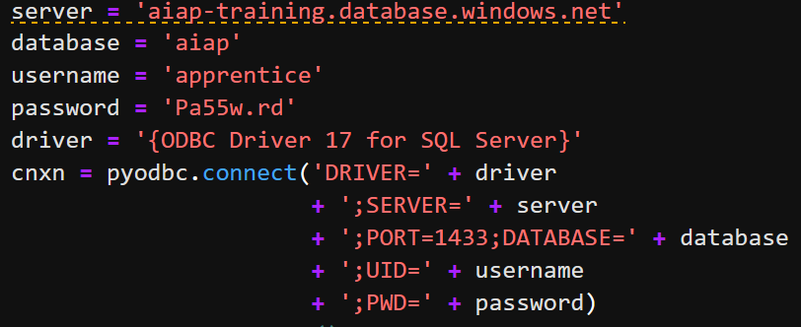
Line Length

Slide 7
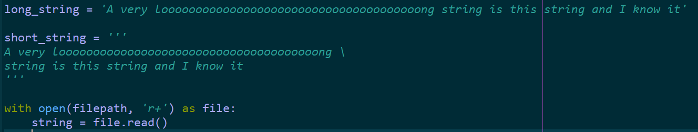
Line Length

Slide 8

Function Writing

Slide 9
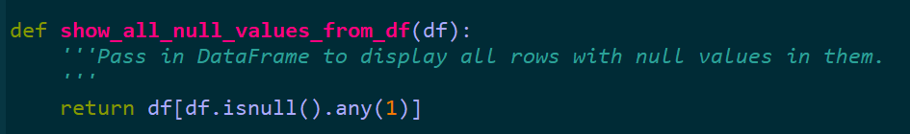
Function Writing

Slide 10
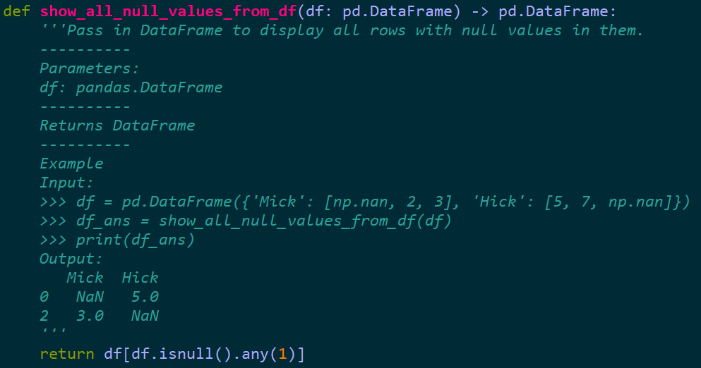
Function Writing

Slide 11
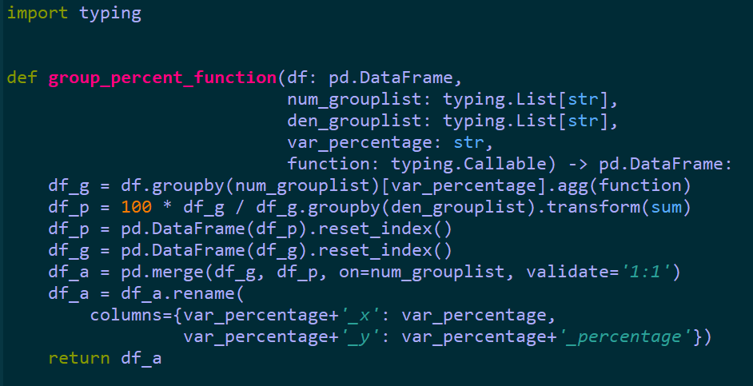
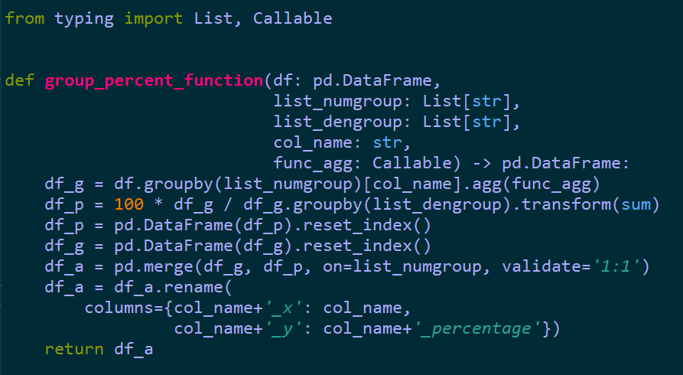
Function Writing

Slide 12
Dictionaries are good, use them

Slide 13
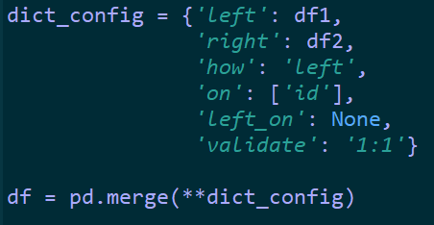
Dictionaries are good, use them

Slide 14
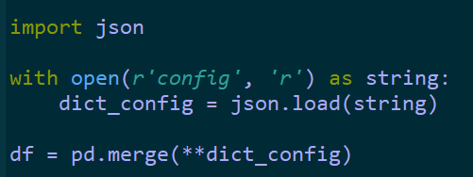
Dictionaries are good, use them

Slide 15
What is good code?
Main Points
Consistency
Be like English
Consider:
Wikipedia
Your own essay/journal
Revisits
import this

Slide 16
Virtual Environments
Conda vs pip
Smartphone vs Alarm Clock
Things to consider:
Size
Control (Deployment/Maintenance)

Slide 17
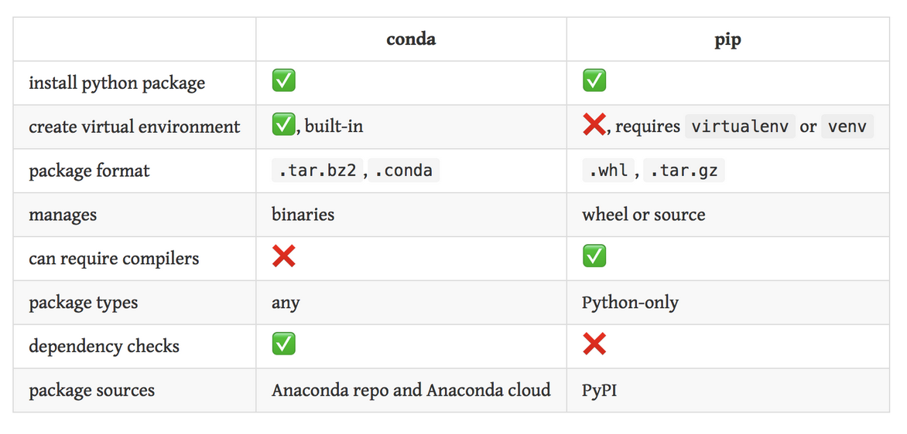
Virtual Environments

Slide 18
Virtual Environments
Simple tutorial on virtualenv:
pip install virtualenv -U
cd /directory
virtualenv /env_name
For Linux:
source /env_name/bin/activate
Or for Windows:
source /env_name/Scripts/activate
pip install -r requirements.txt
pip freeze -l > requirements.txt
deactivate

Slide 19
Jupyter Tooling
Jupyterlab
Console
Directory
Tabs
Extensions
pip install jupyterlab

Slide 20
Jupyter Tooling
To install Extensions, first install Node.js.
jupyter labextension install jupyterlab-drawio
pip install jupyterlab-git
Git Bash aliases
alias python='winpty python.exe'
alias jupyterlab='python -m jupyterlab & disown’
Other useful stuff
pip install spyder
pip install youtube-dl
pip install tagui
nbconvert

Slide 21
Slides
https://github.com/ycx91/aiap_tooling/blob/master/aiaptooling.pdf

