Slide 1
The relationship between temperature, humidity and human stress
PRINCIPLES AND APPLICATIONS OF DATA SCIENCE GROUP PROJECT PROPOSAL
Name: 顏翊純、黃彥文
Sid: 110599002、109598113
Date: 04/20/2022
National Taipei University of Technology
Computer Science and Information Engineering

Slide 2
OUTLINE
Introduction
Motivation
Contributions
Objectives
Plan and Deadlines
Related Work and Resources
Methodology and Tools
Expected Results
Timeline

Slide 3
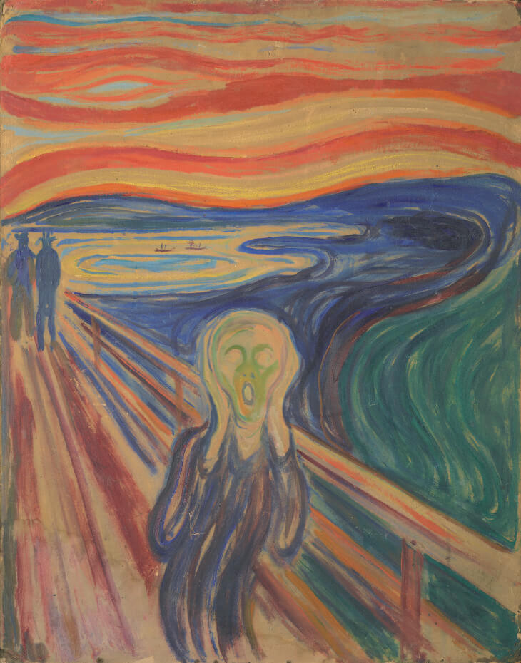
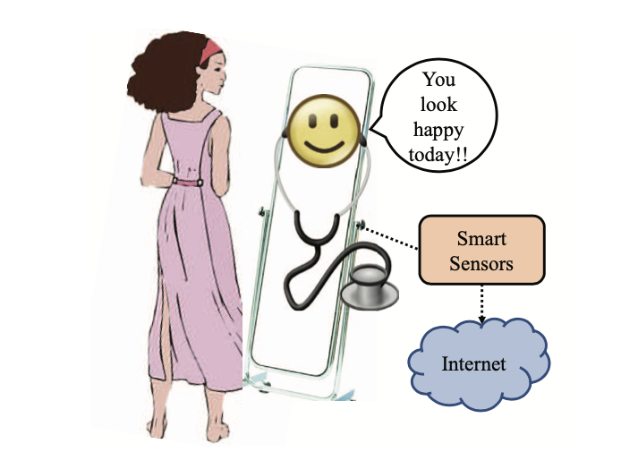
INTRODUCTION Motivation
Edvard Munck
the scream (1893)
Overview of the iStress System created by niversity of North Texas's students
Notes:
This is the paintings, The Scream, which is drawn by Edvard Munch and it can be seen as a symbol of modern spiritual anguish. Stress is everywhere in our daily life. New York Times has written the article, which titled is << His College Knew of His Despair. His Parents Didn’t, Until It Was Too Late.>>, and it used the word “despair” to talking about the university students may go through in America.We realized that there are more and more people suffer from Depression or Bipolar Disorder recently.
We thought stress is an important issued that people need to face today, so we start to found that if there is something we can do before these happens. We start to search for human stress, and two papers written by University of North Texas's students of computer science were found. They create an IoT device which can detect the data from human body that can help to detect the stress immediately. We used the data provided by this project to create a model which can predict the human stress by temperature and humidity.

Slide 4
INTRODUCTION Contributions and Objectives
Contributions
Most of people suffer a big stress and they are not conscious of when it started.
Help to realize stress earlier before it grow larger
Objectives
Create a model which can predict the human stress by temperature and humidity data.
Notes:
We found that most of them have some common personality, they suffer a big stress at the end, but they are not conscious of when these stresses started. We hoped that we can create a model which can predict the stress, by this way, people may can do something relaxing at the beginning to make these stress don’t grow larger and larger.

Slide 5
PROJECT PLAN AND DEADLINES Related Work and Resources
L. Rachakonda, S. P. Mohanty, E. Kougianos, and P. Sundaravadivel collected the data from IoT devices. These data classified the stress to three levels, and higher level means higher stress.
Analyze these data, see their relationship:
Draw the scatter graph to see the distribution.
Use correlation coefficient to check their correlation.
Use different algorithms (Supervised learning) to create the model:
Use K-NN algorithm to create a model and calculate the accuracy.
Use SVM algorithm to create a model and calculate the accuracy.
Use Decision Tree algorithm to create a model and calculate the accuracy.
Use the data of humidity and temperature from Taiwan to see the prediction of stress level in a year.

Slide 6
PROJECT PLAN AND DEADLINES Methodology, Tools and Expected Results
Methodology
correlation coefficient
K-NN
SVM
Decision Tree
Tools
Jupyter notebook
Python Library
Expected Results
Analyze the relationship between temperature, humidity and stress.
Create a model which can use temperature and humidity to predict the stress level.

Slide 7
PROJECT PLAN AND DEADLINES Timeline
3/10
discuss project plan
4/14
midterm report & presentation practice
4/20
Final Demo
3/17
3/27
4/02
4/07
plots data directly & analyze
environment setting
k-nn practice
midterm report
Proposal Presentation
6/15
4/28
5/05
5/12
5/26
6/02
correlation coefficient
SVM
Decision tree
Use temperature and humidity to predict stress level
Final report

