Slide 1
Final Project Smart Mailbox
Group 4
黃昱維 葉為元 松井孔明
林昱龍 顏毓均

Slide 2
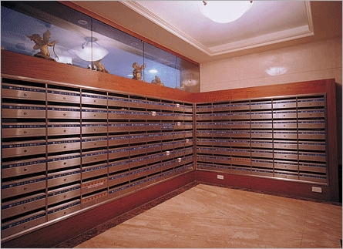

Slide 3

You have got a letter !

Slide 4
Design

Slide 5



got a letter !
IR remote
Mail Box

Slide 6

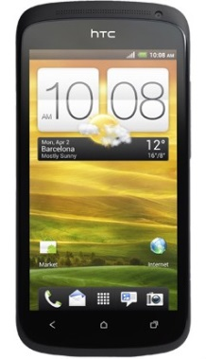
雲端/伺服器
Notification
wifi
Raspberry Pi
APP

Slide 7
What we need?

Slide 8
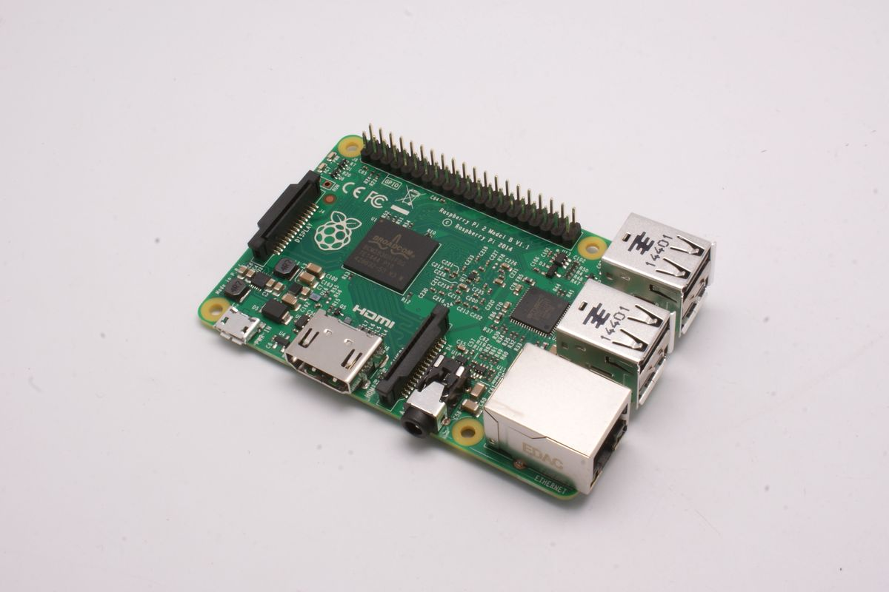
Raspberry Pi
http://www.raspberrypi.com.tw/4063/54/

Slide 9
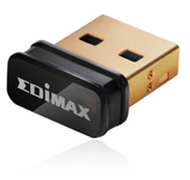
EW-7811Un Wireless 802.11n 高效能隱形USB無線網路卡

Slide 10
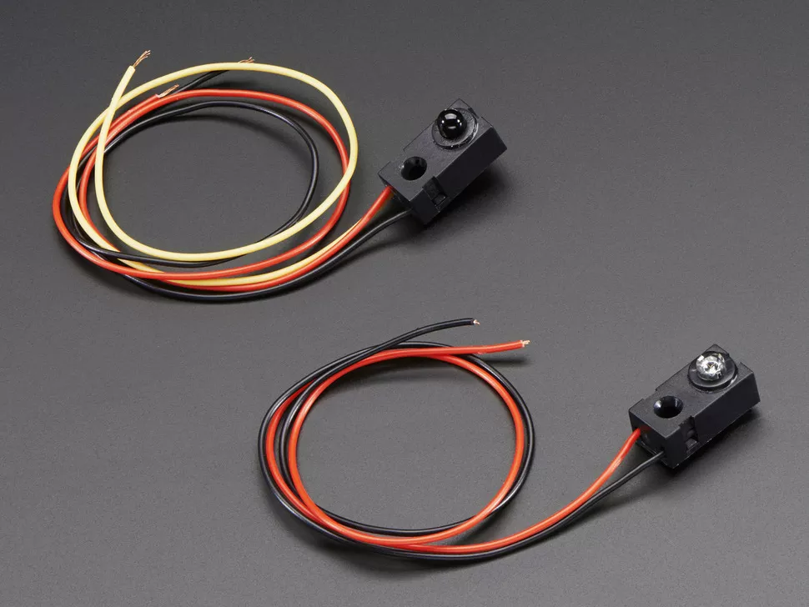
Infrared (IR) break-beam sensors
https://www.adafruit.com/products/2168

Slide 11

Mail Box

Slide 12
Thank you for listening.

