Slide 1


ECE 420 Final Project Presentation
Electrical & Computer Engineering
By Ethan. Z & Eric. T
May 3rd 2024

Slide 2

Table of content
1. App operation overview
a. Introduction
b. User Interface
2. System Designs
a. System level algorithm
b. System architecture
3. Algorithms
a. REPET
b. Pitch correction
4. Results & Feedback
a. Demo
ELECTRICAL & COMPUTER ENGINEERING
GRAINGER ENGINEERING

Slide 3
App Operation Overview
ELECTRICAL & COMPUTER ENGINEERING
GRAINGER ENGINEERING

Slide 4

Introduction
Purpose & Function
The Main functionality of our app is to provide auto-tune feature, which adjusts the pitch of the user’s singing to a pre-processed or live-recorded soundtrack. Allowing users to enhance their vocal performance.
A key feature of the app is its ability to separate BGM and vocal components from any song captured via Android’s integrated microphone. This method allows individual component of the song to be analyzed and manipulated.
Algorithms Used
Repet for BGM/Vocal separation,
TD-PSOLA for Pitch Synthesis,
STFT/Autocorrelation for spectrum analysis.
ELECTRICAL & COMPUTER ENGINEERING
GRAINGER ENGINEERING

Slide 5
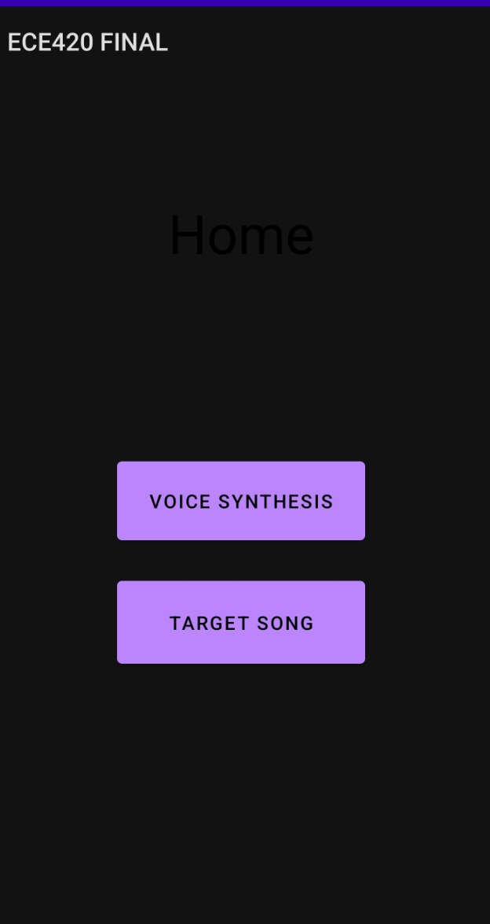
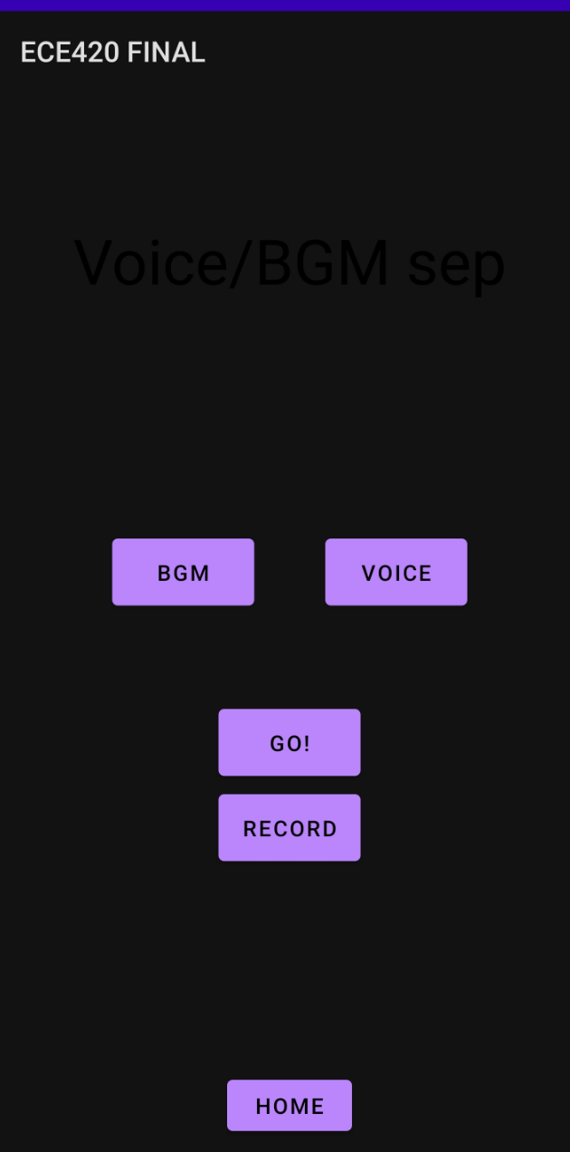
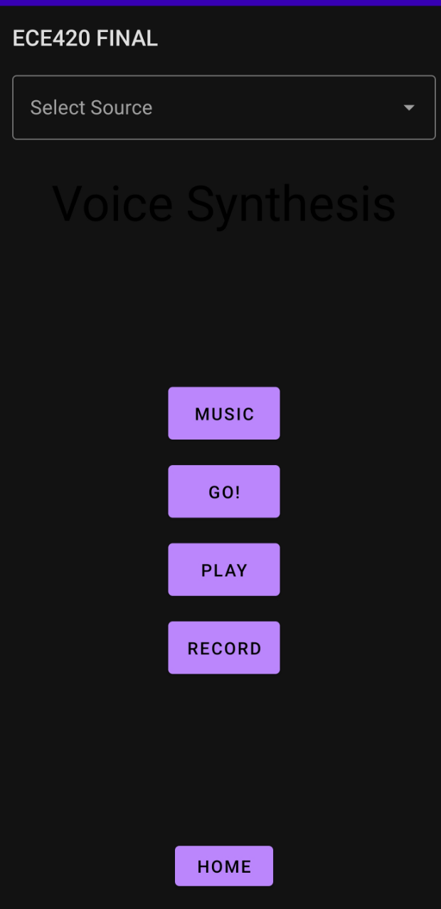
User Interface
Home Screen Target Song Screen Voice Synthesis Screen
Select source of target BGM
Play the BGM
Play the BGM
Play the vocal component
Go to Voice Synthesis screen
Encode and store the result
Encode and write the processing result (BMG & Vocal) to storage
Play the Result
Go to BGM/Vocal processing
screen
Record the song and encode/ write to storage
Record the song
Go to Home Screen
ELECTRICAL & COMPUTER ENGINEERING
GRAINGER ENGINEERING

Slide 6
System Designs
ELECTRICAL & COMPUTER ENGINEERING
GRAINGER ENGINEERING

Slide 7
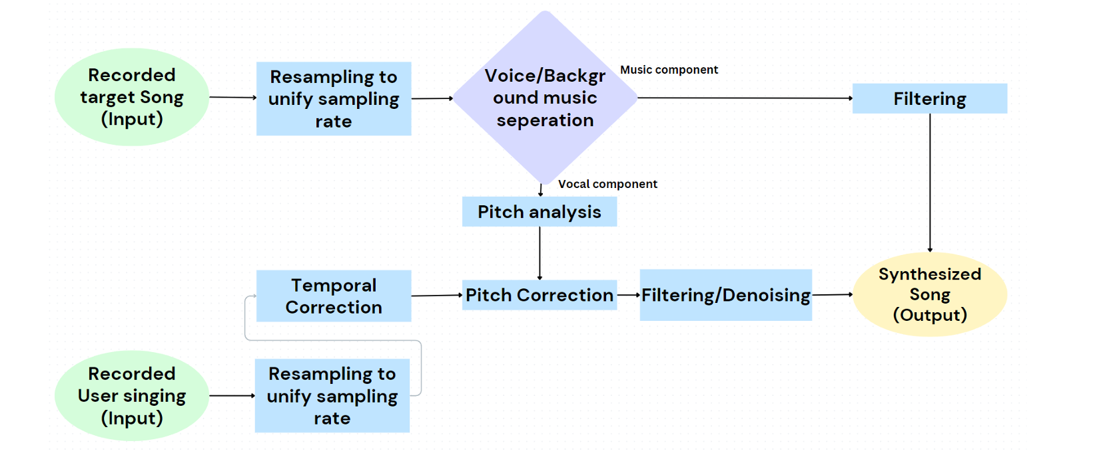
System level algorithm
ELECTRICAL & COMPUTER ENGINEERING
GRAINGER ENGINEERING

Slide 8
System Architecture
REPET
Processes
(C++)
APK storage
All audio data are stored in storage in stead of loaded in the memory
The encoding and decoding of audio data is handled by ffmpeg in Java/Kotlin
The Front end passes decoded audio data (int16 array) to the C++ Processing Frames
Front end
(JAVA/KOTLIN)
Run time storage
Pitch Synthesis
Processes
(C++)
ELECTRICAL & COMPUTER ENGINEERING
GRAINGER ENGINEERING

Slide 9
Algorithms
ELECTRICAL & COMPUTER ENGINEERING
GRAINGER ENGINEERING

Slide 10
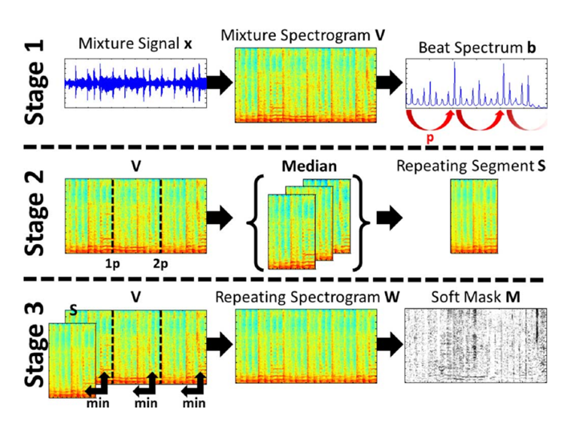
REpeating Pattern Extraction Technique (REPET)
Purpose of REPET: REPET is specifically designed to identify and extract repeating musical structures from a mixed audio signal.
How It Works: The algorithm operates by exploiting the repetitive nature of the background music in most recorded songs. REPET identifies the repeating patterns by analyzing the audio signal's spectrogram and isolates the background track from non-repeating components like vocals.
Run time storage
ELECTRICAL & COMPUTER ENGINEERING
GRAINGER ENGINEERING

Slide 11
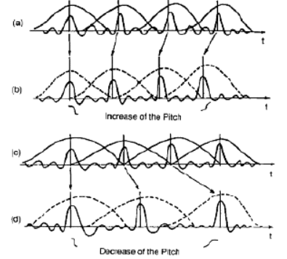
Pitch correction
Partition: the User singing and the vocal component will be partitioned to segments with 1024 samples of width
Frequency analysis: Autocorrelation will be applied to each segment of vocal component to detect fundamental frequency and period
Pitch Synthesis: Each segment of the user singing would be match with a segment from the vocal track. The segment will then be pitch changed to match the frequency of respective vocal track
Run time storage
ELECTRICAL & COMPUTER ENGINEERING
GRAINGER ENGINEERING

Slide 12
Results & FeedBack
Demo/ Q&A
ELECTRICAL & COMPUTER ENGINEERING
GRAINGER ENGINEERING

Slide 13


