Slide 1
Course-Project Applied Data Analytics II
Youssouf Diallo

Slide 2
Plan
Research statement
Dataset Description
Applied Data analytics
Algorithms applied
Conclusion

Slide 3
Research statement
1- Predict the amount purchased by a client
2- Identify which Age group tend to buy a lot during a Black Friday sale
3- Which city is more productive
4- Segment customers based on their spending

Slide 4
Dataset Description
Features 12 columns with 537,577 observations
Link: https://www.kaggle.com/mehdidag/black-friday/version/1
Product_ID: Help identify a product in the store
Gender: Define the user gender which will be either Male (M) or Female(F)
Age: Define the age of users [0-17[, [18-25[, [26-35[, [36-45[, [46-50[, 55+

Slide 5
Dataset Description
Occupation: Define the occupation of each customer
City_Category: The store is implanted in three different city (A, B, and C)
Stay_In_Current_City_Years: Define how many years, a customer resides in a city
Marital_Status: Define the customer's status 1 for married and unmarried
Product_Category_1: Define the number of items purchased within the Product_Category_1
Product_Category_2: Define the number of items purchased within the Product_Category_2
Product_Category_3: Define the number of items purchased within the Product_Category_3
Purchase: Define the amount spent by each customer to purchase the three products. The amount purchased is in US dollars.

Slide 6
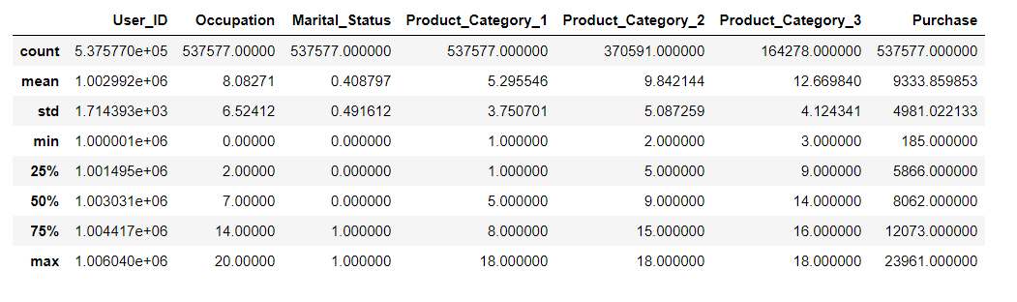
Descriptive statistics

Slide 7
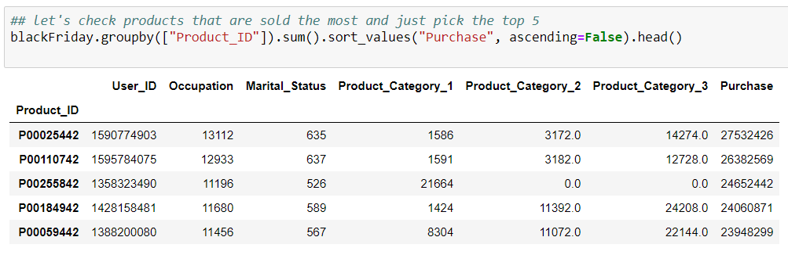
What was the most profitable product on Black Friday ?
Product with ID (P00025442) was the most profitable

Slide 8
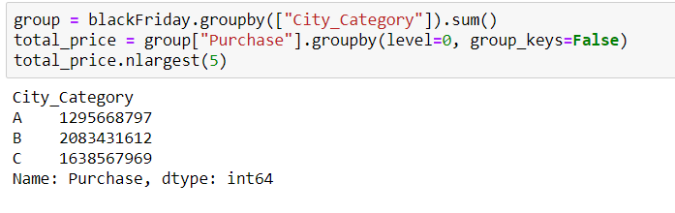
What was the most profitable city?
The result shows that City B was the most profitable

Slide 9
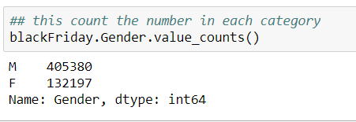
Determine which gender buy a lot
Men 75.40 % and 24.6 % women

Slide 10
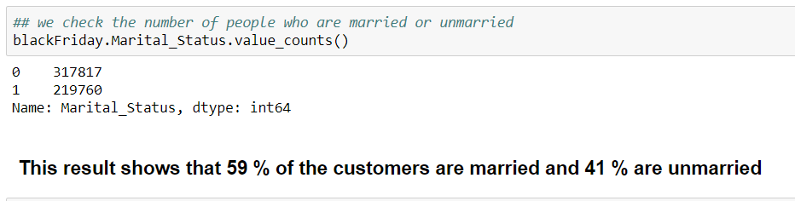
Marital status of customers

Slide 11
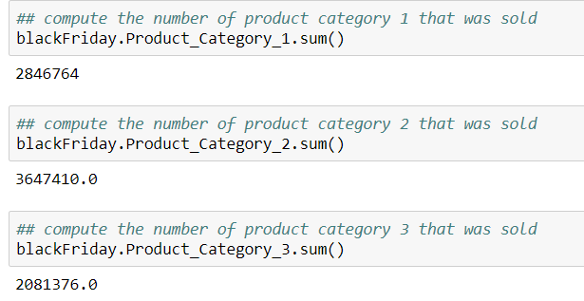
Number items sold for each category
Product category 2 was the most sold

Slide 12
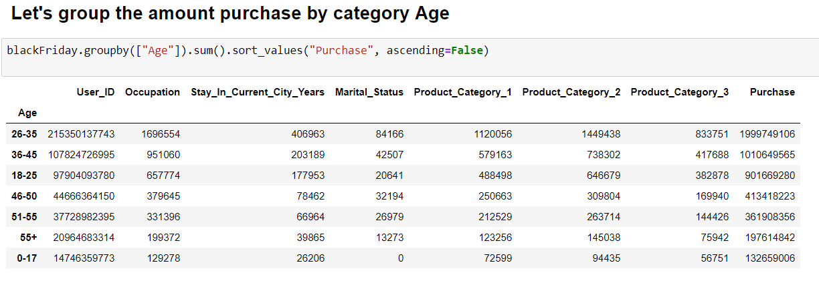
Amount spent by age group
[26-35 [ spent a lot
[0-17 [ spent less

Slide 13
Data preparation
Handling missing values
Changing data types
Split into training and testing
Fill NaN with Zero
Float to int and object to int

Slide 14
Linear Regression
Predict the amount purchased by a client using Regression Analysis
X = independent variables, or explanatory variables (Occupation, Marital_Status,Stay_In_Current_City_Years,Product_category1,2 and 3
Y = Purchase (referred to as the dependent variable or response variable)

Slide 15
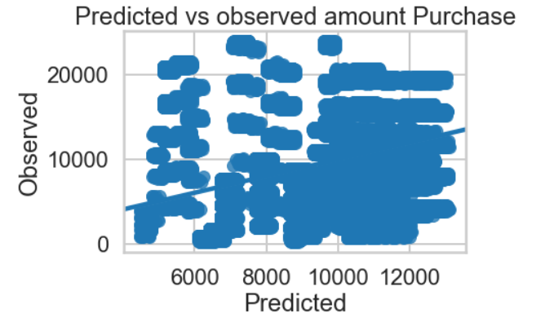
Regression Plot
Accuracy of score is 13 %
Very bad performance

Slide 16
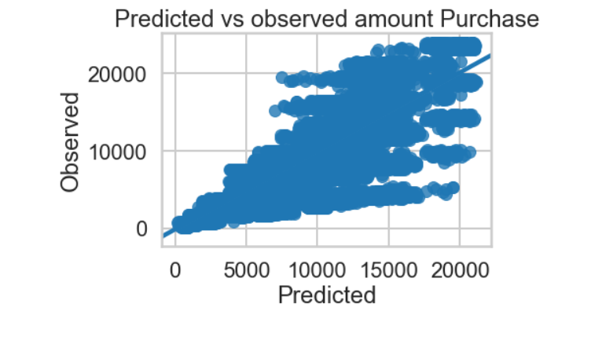
Extreme Gradient Boosting Regressor(XGBoost)
XGBoost has improved our model and the accuracy moves from 0.13 to 0.459 %

Slide 17
Decision Tree Classifier
Identify which Age group tend to buy a lot during a Black Friday sales
Input: Occupation, Stay_In_Current_City_Years, Marital Status, Purchase, Product_Category_1, Product_Category_2, and Product_Category_3
Target: Age ([0-17[, [18-25[, [26,35[, [36-45[, [46-50[, [51-55[, and 55+)
The accuracy score is 41.68%.
How can we improve?
Criterion="entropy",max_depth=8)
The accuracy score is 50.6 %

Slide 18
Decision Tree Classifier
Identify which Age group tend to buy a lot during a Black Friday sale
Target= Age
Input = (Occupation, Stay_In_Current_City_Years, Marital_Status,Purchase,Product_Category_1,Product_Category_2,Product_Category_3)
we find that the accuracy of the decision tree classifier is 41.68%

Slide 19
Decision Tree Classifier
Determine which city is more productive
Target= City
Input = (Occupation,Marital status Stay_In_Current_City_Years,Purchase, Product_Category_1,Product_Category_2,Product_Category_3)
The accuracy of the model is 42.23 %
How can we improve the score?
Use XGboost Classifier
The accuracy of the model is 44.88 % the model improves slightly with XGboost

Slide 20
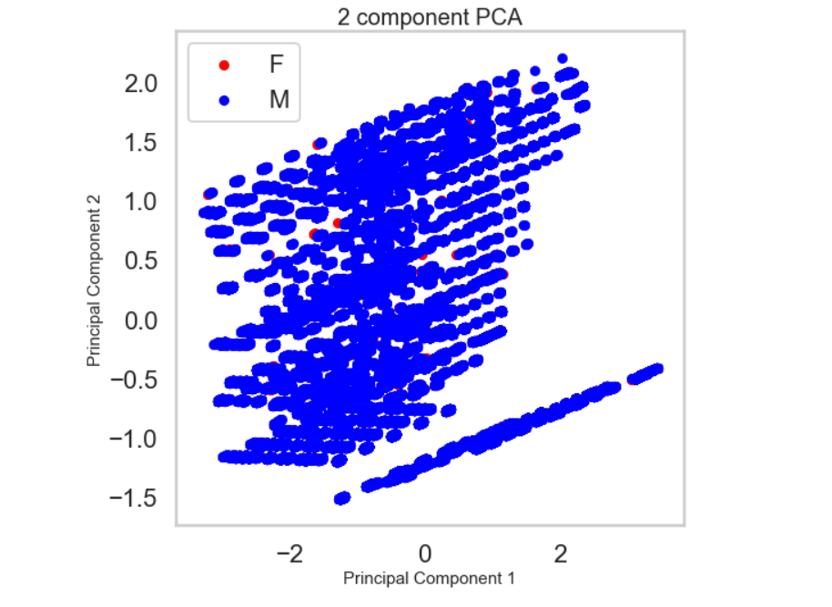
Principal Component Analysis
Segment customers based on their spending
Target= Gender
Input=(Purchase, product_1, product_2, product_3)

Slide 21
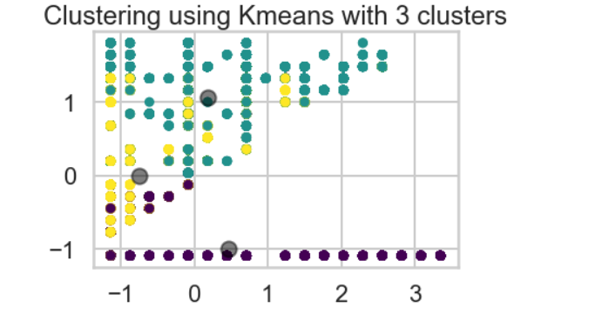
K-Means Clustering
we clearly see that the data are not around the cluster, that means the clustering did not work well

Slide 22
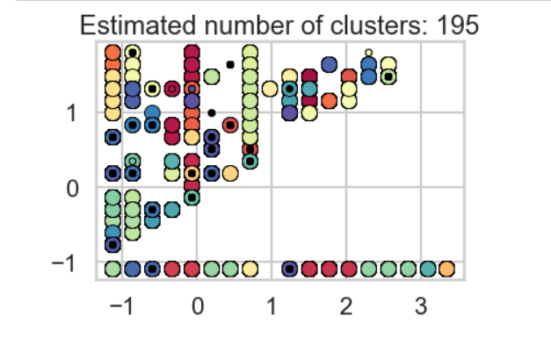
Density Based Spatial Clustering of Application with Noisy (DBSCAN)
The accuracy of the model is 42.80 %
Number of clusters: 195
Number of noise points: 176

Slide 23
Conclusion
After trying different model and technique, I was able the predict the purchase amount, however, the classification and clustering did not perform well. Therefore, I cannot answer with clarity to those research questions.
For further research, I recommend looking at the classification and clustering to see if we can come up with an accurate response. I suggest looking into Deep learning.

Slide 24
Thank you
Do you have Questions?

