Slide 1
Colors, Fonts & Text
{ }
LESSON 2 OF 7
CSS
Make your pages readable, on-brand and easy to maintain
High school | Prior knowledge: Lesson 1 | ~45 min

Slide 2

Learning objective
Key terms
By the end of this lesson you can:
Hex code
A colour written as #RRGGBB: red, green and blue amounts in base 16, like #2965f1.
Choose colours with names, hex codes, rgb() and hsl()
Unit
What a number measures: px (pixels), rem (a multiple of the root font size), % and more.
Style text with font-family, font-size, line-height and text-align
Typeface
A family of letter designs, such as Arial or Georgia. In CSS: font-family.
Store reusable values in CSS variables
CSS variable
A named value, written --name, that you reuse with var(--name). Also called a custom property.

Slide 3
The big ideas
1
2
3
One colour, many notations
Text is about readability
Units: px vs rem
Colours can be a name, a hex code, rgb() with three 0-255 numbers, or hsl() with hue (0-360 degrees), saturation and lightness. hsl is the easiest to tweak by hand.
Choose a font-family with a fallback, a comfortable font-size, a line-height around 1.5 to 1.7, and enough contrast between text and background.
px is a fixed size. rem is relative to the page's root font size (16px by default), so text scales when a user changes their browser settings. Prefer rem for font sizes.
hsl(222, 88%, 55%)
line-height: 1.6;
font-size: 1.25rem;

Slide 4
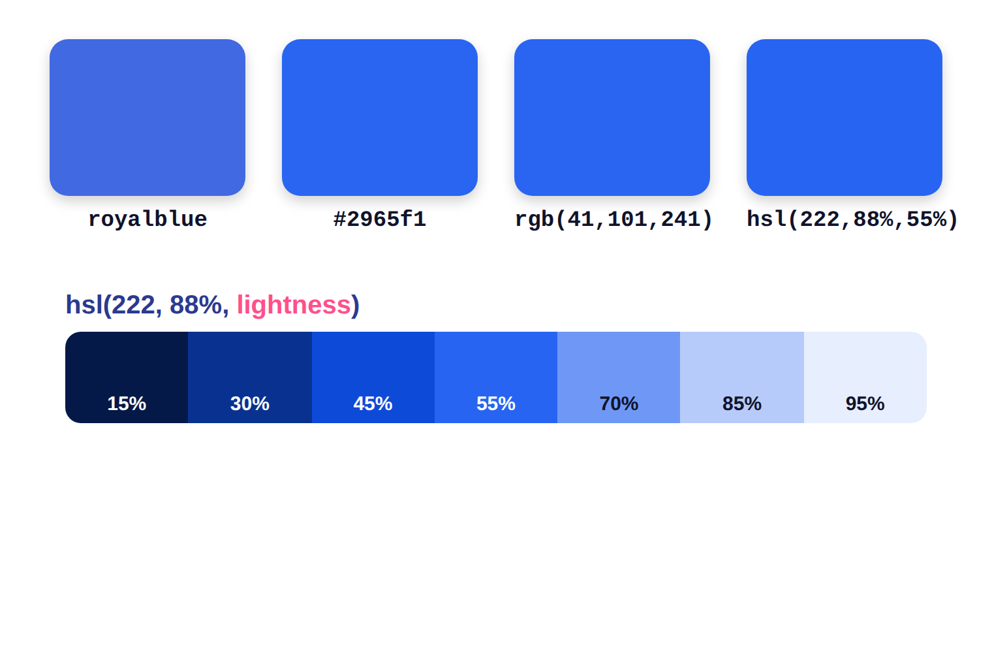
One blue, four ways to write it
1
The same colour can be written as a name, hex, rgb() or hsl().
2
In hsl(), hue is the colour on a 0-360 degree wheel; saturation is how vivid; lightness is how bright.
3
Keep hue and saturation, change only lightness: instant shades for hover and borders.

Slide 5
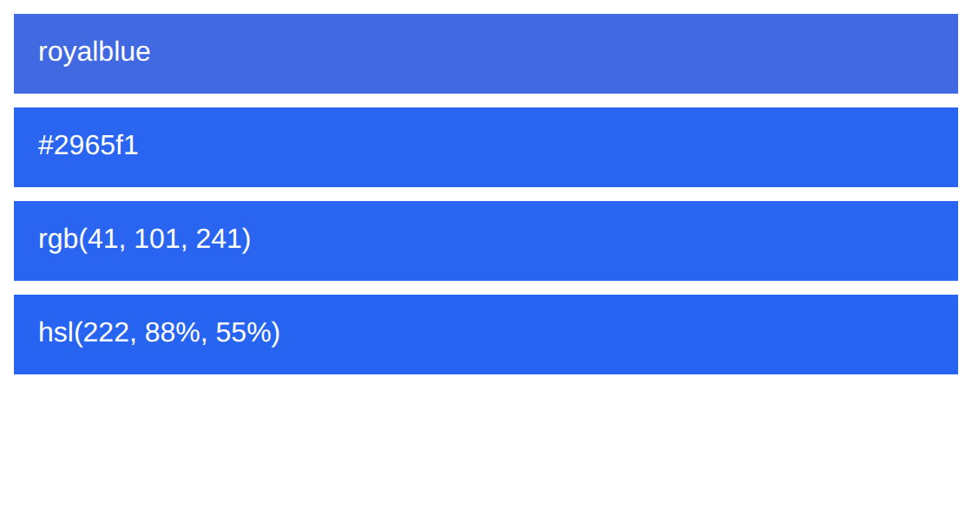
Example 1: Four ways to write a colour
These four boxes use the same blue written in different notations.
style.css
lesson2/example1/index.html
.box {
color: white;
padding: 14px;
font-family: Arial, sans-serif;
margin-bottom: 8px;
}
.a { background: royalblue; }
.b { background: #2965f1; }
.c { background: rgb(41, 101, 241); }
.d { background: hsl(222, 88%, 55%); }
1
2
3
4
5
HTML used
1
margin-bottom adds space below each box (see Lesson 3).
<div class="box a">royalblue</div>
<div class="box b">#2965f1</div>
<div class="box c">rgb(41, 101, 241)</div>
<div class="box d">hsl(222, 88%, 55%)</div>
2
A colour name: easy to read, but only about 140 exist.
3
Hex #RRGGBB: red, green and blue amounts from 00 to ff.
4
rgb(): each channel is a number from 0 to 255.
5
hsl(): hue 0-360 degrees, then saturation and lightness in %.
Notes:
1. margin-bottom adds space below each box (see Lesson 3).
2. A colour name: easy to read, but only about 140 exist.
3. Hex #RRGGBB: red, green and blue amounts from 00 to ff.
4. rgb(): each channel is a number from 0 to 255.
5. hsl(): hue 0-360 degrees, then saturation and lightness in %.

Slide 6
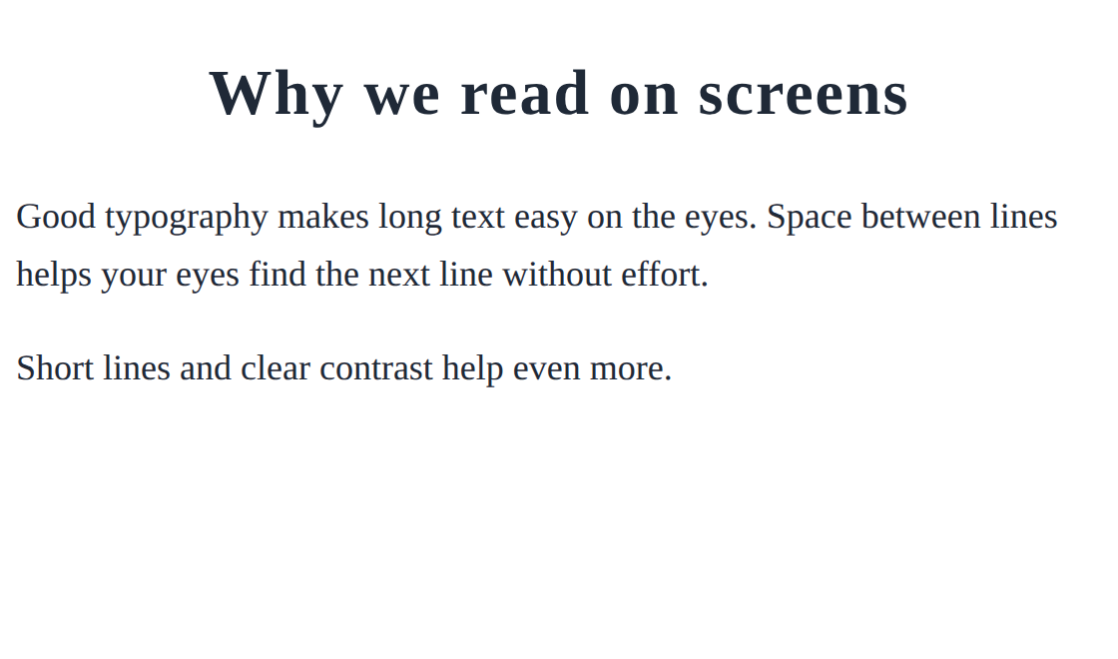
Example 2: Readable typography
Good text styling is mostly about size, spacing and alignment.
style.css
lesson2/example2/index.html
body {
font-family: Georgia, serif;
font-size: 18px;
line-height: 1.6;
color: #1f2937;
}
h1 {
font-size: 2rem;
text-align: center;
letter-spacing: 1px;
}
1
2
3
4
1
Georgia is a serif font; serif is the generic fallback if it is missing.
HTML used
2
line-height: 1.6 (no unit) means 1.6 times the font size.
<h1>Why we read on screens</h1>
<p>Good typography makes long text easy on the eyes. Space between lines helps your eyes find the next line without effort.</p>
<p>Short lines and clear contrast help even more.</p>
3
2rem = twice the root font size (32px by default).
4
text-align centres the heading; letter-spacing adds space between letters.
Notes:
1. Georgia is a serif font; serif is the generic fallback if it is missing.
2. line-height: 1.6 (no unit) means 1.6 times the font size.
3. 2rem = twice the root font size (32px by default).
4. text-align centres the heading; letter-spacing adds space between letters.

Slide 7

Example 3: CSS variables (custom properties)
Store a value once, reuse it everywhere, and change it in one place.
style.css
lesson2/example3/index.html
1
:root {
--brand: #2965f1;
--accent: #ff4f8b;
}
.btn {
background: var(--brand);
color: white;
border: none;
padding: 10px 20px;
border-radius: 8px;
}
.btn.alt { background: var(--accent); }
2
3
1
:root is the top of the page, so variables defined here work everywhere.
2
A custom property name always starts with two dashes.
3
var(--brand) reads the value. Change --brand once and every button follows.
4
4
.btn.alt (no space) targets elements with BOTH classes.
HTML used
<button class="btn">Join</button>
<button class="btn alt">Donate</button>
Notes:
1. :root is the top of the page, so variables defined here work everywhere.
2. A custom property name always starts with two dashes.
3. var(--brand) reads the value. Change --brand once and every button follows.
4. .btn.alt (no space) targets elements with BOTH classes.

Slide 8




Real-world: brand colours and readable text
Brand identity
Accessibility
Respecting user settings
Companies keep brand colours in variables, so a redesign means changing a few lines instead of hundreds.
Enough contrast and a sensible line-height help people with low vision or dyslexia. Teachers and exam boards care about this too.
Using rem lets text grow when users raise their browser font size, instead of ignoring their needs.
Try it yourself: open DevTools (F12), select the body, and look at Computed. Find the font-family the browser really used and the font-size in px.

Slide 9
Common mistakes
Avoid
Do this instead
Why
font-family: Times New Roman;
font-family: "Times New Roman", serif;
Font names with spaces need quotes, and you should always add a generic fallback such as serif.
line-height: 1.6px;
line-height: 1.6;
With px you set a tiny fixed height. A unitless number scales with the font size.
color: #333;
background: #444;
color: #ffffff;
background: #1f2937;
Low contrast is hard to read. Aim for strong contrast between text and background.

Slide 10


Tips & best practices
Pick a small palette
Check contrast
Choose 1 main colour, 1 accent and a few neutrals. Store them as variables on :root.
DevTools shows a contrast ratio in the colour picker. Aim for 4.5:1 or better for body text.
Limit your fonts
Use hsl for shades
Two typefaces are plenty: one for headings, one for body text. More looks messy and loads slower.
Need a darker hover colour? Keep the hue and lower the lightness by 8 to 10 percent.

Slide 11
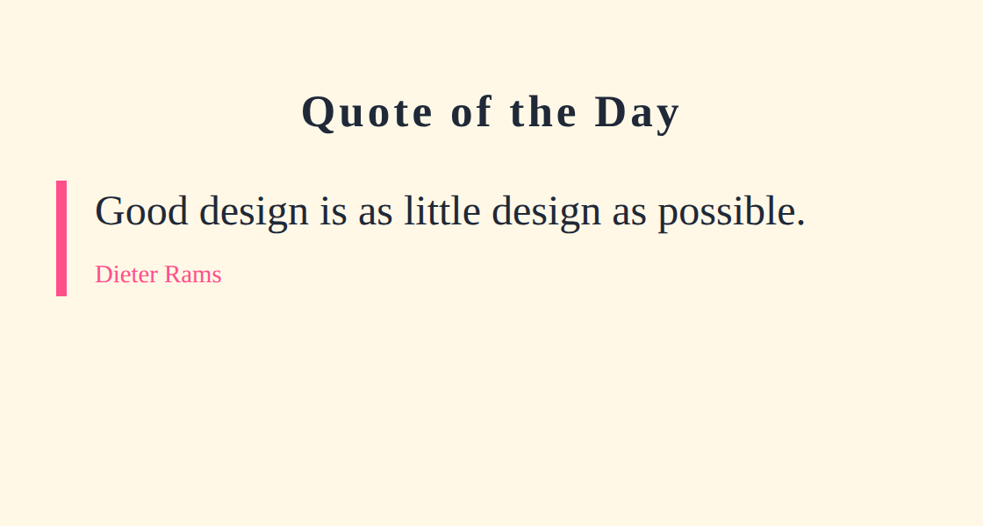
Activity: design a quote card
Time: 20 min
Hands-on
Goal: your page should look like this
Edit style.css in the starter folder. Use variables for your colours.
lesson2/activity/solution/index.html
1
Declare --ink, --paper and --accent on :root (any colours you like).
2
Style body with the paper background, the ink text colour, font-family Georgia, serif.
3
Give blockquote a large font-size (1.5rem), line-height 1.5 and a thick left border in the accent colour.
4
Make cite small (0.9rem), not italic, in the accent colour.
5
Centre the h1 and add letter-spacing.
Start from: code/lesson2/activity/
Check with: code/lesson2/activity/solution/
Bonus: Change only the three variables to create a dark version.

Slide 12

Challenge: a light and dark theme
Time: 25 min
Challenge
Target: match this result
Make the card's colours come only from variables, then re-theme it by overriding them.
lesson2/challenge/solution/index.html
1
On :root define --bg, --text and --accent for a light theme.
2
Use var() for the background, text and heading colours.
3
Write body.dark with new values for the same three variables.
4
Add class="dark" to the body in index.html and watch everything change.
Start from: code/lesson2/challenge/
Check with: code/lesson2/challenge/solution/
Bonus: Give .tag a hsl() background and a hover colour that is 10% darker.

Slide 13
Quick check
Think first, then click to reveal each answer.
Which is the same colour as rgb(255, 0, 0)?
Red: #ff0000, or the name red. Red is at maximum (ff = 255), green and blue are 0.
1
Why is line-height: 1.6 better than 1.6px?
No unit means 1.6 times the font size, so spacing scales with any text size. 1.6px is almost no height.
2
How do you read a variable named --brand?
var(--brand). Define it first, for example on :root.
3

Slide 14
Summary
Colours: names, #hex, rgb() and hsl(). Use hsl() to make shades.
Keep going
Your code
code/lesson2/ (examples, activity, challenge)
Practise online
playground.html (works offline) or the CodePen links in codepen.html
Next lesson
Lesson 3: The Box Model (padding, border, margin)
font-family needs fallbacks; line-height 1.5 to 1.7 reads well.
Prefer rem for font sizes so text respects user settings.
Variables: define --name on :root, use var(--name).
Contrast matters: readable text is part of good design.

