Slide 1
The Box Model
{ }
LESSON 3 OF 7
CSS
Every element is a box: learn to size and space it
High school | Prior knowledge: Lessons 1-2 | ~45 min

Slide 2

Learning objective
Key terms
By the end of this lesson you can:
Padding
Space INSIDE an element, between its content and its border.
Describe the four layers of the box model
Border
A line drawn around the padding. It has a width, a style and a colour.
Control space with padding, border and margin
Margin
Space OUTSIDE an element, pushing other elements away. It is always transparent.
Use box-sizing: border-box and display: inline-block to size elements predictably
Block / inline
Block elements start on a new line and fill the width. Inline elements flow inside a line of text.

Slide 3
The big ideas
1
2
3
Every element is a box
Padding is inside, margin is outside
border-box makes sizing sane
The browser wraps each element in a rectangular box with four layers, from the inside out: content, padding, border and margin. Learn the layers and layout starts to make sense.
Padding makes the element itself roomier, and the background colour fills it. Margin keeps neighbours apart and never shows a background colour.
By default width only measures the content, so padding and border make the box bigger. With box-sizing: border-box the width includes padding and border.
content > padding > border > margin
padding: 16px; margin: 24px;
* { box-sizing: border-box; }

Slide 4
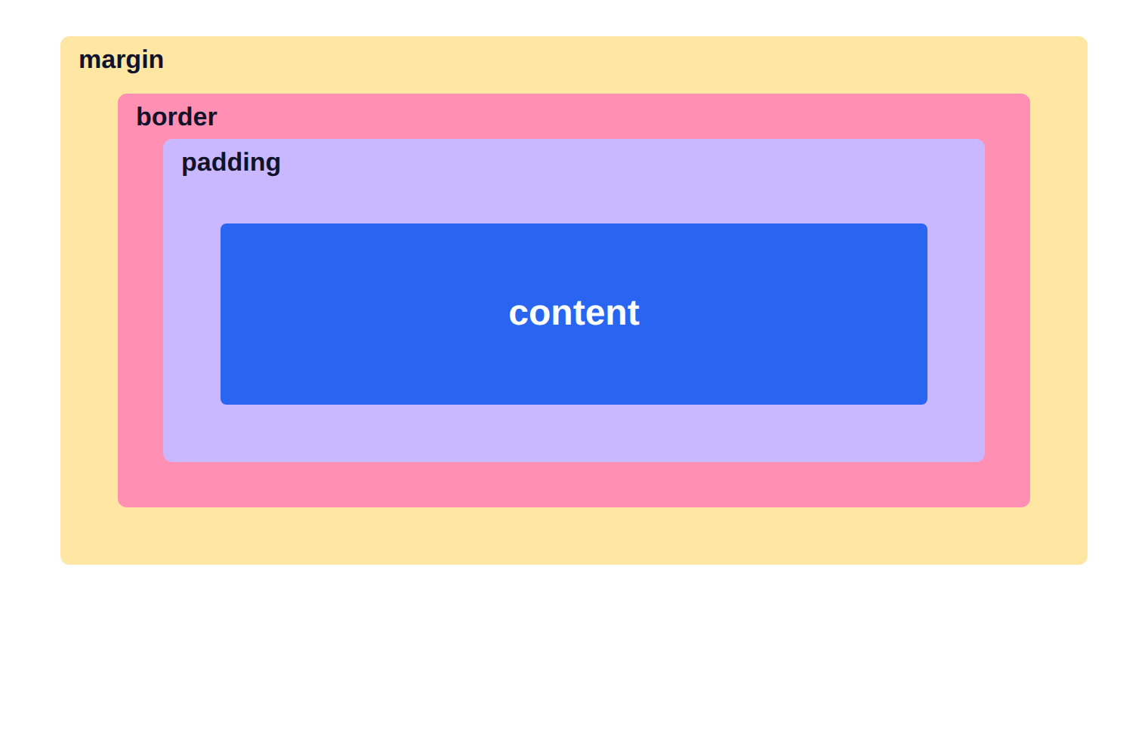
The box model, layer by layer
1
From the inside out: content, then padding, then border, then margin.
2
Padding and border are part of the element's visible box. Margin is the space around it.
3
Total width = content + padding + border (left and right), unless you use border-box.

Slide 5
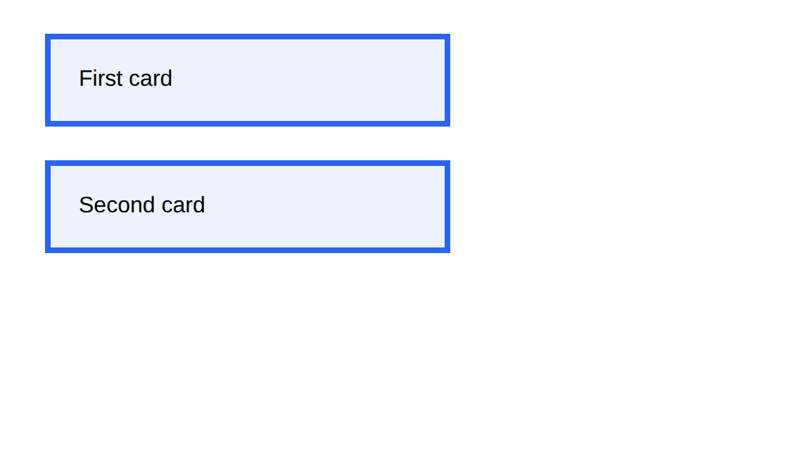
Example 1: Padding, border and margin
Two cards: watch how the margin separates them while padding fills each one.
style.css
lesson3/example1/index.html
.card {
width: 240px;
padding: 20px;
border: 4px solid #2965f1;
margin: 24px;
background: #eef2ff;
font-family: Arial, sans-serif;
}
1
2
3
4
HTML used
<div class="card">First card</div>
<div class="card">Second card</div>
width sets the CONTENT width (by default).
1
2
padding: 20px adds space on all four sides inside the border.
3
border: width, style, colour.
4
margin: 24px keeps cards away from each other and from the edges.
Notes:
1. width sets the CONTENT width (by default).
2. padding: 20px adds space on all four sides inside the border.
3. border: width, style, colour.
4. margin: 24px keeps cards away from each other and from the edges.

Slide 6
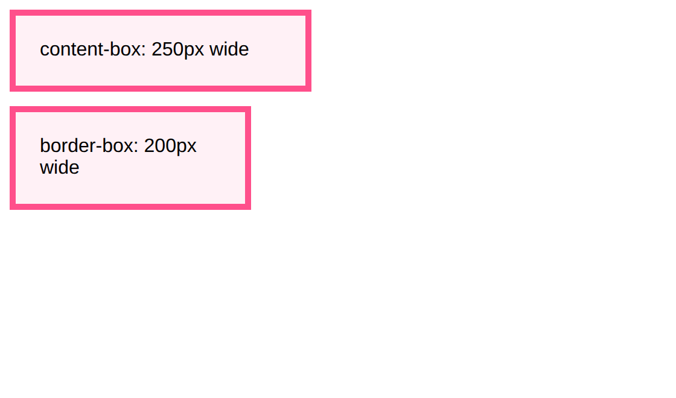
Example 2: box-sizing: content-box vs border-box
Both boxes say width: 200px, but they do not end up the same size.
style.css
lesson3/example2/index.html
.box {
width: 200px;
padding: 20px;
border: 5px solid #ff4f8b;
background: #fff1f6;
margin-bottom: 12px;
font-family: Arial, sans-serif;
}
.content-box { box-sizing: content-box; }
.border-box { box-sizing: border-box; }
1
2
3
HTML used
1
We ask for a 200px wide box in both cases.
<div class="box content-box">content-box: 250px wide</div>
<div class="box border-box">border-box: 200px wide</div>
2
content-box (default): 200 + 2x20 padding + 2x5 border = 250px.
3
border-box: padding and border are inside the 200px, so it stays 200px.
Notes:
1. We ask for a 200px wide box in both cases.
2. content-box (default): 200 + 2x20 padding + 2x5 border = 250px.
3. border-box: padding and border are inside the 200px, so it stays 200px.

Slide 7
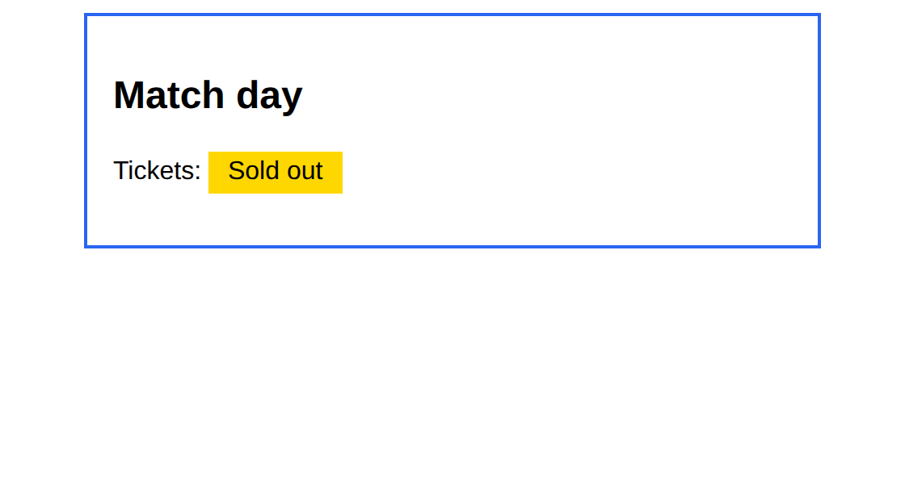
Example 3: Centring and inline-block
margin: 0 auto centres a block with a set width. inline-block lets inline items have a box.
style.css
lesson3/example3/index.html
.page {
max-width: 420px;
margin: 0 auto;
padding: 16px;
border: 2px solid #2965f1;
font-family: Arial;
}
.tag {
display: inline-block;
padding: 4px 12px;
background: gold;
}
1
2
3
1
max-width: the box can shrink but never grows past 420px.
HTML used
2
margin: 0 auto means 0 top and bottom, auto left and right = centred.
<div class="page">
<h2>Match day</h2>
...
3
inline-block keeps the item in the line but lets it use width, height and padding.
Notes:
1. max-width: the box can shrink but never grows past 420px.
2. margin: 0 auto means 0 top and bottom, auto left and right = centred.
3. inline-block keeps the item in the line but lets it use width, height and padding.

Slide 8




Real-world: cards, buttons and comfortable pages
Cards and buttons
Readable articles
Product grids
Every card, button and menu item on a website is a box with padding for breathing room and a border or shadow.
News sites limit article width with max-width and centre it with margin: 0 auto, so lines are not too long to read.
Online shops use margin and gap to keep products apart, and border-box so cards line up exactly.
Try it yourself: open DevTools (F12), select any element and hover the box-model diagram in the Computed tab. The browser highlights margin, border, padding and content in different colours.

Slide 9
Common mistakes
Avoid
Do this instead
Why
padding: 20;
padding: 20px;
A number needs a unit. Only 0 can be written without one.
span { margin: 0 auto; }
span {
display: block;
width: 200px;
margin: 0 auto;
}
Auto margins centre only blocks with a width. Inline elements ignore them.
.box {
width: 100%;
padding: 20px;
}
* { box-sizing: border-box; }
.box {
width: 100%;
padding: 20px;
}
With the default content-box, 100% plus padding is wider than the screen and causes a horizontal scrollbar.

Slide 10


Tips & best practices
Start every stylesheet with border-box
Let DevTools show you
Add *, *::before, *::after { box-sizing: border-box; } and sizes behave the way you expect.
Hover an element in the Elements panel to see its margin (orange), padding (green) and content (blue).
Padding inside, margin between
Remember the order
Use padding to give an element room. Use margin to separate it from its neighbours.
padding: 10px 20px 30px 40px goes top, right, bottom, left (clockwise). Two values mean vertical, horizontal.

Slide 11
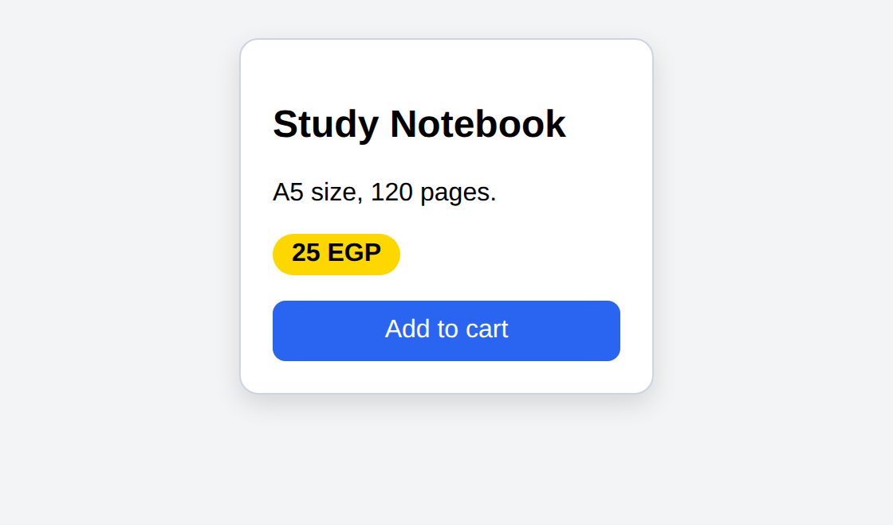
Activity: build a product card
Time: 20 min
Hands-on
Goal: your page should look like this
Turn the plain content into a neat card using only box-model properties.
lesson3/activity/solution/index.html
1
Add * { box-sizing: border-box; } at the top.
2
Give .product width 260px, padding 20px, a 1px solid grey border and border-radius 12px.
3
Add margin: 24px auto so the card is centred.
4
Style .price as a gold pill: display inline-block, padding 4px 12px, border-radius 20px.
5
Make the button fill the card width (display: block; width: 100%) with padding 10px.
Start from: code/lesson3/activity/
Check with: code/lesson3/activity/solution/
Bonus: Add a box-shadow: 0 6px 16px rgba(0,0,0,0.12) to lift the card.

Slide 12
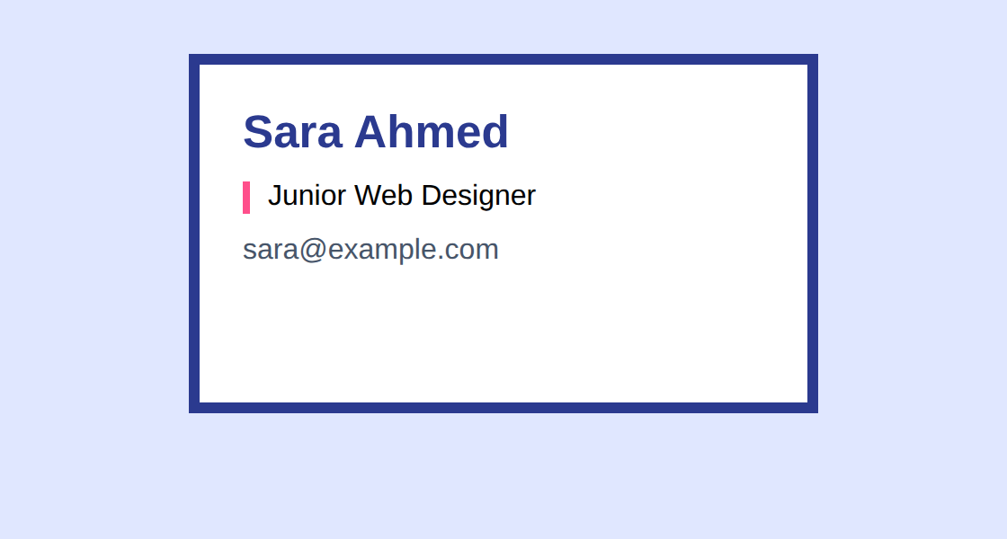
Challenge: the exact business card
Time: 25 min
Challenge
Target: match this result
Create a business card that is EXACTLY 350px wide and 200px tall in total, border included.
lesson3/challenge/solution/index.html
1
Use box-sizing so that width: 350px and height: 200px are the final outer size.
2
Give it a 6px solid border, 24px padding and a centred position on the page.
3
Add 12px of space between the three text lines using margin.
4
Check the size in DevTools: the box must measure 350 x 200.
Start from: code/lesson3/challenge/
Check with: code/lesson3/challenge/solution/
Bonus: Make the name line larger and give the job title a coloured left border.

Slide 13
Quick check
Think first, then click to reveal each answer.
Name the four layers of the box model from the inside out.
Content, padding, border, margin.
1
A box has width: 200px; padding: 10px; border: 5px solid. What is its total width with the default box-sizing?
230px: 200 + 2x10 + 2x5. With border-box it would stay 200px.
2
Why does span { margin: 0 auto; } not centre the text?
A span is inline, so auto margins are ignored. Make it display: block with a width.
3

Slide 14
Summary
Every element is a box: content, padding, border, margin.
Keep going
Your code
code/lesson3/ (examples, activity, challenge)
Practise online
playground.html (works offline) or the CodePen links in codepen.html
Next lesson
Lesson 4: Layout with Flexbox
Padding is inside the border; margin is outside and transparent.
box-sizing: border-box makes width include padding and border.
margin: 0 auto centres a block that has a width.
inline-block lets inline items take width, height and padding.

