Slide 1
Responsive Design
{ }
LESSON 6 OF 7
CSS
One website that looks right on phones, tablets and computers
High school | Prior knowledge: Lessons 1-5 | ~50 min

Slide 2

Learning objective
Key terms
By the end of this lesson you can:
Viewport
The visible area of the page in the browser window or on the phone screen.
Explain why pages need the viewport meta tag and flexible units
Media query
An @media rule that applies CSS only when a condition, such as screen width, is true.
Write media queries with a mobile-first approach
Breakpoint
The screen width where the layout changes, for example 600px.
Build fluid layouts with max-width, grid, clamp() and relative units
Mobile-first
Write the phone layout first, then add min-width media queries for larger screens.

Slide 3
The big ideas
1
2
3
Tell phones the truth
Be fluid by default
Add rules at breakpoints
Without the viewport meta tag, phones pretend to be about 980px wide and shrink your page. This one line in <head> turns on real, responsive behaviour.
Use percentages, fr units, max-width and rem instead of fixed pixel widths. Let images shrink with max-width: 100%. The layout then bends instead of breaking.
Start with the single-column phone layout. Then use @media (min-width: ...) to add columns when there is room. Choose breakpoints where YOUR design starts to look bad.
<meta name="viewport" content="width=device-width, initial-scale=1">
img { max-width: 100%; }
@media (min-width: 600px)

Slide 4
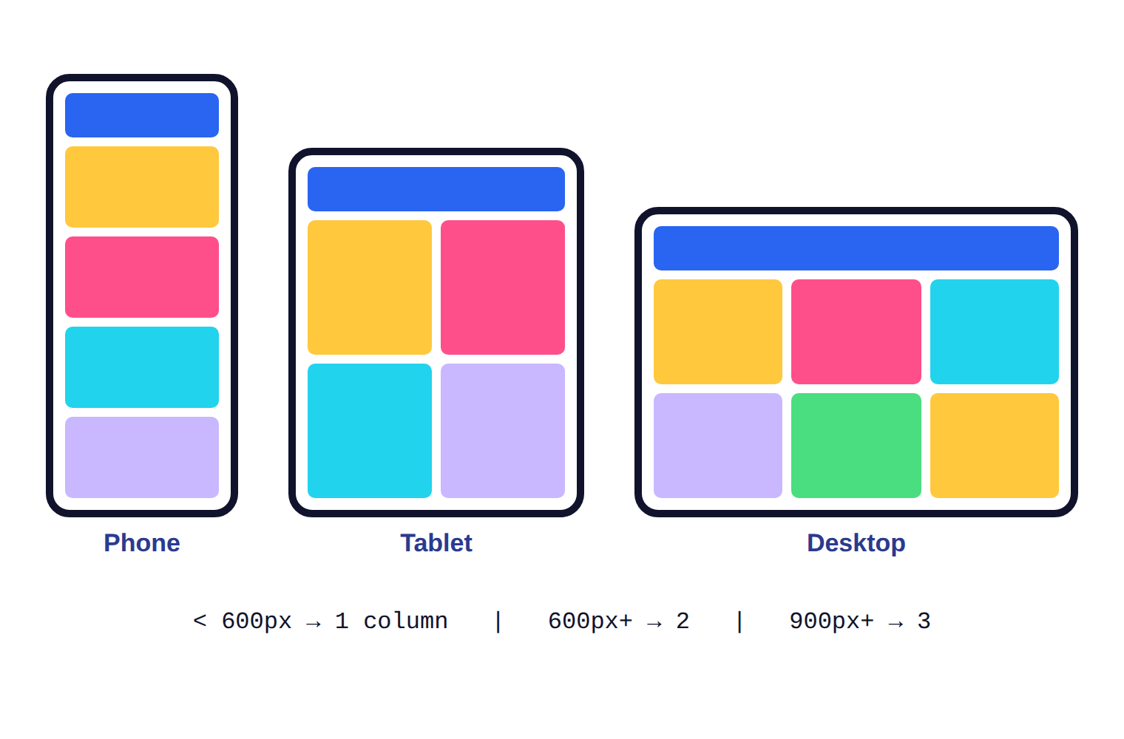
One page, three screens
1
Phone (under 600px): one column. Everything is stacked.
2
Tablet (600px and up): two columns for the cards.
3
Desktop (900px and up): three columns and more space.

Slide 5

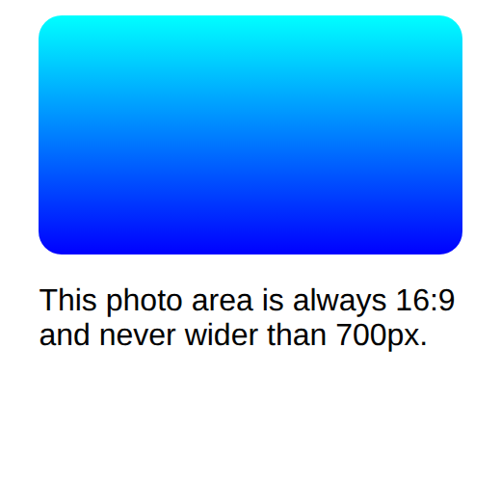
Example 1: Fluid containers and images
Use percentages and max-width so content adapts instead of overflowing.
style.css
lesson6/example1/index.html
.container {
width: 90%;
max-width: 700px;
margin: 0 auto;
font-family: Arial;
}
.photo {
aspect-ratio: 16 / 9;
background: linear-gradient(cyan, blue);
border-radius: 12px;
}
img { max-width: 100%; height: auto; }
1
2
3
Desktop (560px)
Phone (260px)
1
90% of the screen width: it shrinks with the screen.
4
2
max-width stops it growing too wide on large screens.
HTML used
3
aspect-ratio keeps the 16:9 shape at any width.
<div class="container">
<div class="photo"></div>
...
4
Rule for real images: never wider than their container, keep proportions.
Notes:
1. 90% of the screen width: it shrinks with the screen.
2. max-width stops it growing too wide on large screens.
3. aspect-ratio keeps the 16:9 shape at any width.
4. Rule for real images: never wider than their container, keep proportions.

Slide 6
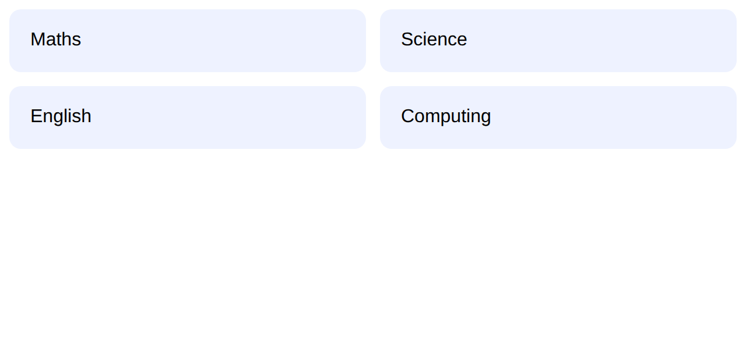
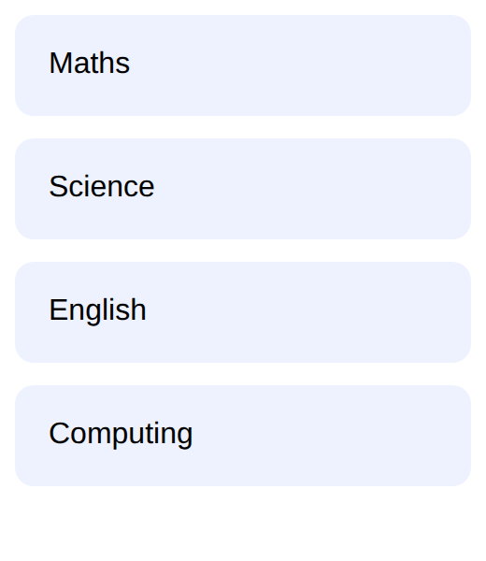
Example 2: Mobile-first media queries
One column by default, two columns once the screen is at least 600px wide.
style.css
lesson6/example2/index.html
.cards {
display: grid;
gap: 12px;
font-family: Arial;
}
.card {
background: #eef2ff;
padding: 18px;
border-radius: 10px;
}
@media (min-width: 600px) {
.cards {
grid-template-columns: 1fr 1fr;
}
}
1
Wide (640px)
Narrow (260px)
2
1
No columns defined: a single column (the phone layout).
3
2
@media (min-width: 600px): rules inside apply only on screens 600px or wider.
3
Two equal columns appear when there is room.
Notes:
1. No columns defined: a single column (the phone layout).
2. @media (min-width: 600px): rules inside apply only on screens 600px or wider.
3. Two equal columns appear when there is room.

Slide 7

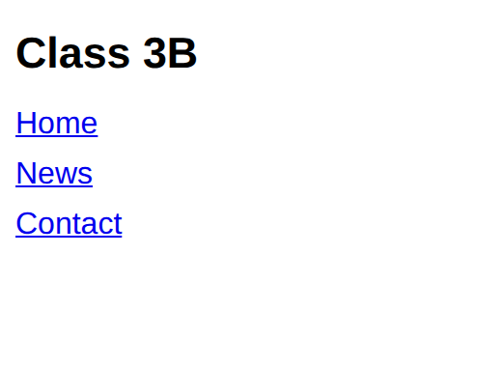
Example 3: Fluid type and a responsive menu
clamp() sets a flexible font size; a media query switches the menu to a row.
style.css
lesson6/example3/index.html
body { font-family: Arial; }
h1 {
font-size: clamp(1.4rem, 5vw, 3rem);
}
.nav {
display: flex;
flex-direction: column;
gap: 8px;
}
@media (min-width: 600px) {
.nav { flex-direction: row; gap: 20px; }
}
1
2
Wide (640px)
Narrow (260px)
1
clamp(min, preferred, max): grows with the screen but stays between 1.4rem and 3rem.
3
2
On phones the links are stacked in a column.
3
From 600px the menu becomes a row.
HTML used
<h1>Class 3B</h1>
<nav class="nav">
...
Notes:
1. clamp(min, preferred, max): grows with the screen but stays between 1.4rem and 3rem.
2. On phones the links are stacked in a column.
3. From 600px the menu becomes a row.

Slide 8




Real-world: one site, every device
Most visitors are on phones
Shops and services
School and exam portals
Many people browse mainly on a phone. A page that needs zooming and sideways scrolling loses visitors fast.
Online shops show one product per row on phones and a full grid on desktops, using exactly these techniques.
Students open the same portal on a computer in class and on a phone at home. Responsive CSS serves both.
Try it yourself: open DevTools (F12) and press Ctrl+Shift+M (Cmd+Shift+M on Mac) for the device toolbar. Pick a phone, then drag the width to see your breakpoints trigger.

Slide 9
Common mistakes
Avoid
Do this instead
Why
<head>
<title>My page</title>
</head>
<head>
<meta name="viewport"
content="width=device-width,
initial-scale=1">
Without the viewport meta tag phones show a zoomed-out desktop page and media queries behave oddly.
.page { width: 960px; }
.page {
width: 100%;
max-width: 960px;
}
A fixed width forces sideways scrolling on small screens. max-width lets it shrink.
@media min-width: 600px {
...
}
@media (min-width: 600px) {
...
}
The condition must be in parentheses. Without them the query is invalid and ignored.

Slide 10


Tips & best practices
Design for the phone first
Test with the device toolbar
Write the small-screen layout as your base, then add min-width queries. The CSS stays shorter and faster.
Drag the viewport width slowly and add a breakpoint wherever the layout starts to look cramped.
Keep text readable
Let layout tools do the work
Never disable zoom. Use rem for text, keep lines under about 75 characters, and make tap targets at least 44px.
flex-wrap and grid with auto-fit and minmax() often need no media queries at all.

Slide 11
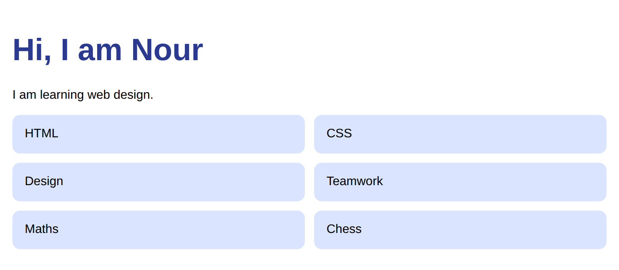
Activity: a responsive profile page
Time: 25 min
Hands-on
Goal: your page should look like this
The HTML includes the viewport tag. Write the CSS phone-first, then add the wider layouts.
lesson6/activity/solution/index.html
1
Base styles: centre .wrap with max-width 900px and padding 16px, and make images and the avatar fluid.
2
Make .skills a grid with gap 12px; on phones it is one column.
3
At min-width 600px set .skills to two columns.
4
At min-width 900px set .skills to three columns.
Start from: code/lesson6/activity/
Check with: code/lesson6/activity/solution/
5
Use clamp() for the h1 size.
Bonus: At 900px+ also put the intro text and avatar side by side with flexbox.

Slide 12
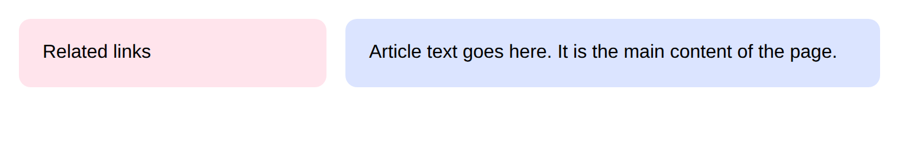
Challenge: a layout that rearranges
Time: 30 min
Challenge
Target: match this result
Build a page whose sidebar sits BELOW the article on phones and BESIDE it on larger screens.
lesson6/challenge/solution/index.html
1
Phone layout: .layout is a flex column with gap 16px, article first, sidebar second.
2
At min-width 700px switch .layout to a row.
Start from: code/lesson6/challenge/
Check with: code/lesson6/challenge/solution/
3
Give the article flex: 1 and the sidebar a fixed 220px width at that size.
4
Add the viewport meta tag to the HTML head (already provided) and test in DevTools.
Bonus: Use the order property so the sidebar appears FIRST on wide screens.

Slide 13
Quick check
Think first, then click to reveal each answer.
Which line makes media queries work properly on phones?
The viewport meta tag: <meta name="viewport" content="width=device-width, initial-scale=1">.
1
What does mobile-first mean in CSS?
Write the phone layout as the base styles and add min-width media queries for bigger screens.
2
Why use max-width: 960px instead of width: 960px?
max-width lets the element shrink on small screens; a fixed width causes sideways scrolling.
3

Slide 14
Summary
Add the viewport meta tag to every page.
Keep going
Your code
code/lesson6/ (examples, activity, challenge)
Practise online
playground.html (works offline) or the CodePen links in codepen.html
Next lesson
Lesson 7: Transitions, Transforms & Animations
Prefer %, fr, rem and max-width over fixed pixel sizes.
Mobile-first: base styles for phones, @media (min-width: ...) for more room.
clamp(), auto-fit and flex-wrap reduce the need for breakpoints.
Test with the DevTools device toolbar at many widths.

