Slide 1
Transitions, Transforms & Animations
{ }
LESSON 7 OF 7
CSS
Bring your pages to life, and keep the motion accessible
High school | Prior knowledge: Lessons 1-6 | ~50 min

Slide 2

Learning objective
Key terms
By the end of this lesson you can:
Transition
A smooth change from one set of styles to another, for example on hover.
Animate changes between two states with transition
Transform
A visual change to an element: translate (move), scale, rotate or skew.
Move, scale and rotate elements with transform
Keyframes
The named steps of an animation, written with @keyframes (from/to or percentages).
Create multi-step animations with @keyframes, and respect reduced-motion settings
Easing
The speed curve of motion: ease, linear, ease-in-out and others.

Slide 3
The big ideas
1
2
3
Transitions: two states, smooth change
Transforms move things visually
Animations run on their own
Put transition on the NORMAL state: which property, how long, which easing. When the style changes (for example on :hover) the browser animates the difference.
translate, scale and rotate change how an element is drawn without moving its neighbours. They are smooth and fast, so they are the best choice for animation.
Define steps with @keyframes, then attach them with animation: name, duration, easing, repeat. Always respect users who ask for less motion.
transition: background 0.3s ease;
transform: scale(1.1);
animation: spin 1s infinite;

Slide 4
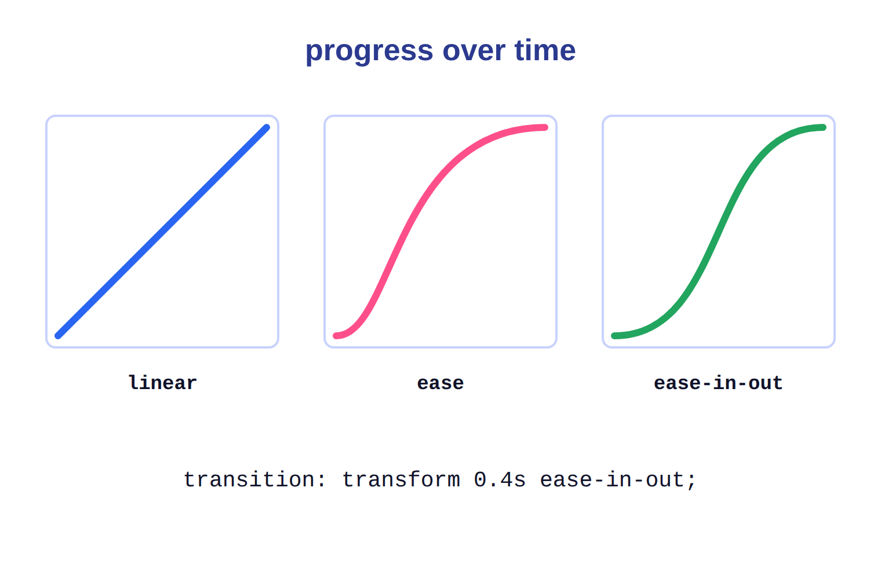
Easing: the speed curve
1
linear: constant speed. Good for spinners.
2
ease (default) and ease-in-out: start and end gently, which feels natural.
3
Time goes left to right, progress bottom to top. A steeper line means faster movement.

Slide 5
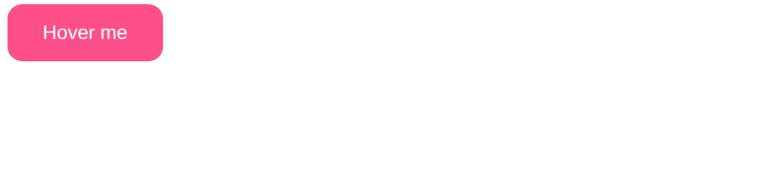
Example 1: A hover transition
The transition lives on the normal state, the change lives on :hover.
style.css
lesson7/example1/index.html
.btn {
background: #2965f1;
color: white;
border: none;
padding: 12px 24px;
border-radius: 10px;
transition: background 0.3s, transform 0.3s;
}
.btn:hover {
background: #ff4f8b;
transform: translateY(-4px) scale(1.05);
}
1
1
Two transitions, 0.3 seconds each (default easing is ease).
2
Hover colour. Because of the transition it fades instead of snapping.
2
3
3
translateY(-4px) lifts the button 4px; scale(1.05) makes it 5% bigger.
HTML used
<button class="btn">Hover me</button>
Notes:
1. Two transitions, 0.3 seconds each (default easing is ease).
2. Hover colour. Because of the transition it fades instead of snapping.
3. translateY(-4px) lifts the button 4px; scale(1.05) makes it 5% bigger.

Slide 6

Example 2: Keyframe animation: a bouncing ball
@keyframes defines the steps; animation attaches them to an element.
style.css
lesson7/example2/index.html
.ball {
width: 60px;
height: 60px;
border-radius: 50%;
background: #ff4f8b;
animation: bounce 1s infinite alternate;
}
@keyframes bounce {
from { transform: translateY(0); }
to { transform: translateY(120px); }
}
1
2
3
4
1
animation shorthand: name, duration, repeat, direction.
HTML used
2
infinite = forever; alternate = forwards, then back.
<div class="ball"></div>
The @keyframes name must match the animation name.
3
4
Start at 0, end 120px lower; the browser fills in between.
Notes:
1. animation shorthand: name, duration, repeat, direction.
2. infinite = forever; alternate = forwards, then back.
3. The @keyframes name must match the animation name.
4. Start at 0, end 120px lower; the browser fills in between.

Slide 7

Example 3: A loading spinner (and reduced motion)
A linear, endless rotation. Slow it down for people who prefer less motion.
style.css
lesson7/example3/index.html
.spinner {
width: 48px;
height: 48px;
border: 6px solid #e0e7ff;
border-top-color: #2965f1;
border-radius: 50%;
animation: spin 0.9s linear infinite;
}
@keyframes spin {
to { transform: rotate(360deg); }
}
@media (prefers-reduced-motion: reduce) {
.spinner { animation-duration: 3s; }
}
1
2
1
A circle with a light border, and only the top border coloured.
3
2
linear keeps the speed constant, which suits a spinner.
4
With only a 'to' step, the animation starts from the element's normal state.
3
4
prefers-reduced-motion: users can ask their system for less motion. Respect it.
HTML used
<div class="spinner"></div>
Notes:
1. A circle with a light border, and only the top border coloured.
2. linear keeps the speed constant, which suits a spinner.
3. With only a 'to' step, the animation starts from the element's normal state.
4. prefers-reduced-motion: users can ask their system for less motion. Respect it.

Slide 8




Real-world: feedback, focus and flow
Interface feedback
Loading states
Storytelling
Buttons that lift or change colour, menus that slide in: small transitions tell users the page noticed their action.
Spinners and progress bars show that something is happening, which keeps people from clicking again and again.
Landing pages fade and slide content into view as you scroll, guiding attention. Used well, motion explains; used badly, it distracts.
Try it yourself: open DevTools, choose the Animations panel (in the More tools menu), then hover or reload. You can slow animations down to 10% to see exactly what happens.

Slide 9
Common mistakes
Avoid
Do this instead
Why
.btn:hover {
transition: 0.3s;
background: pink;
}
.btn {
transition: 0.3s;
}
.btn:hover {
background: pink;
}
A transition only on :hover animates in but snaps back. Put it on the normal state to animate both ways.
transition: all 1s;
/* animates width, top... */
transition: transform 0.3s,
opacity 0.3s;
Animate transform and opacity: they are smooth. Animating width, height or top forces slow re-layout.
animation: spinn 1s infinite;
@keyframes spin { ... }
animation: spin 1s infinite;
@keyframes spin { ... }
The names must match exactly, otherwise nothing animates and there is no error message.

Slide 10




Tips & best practices
Keep it quick
Respect reduced motion
UI transitions feel best between 150ms and 400ms. Long animations make an interface feel slow.
Wrap strong movement in @media (prefers-reduced-motion: no-preference) or tone it down for users who ask.
Animate transform and opacity
Animate with purpose
These two properties are handled by the graphics hardware and stay smooth even on a phone.
Ask: does this motion help the user understand something? If not, leave it out.

Slide 11
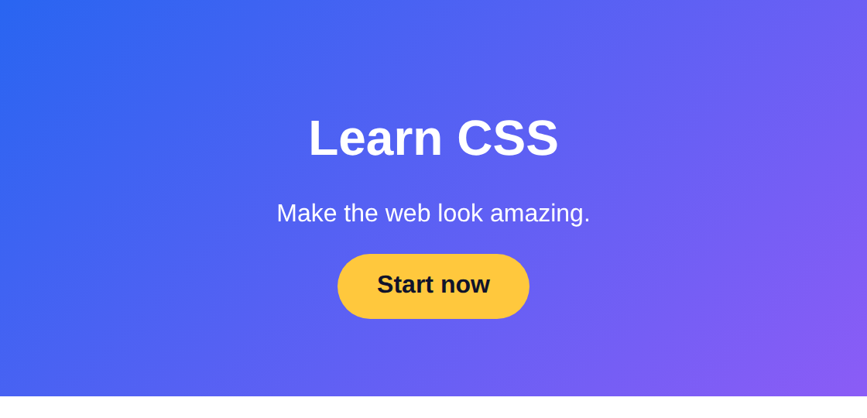
Activity: animated landing hero
Time: 25 min
Hands-on
Goal: your page should look like this
Make the hero text slide up and fade in one after another, and add a hover effect to the button.
lesson7/activity/solution/index.html
1
Write @keyframes rise: from opacity 0 and translateY(20px) to opacity 1 and translateY(0).
2
Give h1, p and the button animation: rise 0.8s ease both. (both keeps the final state.)
3
Stagger them with animation-delay: 0s, 0.2s and 0.4s.
4
Add a transition and a :hover transform: scale(1.06) on the button.
5
Wrap the animation in prefers-reduced-motion: no-preference.
Start from: code/lesson7/activity/
Check with: code/lesson7/activity/solution/
Bonus: Add a pulsing glow with a second @keyframes using box-shadow.

Slide 12
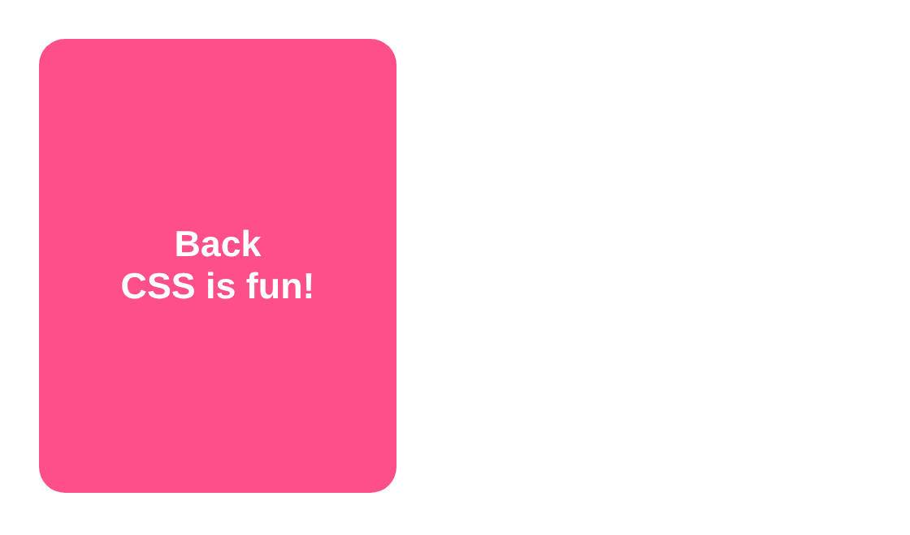
Challenge: the flip card
Time: 35 min
Challenge
Target: match this result
Build a card that flips to show its back when you hover. You will use 3D transforms.
lesson7/challenge/solution/index.html
1
Set perspective: 800px on .scene (it gives the 3D depth). Size it 220 x 280px.
2
Make .card fill the scene, set transform-style: preserve-3d and a 0.8s transition on transform.
3
On .scene:hover .card use transform: rotateY(180deg).
4
Stack the faces with position: absolute; inset: 0 and hide their backs with backface-visibility: hidden.
5
Rotate .back by 180deg so its text reads correctly after the flip.
Start from: code/lesson7/challenge/
Check with: code/lesson7/challenge/solution/
Bonus: Add a second card, or flip on keyboard focus with :focus-within for accessibility.

Slide 13
Quick check
Think first, then click to reveal each answer.
Where should the transition property go: the normal state or :hover?
On the normal state, so the change animates both when entering and leaving the hover.
1
Which two properties are best to animate for smooth motion?
transform and opacity.
2
How can CSS respect users who get dizzy from motion?
Use @media (prefers-reduced-motion: reduce) to remove or slow animations.
3

Slide 14
Summary
transition animates between two states; put it on the normal state.
Keep going
Your code
code/lesson7/ (examples, activity, challenge)
Practise online
playground.html (works offline) or the CodePen links in codepen.html
Next lesson
Course complete! Build a mini-site that uses all 7 lessons.
transform: translate, scale and rotate change how an element is drawn.
@keyframes + animation create multi-step motion.
Easing sets the feel: linear for spinners, ease for most UI.
Animate transform and opacity, keep it short, and honour reduced motion.

