Slide 1
Layout with Flexbox
{ }
LESSON 4 OF 7
CSS
Arrange items in a row or column, align them and share the space
High school | Prior knowledge: Lessons 1-3 | ~50 min

Slide 2

Learning objective
Key terms
By the end of this lesson you can:
Flex container
The parent element that has display: flex. It controls the layout of its children.
Turn a parent into a flex container with display: flex
Flex item
A direct child of a flex container. Items line up in a row by default.
Align and space items with justify-content, align-items and gap
Main axis
The direction items flow: horizontal for a row, vertical for a column.
Wrap and size items with flex-wrap and flex
Cross axis
The direction at right angles to the main axis.

Slide 3
The big ideas
1
2
3
Flex is set on the PARENT
Two axes, two properties
Items can grow, shrink and wrap
Write display: flex on the container and its direct children become flex items, lined up in a row. You almost never style the layout on the items themselves.
justify-content places items along the main axis. align-items places them along the cross axis. flex-direction: column swaps the two axes.
flex: 1 1 180px means: may grow, may shrink, ideal width 180px. With flex-wrap: wrap, items that do not fit move to the next line. gap adds space between items.
.nav { display: flex; }
justify-content / align-items
flex-wrap: wrap; gap: 16px;

Slide 4
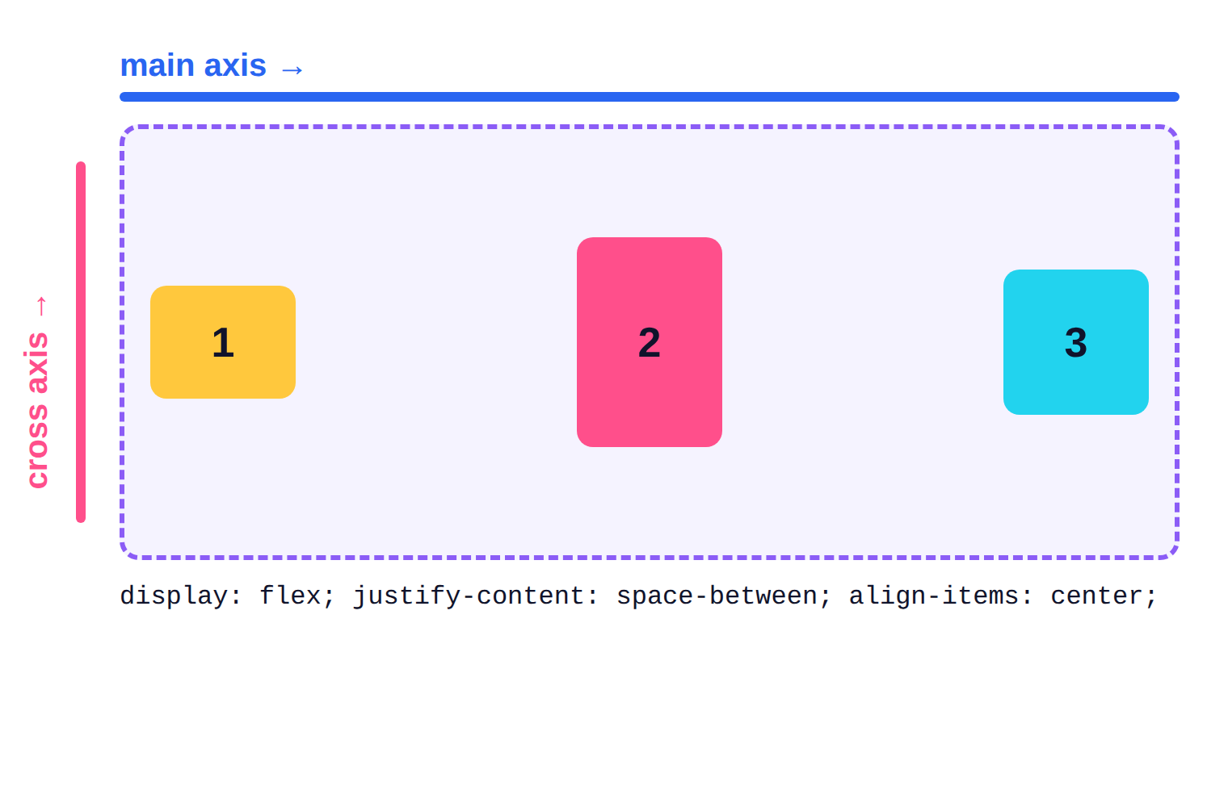
Main axis and cross axis
1
Default: the main axis runs left to right, the cross axis top to bottom.
2
justify-content: space-between pushes the first and last items to the edges.
3
align-items: center centres the items on the cross axis.

Slide 5
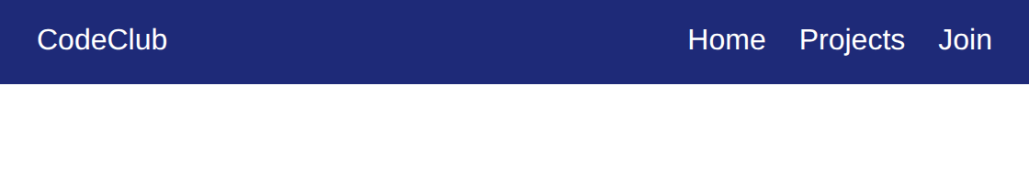
Example 1: A navigation bar
justify-content: space-between and align-items: center in one flex container.
style.css
lesson4/example1/index.html
body { margin: 0; font-family: Arial; }
.nav {
display: flex;
justify-content: space-between;
align-items: center;
background: #1e2a78;
padding: 14px 20px;
}
.nav a { color: white; text-decoration: none; }
.links { display: flex; gap: 18px; }
1
2
3
1
display: flex makes .nav a flex container: logo and links become items.
2
space-between puts the first item at the left, the last at the right.
4
3
align-items: center centres the items vertically.
HTML used
4
The links container is also flex; gap adds 18px between links.
<nav class="nav">
<a class="logo" href="#">CodeClub</a>
<div class="links">
<a href="#">Home</a>
<a href="#">Projects</a>
...
Notes:
1. display: flex makes .nav a flex container: logo and links become items.
2. space-between puts the first item at the left, the last at the right.
3. align-items: center centres the items vertically.
4. The links container is also flex; gap adds 18px between links.

Slide 6
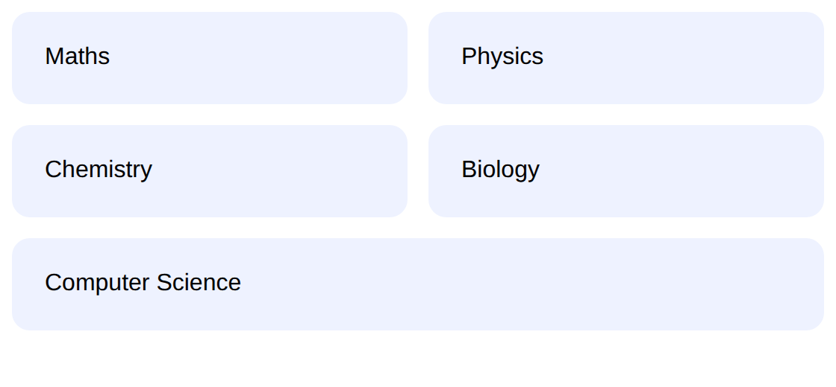
Example 2: Cards that wrap and share space
flex: 1 1 180px lets cards grow, shrink and wrap onto new rows.
style.css
lesson4/example2/index.html
.cards {
display: flex;
flex-wrap: wrap;
gap: 14px;
font-family: Arial;
}
.card {
flex: 1 1 150px;
background: #eef2ff;
border-radius: 12px;
padding: 22px;
}
1
2
3
4
1
flex-wrap: wrap lets items move to a new line instead of squashing.
2
gap sets the space between rows and columns.
HTML used
<div class="cards">
<div class="card">Maths</div>
...
3
flex: 1 1 150px = grow 1, shrink 1, ideal width 150px.
4
Result: each row fills the full width, and the last row stretches too.
Notes:
1. flex-wrap: wrap lets items move to a new line instead of squashing.
2. gap sets the space between rows and columns.
3. flex: 1 1 150px = grow 1, shrink 1, ideal width 150px.
4. Result: each row fills the full width, and the last row stretches too.

Slide 7
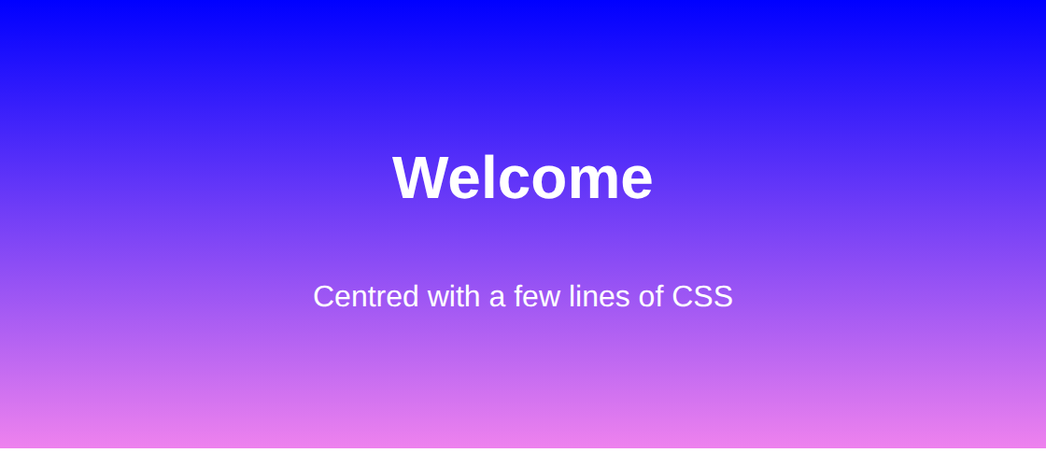
Example 3: Centre anything
The classic: centre content horizontally AND vertically with flexbox.
style.css
lesson4/example3/index.html
body { margin: 0; }
.hero {
display: flex;
flex-direction: column;
justify-content: center;
align-items: center;
min-height: 240px;
background: linear-gradient(blue, violet);
color: white;
font-family: Arial;
}
1
2
3
4
1
flex-direction: column stacks items; now the main axis is vertical.
HTML used
2
So justify-content centres vertically and align-items centres horizontally.
<section class="hero">
<h1>Welcome</h1>
<p>Centred with a few lines of CSS</p>
</section>
3
min-height gives the box room so there is something to centre inside.
4
linear-gradient() blends colours; it is used like a background image.
Notes:
1. flex-direction: column stacks items; now the main axis is vertical.
2. So justify-content centres vertically and align-items centres horizontally.
3. min-height gives the box room so there is something to centre inside.
4. linear-gradient() blends colours; it is used like a background image.

Slide 8




Real-world: menus, cards and toolbars
Navigation bars
Card rows
App-like screens
Almost every site menu is a flex container: logo on one side, links on the other, everything centred vertically.
Course lists, photo galleries and team pages use wrapping flex rows that adapt to any screen width.
Toolbars, chat bubbles and buttons with icons use flex to line up an icon and text perfectly.
Try it yourself: open DevTools on a site you use, find an element showing a small 'flex' badge in the Elements panel, and click it to see the flex overlay.

Slide 9
Common mistakes
Avoid
Do this instead
Why
.item { display: flex; }
.container { display: flex; }
display: flex goes on the PARENT. Setting it on the items does not arrange them.
flex-direction: column;
justify-content: center;
/* expects horizontal */
flex-direction: column;
align-items: center;
/* horizontal centring */
With a column, the axes swap: align-items now works horizontally.
body {
display: flex;
align-items: center;
}
body {
display: flex;
align-items: center;
min-height: 100vh;
}
Vertical centring needs height. 100vh means 100% of the viewport (window) height.

Slide 10



Tips & best practices
Use gap, not margins
Remember: row is the default
gap spaces items evenly without extra space at the ends. It also works with wrapping.
flex-direction defaults to row. Add column when you want a vertical stack.
Debug with the overlay
Use flex for one dimension
DevTools shows the container, items and free space. It makes surprising layouts easy to explain.
Flexbox lays out a row OR a column. For rows AND columns together, use Grid (next lesson).

Slide 11
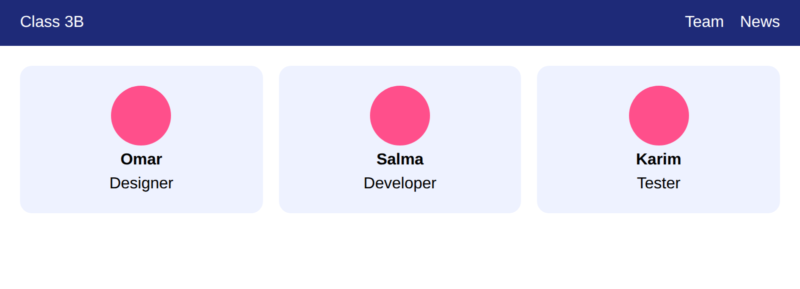
Activity: a team page
Time: 25 min
Hands-on
Goal: your page should look like this
Build a navigation bar and a row of three profile cards with flexbox.
lesson4/activity/solution/index.html
1
Make .nav a flex container with the logo on the left, links on the right, centred vertically.
2
Give the links container display: flex and gap: 16px.
3
Make .team a flex container with gap: 16px and flex-wrap: wrap.
4
Give each .member flex: 1 1 180px, padding 20px, a light background and rounded corners.
Start from: code/lesson4/activity/
Check with: code/lesson4/activity/solution/
5
Centre the text inside each member by using flex-direction: column with align-items: center.
Bonus: Add .avatar: a 60px circle (border-radius: 50%) in colour above each name.

Slide 12
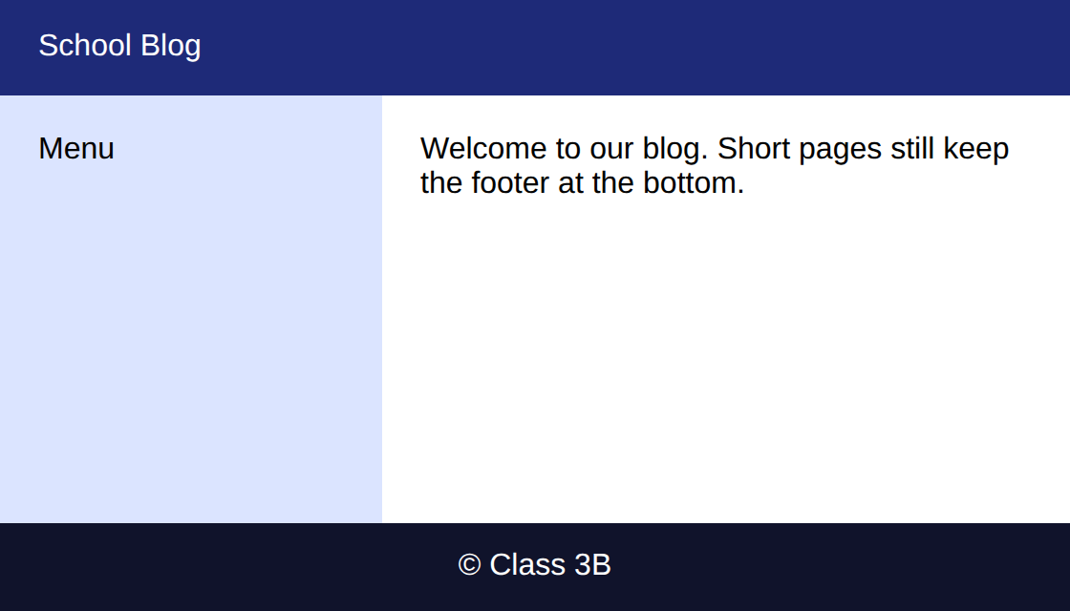
Challenge: header, sidebar, footer
Time: 30 min
Challenge
Target: match this result
Build a full-page layout where the footer sticks to the bottom even with little content.
lesson4/challenge/solution/index.html
1
Make body a flex column with min-height: 100vh.
2
Make .layout a flex row; the sidebar is 160px wide and the main area takes the rest with flex: 1.
3
Make .layout grow to fill the free space (flex: 1) so the footer is pushed to the bottom.
4
Give header, aside, main and footer distinct background colours and padding.
Start from: code/lesson4/challenge/
Check with: code/lesson4/challenge/solution/
Bonus: Make the layout stack in a column on narrow screens by using flex-wrap.

Slide 13
Quick check
Think first, then click to reveal each answer.
On which element do you write display: flex: the parent or the children?
The parent (container). Its direct children become flex items.
1
In a row, which property centres items vertically?
align-items: center (it works on the cross axis).
2
What does flex: 1 1 200px mean?
Grow = 1, shrink = 1, starting width (basis) = 200px.
3

Slide 14
Summary
display: flex on the parent turns children into flex items.
Keep going
Your code
code/lesson4/ (examples, activity, challenge)
Practise online
playground.html (works offline) or the CodePen links in codepen.html
Next lesson
Lesson 5: CSS Grid
justify-content uses the main axis; align-items uses the cross axis.
flex-direction: column swaps the axes.
gap, flex-wrap and flex give spacing, wrapping and flexible sizes.
Flexbox is for one dimension; Grid is for rows and columns together.

