Slide 1
CSS Basics & Selectors
{ }
LESSON 1 OF 7
CSS
Teach the browser how your HTML should look
High school | Prior knowledge: basic HTML | ~45 min
Notes:
Welcome the class. Ask: what is the difference between what a page SAYS (HTML) and how it LOOKS (CSS)?

Slide 2

Learning objective
Key terms
By the end of this lesson you can:
CSS
Cascading Style Sheets: the language that describes how HTML elements look.
Explain what CSS is and how it differs from HTML
Selector
The part of a rule that picks which elements to style, such as h1 or .card.
Write a CSS rule made of a selector, a property and a value
Property
The thing you want to change, such as color or font-size.
Target elements with element, class and ID selectors
Declaration
One property and its value, written as property: value; (it ends with a semicolon).

Slide 3
The big ideas
1
2
3
HTML builds, CSS decorates
Three ways to add CSS
The cascade decides the winner
HTML says what something IS: a heading, a paragraph, a link. CSS says how it LOOKS: its colour, size, spacing and position. Keeping them apart makes pages easier to change.
Inline: a style attribute on one tag. Internal: a <style> block in the page. External: a separate .css file linked with <link>. External is best because one file can style every page.
When two rules disagree, the browser picks one. A more specific selector wins (ID beats class beats element). If they are equally specific, the rule written later wins.
h1 { color: blue; }
<link rel="stylesheet" href="style.css">
#id > .class > element

Slide 4
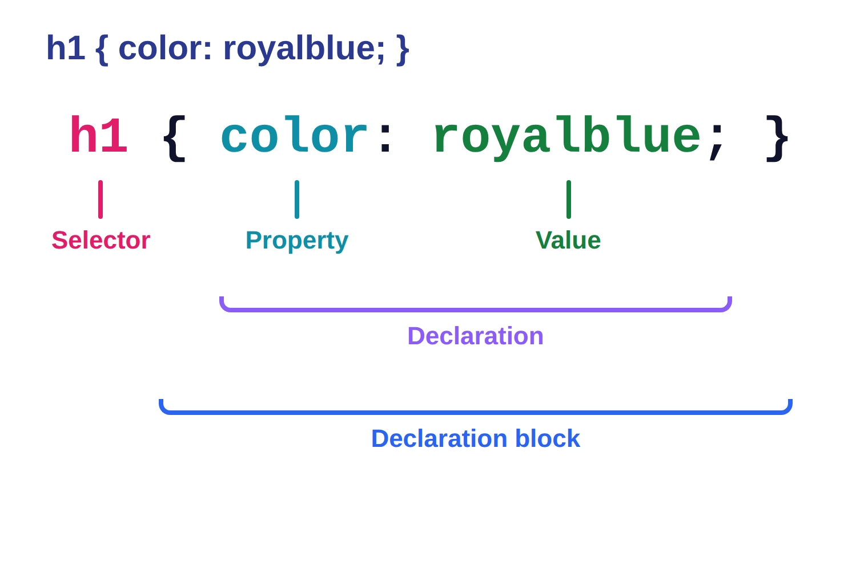
Anatomy of a CSS rule
1
Selector: tells the browser WHICH elements to style.
2
Property: WHAT you want to change. Value: HOW you want to change it.
3
Curly braces { } hold the declarations. Each declaration ends with a semicolon.

Slide 5
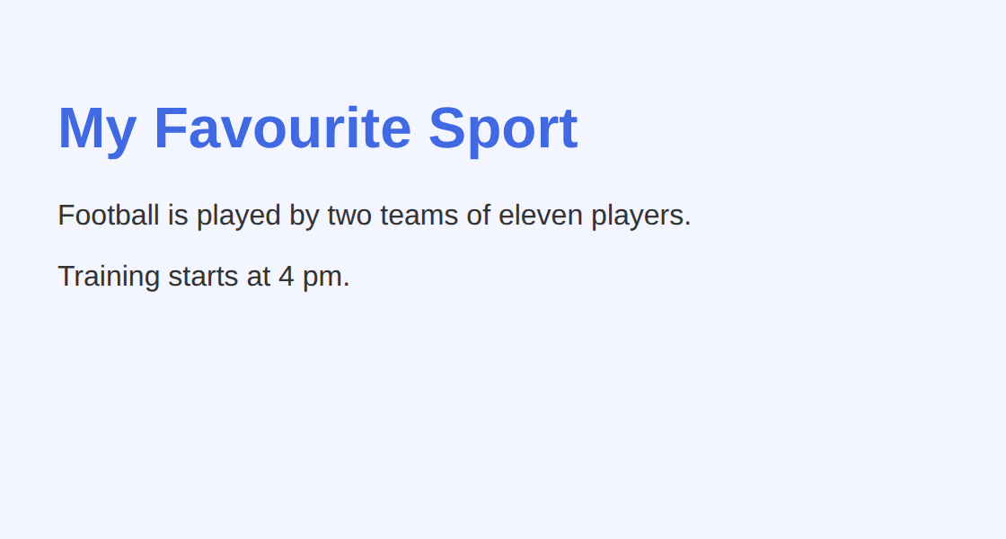
Example 1: Element selectors
An element selector is just the tag name. It styles every element of that type.
style.css
lesson1/example1/index.html
1
body {
font-family: Arial, sans-serif;
background-color: #f4f6ff;
padding: 24px;
}
h1 {
color: royalblue;
}
p {
color: #333333;
}
2
3
4
1
Element selector: styles the whole <body>, so every child inherits the font.
HTML used
2
font-family is a list: the browser uses the first font it has; sans-serif is the safe fallback.
<h1>My Favourite Sport</h1>
<p>Football is played by two teams of eleven players.</p>
<p>Training starts at 4 pm.</p>
3
color: royalblue uses a named colour (about 140 names exist).
4
#333333 is a hex colour (red, green, blue in base 16): a dark grey.
Notes:
1. Element selector: styles the whole <body>, so every child inherits the font.
2. font-family is a list: the browser uses the first font it has; sans-serif is the safe fallback.
3. color: royalblue uses a named colour (about 140 names exist).
4. #333333 is a hex colour (red, green, blue in base 16): a dark grey.

Slide 6
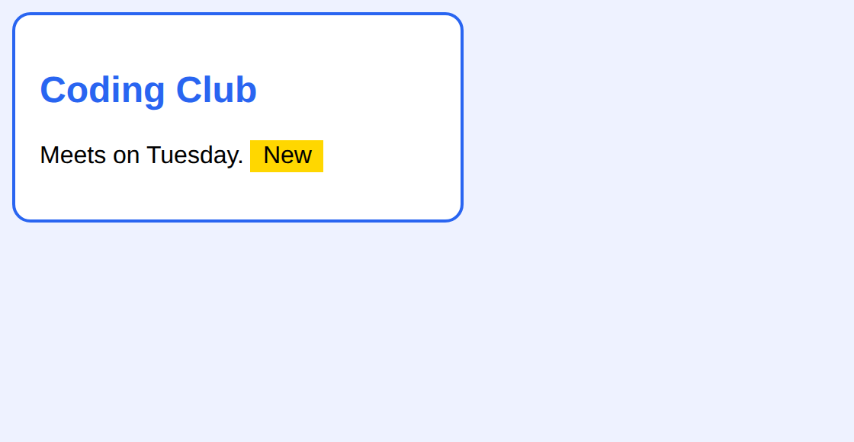
Example 2: Class and ID selectors
Use a class (.name) for groups of elements and an ID (#name) for one unique element.
style.css
lesson1/example2/index.html
body { background: #eef2ff; }
.card {
font-family: Arial;
background: white;
border: 2px solid #2965f1;
border-radius: 12px;
padding: 16px;
width: 260px;
}
.badge { background: gold; padding: 2px 8px; }
#title { color: #2965f1; }
1
2
3
4
1
.card is a class selector (starts with a dot). Reuse it on as many elements as you like.
HTML used
2
border is a shorthand: width, style and colour in one line.
<div class="card">
<h2 id="title">Coding Club</h2>
<p>Meets on Tuesday. <span class="badge">New</span></p>
</div>
3
.badge shows a second class; it only styles the element that has class="badge".
4
#title is an ID selector (starts with #). Use an ID only once per page.
Notes:
1. .card is a class selector (starts with a dot). Reuse it on as many elements as you like.
2. border is a shorthand: width, style and colour in one line.
3. .badge shows a second class; it only styles the element that has class="badge".
4. #title is an ID selector (starts with #). Use an ID only once per page.

Slide 7

Example 3: Pseudo-classes & specificity
A pseudo-class (such as :hover) styles an element while it is in a certain state.
style.css
lesson1/example3/index.html
.nav { font-family: Arial; font-size: 20px; }
.nav a {
color: #2965f1;
text-decoration: none;
padding: 8px 14px;
border-radius: 8px;
}
.nav a:hover {
color: white;
background: #ff4f8b;
}
1
2
3
4
1
Descendant selector: every <a> link that sits inside an element with class nav.
2
text-decoration: none removes the default underline from links.
HTML used
3
:hover applies only while the mouse pointer is over the link.
<nav class="nav">
<a href="#">Home</a>
<a href="#">Games</a>
...
4
It is more specific than .nav a, so its colours win when you hover.
Notes:
1. Descendant selector: every <a> link that sits inside an element with class nav.
2. text-decoration: none removes the default underline from links.
3. :hover applies only while the mouse pointer is over the link.
4. It is more specific than .nav a, so its colours win when you hover.

Slide 8




Real-world: one stylesheet, a whole website
School portal
News website
Themes & dark mode
One external stylesheet gives every page the same colours and fonts, so the site feels like one place.
A class such as .headline is written once and reused on hundreds of articles. Change it once and all update.
Changing a few rules re-skins the whole site. Selectors are how designers target exactly what to change.
Try it yourself: open any website, press F12 (or right-click > Inspect), click an element and read the rules in the Styles panel. Try editing a colour live.

Slide 9
Common mistakes
Avoid
Do this instead
Why
h1 {
color blue
}
h1 {
color: blue;
}
A declaration needs a colon between property and value, and a semicolon at the end.
<h1 id="title">
.title { color: red; }
<h1 id="title">
#title { color: red; }
The symbol must match the HTML: # for an ID, . for a class. Otherwise nothing matches.
h1 {
colour: red;
}
h1 {
color: red;
}
CSS uses American spelling. Unknown properties are silently ignored, so check spelling first.

Slide 10



Tips & best practices
Use an external stylesheet
Prefer classes to IDs
Put CSS in style.css and link it from every page. One change updates the whole site.
Classes are reusable and easier to override. Save IDs for page anchors and unique hooks.
Inspect, then experiment
Comment and format neatly
Press F12 to see which rules apply to an element and test changes live before editing your file.
Write /* notes */ for yourself. One declaration per line, two-space indent, always end with a semicolon.

Slide 11
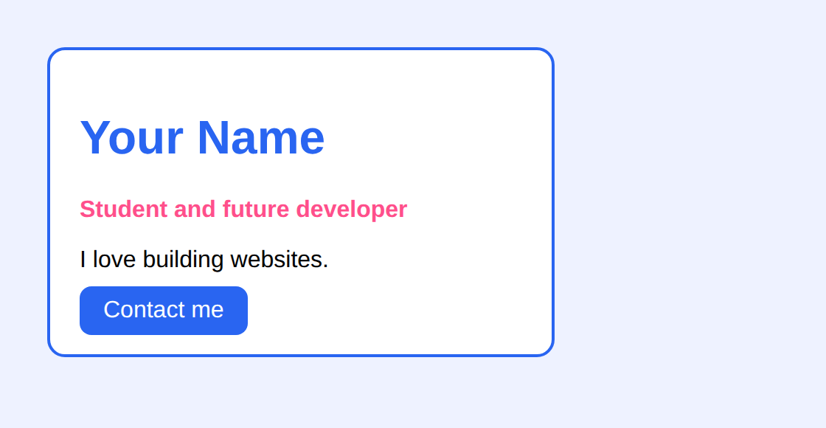
Activity: style a profile card
Time: 20 min
Hands-on
Goal: your page should look like this
Open the starter folder and edit style.css. The HTML is done; you write the CSS.
lesson1/activity/solution/index.html
1
Style body: font-family Arial, sans-serif; a pale background-color; padding 24px.
2
Make .profile a white card with a 2px solid blue border, border-radius 12px, padding 20px and width 300px.
3
Use the ID selector #name to colour the heading blue.
4
Make .role pink and bold (font-weight: bold).
5
Turn .btn into a blue button with white text, then change its background on :hover.
Start from: code/lesson1/activity/
Check with: code/lesson1/activity/solution/
Bonus: Add a second class to one element and give it its own rule.

Slide 12
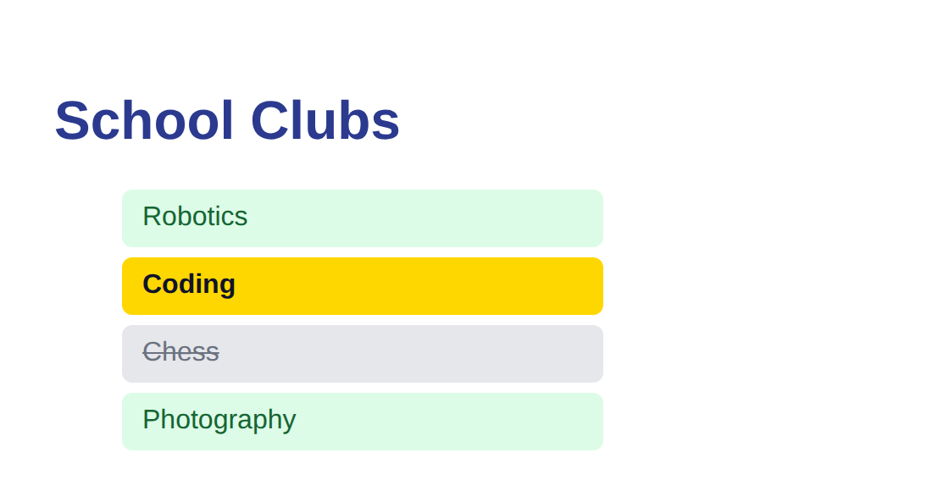
Challenge: the school clubs list
Time: 25 min
Challenge
Target: match this result
Style the list using only selectors you know. No changes to the HTML are allowed.
lesson1/challenge/solution/index.html
1
Every li gets padding, rounded corners and no bullet (list-style: none).
2
Clubs with class open get a light green background and dark green text.
3
Clubs with class full are grey with text-decoration: line-through.
4
The element with id featured gets a gold background. Does it beat .open? Why?
Start from: code/lesson1/challenge/
Check with: code/lesson1/challenge/solution/
Bonus: Add li:hover so the hovered club gets a blue outline.

Slide 13
Quick check
Think first, then click to reveal each answer.
Which symbol starts a class selector, and which starts an ID selector?
A dot (.) for a class and a hash (#) for an ID.
1
What is wrong with this rule?
h1 { color blue }
It is missing the colon and the semicolon. Correct: h1 { color: blue; }
2
A paragraph has class="note" and the rules p { color: red; } and .note { color: green; } both exist. Which colour wins?
Green. A class selector is more specific than an element selector.
3

Slide 14
Summary
CSS controls how HTML looks; HTML controls what it means.
Keep going
Your code
code/lesson1/ (examples, activity, challenge)
Practise online
playground.html (works offline) or the CodePen links in codepen.html
Next lesson
Lesson 2: Colors, Fonts & Text (and CSS variables)
A rule = selector + { property: value; } declarations.
Element selectors target tags, .class targets groups, #id targets one element.
Pseudo-classes such as :hover style an element's state.
When rules clash, the most specific selector wins; ties go to the later rule.

