Slide 1
CSS Grid
{ }
LESSON 5 OF 7
CSS
Design whole page layouts with rows and columns
High school | Prior knowledge: Lessons 1-4 | ~50 min

Slide 2

Learning objective
Key terms
By the end of this lesson you can:
Grid container
The parent element with display: grid. Its children are placed on the grid.
Create a grid with display: grid and grid-template-columns
Track
A single row or column of the grid.
Size tracks with fr units, repeat() and gap
fr unit
A fraction of the free space: 1fr 2fr gives the second column twice the width of the first.
Place and span items, and name areas with grid-template-areas
Grid line
The numbered lines between tracks. A 3-column grid has 4 vertical lines (1 to 4).

Slide 3
The big ideas
1
2
3
Grid is two-dimensional
Define the tracks
Place items by line or name
Flexbox arranges items in one line at a time. Grid arranges rows AND columns together, so it suits whole page layouts and galleries.
grid-template-columns lists the width of each column. repeat(3, 1fr) means three equal columns that share the free space. gap adds space between tracks.
Items fill the grid automatically. To move or stretch one, use grid-column and grid-row with span, or name areas and place items with grid-area.
display: grid;
repeat(3, 1fr)
grid-column: span 2;

Slide 4
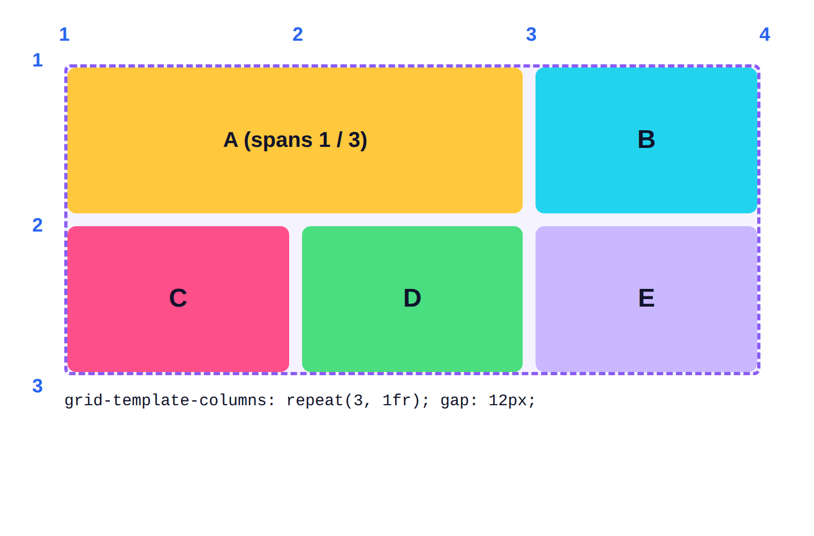
Tracks and grid lines
1
A grid with 3 columns and 2 rows has 4 column lines and 3 row lines.
2
grid-column: 1 / 3 starts at line 1 and ends at line 3: it covers TWO columns.
3
gap leaves space between tracks without extra margins.

Slide 5
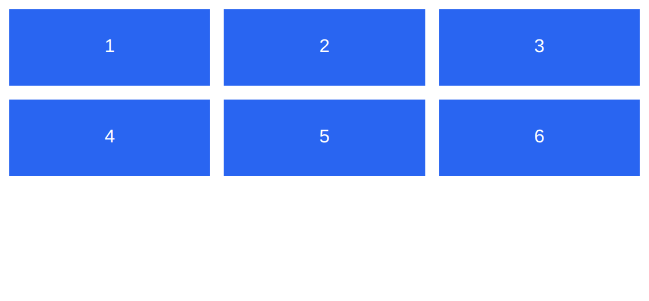
Example 1: A simple grid
Three equal columns with repeat() and a gap between the tracks.
style.css
lesson5/example1/index.html
.gallery {
display: grid;
grid-template-columns: repeat(3, 1fr);
gap: 12px;
}
.gallery div {
background: #2965f1;
color: white;
padding: 24px;
text-align: center;
font-family: Arial;
}
1
2
3
4
1
display: grid makes .gallery a grid container.
2
repeat(3, 1fr) = three equal columns.
HTML used
<div class="gallery">
<div>1</div><div>2</div><div>3</div>
...
3
gap: 12px spaces rows and columns.
4
Items fill the cells left to right, row by row.
Notes:
1. display: grid makes .gallery a grid container.
2. repeat(3, 1fr) = three equal columns.
3. gap: 12px spaces rows and columns.
4. Items fill the cells left to right, row by row.

Slide 6
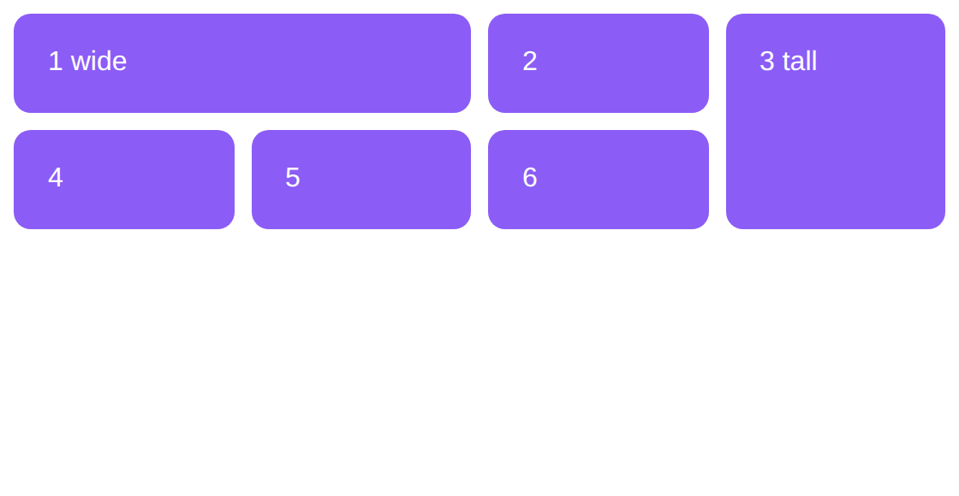
Example 2: Spanning rows and columns
An item can cover more than one cell with span.
style.css
lesson5/example2/index.html
.grid {
display: grid;
grid-template-columns: repeat(4, 1fr);
gap: 10px;
font-family: Arial;
}
.grid div {
background: #8b5cf6;
color: white;
padding: 20px;
border-radius: 10px;
}
.wide { grid-column: span 2; }
.tall { grid-row: span 2; }
1
2
3
1
Four equal columns.
2
grid-column: span 2 makes .wide cover two columns.
HTML used
<div class="grid">
...
3
grid-row: span 2 makes .tall cover two rows. The grid packs the rest around it.
Notes:
1. Four equal columns.
2. grid-column: span 2 makes .wide cover two columns.
3. grid-row: span 2 makes .tall cover two rows. The grid packs the rest around it.

Slide 7
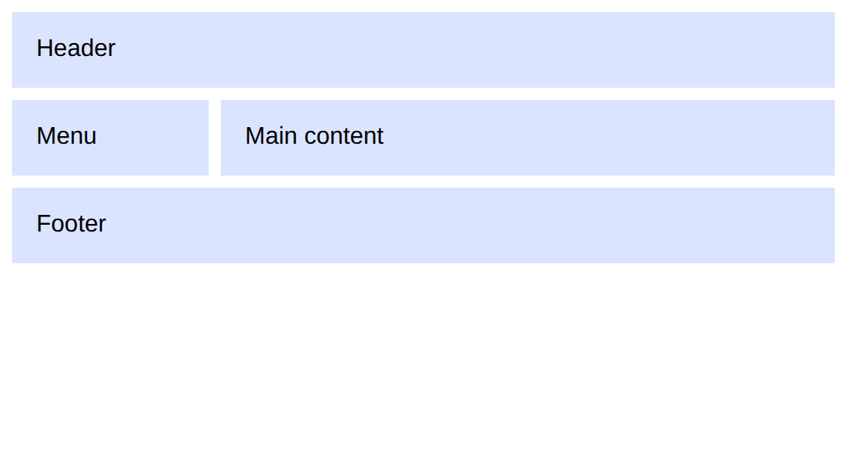
Example 3: Page layout with named areas
Draw the layout in your CSS with grid-template-areas.
style.css
lesson5/example3/index.html
.page {
display: grid;
grid-template-columns: 130px 1fr;
grid-template-areas:
"head head"
"side main"
"foot foot";
gap: 8px;
font-family: Arial;
}
.page > * { background: #dbe4ff; padding: 16px; }
header { grid-area: head; }
aside { grid-area: side; }
main { grid-area: main; }
footer { grid-area: foot; }
1
2
3
4
1
A 130px sidebar column and a flexible main column.
2
Each quoted string is a row; the same name side by side means that area spans.
3
.page > * selects every direct child of .page.
4
grid-area: head puts the header in the area named head.
Notes:
1. A 130px sidebar column and a flexible main column.
2. Each quoted string is a row; the same name side by side means that area spans.
3. .page > * selects every direct child of .page.
4. grid-area: head puts the header in the area named head.

Slide 8




Real-world: galleries, dashboards and magazines
Photo galleries
Dashboards
Magazine and news layouts
Grid keeps images in tidy rows and columns, and span lets one feature photo be bigger than the others.
Charts, tables and stat cards sit on a grid so every panel lines up in both directions.
Large featured stories next to small ones use named areas and spans, like a printed front page.
Try it yourself: open DevTools on a gallery or dashboard site and look for a 'grid' badge in Elements. Click it to show numbered grid lines on the page.

Slide 9
Common mistakes
Avoid
Do this instead
Why
.gallery {
grid-template-columns: 1fr 1fr;
}
.gallery {
display: grid;
grid-template-columns: 1fr 1fr;
}
Without display: grid, the grid properties do nothing.
grid-column: 1 / 3;
/* meant columns 1 to 3 */
grid-column: 1 / 4;
/* or span 3 */
The numbers are LINES, not columns. 1 / 3 covers only two columns.
grid-template-columns:
300px 300px 300px;
grid-template-columns:
repeat(3, 1fr);
Fixed pixel tracks overflow small screens. Use fr (or minmax) so tracks adapt.

Slide 10



Tips & best practices
Pick the right tool
auto-fit does the maths
One row or column of items: Flexbox. A full layout with rows and columns: Grid. Use both together.
repeat(auto-fit, minmax(160px, 1fr)) makes as many columns as fit, no media queries needed.
Show the grid lines
Use names for page layouts
Turn on the grid overlay in DevTools to see line numbers and track sizes while you work.
grid-template-areas reads like a drawing of the page, so teammates understand it at a glance.

Slide 11
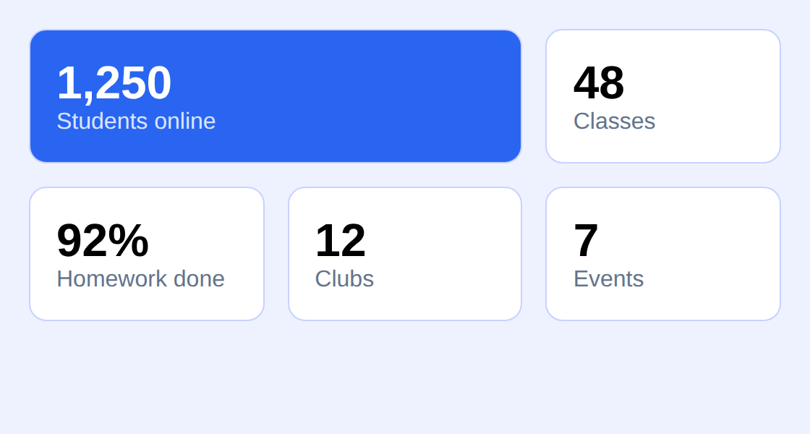
Activity: a stats dashboard
Time: 25 min
Hands-on
Goal: your page should look like this
Create a responsive grid of stat cards without writing a single media query.
lesson5/activity/solution/index.html
1
Make .stats a grid with gap: 16px and padding: 20px.
2
Set grid-template-columns: repeat(auto-fit, minmax(150px, 1fr)).
3
Style .stat with a white background, rounded corners, padding and a soft border.
4
Make .big (the first stat) span two columns with grid-column: span 2.
5
Style the numbers (strong) large and bold, and the labels (span) grey.
Start from: code/lesson5/activity/
Check with: code/lesson5/activity/solution/
Bonus: Resize the browser window and watch the columns appear and disappear.

Slide 12
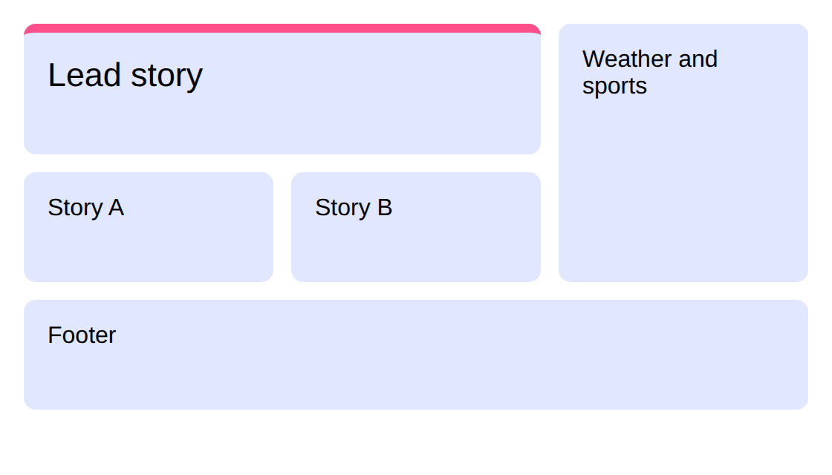
Challenge: the news front page
Time: 30 min
Challenge
Target: match this result
Lay out a newspaper-style page using grid-template-areas. Do not edit the HTML.
lesson5/challenge/solution/index.html
1
Create a 3-column grid with gap 12px.
2
Place the headline story across the top two columns and two rows (area: lead).
3
Put the sidebar in the third column spanning both rows (area: side).
4
Put two smaller stories under the lead (areas: a and b) and a footer across the page.
Start from: code/lesson5/challenge/
Check with: code/lesson5/challenge/solution/
Bonus: Give the lead story a larger font and a coloured top border.

Slide 13
Quick check
Think first, then click to reveal each answer.
What does grid-template-columns: 1fr 2fr 1fr create?
Three columns; the middle one is twice as wide as each of the others.
1
grid-column: 2 / 4 covers how many columns?
Two (column 2 and column 3). The numbers are grid lines.
2
When would you choose Flexbox instead of Grid?
For a single row or column of items, such as a navigation bar or button group.
3

Slide 14
Summary
display: grid on the parent; children are placed in cells.
Keep going
Your code
code/lesson5/ (examples, activity, challenge)
Practise online
playground.html (works offline) or the CodePen links in codepen.html
Next lesson
Lesson 6: Responsive Design
grid-template-columns, repeat() and fr define flexible tracks.
gap spaces tracks; span stretches an item across several.
grid-template-areas lets you draw the layout with names.
auto-fit with minmax() gives responsive grids without media queries.

