Slide 1
SBDC
Yifan Dang, Yunsheng Liu, Suyang Xu, Yichun Zhu

Slide 2
Outline
How to start a business?
How does geographical factors influence business?
How important is consulting service to entrepreneurs?

Slide 3
Method
Separate the data set into:
10000 training set;
7000 testing set;
Shuffle 10000 training set for 100 times to do validation test
Use 60% of training data for each validation shuffle

Slide 4
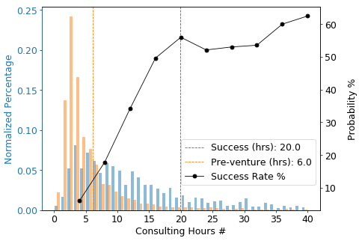
To Start A Good Business?
Consulting time matters!
Considering only cases where entrepreneurs don’t start a business when consulting.

Slide 5
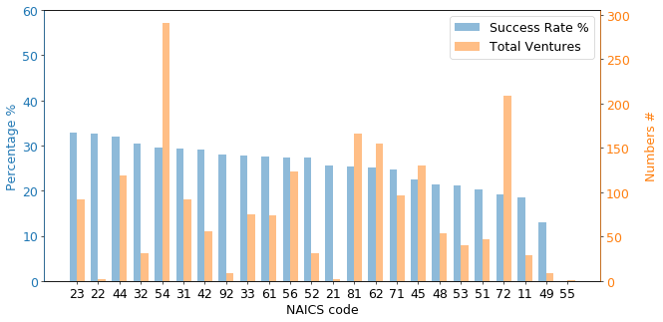
To Start A Good Business?
Industry is important!

Slide 6
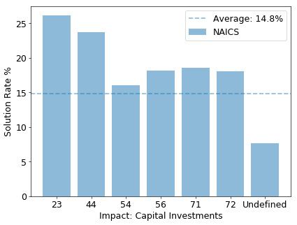



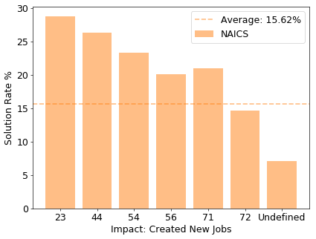
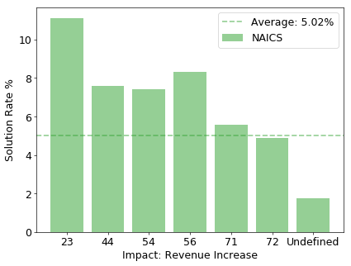
To Start A Good Business?
For industry having lower success rate than average:
More service related to jobs;
More service related to increase revenue;

Slide 7
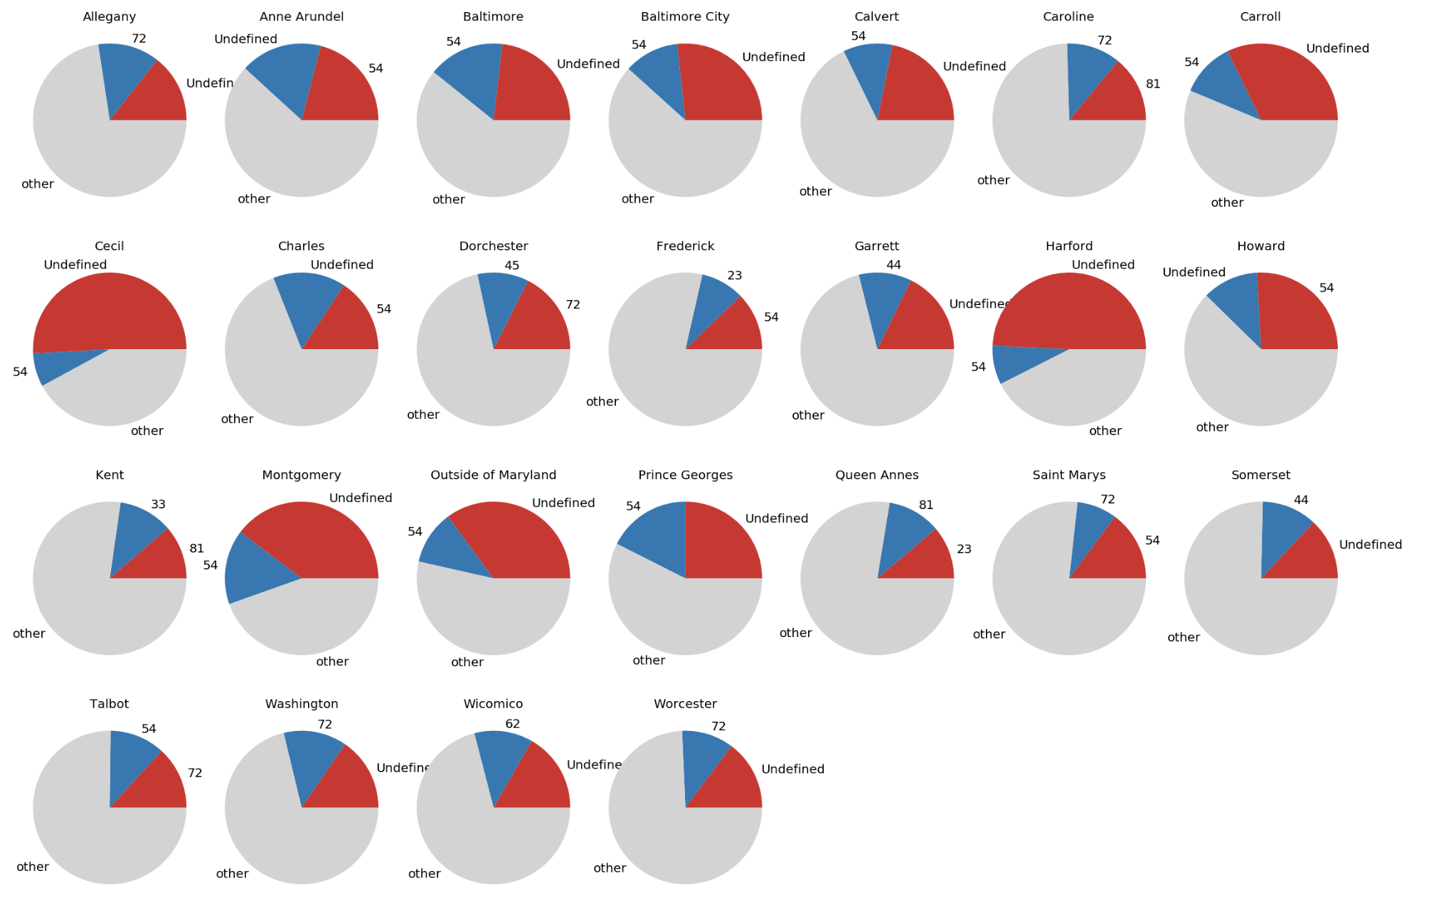
To Do Good Business?
Location matters!

Slide 8
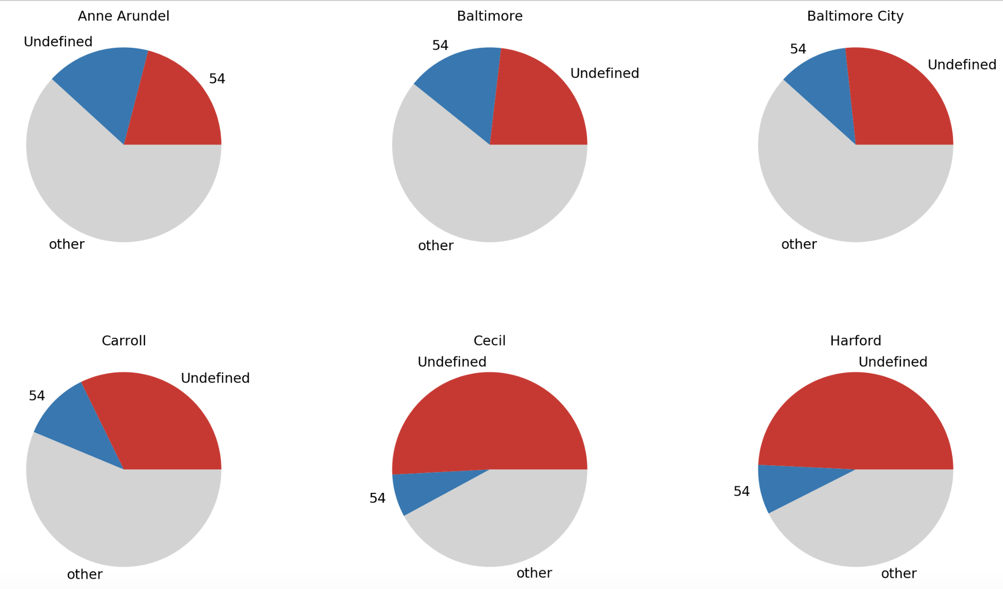
To Do Good Business?
Dominating industries in specific counties

Slide 9
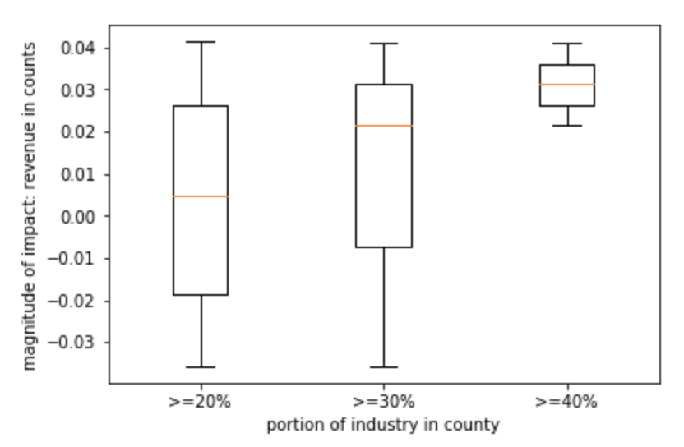
To Do Good Business?
Probability to have positive service impact compared with the same industry in other counties.

Slide 10
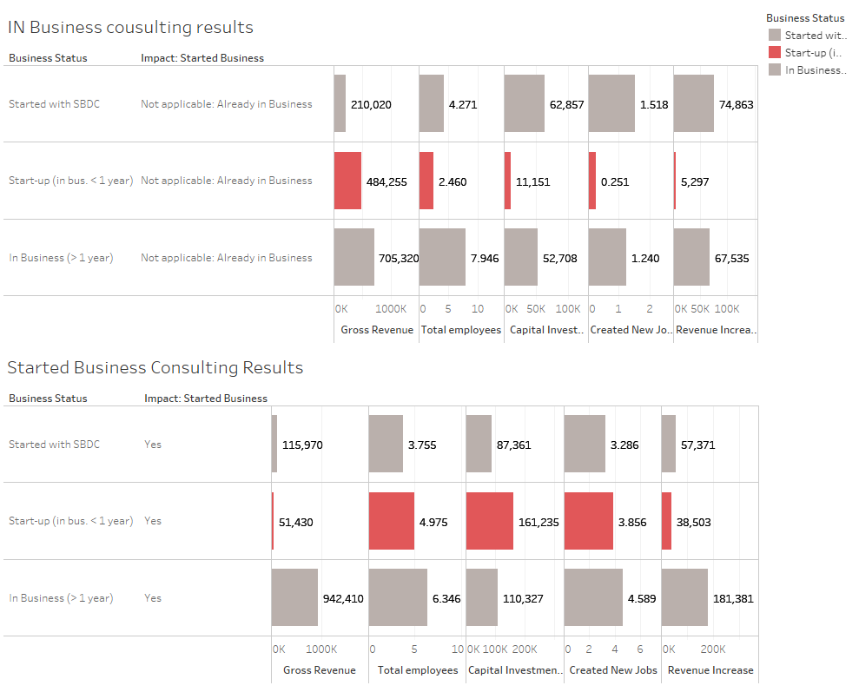
Consulting Services Are More Important to Entrepreneurs!

Slide 11
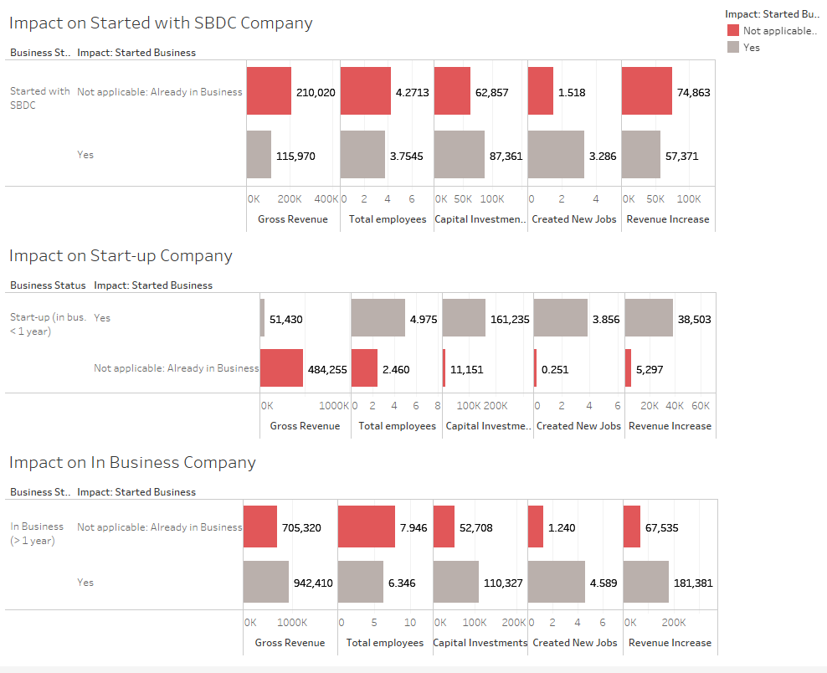
Consulting Services Are More Important to Entrepreneurs!

Slide 12
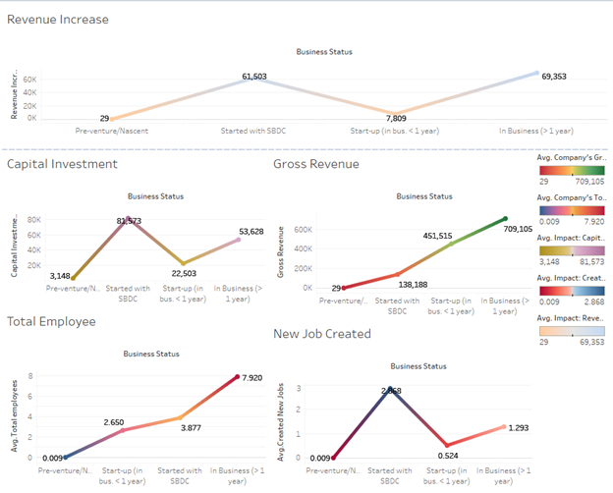
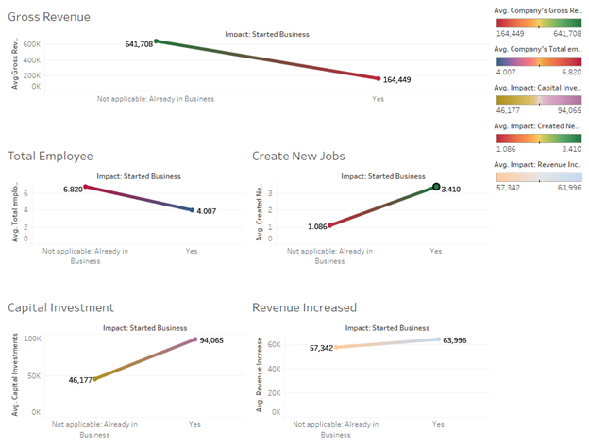
Consulting Services Are More Important to Entrepreneurs!

Slide 13
Conclusions & Suggestions & Questions

