Slide 1






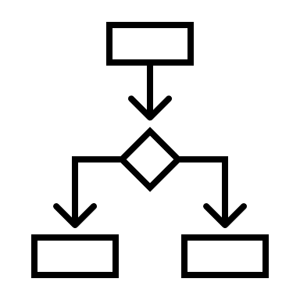




Users
Objects
Authentication
Authorization
Encryption at rest
Encryption in transit
Groups (Roles)
Access rights
Audit logs
Access levels

