Slide 1
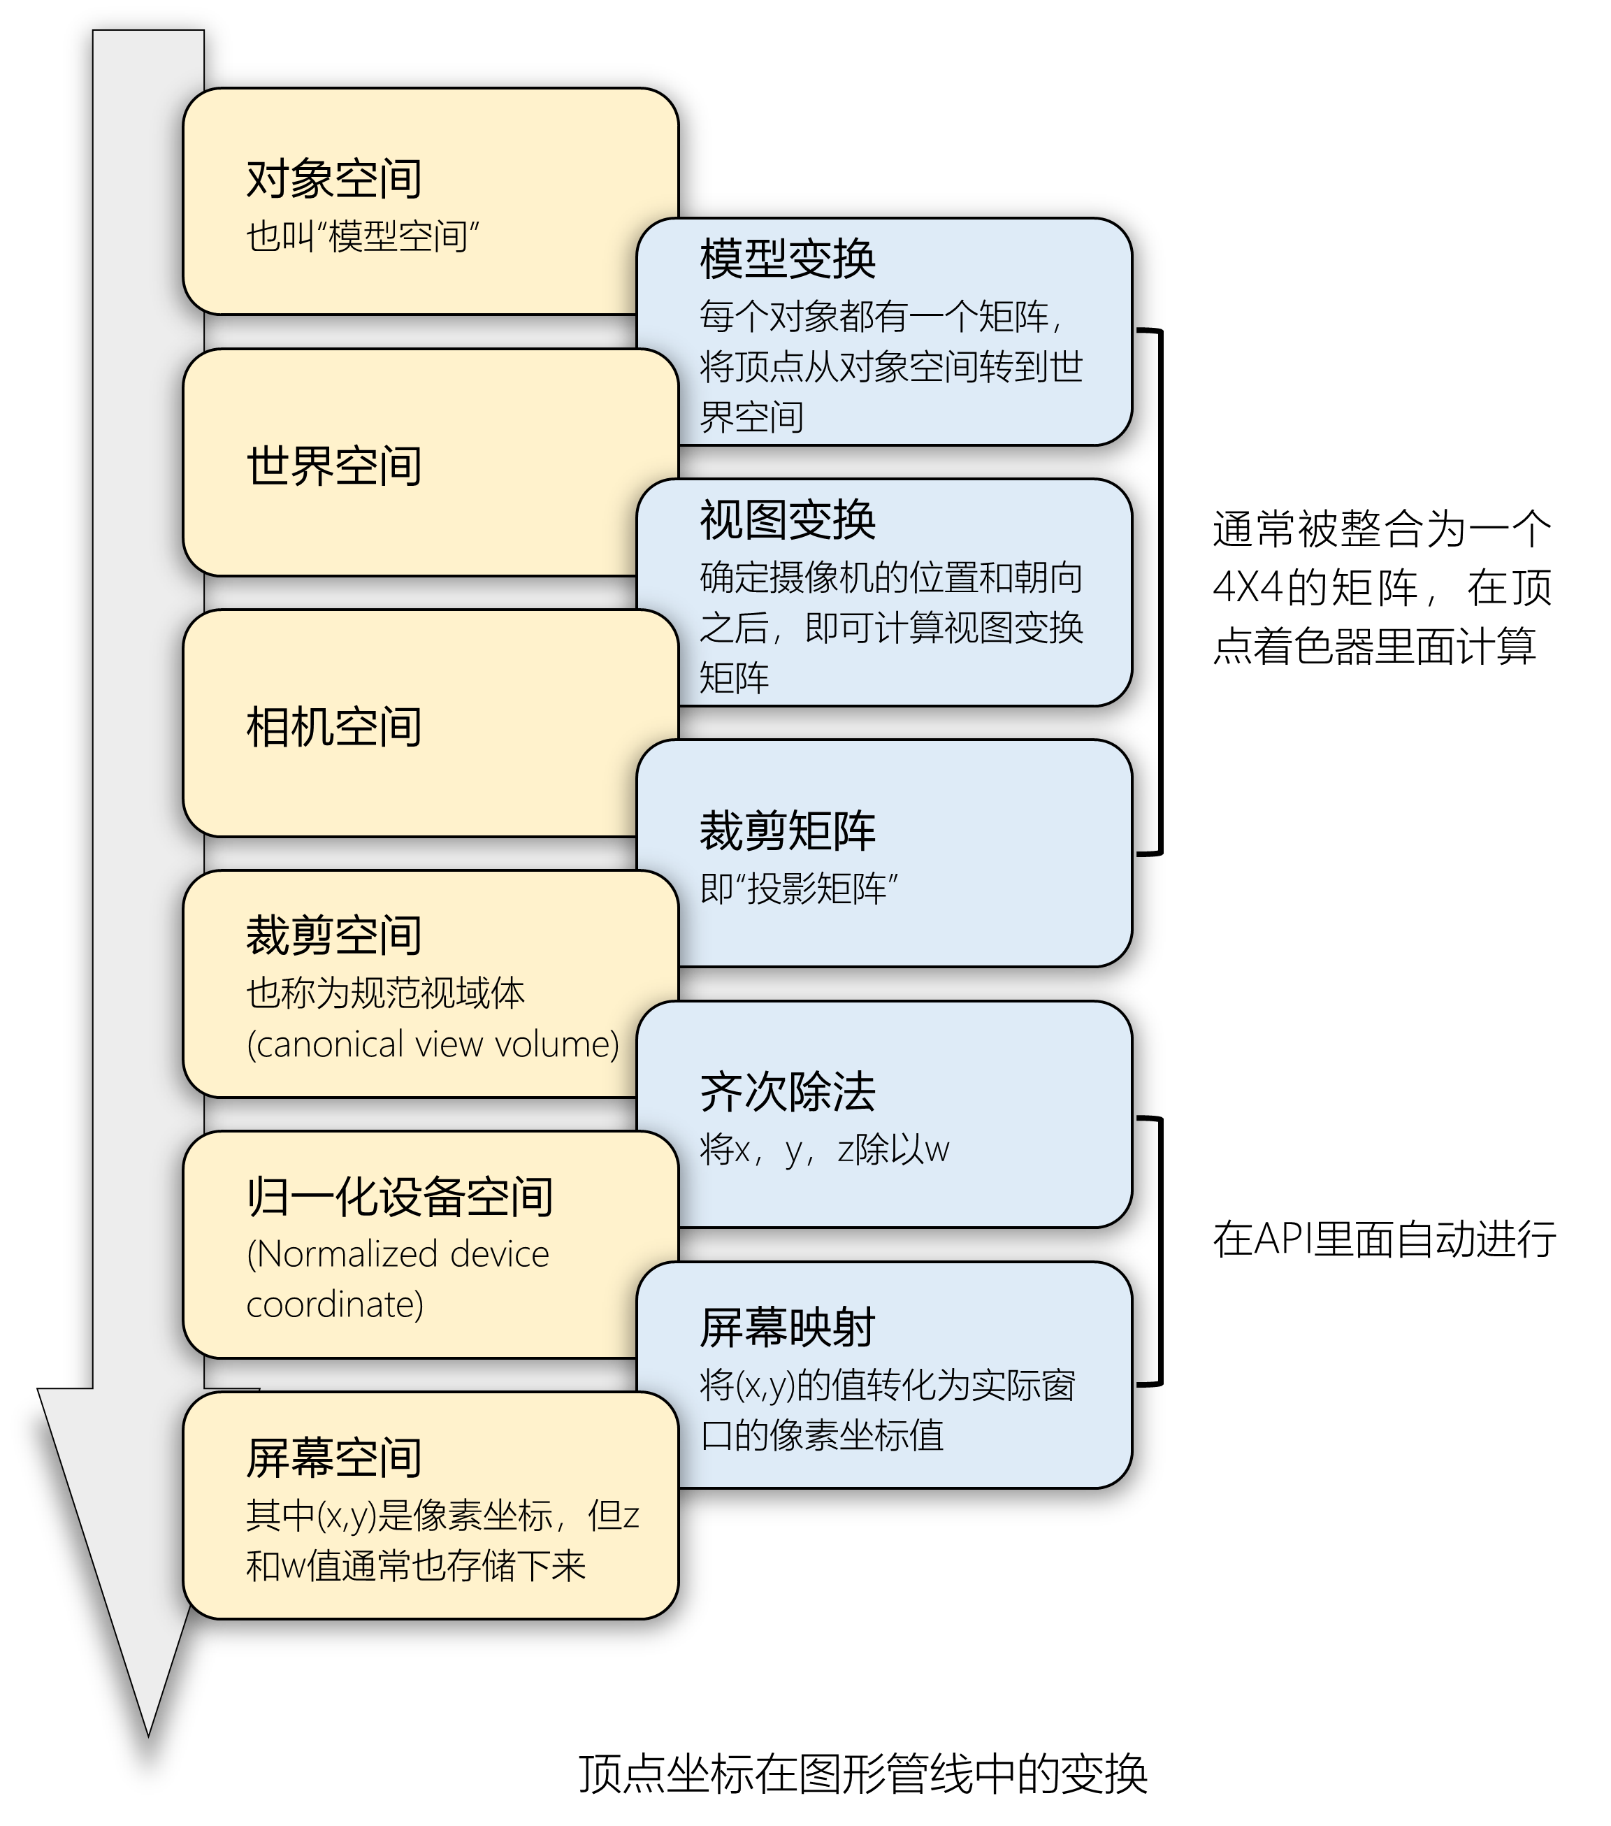
对象空间
也叫“模型空间”
模型变换
每个对象都有一个矩阵，将顶点从对象空间转到世界空间
世界空间
视图变换
确定摄像机的位置和朝向之后，即可计算视图变换矩阵
通常被整合为一个4X4的矩阵，在顶点着色器里面计算
相机空间
裁剪矩阵
即“投影矩阵”
裁剪空间
也称为规范视域体
(canonical view volume)
齐次除法
将x，y，z除以w
归一化设备空间
(Normalized device coordinate)
在API里面自动进行
屏幕映射
将(x,y)的值转化为实际窗口的像素坐标值
屏幕空间
其中(x,y)是像素坐标，但z和w值通常也存储下来
顶点坐标在图形管线中的变换

Slide 2

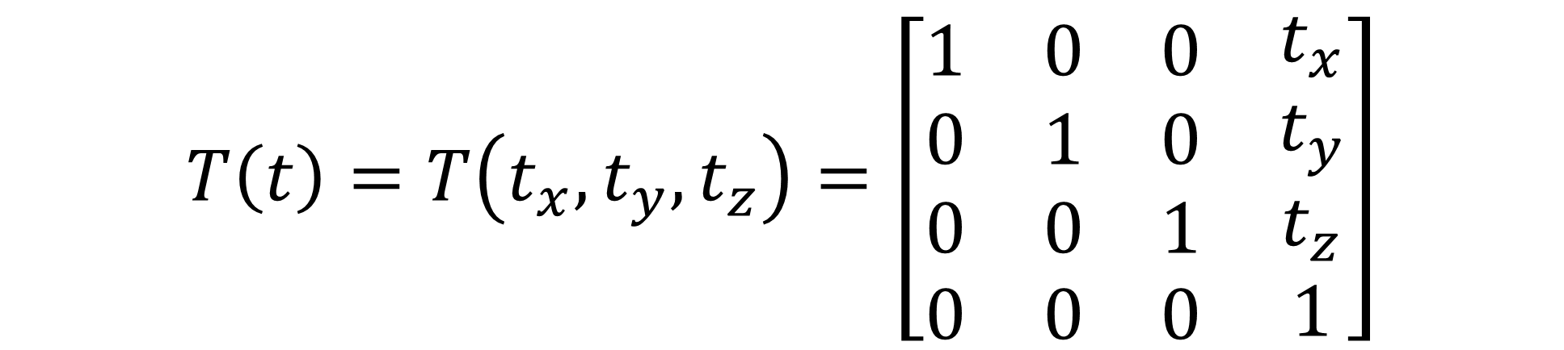
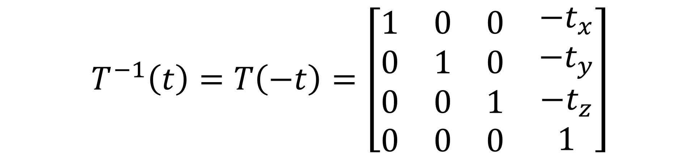
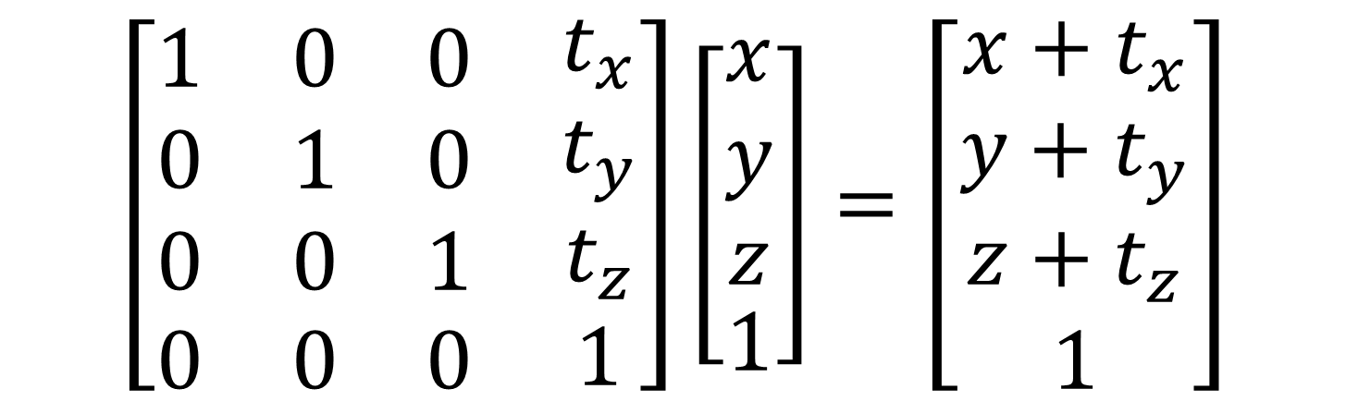
$$T\left(t\right)=T\left(t_{x},t_{y},t_{z}\right)=\left[\begin{matrix}\begin{matrix}1 & 0 & 0 \\ 0 & 1 & 0 \\ 0 & 0 & 1\end{matrix} & \begin{matrix}t_{x} \\ t_{y} \\ t_{z}\end{matrix} \\ \begin{matrix}0 & 0 & 0\end{matrix} & 1\end{matrix}\right]$$
$$\left[\begin{matrix}\begin{matrix}1 & 0 & 0 \\ 0 & 1 & 0 \\ 0 & 0 & 1\end{matrix} & \begin{matrix}t_{x} \\ t_{y} \\ t_{z}\end{matrix} \\ \begin{matrix}0 & 0 & 0\end{matrix} & 1\end{matrix}\right]\left[\begin{matrix}\begin{matrix}x \\ y \\ z\end{matrix} \\ 0\end{matrix}\right]=\left[\begin{matrix}\begin{matrix}x \\ y \\ z\end{matrix} \\ 0\end{matrix}\right]$$
$$\left[\begin{matrix}\begin{matrix}1 & 0 & 0 \\ 0 & 1 & 0 \\ 0 & 0 & 1\end{matrix} & \begin{matrix}t_{x} \\ t_{y} \\ t_{z}\end{matrix} \\ \begin{matrix}0 & 0 & 0\end{matrix} & 1\end{matrix}\right]\left[\begin{matrix}\begin{matrix}x \\ y \\ z\end{matrix} \\ 1\end{matrix}\right]=\left[\begin{matrix}\begin{matrix}x+t_{x} \\ y+t_{y} \\ z+t_{z}\end{matrix} \\ 1\end{matrix}\right]$$
$$T^{−1}\left(t\right)=T\left(−t\right)=\left[\begin{matrix}\begin{matrix}1 & 0 & 0 \\ 0 & 1 & 0 \\ 0 & 0 & 1\end{matrix} & \begin{matrix}{−t}_{x} \\ {−t}_{y} \\ {−t}_{z}\end{matrix} \\ \begin{matrix}0 & 0 & 0\end{matrix} & 1\end{matrix}\right]$$

Slide 3
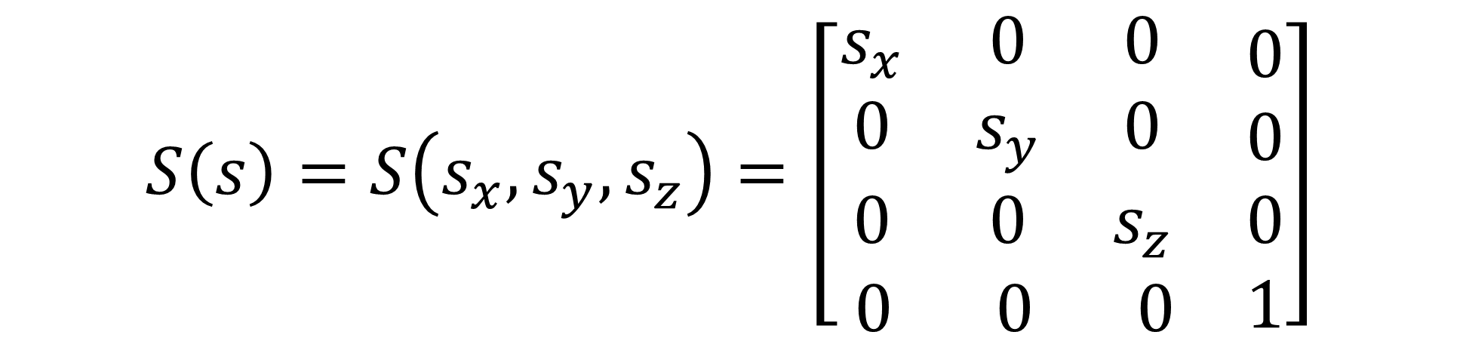
$$S\left(s\right)=S\left(s_{x},s_{y},s_{z}\right)=\left[\begin{matrix}\begin{matrix}s_{x} & 0 & 0 \\ 0 & s_{y} & 0 \\ 0 & 0 & s_{z}\end{matrix} & \begin{matrix}0 \\ 0 \\ 0\end{matrix} \\ \begin{matrix} 0 & 0 & 0\end{matrix} & 1\end{matrix}\right]$$
$$\left[\begin{matrix}\begin{matrix}1 & 0 & 0 \\ 0 & 1 & 0 \\ 0 & 0 & 1\end{matrix} & \begin{matrix}t_{x} \\ t_{y} \\ t_{z}\end{matrix} \\ \begin{matrix}0 & 0 & 0\end{matrix} & 1\end{matrix}\right]\left[\begin{matrix}\begin{matrix}x \\ y \\ z\end{matrix} \\ 0\end{matrix}\right]=\left[\begin{matrix}\begin{matrix}x \\ y \\ z\end{matrix} \\ 0\end{matrix}\right]$$
$$\left[\begin{matrix}\begin{matrix}1 & 0 & 0 \\ 0 & 1 & 0 \\ 0 & 0 & 1\end{matrix} & \begin{matrix}t_{x} \\ t_{y} \\ t_{z}\end{matrix} \\ \begin{matrix}0 & 0 & 0\end{matrix} & 1\end{matrix}\right]\left[\begin{matrix}\begin{matrix}x \\ y \\ z\end{matrix} \\ 1\end{matrix}\right]=\left[\begin{matrix}\begin{matrix}x+t_{x} \\ y+t_{y} \\ z+t_{z}\end{matrix} \\ 1\end{matrix}\right]$$
$$T^{−1}\left(t\right)=T\left(−t\right)=\left[\begin{matrix}\begin{matrix}1 & 0 & 0 \\ 0 & 1 & 0 \\ 0 & 0 & 1\end{matrix} & \begin{matrix}{−t}_{x} \\ {−t}_{y} \\ {−t}_{z}\end{matrix} \\ \begin{matrix}0 & 0 & 0\end{matrix} & 1\end{matrix}\right]$$

Slide 4
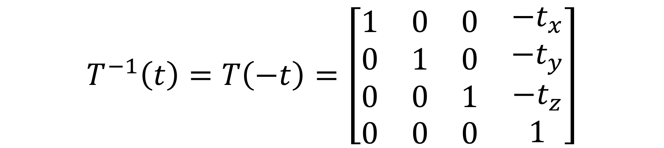

$$v=\left[\begin{matrix}v_{x} \\ v_{y}\end{matrix}\right]=\left[\begin{matrix}rcosθ \\ rsinθ\end{matrix}\right]$$
$$\left[\begin{matrix}rcos(θ+φ) \\ rsin(θ+φ)\end{matrix}\right]=\left[\begin{matrix}r(cosθcosφ−sinθsinφ) \\ r(sinθcosφ+cosθsinφ)\end{matrix}\right]=R\left(φ\right)\left[\begin{matrix}rcosθ \\ rsinθ\end{matrix}\right]$$
$$R\left(φ\right)=\left[\begin{matrix}cosφ & −sinφ \\ sinφ & cosφ\end{matrix}\right]$$
分别对“方向”和“点”执行平移
$$T^{−1}\left(t\right)=T\left(−t\right)=\left[\begin{matrix}\begin{matrix}1 & 0 & 0 \\ 0 & 1 & 0 \\ 0 & 0 & 1\end{matrix} & \begin{matrix}{−t}_{x} \\ {−t}_{y} \\ {−t}_{z}\end{matrix} \\ \begin{matrix}0 & 0 & 0\end{matrix} & 1\end{matrix}\right]$$
平移变换矩阵的逆

Slide 5
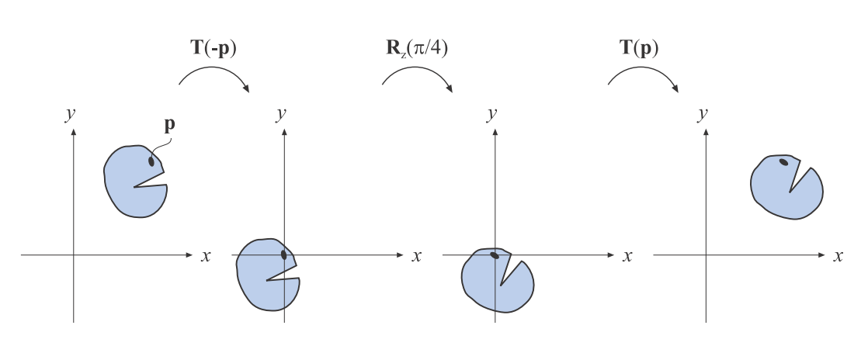
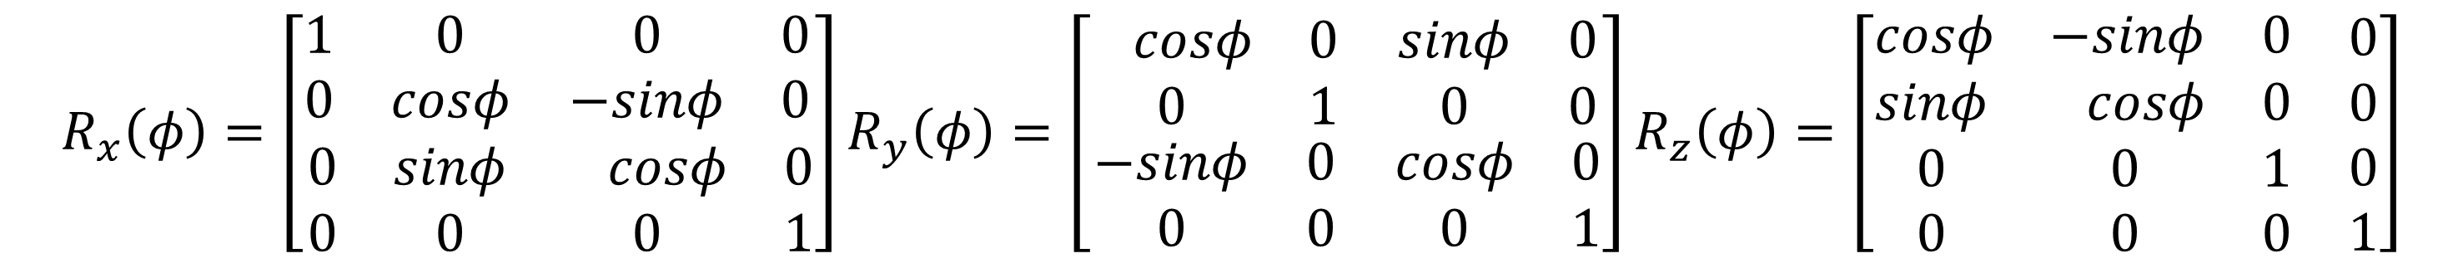
$$X=T\left(p\right)R\left(φ\right)T(−p)$$
$$R_{x}\left(φ\right)=\left[\begin{matrix}\begin{matrix}1 & 0 \\ 0 & cosφ\end{matrix} & \begin{matrix}0 & 0 \\ −sinφ & 0\end{matrix} \\ \begin{matrix}0 & sinφ \\ 0 & 0\end{matrix} & \begin{matrix}−cosφ & 0 \\ 0 & 1\end{matrix}\end{matrix}\right]R_{y}\left(φ\right)=\left[\begin{matrix}\begin{matrix}−cosφ & 0 \\ 0 & 1\end{matrix} & \begin{matrix}sinφ & 0 \\ 0 & 0\end{matrix} \\ \begin{matrix}−sinφ & 0 \\ 0 & 0\end{matrix} & \begin{matrix}cosφ & 0 \\ 0 & 1\end{matrix}\end{matrix}\right]R_{z}\left(φ\right)=\left[\begin{matrix}\begin{matrix}cosφ & −sinφ & 0\end{matrix} & 0 \\ \begin{matrix}sinφ & −cosφ & 0 \\ 0 & 0 & 1 \\ 0 & 0 & 0\end{matrix} & \begin{matrix}0 \\ 0 \\ 1\end{matrix}\end{matrix}\right]$$
$$R^{−1}(φ)=R\left(−φ\right)$$

Slide 6




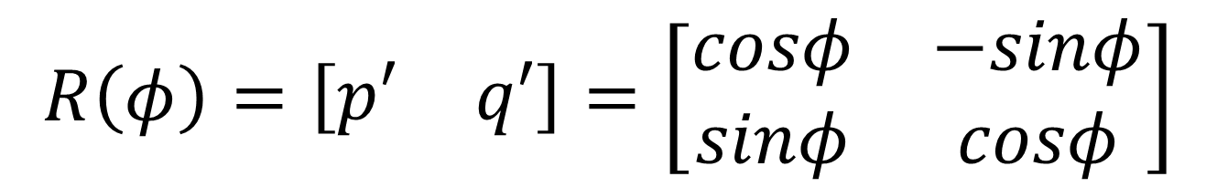
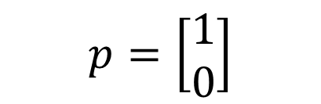


$$q=\left[\begin{matrix}0 \\ 1\end{matrix}\right]$$
$$p′=\left[\begin{matrix}cosφ \\ sinφ\end{matrix}\right]$$
$$R\left(φ\right)=\left[\begin{matrix}p′ & q′\end{matrix}\right]=\left[\begin{matrix}cosφ & −sinφ \\ sinφ & cosφ\end{matrix}\right]$$
$$q′=\left[\begin{matrix}−sinφ \\ cosφ\end{matrix}\right]$$
$$φ$$
$$p=\left[\begin{matrix}1 \\ 0\end{matrix}\right]$$
$$φ$$
$$X=T\left(p\right)R\left(φ\right)T(−p)$$
$$R_{x}\left(φ\right)=\left[\begin{matrix}\begin{matrix}1 & 0 \\ 0 & cosφ\end{matrix} & \begin{matrix}0 & 0 \\ −sinφ & 0\end{matrix} \\ \begin{matrix}0 & sinφ \\ 0 & 0\end{matrix} & \begin{matrix}−cosφ & 0 \\ 0 & 1\end{matrix}\end{matrix}\right]R_{y}\left(φ\right)=\left[\begin{matrix}\begin{matrix}−cosφ & 0 \\ 0 & 1\end{matrix} & \begin{matrix}sinφ & 0 \\ 0 & 0\end{matrix} \\ \begin{matrix}−sinφ & 0 \\ 0 & 0\end{matrix} & \begin{matrix}cosφ & 0 \\ 0 & 1\end{matrix}\end{matrix}\right]R_{z}\left(φ\right)=\left[\begin{matrix}\begin{matrix}cosφ & −sinφ & 0\end{matrix} & 0 \\ \begin{matrix}sinφ & −cosφ & 0 \\ 0 & 0 & 1 \\ 0 & 0 & 0\end{matrix} & \begin{matrix}0 \\ 0 \\ 1\end{matrix}\end{matrix}\right]$$
$$R^{−1}(φ)=R\left(−φ\right)$$
$$F\left(x\right)+F\left(y\right)= F\left(x+y\right)$$
$$F(kx) = kF(x)$$

Slide 7








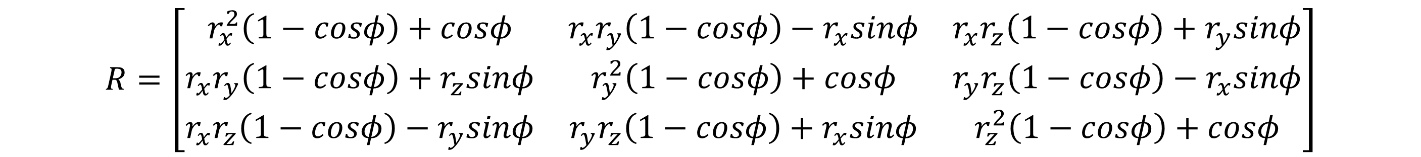




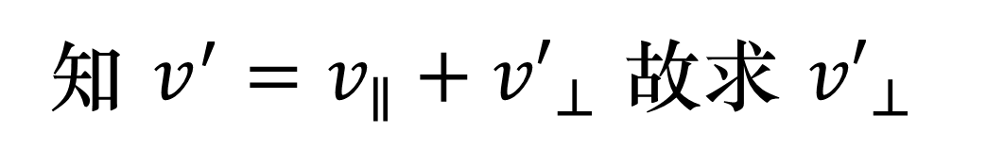


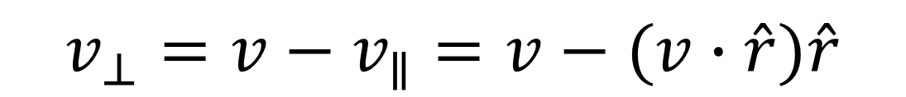



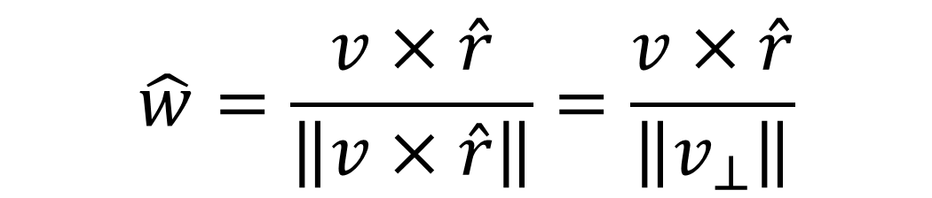
$${v′}_{⊥}$$
$$v′$$
$$v_{∥}=(v∙\hat{r})\hat{r}$$
$$φ$$
$$v_{⊥}$$
$$v_{∥}$$
$$v_{⊥}=v−v_{∥}=v−(v∙\hat{r})\hat{r}$$
$$\hat{r}$$
$$v$$
知 $v^{′}=v_{∥}+{v′}_{⊥}$ 故求 ${v′}_{⊥}$
$${v′}_{⊥}$$
$$w$$
$$\hat{w}=\frac{v×\hat{r}}{\left\|v×\hat{r}\right\|}=\frac{v×\hat{r}}{\left\|v_{⊥}\right\|}$$
$$v′$$
$$φ$$
$$v_{∥}$$
$$v_{⊥}$$
$${\hat{v}}_{⊥}=\frac{v_{⊥}}{\left\|v_{⊥}\right\|}$$
$$\hat{r}$$
$${v′}_{⊥}=\left\|v_{⊥}\right\|(cosφ{\hat{v}}_{⊥}+sinφ\hat{w})$$
$$v$$
$$v^{′}=v_{∥}+{v′}_{⊥}=\left(v∙\hat{r}\right)\hat{r}+\left\|v_{⊥}\right\|(cosφ{\hat{v}}_{⊥}+sinφ\hat{w})$$
$$=\left(v∙\hat{r}\right)\hat{r}+ cosφ(v−\left(v∙\hat{r}\right)\hat{r})+sinφ(v×\hat{r})$$
$$R=\left[\begin{matrix}r_{x}^{2}\left(1−cosφ\right)+cosφ & r_{x}r_{y}\left(1−cosφ\right)−r_{x}sinφ & r_{x}r_{z}\left(1−cosφ\right)+r_{y}sinφ \\ r_{x}r_{y}\left(1−cosφ\right)+r_{z}sinφ & r_{y}^{2}\left(1−cosφ\right)+cosφ & r_{y}r_{z}\left(1−cosφ\right)−r_{x}sinφ \\ r_{x}r_{z}\left(1−cosφ\right)−r_{y}sinφ & r_{y}r_{z}\left(1−cosφ\right)+r_{x}sinφ & r_{z}^{2}\left(1−cosφ\right)+cosφ\end{matrix}\right]$$

Slide 8




























$${v′}_{⊥}$$
$$v′$$
$$v_{∥}=(v∙\hat{r})\hat{r}$$
$$φ$$
$$v_{⊥}$$
$$v_{∥}$$
$$v_{⊥}=v−v_{∥}=v−(v∙\hat{r})\hat{r}$$
$$\hat{r}$$
$$v$$
知 $v^{′}=v_{∥}+{v′}_{⊥}$ 故求 ${v′}_{⊥}$
$$y$$
$$y$$
$$y$$
$$v$$
$$s$$
$$s$$
$$r$$
$$v$$
$$s$$
$$r$$
$$φ$$
$$r$$
$$v′$$
$$x$$
$$x$$
$$x$$
$$t$$
$$t$$
$$z$$
$$t$$
$$z$$
$$z$$
$$M$$
$$R_{x}(φ)$$
$$M^{−1}$$
$$M^{−1}=\left[\begin{matrix}r & s & t\end{matrix}\right]$$
$$M={\left[\begin{matrix}r & s & t\end{matrix}\right]}^{−1}={\left[\begin{matrix}r & s & t\end{matrix}\right]}^{T}=\left[\begin{matrix}r^{T} \\ s^{T} \\ t^{T}\end{matrix}\right]$$
$$X=M^{T}R_{x}\left(φ\right)M$$

