Slide 1

HP407
Meta-analysis for caregiver interventions in low- and middle-income countries (LMICs)
Summative project
Updated 23 December 2022
Student assignment

Slide 2
Group work and individual write-up
Useful links
Search terms and strategy
Shared folder: https://drive.google.com/drive/folders/1fVF72syScyPgC2cWsXoUsrFUFjG3d-_q?usp=sharing
PRISMA flow chart: https://prisma-statement.org/prismastatement/flowdiagram.aspx
List of included studies
Shared folder: https://drive.google.com/drive/folders/1LZ5OD_R0NvvKsEme2n-FZD0g4mrJasa3?usp=sharing
Data extraction tables
Shared folder: https://drive.google.com/drive/folders/1fgSUbY6VxDiV1ipVVD32cLXsKh4Z8Vzk?usp=sharing
Risk of bias assessment tables
It is part of the data extraction tables
Shared folder: https://drive.google.com/drive/folders/1c88UygDkwPhLJupWnOMWvENrJoiQRh5_?usp=sharing
Risk of bias assessment guideline: https://drive.google.com/file/d/19R9savfPdCHC8XLz2iiMvL_71lPJERWK/view (Should write with your own words!)
Deadline: Thursday, 26 January 2023, 12:00 PM
In the guideline, it is said,
Remember that your individual research project report will account for 100% of the course grade on HP407. Although you are working on completing a systematic review and meta-analysis in groups, your final reports will be developed individually.
Parts allowed to be the same across group members:
search terms and strategy
list of included studies
data extraction tables
forest plots
risk of bias assessment tables

Slide 3
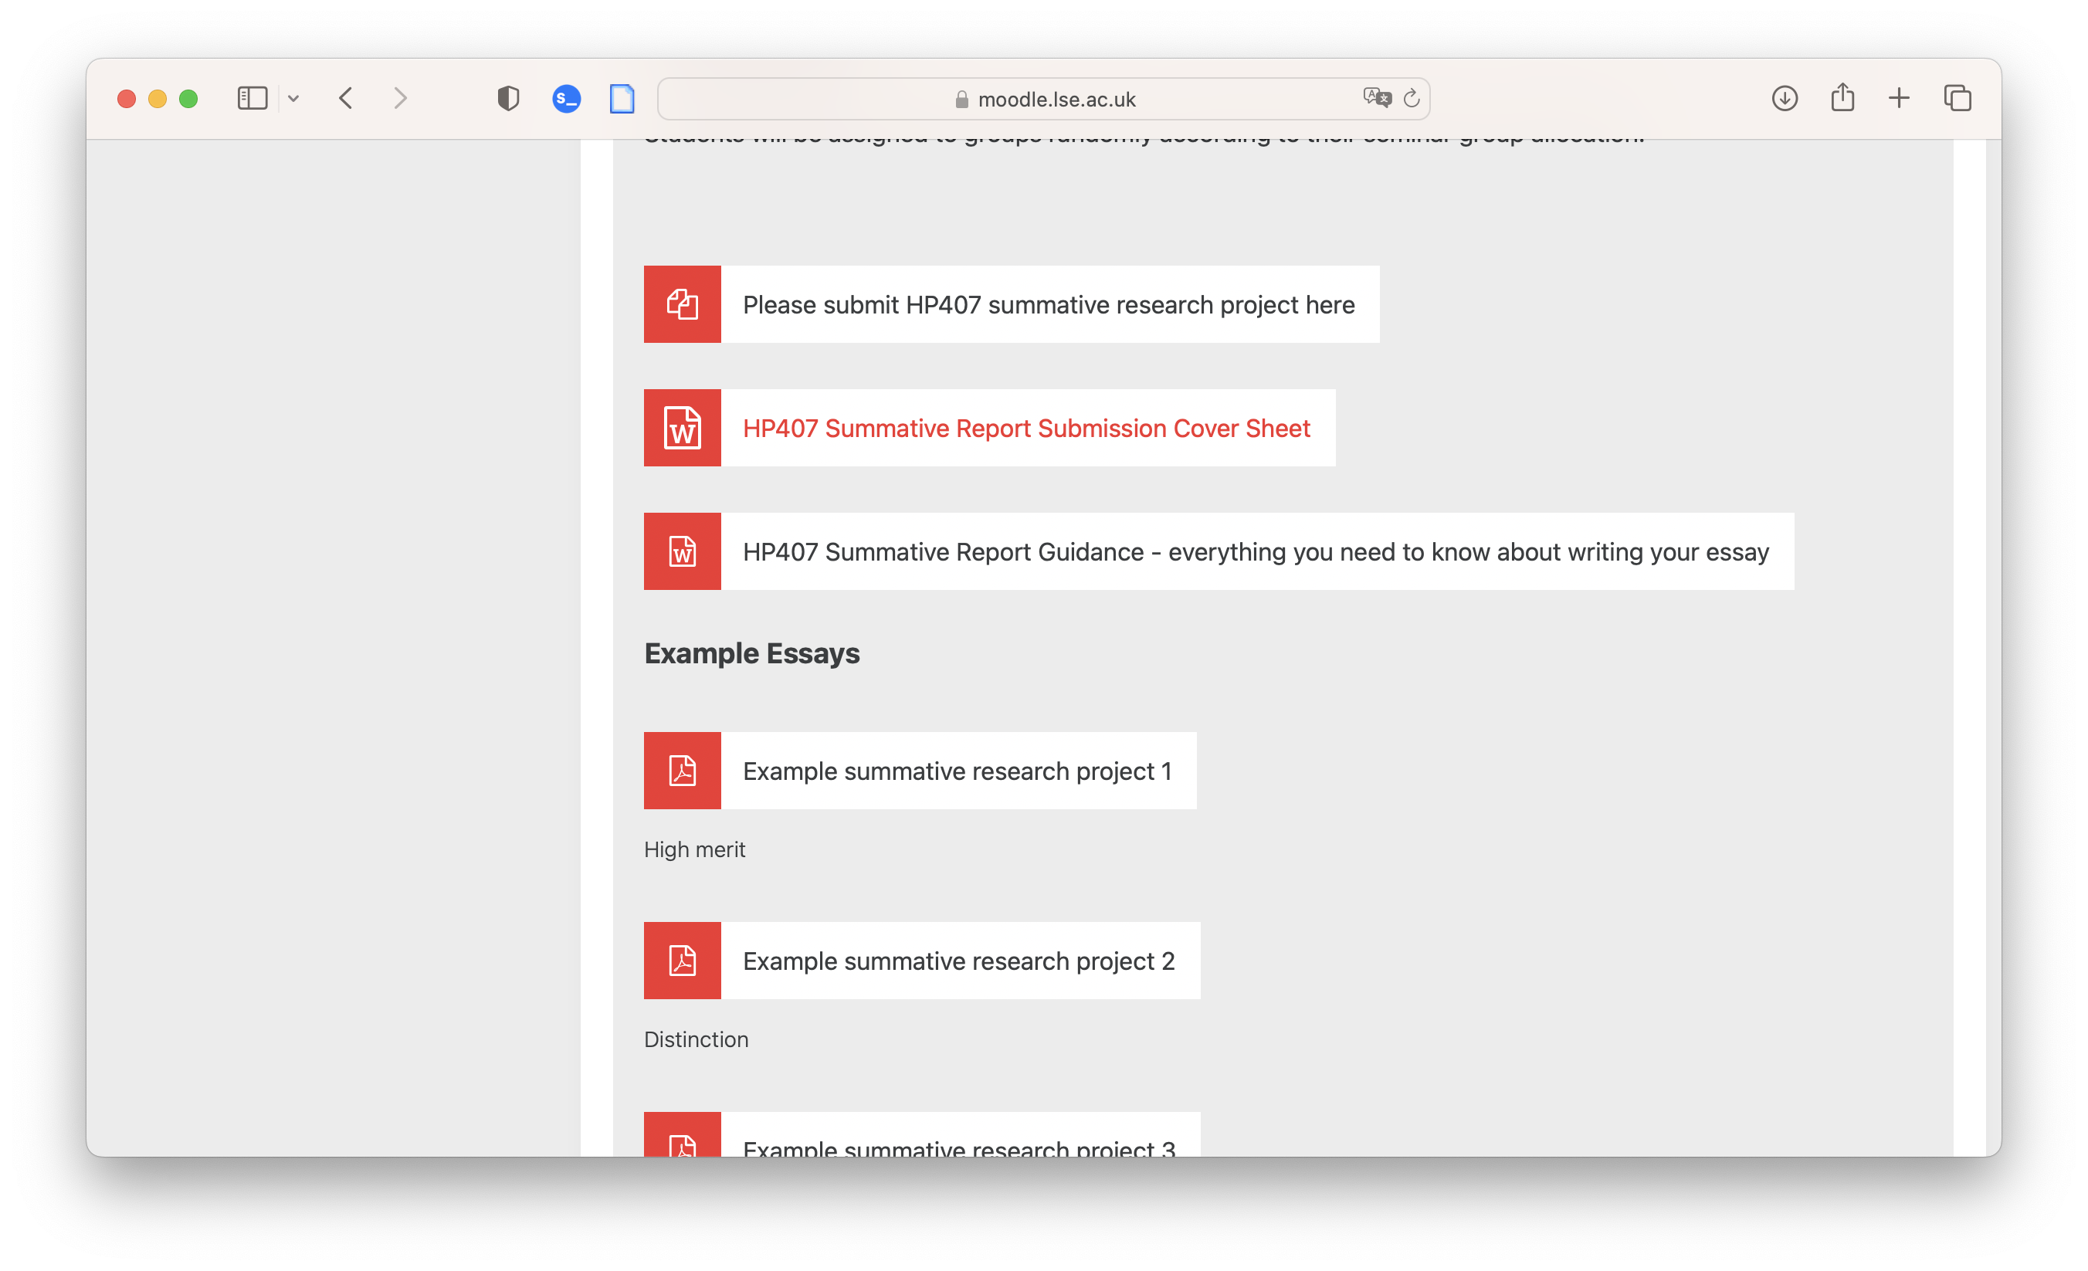
Cover page & report guideline
Before you start writing the assignment,
Use the cover page from Moodle and
Read the report guideline
Over here!
You can also have a look at the example essays below!

Slide 4
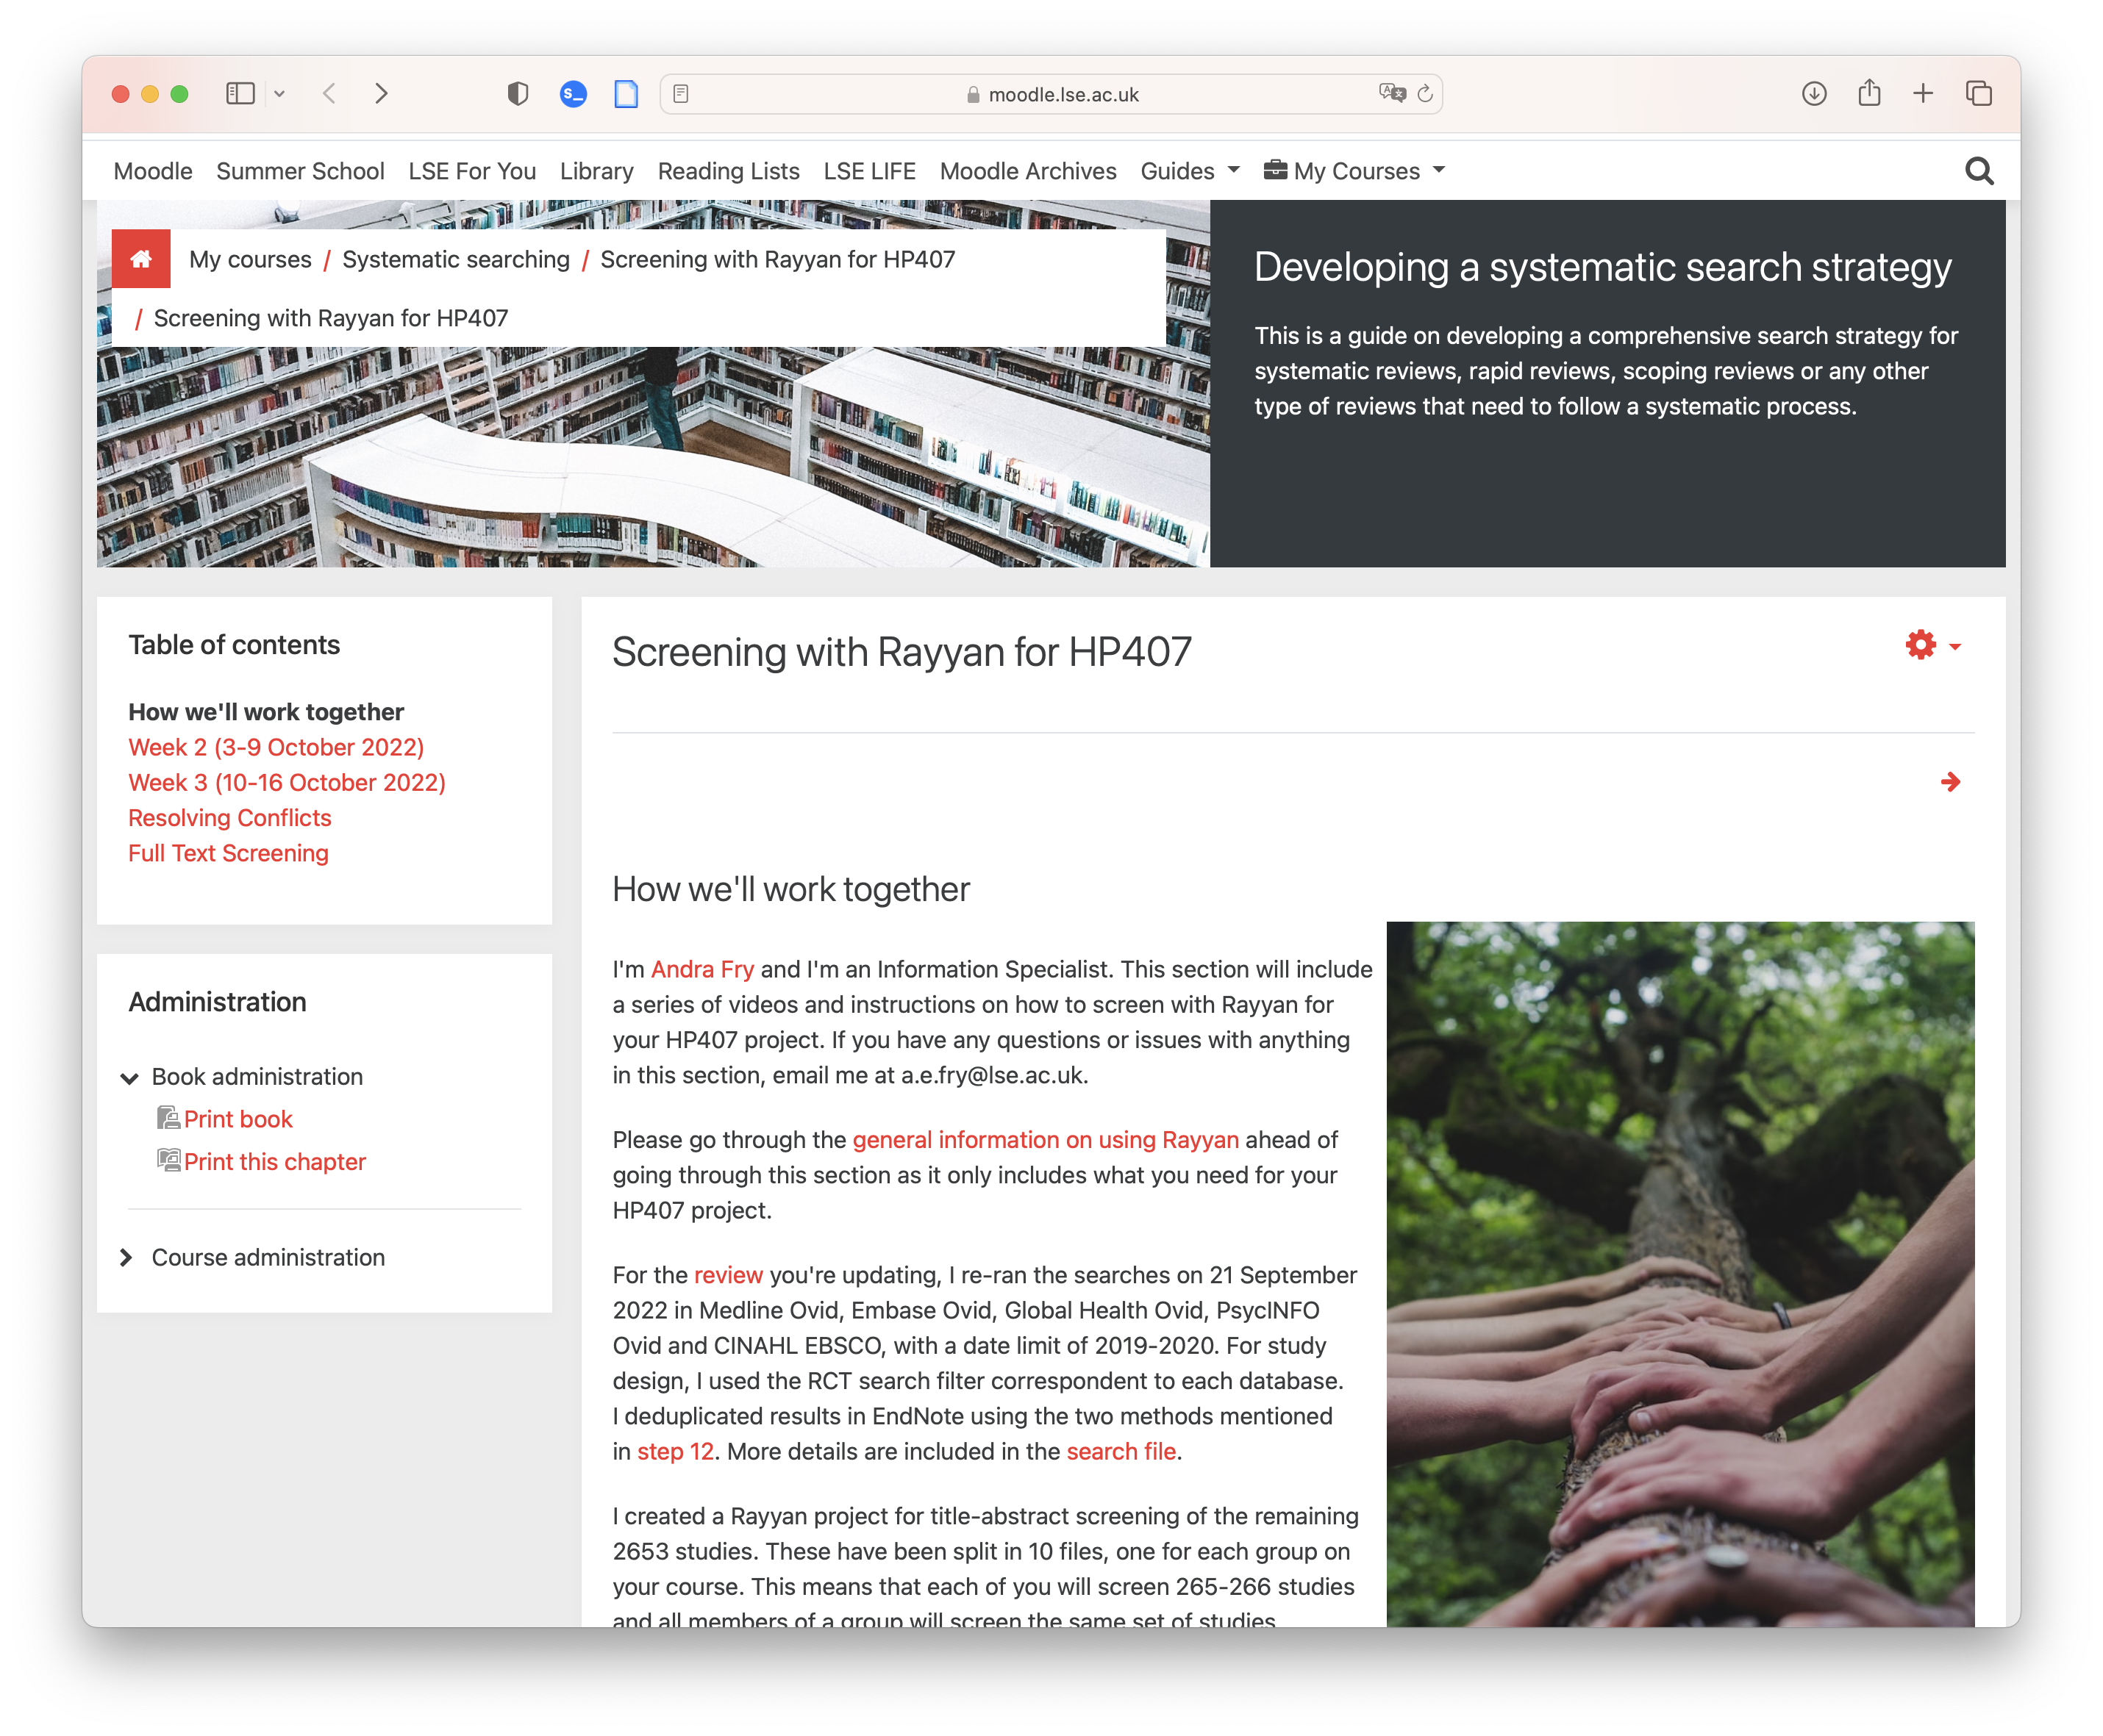
Search terms and strategy
Th file containing search terms and strategy is available on Moodle but not under HP407 directory
I also copy the table I use in my report to the shared Google Drive with the name “(Table) Search strategy.docx”
Originally here!
You can also have a look at other information on the page

Slide 5
List of included studies
During the 13 December office hour session, we were told:
We will need to include 7 studies assigned to our group for systematic review
We don’t need to include all of 7 studies for meta-analysis, which is different from systematic review
We don’t need to include studies from previous records (in the large dataset)
Below is an example from my report, stating the characteristics of the included studies. For more information, you can assess the file “(Table) Selected characteristics of included studies_v3.docx” in the shared Google Drive
Study identifier | Country | Descriptive name of the intervention | Intervention approach(es) | Frequency | Randomisation unit | Sample size (end of intervention) |  | Time from the beaseline
 |  |  |  |  |  | Control | Intervention | Intervention | Measurement
Chen 2020³⁰ | China | Extended Nursing | General support | Flexible | Individual | 51 | 51 | 8 wk | 1 yr
Govindakumari 2020³¹ | Iran | Resilience Education | Cognitive-behavioural intervention | Weekly | Individual | 27 | 27 | 8 wk | 8 wk
Ghaffari 2019³² | India | Home-based cognitive training program | Cognitive and functional training | Twice a week | Individual | 157 | 157 | 1 wk | 1 mo
Hinton 2020³³ | Vietnam | Multi-component interventions based on REACH | Multi-component intervention | Weekly | Community | 26 | 25 | 3 wk | 3 mo
Pan 2019³⁴ | China | Nurse-led cognitive behavioural sessions and subsequent consultation calls | Cognitive-behavioural intervention | Monthly | Individual | 45 | 54 | 5 mo | 7 mo
Uyar 2019¹⁴ [1] | Turkey | Multicomponent psychosocial intervention | Multi-component intervention | Flexible | Individual | 26 | 28 | 16 wk | 16 wk
Zarepour 2020³⁵ | Iran | On-site educational intervention + informational support on the anxiety of family | Psychoeducational intervention | Twice a week [2] | Individual | 35 | 35 | 4 wk | 4 wk + 1 mo 4 wk + 3 mo
[1] Uyar et al (2019) stated in the Abstract that “the intervention (n=31) and control groups (n=30)” but in the main text, the authors stated that “the intervention (n=30) and control groups (n=31)”. Thus, we consider this to be a typo about the baseline sample size.
[2] According to Zarepour (2020), the frequency is “7 sessions in 4 wk”, which is around 2 sessions a week

Slide 6
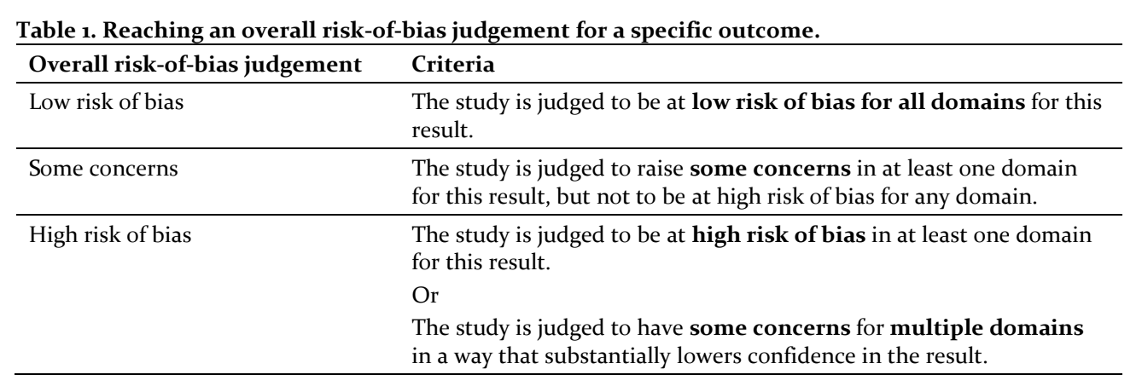
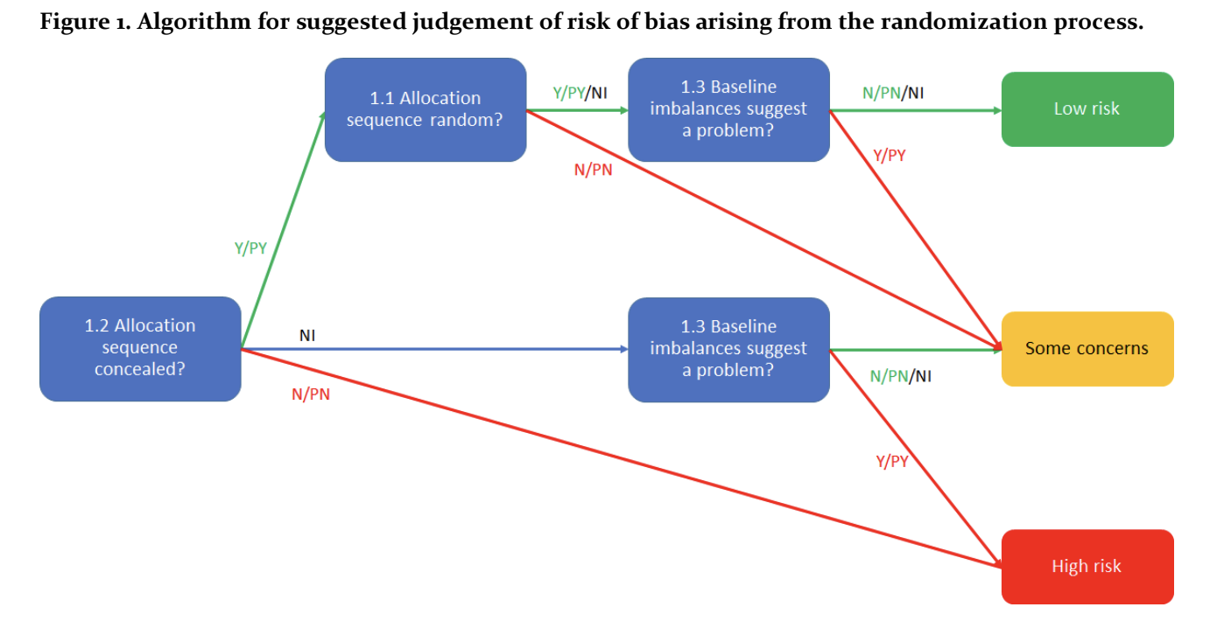
Risk of bias assessment table
I am modifying my version of risk of bias assessment, which will deviate from the group discussion we did last time, as I guess we did not fully comply with the guideline of RoB.
I access the information at https://www.riskofbias.info/welcome/rob-2-0-tool and read the full guideline of the current version, which is available at https://drive.google.com/file/d/19R9savfPdCHC8XLz2iiMvL_71lPJERWK/view
The guideline describes in detail about the differences between low risk, high risk and some concerns for each item assessed.
Thus, I use the principles and flow charts (as illustrated on the right and in the guideline) to re-assess the risk of bias and shared my risk of bias table with more details in the shared Google Drive folder.

Slide 7
Data extraction table
Type of data items | Collected data items
Publication details | Source: 2019 meta-analysis OR 2022 search Year of publication Authors Title Journal Volume Issue Pages DOI
Intervention details | Intervention type: see Table 4 for details Country: state where the research was conducted Setting: urban OR rural nursing home OR community OR others Study design parallel group OR cross-over randomised OR nonrandomised Intervention and control names, as described in the paper Detailed description of intervention quoted from the paper Intervention duration described in the paper Intervention duration converted to days Intervention frequency
Participant details | Participant inclusion criteria Participant exclusion criteria Type of dementia or mild cognitive impairment defined by the authors Education Gender
Outcome data | List of health-related outcome measures for caregivers: see Table 4 for details List of health-related outcome measures for care recipients: see Table 4 for details Point of measurement Raw summary statistics Baseline sample size Baseline mean effect Baseline SD Sample size at the point of measurement Mean of the effect at the point of measurement SD of the effect at the point of measurement Change from baseline data Standardised mean difference (SMD) or mean difference (MD) Hedge’s g converted from SMD/MD Sample size of control and experimental groups
I share my data extraction table as “Dataset_version_latest.xlsx” in the shared Google Drive folder
The dataset contains two sets of risk of bias information, which can be told according to their column names.
I also re-categorised the interventions according to Walter and Pinquart (2020) and their previous works:
https://pubmed.ncbi.nlm.nih.gov/33226434/
About previous studies in the large dataset:
I further included 22 studies from the large dataset, which is optional for this project as confirmed on 13 December office hour. Thus, you can exclude these studies by filtering the studies with their sources, which is the first column in the table.
My list of data items

Slide 8
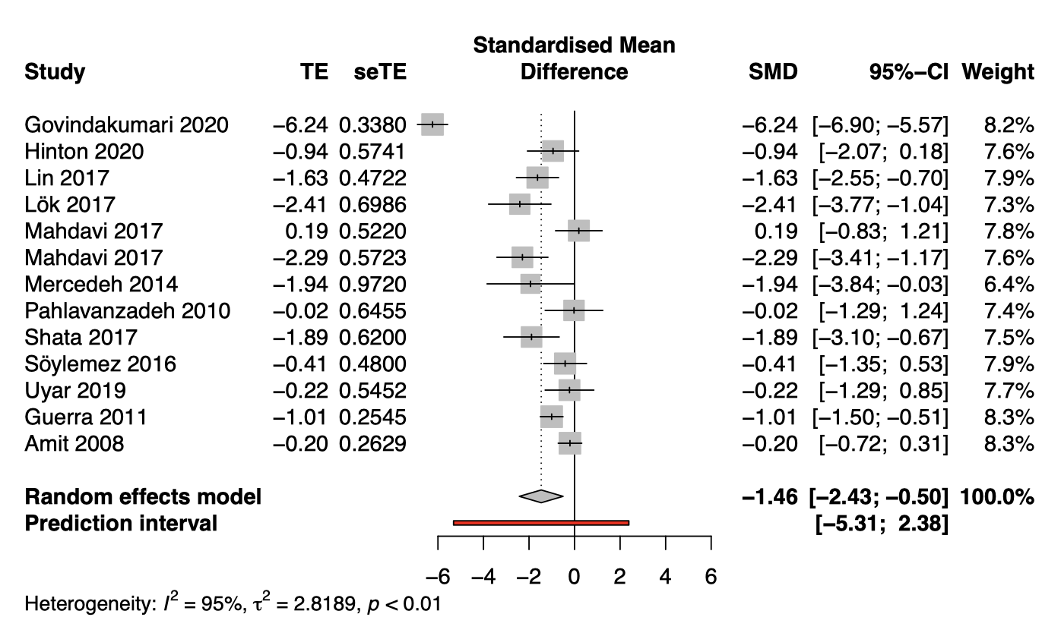
Forest plot examples
I only have some examples for caregiver burden and caregiver depression using all studies in the extracted dataset. Thus, it is a bit more than the requirements of Dr Naci
I feel that these two plots might be sufficient to write a report in any case of emergency. And my eventual output will differ from the two displayed here.
Please do let me know if you find any problems with the plots, but do not ask me how to generate the plots with Stata, as I don’t use it…
Caregiver burden
Caregiver depression

Slide 9
Last but not the least
In the guideline, it is said,
Remember that your individual research project report will account for 100% of the course grade on HP407. Although you are working on completing a systematic review and meta-analysis in groups, your final reports will be developed individually.
Parts allowed to be the same across group members:
search terms and strategy
list of included studies
data extraction tables
forest plots
risk of bias assessment tables
A few words…
You don’t need to ask me for permission if you want to reuse any tables and figures in the shared Google Drive, as long as they are in the parts allowed to be the same across group members. I will also try to update these files if there is any error or mistake.
For other parts, do remember to paraphrase and avoid plagiarism when you write the report.
You can ask me if you are uncertain about anything in the folder or about the assignment. I will be happy to help.
Merry Xmas and happy new year!

