Slide 1
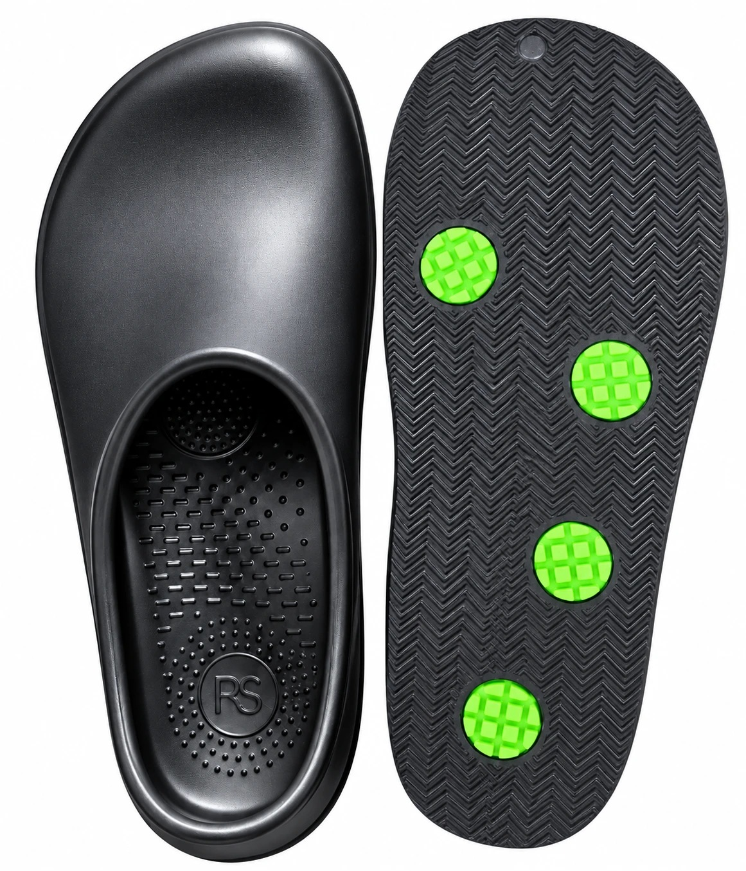

Made for
Standing.
Work footwear, insoles and daily goods
for people who stand all day.
PRODUCT INTRODUCTION 2026
R&D Makers Co., Ltd. · rndmakers.kr

Slide 2
ABOUT US
Everyday products that use recycled materials.
R&D Makers processes recycled materials — end-of-life tire rubber, wallpaper PVC and forest-thinning wood — and manufactures footwear and daily goods in Korea.
RHARA SHOE
re.feeel
Track record
Work footwear & insoles
Daily goods
Retail supply
Shoes and insoles for people who stand all day — stores, warehouses, service counters.
Toothbrush, floss, cup, bath slippers and pens.
Bath slippers supplied through a Korean household goods retail channel.
Company
R&D Makers Co., Ltd. · CEO Dongkyu Shin
Business reg. no.
709-81-02967
Production
Partner factories in Korea
RHARA SHOE
02

Slide 3
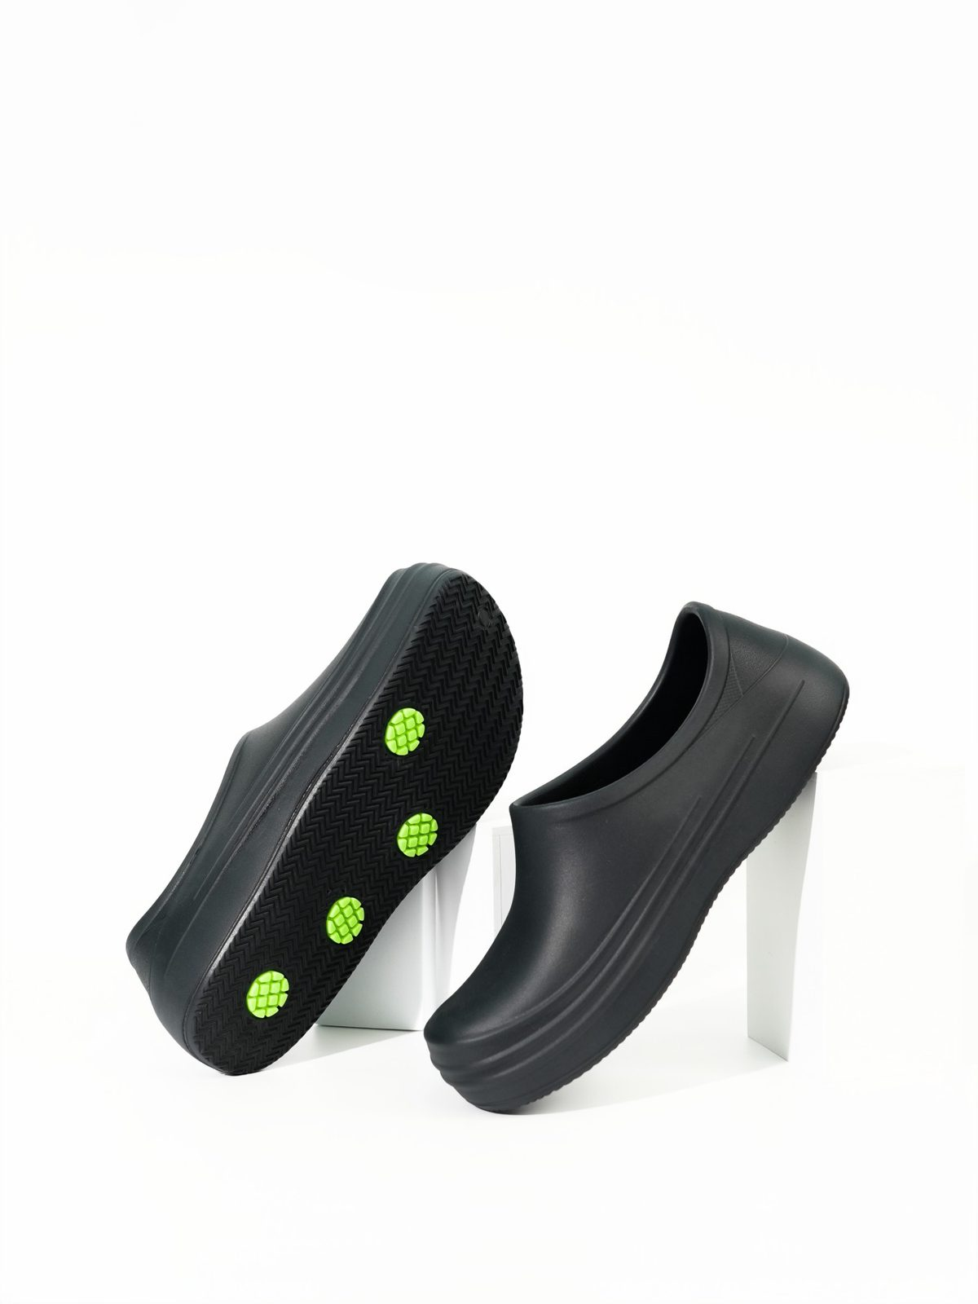
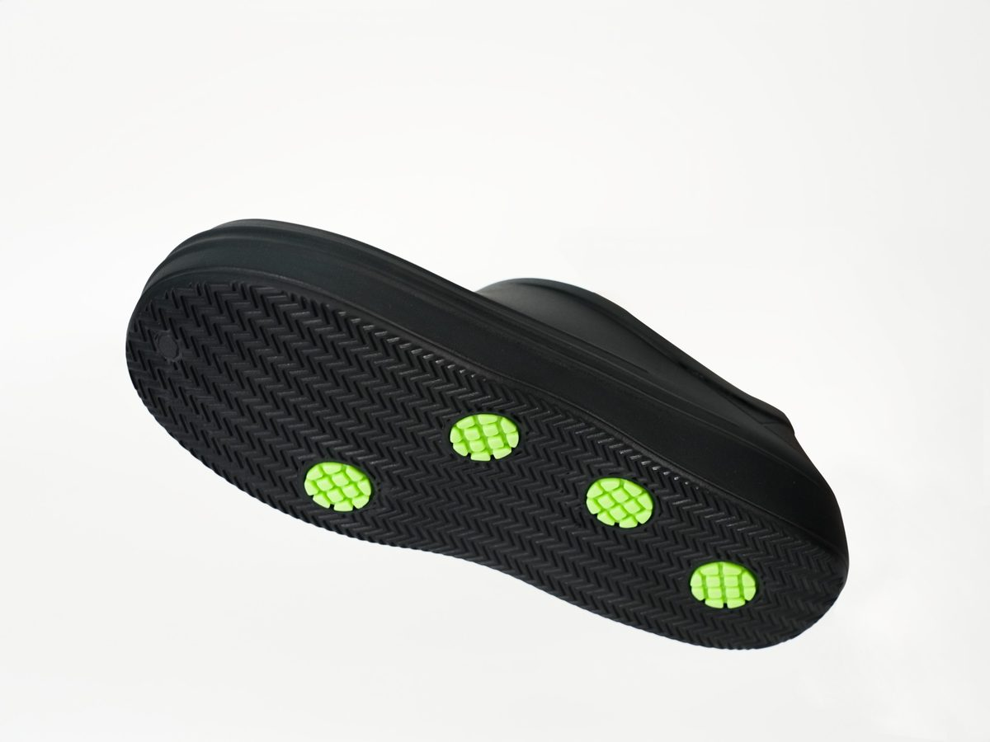
PRODUCT 01 · WORK SHOE
Quad-Grip All-Day Walking Shoe
Sizes
230 – 280 mm
Colors
Charcoal · Gray · Mint White
Weight
257 g per shoe (270 mm)
Upper & sole
E-Silipolyrene (EVA + silicone blend)
Grip pads
Recycled tire rubber · recycled wallpaper PVC
01
02
03
Quad-Grip
One-piece
Soft collar
Four grip pads placed on the outsole.
No separate insole. Easy to rinse.
Thick, rounded opening.
RHARA SHOE
03

Slide 4
TEST RESULT · STAFF SHOE PROPOSAL
A work shoe for your store team.
Slip resistance test
0.36
Proposed for
Coefficient of friction
steel floor + detergent, heel
Checkout · Stocking · Warehouse staff
(non-oily floors)
Four-point grip pad outsole (Quad-Grip)
One-piece footbed — easy to rinse
Sizes 230–280 mm; 3 colors to separate teams
Bulk size-run packing on request
Samples available for on-site wear trials
Method
KS M ISO 13287:2019
Sample
Size 260 mm, left, 1 shoe · Nov 2026
Laboratory
Korea Institute of Materials Convergence Tech. (S-26-0313)
Glycerol
Steel floor + glycerol, heel: 0.17
Test result only — not a safety-shoe certification. Not rated for oily floors. Test report available on request.
RHARA SHOE
04

Slide 5
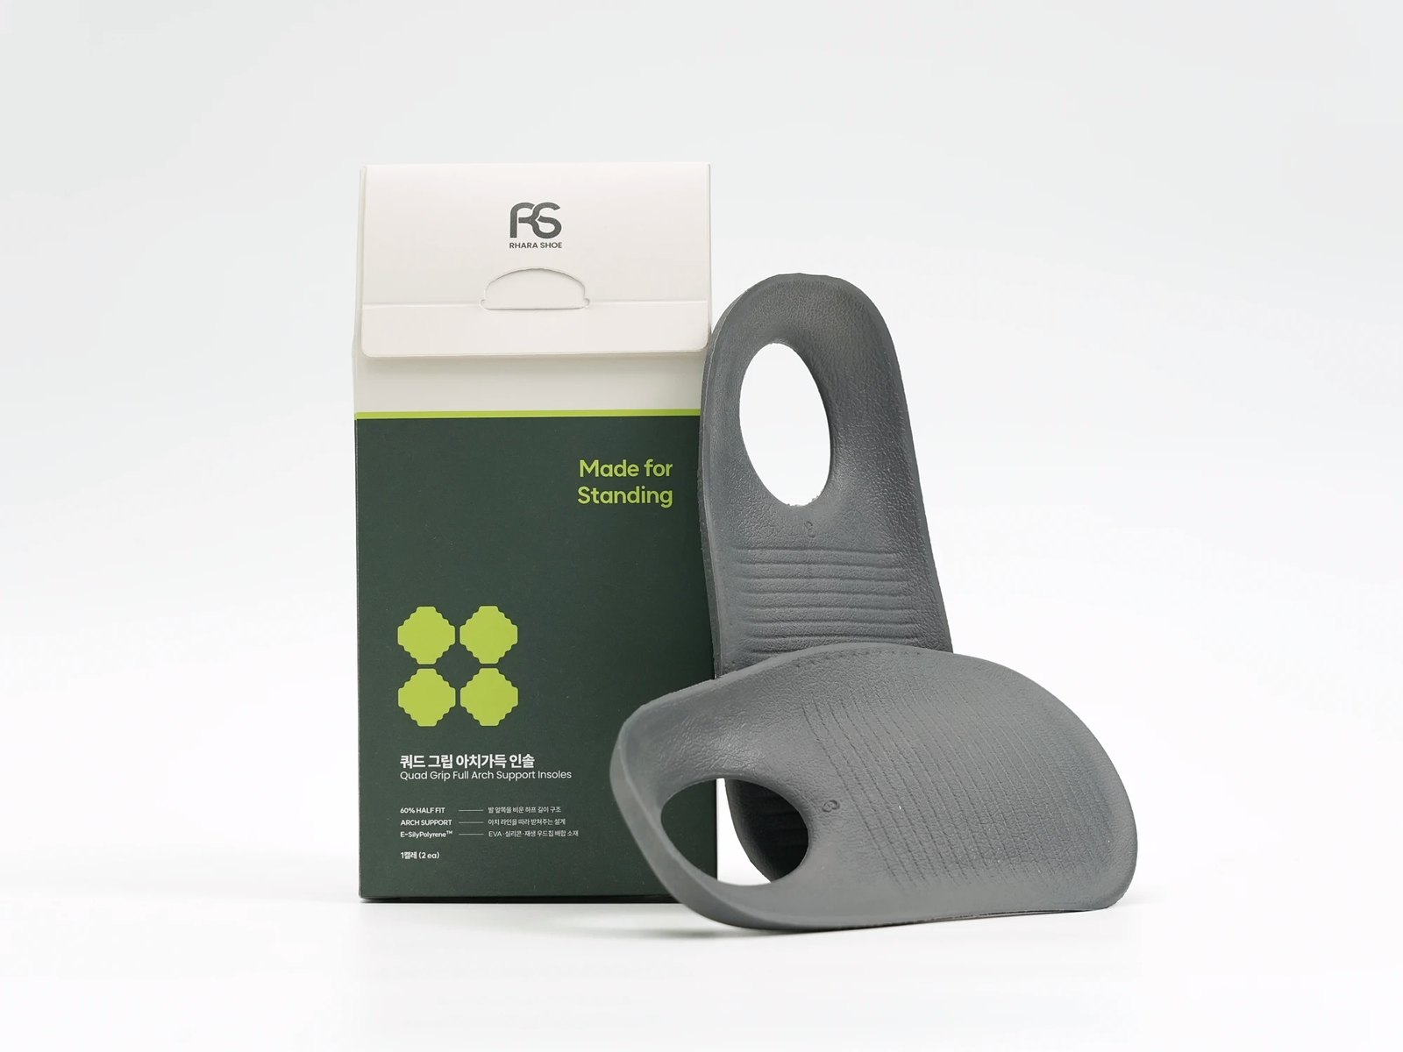
PRODUCT 02 · INSOLE
Quad-Grip Arch-Full Insole
Sizes
M 15 cm · L 17 cm (half-length)
Colors
Gray · Mocha Mousse
Material
E-Silipolyrene + wood-chip blend
Structure
Arch-full shape · heel cup · air holes
How to use
Place under the existing insole. No cutting needed.
Add it to the shoes your team already wears — or stock it as an add-on item.
Not a medical device.
RHARA SHOE
05

Slide 6
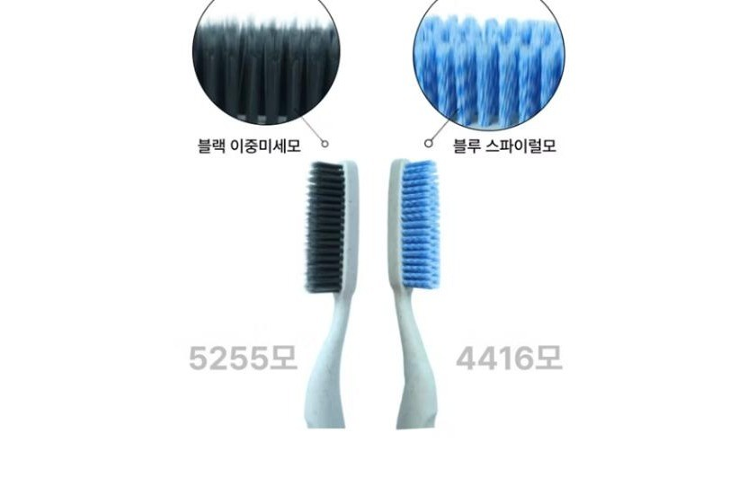
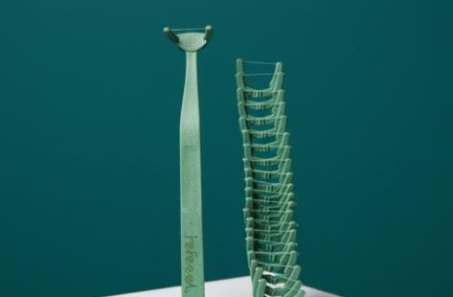
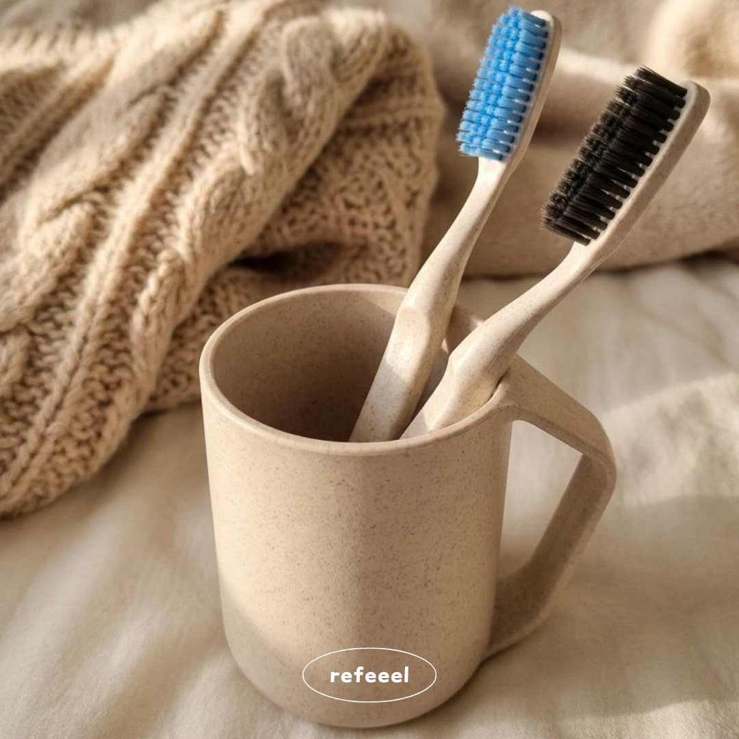
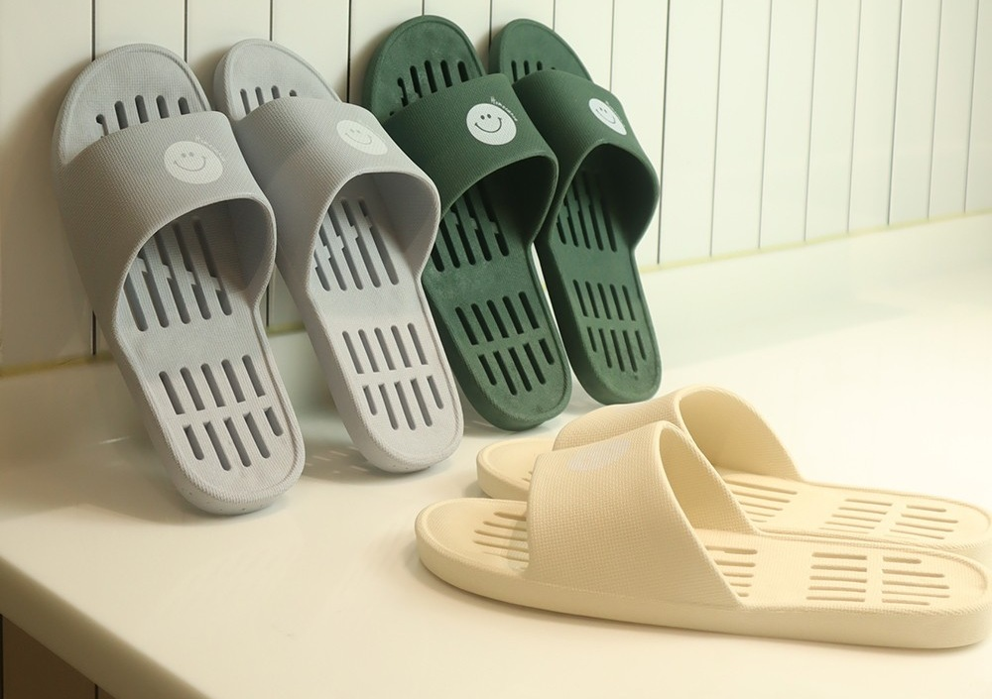
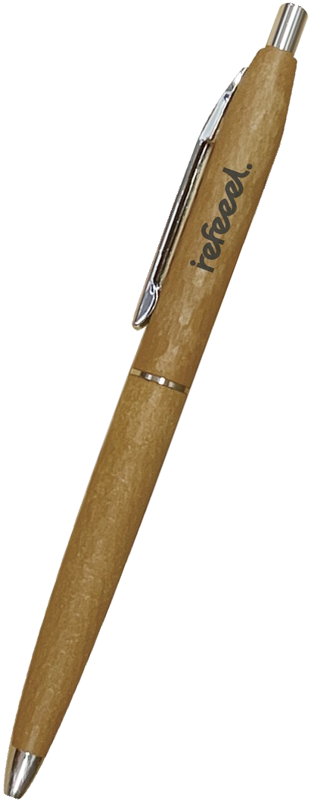
PRODUCT 03 · DAILY GOODS
re.feeel daily goods
Toothbrush
Floss pick
Rinse cup
Smile bath slippers
CXP ballpoint pen
Recycled wallpaper PVC · 2 types
Forest-thinning wood
Detailed spec sheets per item available on request.
RHARA SHOE
06

Slide 7
SUPPLY TERMS
MOQ & terms
Minimum order quantity
Custom packaging
Quad-Grip All-Day Walking Shoe
600 pairs
Available for orders at or above MOQ.
Quad-Grip Arch-Full Insole
600 pairs
Smile bath slippers
600 pairs
CXP ballpoint pen
600 pcs
Pricing
Quotation by item and quantity
Toothbrush
2,000 pcs
Lead time
Confirmed with production schedule
Floss pick
2,000 pcs
Samples
Available for evaluation
Rinse cup
2,000 pcs
Documents
Export documents on request
Oral care products (toothbrush, floss pick, rinse cup): any U.S. FDA registration, testing or other regulatory steps involving significant cost or time are not included and will be agreed separately (scope, cost sharing, schedule).
RHARA SHOE
07

Slide 8
Let’s talk.
Samples, spec sheets and quotations are available on request.
Contact
Dongkyu Shin, CEO
Email
rndceo@rndmakers.kr
Phone
+82 507-1317-2516
Web
rndmakers.kr
Company
R&D Makers Co., Ltd.
RHARA SHOE
08

