Slide 1
iGEM bee gut microbiome
Idea proposal (dry lab)

Slide 2
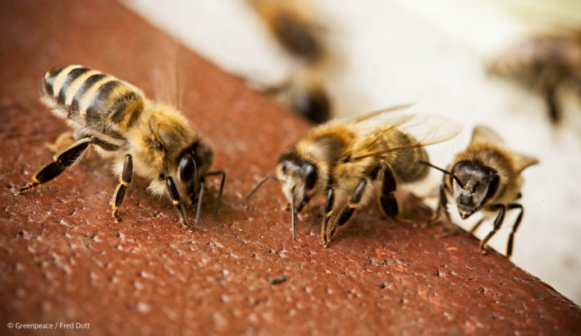
Summary
Values of bees
Bees are the most important pollinators. Pollinators transfer pollen from various crops, facilitating seed formation and fruit production. The economic value of pollinators, including honeybees, in global crop production is estimated to be approximately $235 billion to $577 billion annually. Furthermore, the increasing variety and area of subtropical crops with high pollinator dependence are enhancing the importance of pollinators. For these reasons, honeybees impact 11 out of the 17 United Nations Sustainable Development Goals (SDGs).
Colony Collapse Disorder
A recent phenomenon of mass disappearance of honeybees has been occurring. During the winter of 2021, 7.8 billion honeybees vanished without a trace due to Colony Collapse Disorder (CCD). This scale of damage appears to be continuously growing. Between September and November 2022 alone, 10 billion honeybees disappeared, followed by an estimated 14 billion honeybees disappearing in early 2023. Factors such as climate change and parasitic mites are causing the decline of honeybee populations, severely threatening the beekeeping industry.

Slide 3




Colony Collapse Disorder(CDD)
Pesticides and
Biocides
Loss of
Genetic Diversity
Malnutrition
Pests and
Diseases
Acute and chronic toxicity caused by exposure to herbicides and insecticides.
Lack of genetic variation due to prolonged artificial breeding.
Environmental changes and reliance on monoculture crops as food sources
Threats such as Varroa destructor mites, Tropilaelaps mites, Asian hornets, and viral infections.

Slide 4
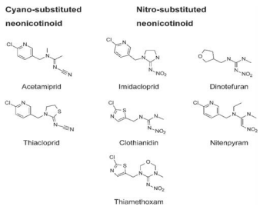
Pesticides
One of the most well-known pesticides harmful to honeybees is the neonicotinoid class of pesticides. Neonicotinoids, which began to be widely used in the 1990s, work by binding to nicotinic acetylcholine receptors at insect nerve synapses, causing overexcitation and eventual death. They are colorless, odorless, highly water-soluble, and have strong systemic and translocative properties.
Initially, these pesticides were thought to have low environmental risks because they were applied directly to plants or coated onto seeds, allowing the active ingredients to be absorbed and distributed within the plant. However, after the mass Colony Collapse Disorder (CCD) outbreak in the U.S. in 2006, the U.S. Environmental Protection Agency (EPA) identified neonicotinoids as one of the possible causes.
Among neonicotinoid insecticides, imidacloprid, thiamethoxam, and clothianidin are highly toxic to honeybees, with even small amounts proving lethal. While acetamiprid and thiacloprid are considered low-toxicity pesticides, recent studies have shown that they can impair honeybee olfactory response and learning ability, negatively affecting foraging behavior. The risks are particularly high when large-scale seed-coated crops like corn are planted over extensive areas.

Slide 5
Pesticides
Organochlorine pesticides (DDT) were discovered to have insecticidal properties by P. Müller in 1939 and were used as insecticides in both warfare and agriculture. They inhibit insect acetylcholinesterase (AChE), causing nerve paralysis. Due to their strong insecticidal effects and the absence of immediate side effects upon human contact, they were regarded as revolutionary pesticides. However, in 1962, Rachel Carson published "Silent Spring," highlighting the severe residual problems and ecological disruption caused by DDT through biomagnification, leading to its ban.
Even after DDT, various pesticides have been developed that pose threats to pollinators. Organophosphate pesticides are compounds formed by combining phosphorus (P) with oxygen or sulfur. They are highly toxic and work by specifically breaking down acetylcholine, thereby stopping nerve transmission. Although they degrade easily, many of these pesticides are highly toxic to humans and livestock.
Pyrethroid pesticides are synthetic substances based on the insecticidal components of pyrethrum. They affect sodium channels in nerve transmission, causing excessive excitation and a knockdown effect. Pyrethroids are considered safer than organophosphates because they have lower toxicity to humans and livestock. Although they are highly effective as insecticides, they are light-sensitive and have low residual persistence, making them mainly used for controlling sanitary pests (insects that spread diseases through bloodsucking) and stored-product pests (insects that damage stored grains such as rice).
Insect Growth Regulators (IGRs) include insect hormone analogs and chitin synthesis inhibitors that interfere with insect molting processes. Since they specifically target insects, they have low toxicity to humans and livestock, but they can still affect non-target insects such as honeybees. Research has shown that IGRs can act on the ovaries of queen bees, reducing hatching rates, impairing the learning and foraging abilities of exposed worker bees, and disrupting larval molting processes.

Slide 6



How are we going to fix it?
Our goal is to engineer S. alvi, a key gut microbe in honeybees, by inserting a gene that degrades pesticides, thereby creating pesticide-resistant bees. This is expected to significantly contribute to preventing CCD (Colony Collapse Disorder).

Slide 7
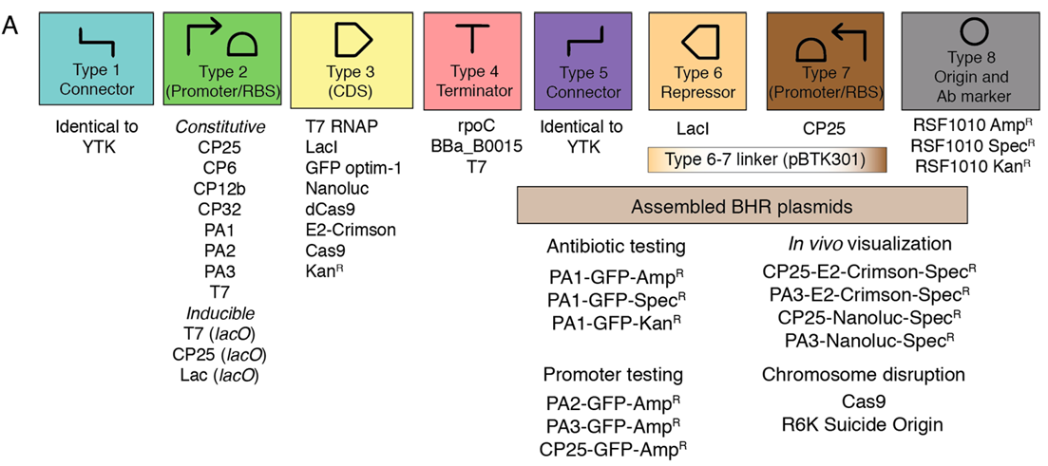
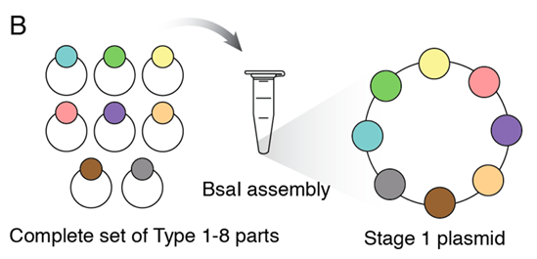
Method
Golden Gate assembly
We plan to use BTK, a genetic modification toolkit designed for S. alvi. BTK utilizes Type II restriction enzymes, which have separate recognition and cleavage sites, to divide the genetic components into types 1 through 8, allowing for convenient assembly using specifically designed overhangs. For example, Type 1 includes various connectors, Type 2 contains promoters and ribosome binding sites, and Type 3 consists of CDS.

Slide 8
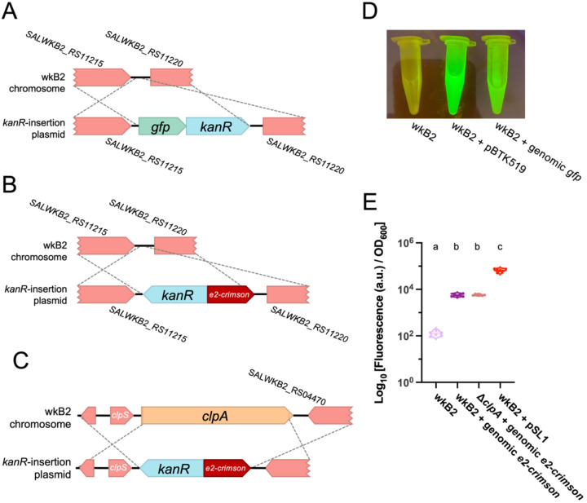
Method
Since plasmids may not be stably maintained in the gut environment of honeybees, we plan to integrate the gene directly into the genome of S. alvi. To achieve this, we will employ homologous recombination using RecA and other recombination proteins. This process requires the plasmid to contain homologous arms on both sides of the target gene. The BTK toolkit provides modules for designing and inserting such homologous arms, allowing us to proceed with genome integration effectively.
Homologous recombination

