Slide 1
Contact Management System
T.Yashitha 2310030070
Y. Deepthi 2310030447
Jayathi 2310030155
Aneeshwa 2310030400

Slide 2
Introduction to the Project
The Contact Management App helps to save and organize contacts easily. You can add, edit, delete, and find contacts with details like name, phone, and email. Group them into categories. Mark favorites for quick access. Import and export contacts using CSV files and avoid duplicates. The simple menu makes it easy to sort and search. It is designed for future upgrades like social media links. Built with smart coding, it is reliable and easy to use.

Slide 3
Technology Stack - Overview
Frontend Framework: HTML,CSS,JAVA-SCRIPT
State Management:
Redux, Context API
Backend Framework:
JAVA
Database:
PostgreSQL, MySQL (SQL)
Authentication:
JWT
Containerization:
Docker
ADDITIONAL:springboot

Slide 4
Model Component
Represents the data and logic of the application.
Function: It defines how the data is stored and how to retrieve, add, update, or delete it.
In the Contact Management System, the Model will represent the contact data such as Name, Email, Phone number, etc.

Slide 5
View Component
The presentation layer that displays the data.
Function: It defines how the data is presented to the user and how the user interacts with it.
In the Contact Management System, the View could be the contact list, individual contact details page, or forms to add/edit contacts.

Slide 6
Advanced features:
1.Favorites
2.Recent contacts
3.Duplicate detection
4.Back-up and restore
User interface (UI) features
Sorting: Sort contacts by name, date added, or last modified.
Filtering: Filter contacts by group, favorites, or other criteria.
Pagination: Display contacts in pages for better usability

Slide 7
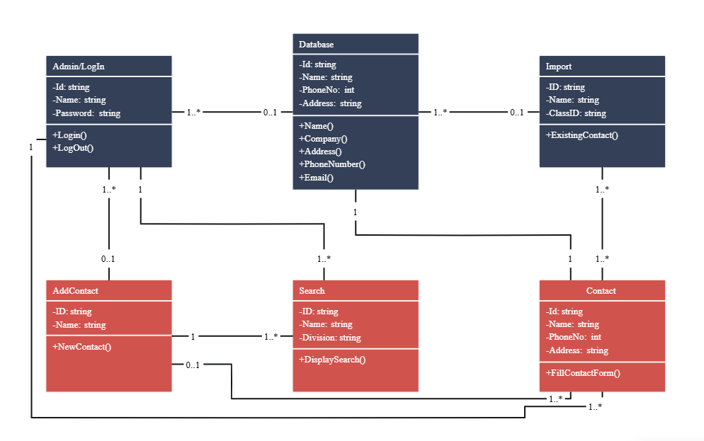


Class Diagram

Slide 8
USE-CASE DIAGRAM
user
add
search
update
delete
view
groups
favourites

Slide 9
INTERACTION DIAGRAM
user
UI
MANAGER
DATABASE
ENTER
VALIDATE
STORE
SUCESS

Slide 10
ACTIVITY DIAGRAM
k
start
Enter valid info
Valid ?
yes
no
save
terminate
display

Slide 11
ROLES
Yashitha- frontend
Deepthi-backend
Jayathi-code
Aneeshwa-ppt’s

Slide 12
THANK YOU

