Slide 1
Clustering

Slide 2
The Problem of Clustering
Given a set of points, with a notion of distance between points, group the points into some number of clusters, so that
  members of a cluster are close/similar to each other
  Members of different clusters are dissimilar
Usually:
  points are in a high--‐dimensional space
  similarity is defined using a distance measure
    Euclidean, Cosine, Jaccard, edit distance, …

Slide 3
Example: Clusters
x
xx x
x x
x x x
x
x x x
x
x
x x
x x x x
x x x x
x x x
x x
x x
x x x x
x x x
x
x

Slide 4
Application: SkyCat
A catalog of 2 billion “sky objects” represents objects by their radiation in 7 dimensions (frequency bands).
Problem: Cluster into similar objects, e.g., galaxies, nearby stars, quasars, etc.
Sloan Sky Survey is a newer, better version.

Slide 5
Clustering Movies
Intuitively: Movies divide into categories, and customers prefer a few categories.
  But what are categories really?
Represent a movie by the customers who bought/rated it
Similar movies have similar sets of customers, and vice-versa
Space of all movies:
  Think of a space with one dimension for each customer.
    Values in a dimension may be 0 or 1 only.
    A movies’s point in this space is (x₁, x₂,…, x_{k}), where x_{i} = 1 iff the i ^{th} customer bought the movie.

Slide 6
Cosine, Jaccard, and Euclidean
We have a choice:
  Sets as vectors: measure similarity by the cosine distance.
  Sets as sets: measure similarity by the Jaccard distance.
  Sets as points: measure similarity by Euclidean distance.

Slide 7
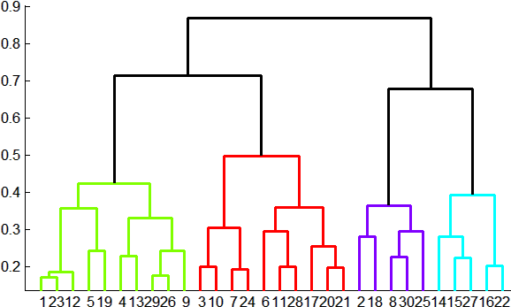
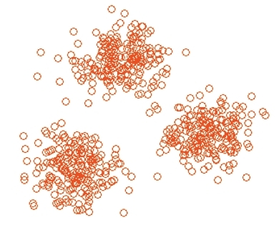
Methods of Clustering
Hierarchical:
  Agglomerative (bottom up):
    Initially, each point is a cluster
    Repeatedly combine the two
    “nearest” clusters into one.
  Divisive (top down):
    Start with one cluster and recursively split it
Point Assignment:
  Maintain a set of clusters
  Points belong to “nearest” cluster

Slide 8
Hierarchical Clustering
Key operation:
Repeatedly combine two nearest clusters
Three important questions:
  How do you represent a cluster of more than one point?
  How do you determine the “nearness” of clusters?
  When to stop combining clusters?

Slide 9
Hierarchical Clustering – (2)
Key problem: as you build clusters, how do you represent the location of each cluster, to tell which pair of clusters is closest?
Euclidean case: each cluster has a
centroid = average of its points
  Measure cluster distances by distances of centroids

Slide 10
Example: Hierarchical clustering
(5,3)
o
(1,2)
o
o (2,1) o (4,1)
o (0,0) o
(5,0)
x (1.5,1.5)
x (4.7,1.3)
x (1,1)
x (4.5,0.5)
Data
Dendrogram

Slide 11
Agglomerative clustering algorithm
Most popular hierarchical clustering technique
Basic algorithm
  Compute the distance matrix between the input data points
  Let each data point be a cluster
  Repeat
  Merge the two closest clusters
  Update the distance matrix
  Until only a single cluster remains
Key operation is the computation of the distance between two clusters
  Different definitions of the distance between clusters lead to different algorithms

Slide 12
Input/ Initial setting
Start with clusters of individual points and a distance/proximity matrix
p1
p2
p3
p4
p5
. . .
p1
p2
p3
p4
p5
.
.
.
Distance/Proximity Matrix

Slide 13
Intermediate State
After some merging steps, we have some clusters
C1
C2
C3
C4
C5
C1
C2
C3
C3
C4
C4
C5
C1
Distance/Proximity Matrix
C2
C5

Slide 14
Intermediate State
Merge the two closest clusters (C2 and C5) and update the distance matrix.
C1
C2
C3
C4
C5
C1
C3
C2
C4
C3
C4
C5
C1
Distance/Proximity Matrix
C2
C5

Slide 15
After Merging
“How do we update the distance matrix?”
C2 U C5
C1
C3
C4
C3
C1
?
C4
C2 U C5
? ? ? ?
C3
?
C1
C4
?
C2 U C5

Slide 16
Distance between two clusters
Each cluster is a set of points
How do we define distance between two sets of points
  Lots of alternatives
  Not an easy task

Slide 17
Distance between two clusters
Single-link distance between clusters C_{i} and C_{j} is the minimum distance between any object in C_{i} and any object in C_{j}
The distance is defined by the two most similar objects

Slide 18
Single-link clustering: example
Determined by one pair of points, i.e., by one link in the proximity graph.
1
2
3
4
5

Slide 19
Single-link clustering: example
5
1
3
5
2
1
2
3
6
4
4
Nested Clusters
Dendrogram

Slide 20
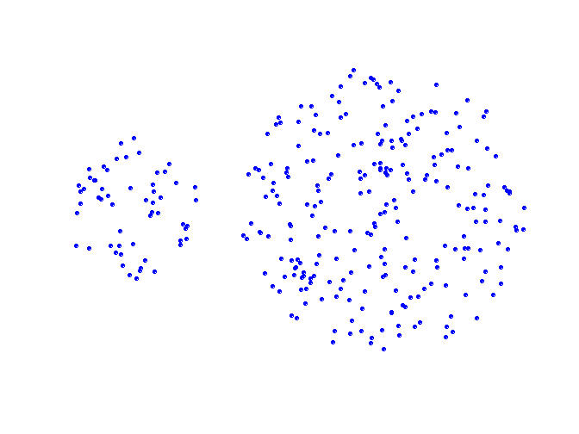
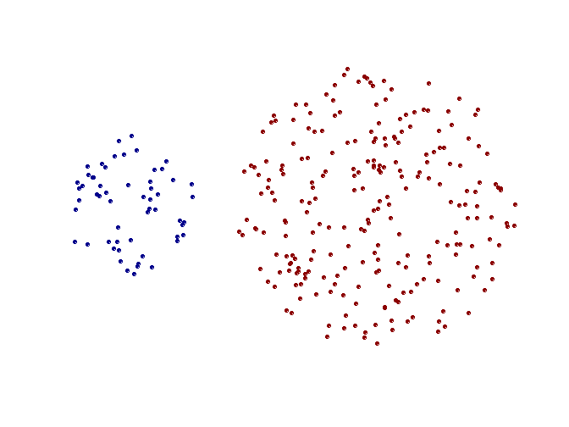
Strengths of single-link clustering
Original Points
Two Clusters
Can handle non-elliptical shapes

Slide 21
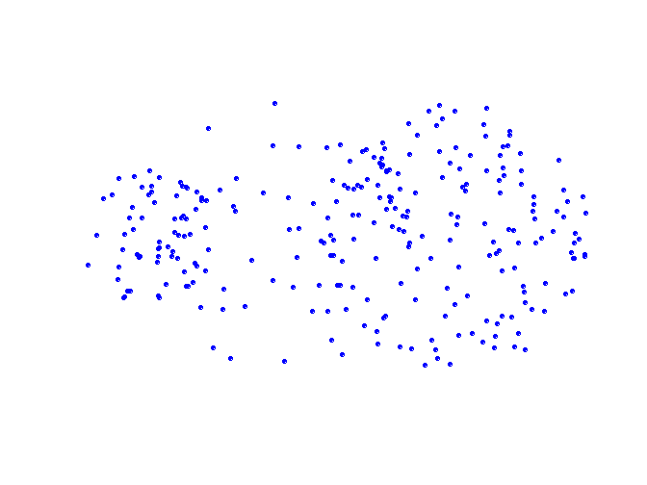
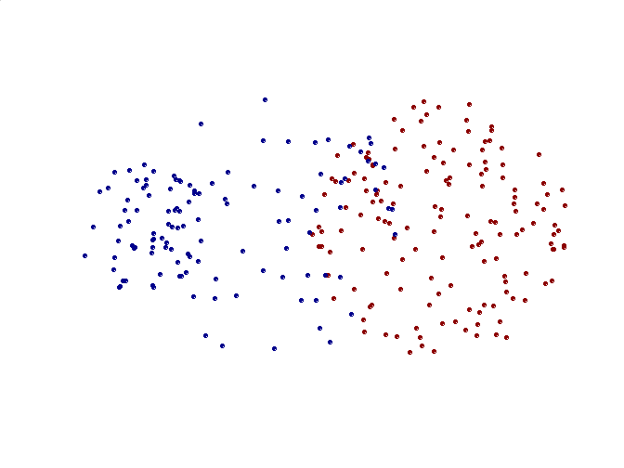
Limitations of single-link clustering
Original Points
Two Clusters
Sensitive to noise and outliers
It produces long, elongated clusters

Slide 22
Distance between two clusters
Complete-link distance between clusters C_{i} and C_{j} is the maximum distance between any object in C_{i} and any object in C_{j}
The distance is defined by the two most dissimilar objects

Slide 23
Complete-link clustering: example
Distance between clusters is determined by the two most distant points in the different clusters
1
2
3
4
5

Slide 24
Complete-link clustering: example
4
1
2
5
5
2
3
6
3
1
4
Nested Clusters
Dendrogram

Slide 25
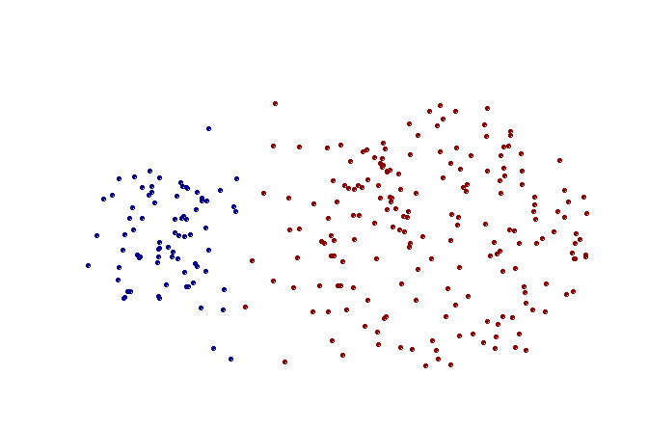
Strengths of complete-link clustering
Original Points
Two Clusters
More balanced clusters (with equal diameter)
Less susceptible to noise

Slide 26
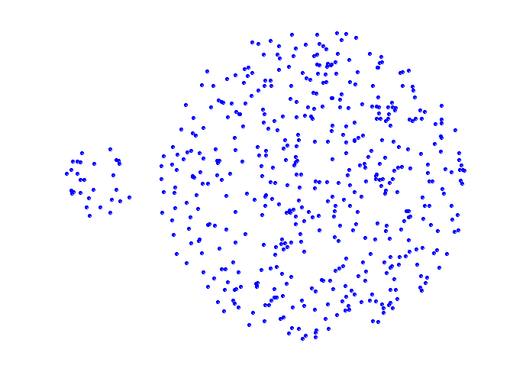
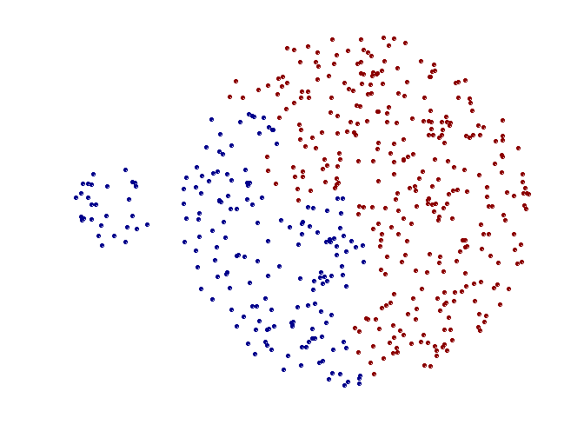
Limitations of complete-link clustering
Original Points
Two Clusters
Tends to break large clusters
All clusters tend to have the same diameter – small clusters are merged with larger ones

Slide 27
Distance between two clusters
Group average distance between clusters C_{i} and C_{j} is the average distance between any object in C_{i} and any object in C_{j}

Slide 28
Average-link clustering: example
Proximity of two clusters is the average of pairwise proximity between points in the two clusters.
1
2
3
4
5

Slide 29
Average-link clustering: example
5
4
1
2
5
2
3
6
1
4
3
Nested Clusters
Dendrogram

Slide 30
Average-link clustering: discussion
Compromise between Single and Complete Link
Strengths
  Less susceptible to noise and outliers
Limitations
  Biased towards globular clusters

Slide 31
Distance between two clusters
Centroid distance between clusters C_{i} and C_{j} is the distance between the centroid r_{i} of C_{i} and the centroid r_{j} of C_{j}

Slide 32
Distance between two clusters
Ward’s distance between clusters C_{i} and C_{j} is the difference between the total within cluster sum of squares for the two clusters separately, and the within cluster sum of squares resulting from merging the two clusters in cluster C_{ij}
r_{i}: centroid of C_{i}
r_{j}: centroid of C_{j}
r_{ij}: centroid of C_{ij}

Slide 33
Ward’s distance for clusters
Similar to group average and centroid distance
Less susceptible to noise and outliers
Biased towards globular clusters
Hierarchical analogue of k-means
  Can be used to initialize k-means

Slide 34
Hierarchical Clustering: Comparison
5
1
4
1
3
2
5
5
5
2
1
MIN
2
MAX
2
3
6
3
3
6
1
4
4
4
5
5
1
4
1
2
2
5
2
Ward’s Method
5
2
3
6
Group Average
3
3
6
4
1
1
4
4
3

Slide 35
Implementing hierarchical clustering
Naïve implementation:
  At each step, compute pairwise distances between all pairs of clusters
  O(N³)
Careful implementation using priority queue can reduce time to O(N² log N)
  Still too expensive for really big datasets that do not fit in memory

Slide 36
Hierarchical Clustering: Time and Space requirements
For a dataset X consisting of n points
O(n²) space; it requires storing the distance matrix
O(n³) time in most of the cases
  There are n steps and at each step the size n² distance matrix must be updated and searched
  Complexity can be reduced to O(n² log(n) ) time for some approaches by using appropriate data structures

Slide 37
Divisive hierarchical clustering
Start with a single cluster composed of all data points
Split this into components
Continue recursively
Monothetic divisive methods split clusters using one variable/dimension at a time
Polythetic divisive methods make splits on the basis of all variables together
Any intercluster distance measure can be used
Computationally intensive, less widely used than agglomerative methods

Slide 38
And in the Non-Euclidean Case?
The only “locations” we can talk about are the points themselves.
  i.e., there is no “average” of two points.
Approach 1: clustroid = point “closest” to other points.
  Treat clustroid as if it were centroid, when computing intercluster distances.

Slide 39
“Closest” Point?
Possible meanings:
  Smallest maximum distance to the other points.
  Smallest average distance to other points.
  Smallest sum of squares of distances to other points.
    For distance metric d clustroid c of cluster C is:

Slide 40
Defining “Nearness” of Clusters
Approach 2: intercluster distance = minimum of the distances between any two points, one from each cluster.
Approach 3: Pick a notion of “cohesion” of clusters, e.g., maximum distance from the clustroid.
  Merge clusters whose union is most cohesive.

Slide 41
Cohesion
Approach 1: Use the diameter of the merged cluster = maximum distance between points in the cluster.
Approach 2: Use the average distance between points in the cluster.
Approach 3: Use a density-based approach: take the diameter or avg. distance, e.g., and divide by the number of points in the cluster.
  Perhaps raise the number of points to a power first, e.g., square-root.

Slide 42
Partitioning algorithms: basic concept
Construct a partition of a set of n objects into a set of k clusters
  Each object belongs to exactly one cluster
  The number of clusters k is given in advance

Slide 43
The k-means problem
Given a set X of n points in a d-dimensional space and an integer k
Task: choose a set of k points {c₁, c₂,…,c_{k}} in the d-dimensional space to form clusters {C₁, C₂,…,C_{k}} such that
is minimized
Some special cases: k = 1, k = n

Slide 44
Algorithmic properties of the k-means problem
NP-hard if the dimensionality of the data is at least 2 (d>=2)
Finding the best solution in polynomial time is infeasible
For d=1 the problem is solvable in polynomial time (how?)
A simple iterative algorithm works quite well in practice

Slide 45
The k-means algorithm
One way of solving the k-means problem
Randomly pick k cluster centers {c₁,…,c_{k}}
For each i, set the cluster C_{i} to be the set of points in X that are closer to c_{i} than they are to c_{j} for all i≠j
For each i let c_{i} be the center of cluster C_{i} (mean of the vectors in C_{i})
Repeat until convergence

Slide 46
Properties of the k-means algorithm
Finds a local optimum
Converges often quickly (but not always)
The choice of initial points can have large influence in the result

Slide 47
Two different K-means Clusterings
Original Points
Optimal Clustering
Sub-optimal Clustering

Slide 48
k – Means Algorithm(s)
Assumes Euclidean space/distance.
Start by picking k, the number of clusters.
Initialize clusters by picking one point per cluster.
  Example: pick one point at random, then k-1 other points, each as far away as possible from the previous points.

Slide 49
Populating Clusters
For each point, place it in the cluster whose current centroid it is nearest.
After all points are assigned, fix the centroids of the k clusters.
Optional: reassign all points to their closest centroid.
  Sometimes moves points between clusters.

Slide 50
Example: Assigning Clusters
Reassigned
points
2
4
x
6
7
5
x
3
1
8
Clusters after first round

Slide 51
Getting k Right
  Try different k, looking at the change in the average distance to centroid, as k increases.
Average falls rapidly until right k, then changes little.
Best value
of k
Average
distance to
centroid
k

Slide 52
Example: Picking k
x
xx x
x x
x x x
x
x x x
x
Too few;
many long
distances
to centroid.
x
x x
x x x x
x x x x
x x x
x x
x x
x x x x
x x x
x
x

Slide 53
Example: Picking k
x
xx x
x x
x x x
x
x x x
x
x
Just right;
distances
rather short.
x x
x x x x
x x x x
x x x
x x
x x
x x x x
x x x
x
x

Slide 54
Example: Picking k
Too many;
little improvement
in average
distance.
x
xx x
x x
x x x
x
x x x
x
x
x x
x x x x
x x x x
x x x
x x
x x
x x x x
x x x
x
x

Slide 55
BFR Algorithm
BFR [Bradley-Fayyad-Reina] is a variant of
k-means designed to handle very large
(disk-resident) data sets.
It assumes that clusters are normally distributed around a centroid in a Euclidean space.
  Standard deviations in different dimensions
  may vary.

Slide 56
BFR Algorithm (2)
Points are read one main-memory-full at a time.
Most points from previous memory loads are summarized by simple statistics.
To begin, from the initial load we select the initial k centroids by some sensible approach.

Slide 57
Initialization: k -Means
Possibilities include:
  Take a small random sample and cluster optimally
  Take a sample; pick a random point, and then
  k–1 more points, each as far from the previously selected points as possible.

Slide 58
Three Classes of Points
The discard set (DS): points close enough to a centroid to be summarized.
The compression set (CS): groups of points that are close together but not close to any centroid. They are summarized, but not assigned to a cluster.
The retained set (RS): isolated points.

Slide 59
“Galaxies” Picture
Points in
the RS
Compressed sets.
Their points are in
the CS.
A cluster. Its points
are in the DS.
The centroid

Slide 60
Summarizing Sets of Points
For each cluster, the discard set is summarized by:
  The number of points, N.
  The vector SUM, whose i^{th} component is the sum of the coordinates of the points in the i^{th} dimension.
  The vector SUMSQ: i^{th} component = sum of squares of coordinates in i^{th} dimension.

Slide 61
Comments
2d + 1 values represent any size cluster.
  d = number of dimensions.
Averages in each dimension (centroid) can be calculated as SUM_{i} /N.
  SUM_{i} = i ^{th} component of SUM.
Variance of a cluster’s discard set in dimension i is: (SUMSQ_{i} /N ) – (SUM_{i} /N )²
  And standard deviation is the square root of that.
Q: Why use this representation of clusters?

Slide 62
Processing “Memory-Load” of Points
Find those points that are “sufficiently close” to a cluster centroid; add those points to that cluster and the DS.
Use any main-memory clustering algorithm to cluster the remaining points and the old RS.
  Clusters go to the CS; outlying points to the RS.

Slide 63
Processing – (2)
Adjust statistics of the clusters to account for the new points.
  Add N’s, SUM’s, SUMSQ’s.
Consider merging compressed sets in the CS.
If this is the last round, merge all compressed sets in the CS and all RS points into their nearest cluster.

Slide 64
A Few Details . . .
How do we decide if a point is “close enough” to a cluster that we will add the point to that cluster?
How do we decide whether two compressed sets deserve to be combined into one?

Slide 65
How Close is Close Enough?
We need a way to decide whether to put a new point into a cluster.
BFR suggest two ways:
  The Mahalanobis distance is less than a threshold.
  Low likelihood of the currently nearest centroid changing.

Slide 66
Mahalanobis Distance
Normalized Euclidean distance from centroid.
For point (x₁,…,x_{k}) and centroid (c₁,…,c_{k}):
  Normalize in each dimension: y_{i} = (x_{i} -c_{i})/σ_{i}
  Take sum of the squares of the y_{i} ’s.
  Take the square root.

Slide 67
Mahalanobis Distance – (2)
If clusters are normally distributed in d dimensions, then after transformation, one standard deviation = √d.
  i.e., 70% of the points of the cluster will have a Mahalanobis distance < √d.
Accept a point for a cluster if its M.D.
is < some threshold, e.g. 4 standard deviations.

Slide 68
Picture: Equal M.D. Regions
2σ
σ

Slide 69
Should 2 CS subclusters be combined?
Compute the variance of the combined subcluster.
  N, SUM, and SUMSQ allow us to make that calculation quickly.
Combine if the variance is below some threshold.
Many alternatives: treat dimensions differently, consider density.

Slide 70
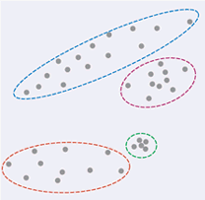
The CURE Algorithm
Problem with BFR/k -means:
  Assumes clusters are normally distributed in each dimension.
  And axes are fixed – ellipses at
  an angle are not OK.
CURE:
  Assumes a Euclidean distance.
  Allows clusters to assume any shape.
Vs.

Slide 71
Example: Salaries
h
h
h
e
e
e
h
e
e
e
h
e
e
e
e
h
salary
e
h
h
h
h
h
h
h
age

Slide 72
Starting CURE
Pick a random sample of points that fit in main memory.
Cluster these points hierarchically – group nearest points/clusters.
For each cluster, pick a sample of points, as dispersed as possible.
From the sample, pick representatives by moving them (say) 20% toward the centroid of the cluster.

Slide 73
Example: Initial Clusters
h
h
h
e
e
e
h
e
e
e
h
e
e
e
e
h
salary
e
h
h
h
h
h
h
h
age

Slide 74
Example: Pick Dispersed Points
h
h
h
e
e
e
h
e
e
e
h
e
e
e
e
h
salary
e
Pick (say) 4
remote points
for each
cluster.
h
h
h
h
h
h
h
age

Slide 75
Example: Pick Dispersed Points
h
h
h
e
e
e
h
e
e
e
h
e
e
e
e
h
salary
e
Move points
(say) 20%
toward the
centroid.
h
h
h
h
h
h
h
age

Slide 76
Finishing CURE
Now, visit each point p in the data set.
Place it in the “closest cluster.”
  Normal definition of “closest”: that cluster with the closest (to p ) among all the sample points of all the clusters.

Slide 77
Model-based clustering
Assume data generated from k probability distributions
Goal: find the distribution parameters
Algorithm: Expectation Maximization (EM)
Output: Distribution parameters and a soft assignment of points to clusters

Slide 78
Model-based clustering
Assume k probability distributions with parameters: (θ₁,…, θ_{k})
Given data X, compute (θ₁,…, θ_{k}) such that Pr(X|θ₁,…, θ_{k}) [likelihood] or ln(Pr(X|θ₁,…, θ_{k})) [loglikelihood] is maximized.
Every point xєX need not be generated by a single distribution but it can be generated by multiple distributions with some probability [soft clustering]

Slide 79
EM Algorithm
Initialize k distribution parameters (θ₁,…, θ_{k}); Each distribution parameter corresponds to a cluster center
Iterate between two steps
  Expectation step: (probabilistically) assign points to clusters
  Maximation step: estimate model parameters that maximize the likelihood for the given assignment of points

Slide 80
EM Algorithm
Initialize k cluster centers
Iterate between two steps
  Expectation step: assign points to clusters
  Maximation step: estimate model parameters

