Slide 1
Link Analysis: PageRank

Slide 2
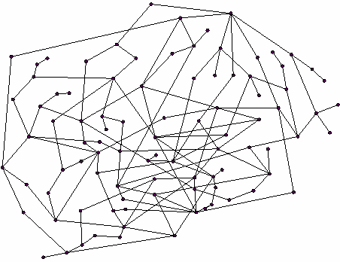
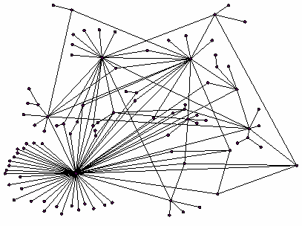
Ranking Nodes on the Graph
Web pages are not equally “important”
www.joe-schmoe.com vs. www.stanford.edu
Since there is large diversity in the connectivity of the web graph we can rank the pages by the link structure
vs.

Slide 3
Link Analysis Algorithms
We will cover the following Link Analysis approaches to computing importances of nodes in a graph:
Page Rank
Hubs and Authorities (HITS)
Topic-Specific (Personalized) Page Rank
Web Spam Detection Algorithms

Slide 4
Links as Votes
Idea: Links as votes
Page is more important if it has more links
In-coming links? Out-going links?
Think of in-links as votes:
www.stanford.edu has 23,400 inlinks
www.joe-schmoe.com has 1 inlink
Are all in-links are equal?
Links from important pages count more
Recursive question!

Slide 5
Simple Recursive Formulation
Each link’s vote is proportional to the importance of its source page
If page p with importance x has n out-links, each link gets x/n votes
Page p’s own importance is the sum of the votes on its in-links
p

Slide 6
PageRank: The “Flow” Model
A “vote” from an important page is worth more
A page is important if it is pointed to by other important pages
Define a “rank” r_{j} for node j
The web in 1839
y/2
y
a/2
y/2
m
a
m
a/2
Flow equations:
r_{y} = r_{y} /2 + r_{a} /2
r_{a} = r_{y} /2 + r_{m}
r_{m} = r_{a} /2

Slide 7
Solving the Flow Equations
Flow equations:
r_{y} = r_{y} /2 + r_{a} /2
r_{a} = r_{y} /2 + r_{m}
r_{m} = r_{a} /2
3 equations, 3 unknowns, no constants
No unique solution
Additional constraint forces uniqueness
r_{y} + r_{a} + r_{m} = 1
r_{y} = 2/5, r_{a} = 2/5, r_{m} = 1/5
Gaussian elimination method works for small examples, but we need a better method for large web-size graphs

Slide 8
PageRank: Matrix Formulation
Stochastic adjacency matrix M
Let page j has d_{j} out-links
If j → i, then M_{ij} = 1/d_{j} else M_{ij} = 0
M is a column stochastic matrix
Columns sum to 1
Rank vector r: vector with an entry per page
r_{i} is the importance score of page i
∑_{i} r_{i} = 1
The flow equations can be written r = M r

Slide 9
Example
Suppose page j links to 3 pages, including i
j
i
i
=
1/3
M
r
r

Slide 10
Eigenvector Formulation
The flow equations can be written r = M ∙ r
So the rank vector is an eigenvector of the stochastic web matrix
In fact, its first or principal eigenvector, with corresponding eigenvalue 1

Slide 11
Example: Flow Equations & M
 | y | a | m
y | ½ | ½ | 0
a | ½ | 0 | 1
m | 0 | ½ | 0
y
a
m
r = Mr
r_{y} = r_{y} /2 + r_{a} /2
r_{a} = r_{y} /2 + r_{m}
r_{m} = r_{a} /2
y ½ ½ 0 y
a = ½ 0 1 a
m 0 ½ 0 m

Slide 12
Power Iteration Method
Given a web graph with n nodes, where the nodes are pages and edges are hyperlinks
Power iteration: a simple iterative scheme
Suppose there are N web pages
Initialize: r⁽⁰⁾ = [1/N,….,1/N]^{T}
Iterate: r^{(t+1)} = M ∙ r^{(t)}
Stop when |r^{(t+1)} – r^{(t)}|₁ < ε
|x|₁ = ∑_{1≤i≤N}|x_{i}| is the L1 norm
Can use any other vector norm e.g., Euclidean
d_{i} …. out-degree of node i

Slide 13
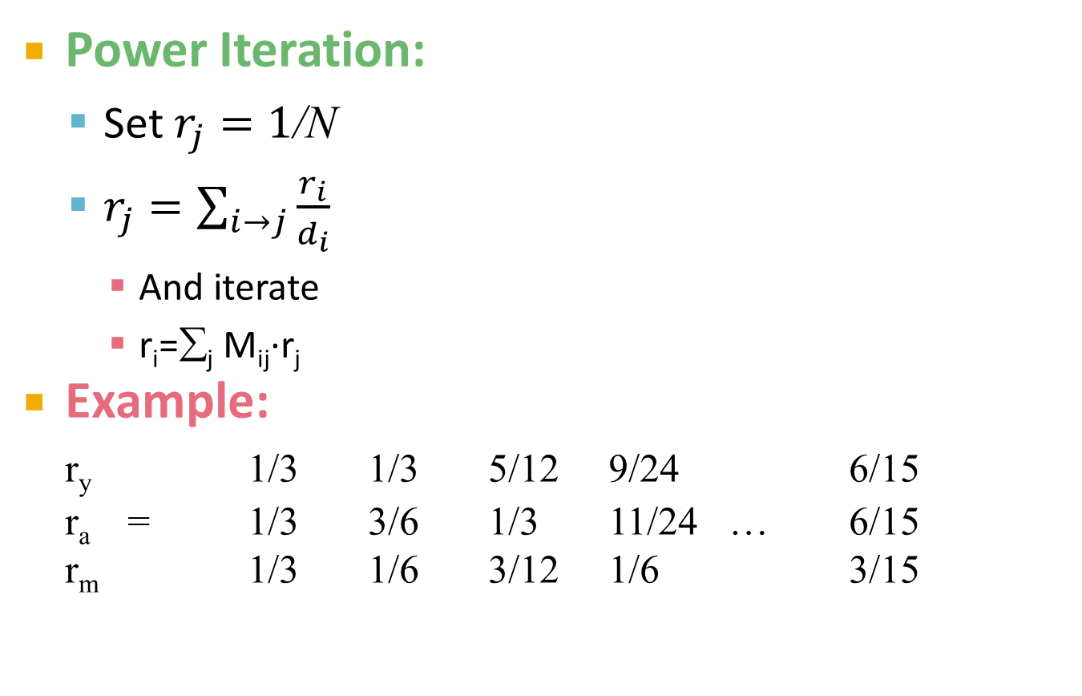
PageRank: How to solve?
y
 | y | a | m
y | ½ | ½ | 0
a | ½ | 0 | 1
m | 0 | ½ | 0
Power Iteration:
Set $r_{j}=1$/N
$r_{j}=\sum_{i→j}{\frac{r_{i}}{d_{i}}}$
And iterate
r_{i}=∑_{j} M_{ij}∙r_{j}
Example:
r_{y} 1/3 1/3 5/12 9/24 6/15
r_{a} = 1/3 3/6 1/3 11/24 … 6/15
r_{m} 1/3 1/6 3/12 1/6 3/15
a
m
r_{y} = r_{y} /2 + r_{a} /2
r_{a} = r_{y} /2 + r_{m}
r_{m} = r_{a} /2
Iteration 0, 1, 2, …

Slide 14
Random Walk Interpretation
i₁
i₂
i₃
Imagine a random web surfer:
At any time t, surfer is on some page u
At time t+1, the surfer follows an out-link from u uniformly at random
Ends up on some page v linked from u
Process repeats indefinitely
Let:
p(t) … vector whose i^{th} coordinate is the prob. that the surfer is at page i at time t
p(t) is a probability distribution over pages
j

Slide 15
The Stationary Distribution
i₁
i₂
i₃
Where is the surfer at time t+1?
Follows a link uniformly at random
p(t+1) = M · p(t)
Suppose the random walk reaches a state p(t+1) = M · p(t) = p(t)
then p(t) is stationary distribution of a random walk
Our rank vector r satisfies r = M · r
So, it is a stationary distribution for the random walk
j

Slide 16
PageRank: Three Questions
Does this converge?
Does it converge to what we want?
Are results reasonable?
or
equivalently

Slide 17
Does This Converge?
Example:
r_{a} 1 0 1 0
r_{b} 0 1 0 1
a
b
=
Iteration 0, 1, 2, …

Slide 18
Does it Converge to What We Want?
Example:
r_{a} 1 0 0 0
r_{b} 0 1 0 0
a
b
=
Iteration 0, 1, 2, …

Slide 19
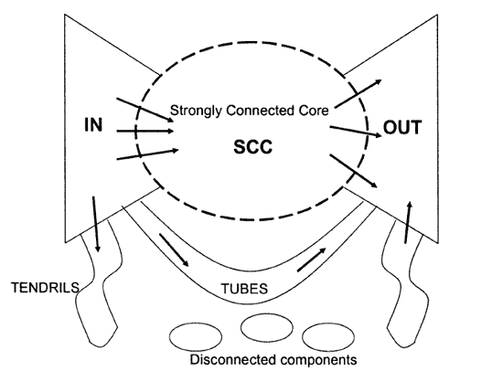
Problems with the “Flow” Model
2 problems:
Some pages are “dead ends” (have no out-links)
Such pages cause importance to “leak out”
Spider traps (all out links are within the group)
Eventually spider traps absorb all importance

Slide 20
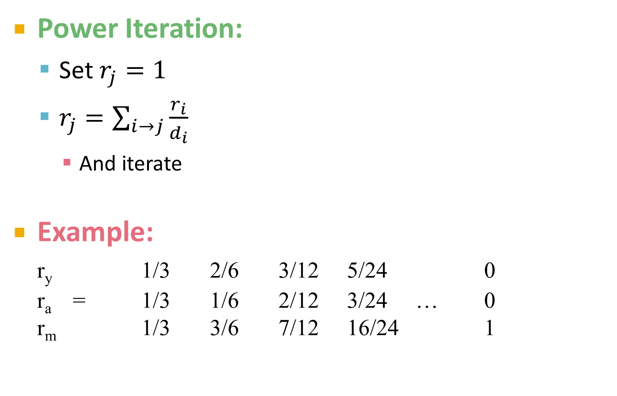
Problem: Spider Traps
y
 | y | a | m
y | ½ | ½ | 0
a | ½ | 0 | 0
m | 0 | ½ | 1
Power Iteration:
Set $r_{j}=1$
$r_{j}=\sum_{i→j}{\frac{r_{i}}{d_{i}}}$
And iterate
Example:
r_{y} 1/3 2/6 3/12 5/24 0
r_{a} = 1/3 1/6 2/12 3/24 … 0
r_{m} 1/3 3/6 7/12 16/24 1
a
m
r_{y} = r_{y} /2 + r_{a} /2
r_{a} = r_{y} /2
r_{m} = r_{a} /2 + r_{m}
Iteration 0, 1, 2, …

Slide 21
Solution: Random Teleports
The Google solution for spider traps: At each time step, the random surfer has two options:
With probability β, follow a link at random
With probability 1-β, jump to some page uniformly at random
Common values for β are in the range 0.8 to 0.9
Surfer will teleport out of spider trap within a few time steps
y
y
a
m
a
m

Slide 22

Problem: Dead Ends
y
 | y | a | m
y | ½ | ½ | 0
a | ½ | 0 | 0
m | 0 | ½ | 0
Power Iteration:
Set $r_{j}=1$
$r_{j}=\sum_{i→j}{\frac{r_{i}}{d_{i}}}$
And iterate
Example:
r_{y} 1/3 2/6 3/12 5/24 0
r_{a} = 1/3 1/6 2/12 3/24 … 0
r_{m} 1/3 1/6 1/12 2/24 0
a
m
r_{y} = r_{y} /2 + r_{a} /2
r_{a} = r_{y} /2
r_{m} = r_{a} /2
Iteration 0, 1, 2, …

Slide 23
Solution: Dead Ends
Teleports: Follow random teleport links with probability 1.0 from dead-ends
Adjust matrix accordingly
y
y
a
m
a
m
 | y | a | m
y | ½ | ½ | 0
a | ½ | 0 | 0
m | 0 | ½ | 0
 | y | a | m
y | ½ | ½ | ⅓
a | ½ | 0 | ⅓
m | 0 | ½ | ⅓

Slide 24
Why Teleports Solve the Problem?
Markov Chains
Set of states X
Transition matrix P where P_{ij} = P(X_{t}=i | X_{t-1}=j)
π specifying the probability of being at each state x ∈ X
Goal is to find π such that π = P π

Slide 25
Why is This Analogy Useful?
Theory of Markov chains
Fact: For any start vector, the power method applied to a Markov transition matrix P will converge to a unique positive stationary vector as long as P is stochastic, irreducible and aperiodic.

Slide 26
Make M Stochastic
Stochastic: Every column sums to 1
A possible solution: Add green links
a_{i}…=1 if node i has out deg 0, =0 else
1…vector of all 1s
y
 | y | a | m
y | ½ | ½ | 1/3
a | ½ | 0 | 1/3
m | 0 | ½ | 1/3
r_{y} = r_{y} /2 + r_{a} /2 + r_{m} /3
r_{a} = r_{y} /2+ r_{m} /3
r_{m} = r_{a} /2 + r_{m} /3
a
m

Slide 27
Make M Aperiodic
A chain is periodic if there exists k > 1 such that the interval between two visits to some state s is always a multiple of k.
A possible solution: Add green links
y
a
m

Slide 28
Make M Irreducible
From any state, there is a non-zero probability of going from any one state to any another
A possible solution: Add green links
y
a
m

Slide 29
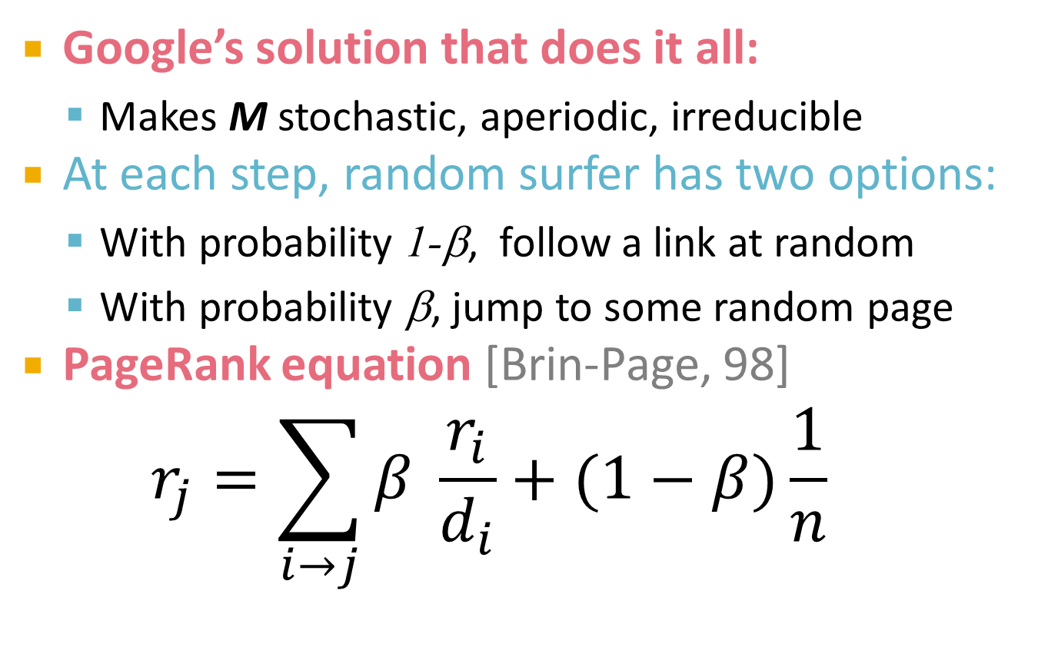
Solution: Random Jumps
Google’s solution that does it all:
Makes M stochastic, aperiodic, irreducible
At each step, random surfer has two options:
With probability 1-β, follow a link at random
With probability β, jump to some random page
PageRank equation [Brin-Page, 98] $r_{j}=\sum_{i→j}{β \frac{r_{i}}{d_{i}}}+(1−β)\frac{1}{n}$
From now on: We assume M has no dead ends That is, we follow random teleport links with probability 1.0 from dead-ends
d_{i} … out-degree of node i

Slide 30
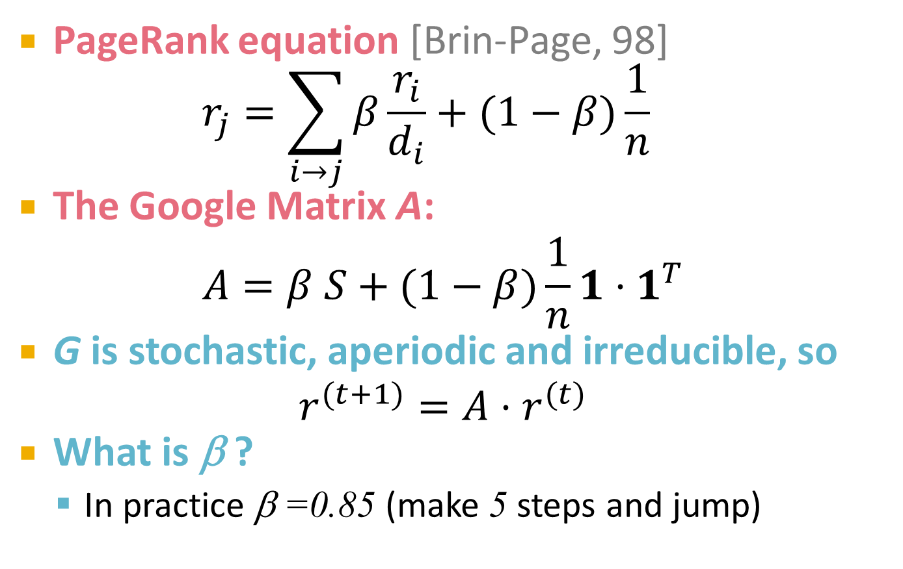
The Google Matrix
PageRank equation [Brin-Page, 98] $r_{j}=\sum_{i→j}{β\frac{r_{i}}{d_{i}}}+(1−β)\frac{1}{n}$
The Google Matrix A:
$$A=β S+(1−β)\frac{1}{n}1{⋅1}^{T}$$
G is stochastic, aperiodic and irreducible, so
$$r^{(t+1)}=A⋅r^{(t)}$$
What is β ?
In practice β =0.85 (make 5 steps and jump)

Slide 31
Random Teleports (β = 0.8)
S
1/n·1·1^{T}
0.8·½+0.2·⅓
y
1/2 1/2 0
1/2 0 0
0 1/2 1
1/3 1/3 1/3
1/3 1/3 1/3
1/3 1/3 1/3
0.8
+ 0.2
0.8·½+0.2·⅓
0.2·⅓
0.8·½+0.2·⅓
0.2· ⅓
y 7/15 7/15 1/15
a 7/15 1/15 1/15
m 1/15 7/15 13/15
0.8+0.2·⅓
a
0.8·½+0.2·⅓
m
0.2·⅓
0.2· ⅓
A
y
a =
m
1/3
1/3
1/3
0.33
0.20
0.46
0.24
0.20
0.52
0.26
0.18
0.56
7/33
5/33
21/33
. . .

Slide 32
Computing Page Rank
Key step is matrix-vector multiplication
r^{new} = A ∙ r^{old}
Easy if we have enough main memory to hold A, r^{old}, r^{new}
Say N = 1 billion pages
We need 4 bytes for each entry (say)
2 billion entries for vectors, approx 8GB
Matrix A has N² entries
10¹⁸ is a large number!
A = β∙M + (1-β) [1/N]_{NxN}
½ ½ 0
½ 0 0
0 ½ 1
1/3 1/3 1/3
1/3 1/3 1/3
1/3 1/3 1/3
A =
0.8
+0.2
7/15 7/15 1/15
7/15 1/15 1/15
1/15 7/15 13/15
=

Slide 33
Matrix Formulation
Suppose there are N pages
Consider a page j, with set of out-links d_{j}
We have M_{ij} = 1/|d_{j}| when j→i and M_{ij} = 0 otherwise
The random teleport is equivalent to
Adding a teleport link from j to every other page with probability (1-β)/N
Reducing the probability of following each out-link from 1/|d_{j}| to β/|d_{j}|
Equivalent: Tax each page a fraction (1-β) of its score and redistribute evenly

Slide 34
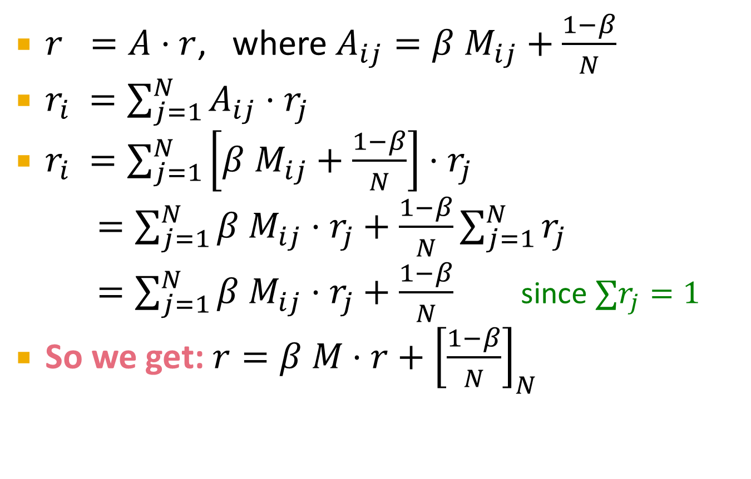
Rearranging the Equation
$r =A⋅r$, where $A_{ij}=β{ M}_{ij}+\frac{1−β}{N}$
$r_{i} =\sum_{j=1}^{N}{A_{ij}⋅r_{j}}$
$r_{i} =\sum_{j=1}^{N}{\left[β{ M}_{ij}+\frac{1−β}{N}\right]⋅r_{j}}$
$=\sum_{j=1}^{N}{β{ M}_{ij}⋅r_{j}+\frac{1−β}{N}}\sum_{j=1}^{N}{r_{j}}$
$=\sum_{j=1}^{N}{β{ M}_{ij}⋅r_{j}+\frac{1−β}{N}}$ since $∑r_{j}=1$
So we get: $r=β M⋅r+{\left[\frac{1−β}{N}\right]}_{N}$
[x]_{N} … a vector of length N with all entries x

Slide 35
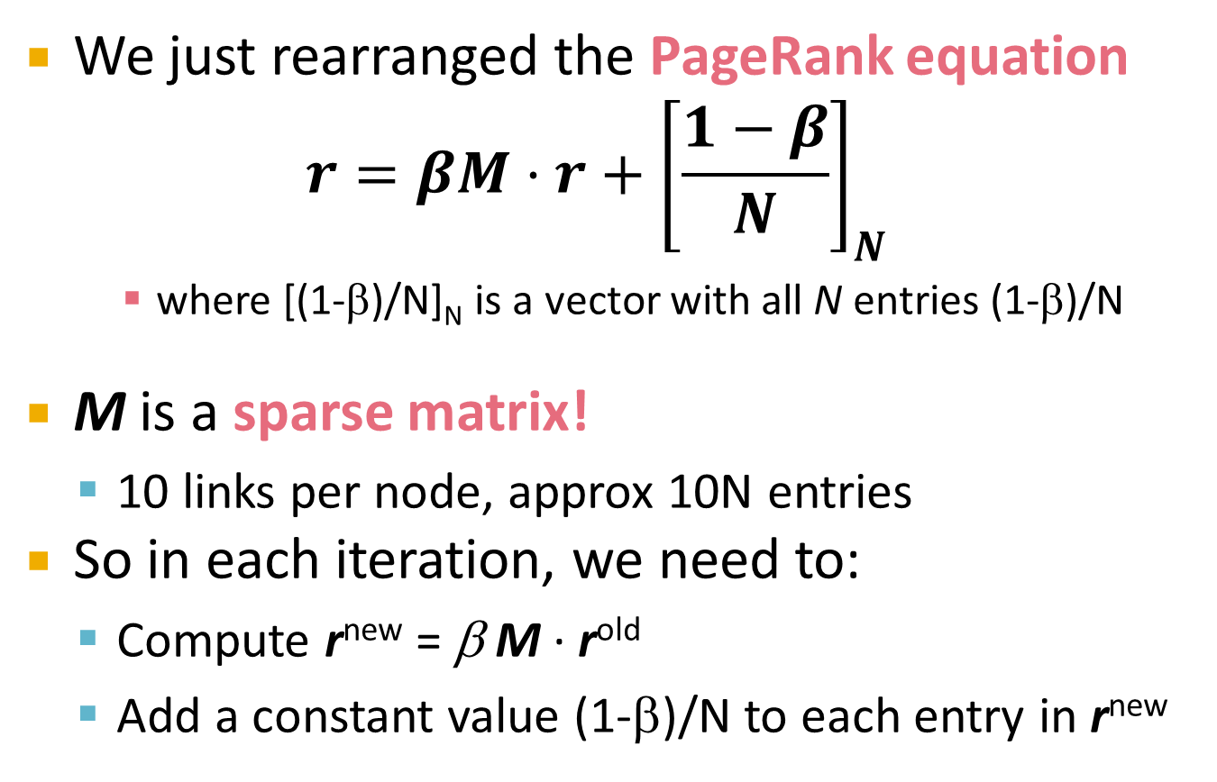
Sparse Matrix Formulation
We just rearranged the PageRank equation
$$r=βM⋅r+{\left[\frac{1−β}{N}\right]}_{N}$$
where [(1-β)/N]_{N} is a vector with all N entries (1-β)/N
M is a sparse matrix!
10 links per node, approx 10N entries
So in each iteration, we need to:
Compute r^{new} = β M ∙ r^{old}
Add a constant value (1-β)/N to each entry in r^{new}

Slide 36
Sparse Matrix Encoding
Encode sparse matrix using only nonzero entries
Space proportional roughly to number of links
Say 10N, or 4*10*1 billion = 40GB
Still won’t fit in memory, but will fit on disk
source
node
degree
destination nodes
0 | 3 | 1, 5, 7
1 | 5 | 17, 64, 113, 117, 245
2 | 2 | 13, 23

Slide 37
Basic Algorithm: Update Step
Assume enough RAM to fit r^{new} into memory
Store r^{old} and matrix M on disk
Then 1 step of power-iteration is:
Initialize all entries of r^{new} to (1-β)/N
For each page p (of out-degree n):
Read into memory: p, n, dest₁,…,dest_{n}, r^{old}(p)
for j = 1…n: r^{new}(dest_{j}) += β r^{old}(p) / n
r^{new}
r^{old}
0
src
degree
destination
0
1
0 | 3 | 1, 5, 6
1 | 4 | 17, 64, 113, 117
2 | 2 | 13, 23
1
2
2
3
3
4
4
5
5
6
6

Slide 38
Analysis
Assume enough RAM to fit r^{new} into memory
Store r^{old} and matrix M on disk
In each iteration, we have to:
Read r^{old} and M
Write r^{new} back to disk
IO cost = 2|r| + |M|
Question:
What if we could not even fit r^{new} in memory?

Slide 39
Block-based Update Algorithm
r^{new}
src
degree
destination
r^{old}
0
0 | 4 | 0, 1, 3, 5
1 | 2 | 0, 5
2 | 2 | 3, 4
0
1
1
2
2
3
4
3
5
4
5

Slide 40
Analysis of Block Update
Similar to nested-loop join in databases
Break r^{new} into k blocks that fit in memory
Scan M and r^{old} once for each block
k scans of M and r^{old}
k(|M| + |r|) + |r| = k|M| + (k+1)|r|
Can we do better?
Hint: M is much bigger than r (approx 10-20x), so we must avoid reading it k times per iteration

Slide 41
Block-Stripe Update Algorithm
src
degree
destination
r^{new}
0 | 4 | 0, 1
1 | 3 | 0
2 | 2 | 1
0
1
r^{old}
0
1
2
2
0 | 4 | 3
2 | 2 | 3
3
4
3
5
0 | 4 | 5
1 | 3 | 5
2 | 2 | 4
4
5

Slide 42
Block-Stripe Analysis
Break M into stripes
Each stripe contains only destination nodes in the corresponding block of r^{new}
Some additional overhead per stripe
But it is usually worth it
Cost per iteration
|M|(1+ε) + (k+1)|r|

Slide 43
Some Problems with Page Rank
Measures generic popularity of a page
Biased against topic-specific authorities
Solution: Topic-Specific PageRank (next)
Uses a single measure of importance
Other models e.g., hubs-and-authorities
Solution: Hubs-and-Authorities (next)
Susceptible to Link spam
Artificial link topographies created in order to boost page rank
Solution: TrustRank (next)

