Slide 1
Link Analysis: PageRank and Similar Ideas

Slide 2
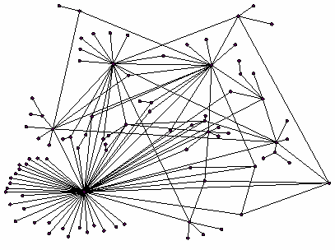
Recap: PageRank
Rank nodes using link structure
PageRank:
Link voting:
P with importance x has n out-links, each link gets x/n votes
Page R’s importance is the sum of the votes on its in-links
Complications: Spider traps, Dead-ends
At each step, random surfer has two options:
With probability β, follow a link at random
With prob. 1-β, jump to some page uniformly at random

Slide 3
Some Problems with Page Rank
Measures generic popularity of a page
Biased against topic-specific authorities
Solution: Topic-Specific PageRank (next)
Susceptible to Link spam
Artificial link topographies created in order to boost page rank
Solution: TrustRank (next)
Uses a single measure of importance
Other models e.g., hubs-and-authorities
Solution: Hubs-and-Authorities (next)

Slide 4
Topic-Specific PageRank
Instead of generic popularity, can we measure popularity within a topic?
Goal: Evaluate Web pages not just according to their popularity, but by how close they are to a particular topic, e.g. “sports” or “history.”
Allows search queries to be answered based on interests of the user
Example: Query “Trojan” wants different pages depending on whether you are interested in sports or history.

Slide 5
Topic-Specific PageRank
Assume each walker has a small probability of “teleporting” at any step
Teleport can go to:
Any page with equal probability
To avoid dead-end and spider-trap problems
A topic-specific set of “relevant” pages (teleport set)
For topic-sensitive PageRank.
Idea: Bias the random walk
When walked teleports, she pick a page from a set S
S contains only pages that are relevant to the topic
E.g., Open Directory (DMOZ) pages for a given topic
For each teleport set S, we get a different vector r_{S}

Slide 6
Matrix Formulation
Let:
A_{ij} = β M_{ij} + (1-β) /|S| if i∈S
β M_{ij} otherwise
A is stochastic!
We have weighted all pages in the teleport set S equally
Could also assign different weights to pages!
Compute as for regular PageRank:
Multiply by M, then add a vector
Maintains sparseness

Slide 7
Example
Suppose S = {1}, β = 0.8
0.2
0.5
1
0.4
0.5
0.4
1
2
3
0.8
Node Iteration
0 1 2 … stable
1 1.0 0.2 0.52 0.294
2 0 0.4 0.08 0.118
3 0 0.4 0.08 0.327
4 0 0 0.32 0.261
1
1
0.8
0.8
4
Note how we initialize the PageRank vector differently from the unbiased PageRank case.

Slide 8
Discovering the Topic
Create different PageRanks for different topics
The 16 DMOZ top-level categories:
arts, business, sports,…
Which topic ranking to use?
User can pick from a menu
Classify query into a topic
Can use the context of the query
E.g., query is launched from a web page talking about a known topic
History of queries e.g., “basketball” followed by “Jordan”
User context, e.g., user’s bookmarks, …

Slide 9
Web Spam

Slide 10
What is Web Spam?
Spamming:
any deliberate action to boost a web page’s position in search engine results, incommensurate with page’s real value
Spam:
web pages that are the result of spamming
This is a very broad definition
SEO industry might disagree!
SEO = search engine optimization
Approximately 10-15% of web pages are spam

Slide 11
Web Search
Early search engines:
Crawl the Web
Index pages by the words they contained
Respond to search queries (lists of words) with the pages containing those words
Early page ranking:
Attempt to order pages matching a search query by “importance”
First search engines considered:
1) Number of times query words appeared.
2) Prominence of word position, e.g. title, header.

Slide 12
First Spammers
As people began to use search engines to find things on the Web, those with commercial interests tried to exploit search engines to bring people to their own site – whether they wanted to be there or not.
Example:
Shirt-seller might pretend to be about “movies.”
Techniques for achieving high relevance/importance for a web page

Slide 13
First Spammers: Term Spam
How do you make your page appear to be about movies?
1) Add the word movie 1000 times to your page
Set text color to the background color, so only search engines would see it
2) Or, run the query “movie” on your target search engine
See what page came first in the listings
Copy it into your page, make it “invisible”
These and similar techniques are term spam

Slide 14
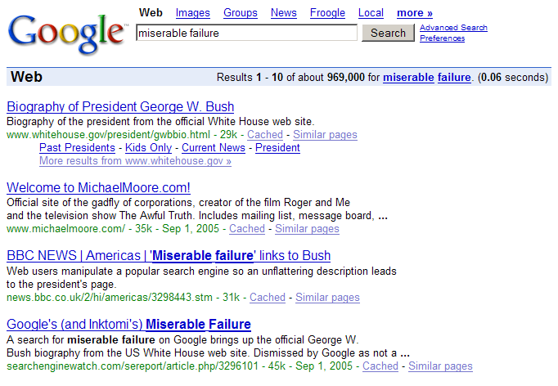
Google’s Solution to Term Spam
Believe what people say about you, rather than what you say about yourself
Use words in the anchor text (words that appear underlined to represent the link) and its surrounding text
PageRank as a tool to measure the “importance” of Web pages

Slide 15
Why It Works?
Our hypothetical shirt-seller loses
Saying he is about movies doesn’t help, because others don’t say he is about movies
His page isn’t very important, so it won’t be ranked high for shirts or movies
Example:
Shirt-seller creates 1000 pages, each links to his with “movie” in the anchor text
These pages have no links in, so they get little PageRank
So the shirt-seller can’t beat truly important movie pages like IMDB

Slide 16
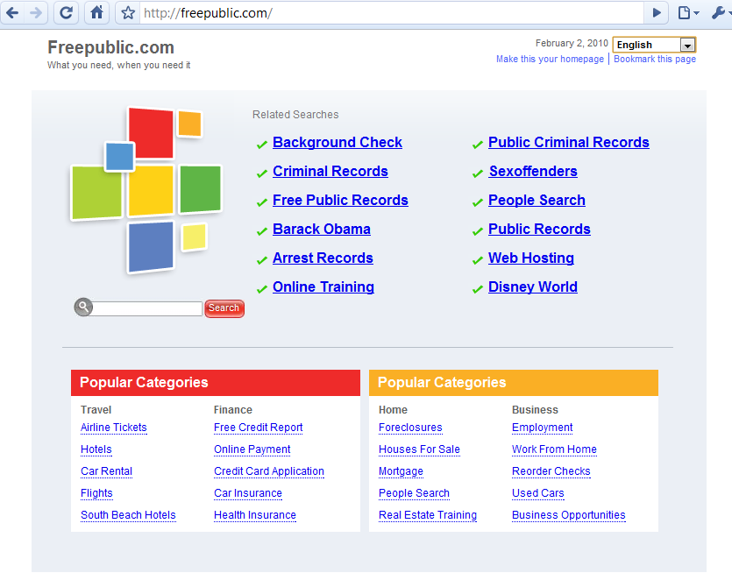
Google vs. Spammers: Round 2
Once Google became the dominant search engine, spammers began to work out ways to fool Google
Spam farms were developed to concentrate PageRank on a single page
Link spam:
Creating link structures that boost PageRank of a particular page

Slide 17
Link Spamming
Three kinds of web pages from a spammer’s point of view:
Inaccessible pages
Accessible pages:
e.g., blog comments pages
spammer can post links to his pages
Own pages:
Completely controlled by spammer
May span multiple domain names

Slide 18
Link Farms
Spammer’s goal:
Maximize the PageRank of target page t
Technique:
Get as many links from accessible pages as possible to target page t
Construct “link farm” to get PageRank multiplier effect

Slide 19
Link Farms
Accessible
Own
Inaccessible
1
t
2
M
Millions of farm pages
One of the most common and effective organizations for a link farm

Slide 20
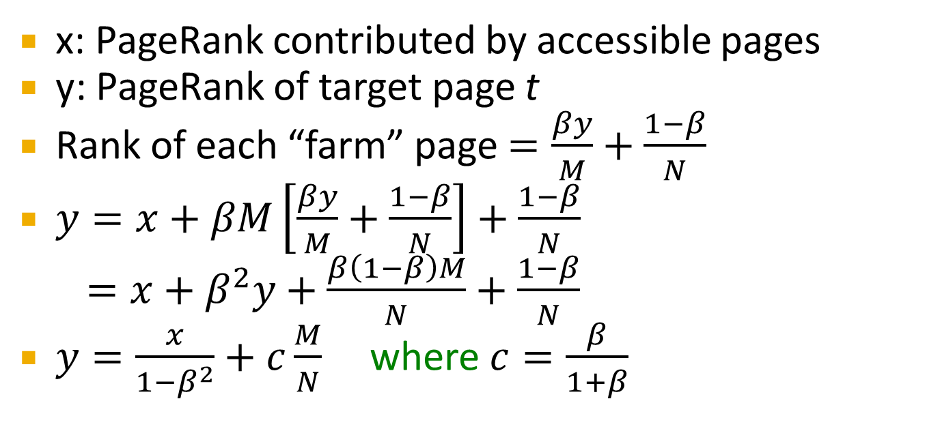
Analysis
Accessible
Own
Inaccessible
1
t
2
N…# pages on the web
M…# of pages spammer owns
M
x: PageRank contributed by accessible pages
y: PageRank of target page t
Rank of each “farm” page $=\frac{βy}{M}+\frac{1−β}{N}$
$y=x+βM\left[\frac{βy}{M}+\frac{1−β}{N}\right]+\frac{1−β}{N}$
$=x+β^{2}y+\frac{β\left(1−β\right)M}{N}+\frac{1−β}{N}$
$y=\frac{x}{1−β^{2}}+c\frac{M}{N}$ where $c=\frac{β}{1+β}$
Very small; ignore Now we solve for y

Slide 21
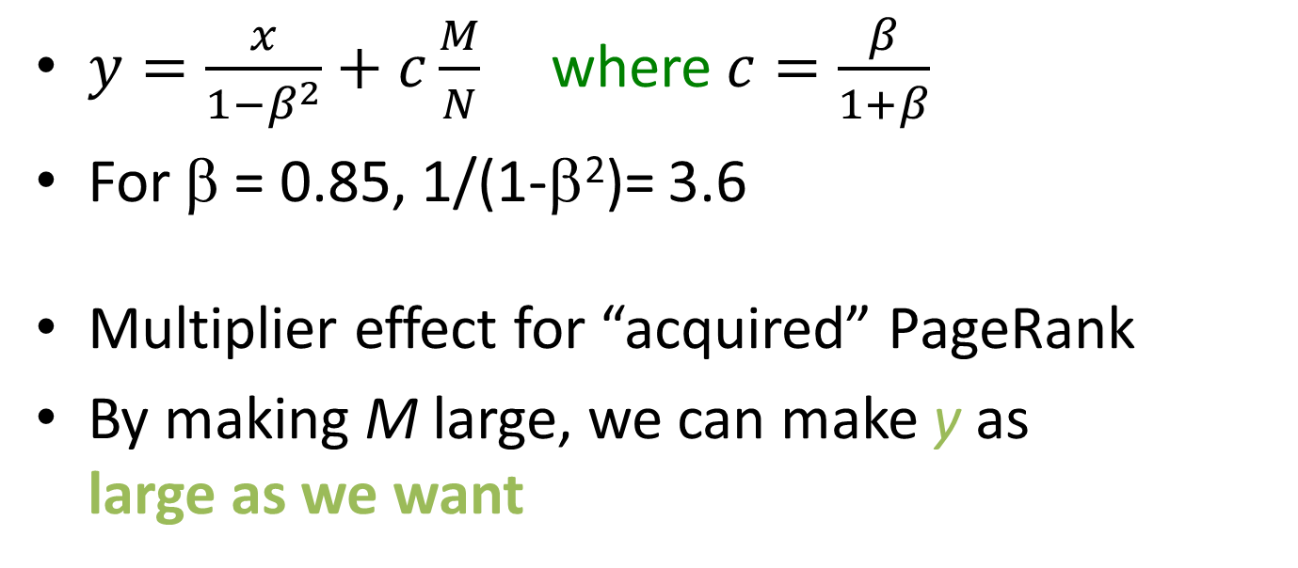
Analysis
Accessible
Own
Inaccessible
1
t
2
N…# pages on the web
M…# of pages spammer owns
M
$y=\frac{x}{1−β^{2}}+c\frac{M}{N}$ where $c=\frac{β}{1+β}$
For β = 0.85, 1/(1-β²)= 3.6
Multiplier effect for “acquired” PageRank
By making M large, we can make y as large as we want

Slide 22
Combating Web Spam

Slide 23
Combating Spam
Combating term spam
Analyze text using statistical methods
Similar to email spam filtering
Also useful: Detecting approximate duplicate pages
Combating link spam
Detection and blacklisting of structures that look like spam farms
Leads to another war – hiding and detecting spam farms
TrustRank = topic-specific PageRank with a teleport set of “trusted” pages
Example: .edu domains, similar domains for non-US schools

Slide 24
TrustRank: Idea
Basic principle: Approximate isolation
It is rare for a “good” page to point to a “bad” (spam) page
Sample a set of “seed pages” from the web
Have an oracle (human) identify the good pages and the spam pages in the seed set
Expensive task, so we must make seed set as small as possible

Slide 25
Trust Propagation
Call the subset of seed pages that are identified as “good” the “trusted pages”
Perform a topic-sensitive PageRank with teleport set = trusted pages.
Propagate trust through links:
Each page gets a trust value between 0 and 1
Use a threshold value and mark all pages below the trust threshold as spam

Slide 26
Why is it a good idea?
Trust attenuation:
The degree of trust conferred by a trusted page decreases with distance
Trust splitting:
The larger the number of out-links from a page, the less scrutiny the page author gives each out-link
Trust is “split” across out-links

Slide 27
Picking the Seed Set
Two conflicting considerations:
Human has to inspect each seed page, so seed set must be as small as possible
Must ensure every “good page” gets adequate trust rank, so need make all good pages reachable from seed set by short paths

Slide 28
Approaches to Picking Seed Set
Suppose we want to pick a seed set of k pages
PageRank:
Pick the top k pages by PageRank
Theory is that you can’t get a bad page’s rank really high
Use domains whose membership is controlled, like .edu, .mil, .gov

Slide 29
Spam Mass
In the TrustRank model, we start with good pages and propagate trust
Complementary view:
What fraction of a page’s PageRank comes from “spam” pages?
In practice, we don’t know all the spam pages, so we need to estimate

Slide 30
Spam Mass Estimation
r(p) = PageRank of page p
r⁺(p) = page rank of p with teleport into “good” pages only
Then:
r⁻(p) = r(p) – r⁺(p)
Spam mass of p = r⁻(p)/ r (p)

Slide 31
HITS: Hubs and Authorities

Slide 32
Hubs and Authorities
HITS (Hypertext-Induced Topic Selection)
is a measure of importance of pages or documents, similar to PageRank
Proposed at around same time as PageRank (‘98)
Goal: Imagine we want to find good newspapers
Don’t just find newspapers. Find “experts” – people who link in a coordinated way to good newspapers
Idea: Links as votes
Page is more important if it has more links
In-coming links? Out-going links?

Slide 33
Finding newspapers
Hubs and Authorities Each page has 2 scores:
Quality as an expert (hub):
Total sum of votes of pages pointed to
Quality as an content (authority):
Total sum of votes of experts
Principle of repeated improvement
NYT: 10
Ebay: 3
Yahoo: 3
CNN: 8
WSJ: 9

Slide 34
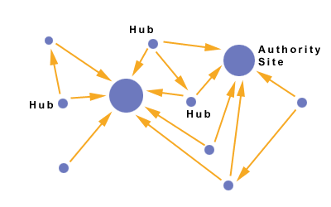
Hubs and Authorities
Interesting pages fall into two classes:
Authorities are pages containing useful information
Newspaper home pages
Course home pages
Home pages of auto manufacturers
Hubs are pages that link to authorities
List of newspapers
Course bulletin
List of US auto manufacturers
NYT: 10
Ebay: 3
Yahoo: 3
CNN: 8
WSJ: 9

Slide 35
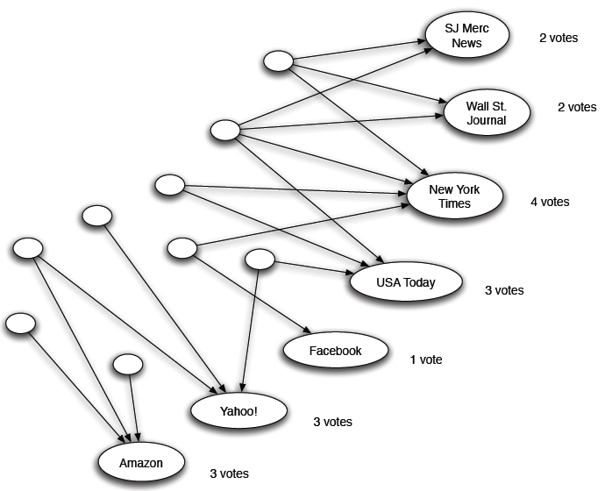
Counting in-links: Authority
Each page starts with hub score 1
Authorities collect their votes
(Note this is idealized example. In reality graph is not bipartite and each page has both the hub and authority score)

Slide 36
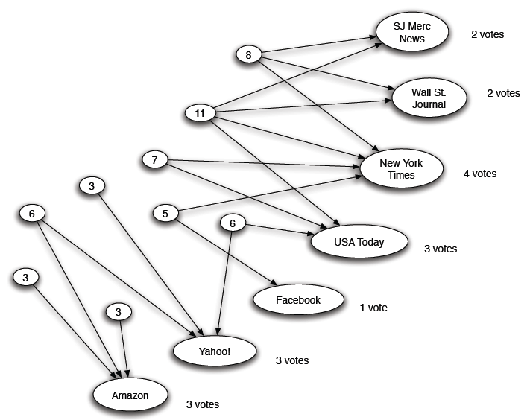
Expert Quality: Hub
Hubs collect authority scores
(Note this is idealized example. In reality graph is not bipartite and each page has both the hub and authority score)

Slide 37
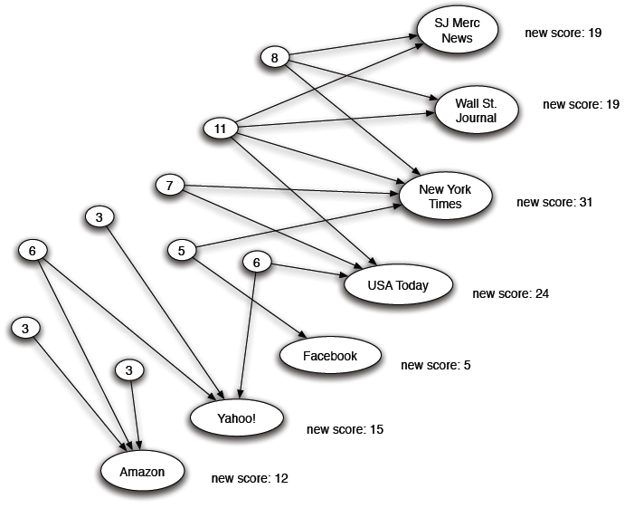
Reweighting
Authorities collect hub scores
(Note this is idealized example. In reality graph is not bipartite and each page has both the hub and authority score)

Slide 38
Mutually Recursive Definition
A good hub links to many good authorities
A good authority is linked from many good hubs
Model using two scores for each node:
Hub score and Authority score
Represented as vectors h and a

Slide 39
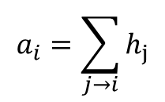
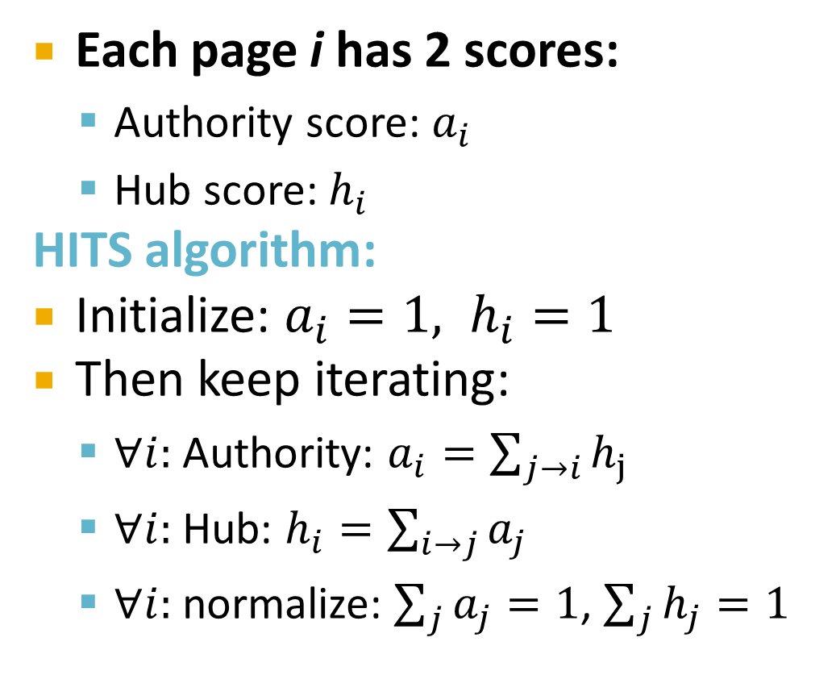
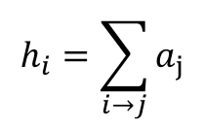
Hubs and Authorities
[Kleinberg ‘98]
j₁
j₂
j₃
j₄
Each page i has 2 scores:
Authority score: $a_{i}$
Hub score: $h_{i}$
HITS algorithm:
Initialize: $a_{i}=1, h_{i}=1$
Then keep iterating:
$∀i:$Authority: $a_{i}=\sum_{j→i}{h_{j}}$
$∀i:$Hub: $h_{i}=\sum_{i→j}{a_{j}}$
$∀i:$normalize: $\sum_{j}{a_{j}}=1$, $\sum_{j}{h_{j}}=1$
i
$$a_{i}=\sum_{j→i}{h_{j}}$$
i
j₁
j₂
j₃
j₄
$$h_{i}=\sum_{i→j}{a_{j}}$$

Slide 40
Transition Matrix A
[Kleinberg ‘98]
HITS converges to a single stable point
Slightly change the notation:
Vector a = (a₁…,a_{n}), h = (h₁…,h_{n})
Adjacency matrix (n x n): A_{ij}=1 if ij
Then:
So:
And likewise:

Slide 41
Hub and Authority Equations
The hub score of page i is proportional to the sum of the authority scores of the pages it links to: h = λ A a
Constant λ is a scale factor, λ=1/∑h_{i}
The authority score of page i is proportional to the sum of the hub scores of the pages it is linked from: a = μ A^{T} h
Constant μ is scale factor, μ=1/∑a_{i}

Slide 42
Iterative algorithm
The HITS algorithm:
Initialize h, a to all 1’s
Repeat:
h = A a
Scale h so that its sums to 1.0
a = A^{T} h
Scale a so that its sums to 1.0
Until h, a converge (i.e., change very little)

Slide 43
Example
1 1 1
A = 1 0 1
0 1 0
1 1 0
A^{T} = 1 0 1
1 1 0
Yahoo
Amazon
M’soft
a(yahoo)
a(amazon)
a(m’soft)
=
=
=
1
1
1
1
1
1
1
4/5
1
1
0.75
1
. . .
. . .
. . .
1
0.732
1
h(yahoo) = 1
h(amazon) = 1
h(m’soft) = 1
1
2/3
1/3
1
0.71
0.29
1
0.73
0.27
. . .
. . .
. . .
1.000
0.732
0.268

Slide 44
Hubs and Authorities
HITS algorithm in new notation:
Set: a = h = 1^{n}
Repeat:
h = A a, a = A^{T} h
Normalize
Then: a=A^{T}(A a)
Thus, in 2k steps: a=(A^{T} A)^{k} a h=(A A^{T})^{k} h
new h
a is being updated (in 2 steps):
A^{T}(A a)=(A^{T} A) a
h is updated (in 2 steps):
A (A^{T} h)=(A A^{T}) h
new a
Repeated matrix powering

Slide 45
Existence and Uniqueness
λ=1/∑h_{i}
μ=1/∑a_{i}
h = λ A a
a = μ A^{T} h
h = λ μ A A^{T} h
a = λ μ A^{T} A a
Under reasonable assumptions about A, the HITS iterative algorithm converges to vectors h* and a*:
h* is the principal eigenvector of matrix A A^{T}
a* is the principal eigenvector of matrix A^{T} A

Slide 46
PageRank and HITS
PageRank and HITS are two solutions to the same problem:
What is the value of an in-link from u to v?
In the PageRank model, the value of the link depends on the links into u
In the HITS model, it depends on the value of the other links out of u
The destinies of PageRank and HITS post-1998 were very different

