Slide 2
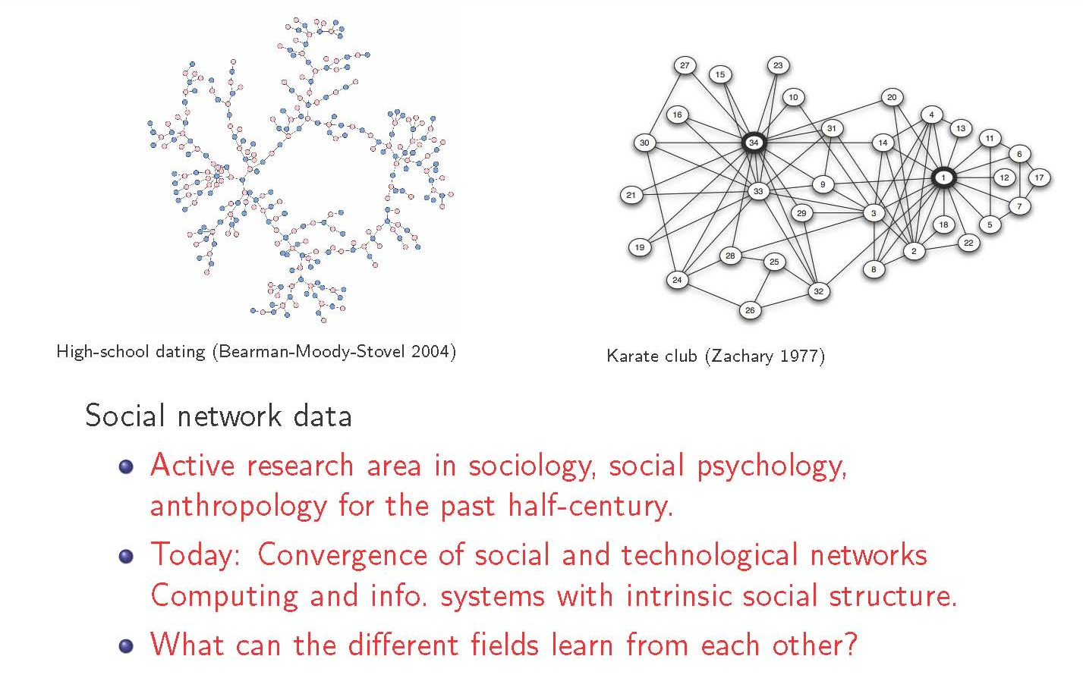
Social Network Analysis

Slide 3
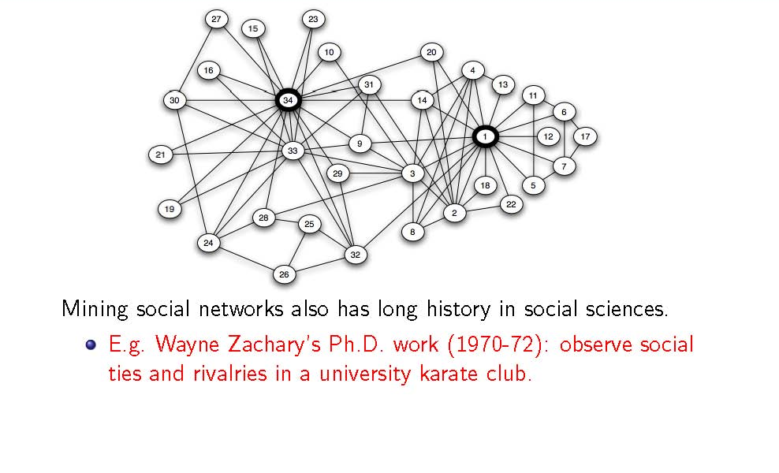
Mining Social Network Data

Slide 4
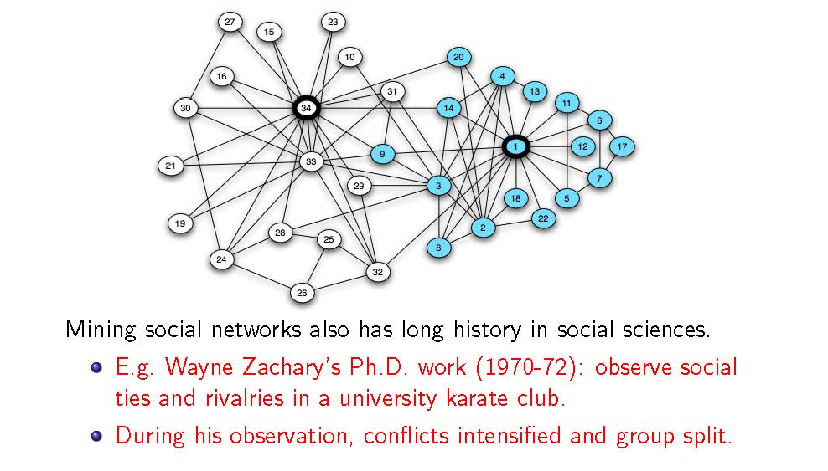
Mining Social Network Data

Slide 5
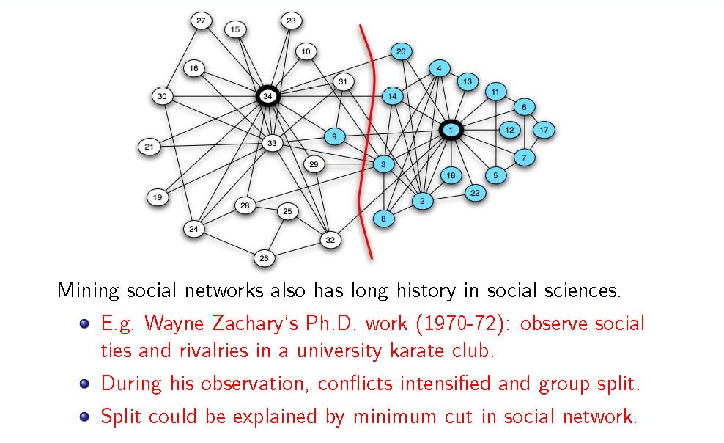
Mining Social Network Data

Slide 6
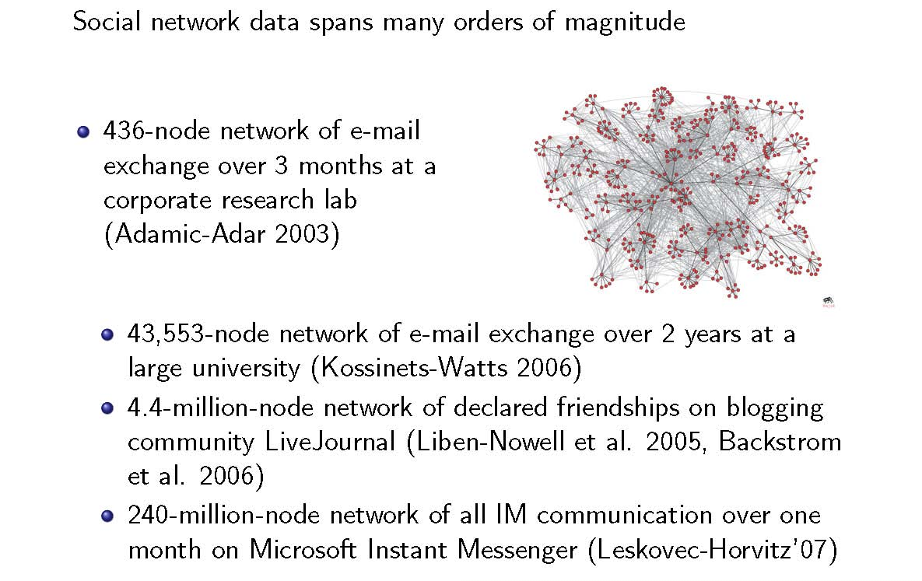
A matter of Scale

Slide 8

Discovering Clusters in Graphs
CS246: Mining Massive Datasets
Jure Leskovec, Stanford University
http://cs246.stanford.edu

Slide 9
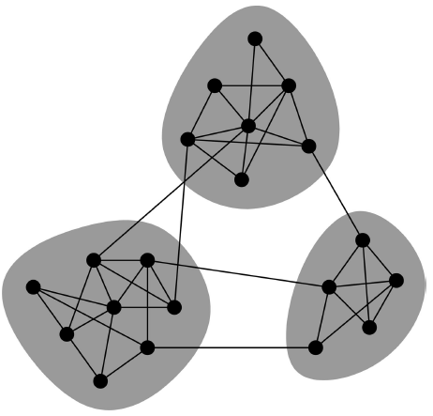
Network Communities
Networks of tightly connected groups
Network communities:
Sets of nodes with lots of connections inside and few to outside (the rest of the network)
Communities, clusters, groups, modules

Slide 10
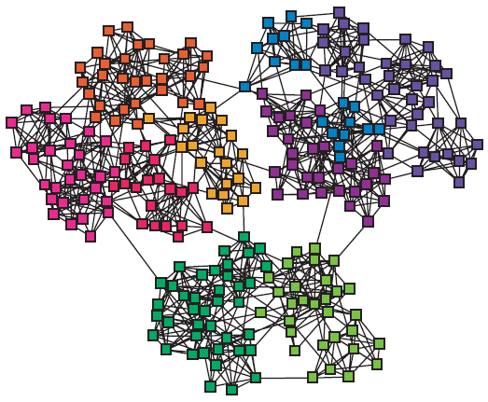
Finding Network Communities
How to automatically find such densely connected groups of nodes?
Ideally such clusters then correspond to real groups
For example:
Communities, clusters, groups, modules

Slide 11
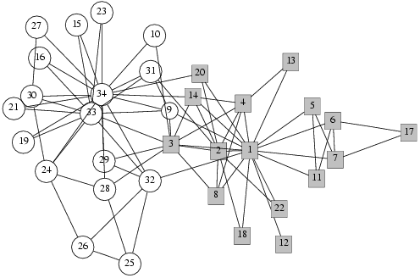
Social Network Data
Zachary’s Karate club network:
Observe social ties and rivalries in a university karate club
During his observation, conflicts led the group to split
Split could be explained by a minimum cut in the network

Slide 12
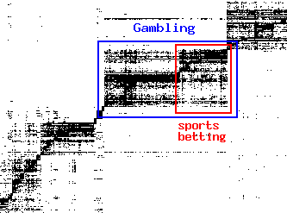
Micro-Markets in Sponsored Search
Find micro-markets by partitioning the “query x advertiser” graph:
query
advertiser

Slide 13
Method No. 1: Trawling
Directed graphs (unweighted edges)

Slide 14
Trawling
[Kumar et al. ‘99]
Searching for small communities in the Web graph
What is the signature of a community / discussion in a Web graph?
Use this to define “topics”:
What the same people on the left talk about on the right
Remember HITS!
…
…
…
Dense 2-layer graph
Intuition: Many people all talking about the same things

Slide 15
Searching for Small Communities
A more well-defined problem: Enumerate complete bipartite subgraphs K_{s,t}
Where K_{s,t} : s nodes on the “left” where each links to the same t other nodes on the “right”
|X| = s = 3
|Y| = t = 4
X
Y
K_{3,4}
Fully connected

Slide 16
The Plan: (1), (2) and (3)
[Kumar et al. ‘99]
Two points:
(1) Dense bipartite graph: the signature of a community/discussion
(2) Complete bipartite subgraph K_{s,t}
K_{s,t} = graph on s nodes, each links to the same t other nodes
Plan:
(A) From (2) get back to (1):
Via: Any dense enough graph contains a smaller K_{s,t} as a subgraph
(B) How do we solve (2) in a giant graph?
What similar problems were solved on big non-graph data?
(3) Frequent itemset enumeration

Slide 17
Frequent Itemset Enumeration
[Agrawal-Srikant ‘99]
Marketbasket analysis. Setting:
Market: Universe U of n items
Baskets: m subsets of U: S₁, S₂, …, S_{m} ⊆ U (S_{i} is a set of items one person bought)
Support: Frequency threshold f
Goal:
Find all subsets T s.t. T ⊆ S_{i} of ≥ f sets S_{i} (items in T were bought together at least f times)
What’s the connection between the itemsets and complete bipartite graphs?

Slide 18
From Itemsets to Bipartite K_{s,t}
[Kumar et al. ‘99]
View each node i as a set S_{i} of nodes i points to
Say we find a frequent itemset Y={a,b,c} of supp. s So, there are s nodes that link to all of {a,b,c}:
a
b
i
c
a
a
d
b
a
S_{i}={a,b,c,d}
b
x
y
z
c
c
b
Find frequent itemsets:
s … minimum support
t … itemset size
c
We found K_{s,t}!
K_{s,t} = a set Y of size t that occurs in s sets S_{i}
a
x
b
y
c
z
Y
X

Slide 19
From Itemsets to Bipartite K_{s,t}
[Kumar et al. ‘99]
Itemsets finds Complete bipartite graphs!
How?
View each node i as a set S_{i} of nodes i points to
K_{s,t} = a set Y of size t that occurs in s sets S_{i}
Looking for K_{s,t} → set of frequency threshold to s and look at layer t – all frequent sets of size t
a
b
S_{i}={a,b,c,d}
i
c
d
a
j
b
i
c
k
d
X
Y
s … minimum support (|X|=s)
t … itemset size (|Y|=t)

Slide 20
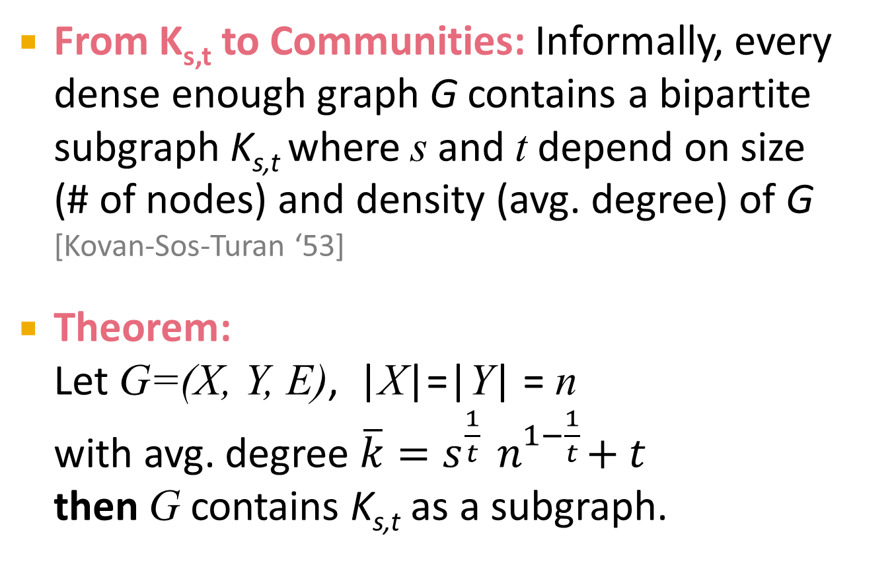
From K_{s,t} to Communities
From K_{s,t} to Communities: Informally, every dense enough graph G contains a bipartite subgraph K_{s,t} where s and t depend on size (# of nodes) and density (avg. degree) of G [Kovan-Sos-Turan ‘53]
Theorem: Let G=(X, Y, E), |X|=|Y| = n with avg. degree $\overline{k}=s^{\frac{1}{t}}{ n}^{1−\frac{1}{t}}+t$ then G contains K_{s,t} as a subgraph.

Slide 21


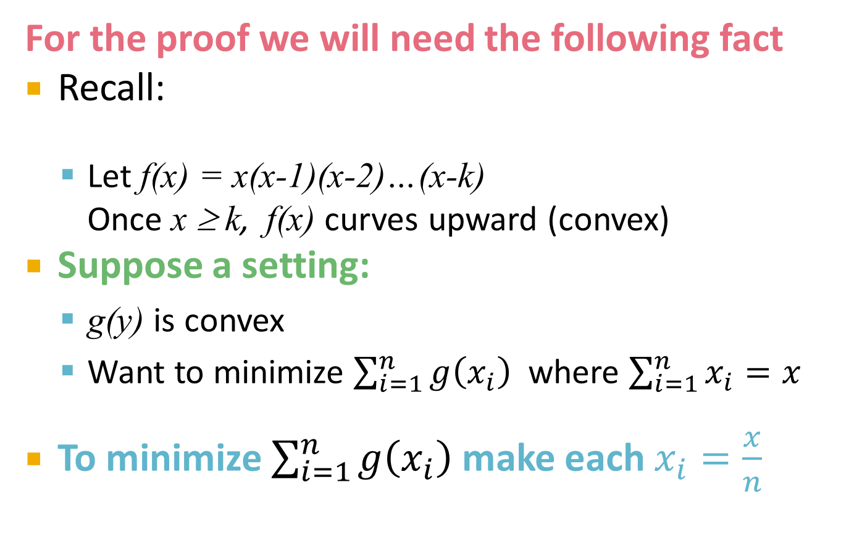

Proof: K_{s,t} and Communities
For the proof we will need the following fact
Recall:
Let f(x) = x(x-1)(x-2)…(x-k) Once x ≥ k, f(x) curves upward (convex)
Suppose a setting:
g(y) is convex
Want to minimize $\sum_{i=1}^{n}{g\left(x_{i}\right)}$where $\sum_{i=1}^{n}{x_{i}}=x$
To minimize $\sum_{i=1}^{n}{g\left(x_{i}\right)}$ make each $x_{i}=\frac{x}{n}$
f(x)
$$\frac{x}{n}$$
$$\frac{x}{n}+ε$$
$$\frac{x}{n}−ε$$
x

Slide 22
Nodes and Buckets
Consider node i of degree k_{i} and neighbor set S_{i}
Put node i in buckets for all size t subsets of i’s neighbors
a
i
i
i
i
….
b
i
(a,b)
(a,c)
(a,d)
(b,c)
c
d
….
Potential right-hand sides of K_{s,t} (i.e., all size t subsets of S_{i})
As soon as s nodes appear in a bucket we have a K_{s,t}

Slide 23
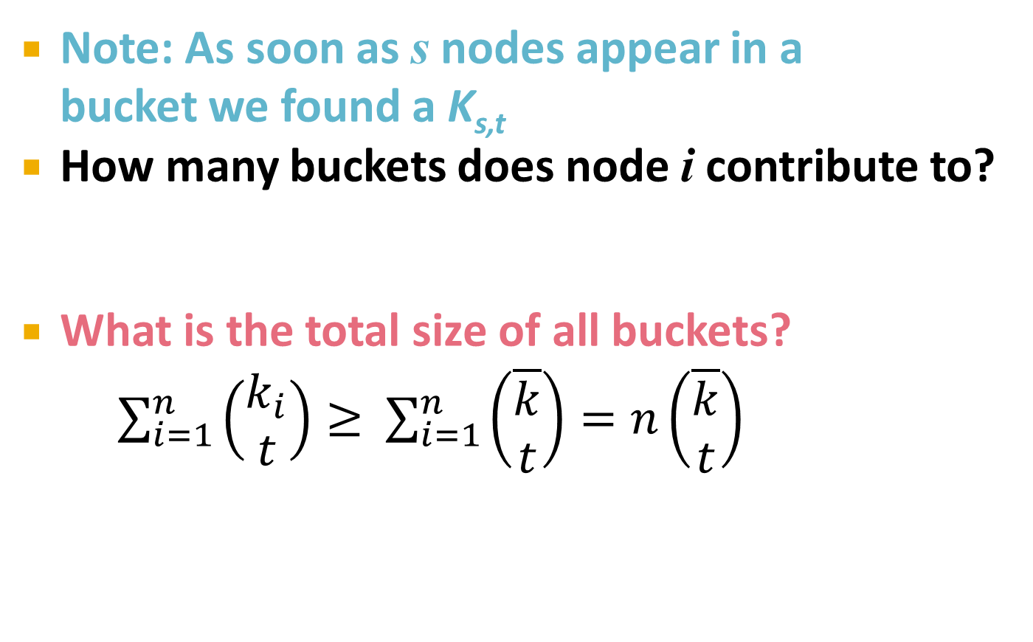

Nodes and Buckets
Note: As soon as s nodes appear in a bucket we found a K_{s,t}
How many buckets does node i contribute to?
What is the total size of all buckets?
$\sum_{i=1}^{n}{\left(\begin{matrix}k_{i} \\ t\end{matrix}\right)≥ }$ $\sum_{i=1}^{n}{\left(\begin{matrix}\overline{k} \\ t\end{matrix}\right)}=n\left(\begin{matrix}\overline{k} \\ t\end{matrix}\right)$
= # of ways to select t elements out of k_{i}
(k_{i} … degree of node i)
By convexity
(and k_{i} > t)
$$\overline{k}=\frac{1}{n}\sum_{i∈N}{k_{i}}$$

Slide 24
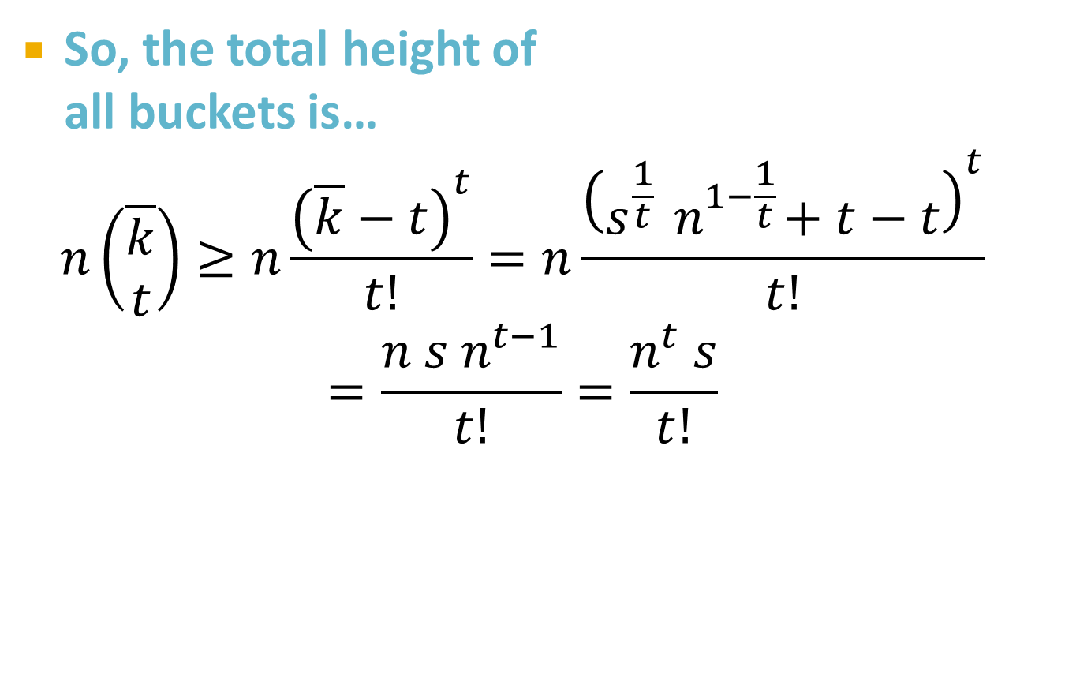
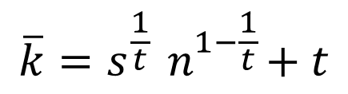
Nodes and Buckets
So, the total height of all buckets is…
$$n\left(\begin{matrix}\overline{k} \\ t\end{matrix}\right)≥n\frac{{\left(\overline{k}−t\right)}^{t}}{t!}=n\frac{{\left(s^{\frac{1}{t}}{ n}^{1−\frac{1}{t}}+t−t\right)}^{t}}{t!}$$
$$=\frac{n s n^{t−1}}{t!}=\frac{n^{t} s}{t!}$$
Plug in:
$$\overline{k}=s^{\frac{1}{t}}{ n}^{1−\frac{1}{t}}+t$$

Slide 25
And We are Done!
We have: Total height of all buckets:
How many buckets are there?
What is the average height of buckets?
⇒ By pigeonhole principle, there must be at least one bucket with more than s nodes in it
⇒ We found a K_{s,t}
So, avg. bucket height ≥ s

Slide 26
Trawling — Summary
[Kumar et al. ‘99]
Analytical result:
Complete bipartite subgraphs K_{s,t} are embedded in larger dense enough graphs (i.e., the communities)
Biparite subgraphs act as “signatures” of communities
Algorithmic result:
Frequent itemset extraction and dynamic programming finds graphs K_{s,t}
Method is super scalable

Slide 27
Method #2: Spectral Graph Partitioning
Undirected graphs (but can be have (non-negative) weighted edges)

Slide 28
Graph Partitioning
1
5
Undirected graph G(V,E):
Bi-partitioning task:
Divide vertices into two d
isjoint groups A, B
Questions:
How can we define a “good” partition of G?
How can we efficiently identify such a partition?
2
6
4
3
A
5
B
1
2
6
3
4

Slide 29
Graph Partitioning
What makes a good partition?
Maximize the number of within-group connections
Minimize the number of between-group connections
5
1
2
6
4
3
A
B

Slide 30
Graph Cuts
Express partitioning objectives as a function of the “edge cut” of the partition
Cut: Set of edges with only one vertex in a group:
A
B
5
1
cut(A,B) = 2
2
6
4
3

Slide 31
Graph Cut Criterion
Criterion: Minimum-cut
Minimise weight of connections between groups
Degenerate case:
Problem:
Only considers external cluster connections
Does not consider internal cluster connectivity
min_{A,B} cut(A,B)
“Optimal cut”
Minimum cut

Slide 32
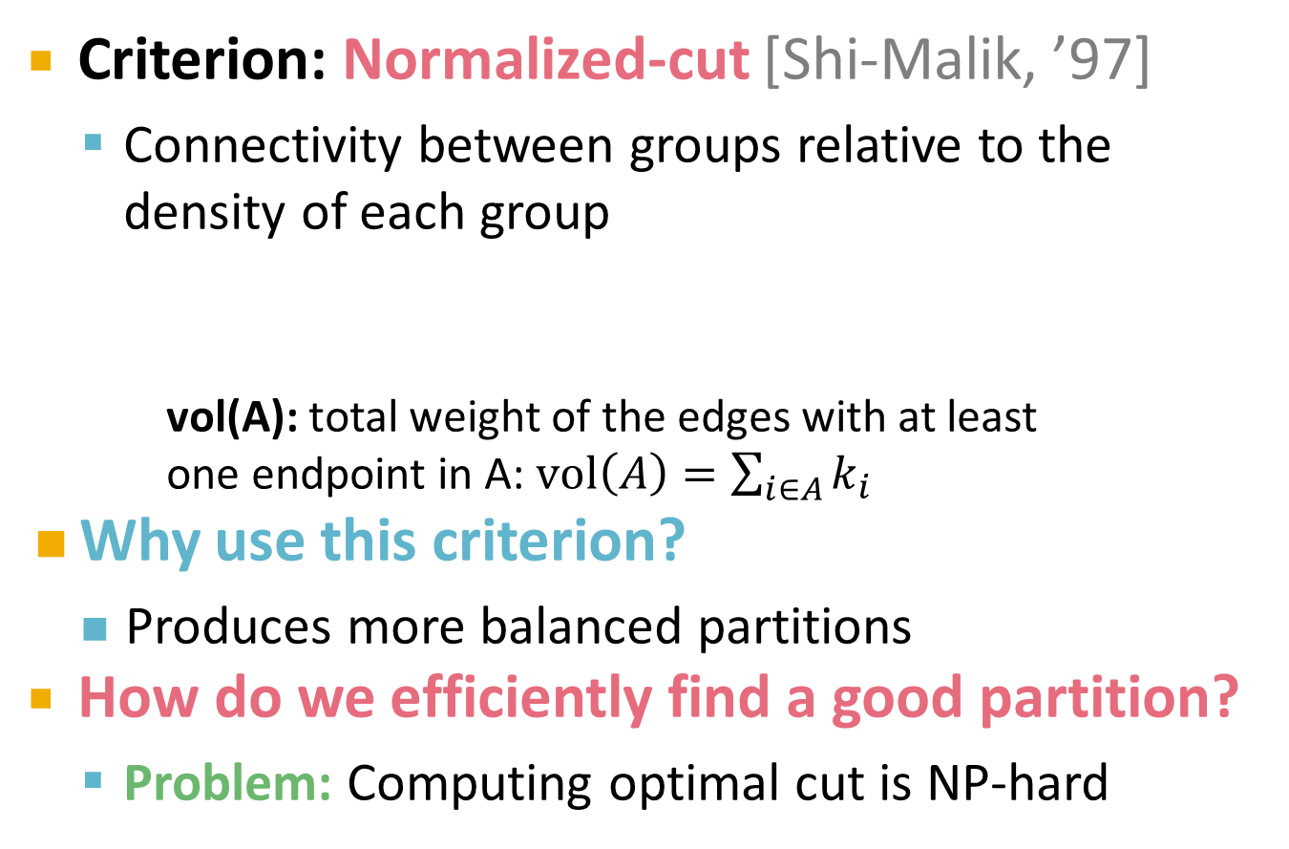
Graph Cut Criteria
[Shi-Malik]
Criterion: Normalized-cut [Shi-Malik, ’97]
Connectivity between groups relative to the density of each group
vol(A): total weight of the edges with at least one endpoint in A: $vol\left(A\right)=\sum_{i∈A}{k_{i}}$
Why use this criterion?
Produces more balanced partitions
How do we efficiently find a good partition?
Problem: Computing optimal cut is NP-hard
k_{i} … degree of node i

Slide 33
Spectral Graph Partitioning
A: adjacency matrix of undirected G
A_{ij} = 1 if (i, j) is an edge, else 0
x is a vector in ℜ^{n} with components (x₁,…, x_{n})
just a label/value of each node of G
What is the meaning of A⋅ x?
Entry y_{j} is a sum of labels x_{i} of neighbors of j
x_{i}
y_{j}

Slide 34
What is the meaning of A·x?
j^{th} coordinate of Ax:
Sum of the x-values of neighbors of j
Make this a new value at node j
Spectral Graph Theory:
Analyze the “spectrum” of matrix representing G
Spectrum: Eigenvectors of a graph, ordered by the magnitude (strength) of their corresponding eigenvalues:
Note: We order λ_{i} in increasing order

Slide 35
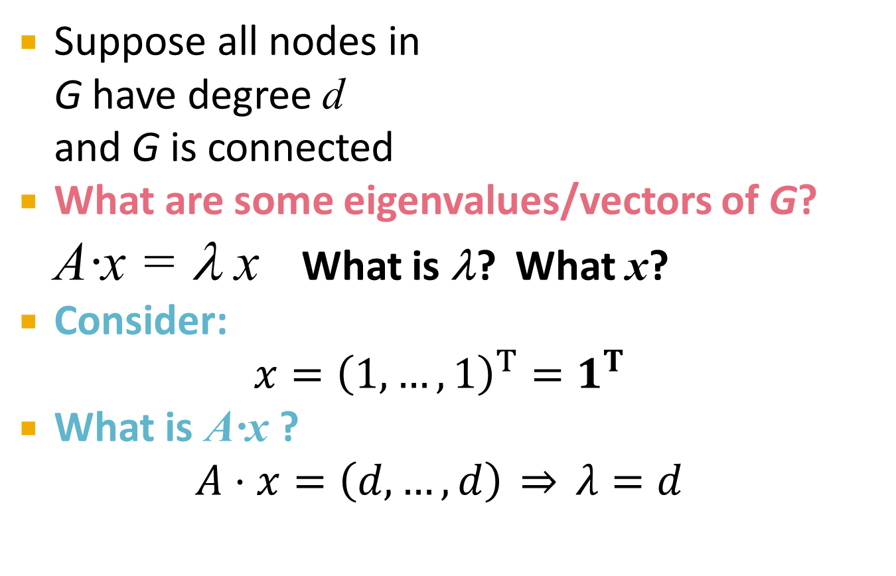
Example: d-regular Graph
Suppose all nodes in G have degree d and G is connected
What are some eigenvalues/vectors of G?
A·x = λ x What is λ? What x?
Consider: $x={\left(1,…,1\right)}^{T}=1^{T}$
What is A·x ? $A⋅x=\left(d,…,d\right) \overset{⇒}{} λ=d$

Slide 36

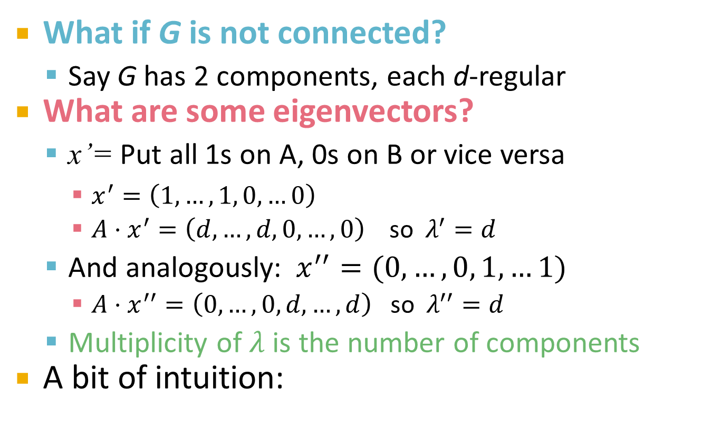

Example: Graph on 2 Components
What if G is not connected?
Say G has 2 components, each d-regular
What are some eigenvectors?
x’= Put all 1s on A, 0s on B or vice versa
$x^{′}=\left(1,…,1, 0,…0\right)$
$A⋅x^{′}=\left(d,…,d, 0, …, 0\right)$ so $λ^{′}=d$
And analogously: $x^{′′}=(0,…,0, 1,…1)$
$A⋅x^{′′}=\left(0,…,0, d, …, d\right)$ so $λ^{′′}=d$
Multiplicity of $λ$ is the number of components
A bit of intuition:
A
B
$$λ_{1}=λ_{2}$$
$$λ_{1}≈λ_{2}$$

Slide 37
Matrix Representations
Adjacency matrix (A):
n× n matrix
A=[a_{ij}], a_{ij}=1 if edge between node i and j
Important properties:
Symmetric matrix
Eigenvectors are real and orthogonal
 | 1 | 2 | 3 | 4 | 5 | 6
1 | 0 | 1 | 1 | 0 | 1 | 0
2 | 1 | 0 | 1 | 0 | 0 | 0
3 | 1 | 1 | 0 | 1 | 0 | 0
4 | 0 | 0 | 1 | 0 | 1 | 1
5 | 1 | 0 | 0 | 1 | 0 | 1
6 | 0 | 0 | 0 | 1 | 1 | 0
1
5
2
6
4
3

Slide 38
Matrix Representations
Degree matrix (D):
n× n diagonal matrix
D=[d_{ii}], d_{ii} = degree of node i
 | 1 | 2 | 3 | 4 | 5 | 6
1 | 3 | 0 | 0 | 0 | 0 | 0
2 | 0 | 2 | 0 | 0 | 0 | 0
3 | 0 | 0 | 3 | 0 | 0 | 0
4 | 0 | 0 | 0 | 3 | 0 | 0
5 | 0 | 0 | 0 | 0 | 3 | 0
6 | 0 | 0 | 0 | 0 | 0 | 2
1
5
2
6
4
3

Slide 39
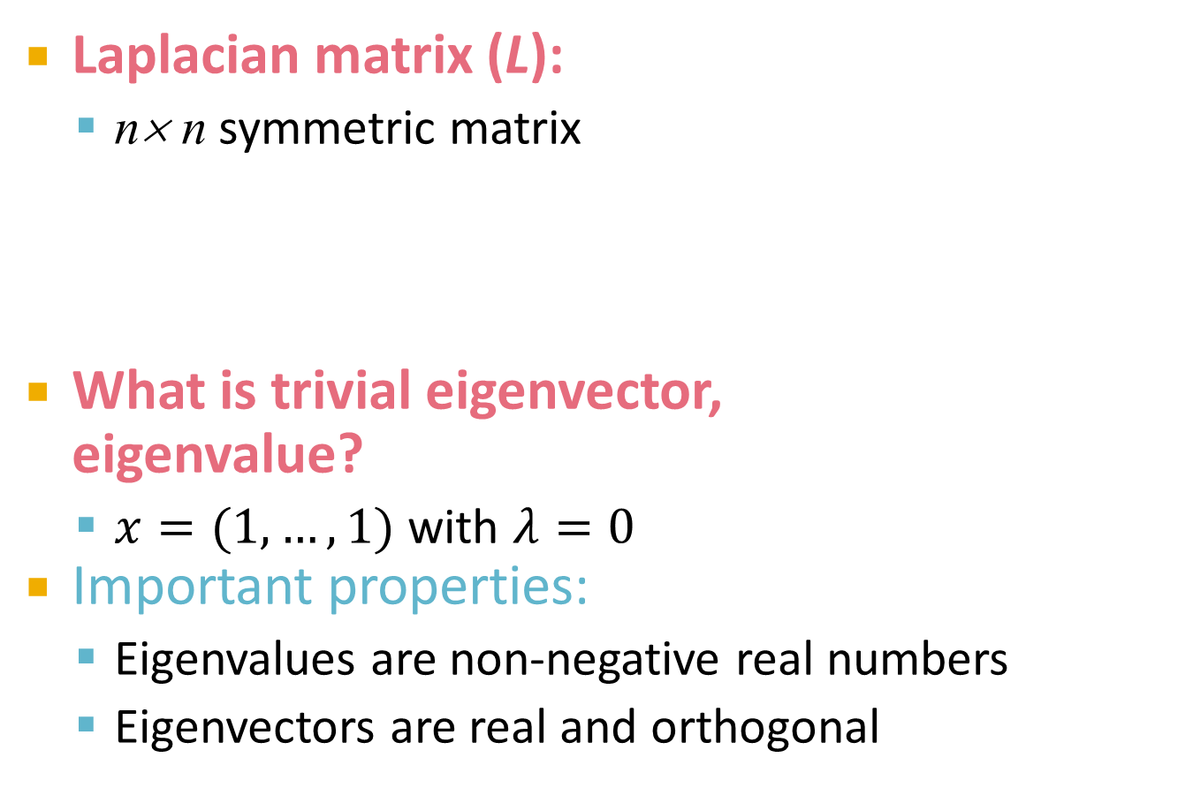
Matrix Representations
 | 1 | 2 | 3 | 4 | 5 | 6
1 | 3 | -1 | -1 | 0 | -1 | 0
2 | -1 | 2 | -1 | 0 | 0 | 0
3 | -1 | -1 | 3 | -1 | 0 | 0
4 | 0 | 0 | -1 | 3 | -1 | -1
5 | -1 | 0 | 0 | -1 | 3 | -1
6 | 0 | 0 | 0 | -1 | -1 | 2
Laplacian matrix (L):
n× n symmetric matrix
What is trivial eigenvector, eigenvalue?
$x=(1,…,1)$ with $λ=0$
Important properties:
Eigenvalues are non-negative real numbers
Eigenvectors are real and orthogonal
1
5
2
6
4
3
L = D - A

Slide 40
Overview
Here is what we will do next:
We just saw that L has eigenvalue 0 and eigenvector (1,…,1)
Now the question is, what is lambda2 doing?
We will see that eigenvector that corresponds to lambda2 really does community detection
It tries to separate nodes on the left and on the right of zero so that the minimum number of edges points across zero
Give a picture of the embedding and how it has to sum to zero and have unit lenght

Slide 41
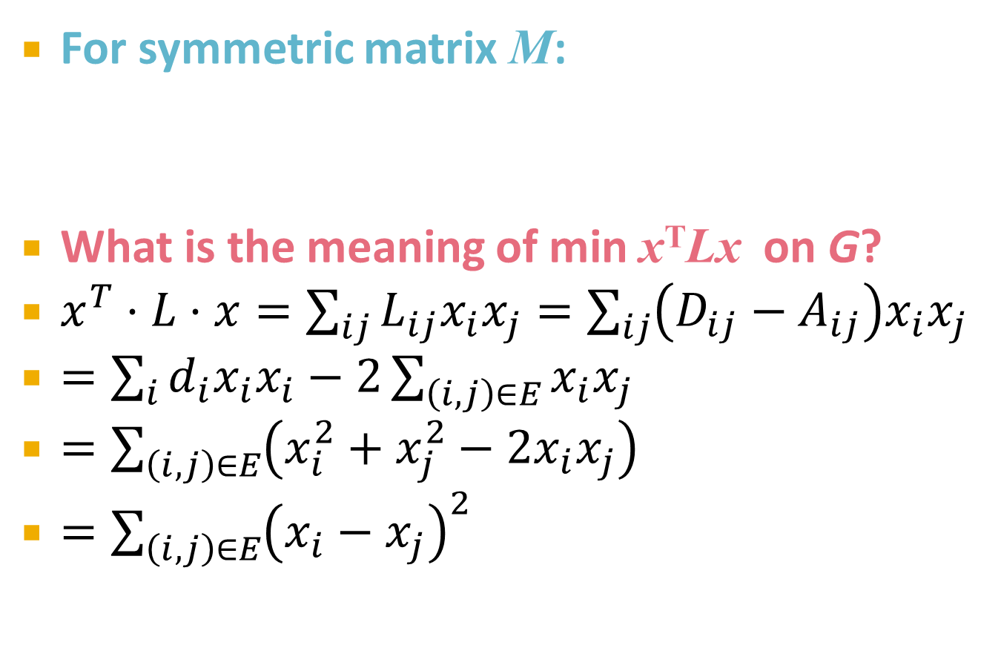
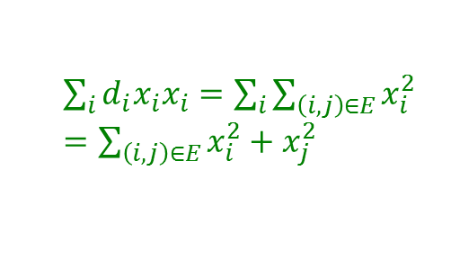
λ₂ as an Optimization Problem
Say that really each eigne pairs is a solution to the above equestion:
-- I want smallest possible eigenvalue and a vector that is orthogonal to everty other one and has length 1
For symmetric matrix M:
What is the meaning of min x^{T}Lx on G?
$x^{T}⋅L⋅x=\sum_{ij}{L_{ij}x_{i}x_{j}}=\sum_{ij}{\left(D_{ij}−A_{ij}\right)x_{i}x_{j}}$
$=\sum_{i}{d_{i}x_{i}x_{i}}−2\sum_{\left(i,j\right)∈E}{x_{i}x_{j}}$
$=\sum_{\left(i,j\right)∈E}{\left(x_{i}^{2}+x_{j}^{2}−2x_{i}x_{j}\right)}$
$=\sum_{\left(i,j\right)∈E}{{\left(x_{i}−x_{j}\right)}^{2}}$
x_{i}
x_{j}
$\sum_{i}{d_{i}x_{i}x_{i}}=\sum_{i}{\sum_{\left(i,j\right)∈E}{x_{i}^{2}}}$
$=\sum_{\left(i,j\right)∈E}{x_{i}^{2}+x_{j}^{2}}$
Think of x_{i} as a numeric value of node i Then we want so set values x_{i} such that they don’t differ across the edges

Slide 42
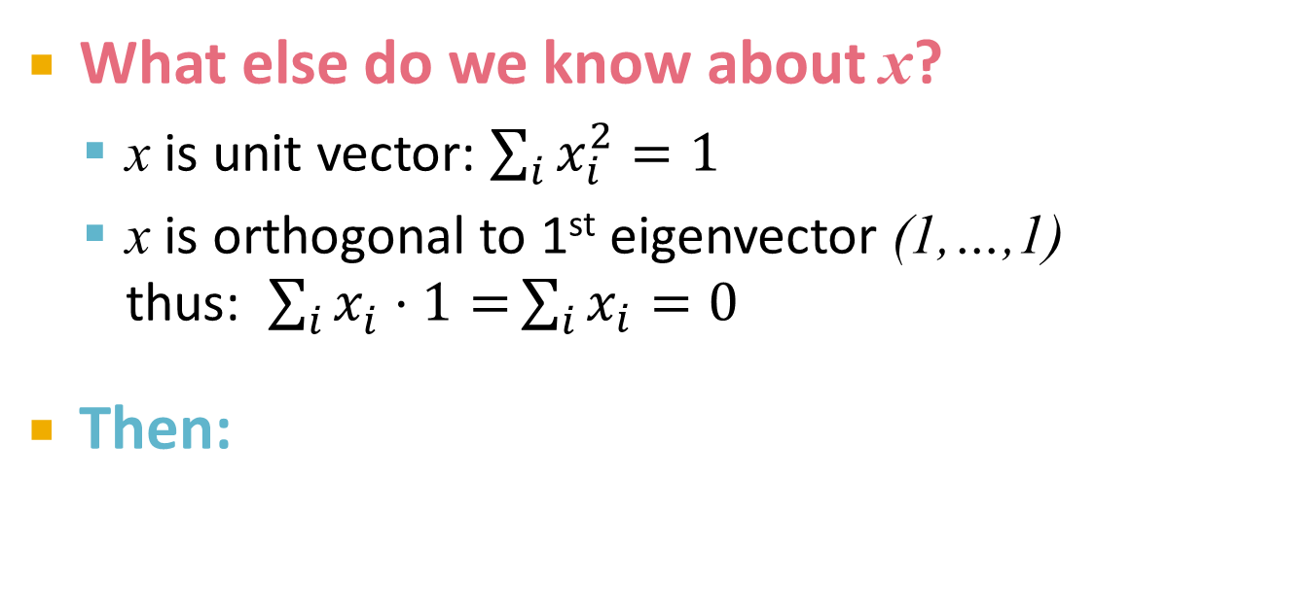
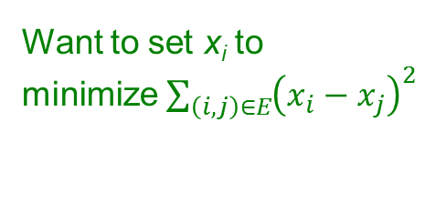
λ₂ as an Optimization Problem
What else do we know about x?
x is unit vector: $\sum_{i}{x_{i}^{2}=1}$
x is orthogonal to 1st eigenvector (1,…,1) thus: $\sum_{i}{x_{i}^{}⋅1=}\sum_{i}{x_{i}}=0$
Then:
All labelings of nodes so that Σ_{i} x_{i} = 0
1
5
Want to set x_{i} to minimize $\sum_{\left(i,j\right)∈E}{{\left(x_{i}−x_{j}\right)}^{2}}$
2
6
4
3

Slide 43
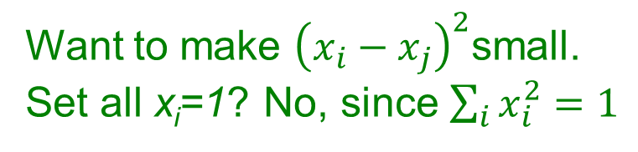
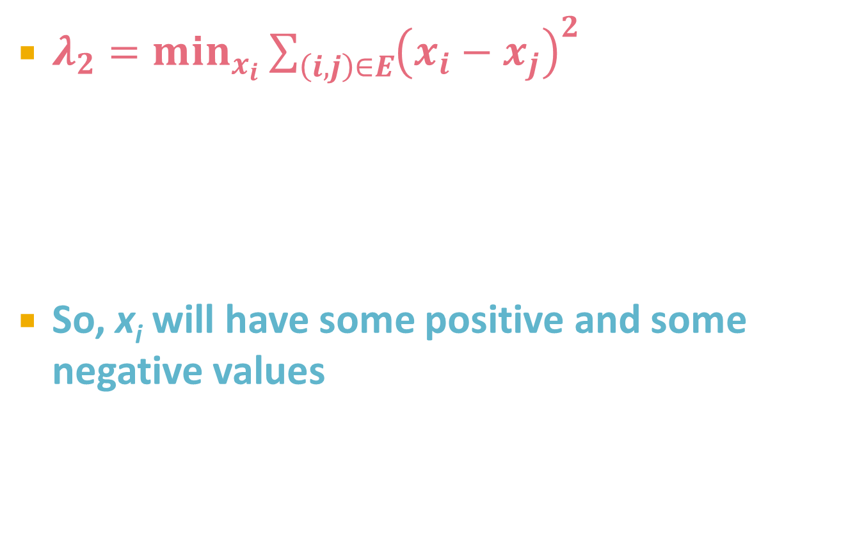
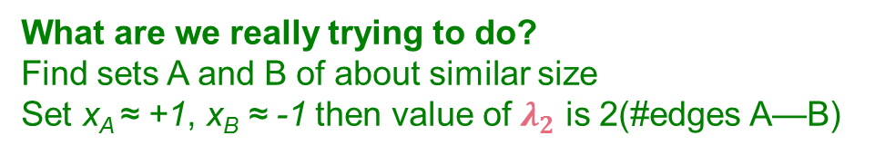
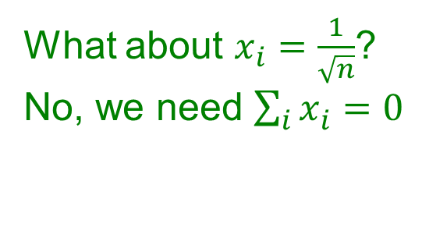
λ₂ as an Optimization Problem
$λ_{2}=\min_{x_{i}}{\sum_{\left(i,j\right)∈E}{{\left(x_{i}−x_{j}\right)}^{2}}}$
So, x_{i} will have some positive and some negative values
Want to make ${\left(x_{i}−x_{j}\right)}^{2}$small. Set all x_{i}=1? No, since $\sum_{i}{x_{i}^{2}=1}$
1
5
2
6
4
What about $x_{i}=\frac{1}{\sqrt{n}}$? No, we need $\sum_{i}{x_{i}^{}=0}$
3
A
B
What are we really trying to do? Find sets A and B of about similar size Set x_{A} ≈ +1, x_{B} ≈ -1 then value of $λ_{2}$ is 2(#edges A—B)

Slide 44
*****Notes from 2012******
Make sure you tell people what lambda_2 will be useful for finding communities
Proving the trawling result was useful but again make sure to give an intro about what are we going to do – pigeon hole principle, buckets, size of buckets, one bucket must be too big
There was questions that we proved G-->K_st exists, but we would like the proof to go the other way
Answer: we want to remove false negatives, having a few false positives we can also go and remove them later
NEXT YEAR: skip the trawling proof and this way I will be able to cover spectral clustering completely

Slide 45
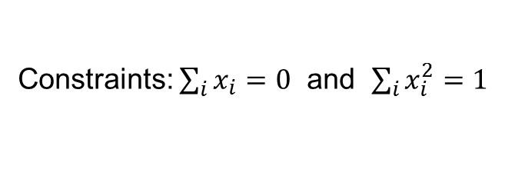
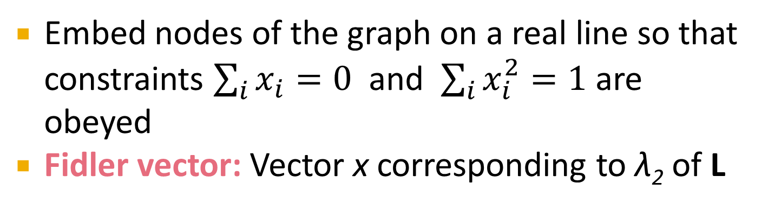
λ₂ as an Optimization Problem
ℜ
0
Constraints: $\sum_{i}{x_{i}=0}$ and $\sum_{i}{x_{i}^{2}=1}$
Embed nodes of the graph on a real line so that constraints $\sum_{i}{x_{i}=0}$ and $\sum_{i}{x_{i}^{2}=1}$ are obeyed
Fidler vector: Vector x corresponding to λ₂ of L

Slide 46
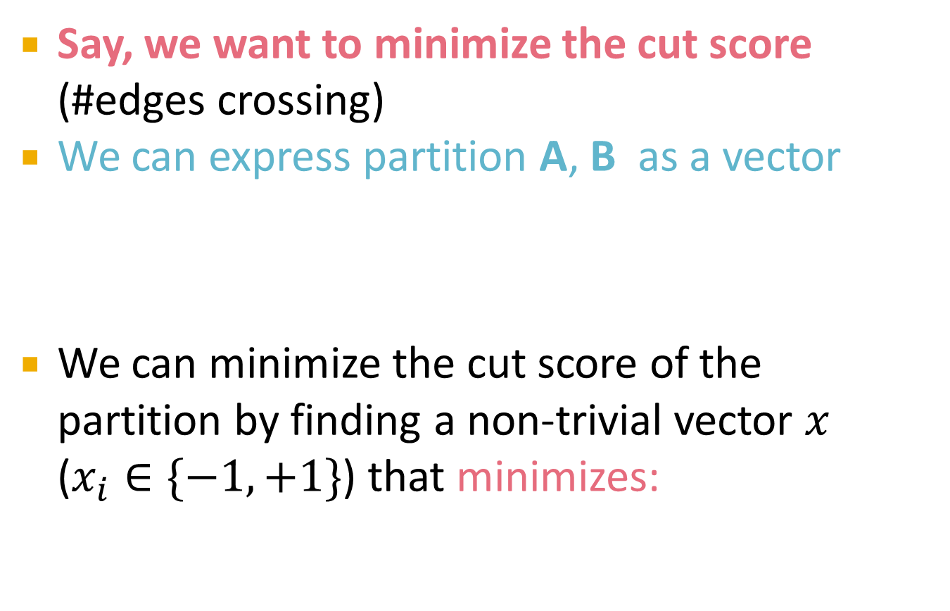
Finding the Optimal Cut
Say, we want to minimize the cut score (#edges crossing)
We can express partition A, B as a vector
We can minimize the cut score of the partition by finding a non-trivial vector $x$ ($x_{i}∈\{−1,+1\}$) that minimizes:
A
B
Looks like our equation for λ₂!

Slide 47
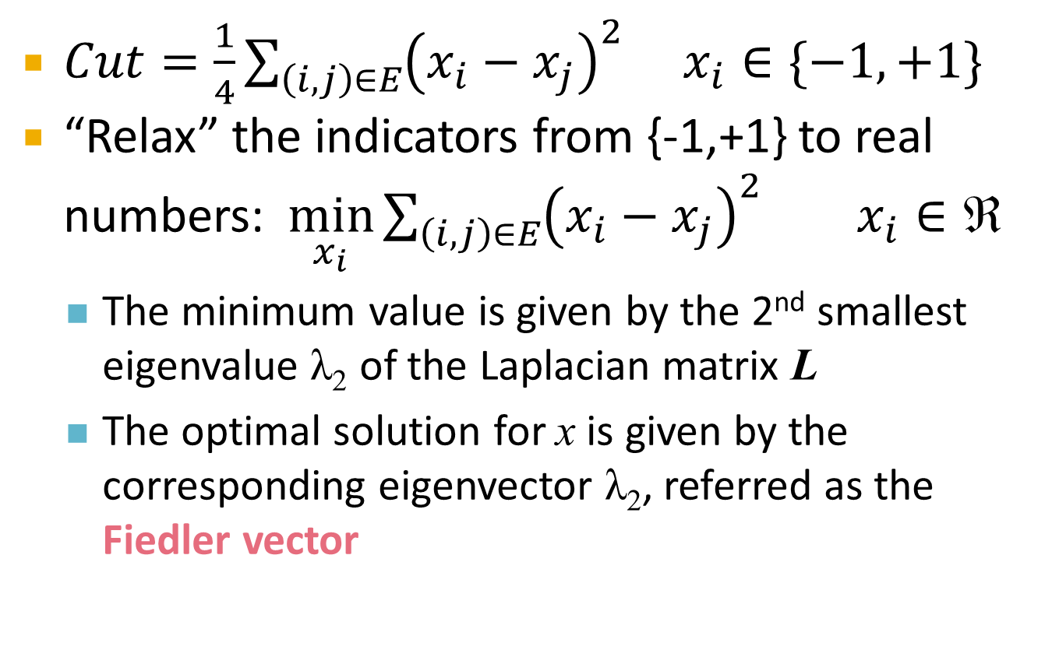
Optimal Cut and λ₂
$Cut=\frac{1}{4}\sum_{\left(i,j\right)∈E}{{\left(x_{i}−x_{j}\right)}^{2}}$ $x_{i}∈\{−1,+1\}$
“Relax” the indicators from {-1,+1} to real numbers: $\min_{x_{i}}{\sum_{\left(i,j\right)∈E}{{\left(x_{i}−x_{j}\right)}^{2}}}$ $x_{i}∈\text{ℜ}$
The minimum value is given by the 2nd smallest eigenvalue λ₂ of the Laplacian matrix L
The optimal solution for x is given by the corresponding eigenvector λ₂, referred as the Fiedler vector
To learn more: A Tutorial on Spectral Clustering by U. von Luxburg

Slide 48
So far…
How to define a “good” partition of a graph?
Minimize a given graph cut criterion
How to efficiently identify such a partition?
Approximate using information provided by the eigenvalues and eigenvectors of a graph
Spectral Clustering

Slide 49
Spectral Clustering Algorithms
Three basic stages:
Pre-processing
Construct a matrix representation of the graph
Decomposition
Compute eigenvalues and eigenvectors of the matrix
Map each point to a lower-dimensional representation based on one or more eigenvectors
Grouping
Assign points to two or more clusters, based on the new representation

Slide 50
Spectral Partitioning Algorithm
 | 1 | 2 | 3 | 4 | 5 | 6
1 | 3 | -1 | -1 | 0 | -1 | 0
2 | -1 | 2 | -1 | 0 | 0 | 0
3 | -1 | -1 | 3 | -1 | 0 | 0
4 | 0 | 0 | -1 | 3 | -1 | -1
5 | -1 | 0 | 0 | -1 | 3 | -1
6 | 0 | 0 | 0 | -1 | -1 | 2
Pre-processing:
Build Laplacian matrix L of the graph
Decomposition:
Find eigenvalues λ and eigenvectors x of the matrix L
Map vertices to corresponding components of λ₂
0.0
0.4
0.3
-0.5
-0.2
-0.4
-0.5
1.0
0.4
0.6
0.4
-0.4
0.4
0.0
λ=
3.0
X =
0.4
0.3
0.1
0.6
-0.4
0.5
3.0
0.4
-0.3
0.1
0.6
0.4
-0.5
4.0
0.4
-0.3
-0.5
-0.2
0.4
0.5
5.0
0.4
-0.6
0.4
-0.4
-0.4
0.0
1
0.3
2
0.6
3
0.3
How do we now find clusters?
4
-0.3
5
-0.3
6
-0.6

Slide 51
Spectral Partitioning
Grouping:
Sort components of reduced 1-dimensional vector
Identify clusters by splitting the sorted vector in two
How to choose a splitting point?
Naïve approaches:
Split at 0, (or mean or median value)
More expensive approaches:
Attempt to minimize normalized cut criterion in 1-dim
1
0.3
Split at 0:
Cluster A: Positive points
Cluster B: Negative points
A
B
2
0.6
3
0.3
4
-0.3
1
0.3
4
-0.3
5
-0.3
2
0.6
5
-0.3
6
-0.6
3
0.3
6
-0.6

Slide 52
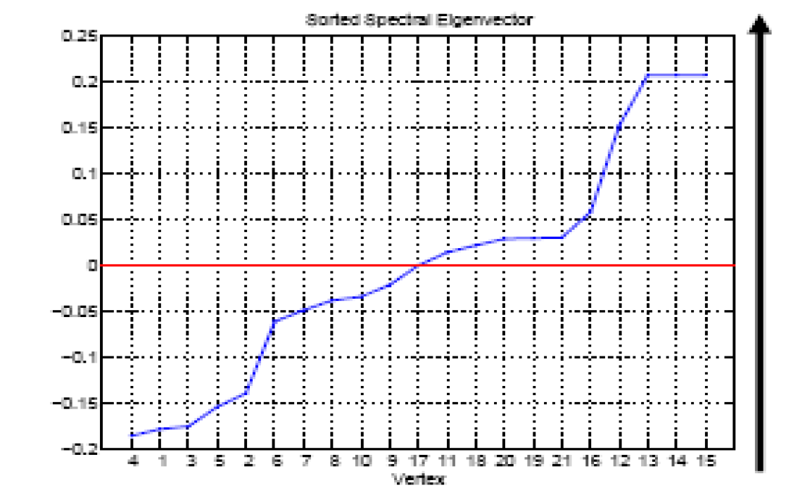
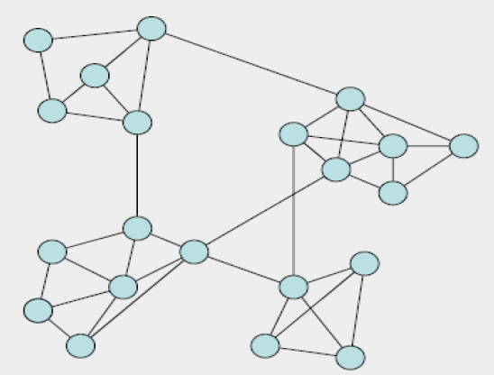
Example: Spectral Partitioning

Slide 53
K-Way Spectral Clustering
How do we partition a graph into k clusters?
Two basic approaches:
Recursive bi-partitioning [Hagen et al., ’92]
Recursively apply bi-partitioning algorithm in a hierarchical divisive manner
Disadvantages: Inefficient, unstable
Cluster multiple eigenvectors [Shi-Malik, ’00]
Build a reduced space from multiple eigenvectors
Node i is described by its k eigenvector components (x_{2,i}, x_{3,i}, …, x_{k,i})
Use k-means to cluster the points
A preferable approach…

Slide 54
How to select k?
Eigengap:
The difference between two consecutive eigenvalues
Most stable clustering is generally given by the value k that maximizes the eigengap
Example:
λ₁
λ₂
Choose k=2

Slide 55
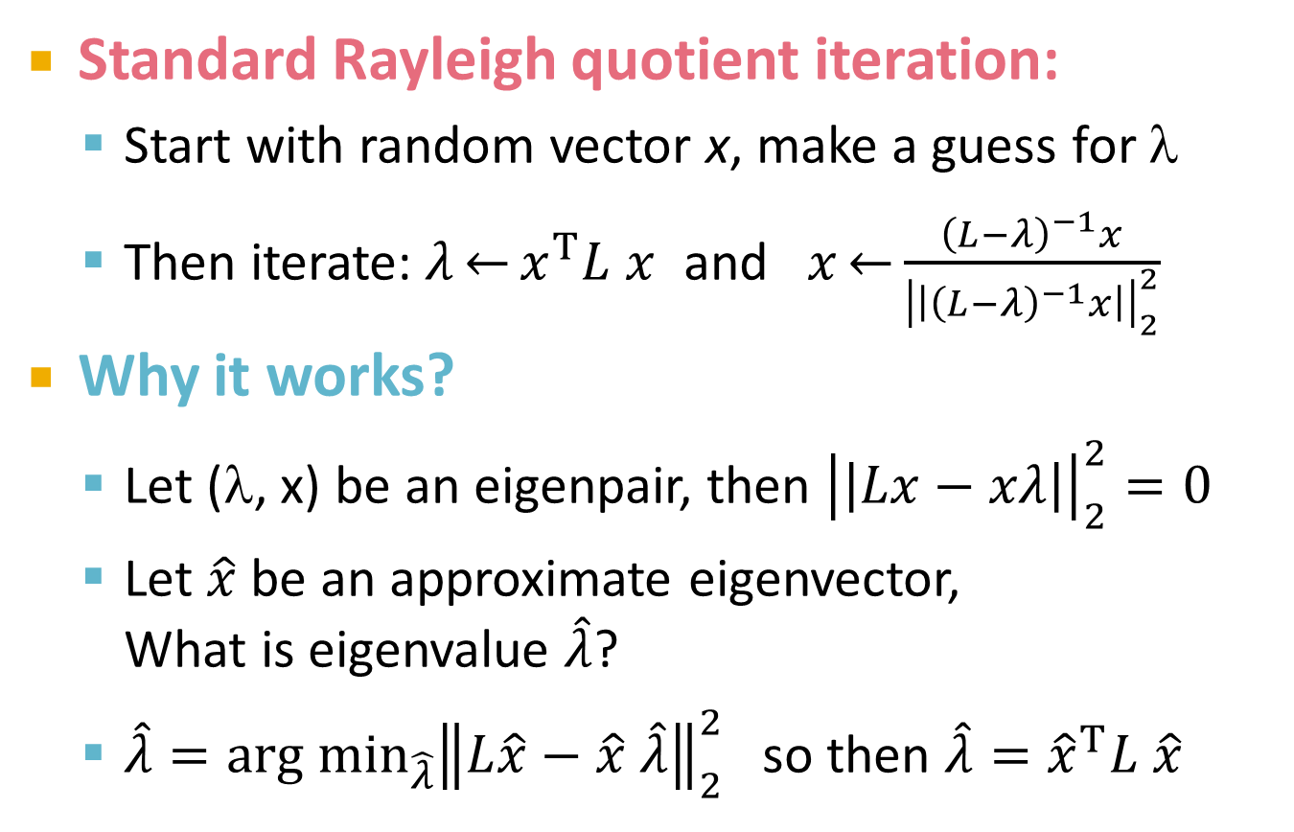
How to compute λ₂?
Standard Rayleigh quotient iteration:
Start with random vector x, make a guess for λ
Then iterate:$λ\overset{←}{}x^{T}L x$ and $x\overset{←}{}\frac{{\left(L−λ\right)}^{−1}x}{{\left|\left|{\left(L−λ\right)}^{−1}x\right|\right|}_{2}^{2}}$
Why it works?
Let (λ, x) be an eigenpair, then ${\left|\left|Lx−xλ\right|\right|}_{2}^{2}=0$
Let $\hat{x}$ be an approximate eigenvector, What is eigenvalue $\hat{λ}$?
$\hat{λ}=\underset{\hat{λ}}{arg min}{{\left\|L\hat{x}−\hat{x} \hat{λ}\right\|}_{2}^{2}}$ so then $\hat{λ}={\hat{x}}^{T}L \hat{x}$

Slide 56
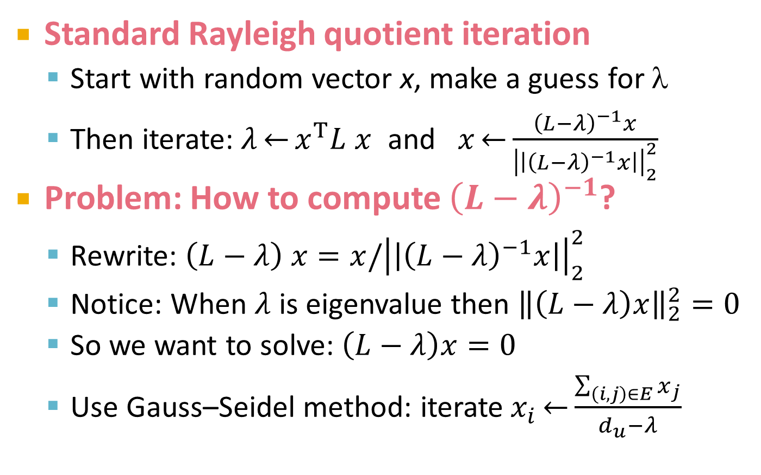
How to compute λ₂?
Standard Rayleigh quotient iteration
Start with random vector x, make a guess for λ
Then iterate:$λ\overset{←}{}x^{T}L x$ and $x\overset{←}{}\frac{{\left(L−λ\right)}^{−1}x}{{\left|\left|{\left(L−λ\right)}^{−1}x\right|\right|}_{2}^{2}}$
Problem: How to compute ${\left(L−λ\right)}^{−1}$?
Rewrite: $\left(L−λ\right) x=x/{\left|\left|{\left(L−λ\right)}^{−1}x\right|\right|}_{2}^{2}$
Notice: When $λ$ is eigenvalue then ${\left\|\left(L−λ\right)x\right\|}_{2}^{2}=0$
So we want to solve: $\left(L−λ\right)x=0$
Use Gauss–Seidel method: iterate$x_{i}\overset{←}{}\frac{\sum_{\left(i,j\right)∈E}{x_{j}}}{d_{u}−λ}$

Slide 57
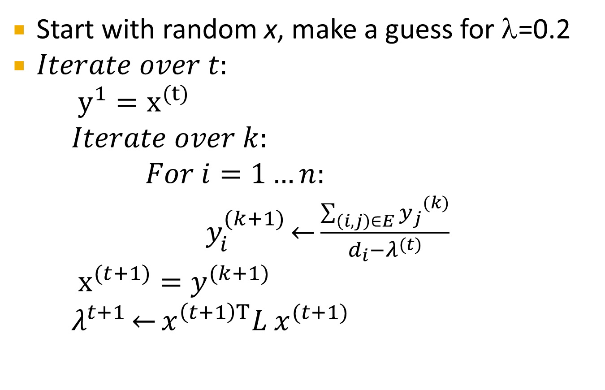
How to compute λ₂? Summary
Start with random x, make a guess for λ=0.2
$Iterate over t:$
$y^{1}=x^{(t)}$
$Iterate over k:$
$For i=1…n:$
$y_{i}^{(k+1)}\overset{←}{}\frac{{\sum_{\left(i,j\right)∈E}{y_{j}}}^{(k)}}{d_{i}−λ^{(t)}}$
$x^{(t+1)}=y^{(k+1)}$
$λ^{t+1}\overset{←}{}x^{\left(t+1\right)T}L x^{(t+1)}$

Slide 58
Why use multiple eigenvectors?
Approximates the optimal cut [Shi-Malik, ’00]
Can be used to approximate the optimal k-way normalized cut
Emphasizes cohesive clusters
Increases the unevenness in the distribution of the data
Associations between similar points are amplified, associations between dissimilar points are attenuated
The data begins to “approximate a clustering”
Well-separated space
Transforms data to a new “embedded space”, consisting of k orthogonal basis vectors

Slide 59
Many other partitioning methods
METIS:
Heuristic but works really well in practice
http://glaros.dtc.umn.edu/gkhome/views/metis
Graclus:
Based on kernel k-means
http://www.cs.utexas.edu/users/dml/Software/graclus.html
Cluto:
http://glaros.dtc.umn.edu/gkhome/views/cluto/

Slide 60
*****Notes from 2012******

Slide 61
k-Eigenvector Clustering
k-eigenvector Algorithm [Ng et al.,’01]
Pre-processing:
Construct the scaled adjacency matrix A':
Decomposition:
Find the eigenvalues and eigenvectors of A'
Build embedded space from the eigenvectors corresponding to the k largest eigenvalues
Grouping:
Apply k-means to reduced n×k space to get k clusters

