Slide 1
Dimensionality Reduction

Slide 2
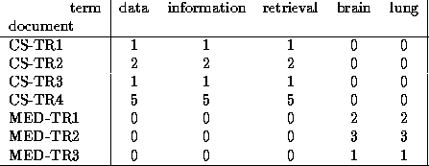
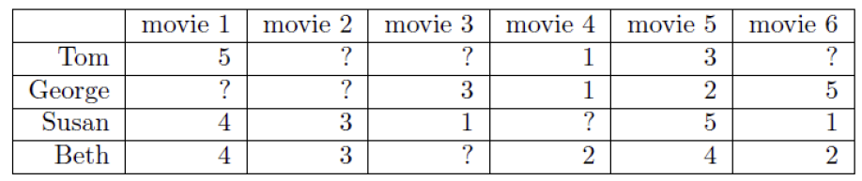
Dimensionality Reduction
High-dimensional == many features
Find concepts/topics/genres:
  Documents:
    Features: Thousands of words, millions of word pairs
  Surveys – Netflix: 480k users x 177k movies

Slide 3
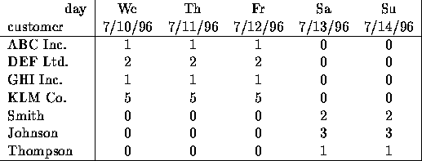
Dimensionality Reduction
Compress / reduce dimensionality:
  10⁶ rows; 10³ columns; no updates
  random access to any cell(s); small error: OK

Slide 4
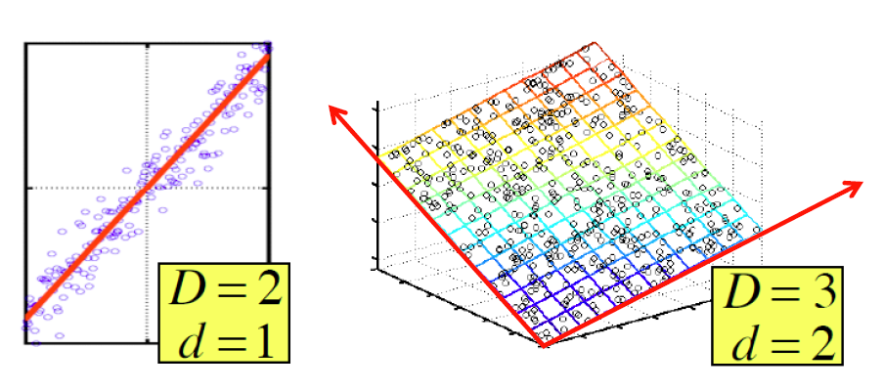
Dimensionality Reduction
Assumption: Data lies on or near a low
d-dimensional subspace
Axes of this subspace are effective representation of the data

Slide 5
Why Reduce Dimensions?
Why reduce dimensions?
Discover hidden correlations/topics
  Words that occur commonly together
Remove redundant and noisy features
  Not all words are useful
Interpretation and visualization
Easier storage and processing of the data

Slide 6
SVD - Definition
A_{[m x n]} = U_{[m x r]} Σ _{[ r x r]} (V_{[n x r]})^{T}
A: Input data matrix
  m x n matrix (e.g., m documents, n terms)
U: Left singular vectors
  m x r matrix (m documents, r concepts)
Σ: Singular values
  r x r diagonal matrix (strength of each ‘concept’)
  (r : rank of the matrix A)
V: Right singular vectors
  n x r matrix (n terms, r concepts)

Slide 7
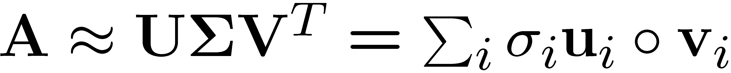
SVD
T
n
n
A
≈
Σ
V^{T}
m
m
U

Slide 8
SVD
T
n
σ₁u₁v₁
σ₂u₂v₂
A
≈
m
+
σ_{i} … scalar
u_{i} … vector
v_{i} … vector

Slide 9
SVD - Properties
It is always possible to decompose a real
matrix A into A = U Σ V^{T} , where
U, Σ, V: unique
U, V: column orthonormal:
  U^{T} U = I; V^{T} V = I (I: identity matrix)
  (Cols. are orthogonal unit vectors)
Σ: diagonal
  Entries (singular values) are positive,
  and sorted in decreasing order (σ₁ ≥ σ₂ ≥ ... ≥ 0)

Slide 10
SVD – Example: Users-to-Movies
A = U Σ V^{T} - example:
Matrix
Alien
Serenity
Casablanca
Amelie
SciFi
=
x
x
Romnce

Slide 11
SVD – Example: Users-to-Movies
A = U Σ V^{T} - example:
Matrix
Alien
Serenity
Casablanca
Amelie
SciFi-concept
Romance-concept
SciFi
=
x
x
Romnce

Slide 12
SVD - Example
U is “user-to-concept”
similarity matrix
A = U Σ V^{T} - example:
Matrix
Alien
Serenity
Casablanca
Amelie
SciFi-concept
Romance-concept
SciFi
=
x
x
Romnce

Slide 13
SVD - Example
A = U Σ V^{T} - example:
Matrix
Alien
Serenity
Casablanca
Amelie
‘strength’ of SciFi-concept
SciFi
=
x
x
Romnce

Slide 14
SVD - Example
A = U Σ V^{T} - example:
Matrix
Alien
Serenity
Casablanca
Amelie
V is “movie-to-concept”
similarity matrix
SciFi-concept
SciFi
=
x
x
Romnce

Slide 15
SVD - Example
A = U Σ V^{T} - example:
Matrix
Alien
Serenity
Casablanca
Amelie
V is “movie-to-concept”
similarity matrix
SciFi-concept
SciFi
=
x
x
Romnce

Slide 16
SVD - Interpretation #1
‘movies’, ‘users’ and ‘concepts’:
U: user-to-concept similarity matrix
V: movie-to-concept sim. matrix
Σ: its diagonal elements:
‘strength’ of each concept

Slide 17
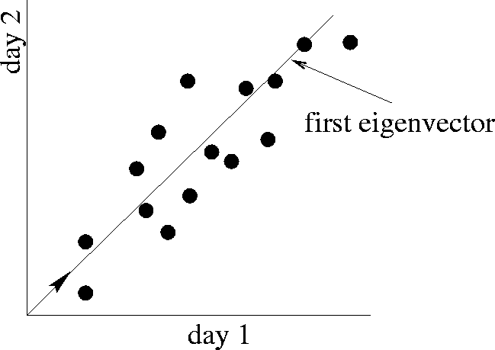
SVD - interpretation #2
SVD gives best axis to project on:
‘best’ = min sum of squares of projection errors
minimum reconstruction error
Movie 2 rating
first right
singular vector
v₁
Movie 1 rating

Slide 18
SVD - Interpretation #2
A = U Σ V^{T} - example:
first right
singular vector
Movie 2 rating
v₁
Movie 1 rating
=
x
x
v₁

Slide 19
SVD - Interpretation #2
A = U Σ V^{T} - example:
variance (‘spread’)
on the v₁ axis
=
x
x

Slide 20
SVD - Interpretation #2
More details
Q: How exactly is dim. reduction done?
=
x
x

Slide 21
SVD - Interpretation #2
More details
Q: How exactly is dim. reduction done?
A: Set the smallest singular values to zero
=
x
x
A=

Slide 22
SVD - Interpretation #2
More details
Q: How exactly is dim. reduction done?
A: Set the smallest singular values to zero
~
x
x
A=

Slide 23
SVD - Interpretation #2
More details
Q: How exactly is dim. reduction done?
A: Set the smallest singular values to zero:
~
x
x
A=

Slide 24
SVD - Interpretation #2
More details
Q: How exactly is dim. reduction done?
A: Set the smallest singular values to zero:
~
x
x
A=

Slide 25
SVD - Interpretation #2
More details
Q: How exactly is dim. reduction done?
A: Set the smallest singular values to zero
B=
Frobenius norm:
ǁMǁ_{F} = Σ_{ij} M_{ij}²
~
A=
ǁA-Bǁ_{F} = Σ_{ij} (A_{ij}-B_{ij})²
^{is “small”}

Slide 26
A
U
Sigma
=
V^{T}
B is approx A
B
U
Sigma
=
V^{T}

Slide 27
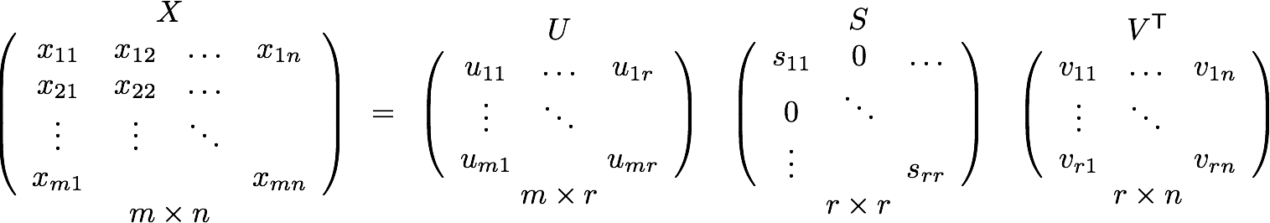
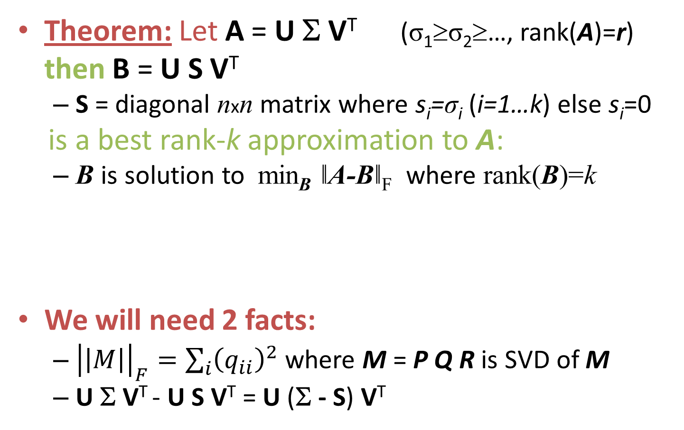



SVD – Best Low Rank Approx.
Theorem: Let A = U Σ V^{T} (σ₁≥σ₂≥…, rank(A)=r)
then B = U S V^{T}
  S = diagonal nxn matrix where s_{i}=σ_{i} (i=1…k) else s_{i}=0
is a best rank-k approximation to A:
  B is solution to min_{B} ǁA-Bǁ_{F} where rank(B)=k
We will need 2 facts:
  ${\left|\left|M\right|\right|}_{F}=\sum_{i}{{\left(q_{ii}\right)}^{2}}$ where M = P Q R is SVD of M
  U Σ V^{T} - U S V^{T} = U (Σ - S) V^{T}
$$Σ$$
$$σ_{11}$$
$$σ_{rr}$$

Slide 28
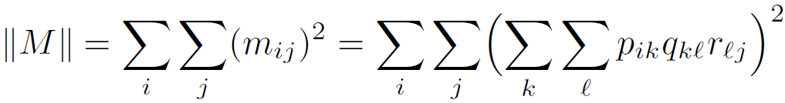


SVD – Best Low Rank Approx.
We will need 2 facts:
  ${\left|\left|M\right|\right|}_{F}=\sum_{k}{{\left(q_{kk}\right)}^{2}}$ where M = P Q R is SVD of M
  U Σ V^{T} - U S V^{T} = U (Σ - S) V^{T}
We apply:
-- P column orthonormal
-- R row orthonormal
-- Q is diagonal
Notes:
Drop summations
USV – UXV = U-U(SV-XV)
AXC –AYC = (AC)(X-Y)

Slide 29

SVD – Best Low Rank Approx.
A = U Σ V^{T} , B = U S V^{T} (σ₁≥σ₂≥… ≥ 0, rank(A)=r)
  S = diagonal nxn matrix where s_{i}=σ_{i} (i=1…k) else s_{i}=0
then B is solution to min_{B} ǁA-Bǁ_{F} , rank(B)=k
Why?
We want to choose s_{i} to minimize $\sum_{i}{{\left(σ_{i}−s_{i}\right)}^{2}}$
we set s_{i}=σ_{i} (i=1…k) else s_{i}=0
  U Σ V^{T} - U S V^{T} = U (Σ - S) V^{T}
Notes:
USV – UXV = U-U(SV-XV)
AXC –AYC = (A-A)(XC-YC)
5 2 4 – 5 3 4
40-60 = 20

Slide 30
SVD - Interpretation #2
Equivalent:
‘spectral decomposition’ of the matrix:
x
σ₁
x
=
u₁
u₂
σ₂
v₁
v₂

Slide 31
SVD - Interpretation #2
Equivalent:
‘spectral decomposition’ of the matrix
m
k terms
=
σ₁
u₁
v^{T}₁
+
σ₂
u₂
v^{T}₂
+...
n x 1
1 x m
n
Assume: σ₁ ≥ σ₂ ≥ σ₃ ≥ ... ≥ 0
Why is setting small σs the thing to do?
Vectors u_{i} and v_{i} are unit length, so σ_{i} scales them.
So, zeroing small σs introduces less error.

Slide 32
SVD - Interpretation #2
Q: How many σs to keep?
A: Rule-of-a thumb:
keep 80-90% of ‘energy’ (=∑σ_{i}²)
m
=
σ₁
u₁
v^{T}₁
+
σ₂
u₂
v^{T}₂
+...
n
assume: σ₁ ≥ σ₂ ≥ σ₃ ≥ ...

Slide 33
SVD - Complexity
To compute SVD:
  O(nm²) or O(n²m) (whichever is less)
But:
  Less work, if we just want singular values
  or if we want first k singular vectors
  or if the matrix is sparse
Implemented in linear algebra packages like
  LINPACK, Matlab, SPlus, Mathematica ...

Slide 34
SVD - Conclusions so far
SVD: A= U Σ V^{T}: unique
  U: user-to-concept similarities
  V: movie-to-concept similarities
  Σ : strength of each concept
Dimensionality reduction:
  keep the few largest singular values
  (80-90% of ‘energy’)
  SVD: picks up linear correlations

Slide 35
Case study: How to query?
Q: Find users that like ‘Matrix’ and ‘Alien’
Matrix
Alien
Serenity
Casablanca
Amelie
SciFi
=
x
x
Romnce

Slide 36
Case study: How to query?
Q: Find users that like ‘Matrix’
A: Map query into a ‘concept space’ – how?
Matrix
Alien
Serenity
Casablanca
Amelie
SciFi
=
x
x
Romnce

Slide 37
Case study: How to query?
Q: Find users that like ‘Matrix’
A: map query vectors into ‘concept space’ – how?
Matrix
Alien
Serenity
Casablanca
Amelie
Alien
q
q=
v2
v1
Project into concept space:
Inner product with each
‘concept’ vector v_{i}
Matrix

Slide 38
Case study: How to query?
Q: Find users that like ‘Matrix’
A: map the vector into ‘concept space’ – how?
Matrix
Alien
Serenity
Casablanca
Amelie
Alien
q
q=
v2
v1
q*v₁
Project into concept space:
Inner product with each
‘concept’ vector v_{i}
Matrix

Slide 39
Case study: How to query?
Compactly, we have:
q_{concept} = q V
E.g.:
Matrix
Alien
Serenity
Casablanca
Amelie
SciFi-concept
=
q=
movie-to-concept
similarities

Slide 40
Case study: How to query?
How would the user d that rated
(‘Alien’, ‘Serenity’) be handled?
d_{concept} = d V
E.g.:
Matrix
Alien
Serenity
Casablanca
Amelie
SciFi-concept
=
d=
movie-to-concept
similarities

Slide 41
Case study: How to query?
Observation: User d that rated (‘Alien’, ‘Serenity’) will be similar to query “user” q that rated (‘Matrix’), although d did not rate ‘Matrix’!
Matrix
Alien
Serenity
Casablanca
Amelie
SciFi-concept
d=
q=
Similarity = 0
Similarity ≠ 0

Slide 42
SVD: Drawbacks
Optimal low-rank approximation:
  in Frobenius norm
Interpretability problem:
  A singular vector specifies a linear
  combination of all input columns or rows
Lack of sparsity:
  Singular vectors are dense!
V^{T}
Σ
=
U

