Slide 1
Recommender Systems: Content-based Systems & Collaborative Filtering

Slide 2
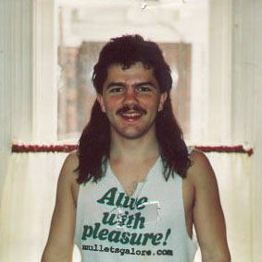
Example: Recommender Systems
Customer X
Buys Metalica CD
Buys Megadeth CD
Customer Y
Does search on Metalica
Recommender system suggests Megadeth from data collected from customer X

Slide 3










Recommendations
Examples:
Search
Recommendations
Items
Products, web sites, blogs, news items, …

Slide 4
From Scarcity to Abundance
Shelf space is a scarce commodity for traditional retailers
Also: TV networks, movie theaters,…
Web enables near-zero-cost dissemination of information about products
From scarcity to abundance
More choice necessitates better filters
Recommendation engines
How Into Thin Air made Touching the Void a bestseller:
http://www.wired.com/wired/archive/12.10/tail.html
Notes:
In 1988, a British mountain climber named Joe Simpson wrote a book called Touching the Void, a harrowing account of near death in the Peruvian Andes. It got good reviews but, only a modest success, it was soon forgotten. Then, a decade later, a strange thing happened. Jon Krakauer wroteInto Thin Air, another book about a mountain-climbing tragedy, which became a publishing sensation. SuddenlyTouching the Void started to sell again.
Random House rushed out a new edition to keep up with demand. Booksellers began to promote it next to their Into Thin Air displays, and sales rose further. A revised paperback edition, which came out in January, spent 14 weeks on theNew York Times bestseller list. That same month, IFC Films released a docudrama of the story to critical acclaim. NowTouching the Void outsells Into Thin Air more than two to one.
What happened? In short, Amazon.com recommendations. The online bookseller's software noted patterns in buying behavior and suggested that readers who liked Into Thin Airwould also like Touching the Void. People took the suggestion, agreed wholeheartedly, wrote rhapsodic reviews. More sales, more algorithm-fueled recommendations, and the positive feedback loop kicked in.

Slide 5
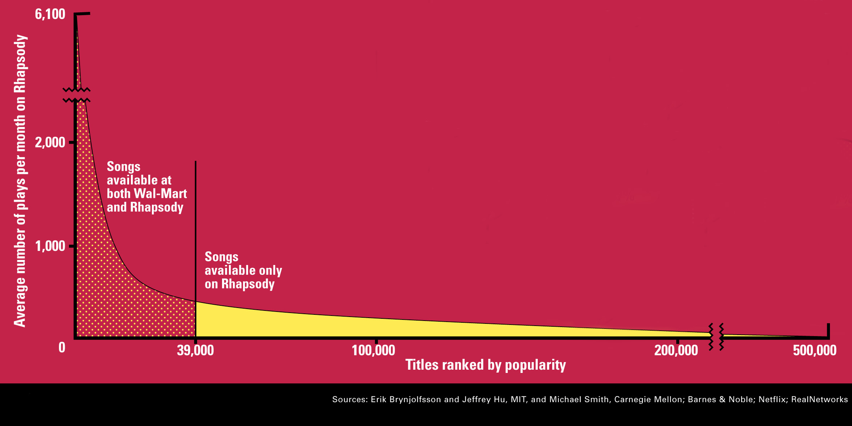
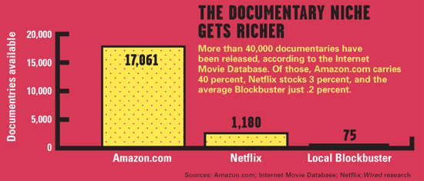
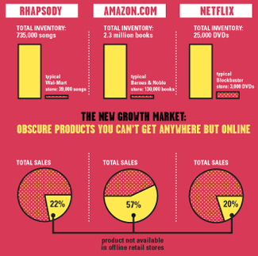
The Long Tail
Source: Chris Anderson (2004)

Slide 6
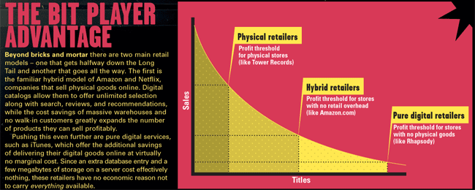
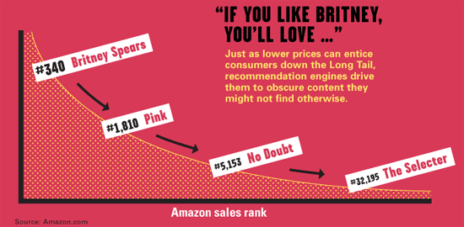
Physical vs. Online
Read http://www.wired.com/wired/archive/12.10/tail.html to learn more!

Slide 7
Types of Recommendations
Editorial and hand curated
List of favorites
Lists of “essential” items
Simple aggregates
Top 10, Most Popular, Recent Uploads
Tailored to individual users
Amazon, Netflix, …

Slide 8
Formal Model
C = set of Customers
S = set of Items
Utility function u: C × S → R
R = set of ratings
R is a totally ordered set
e.g., 0-5 stars, real number in [0,1]

Slide 9
Utility Matrix
Avatar
LOTR
Matrix
Pirates
Alice
Bob
Carol
David

Slide 10
Key Problems
Gathering “known” ratings for matrix
Extrapolate unknown ratings from known ratings
Mainly interested in high unknown ratings
Evaluating extrapolation methods

Slide 11
Gathering Ratings
Explicit
Ask people to rate items
Doesn’t work well in practice – people can’t be bothered
Implicit
Learn ratings from user actions
E.g., purchase implies high rating
What about low ratings?

Slide 12
Extrapolating Utilities
Key problem: matrix U is sparse
Most people have not rated most items
Cold start:
New items have no ratings
New users have no history
Three approaches to Recommender Systems:
Content-based
Collaborative
Hybrid

Slide 13
Content-based Recommendations
Main idea: Recommend items to customer x similar to previous items rated highly by x
Example:
Movie recommendations
Recommend movies with same actor(s), director, genre, …
Websites, blogs, news
Recommend other sites with “similar” content

Slide 14
Plan of Action
Item profiles
likes
build
recommend
match
Red
Circles
Triangles
User profile

Slide 15
Item Profiles
For each item, create an item profile
Profile is a set (vector) of features
Movies: author, title, actor, director,…
Text: set of “important” words in document
How to pick important features?
Usual heuristic from text mining is TF-IDF (Term frequency * Inverse Doc Frequency)
Term … feature
Document … item

Slide 16
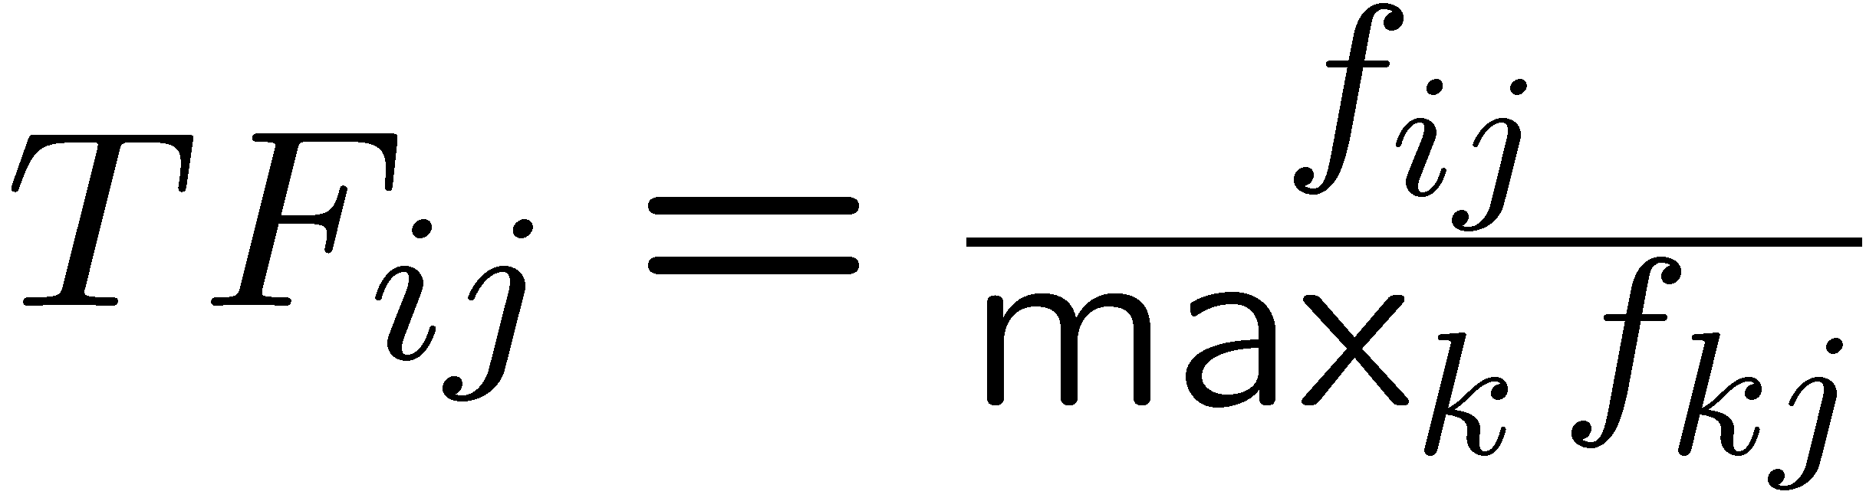
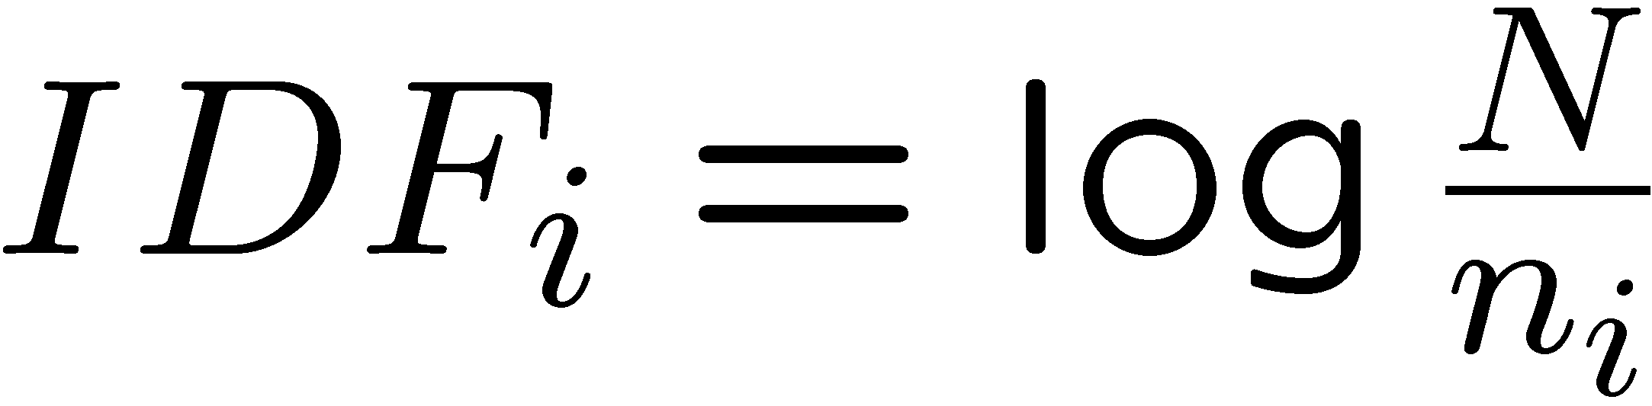
Sidenote: TF-IDF
f_{ij} = frequency of term (feature) i in document (item) j
n_{i} = number of docs that mention term i
N = total number of docs
TF-IDF score: w_{ij} = TF_{ij} × IDF_{i}
Doc profile = set of words with highest TF-IDF scores, together with their scores
Note: we normalize TF to discount for “longer” documents

Slide 17
User Profiles and Prediction
User profile possibilities:
Weighted average of rated item profiles
Variation: weight by difference from average rating for item
…
Prediction heuristic:
Given user profile u and item profile i, estimate u(u,i) = cos(u,i) = u·i/(|u||i|)
Need efficient method to find items with high utility: LSH!

Slide 18
Pros: Content-based Approach
+: No need for data on other users
No cold-start or sparsity problems
+: Able to recommend to users with unique tastes
+: Able to recommend new and unpopular items
No first-rater problem
Can provide explanations of recommended items by listing content-features that caused an item to be recommended

Slide 19
Cons: Content-based Approach
–: Finding the appropriate features is hard
E.g., images, movies, music
–: Overspecialization
Never recommends items outside user’s content profile
People might have multiple interests
Unable to exploit quality judgments of other users
–: Recommendations for new users
How to build a user profile?

Slide 20
Collaborative Filtering

Slide 21
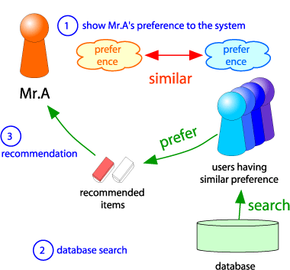
Collaborative Filtering
Consider user x
Find set N of other users whose ratings are “similar” to x’s ratings
Estimate x’s ratings based on ratings of users in N
x
N

Slide 22
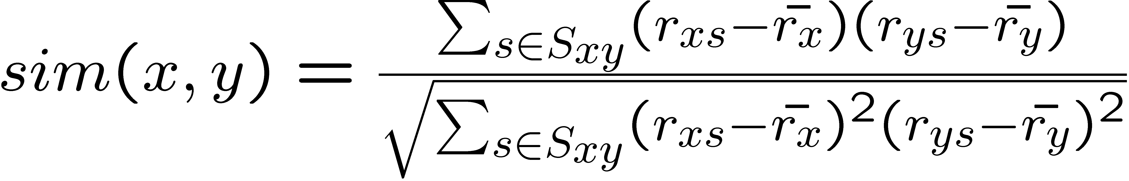
Similar Users
Let r_{x} be the vector of user x’s ratings
Jaccard similarity measure
Problem: Ignores the value of the rating
Cosine similarity measure
sim(x,y) = cos(r_{x} , r_{y})
Problem: Treats missing ratings as “negative”
Pearson correlation coefficient
S_{xy} = items rated by both users x and y
Notes:
-- Jaccard is not appropriate as we want to consider weights

Slide 23
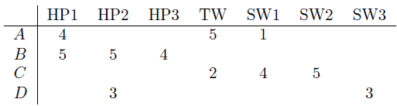
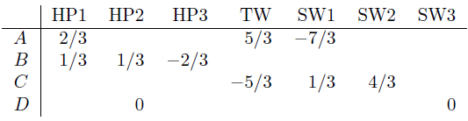
Similarity Metric
Intuitively we want: sim(A, B) > sim(A, C)
Jaccard similarity: 1/5 < 2/4
Cosine similarity: 0.386 > 0.322
Considers missing ratings as “negative”
Solution: subtract the mean
sim A,B vs. A,C:
0.092 > -0.559
Notice cos sim is correlation when data is centered at 0

Slide 24
Rating Predictions
Let r_{x} be the vector of user x’s ratings
Let N be the set of k users most similar to x who have rated item i
Possibilities for prediction for item s of user x:
r_{xi} = 1/k ∑_{y∈N} r_{yi}
r_{xi} = (∑_{y∈N} sim(x,y) r_{yi}) / (∑_{y∈N} sim(x,y))
Other options?
Many tricks possible…

Slide 25
Item-Item Collaborative Filtering
So far: User-user collaborative filtering
Another view: Item-item
For item i, find other similar items
Estimate rating for item based on ratings for similar items
Can use same similarity metrics and prediction functions as in user-user model
s_{ij}… similarity of items i and j
r_{uj}…rating of user u on item j
N(i;u)… set items rated by u similar to i

Slide 26
Item-Item CF (|N|=2)
users
12 | 11 | 10 | 9 | 8 | 7 | 6 | 5 | 4 | 3 | 2 | 1
 | 4 |  | 5 |  |  | 5 |  |  | 3 |  | 1 | 1
3 | 1 | 2 |  |  | 4 |  |  | 4 | 5 |  |  | 2
 | 5 | 3 | 4 |  | 3 |  | 2 | 1 |  | 4 | 2 | 3
 | 2 |  |  | 4 |  |  | 5 |  | 4 | 2 |  | 4
5 | 2 |  |  |  |  | 2 | 4 | 3 | 4 |  |  | 5
 | 4 |  |  | 2 |  |  | 3 |  | 3 |  | 1 | 6
movies
- unknown rating
- rating between 1 to 5

Slide 27
Item-Item CF (|N|=2)
users
12 | 11 | 10 | 9 | 8 | 7 | 6 | 5 | 4 | 3 | 2 | 1
 | 4 |  | 5 |  |  | 5 | ? |  | 3 |  | 1 | 1
3 | 1 | 2 |  |  | 4 |  |  | 4 | 5 |  |  | 2
 | 5 | 3 | 4 |  | 3 |  | 2 | 1 |  | 4 | 2 | 3
 | 2 |  |  | 4 |  |  | 5 |  | 4 | 2 |  | 4
5 | 2 |  |  |  |  | 2 | 4 | 3 | 4 |  |  | 5
 | 4 |  |  | 2 |  |  | 3 |  | 3 |  | 1 | 6
movies
- estimate rating of movie 1 by user 5

Slide 28
Item-Item CF (|N|=2)
users
12 | 11 | 10 | 9 | 8 | 7 | 6 | 5 | 4 | 3 | 2 | 1
 | 4 |  | 5 |  |  | 5 | ? |  | 3 |  | 1 | 1
3 | 1 | 2 |  |  | 4 |  |  | 4 | 5 |  |  | 2
 | 5 | 3 | 4 |  | 3 |  | 2 | 1 |  | 4 | 2 | 3
 | 2 |  |  | 4 |  |  | 5 |  | 4 | 2 |  | 4
5 | 2 |  |  |  |  | 2 | 4 | 3 | 4 |  |  | 5
 | 4 |  |  | 2 |  |  | 3 |  | 3 |  | 1 | 6
movies
Neighbor selection: Identify movies similar to movie 1, rated by user 5

Slide 29
Item-Item CF (|N|=2)
users
12 | 11 | 10 | 9 | 8 | 7 | 6 | 5 | 4 | 3 | 2 | 1
 | 4 |  | 5 |  |  | 5 | ? |  | 3 |  | 1 | 1
3 | 1 | 2 |  |  | 4 |  |  | 4 | 5 |  |  | 2
 | 5 | 3 | 4 |  | 3 |  | 2 | 1 |  | 4 | 2 | 3
 | 2 |  |  | 4 |  |  | 5 |  | 4 | 2 |  | 4
5 | 2 |  |  |  |  | 2 | 4 | 3 | 4 |  |  | 5
 | 4 |  |  | 2 |  |  | 3 |  | 3 |  | 1 | 6
movies
Compute similarity weights: s₁₃=0.41, s₁₆=0.59

Slide 30
Item-Item CF (|N|=2)
users
12 | 11 | 10 | 9 | 8 | 7 | 6 | 5 | 4 | 3 | 2 | 1
 | 4 |  | 5 |  |  | 5 | 2.6 |  | 3 |  | 1 | 1
3 | 1 | 2 |  |  | 4 |  |  | 4 | 5 |  |  | 2
 | 5 | 3 | 4 |  | 3 |  | 2 | 1 |  | 4 | 2 | 3
 | 2 |  |  | 4 |  |  | 5 |  | 4 | 2 |  | 4
5 | 2 |  |  |  |  | 2 | 4 | 3 | 4 |  |  | 5
 | 4 |  |  | 2 |  |  | 3 |  | 3 |  | 1 | 6
movies
Predict by taking weighted average: r₅₁=(0.41*2+0.59*3)/(0.41+0.59)=2.6

Slide 31

CF: Common Practice
Before:
Define similarity s_{ij} of items i and j
Select k nearest neighbors N(i; u)
items most similar to i, that were rated by u
Estimate rating r_{ui} as the weighted average:
baseline estimate for r_{ui}
μ = overall mean movie rating
b_{u} = rating deviation of user u
= avg. rating of user u – μ
b_{i} = rating deviation of movie i

Slide 32
Item-Item vs. User-User
Avatar
LOTR
Matrix
Pirates
Alice
Bob
Carol
David
In practice, it has been observed that item-item often works better than user-user
Why?
Items are simpler, users have multiple tastes
Notes:
There is a difference in the typical behavior of users and items, as it
pertains to similarity. Intuitively, items tend to be classifiable in simple
terms. For example, music tends to belong to a single genre. It is impossi-
ble, e.g., for a piece of music to be both 60’s rock and 1700’s baroque. On
the other hand, there are individuals who like both 60’s rock and 1700’s
baroque, and who buy examples of both types of music.
The consequence is that it is easier to discover items that are similar because they belong
to the same genre, than it is to detect that two users are similar because
they prefer one genre in common, while each also likes some genres that
the other doesn’t care for.

Slide 33
Pros/Cons of Collaborative Filtering
Works for any kind of item
No feature selection needed
Cold Start:
Need enough users in the system to find a match
Sparsity:
The user/ratings matrix is sparse. Hard to find users that have rated the same items
First rater:
Cannot recommend an item that has not been previously rated
New items, Esoteric items
Popularity bias:
Cannot recommend items to someone with unique taste
Tends to recommend popular items

Slide 34
Hybrid Methods
Implement two or more different recommenders and combine predictions
Perhaps using a linear model
Add content-based methods to collaborative filtering
Item profiles for new item problem
Demographics to deal with new user problem

Slide 35
Finding Similar Vectors
Common problem that comes up in many settings
Given a large number N of vectors in some high-dimensional space (M dimensions), find pairs of vectors that have high similarity
e.g., user profiles, item profiles
We already know how to do this!
Near-neighbor search in high dimensions (LSH)

Slide 36
Clustering Users and Items
Hard to detect similarity among either items or users due to little information about user-item pairs.
Solution: Cluster items and/or users
Revise the utility matrix

Slide 37
The Netflix Prize
Training data
100 million ratings, 480,000 users, 17,770 movies
6 years of data: 2000-2005
Test data
Last few ratings of each user (2.8 million)
Evaluation criterion: Root Mean Square Error (RMSE)
Netflix Cinematch RMSE: 0.9514
Competition
2700+ teams
$1 million prize for 10% improvement on Cinematch

Slide 38
The Netflix Utility Matrix
17,700 movies
1 | 3 | 4
 | 3 | 5 |  |  | 5
 |  | 4 | 5 |  | 5
 |  | 3
 |  | 3
2 |  |  | 2 |  | 2
 |  |  |  | 5
 | 2 | 1 |  |  | 1
 | 3 |  |  | 3
1
480,000 users

Slide 39

Utility Matrix: Evaluation
17,700 movies
1 | 3 | 4
 | 3 | 5 |  |  | 5
 |  | 4 | 5 |  | 5
 |  | 3
 |  | 3
2 |  |  | ? |  | ?
 |  |  |  | ?
 | 2 | 1 |  |  | ?
 | 3 |  |  | ?
1
480,000 users
Test Data Set
SSE = $\sum_{(i,u)∈R}{{\left(r_{ui}−{\hat{r}}_{ui}\right)}^{2}}$

Slide 40
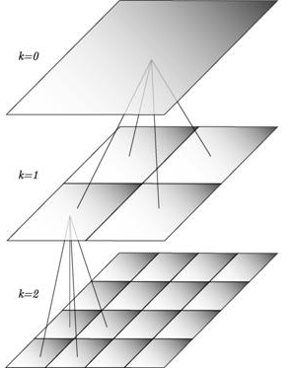
BellKor Recommender System
Basically the winner of the Netflix Challenge
Multi-scale modeling of the data: Combine top level, regional modeling of the data, with a refined, local view:
Global:
Overall deviations of users/movies
Factorization:
Addressing regional effects
CF (k-NN):
Extract local patterns
Global effects
Factorization
CF/NN

Slide 41
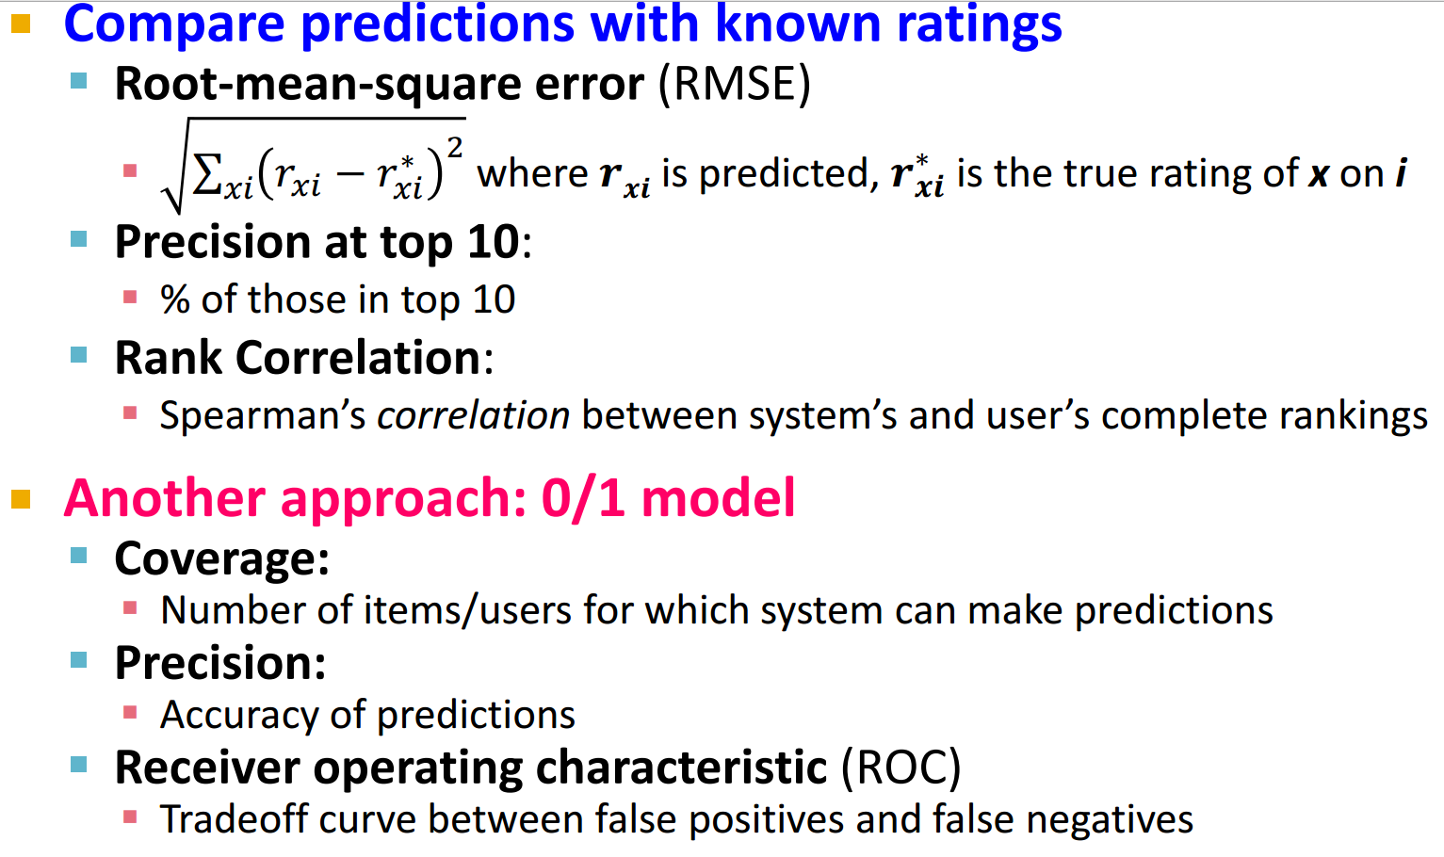
Evaluating Predictions

Slide 42
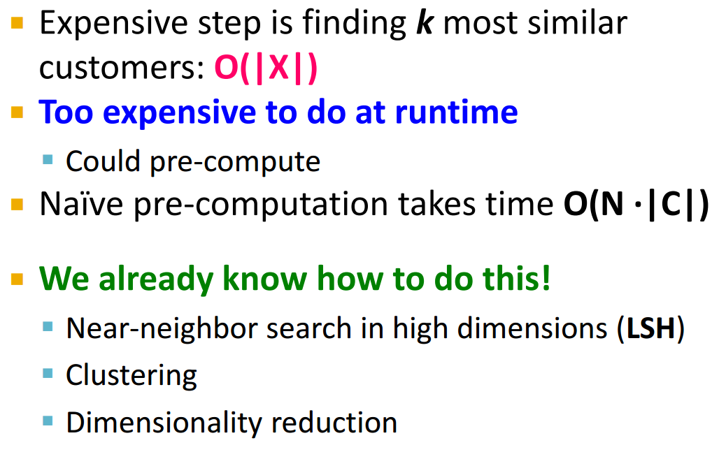
Collaborative Filtering: Complexity

Slide 43
Tip: Add Data
Leverage all the data
Don’t try to reduce data size in an effort to make fancy algorithms work
Simple methods on large data do best
Add more data
e.g., add IMDB data on genres
More data beats better algorithms
http://anand.typepad.com/datawocky/2008/03/more-data-usual.html

