Slide 1
Mining Data Streams

Slide 2
Data Streams
In many data mining situations, we know the entire data set in advance
Stream Management is important when the input rate is controlled externally:
Google queries
Twitter or Facebook status updates
We can think of the data as infinite and non-stationary (the distribution changes over time)

Slide 3
The Stream Model
Input tuples enter at a rapid rate, at one or more input ports (i.e., streams)
The system cannot store the entire stream accessibly
How do you make critical calculations about the stream using a limited amount of (secondary) memory?

Slide 4
Ad-Hoc
Queries
Processor
. . . 1, 5, 2, 7, 0, 9, 3
. . . a, r, v, t, y, h, b
. . . 0, 0, 1, 0, 1, 1, 0
time
Streams Entering
Standing
Queries
Output
Limited
Working
Storage
Archival
Storage

Slide 5
Problems on Data Streams
Types of queries one wants on answer on a stream:
Sampling data from a stream
Construct a random sample
Queries over sliding windows
Number of items of type x in the last k elements of the stream
We will examine these two problems

Slide 6
Problems on Data Streams
Types of queries one wants on answer on a stream:
Filtering a data stream
Select elements with property x from the stream
Counting distinct elements
Number of distinct elements in the last k elements of the stream
Estimating moments
Estimate avg./std. dev. of last k elements
Finding frequent elements

Slide 7
Applications – (1)
Mining query streams
Google wants to know what queries are more frequent today than yesterday
Mining click streams
Yahoo wants to know which of its pages are getting an unusual number of hits in the past hour
Mining social network news feeds
E.g., look for trending topics on Twitter, Facebook

Slide 8
Applications – (2)
Sensor Networks
Many sensors feeding into a central controller
Telephone call records
Data feeds into customer bills as well as settlements between telephone companies
IP packets monitored at a switch
Gather information for optimal routing
Detect denial-of-service attacks

Slide 9
Sampling from a Data Stream

Slide 10
Sampling from a Data Stream
Since we can not store the entire stream, one obvious approach is to store a sample
Two different problems:
Sample a fixed proportion of elements in the stream (say 1 in 10)
Maintain a random sample of fixed size over a potentially infinite stream
At any “time” n we would like a random sample of s elements
For all k, each of n elements seen so far has equal prob. of being sampled

Slide 11
Sampling a Fixed Proportion
Problem 1: Sampling fixed proportion
Scenario: Search engine query stream
Stream of tuples: (user, query, time)
Answer questions such as: How often did a user run the same query on two different days?
Have space to store 1/10th of query stream
Naïve solution:
Generate a random integer in [0..9] for each query
Store the query if the integer is 0, otherwise discard

Slide 12
Problem with Naïve Approach
Simple question: What fraction of queries by an average user are duplicates?
Suppose each user issues s queries once and d queries twice (total of s+2d queries)
Correct answer: d/(s+d)
Sample will contain s/10 of the singleton queries and 2d/10 of the duplicate queries at least once
But only d/100 pairs of duplicates
d/100 = 1/10 * 1/10 * d
Of d “duplicates” 18d/100 appear once
18d/100 = ((1/10*9/10)+(9/10*1/10))*d
So the sample-based answer is: d/(10s+19d)
Notes:
d/100 appear twice: 1st query gets sampled with prob. 1/10, 2nd also with 1/10, there are d such queries: d/100
18d/100 appear once. 1/10 for first to get selection and 9/10 for the second to not get selected. And the other way around so 18d/100

Slide 13
Solution: Sample Users
Pick 1/10th of users and take all their searches in the sample
Use a hash function that hashes the user name or user id uniformly into 10 buckets

Slide 14
Generalized Solution
Stream of tuples with keys:
Key is some subset of each tuple’s components
e.g., tuple is (user, search, time); key is user
Choice of key depends on application
To get a sample of size a/b:
Hash each tuple’s key uniformly into b buckets
Pick the tuple if its hash value is at most a

Slide 15
Maintaining a fixed-size sample
Problem 2: Fixed-size sample
Suppose we need to maintain a sample S of size exactly s
E.g., main memory size constraint
Why? Don’t know length of stream in advance
In fact, stream could be infinite
Suppose at time t we have seen n items
Ensure each item is in the sample S with equal probability s/n

Slide 16
Solution: Fixed Size Sample
Algorithm:
Store all the first s elements of the stream to S
Suppose we have seen n-1 elements, and now the n^{th} element arrives (n > s)
With probability s/n, pick the n^{th} element, else discard it
If we picked the n^{th} element, then it replaces one of the s elements in the sample S, picked uniformly at random
Claim: This algorithm maintains a sample S with the desired property

Slide 17
Proof: By Induction
We prove this by induction:
Assume that after n elements, the sample contains each element seen so far with probability s/n
We need to show that after seeing element n+1 the sample maintains the property
Sample contains each element seen so far with probability s/(n+1)
Obviously, after we see n=s elements the sample has the wanted property
Each out of n=s elements is in the sample with probability s/s = 1

Slide 18
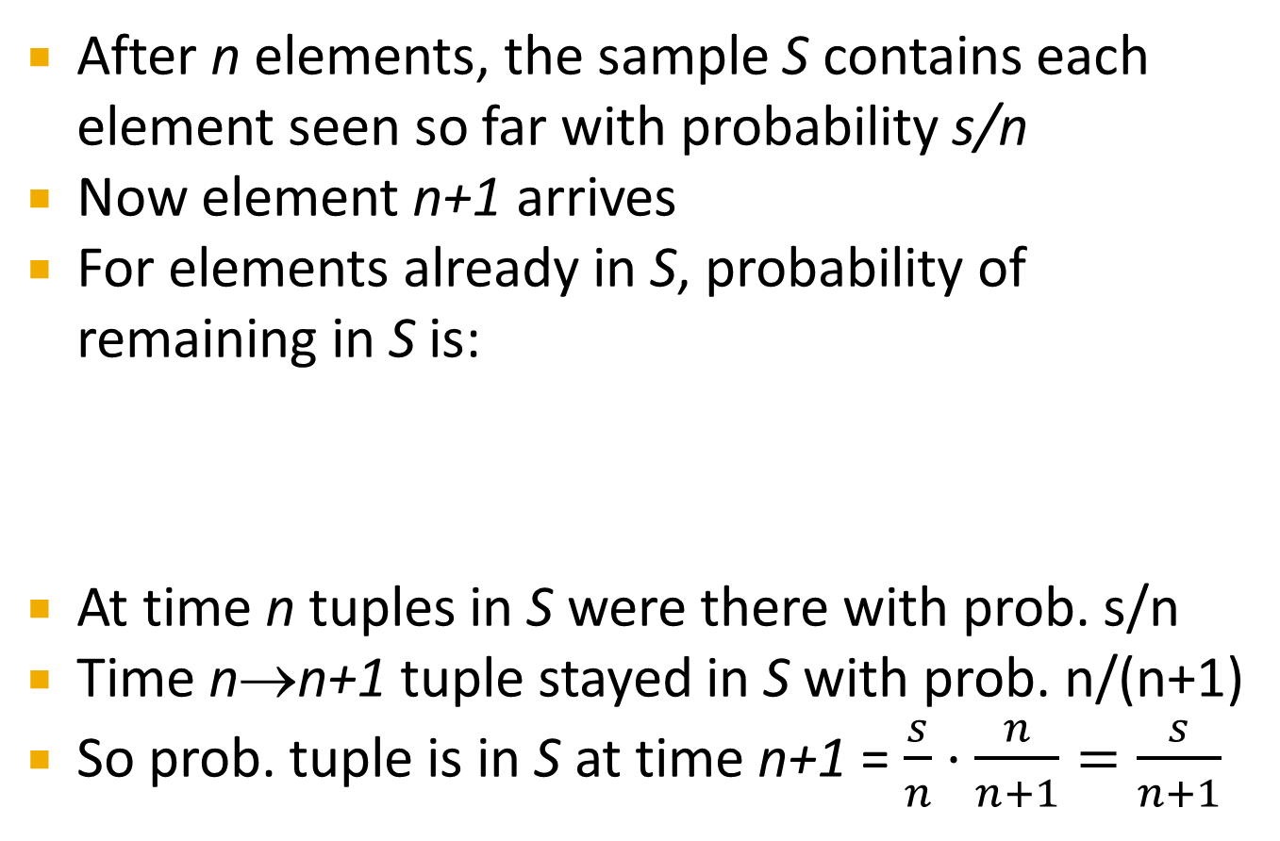
Proof: By Induction
After n elements, the sample S contains each element seen so far with probability s/n
Now element n+1 arrives
For elements already in S, probability of remaining in S is:
At time n tuples in S were there with prob. s/n
Time n→n+1 tuple stayed in S with prob. n/(n+1)
So prob. tuple is in S at time n+1 = $\frac{s}{n}⋅\frac{n}{n+1}=\frac{s}{n+1}$
Element n+1 discarded
Element n+1 not discarded
Element in the sample not picked

Slide 19
Queries over a (long) Sliding Window

Slide 20
Sliding Windows
A useful model of stream processing is that queries are about a window of length N – the N most recent elements received
Interesting case: N is so large it cannot be stored in memory, or even on disk
Or, there are so many streams that windows for all cannot be stored

Slide 21
Sliding Window: 1 Stream
N = 6
q w e r t y u i o p a s d f g h j k l z x c v b n m
q w e r t y u i o p a s d f g h j k l z x c v b n m
q w e r t y u i o p a s d f g h j k l z x c v b n m
q w e r t y u i o p a s d f g h j k l z x c v b n m
Past Future

Slide 22
Counting Bits – (1)
Problem:
Given a stream of 0s and 1s
Be prepared to answer queries of the form How many 1s are in the last k bits? where k ≤ N
Obvious solution: Store the most recent N bits
When new bit comes in, discard the N +1st bit
0 1 0 0 1 1 0 1 1 1 0 1 0 1 0 1 1 0 1 1 0 1 1 0
Past Future

Slide 23
Counting Bits – (2)
You can not get an exact answer without storing the entire window
Real Problem: What if we cannot afford to store N bits?
E.g., we’re processing 1 billion streams and N = 1 billion
But we are happy with an approximate answer
0 1 0 0 1 1 0 1 1 1 0 1 0 1 0 1 1 0 1 1 0 1 1 0
Past Future

Slide 24
An attempt: Simple solution
How many 1s are in the last N bits?
Simple solution that does not really solve our problem: Uniformity assumption
Maintain 2 counters:
S: number of 1s
Z: number of 0s so far
How many 1s are in the last N bits? N∙S/(S+Z)
But, what if stream is non-uniform?
What if distribution changes over time?
N
0 1 0 0 1 1 1 0 0 0 1 0 1 0 0 1 0 0 0 1 0 1 1 0 1 1 0 1 1 1 0 0 1 0 1 0 1 1 0 0 1 1 0 1 0
Past Future

Slide 25
DGIM Method
[Datar, Gionis, Indyk, Motwani]
Store O(log²N ) bits per stream
Gives approximate answer, never off by more than 50%
Error factor can be reduced to any fraction > 0, with more complicated algorithm and proportionally more stored bits

Slide 26
Idea: Exponential Windows
Solution that doesn’t (quite) work:
Summarize exponentially increasing regions of the stream, looking backward
Drop small regions if they begin at the same point as a larger region
6
10
?
4
Window of width 16 has 6 1s
3
2
2
1
1
0
0 1 0 0 1 1 1 0 0 0 1 0 1 0 0 1 0 0 0 1 0 1 1 0 1 1 0 1 1 1 0 0 1 0 1 0 1 1 0 0 1 1 0 1 0
N
We can construct the count of the last N bits, except we are not sure how many of the last 6 are included.
Notes:
The rule for updating is as follows. 1. when a bit comes in, create a bucket of length 1 with the proper count (0 or 1). 2. If any level has 3 buckets: a) add the rightmost two and create a bucket at the next higher level (twice the length) with that sum. b) delete the leftmost two buckets, keeping only the rightmost of the three.. 3. Repeat (2) recursively for progressively higher levels.

Slide 27
What’s Good?
Stores only O(log²N ) bits
O(log N ) counts of log₂N bits each
Easy update as more bits enter
Error in count no greater than the number of 1s in the “unknown” area

Slide 28
What’s Not So Good?
As long as the 1s are fairly evenly distributed, the error due to the unknown region is small – no more than 50%
But it could be that all the 1s are in the unknown area at the end
In that case, the error is unbounded
6
10
?
4
3
2
2
1
1
0
0 1 0 0 1 1 1 0 0 0 1 0 1 0 0 1 0 0 0 1 0 1 1 0 1 1 0 1 1 1 0 0 1 0 1 0 1 1 0 0 1 1 0 1 0
N

Slide 29
Fixup: DGIM method
[Datar, Gionis, Indyk, Motwani]
Instead of summarizing fixed-length blocks, summarize blocks with specific number of 1s:
Let the block “sizes” (number of 1s) increase exponentially
When there are few 1s in the window, block sizes stay small, so errors are small
1001010110001011010101010101011010101010101110101010111010100010110010
N

Slide 30
DGIM: Timestamps
Each bit in the stream has a timestamp, starting 1, 2, …
Record timestamps modulo N (the window size), so we can represent any relevant timestamp in O(log₂N) bits

Slide 31
DGIM: Buckets
A bucket in the DGIM method is a record consisting of:
The timestamp of its end [O(log N) bits]
The number of 1s between its beginning and end [O(log log N) bits]
Constraint on buckets: Number of 1s must be a power of 2
That explains the O(log log N) in (2)

Slide 32
Representing a Stream by Buckets
Either one or two buckets with the same power-of-2 number of 1s
Buckets do not overlap in timestamps
Buckets are sorted by size
Earlier buckets are not smaller than later buckets
Buckets disappear when their end-time is > N time units in the past

Slide 33
Example: Bucketized Stream
At least 1 of
size 16. Partially
beyond window.
2 of
size 8
2 of
size 4
1 of
size 2
2 of
size 1
1001010110001011010101010101011010101010101110101010111010100010110010
N
Properties we maintain:
- Either one or two buckets with the same power-of-2 number of 1s
- Buckets do not overlap in timestamps
- Buckets are sorted by size

Slide 34
Updating Buckets – (1)
When a new bit comes in, drop the last (oldest) bucket if its end-time is prior to N time units before the current time
2 cases: Current bit is 0 or 1
If the current bit is 0, no other changes are needed

Slide 35
Updating Buckets – (2)
If the current bit is 1:
Create a new bucket of size 1, for just this bit
End timestamp = current time
If there are now three buckets of size 1, combine the oldest two into a bucket of size 2
If there are now three buckets of size 2, combine the oldest two into a bucket of size 4
And so on …

Slide 36
Example: Updating Buckets
1001010110001011010101010101011010101010101110101010111010100010110010
0010101100010110101010101010110101010101011101010101110101000101100101
0010101100010110101010101010110101010101011101010101110101000101100101
0101100010110101010101010110101010101011101010101110101000101100101101
0101100010110101010101010110101010101011101010101110101000101100101101
0101100010110101010101010110101010101011101010101110101000101100101101

Slide 37
How to Query?
To estimate the number of 1s in the most recent N bits:
Sum the sizes of all buckets but the last
(note “size” means the number of 1s in the bucket)
Add half the size of the last bucket
Remember: We do not know how many 1s of the last bucket are still within the wanted window

Slide 38
Example: Bucketized Stream
At least 1 of
size 16. Partially
beyond window.
2 of
size 8
2 of
size 4
1 of
size 2
2 of
size 1
1001010110001011010101010101011010101010101110101010111010100010110010
N

Slide 39
Error Bound: Proof
Suppose the last bucket has size 2^{r}
Then by assuming 2^{r-1} (i.e., half) of its 1s are still within the window, we make an error of at most 2^{r-1}
Since there is at least one bucket of each of the sizes less than 2^{r}, the true sum is at least 1 + 2 + 4 + .. + 2^{r-1} = 2^{r} -1
Thus, error at most 50%
1001010110001011010101010101011010101010101110101010111010100010110010
N

Slide 40
Extensions
Can we use the same trick to answer queries “How many 1’s in the last k?” where k < N ?
A: Find earliest bucket B that at overlaps with k. Number of 1s is the sum of sizes of more recent buckets + ½ size of B
Can we handle the case where the stream is not bits, but integers, and we want the sum of the last k elements?
1001010110001011010101010101011010101010101110101010111010100010110010
k

Slide 41
Reducing the Error
Instead of maintaining 1 or 2 of each size bucket, we allow either r -1 or r for r > 2
Except for the largest size buckets; we can have any number between 1 and r of those
Error is at most 1/(r)
By picking r appropriately, we can tradeoff between number of bits and the error

