Slide 1


The Role of Twitter in YouTube Videos Diffusion
Laboratory for Internet Computing
Department of Computer Science
University of Cyprus
http://linc.ucy.ac.cy
George Christodoulou
EPFL
Switzerland
Chryssis Georgiou & George Pallis
Computer Science Department,
University of Cyprus
29 November 2012

Slide 2
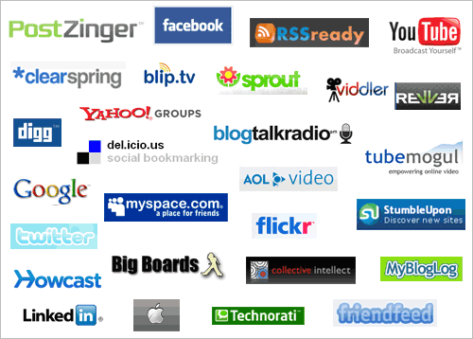
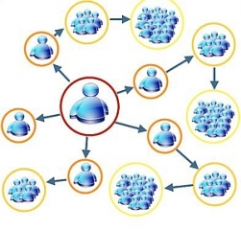
Introduction
Explosive growth of social media: Facebook, Twitter, Digg, etc
The primary causes behind the recent increases in HTTP traffic
Anyone has the potential of spreading a message
Growing popularity of streaming media services

Slide 3
Spread of information
Social network plays fundamental role in spread of information or influence
Viral marketing (Word of mouth)
An idea gets a sudden widespread popularity
Examples:
GMail achieved wide popularity and the only way to obtain an account was through referral
In blogs a piece of information spreads rapidly before eventually picked by mass media
Social Cascade is information spreading through a social network due to influence by others

Slide 4
What is a social cascade?
We say that user B was reached by a social cascade about content c if and only if:
There is another user A which posted content c and
User A posted content c before user B posted it and
There was a social connection from user A to user B when user A posted content c

Slide 5
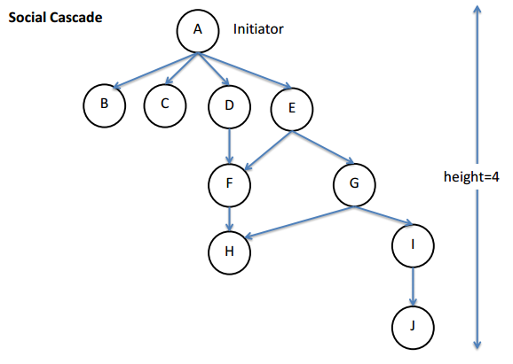
Social Cascade Representation

Slide 6

Twitter Background
Microblogging service
200 million users as of March 2011
User follow other users
Many business, celebrities, news organizations, and others use Twitter
Tweet: A shot post of at most 140 characters
Retweet: A tweet originally posted by a user and reposted by another user

Slide 7

Background
YouTube is the most popular and bandwidth intensive service of today’s Internet
accounts for 20-35% of the Internet traﬃc with 35 hours of videos uploaded every minute and more than 700 billion playbacks in 2010
YouTube has transformed Internet users from video consumers to video producers
More than 400 tweets per minute with a YouTube Link

Slide 8
affects users' navigation behavior
What is the role of
retweeting
in
YouTube video diffusion?

Slide 9
Serious implications and new challenges
for Internet services and content providers
towards improving:
Caching,
Content Delivery Networks,
Searching,
Content Recommendation

Slide 10
Contributions
We present the methodology that we have followed in order to collect the Twitter dataset
1,4 million users
300 million tweets
1,3 millions single messages with a video link
We examine the role of social cascading in YouTube video diffusion

Slide 11
Key Challenge: Gathering the data
Data collection is not a straightforward process
Twitter's recently modified policy of limiting the number of search requests per hour from a given IP address
Data collection took over five months using four Cloud infrastructures
Nephelae Cloud - http://grid.ucy.ac.cy/Nephelae/
Okeanos - https://cms.okeanos.grnet.gr/about/
Amazon EC2
Rackspace

Slide 12
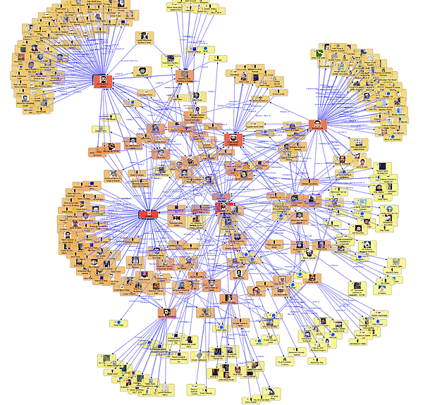
Methodology
Twitter User profiles
Aggregate user profiles and tweets
Analyze tweets to get HTTP URLs
Twitter graph¹
1H. Kwak, C. Lee, H. Park, and S. Moon. What is Twitter, a social network or a news media? In Proceedings of the 19th International Conference on World Wide Web (WWW '11), pages 591{600, New York, NY, USA, 2010. ACM.
Filter the YouTube URLs
Pre-process the content in tweets using URL shortening services
Extract location using Geocoding API of Google Maps
1,384,758 Twitter user profiles
247,399,334 directed follower links
299,071,571 public tweets
1,3 millions YouTube URLs
(December 2011 - April 2012)

Slide 13
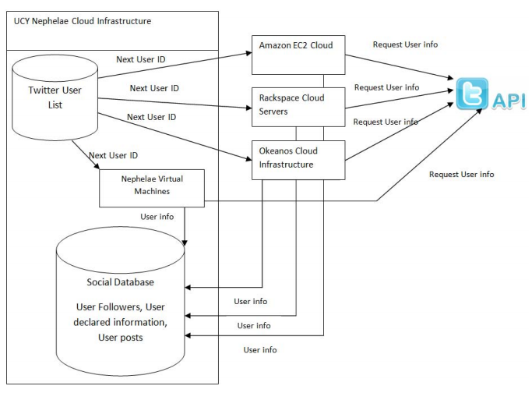
Data Collection System for Twitter

Slide 14
Data Set Characteristics
Twitter User Profile Information
Verified | user’s identity has been verified by email account
Followers_count | the number of users that follow the user
Protected | user's account is private and only their approved followers can read their tweets or see extended information about them
Listed_count | the number of lists the user is a member of
Friends_count | friends count the number of users the user follows
Location | the location of user
Geo_enabled | if enabled allows applications to send tweets with a geographic location attached
Lang | the language of user
Favourites_count | the number of tweets the user has classified as favorites
Created_at | the date that the account has been created
Time_zone | the time zone of each tweet

Slide 15
Data Set Characteristics
Tweet Information
ID | the unique ID of the tweet
Text | the text of tweet (typically up to 140 characters)
Created_at | the date that the tweet has been published
Retweeted | if it is new tweet or a retweet
In_reply_to_status_id | the ID of an existing status that the update is in reply to
In_reply_to_user_id | the user ID that the tweet replies
Urls | the url of the tweet
Retweet_count | the number of times that a tweet has been retweeted

Slide 16
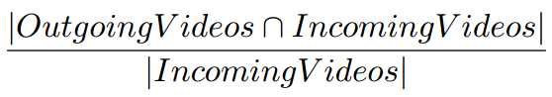
Effects of Social Cascading
How can we investigate the role of the retweeting mechanism in YouTube video diffusion?
video retweet likelihood
OutgoingVideos: the set of videos (over all users) that were retweeted by some user to another user (multiplicities are not counted)
IncomingVideos: all videos that a user received by some other user, as a result of a retweet of the latter

Slide 17




Effects of Social Cascading
IncomingVideos:
1
2
3
3
1
2
OutgoingVideos:
4
1
1
4
1
|OutgoingVideos∩IncomingVideos|:
1

Slide 18
Evaluation

Slide 19
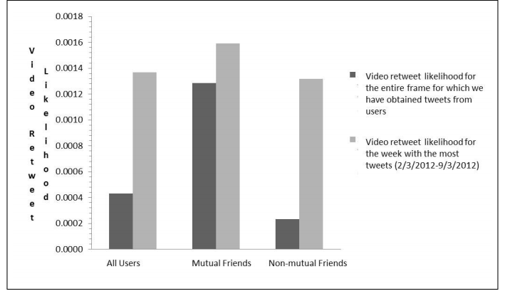
Impact of Twitter Users

Slide 20
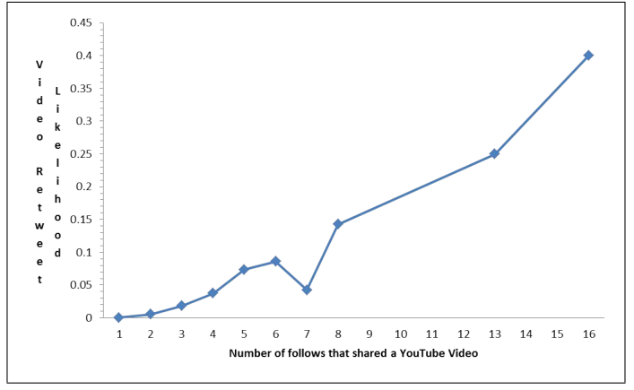
Impact of Twitter Users

Slide 21
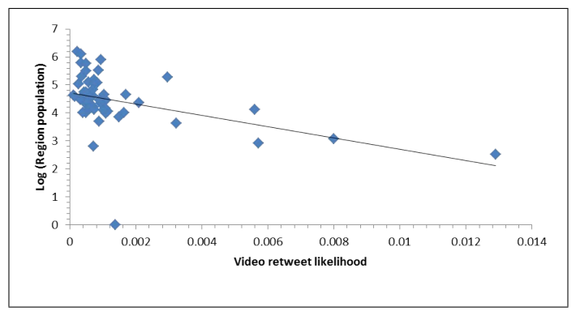
Impact of Geographic Popularity
Twitter uses its own time zone system which divides the globe into 142 zones

Slide 22
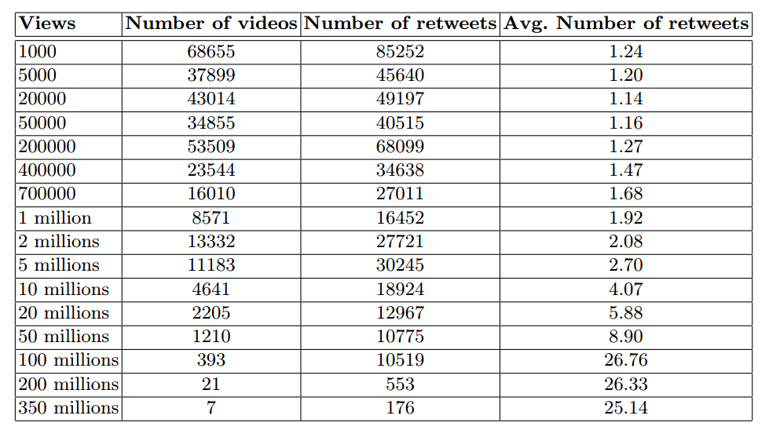
Impact of Videos Popularity

Slide 23
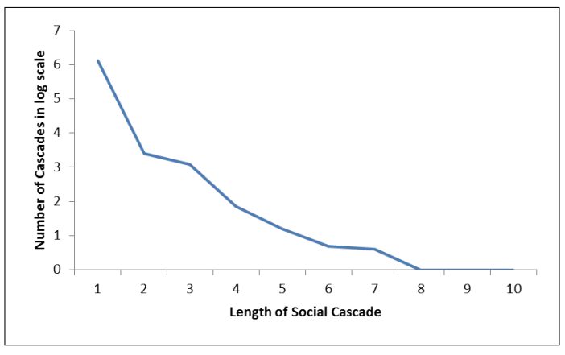
Impact of Social Cascade Length

Slide 24
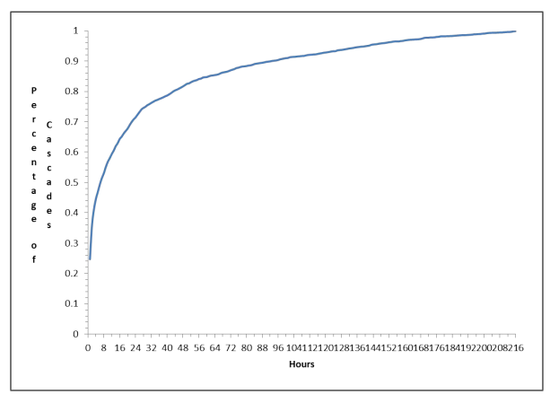
Impact of Time

Slide 25
Conclusions
We study how the retweeting influences the diffusion of YouTube videos
Observations:
Social cascading effect
has high impact on a more focused and less diverse set of geographic regions
ends within 24 hours
Users are influenced more from the follows who also follow them
Ongoing/Future work:
study the retweeting influence wrt the popularity dynamics of YouTube videos over the time
develop a realistic media workload generator

Slide 26
Thank You!
Laboratory for Internet Computing
Department of Computer Science
University of Cyprus
http://linc.ucy.ac.cy
Questions?

Slide 27
Twitter Background

Slide 28
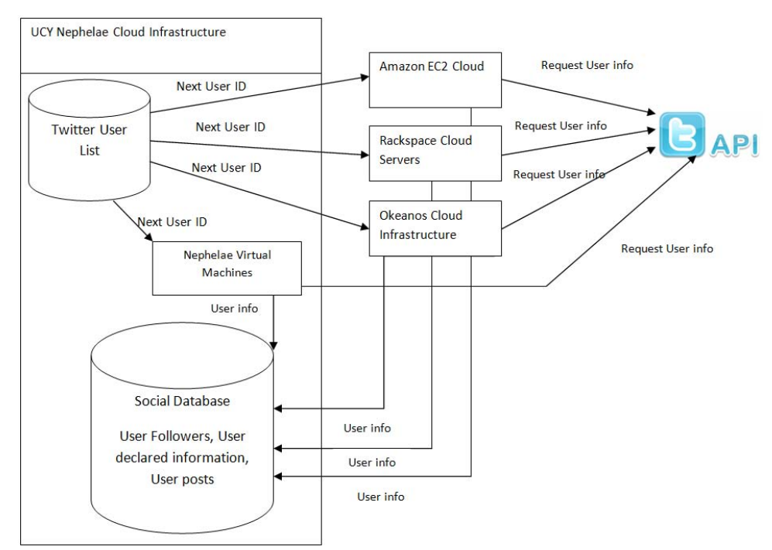
Data Collection System for Twitter

