Slide 1

Toxic Comment Classification Challenge
Presented by Cathy Deng
UIN: 01124163
Master student of Computer Science
Old Dominion University

Slide 2
Project Description
Toxic comments make people stop expressing themselves and give up on seeking different opinions online. To effectively facilitate conversations, platforms need tools to improve online conversation. Google and Conversation AI released the competition “Toxic Comment Classification Challenge”[1] on Kaggle last year, because the tool they were using still made errors.
This project build three multi-headed models that’s capable of detecting different types of toxicity.
The types of toxicity are: toxic, severe_toxic, obscene, threat, insult, identity_hate. These will be the six targets that predicted in this project.

Slide 3
Overview of Data
train.csv:
160k records: each record consists of a comment retrieved from Wikipedia, and 6 labels which were labeled by human raters for toxic behavior.
test.csv:
153k records: After the competition, 6k of the test records are labeled for model evaluation.
This project will use labels of these 6k records to evaluate the model.

Slide 4
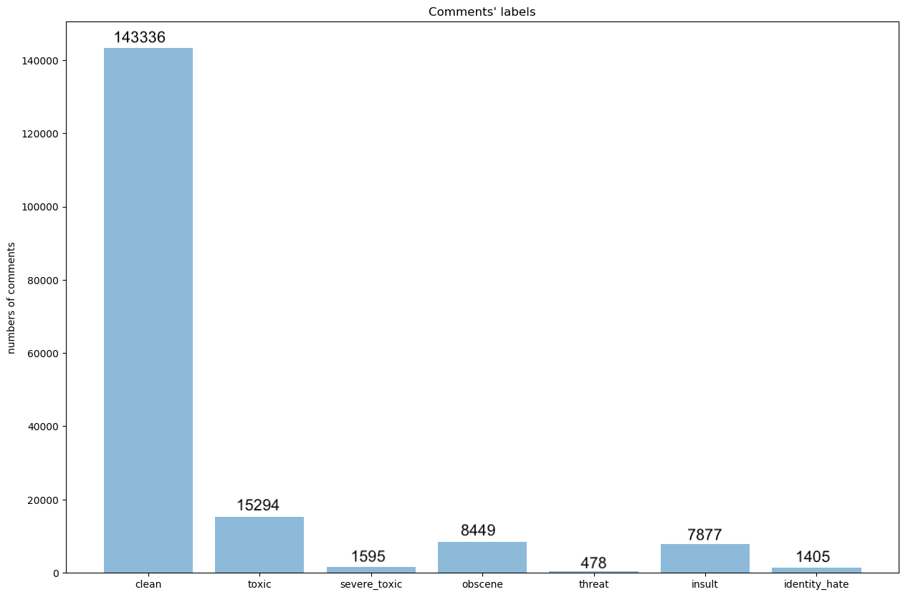
Overview of Data

Slide 5
Technical Approach
Data Preprocess:
Downsample
Get TF-IDF
Use TF-IDF for tokens of each comment as features
Models:
Strategy 1: Binary Relevance
Strategy 2: Classifier Chains
Strategy 3: Label Powerset

Slide 6
Implementation Detail (pyspark)
Data Preprocess:
8 functions to process the data and get TF-IDF
Create RDD for train and test dataset, use map, filter transformations.
After data process, train and test will be stored in drive, so I can use it for different models
Models:
Get train and test dataset, create RDD respectively
Similar to data process, use map, flatMap transformations in this part.

Slide 7
Why approach is scalable
When I process data, I always use transformations, such as map / filter / flatMap.
All transformations in Spark are lazy, they are only computed when an action requires a result. This will make my code run more efficiently.
Also when I use these transformations, the system will parallelize data and process the each line of the data simultaneously. So even the data is very large, the data can be processed with different nodes.

Slide 8
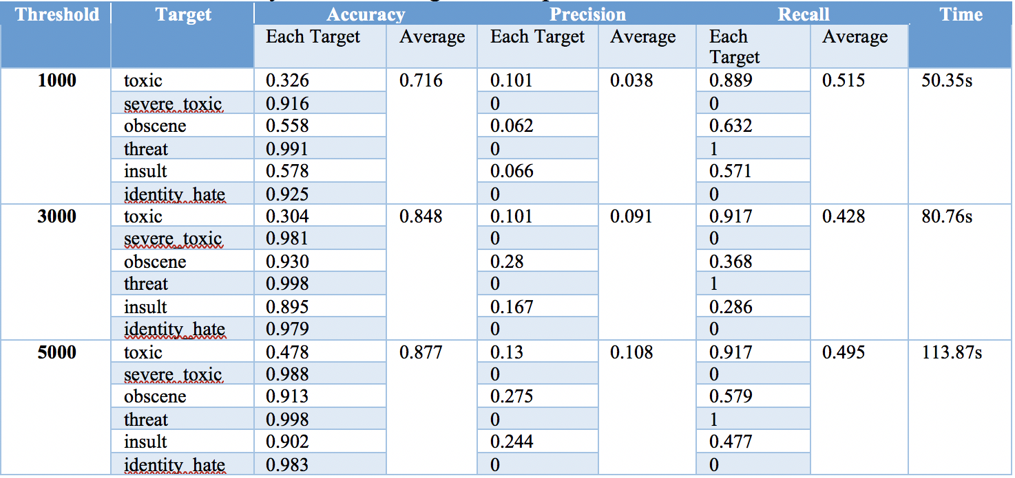
Results of Strategy 1 - Binary Relevance

Slide 9
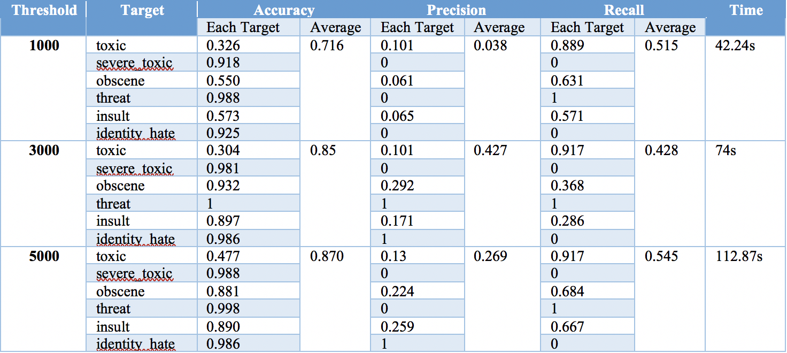
Results of Strategy 2 - Classifier Chains

Slide 10
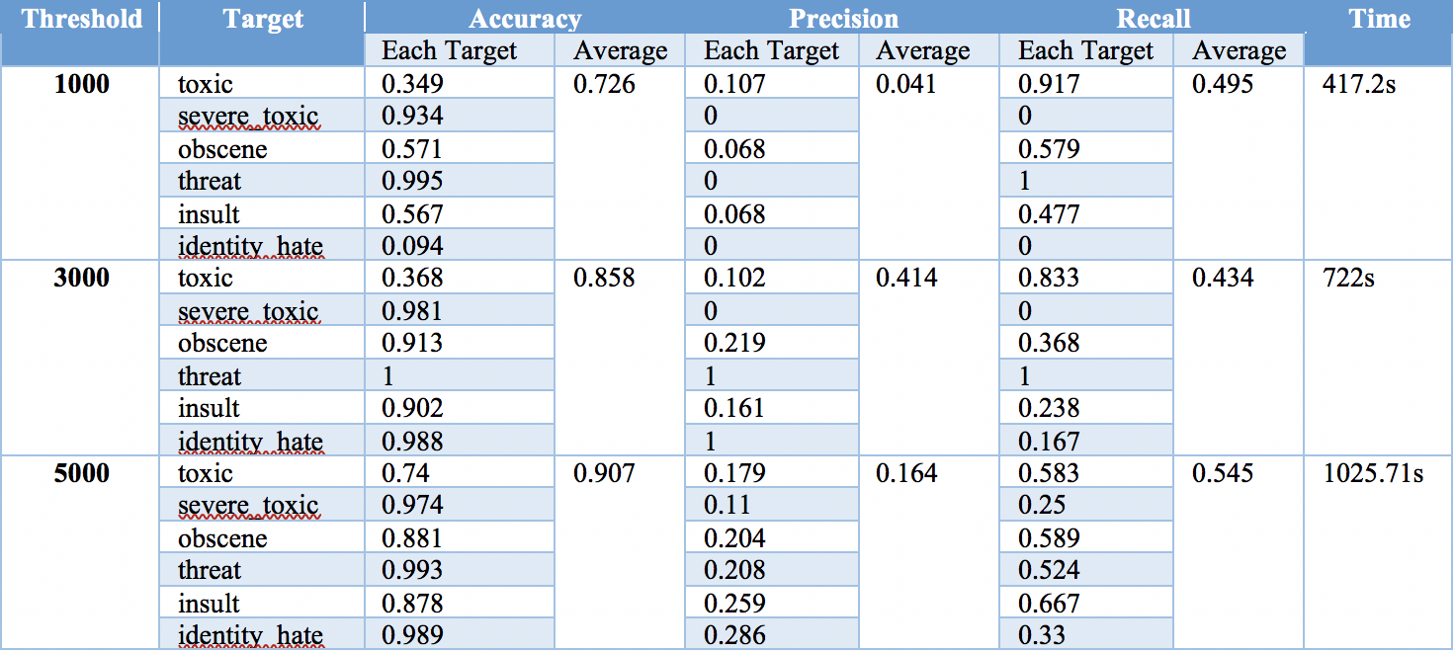
Results of Strategy 3 - Label Powerset

Slide 11
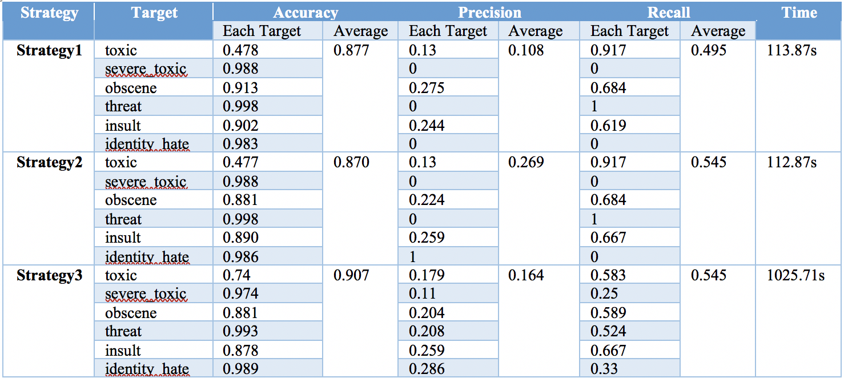
Compare 3 strategies

Slide 12
Lesson Learned
Different from the projects I did before. This project has multi-target. I read some materials about this and learned how to build model for multi-target.
In the project design stage, I planned to use map-reduce frame work to calculate TF-IDF. But when I implemented, I understanded the shortage of Hadoop. So I change to pyspark.
At first, I didn’t quite understand how spark works. I only know that I can use transformations to do simple transformation of the data. When I started to write code for TF-IDF, I used for loop to process each line. It works fine with small dataset. But when I try it with big dataset, it will take 3 to 4 hours to run. When I finally understand how spark works, I write functions for each line and use transformations of rdd. This is really fast. When I ran it on full dataset, it only takes around 15 mins.

Slide 13
Future Enhancement
Use PCA to do feature selection: For a high threshold, each comment will have a large number of features. This will affect the efficiency of our algorithm. I didn’t have time to implement PCA or other feature selection method after data preprocess
Predict different targets at the same time: For strategy 1, different targets are considered as mutually exclusive. So if the model can predict the targets simultaneously instead of sequentially. The model will be much faster. It is the same for strategy 3. After create 2⁶ = 64 labels, all labels are considered as mutually exclusive.

Slide 14
Reference
[1] Toxic Comment Classification Challenge
https://www.kaggle.com/c/jigsaw-toxic-comment-classification-challenge/data
[2] Deep dive into multi-label classification..! (With detailed Case Study)
https://towardsdatascience.com/journey-to-the-center-of-multi-label-classification-384c40229bff
[3] Solving Multi-Label Classification problems (Case studies included)
https://www.analyticsvidhya.com/blog/2017/08/introduction-to-multi-label-classification/

