Slide 1
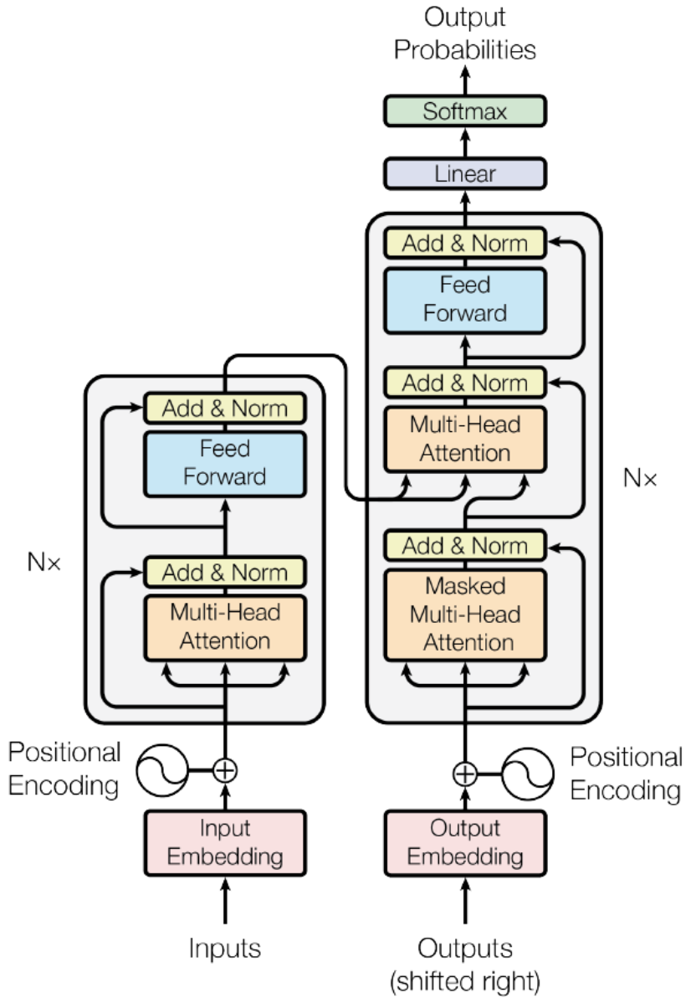
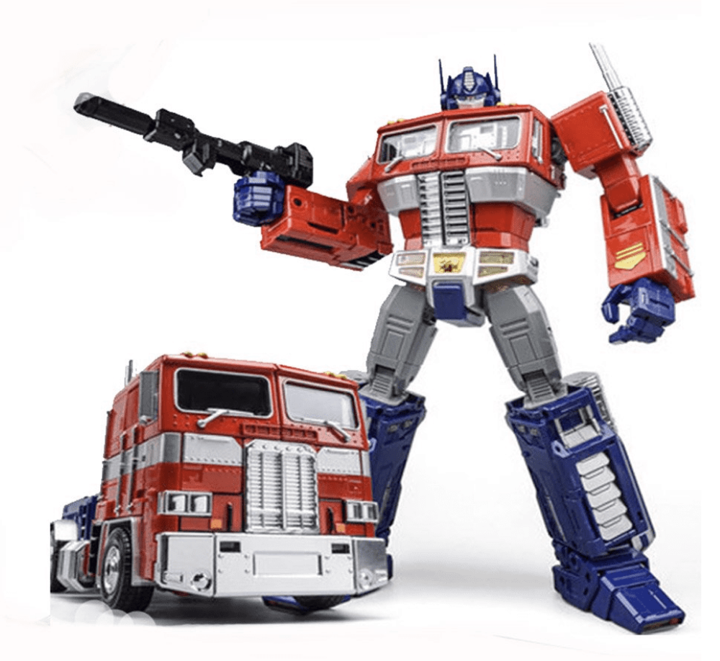
Transformer
A new sequence transduction architecture
Paper:Attention is all you need^{[1]}
Presented by
Mahsa Sharifi
Cathy Deng
Yuming He

Slide 2
Defining the problem
.Sequence modeling and transduction problems
-Language Modeling
-Machine Translation

Slide 3
Previously used, state of the art methods:
Limitation
-RNN(Recurrent Neural Network)
-CNN(Convolutional Neural Network)
-Very slow
-Long term memory

Slide 4
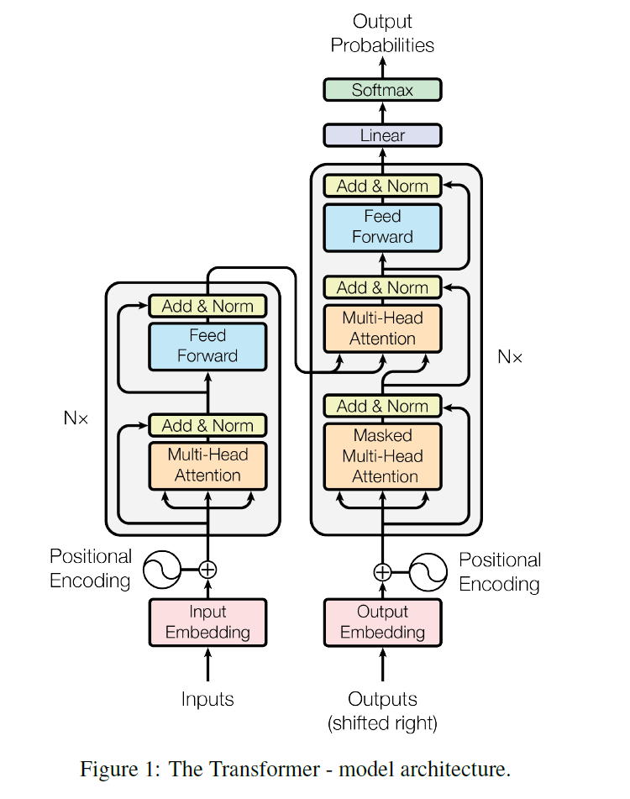
Transformer Architecture
Encoder
6 identical layers
Two sub-layers
Multi-head self-attention
Position-wise fully connected feed-forward network
Decoder
6 identical layers
Three sub-layers
Masked multi-head self-attention
Multi-head self-attention
Position-wise fully connected feed-forward network

Slide 5




Implementation
Programming language: Python
Framework: Pytorch
Files

Slide 6
Implementation
class FeedForward
class PositionalEncoder
Inject the position information in the output of Embedder
class MultiHeadAttention
class Attention
calculate attention using q, k, v generated from the input vector
class WordEmbedder
Convert word to 512
dimentional vector

Slide 7
Implementation
Class Encoder:
Get Input Sentence
Call WordEmbedder
Call Positional Encoder
for i in range(6):
Call MultiHeadAttention
Call FeedForward

Slide 8
Implementation
Class DecoderCycle
Get masked output sentence as input
Call WordEmbedder
Call PositionalEncoder
for i in range(6):
Call MultiHeadAttention with mask
Call MultiHeadAttention
Call FeedForward
Do Linear on the output of previous step
Do Softmax to get the probability
Class Decoder
Call DecoderCycle untile all words in the sentence is predicted

Slide 9
Implementation
Class Transformer
Call Encoder
Call Decoder
Return outputProbability, output

Slide 10
Dataset: WMT 2014 English-to-German
Totally:4.5M sentence pairs | English | German
Orig_pairs | For more information , read our privacy statement . | Mehr Informationen hierzu entnehmen Sie bitte unserer Datenschutzerklärung .
Tokenize, lowercase | ['for', 'more', 'information', ',', 'read', 'our', 'privacy', 'statement', '.'] | ['mehr', 'informationen', 'hierzu', 'entnehmen', 'sie', 'bitte', 'unserer', 'datenschutzerklärung', '.']
Dictionary (TOP:50K) | [13, 53, 126, 4, 889, 39, 2483, 1172, 5] | [92, 43467, 3467, 6742, 47, 391, 137, 0, 4]
Padding (Max:80) | [13, 53, 126, 4, 889, 39, 2483, 1172, 5,X,X,X,X,X,...X,X,X,X,X,X] | [st,92, 43467, 3467, 6742, 47, 391, 137, 0, 4,et,X,X,X,X...,X,X,X,X,X]
Word Embedding | 13 ---> [0.15,0.71,0.18,0.2….] length=512 53 ---> [0.2….] . . X ---> [0.7….] | st ---> [0.13,0.92,0.38,0.9….] length=512 43467 ---> [0.2….] . . X ---> [0.4….]
Figure 5

Slide 11

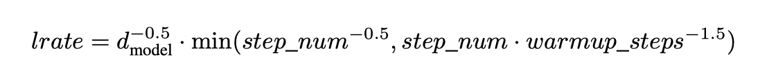
Models
In the paper:
GPUs: 8 (not used)
Adam optimizer (used):
learning rate (used):
Warmup_steps(used) = 4000 (0.04% of total training steps)
training steps(used): 100K
Hyperparameters we decide:
batch size: 4
small epochs to save training time: 3, 5
Save the model with least loss, best accuracy

Slide 12
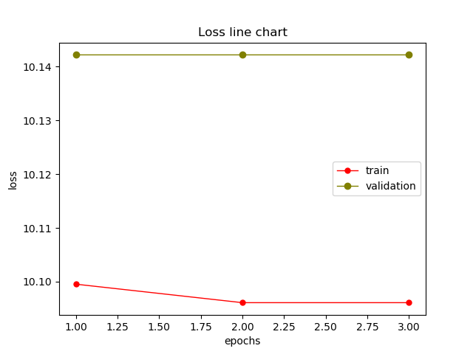
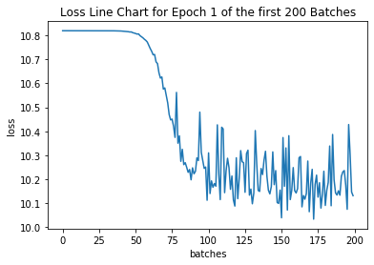
Model 1:
Training dataset: 87400 pairs of sentences
Validation dataset: 5800 pairs of sentences
Testing dataset: 3912 pairs of sentences
Warmup steps: 4000
Epochs: 3

Slide 13
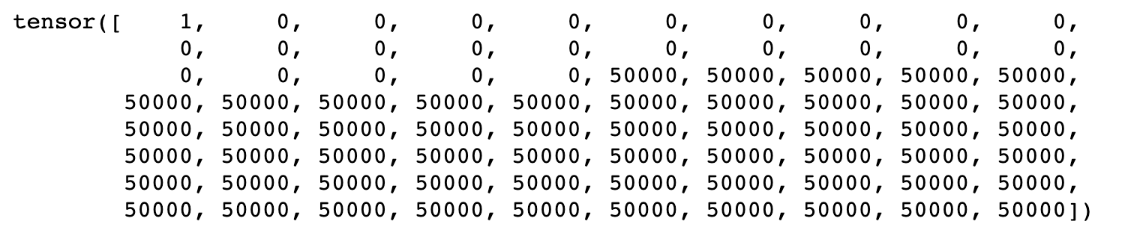
Model 1:
BLEU: 3.62
Sample Prediction:
Model can predict the length of the sentence
Factors might affect the model:
Data is unbalance, too many padding in the dataset
Comparing to vocabulary dictionary(size 50000), sample is limit
Batch size is too small, create a lot of noise
Step size too big

Slide 14
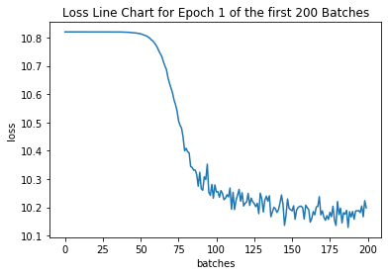
Model 2: test batch size
Same dataset as Model 1
Update weight after every 10 mini batches(size 4)
BLEU: 3.84 (higher than model 1)
Sample Prediction: Same as Model 1, only predict 0, 50000
Loss:
Conclusion: Accumulating weight can avoid some noise

Slide 15
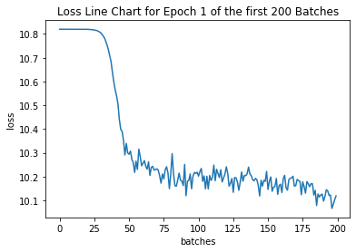
Model 3: increase train dataset
Training dataset: 300K pairs of sentences
Validation dataset: 30K pairs of sentences
Testing dataset: 10K pairs of sentences
Update weights after training 10 mini-batches(size 4)
Train was not finished (more than 5 days)
Loss:

Slide 16
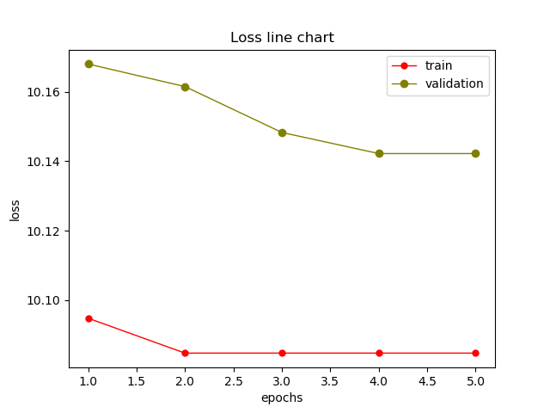
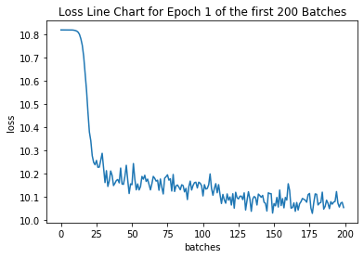
Models 4: change warmup steps
Same dataset as Model 1
Epochs: 5
Update weights after training 10 / 50 mini-batches(size 4)
Warmup-step: 0.04% of total step
Loss:

Slide 17
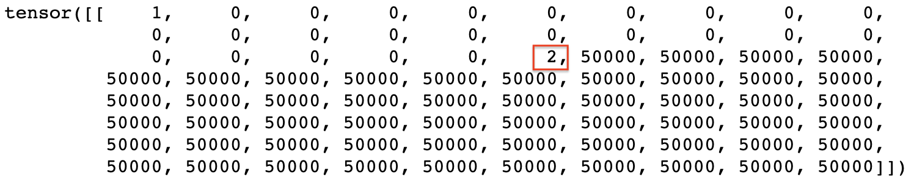
Model 4:
BLEU: 3.65
Sample Prediction:
Model can predict the length of the sentence and provide a eos sign.

Slide 18
Model 5: decrease padding
Divide dataset based on the length of the original sentence and target sentence.
Length <= 10
10 < Length <= 20
20 < Length <= 30
30 < Length <= 40
40 < Length <= 60
60 < Length <= 80
Train a model for each case
Choose 100K data
Train 5 epoch

Slide 19
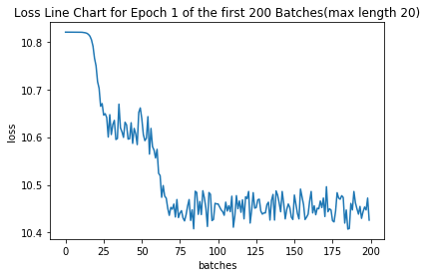
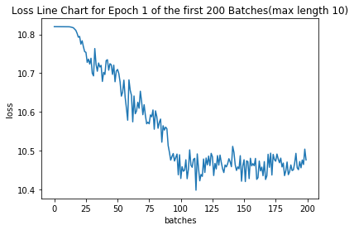
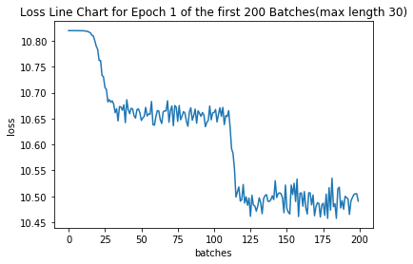
Model 5: decrease padding
Loss:

Slide 20
Model 5: decrease padding
BLEU score:
Model max length 10: 6.09
Model max length 20: 8.38
Model max length 30: 5.41
Model max length 40: 6.09
Sample output:
Max length 10
Max length 20
Max length 30 / 40 (Factor: epochs, data size)

Slide 21
Conclusion
Accumulate gradients help avoid noise
Train dataset size matters to the loss
Correct warmup steps help model decrease loss dramatically
Divide dataset based on the length of sentence solve the too much padding problem

