Slide 1
MANOVA
Multivariate Analysis of Variance

Slide 2
MANOVA
An extension of ANOVA when you have more than one dependent variable (You can also have several Independent variables)
Should be some sound conceptual reason for considering the dependent variables together and they should be correlated with one another at a low to moderate level. By including all outcome variables in the model MANOVA factors in the relationship between them
If they are too highly correlated, there is a risk of multicollinearity.
If they are uncorrelated, there is usually no reason to analyze them together.
MANOVA compares groups and tells you whether the mean differences between the groups on the combination of dependent variables are likely to have occurred by chance
MANOVA creates a summary dependent variable and performs an analysis of variance using this new combined dependent variable

Slide 3
MANOVA
MANOVA is not appropriate if all of your dependent variables are highly intercorrelated. It may be better in these circumstances to combine the dependent variables to give a total score which is then analysed using ANOVA
Consideration has to be given to what is to be gained by using MANOVA. For example, where the dependent variables are highly correlated and have a single underlying dimension, the scores on the dependent variables could be totaled and used as the score variable (i.e. the dependent variable) in ANOVA instead.
This may yield a slightly more powerful test but only in these circumstances where the dependent variables correlate substantially.

Slide 4
MANOVA
If MANOVA is significant, then this indicates that the groups in the study differ in terms of a combination(s) of the dependent variables. this leaves the researcher to examine the data in more detail by doing ANOVAs on the individual dependent variables.

Slide 5
Example of research question
Example: Are males better adjusted than females in terms of their positive and negative mood states and levels of perceived stress?
Note: Two or more continuous dependent variables that are related.
MANOVA tests the null hypothesis that that the population means on a set of dependent variables do not vary across different levels of a factor or grouping variable

Slide 6
MANOVA vs Multiple ANOVAs
MANOVA controls family-wise error rate (Type I error)
MANOVA takes account of relationships between DVs –
MANOVA takes account of the correlations between the dependent variables
Multiple ANOVAs will ignore the relationship between the dependent variables
Thus MANOVA can detect whether groups differ along a combination of dimensions

Slide 7
Theory behind MANOVA
In ANOVA we look at the ratio of systematic to unsystematic variance.
In MANOVA we look at the ratio of a matrix representing the systematic variance of all dependent variables to a matrix representing the unsystematic variance of all dependent variables
SSCP matrices are used in the same way as the simple sums of squares in univariate linear models to derive test statistics that are multivariate equivalents of the F-statistic (i.e., they represent the ratio of systematic to unsystematic variance in the model).

Slide 8
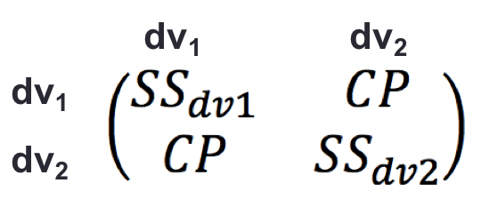
In Univariate ANOVA we calculated the F statistic by dividing the SS_{between} by the SS_{within}
The approach in Multivariate ANOVA is analogous in that we divide two matrices in which the sums of squares and the cross products are represented.
The Total SSCP matrix contains the total sums of squares for each outcome variable and the total cross-product between the outcome variables.
It represents both the total amount of variation that exists within the outcome variables and the total co-dependence that exists between them.

Slide 9
The Total SSCP can be broken down into a Model SSCP and a Residual SSCP
The univariate F is the ratio of systematic variance to unsystematic variance (i.e., it is a function of SS_{M} divided by SS_{R})
The conceptual multivariate equivalent is therefore to divide the Model SSCP matrix by the Residual SSCP matrix
Model SSCP
Residual SSCP

Slide 10
Test Statistics
There are several multivariate test statistics which, despite being differently calculated, do much the same thing – tell you if your group ‘means’ are different on the set of dependent variables as a whole. These multivariate tests include
Pillai’s Trace
Wilks’ Lambda
Hotelling’s Trace
Roy’s Largest Root
Wilks’ Lambda & Pillai’s Trace are good general purpose test statistics
If the p value for the statistic is less than α, then the groups differ significantly with respect to the dependent variables.

Slide 11
MANOVA - Assumptions
Independent observations: each person’s scores are independent of every other person’s scores. Independence of observations is a design issue
Random sampling: Data should be randomly sampled and measured at interval level
If you are planning to use MANOVA before collecting your data, problems may be avoided by making sure that each of your groups (or cells) have the same number of participants. If you do this then violating other assumptions of MANOVA is less of a problem.
Normality: in MANOVA, we assume that the residuals have multivariate normality
Homogeneity of variance-covariance matrices (Box’s Test)
Absence of Multicollinearity
Linearity: Straight line relationship between each pair of dependent variables

Slide 12
Assumption Testing - Normality
Normality:
Check univariate normality and multivariate normality (using Mahalanobis distances)
Univariate normality SPSS: Analyse ↵ Descriptive Stats ↵ Explore↵
Multivariate normality: see over
MANOVA is robust to violations of multivariate normality and to violations of homogeneity of variance/covariance matrices if groups are of nearly equal size

Slide 13
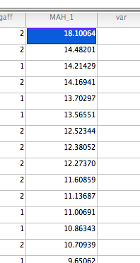
Assumption Testing Multivariate normality
Analyse ↵ Regression↵ Linear↵
and proceed to calculate Mahalanobis distances (the distance of each case from the centroid of the remaining cases – i.e. the point created by the means of all the variables)
This procedure creates a new variable in the data file (mah_1)
Need to compare individual Mahalanobis distances against a critical value (chi-square critical value table)
Picks up cases that have a strange pattern of scores across the dependent variables
MANOVA can tolerate a few non-extreme outliers if there is a reasonable sample size

Slide 14
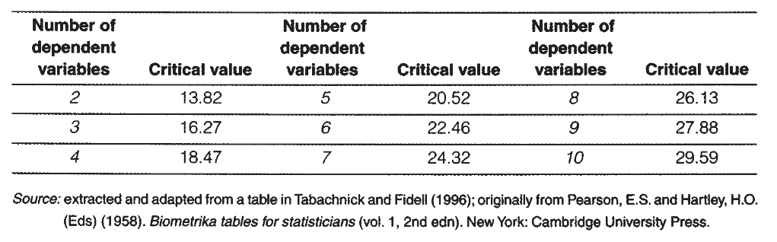
Critical Values Mahalanobis Distances
Cases with a Mahalanobis distance greater than the relevant critical value are multivariate outliers
MANOVA can tolerate some outliers if the data file is of reasonable size and the outliers are not too extreme

Slide 15
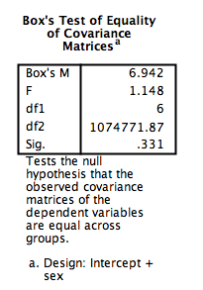
Assumption Testing – Homogeneous covariance matrices - Box’s Test
Box’s test Homogeneity of variance/covariance matrices can be checked with Box’s M test and homogeneity of variance can be assessed with Levene’s statistic.
Box’s test should be inspected, especially when group sizes differ
Should be non-significant when the matrices are similar
If Box’s test yields a significant value this means that the covariances are not similar, which violates one of the assumptions on which MANOVA is built.

Slide 16
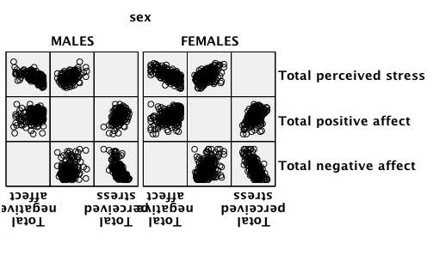
Assumption Testing - Linearity
Linearity: Straight line relationship between each pair of dependent variables?
Generate scatter plots between each pair of variables, separately for our groups (Male & Female)
Graphs↵ Legacy Dialogs↵ Scatter/Dot↵
Matrix Scatter↵

Slide 17
Assumption Testing – Absence of Multicollinearity
Another condition that should be examined is the potential for multicollinearity among the dependent variables. Multicollinearity can affect both results and the validity of interpretation of results.
Multicollinearity: When one variable is a combination of the other variables
Check strength of correlations:
If the correlations were high (say 0.60 or above, we would consider either making a composite variable (in which the highly correlated variables were summed or averaged) or eliminating one of the variables.

Slide 18
Example of research question
Example: Are males better adjusted than females in terms of their positive and negative mood states and levels of perceived stress?
Note: Two or more continuous dependent variables that are related.
MANOVA tests the null hypothesis that that the population means on a set of dependent variables do not vary across different levels of a factor or grouping variable
See survey5ED.sav data file

Slide 19
Matrix Scatter plots

Slide 20
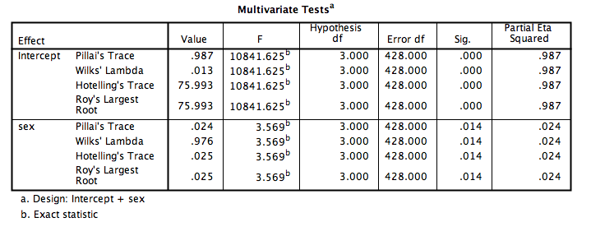

Slide 21
Following up the MANOVA
Software will provide univariate Fs for the separate univariate ANOVAs for each dependent variable. Similar to repeated measures analysis, these ANOVA results are not usually examined unless the multivariate results (the MANOVA) are statistically significant.
The MANOVA may show that there are differences in the ‘means’ of the composite of the dependent variables due to the independent variable group (condition)
Thus univariate ANOVAs can be used to follow up the MANOVA (a different ANOVA for each dependent variable).
The results of these are listed in the table entitled Tests of Between-Subjects Effects.

Slide 22
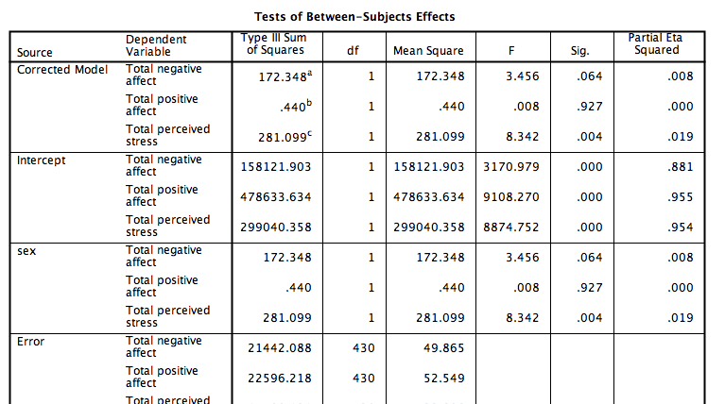
Tests of Between-Subjects Effects
ANOVAs can be used to follow up the MANOVA (a different ANOVA for each dependent variable).
The results of these are listed in the table entitled Tests of Between-Subjects Effects.
Apply Bonferroni adjustment!

Slide 23
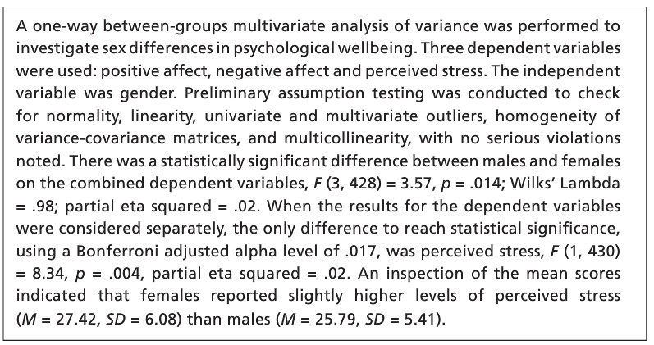

Slide 24
MANOVA Example No.2
See Pesticides_working memory.sav data file
A study looked at whether low-level exposure to certain pesticides brought about neuropsychological impairment. The study involved two groups:
127 farmers who had been exposed to the pesticides.
78 individuals in a control group who had not been exposed to the pesticides.
The dependent variables that we will look at are scores on three subtests designed to measure working memory
The arithmetic test
The digit span test
The letter/number substitution test
The hypothesis we shall be testing is that there will be a difference between the groups in terms of their working memory.

Slide 25
MANOVA

