Slide 1
Data Preprocessing

Slide 2

Low Repeat Benchmarking
Used 7 different approach:
Kmer (from plant-CAD2)
Kmer without overlap with GFF gene annotation
pyTRF
TRF
RepeatMasker (-noint option)
SDUST via pydustmasker
Tantan via pydustmasker
Software sources:
https://github.com/baoxingsong/dCNS/
https://github.com/lmdu/pytrf
https://github.com/Benson-Genomics-Lab/TRF
https://github.com/Dfam-consortium/RepeatMasker/
https://github.com/apcamargo/pydustmasker
Notes:
Just some notes regarding Gunnera tree

Slide 3
Plant-CAD2 Approach
Kmer method from plant-CAD2
Count kmer on genome (k=20)
High copy kmer + low complexity region
Find threshold value via secondary derivative approach
Map high copy kmer back to the genome and masking
Oryza sativa japonica genome
Unique kmer region
High copy kmer = mostly low complexity & SSR
Notes:
Just some notes regarding Gunnera tree

Slide 4
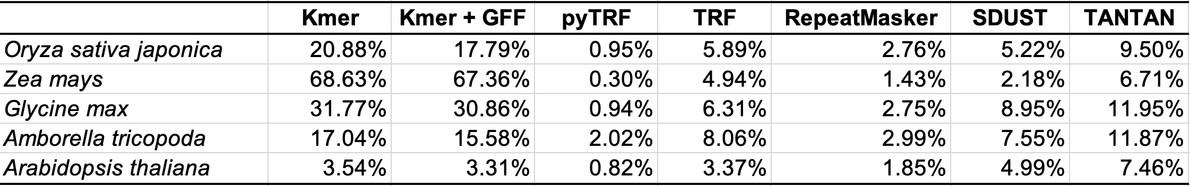
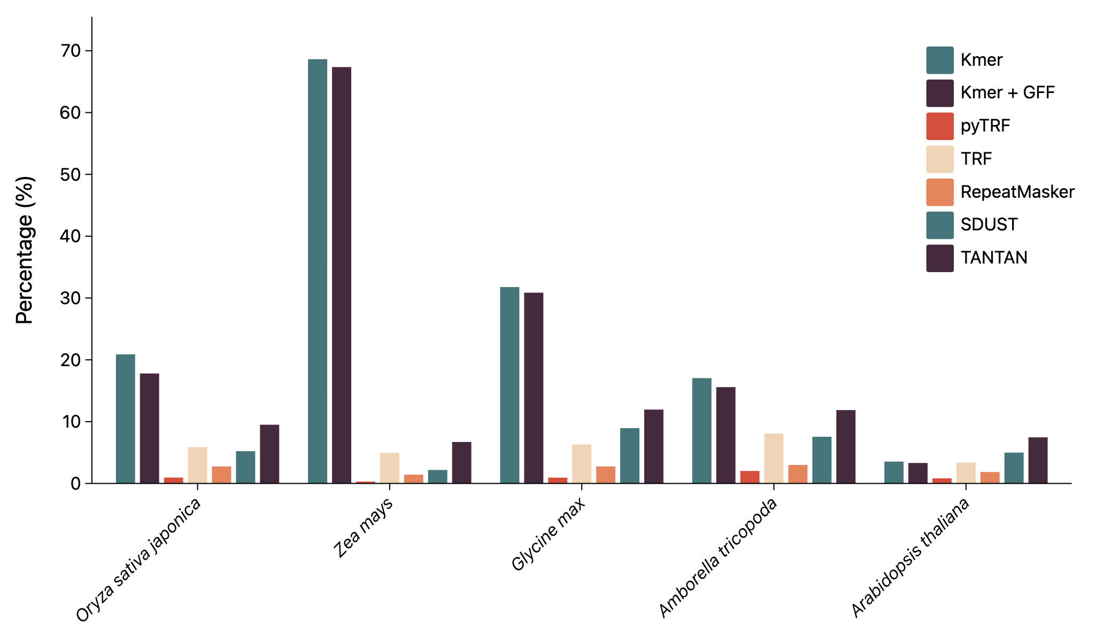
Low Repeat Benchmarking
Masking percentage
Runtime performance
pyTRF > SDUST > Tantan > Kmer > TRF > RepeatMasker
Kmer approach mask more genome region probably not just low complexity repeat, but also high copy TE, satellite, rDNA, segmental duplication, etc.
Notes:
Just some notes regarding Gunnera tree

Slide 5
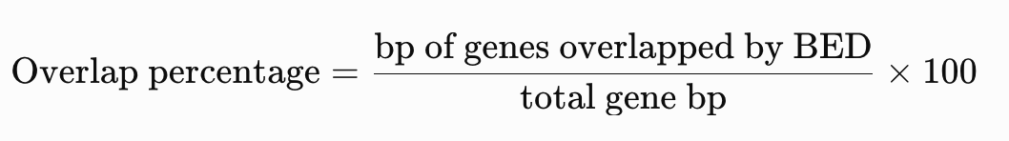
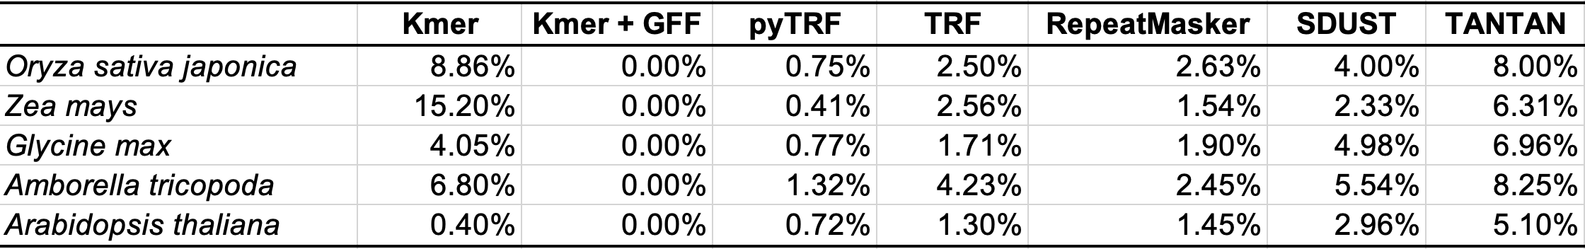
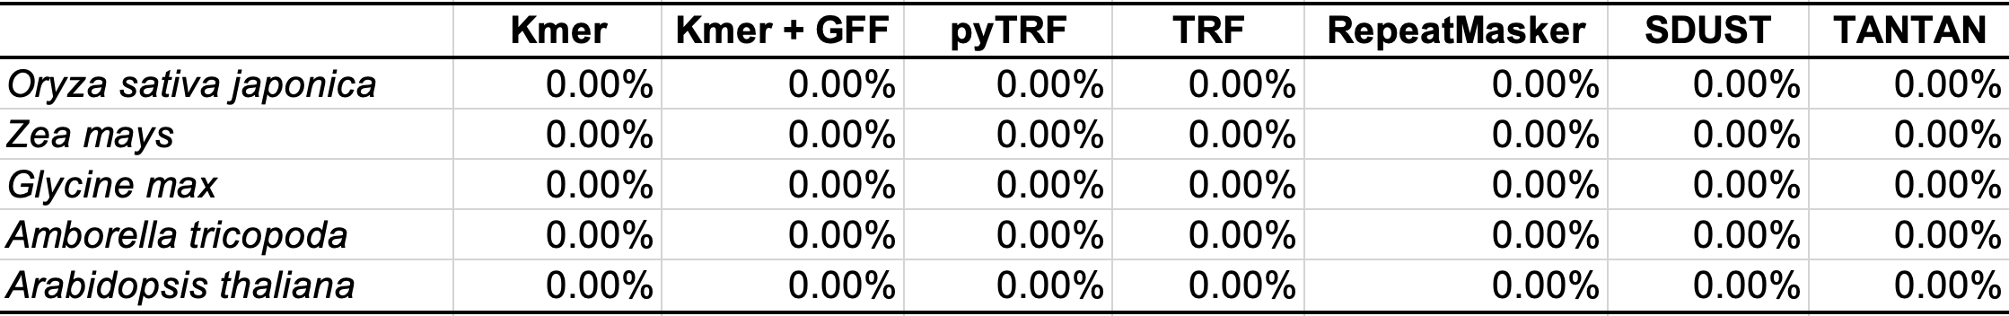
Low Repeat Benchmarking
Overlap with GFF annotation percentage
However, we also can remove identified low complexity region that has overlap with GFF annotation file to make the overlap percentage become zero. It seems that all tools has overlap with GFF annotation beside Kmer + GFF because it already use GFF as input to make sure no overlap
Remove identified low complexity sequence that has overlap with GFF is possible
Notes:
Just some notes regarding Gunnera tree

Slide 6

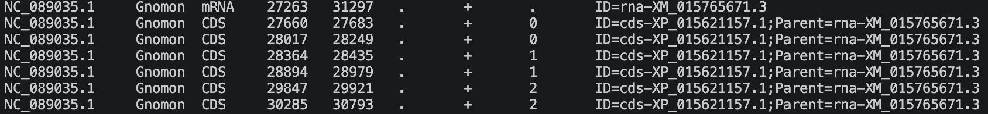
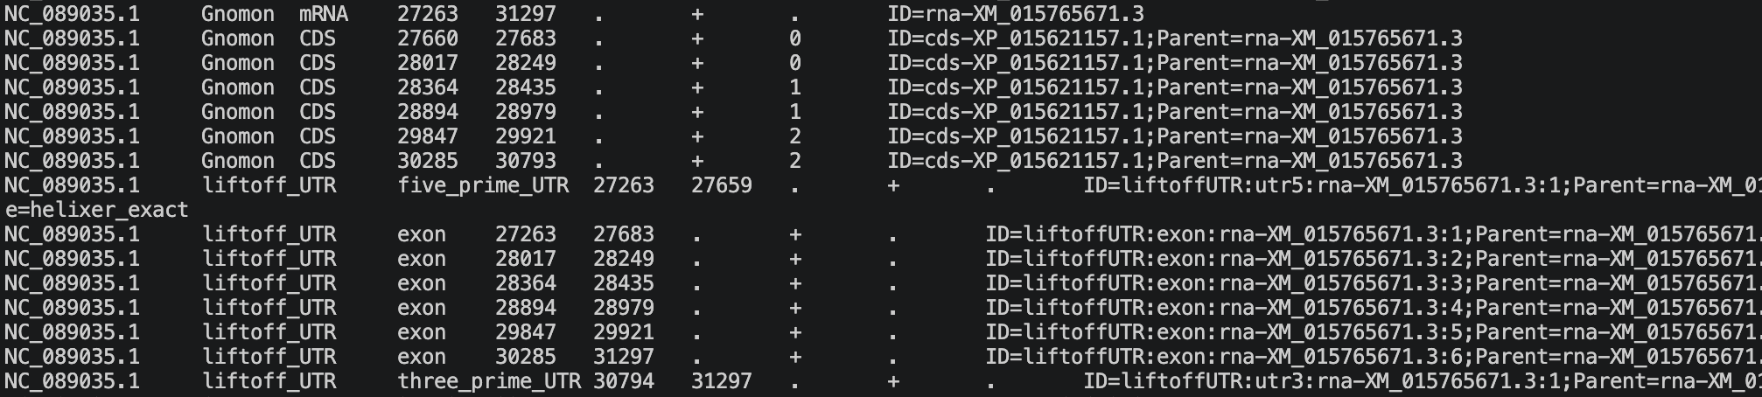
Adding UTR information on GFF
Experimental!
Run Helixer in on the same genome to obtain UTR information
Transfer UTR feature from helixer to original GFF that has high/exact match CDS based on Jaccard + splice junction agreement
Original GFF annotation file
Original GFF only contain mRNA + CDS feature
New GFF after obtained UTR from helixer
Obtained UTR features along side with exon
Tested on Oryza sativa japonica
Notes:
Just some notes regarding Gunnera tree

Slide 7
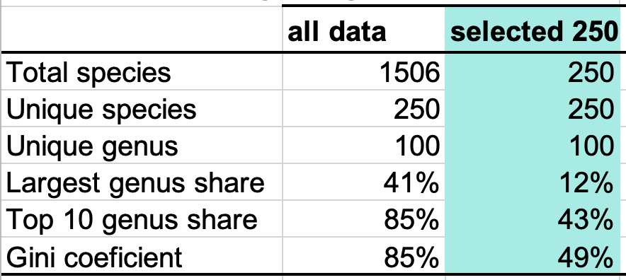
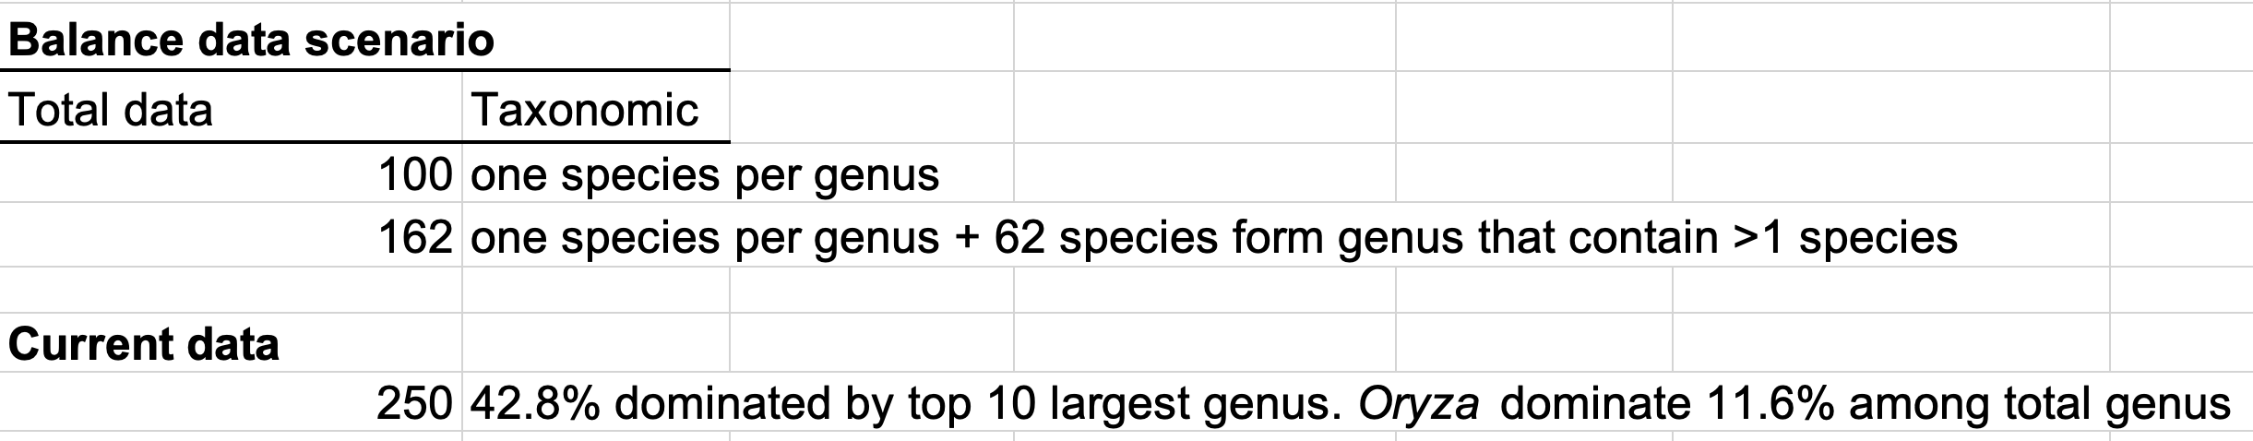
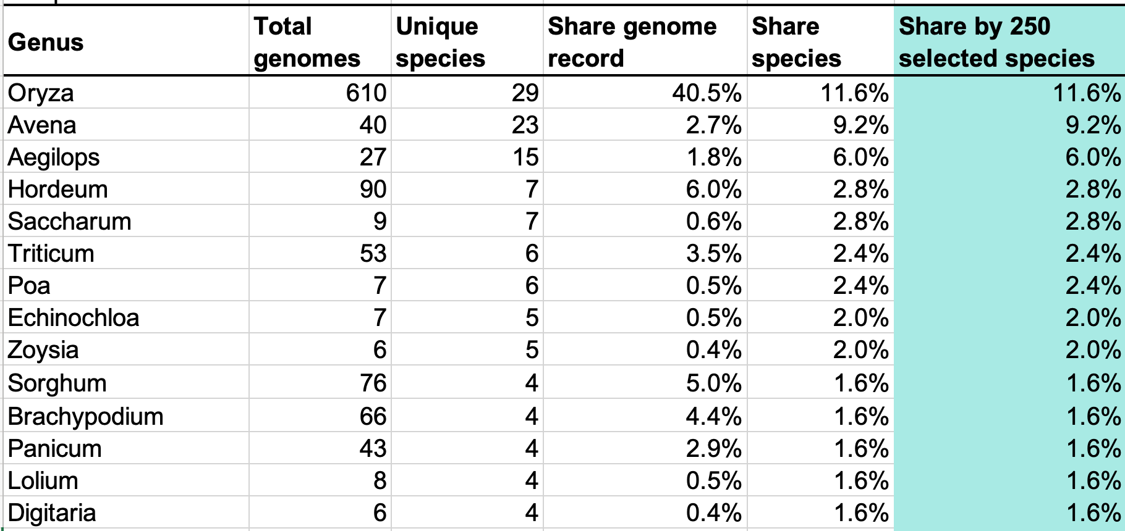
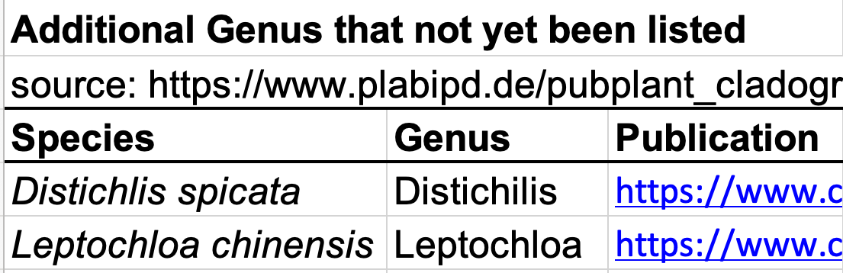
Poaceae Genome List
100 + 2 new genus
Notes:
Just some notes regarding Gunnera tree

Slide 8
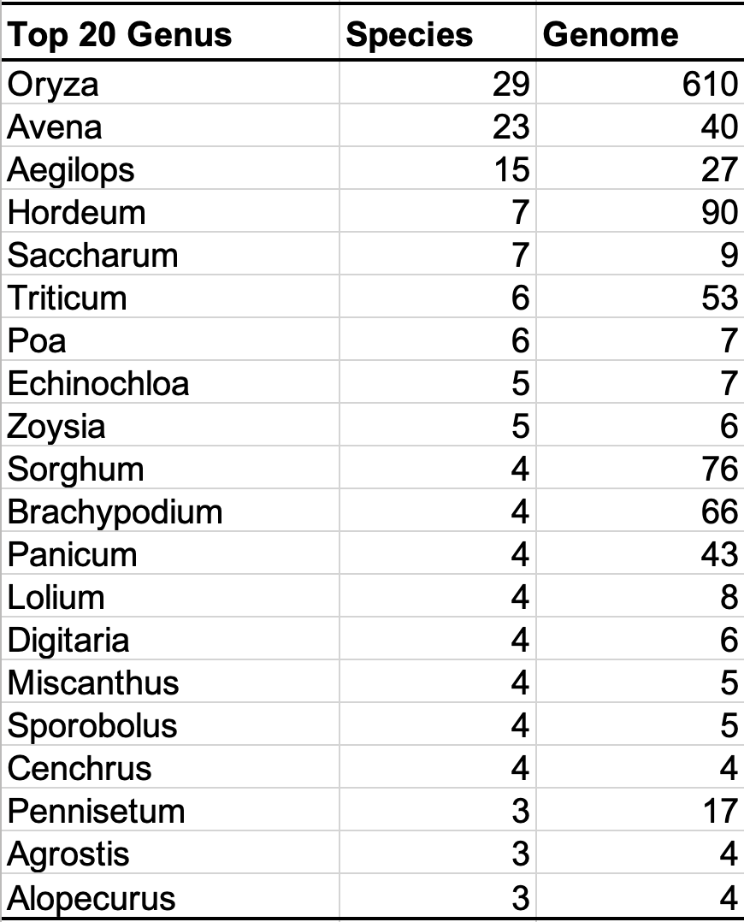
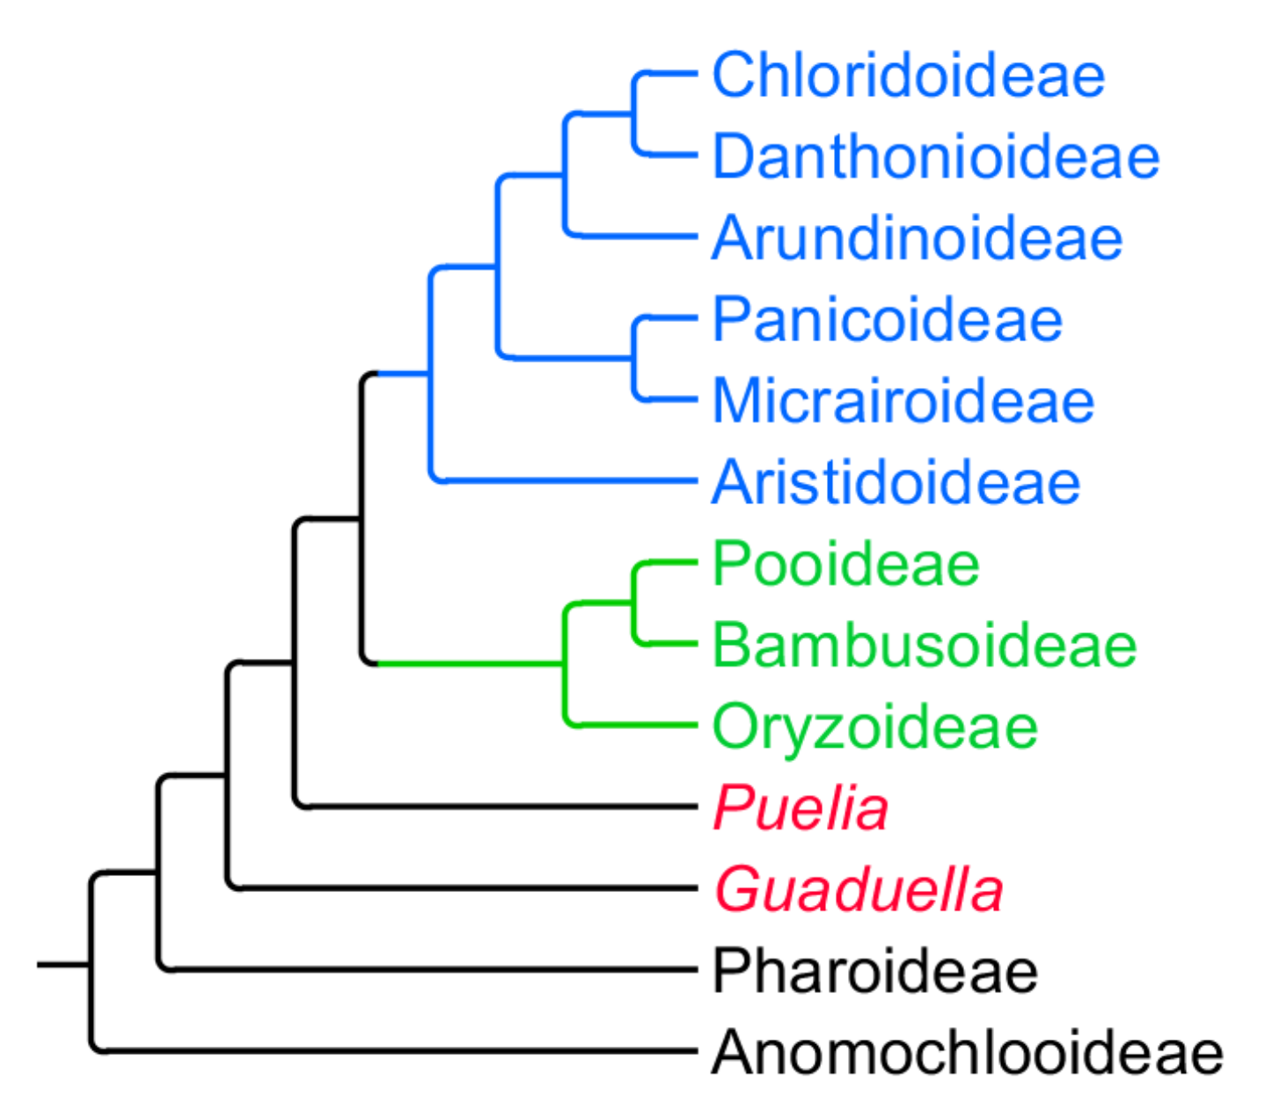
Poaceae Data Training
Subfamily
genome
species
genome
species
30
23
23
23
PACMAD
0
0
0
0
2
2
2
2
477
66
66
66
0
0
0
0
2
2
2
2
BOP
340
100
100
100
31
20
20
20
620
34
34
34
0
0
0
0
0
0
0
0
1
1
1
1
1
1
1
1
Option 1
Option 2
Option 3
Fully balance scenario
Light imbalance scenario
Imbalance scenario
102 species in total, one species from each genus.
164 species in total, one species per genus + 64 species from genus that contain >1 species.
300++ species. One species per genus + economically important species.
Notes:
Just some notes regarding Gunnera tree

Slide 9
TE Annotation (lightweight)
Pipeline 1
Genome
1st RepeatMasker
2nd RepeatMasker
Result
Dfam + RepBase
PlantRep data
Pipeline 2
Genome
1st RepeatMasker
Result
Runtime performance:
Pipeline 2 > Pipeline 3 > Pipeline 1
Dfam + RepBase
Future implementation
Pipeline 3
Specialized Poaceae TE database
Repbase v30.8: Grass + Oryza
Dfam: Grass
RepeatModeler for selected species
Genome
HiTE
Result
Dfam + RepBase
Notes:
Just some notes regarding Gunnera tree

Slide 10
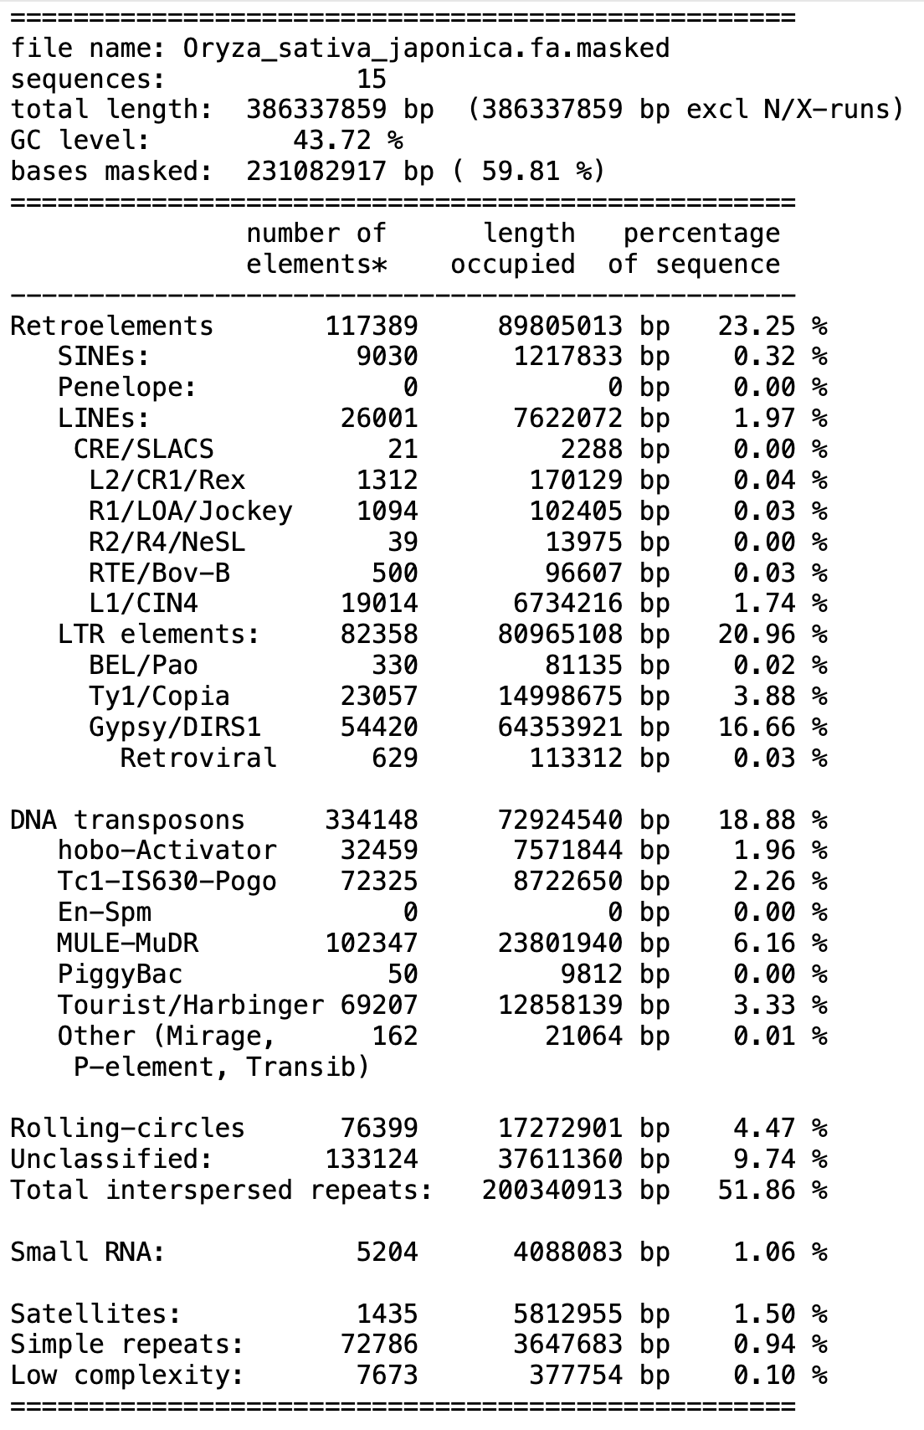
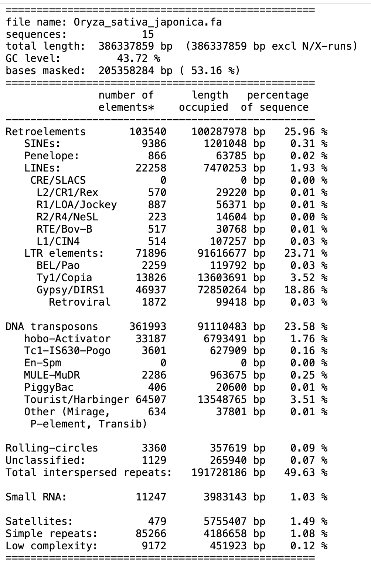
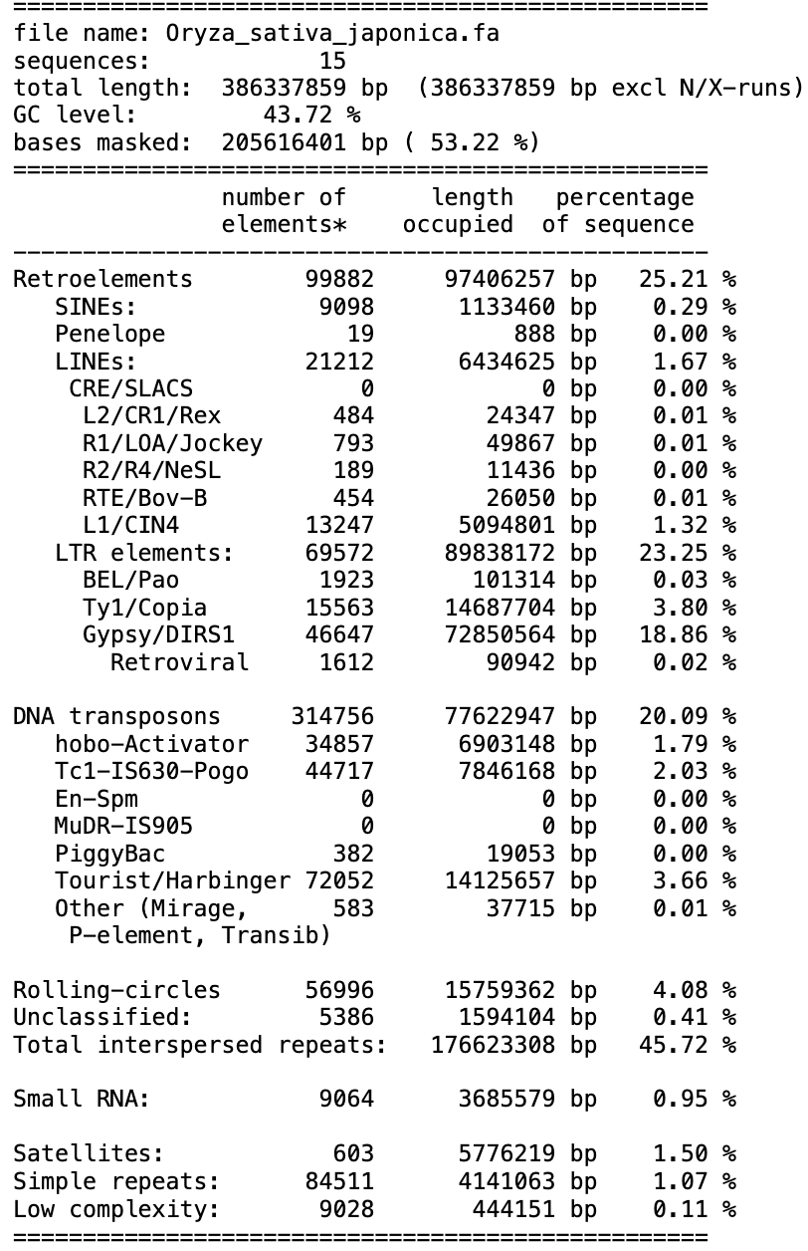
TE Annotation (lightweight)
.tbl output file
Pipeline 1
Pipeline 2
Pipeline 3
Transposable element
Notes:
Just some notes regarding Gunnera tree

Slide 11
Poaceae Data Training
Model evaluation
Evolutionary benchmark (EVObench)
Notes:
Just some notes regarding Gunnera tree

Slide 12
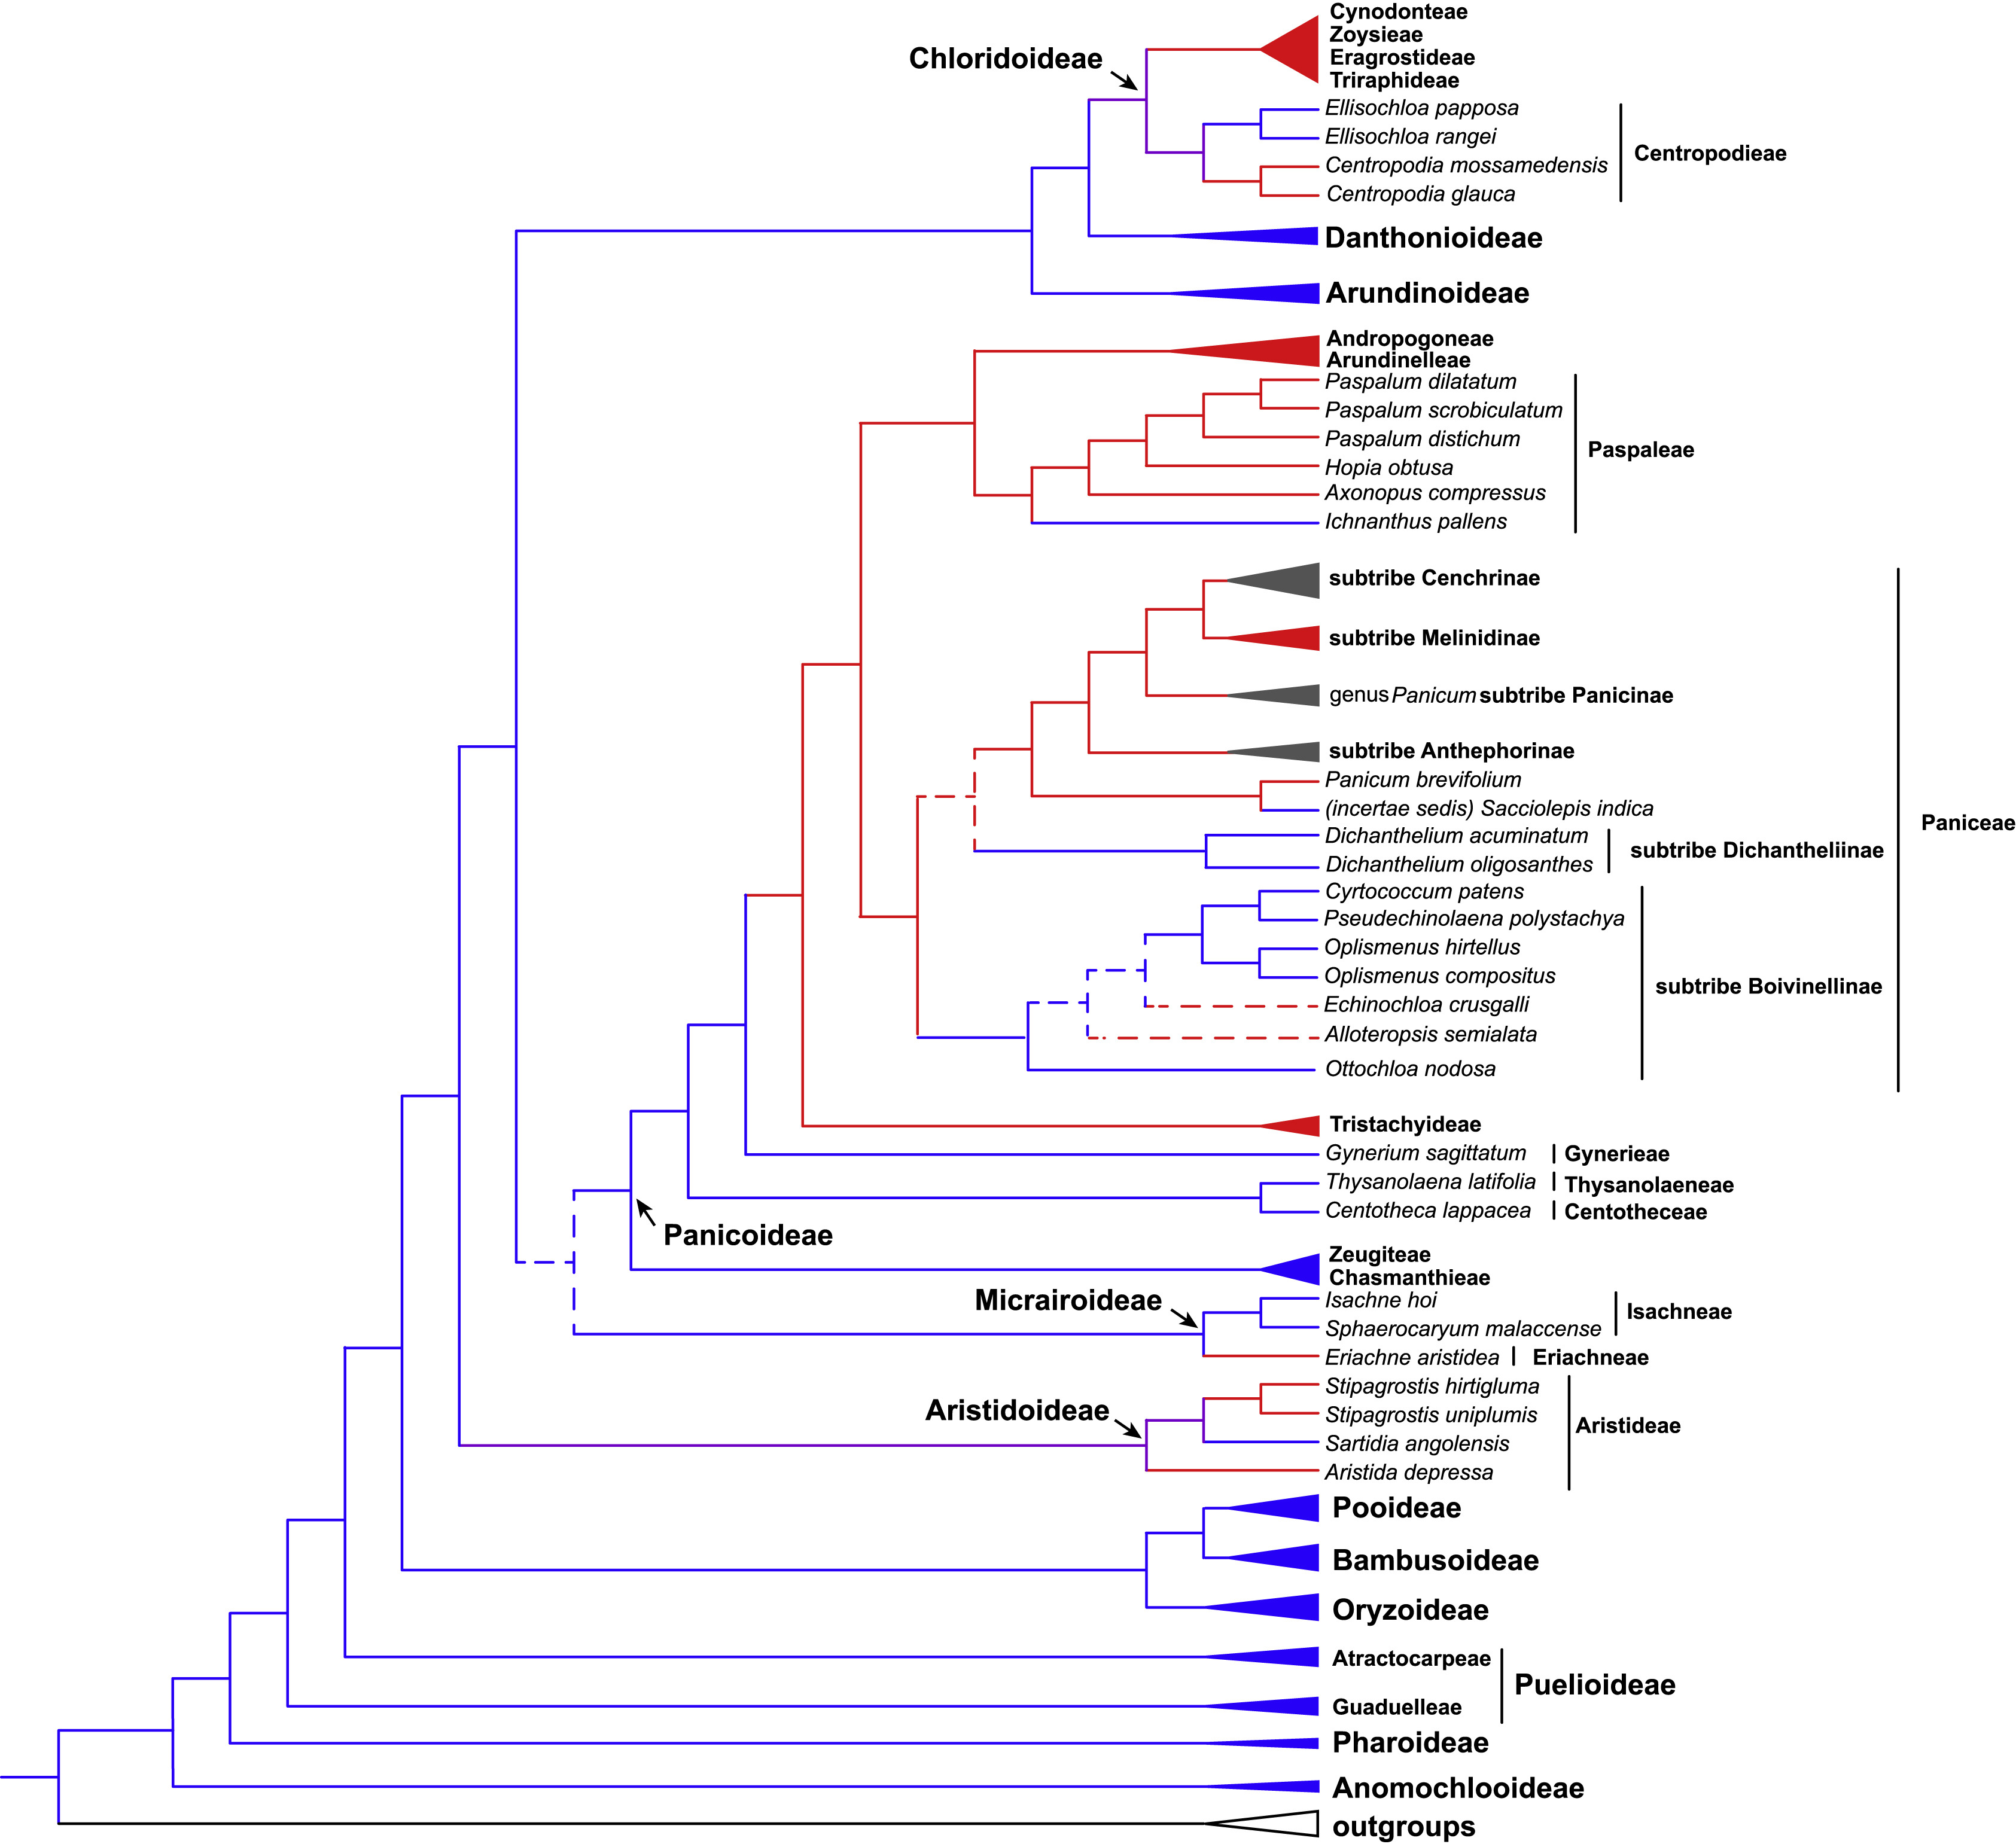
C4 Photosynthesis genes
C₄
Genes related to C4 photosynthesis:
PEPC
NADP-ME
NAD-ME
PPDK
PCK/PPCK
CA
C₃
PEPCK
PPT1
DCT
BASS2
DiT1
DiT2
1-3 kb upstream
1-3 kb downstream
PEPC
Data structure:
Positive = C4 regulatory sequence
Negative = C3 ortholog regulatory sequence
Can the model recognize genomic signatures associated with C4 genes in Poaceae?
Notes:
Just some notes regarding Gunnera tree

Slide 13
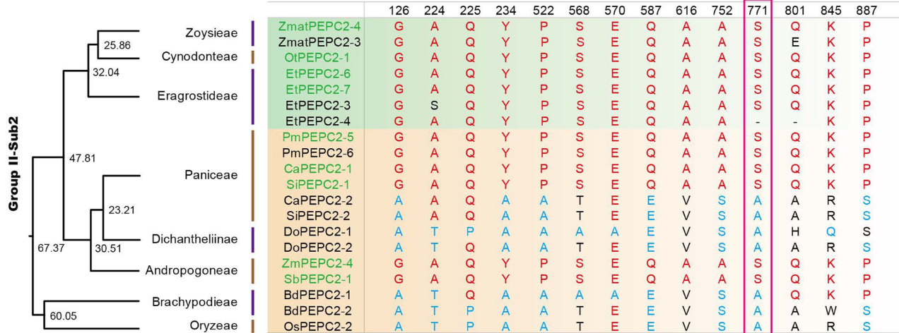
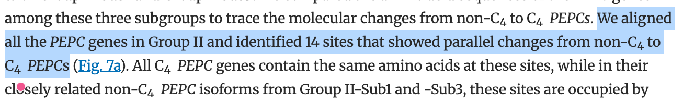
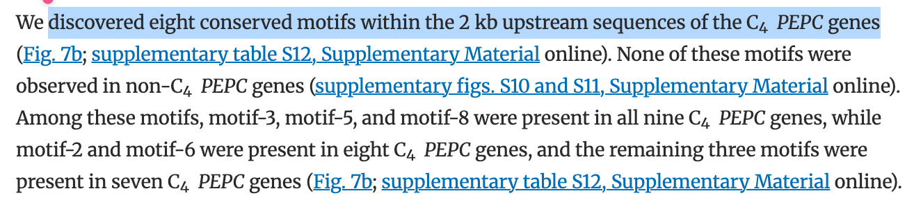
C4 Convergent Sites
Conserved sites labeling:
PEPC, NADP-ME, PPDK orthologs
Multiple sequence alignment
Gene tree
PCOC or CSUBST
Convergent sites
Map protein sites → CDS
Extract sequence window
Negative control (non-convergent sites)
Can the model recognize genomic signatures associated with convergent C4 genes in Poaceae?
https://doi.org/10.1093/gbe/evae163
Notes:
Just some notes regarding Gunnera tree

Slide 14
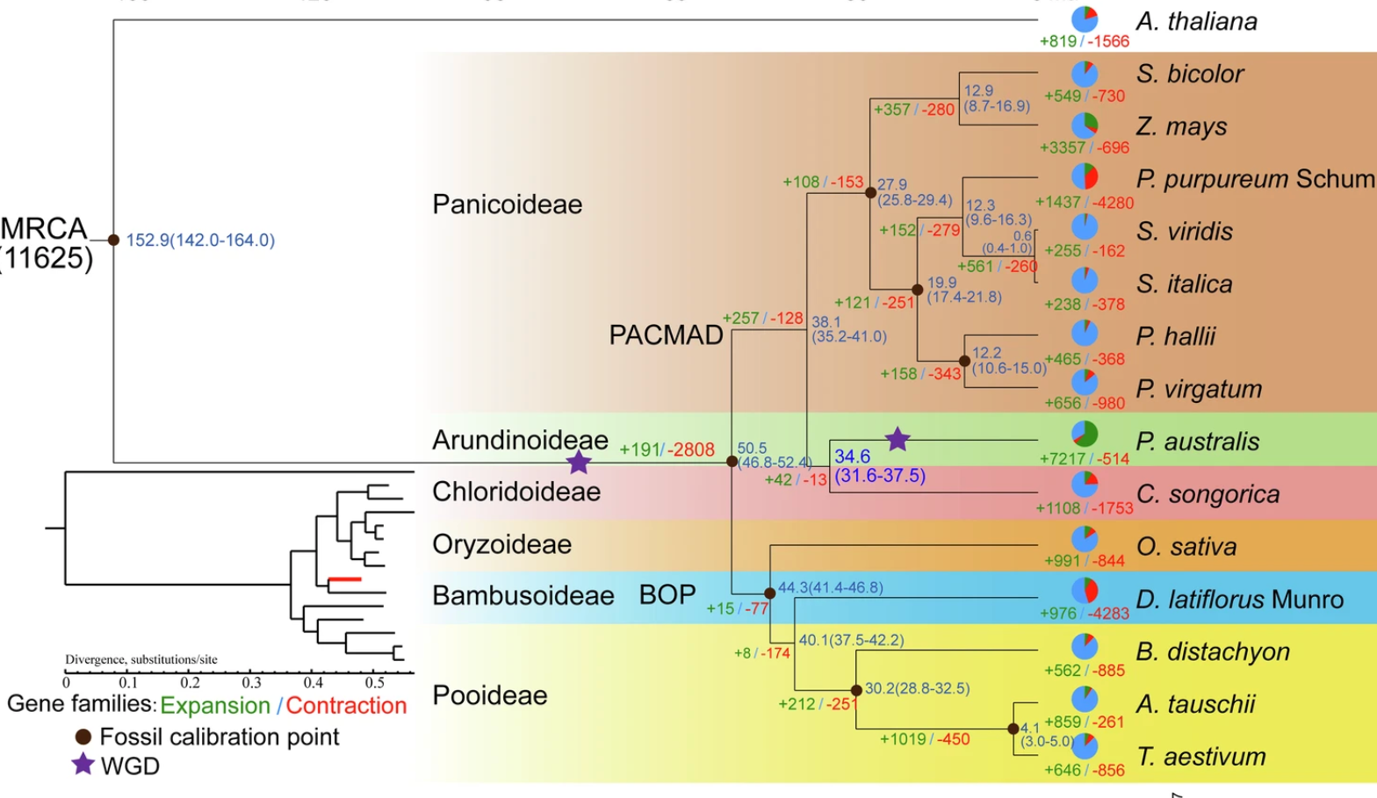
Gene Family Evolution
Gene family labeling procedure
Protein with map back to it DNA sequence
Construct orthogroups with OrthoFinder or SonicParanoid2
Gene family evolution inference with CAFE5 or Count with Wagner algorithm
Expected label:
Simple: conserved vs evolutionary event
Complex label:
Gain
Loss
Expansion
Contraction
Classification + regression: gene family copy number prediction
Can the model identify sequence signatures associated with gene-family evolutionary dynamics?
https://www.nature.com/articles/s42003-025-07532-y
Notes:
Just some notes regarding Gunnera tree

Slide 15
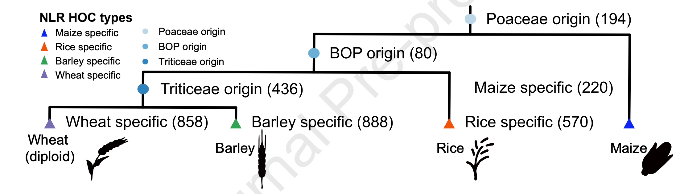
Lineage Specific innovation
Expected label:
Lineage specific (Novel): gene that are present in the species, while being absent in all species of outgroup
Conserved: present across most Poaceae species
Can the model identify DNA sequences belonging to lineage-specific innovations?
https://www.sciencedirect.com/science/article/pii/S1674205226002790
https://www.nature.com/articles/s41586-025-09722-4
Notes:
Just some notes regarding Gunnera tree

Slide 16
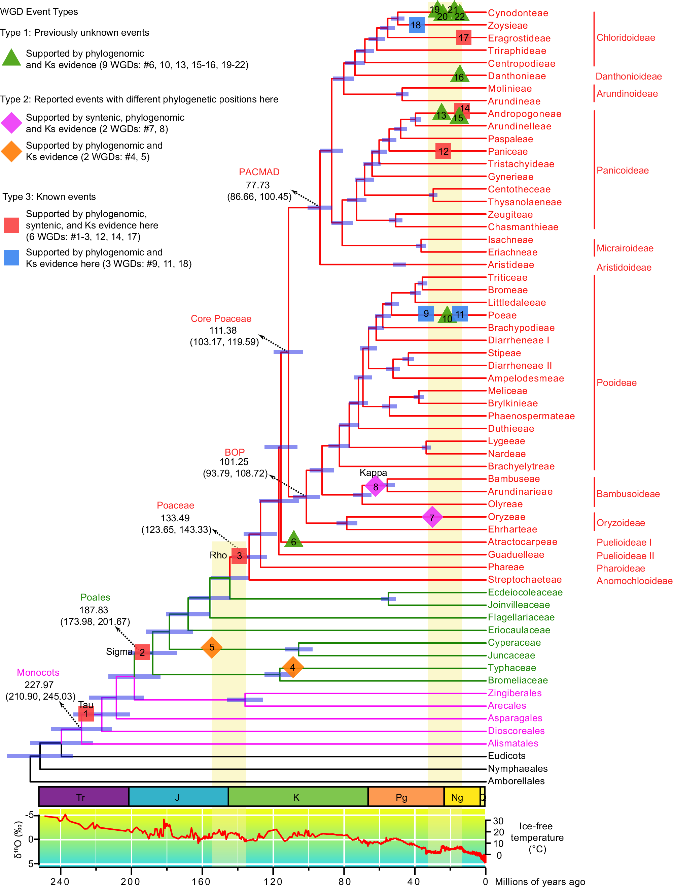

Gene Duplication Timing
Multi label task:
Ancient duplication
Recent duplication
Single copy sequence
Can the model distinguish ancient versus recent duplication?
Notes:
Just some notes regarding Gunnera tree

Slide 17



Selection Pressure
Selection pressure labeling procedure
Orthologues CDS
Codon alignment
Selection pressure analysis → Hyphy: MEME, FEL, aBSREL, Relax
Selected site → map to DNA sequence
Expected label:
Binary: positive vs negative
Multilabel: intensified, relaxed, unchange
Are there sequence signatures that correlate with a particular evolutionary pressure?
Notes:
Just some notes regarding Gunnera tree

Slide 18
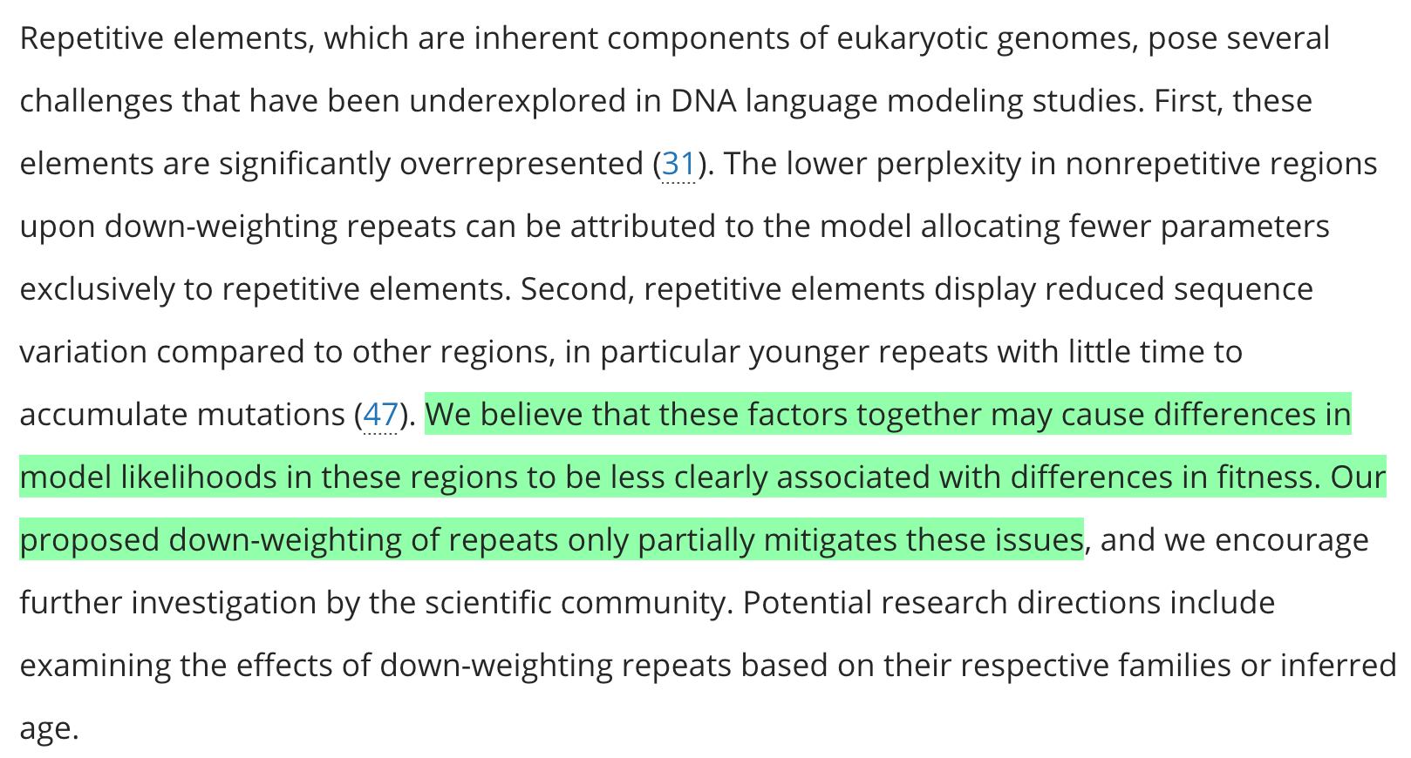
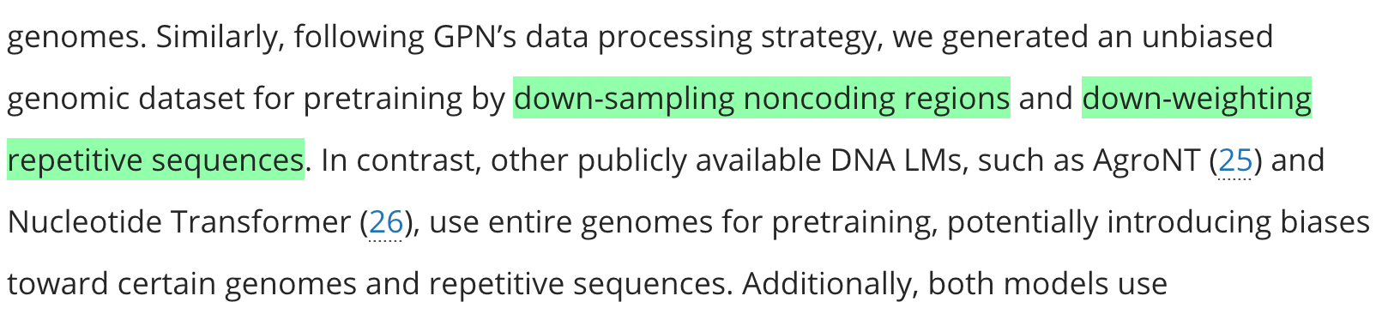
Repetitive Element
Notes:
Just some notes regarding Gunnera tree

