Slide 1
Paper: A spatially resolved multi-omic single-cell atlas of soybean development
yangdong@genomics.cn
2144752653@qq.com
2026/05/20

Slide 2
Brief
Institution, authors, and journal.

Slide 3
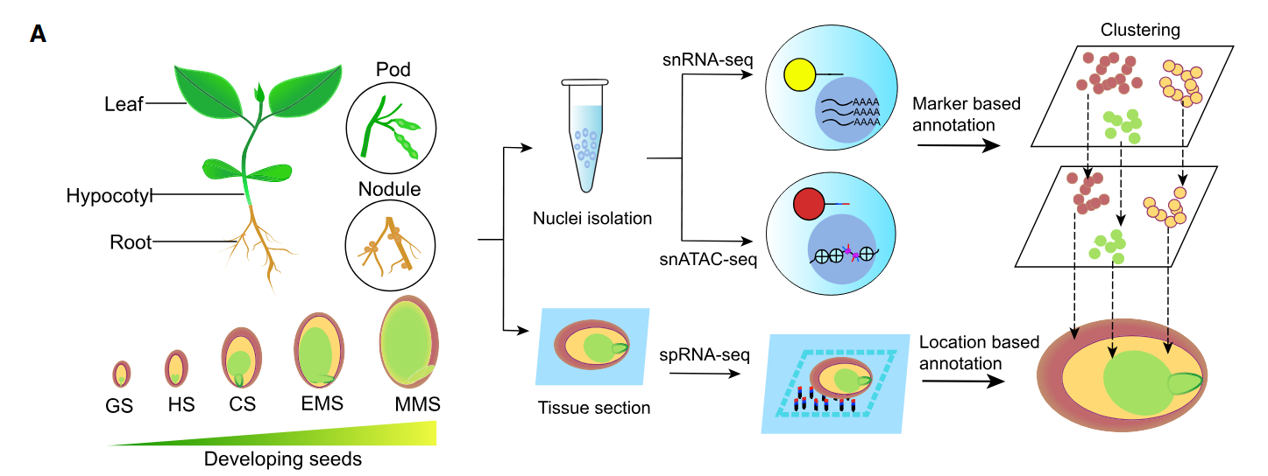
Sample

Slide 4
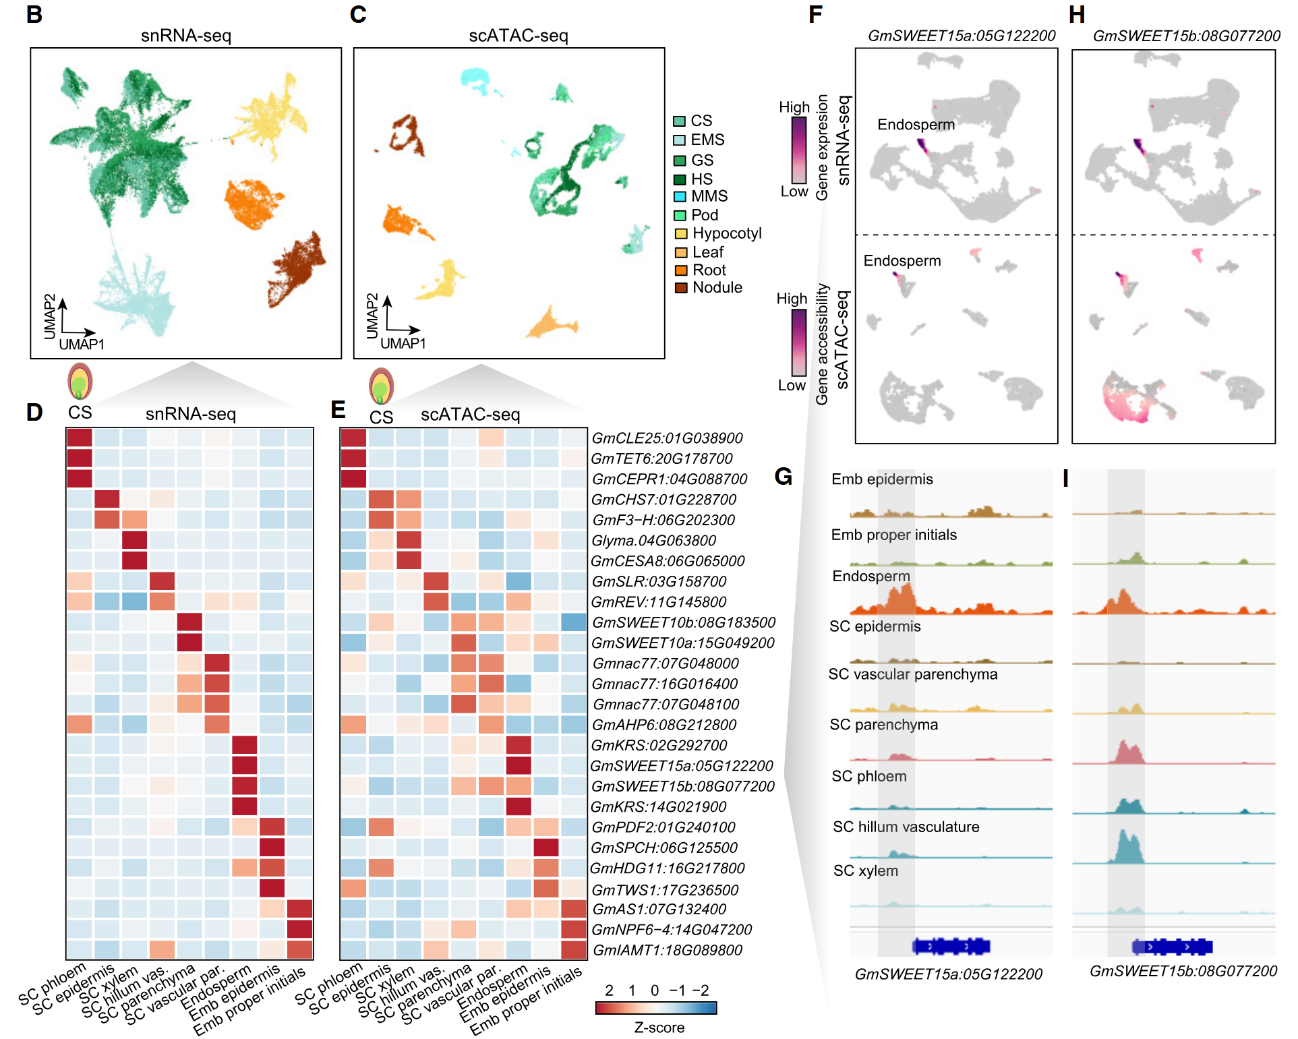
single-cell RNA & ATAC

Slide 5
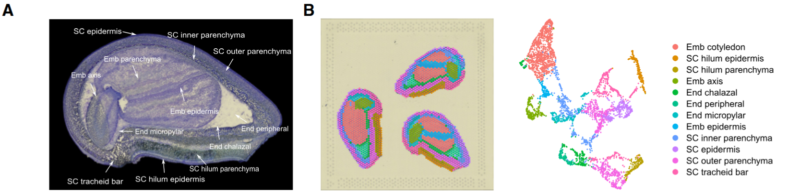
Spatial transcriptome

Slide 6
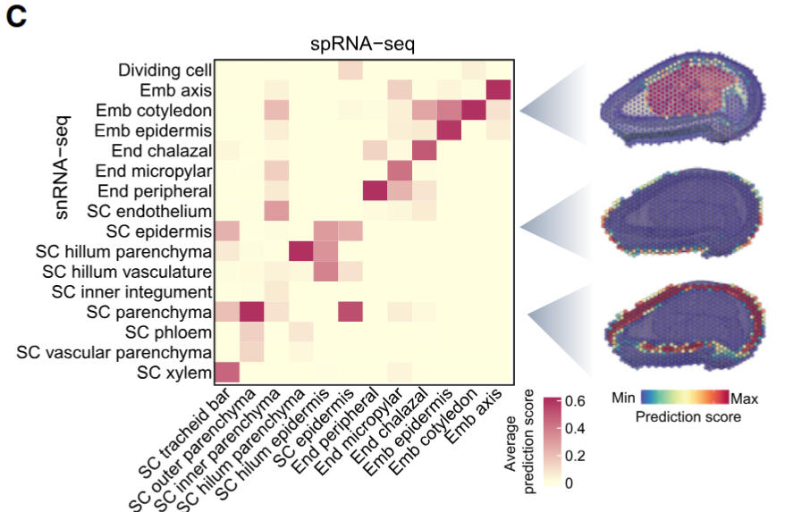
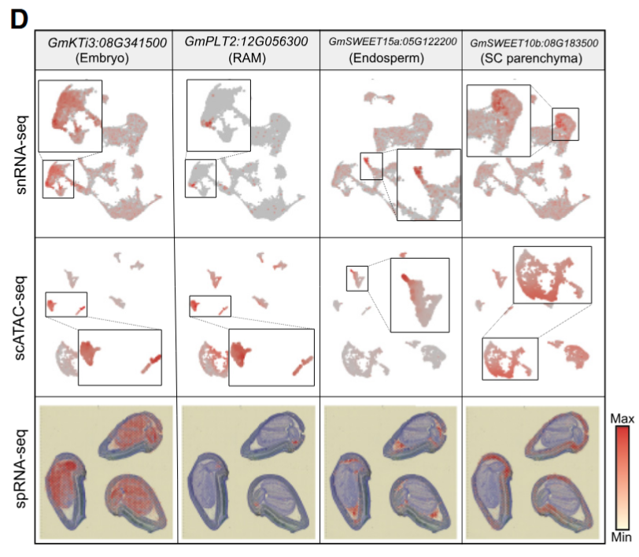
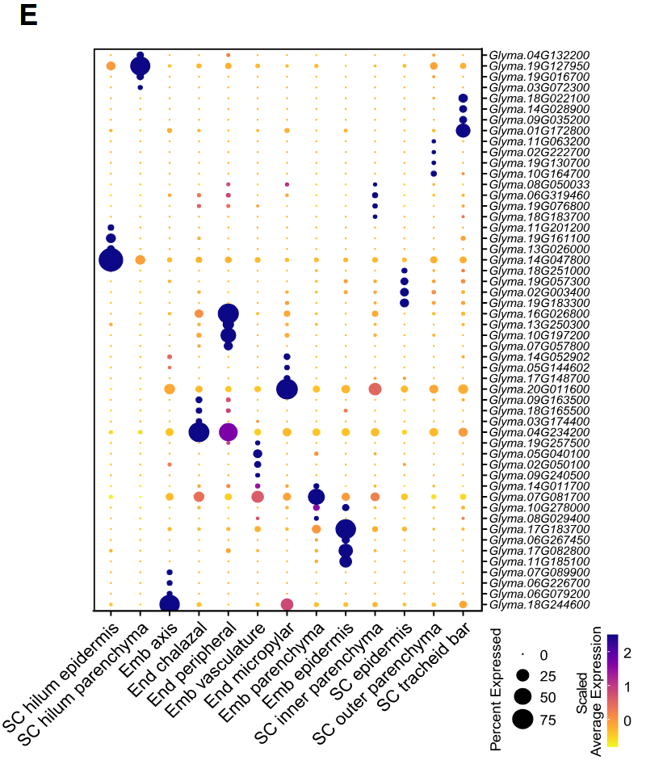
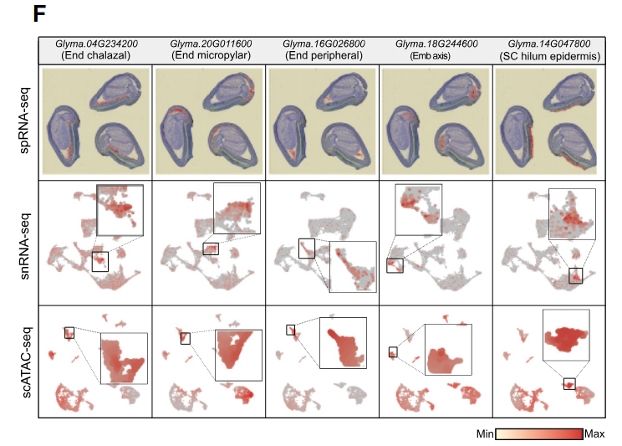
multi-omics & annotation
sptial facilitate cell annotation

Slide 7
ACRs

Slide 8
cell-type-specific ACRs, motifs and TFs.

Slide 9
changes of endosperm across seed development

Slide 10
development of embrogenesis by trajectorying

