Slide 1
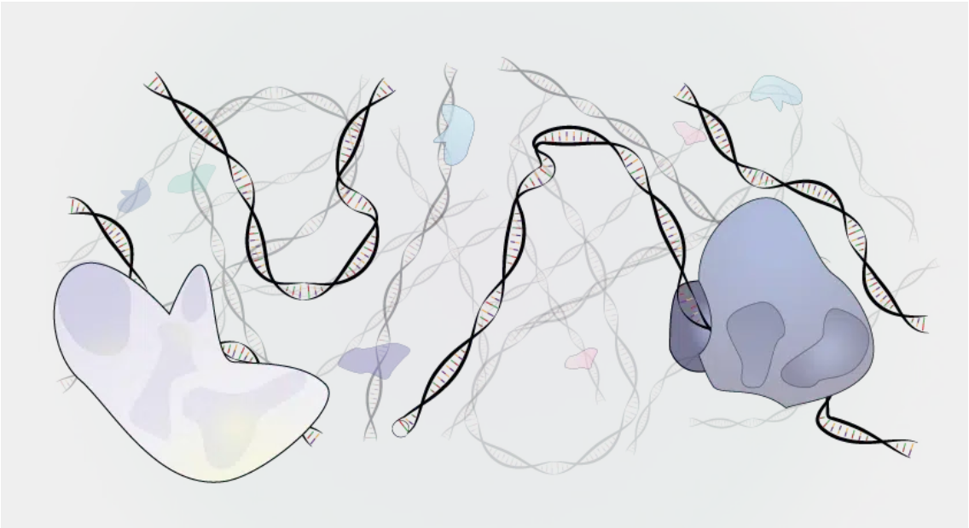
ArchR-ATAC
20260423
https://www.scdiscoveries.com/blog/knowledge/how-scatac-seq-works/

Slide 2
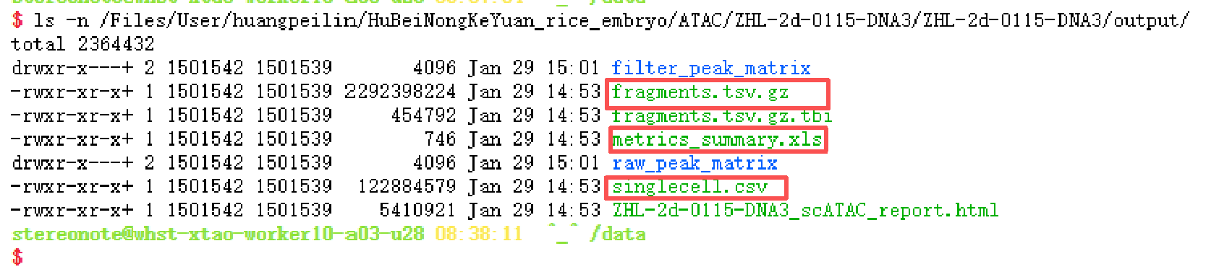
output of Copy-scATAC-seq

Slide 3
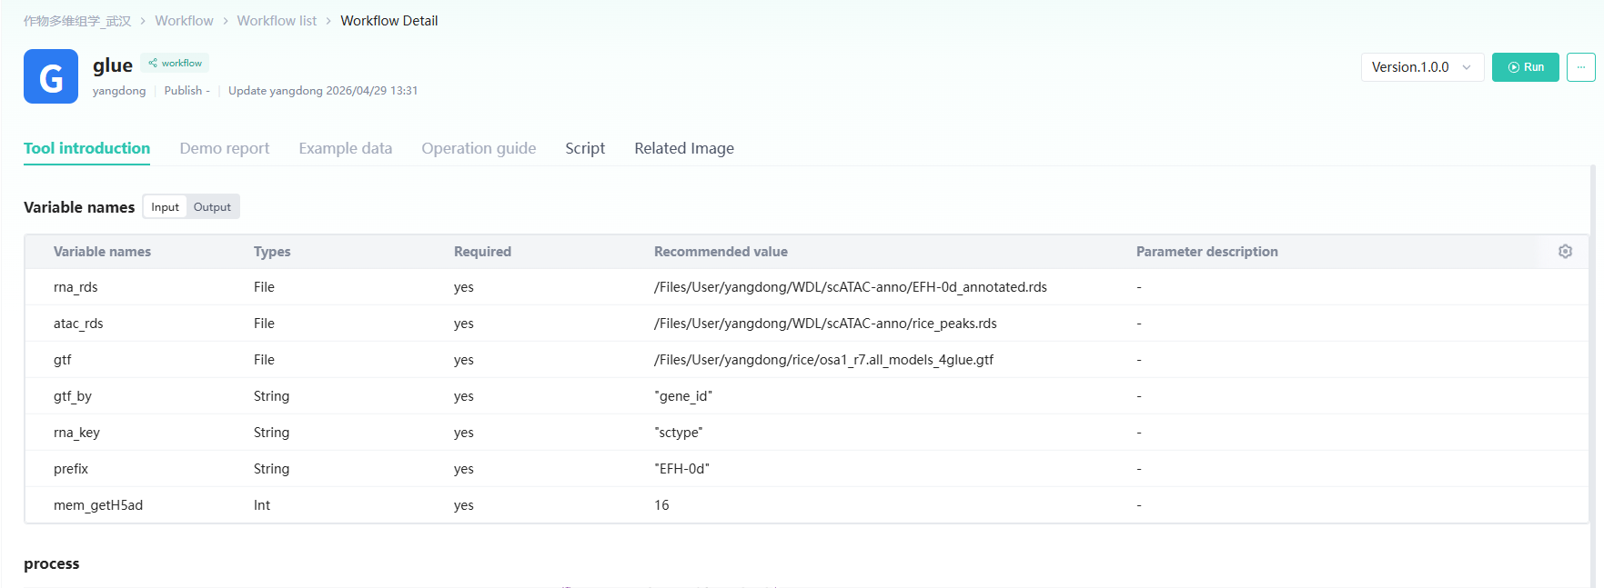
glue
https://github.com/ydgenomics/omics4plant/blob/main/SOFTWARE/GLUE/WORKFLOW/process_model.py

Slide 4
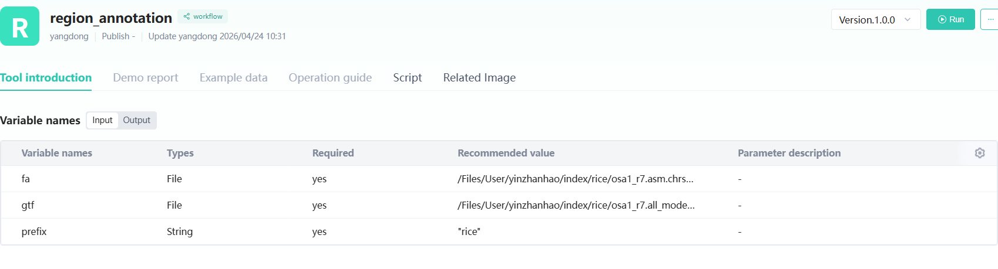
before run ArchR
输入参考基因组的fa和gtf
https://github.com/ydgenomics/omics4plant/tree/main/SOFTWARE/ArchR/NOTEs/NOTE-region_annotation
处理planttfdb拿到的.meme处理可参考：https://github.com/ydgenomics/omics4plant/blob/main/SOFTWARE/ArchR/Tutorial/14_motif/custom_motif.R
NOTE：注意RNA，ATAC，refence，转录因子的基因名的对应

Slide 5
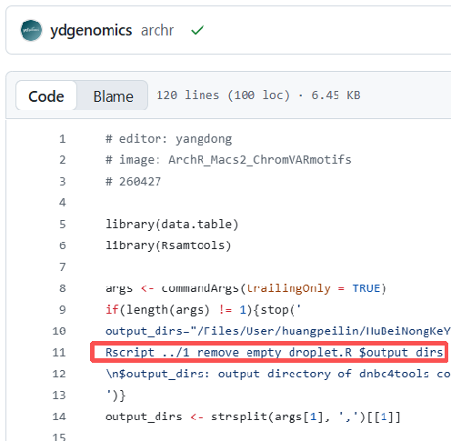
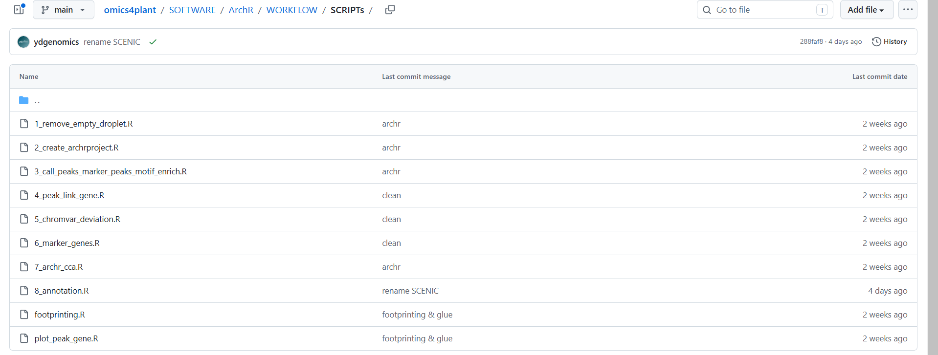
demo and script of ArchR
/Files/User/yangdong/SOFTWARE/archr/ (武汉148)
https://github.com/ydgenomics/omics4plant/tree/main/SOFTWARE/ArchR/WORKFLOW/SCRIPTs (github)
使用shell代码整体R脚本
公共库镜像：ArchR_Macs2_ChromVARmotifs

Slide 6
How to interpret scATAC-seq data?
https://www.scdiscoveries.com/blog/knowledge/how-scatac-seq-works/

Slide 7
What are ACRs and peaks?

Slide 8
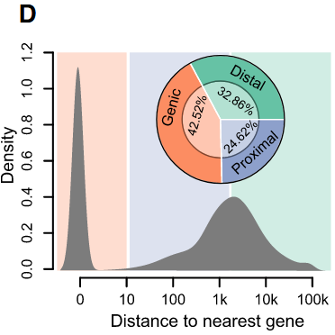
The distribution of ACRs.

Slide 9
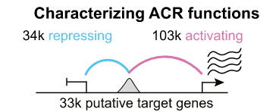
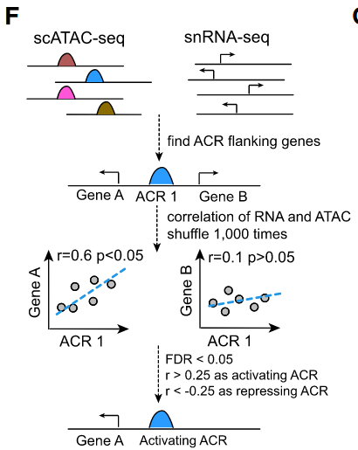
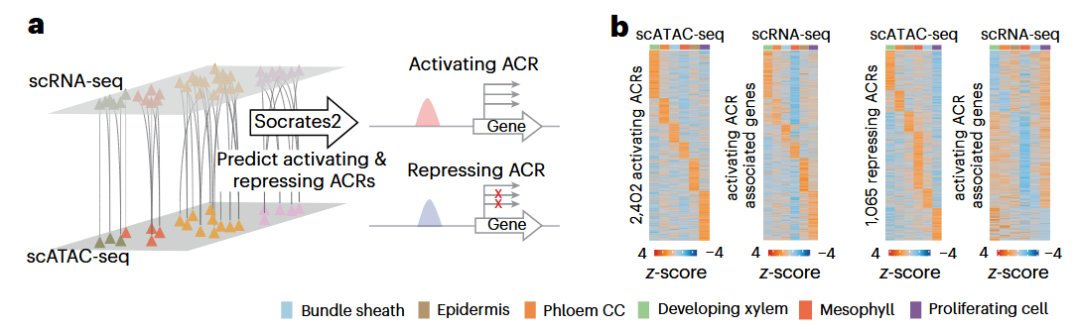
ACRs means trascription?
Peaks in coding regions indicate accessibility for the transcription machinery, so these genes may be expressed or prepared for expression in this cell.
Peaks in non-coding regions indicate accessibility for regulatory proteins, such as transcription factors. These regions may thus be active regulatory elements.
A correlation between non-coding regions and coding regions suggests an interplay between regulatory proteins and genes. The non-coding regions may be cis-regulatory elements for the implicated genes, i.e., regions where regulatory proteins bind that affect a neighboring gene’s expression.
Recurring binding motifs in different non-coding regions can imply which regulatory proteins are active in a cell.

Slide 10
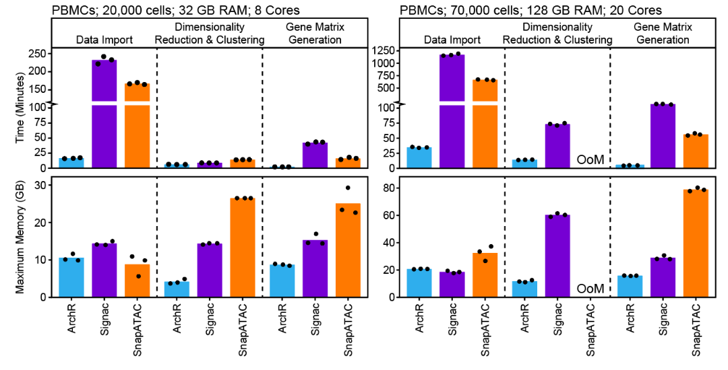

ArchR
How to create ArrowFiles?
What are fragments? “fragments” refers to a table or genomic ranges object containing the chromosome, offset-adjusted single-base chromosome start position, offset-adjusted single-base chromosome end position, and unique cellular barcode ID corresponding to each sequenced fragments. Fragment files are tabix-sorted text files containing each scATAC-seq fragment and the corresponding cell ID, one fragment per line.
Why we select ArchR? It’s very powerful compared with others including running time and memory resources. But a misery is stoped updated and maintained. If you interesed in python env, maybe snapATAC2 is a better begining.
https://www.archrproject.com/bookdown/index.html#section

Slide 11
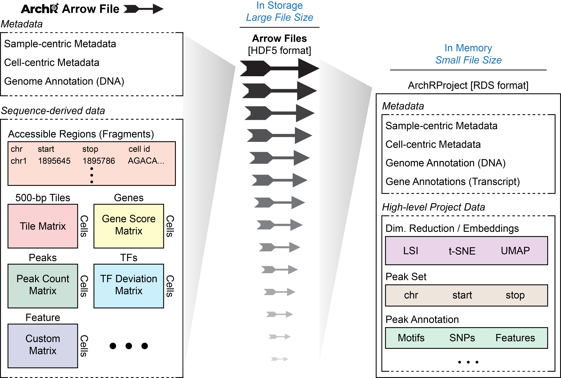
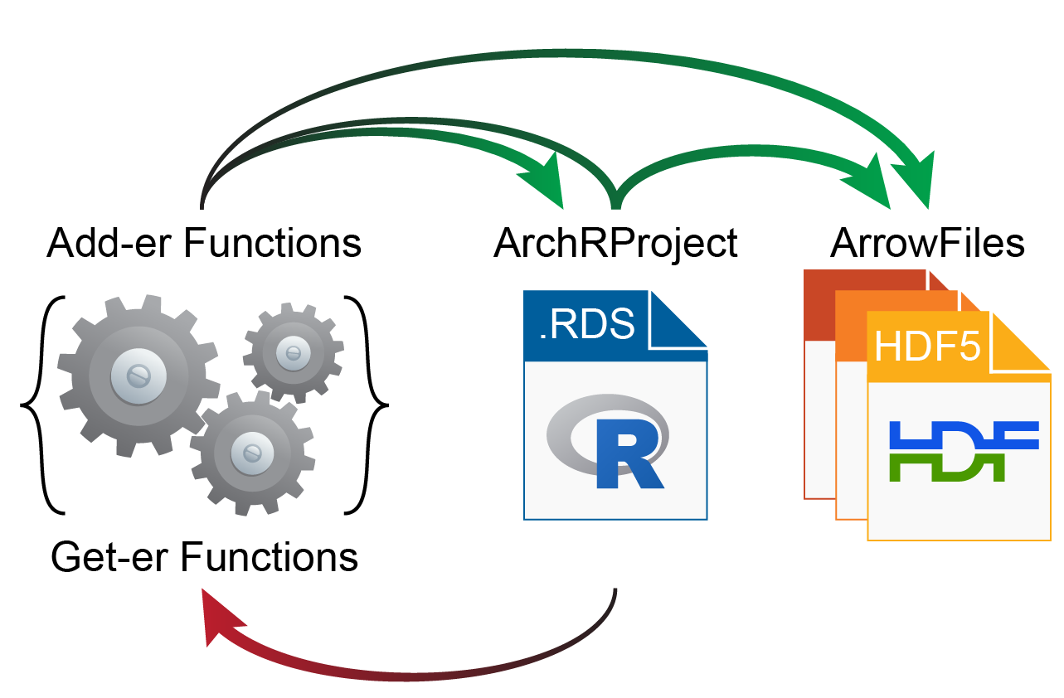
ArchRProject: An ArchR object and a directory
fragments -> arrow files
metadata proj@cellColData
matrix getAvailableMatrices(proj)
reduction & embedding

Slide 12
Annotations of gene and genome
ArchR requires gene and genome annotations to do things such as calculate TSS enrichment scores, nucleotide content, and gene activity scores.
How to custom annotation? (1) from ArchR tutorial https://www.archrproject.com/bookdown/getting-set-up.html#creating-a-custom-archrgenome (2) from omics4plant https://github.com/ydgenomics/omics4plant/tree/main/SOFTWARE/ArchR/NOTEs/NOTE-region_annotation

Slide 13
Per-cell Quality Control
The number of unique nuclear fragments (i.e. not mapping to mitochondrial DNA).
The signal-to-background ratio (TSS signal). Low signal-to-background ratio is often attributed to dead or dying cells which have de-chromatinzed DNA which allows for random transposition genome-wide.
The fragment size distribution. Due to nucleosomal periodicity, we expect to see depletion of fragments that are the length of DNA wrapped around a nucleosome (approximately 147 bp).

Slide 14
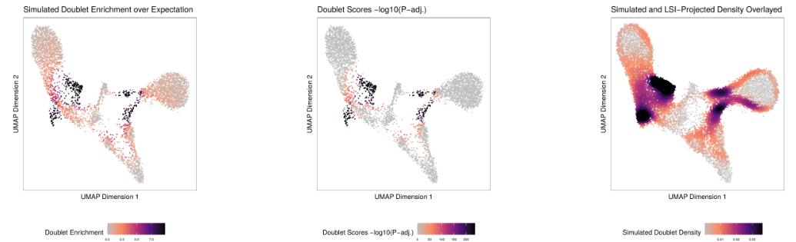
Remove doublet
Doublet Enrichments - These represent the enrichment of simulated doublets nearby each single cell compared to the expected if we assume a uniform distribution.
Doublet Scores - These represent the significance (-log10(binomial adjusted p-value)) of simulated doublets nearby each single cell compared to the expected if we assume a uniform distribution. We have found this value to be less consistent than the doublet enrichments and therefore use doublet enrichments for doublet identification.
Doublet Density - This represents the density of the simulated doublet projections. This allows you to visualize where the synthetic doublets were located after projection into your 2-dimensional embedding.

Slide 15
ArchRProject@cellColData
proj$TSSEnrichment (float)
proj$ReadsInTSS (integer)
proj$ReadsInPromotor (integer) NOTE: promoter regions is -2000 to + 100 from the TSS
proj$PromoterRatio (float)
proj$ReadsInBlacklist (integer) NOTE: blacklist include some unwanted mapped regions such as mito and chloroplast.
proj$BlacklistRatio (float)
proj$NucleosomeRatio (float)
proj$nFrags (integer)
proj$nMonoFrags (integer) > 147bp but < 2*147bp
proj$nDiFrags (integer) > 2*147bp but < 3*147bp
proj#nMultiFrags (integer) > 3*147bp
proj$PassQC (integer, 1 mean passed; 0 mean not)

Slide 16
Cluster
Seurat’s method FindClusters()
scran

Slide 17
Reduction & embedding
umap
LSI
tSNE

Slide 18
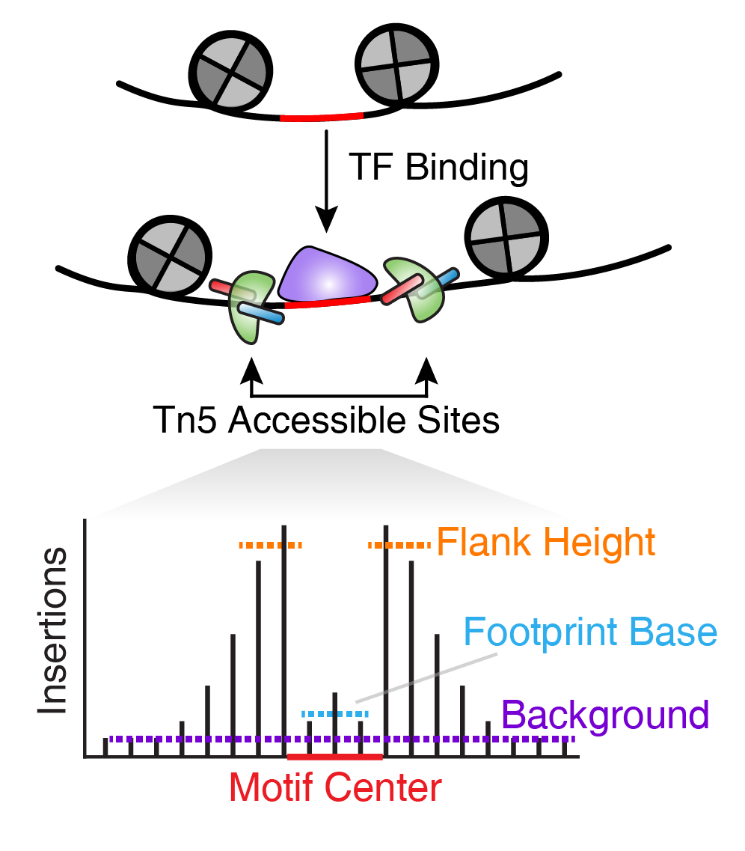
Footprint
What is Footprint and difference with motif enrichment? I think motif enrichment reveal the potential of TF binding the regions, when region/motif opening then TF binding this region, but also TF could not binding such as TF is repressed.
Footprint will find specific signal pattern like center with low signal but around with high signal.
TF footprinting is performed at a single site to determine the precise binding location of the TF. However, in practice, this requires very high sequencing depth, often much higher depth than what most users would obtain from either bulk or single-cell ATAC-seq.

