Slide 1
AI for life

Slide 2
How to get a model?
Data
Model
Compute

Slide 3
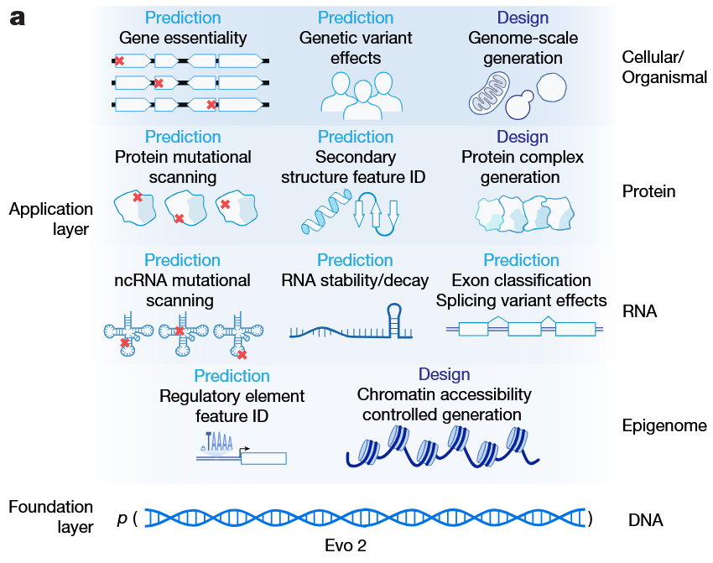
base model & fine tunned model
2026 Nature Genome modelling and design across all domains of life with Evo2

Slide 4
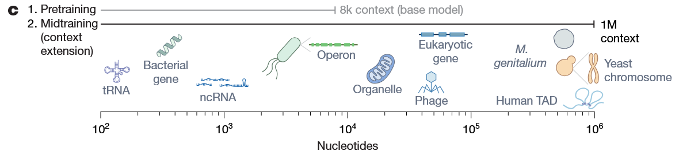
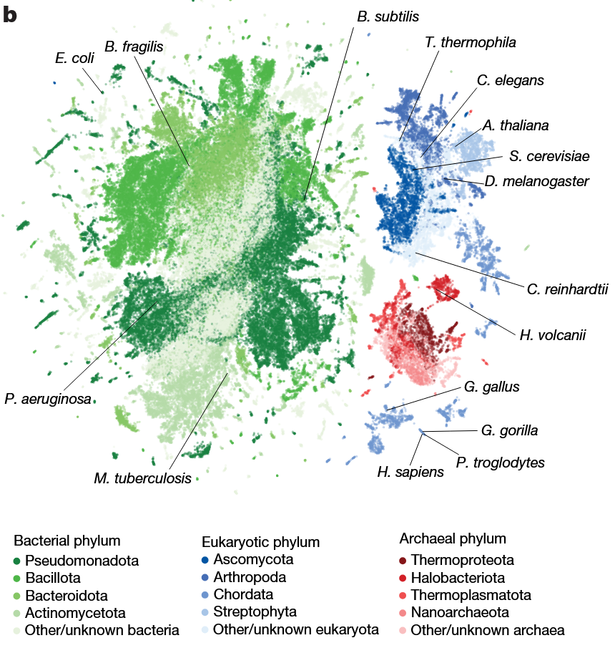
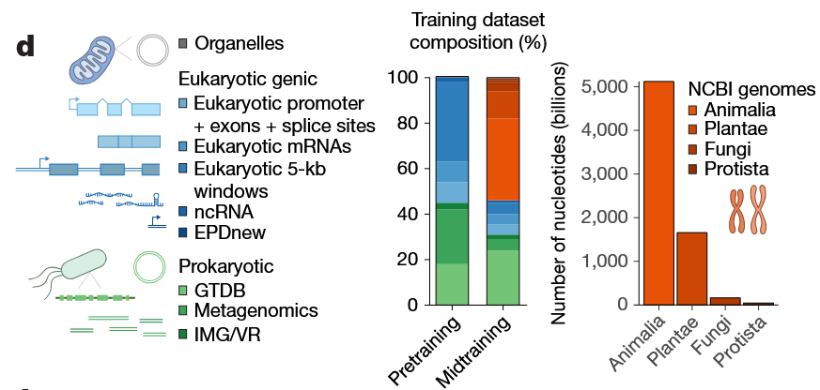
Data: life diversity in molecular
molecular length
organism/species
2026 Nature Genome modelling and design across all domains of life with Evo2

Slide 5
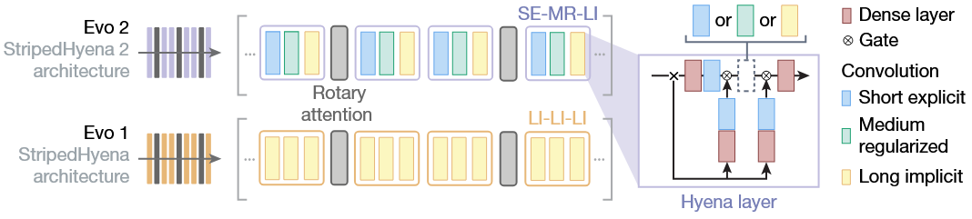
Model: StripedHeyena 2
2026 Nature Genome modelling and design across all domains of life with Evo2

Slide 6
Compute: tokenization & resources
2026 Nature Genome modelling and design across all domains of life with Evo2

Slide 7
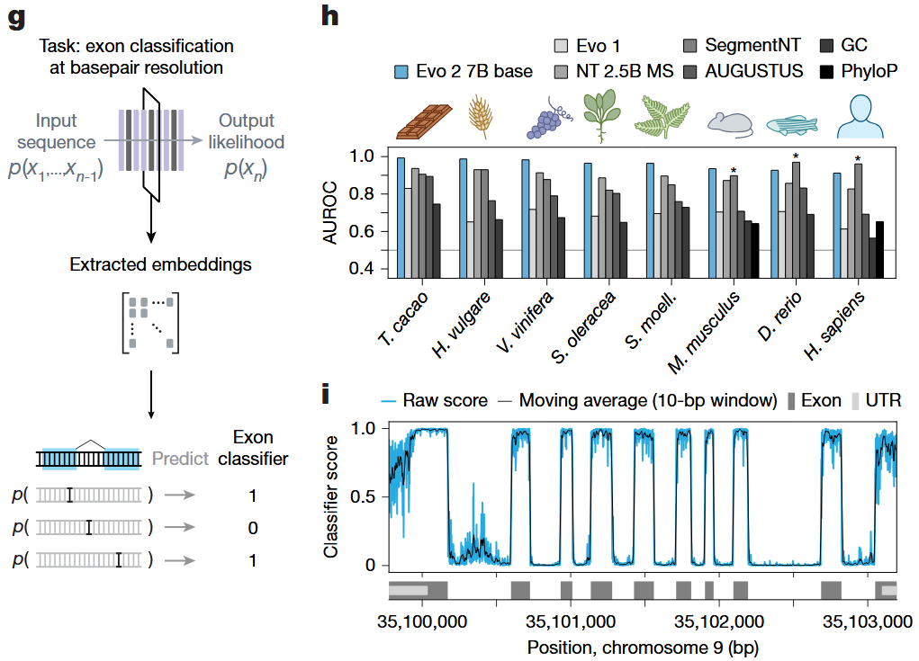
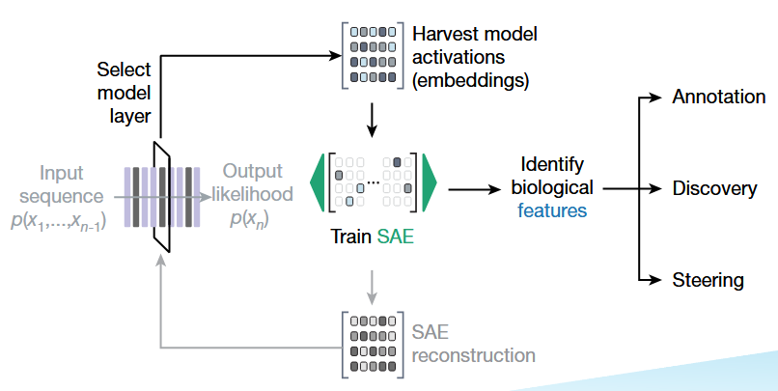
Task/application1: exon classifier / feature annotation
2026 Nature Genome modelling and design across all domains of life with Evo2

Slide 8
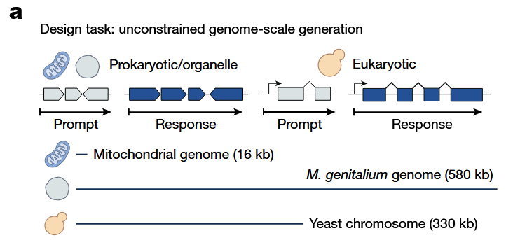
Task/application2: unconstrained genome generation
2026 Nature Genome modelling and design across all domains of life with Evo2

Slide 9
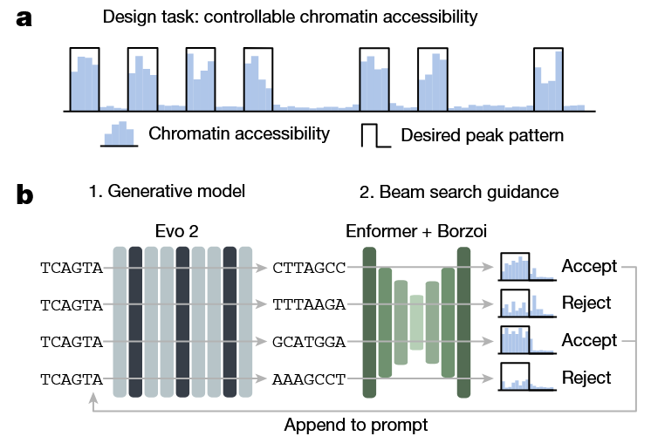
Task/application3: cotrollable chromatin accessibility
2026 Nature Genome modelling and design across all domains of life with Evo2

