Slide 1
Note: for spatial transcriptome
2026/05/21

Slide 2
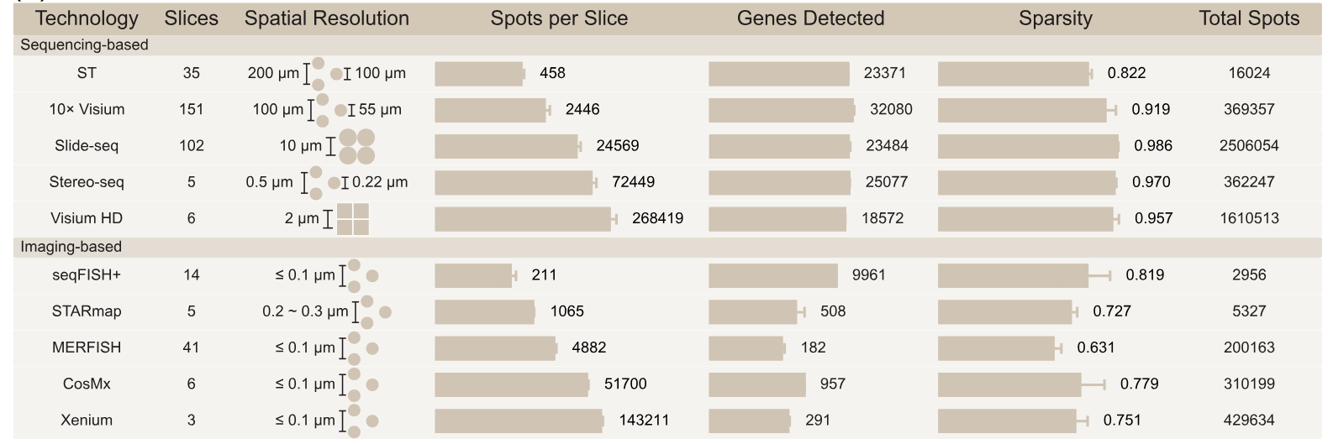
Spatial technologies
Chen, R., Yao, Y., Qian, J., Peng, X., Shao, X., & Fan, X. (2025). A comprehensive benchmarking for spatially resolved transcriptomics clustering methods across variable technologies, organs, and replicates. iMeta, 4(6), e70084. https://doi.org/10.1002/imt2.70084

Slide 3
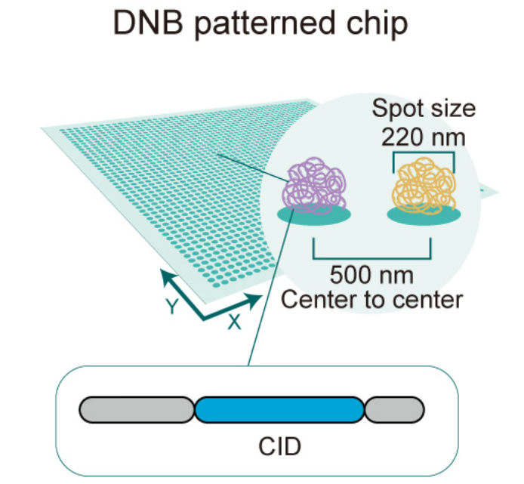
Analysis Object
Main two types of object: Square bin & cell bin, different type could respones different biological problems and adapt to different technologies. (for stereo-seq, high resolution, two are ok)
Square bin: https://stereopy.readthedocs.io/en/latest/Tutorials/SquareBin_Clustering.html
Cell bin: https://stereopy.readthedocs.io/en/latest/Tutorials/CellBin_Clustering.html#Quick-Start-(Cell-Bin)
bin_size: n, n x n number of spots aggregated as one observation
How to get cell resolution data?
(optional) remove background RNA
image process (registration)
cell segment (cellpose + manual)
cellCut (Stereopy)
Stereopy: https://stereopy.readthedocs.io/en/latest/

Slide 4
How to get tissue.gef
Directly from SAW output, we could get raw.gef and tissue.gef. What is tissue.gef? In Stereopy (https://stereopy.readthedocs.io/en/latest/Tutorials/Tissue_Segmentation.html), there are two automatical ways could do it: one, only based on express matrix, real tissue have high expression and aggregate.; two, based on ss-image and expression image. If above ways are not good, we could based registrated image do manual mask.

