Slide 1

EV CHARGING ORCHESTRATION PLATFORM
Platform Delivery Overview
21 Features · 50+ API Endpoints · 19 Frontend Pages
React 18 + TypeScript
ASP.NET Core 8
PostgreSQL 16

Slide 2
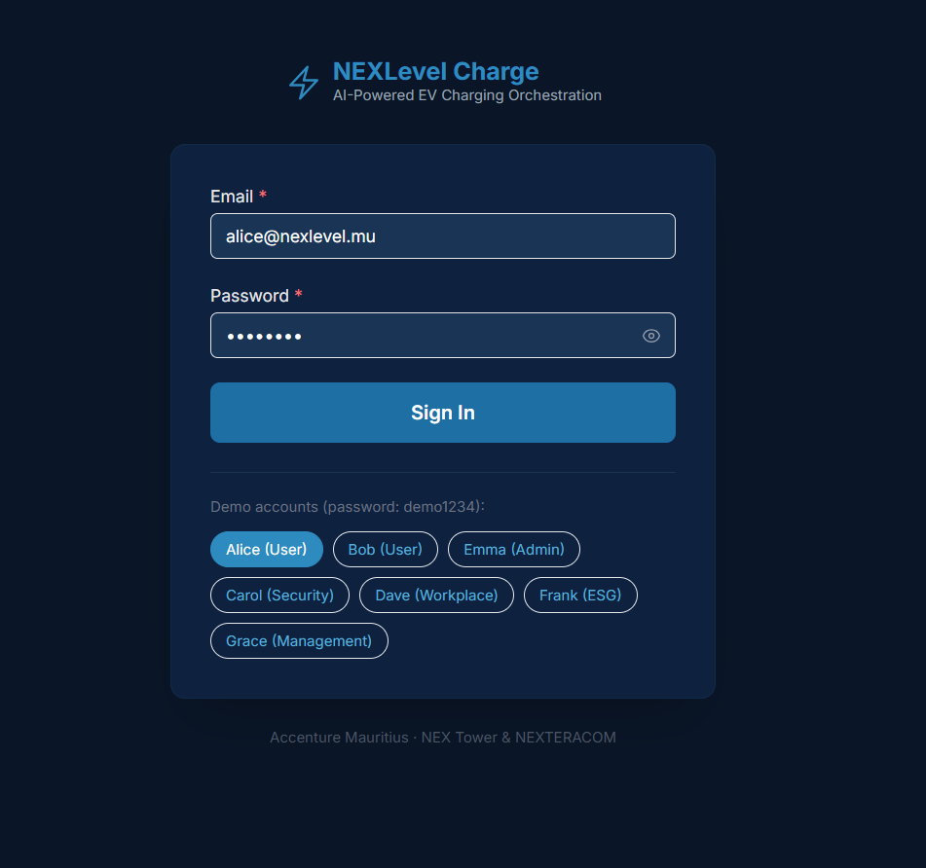
PRODUCT SCREENSHOTS
NEXLevel Charge — Live UI
Login & Role Selection
Running live at localhost:5173 · OCPP 1.6J · Simulated CSMS demo data

Slide 3
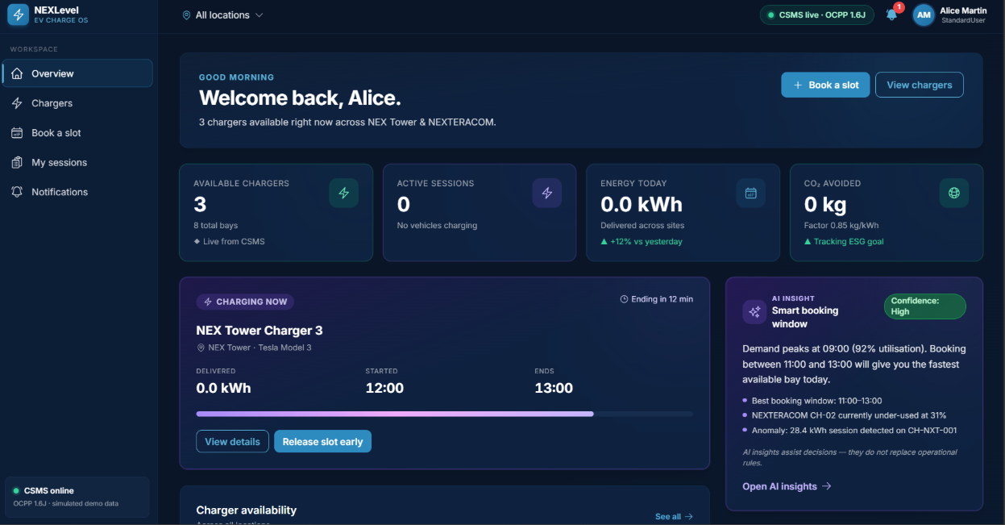
PRODUCT SCREENSHOTS
NEXLevel Charge — Live UI
User Dashboard
Running live at localhost:5173 · OCPP 1.6J · Simulated CSMS demo data

Slide 4
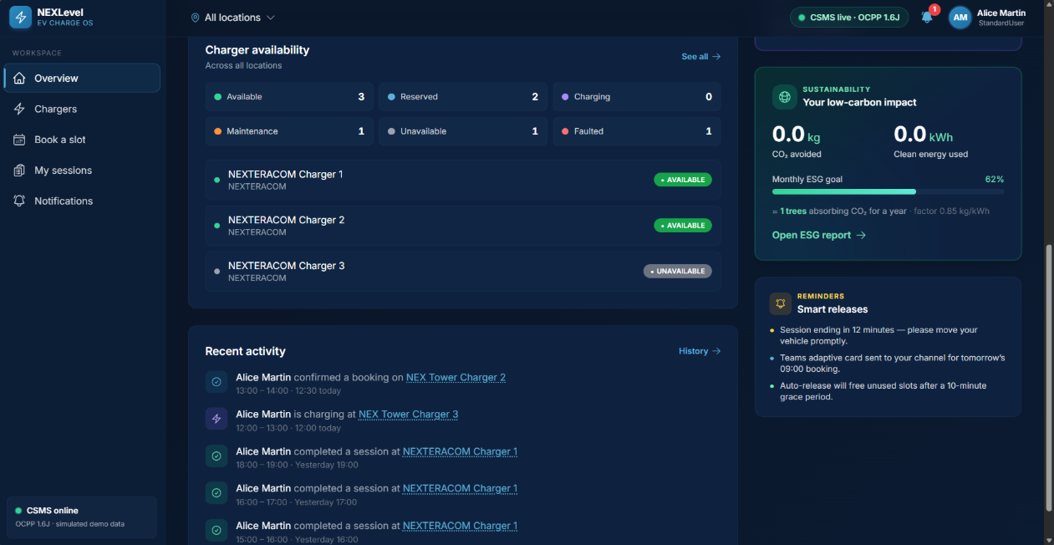
PRODUCT SCREENSHOTS
NEXLevel Charge — Live UI
Charger Availability & Activity
Running live at localhost:5173 · OCPP 1.6J · Simulated CSMS demo data

Slide 5
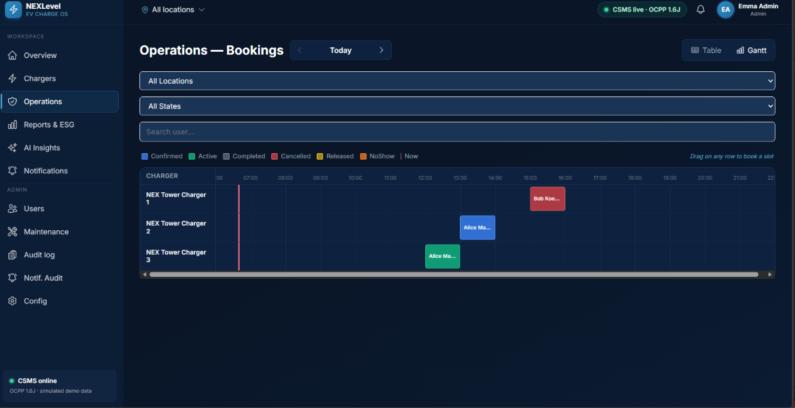
PRODUCT SCREENSHOTS
NEXLevel Charge — Live UI
Admin View
Running live at localhost:5173 · OCPP 1.6J · Simulated CSMS demo data

Slide 6






PLATFORM AT A GLANCE
Key Metrics
21
50+
19
Features Delivered
API Endpoints
Frontend Pages
17 full-stack · 3 backend-only · 1 frontend-only
Across 12 backend controllers
Role-filtered routes with auth guards
6
12
3
User Roles
Database Entities
Background Workers
Admin · StandardUser · Security · Workplace · Management · ESG
PostgreSQL 16 with EF Core migrations
CSMS Sync · No-Show Detection · Reminders

Slide 7
PLATFORM AT A GLANCE
What's Inside the Numbers
Full-Stack Features (17)
12
12
Each feature ships a frontend page, backend controller, database entity, and matching API endpoints — fully integrated end-to-end.
Controllers
DB Entities
Backend REST controllers
EF Core mapped tables
Role-Based Access (6 roles)
Every route, API, and data query is scoped by role. Admins see everything; ESG viewers see only sustainability exports.
50+
3
Immutable Audit Trail
API Endpoints
Async Workers
Every state change — bookings, config, charger status — is logged with actor, timestamp, and a before/after diff. Tamper-proof by design.
Versioned under /api/v1
Always-on hosted services

Slide 8






CAPABILITY OVERVIEW
Six Core Feature Areas
Access & Security
Charger Management
Booking System
JWT auth, RBAC across 6 roles, privacy notices & immutable audit trail
Real-time status, maintenance windows, automatic conflict detection
Fair-use caps, 14-day advance windows, Gantt ops dashboard, 8 booking states
Notifications
Reporting & Analytics
Administration
InApp, Email & Teams Adaptive Cards across all booking lifecycle events
6 report tabs: Overview, Sessions, Energy, Utilisation, Sustainability, AI
EV user eligibility management, system config panel, role-scoped audit logs

Slide 9
CAPABILITY OVERVIEW
Feature Area Deep-Dive
Access & Security
Charger Management
Booking System
JWT login/logout with token refresh
6 live statuses: Available, Charging, Unavailable, Faulted, Reserved, BlockedForMaintenance
1-hour daily fair-use cap; admin override with reason
6 roles: Admin, StandardUser, Security, Workplace, Management, ESGViewer
Admin maintenance windows with overlap detection
14-day advance booking window with date navigation
Versioned privacy policy with user acknowledgement
Force-release conflicting bookings with mandatory reason
8 booking states tracked through full lifecycle
Route guards: auth, role, privacy, eligibility
CSMS connector block/unblock on maintenance create/delete
Operations Gantt chart with bulk release & role filters
Notifications
Reporting & Analytics
Administration
3 delivery channels: InApp, Email, Teams Adaptive Card
6 report tabs with KPI tiles and chart visualisations
Eligible EV user registry: email, badge ID, vehicle info, EID
Events: BookingConfirmed, SessionEnding, NoShowAlert, MaintenanceCreated
AI insights: NL summary, demand forecast, anomaly detection
System config panel: grace period, cap, emission factor, polling
Unread badge counts and per-user notification feed
Confidence levels (Low/Medium/High) based on data volume
All config changes audit-logged automatically
Admin audit view with payload preview modal
Date range and location filters across all reports
Self-service vehicle update for standard users

Slide 10
FEATURE SPOTLIGHT
Booking System
Fair-Use Cap
Booking States
1-hour daily limit per user. Admins can override the cap with a mandatory audit reason.
Pending
Confirmed
14-Day Advance Window
Bookings can be made up to 14 days ahead with date navigation and peak/demand hour highlighting.
Active
Completed
Ops Gantt Dashboard
Cancelled
Released
Admin/Security/Workplace view: table & Gantt chart with 14-day navigation and bulk release actions.
NoShow
Expired
Conflict Detection
Maintenance blocks auto-detect overlapping bookings and support force-release with mandatory reason.
+ 4 charger statuses tracked in real-time via CSMS

Slide 11



FEATURE SPOTLIGHT
Booking System — How It Works
1
2
3
4
User Books
Confirmed
Session Starts
Completed
Selects date, time slot & vehicle. System checks daily cap & 14-day window.
Booking stored, CSMS notified, confirmation notification sent via InApp + Email.
CSMS sync updates booking to Active. Reminder sent 10 min before session ends.
Session ends, energy delivered and CO₂ avoided logged for sustainability reporting.
No-Show Detection
Admin Override & Operator Release
Background worker compares CSMS session start against booking windows. Bookings with no session within the grace period are auto-flagged as NoShow. Alerts sent to user and operations staff.
Admins can override the daily fair-use cap with a mandatory reason captured in the audit log. Operators can release bookings on behalf of users with a 5-character minimum justification.
Booking Detail & CSMS Sync Status
Configurable Thresholds
Each booking page shows the linked charging session, CSMS sync status, energy delivered, and time-sensitive action buttons (cancel, release, operator override).
Grace period, no-show threshold, and daily cap are all managed via the System Configuration Panel — changes take effect immediately and are audit logged.

Slide 12
INTELLIGENCE & INSIGHTS
Reporting & AI Analytics
Natural Language Summary
Plain-English analysis of charging patterns across any date range and location
Demand Forecast
Predicts peak utilisation windows and flags potential capacity shortfalls
Anomaly Detection
Automatically surfaces irregular sessions, no-show spikes, and underused chargers
Confidence Levels
AI results tagged Low / Medium / High based on available session data volume

Slide 13
INTELLIGENCE & INSIGHTS
What Each Report Tab Delivers
Overview
Sessions
Energy
Live KPIs: available chargers, active sessions, energy delivered today, CO₂ avoided. Real-time charger availability grid and recent activity feed.
Full session history with state tracking: Charging, Completed, StoppedByUser, StoppedByAdmin, NoShow, Expired. Linked to bookings and users.
kWh delivered per charger and location over time. Supports carbon accounting using the configurable emission factor (kg CO₂/kWh).
Utilisation
Sustainability
AI Insights
Charger occupancy rates, peak vs off-peak demand patterns, and booking-to-session conversion rates across the fleet.
CO₂ avoided metrics, ESG-ready exports for ReportingESGViewer role, and trend analysis across reporting periods.
Grounded AI analysis: NL summary, demand forecast, detected anomalies, and prioritised recommendations — all confidence-tagged.

Slide 14
ARCHITECTURE
Technology Stack
Frontend
React 18 · Vite · TypeScript · Tailwind CSS
Backend
ASP.NET Core 8 · C# · REST API
Database
PostgreSQL 16 · Entity Framework Core 8 · Npgsql
Auth
JWT Bearer Tokens · Role-Based Access Control
Integration
CSMS HTTP Client · Mock-mode fallback
Background Workers: CSMS Sync (5s polling) · No-Show Detection · Reminder Scheduler

Slide 15


ARCHITECTURE
Technology Choices & Rationale
React 18 + TypeScript + Vite
ASP.NET Core 8 (C#)
PostgreSQL 16 + EF Core 8
Type-safe component architecture across all 19 pages
Minimal API + Controllers hybrid for clean endpoint separation
12 entities with code-first migrations via EF Core 8
Vite dev server for fast HMR; production build with tree-shaking
Dependency injection throughout — services, repositories, workers
Npgsql provider for high-performance .NET ↔ Postgres communication
Tailwind CSS for consistent, responsive UI without a design system dependency
3 hosted IHostedService workers running on startup
Soft deletes on users (Inactive status) to preserve audit history
Role-filtered navigation and lazy-loaded route guards
OpenAPI spec auto-generated from controllers
Connection pooling and async query patterns throughout
JWT Auth + RBAC
CSMS Integration
Background Workers
Stateless JWT Bearer tokens — no server-side session storage
Typed HttpClient with retry and timeout policies
CSMS Sync: polls every 5 seconds, updates session and charger state
Claims-based role enforcement on every protected endpoint
5-second polling for connector state and session updates
No-Show Detection: compares booking windows against session start times
RequireAuth / RequireRole / RequirePrivacyAck guards on frontend routes
Mock-mode fallback keeps the platform functional in demo environments
Reminder Scheduler: fires pre-session and session-ending notifications
Token validated on every request; logout clears client-side token
Connector block/unblock called automatically on maintenance create/delete
All workers are gracefully cancellable on application shutdown

Slide 16

READY FOR PRODUCTION
A complete, secure EV charging
orchestration platform.
21 features spanning the full booking and charging lifecycle
Role-based access control across 6 user types
Real-time CSMS integration with 3 always-on background workers
AI-powered insights with sustainability and ESG reporting
Immutable audit trail and multi-channel notifications

