Slide 1
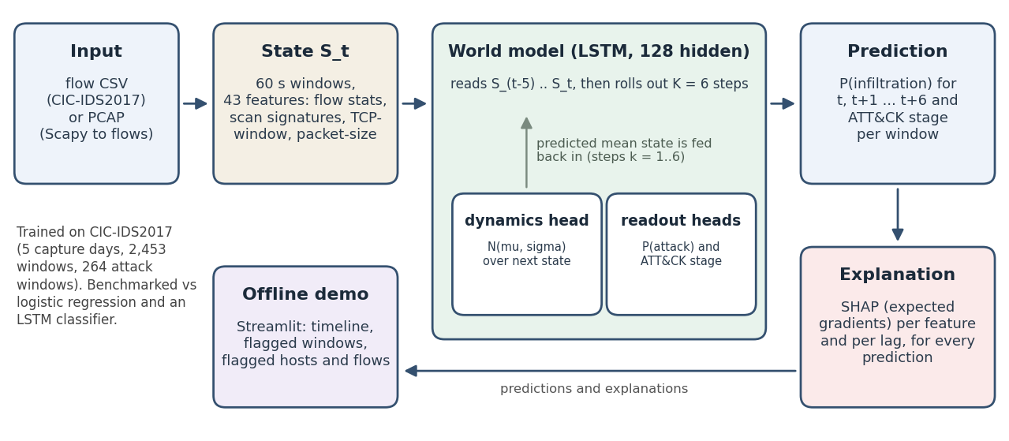
A learned world model of network state, tested honestly
SIH 2026 · PS 26153 · AI-BASED NETWORK ATTACK FORECASTING
Traffic becomes a 60 second state vector; an LSTM learns what the next state looks like.
A 6-step rollout gives P(infiltration) and an ATT&CK stage, and SHAP explains every output.
Built end to end and benchmarked on CIC-IDS2017. The headline is a negative result.
github.com/ydhitler1-arch/network-attack-world-model
Notes:
Open with the framing: we built the complete system the problem statement describes and evaluated it honestly, including where the idea does not work. Reactive IDS classifies flows after the fact; PS 26153 asks for a model of how network state evolves so infiltration risk can be estimated before the kill chain completes. Walk the figure left to right: input, state vector, world model with rollout, prediction, explanation, offline demo.

Slide 2
43 features describe each minute of traffic
2.83M
2,453
264
41
flows after cleaning
windows of 60 seconds
windows with attack traffic
attack episodes over 5 days
Flow level · 22
Base · 13
Packet proxies · 8
TCP flag shares, inter-arrival stats, backward/forward ratios, scan signatures per source
Rates, unique hosts and ports, source entropy, top-source, top-port and top-pair shares
First-packet TCP window and per-flow packet-size distribution, the most a CSV offers
PCAP input also yields TTL, fragmentation flags and retransmissions. A CSV cannot supply them, so the trained model does not use them.
Scaler fit on benign training windows only. Attacks start abruptly at one-minute resolution.
Notes:
CIC-IDS2017: 2.83M flows, 2,453 windows of 60 seconds, 264 attack windows, 41 attack episodes over 5 days. 43 features: 13 base, 22 flow level, 8 packet-level proxies available in a CSV. The PCAP path built with Scapy also extracts TTL and its variance, fragmentation flags and retransmissions, verified on a synthetic capture. The trained model does not use them because the training data cannot provide them. Earlier finding worth mentioning: no precursor signal before attacks at this resolution (DDoS, Hulk, PortScan checked), so forecasting at one-minute resolution is at chance.

Slide 3
Rollout, ATT&CK stage and SHAP on every prediction
Prediction engine
Explanations, validated
An LSTM (100,702 parameters) reads 6 windows and predicts a Gaussian over the next state.
A 6-step rollout feeds the predicted state back in.
Heads read P(infiltration) and the stage at every step; those losses use real history steps only.
r = 0.99
agreement with the shap library
2.1 vs 0.1
logit drop deleting the top 3 features vs random ones
9.5%
completeness error: approximate, not exact
STAGE MAPPING
PortScan = Recon · Patator and web attacks = Initial Access · Infiltration = Lateral Movement · Bot = C2
DoS and DDoS are Impact, outside the five stages. No label is Exfiltration, so that output cannot be learned.
Host counterfactual: removing either host of the DDoS pair from the lookback drops P from 1.00 to about 0.07 to 0.11.
Notes:
The model: one LSTM cell, 128 hidden units, 100,702 parameters. After consuming a state it outputs a Gaussian over the next state (current state plus a learned delta), an infiltration logit and an ATT&CK stage over 7 classes. It reads 6 windows, then rolls out 6 steps feeding its predicted mean state back in, so we get a probability series for the current window and the next six. Explanations use the expected-gradients SHAP estimator, implemented to differentiate through the rollout. Validation: r = 0.99 with the shap library; deleting the top 3, 5 and 10 features lowers the logit by 2.14, 2.81 and 4.11 against about zero for random features (0.09, 0.02 and 0.21); completeness residual 9.5%, so explanations are approximate. One design detail worth mentioning: the infiltration and stage losses are computed on the real history steps only. My first version also trained them on the imagined future steps, which hurt detection (see the results slide). Be explicit about the stage mapping caveats: DoS and DDoS fit none of the five stages so they get a sixth class, and no CIC-IDS2017 label is Exfiltration.

Slide 4
The temporal model does not beat logistic regression
PR-AUC, detecting the current window
The fix that mattered: training the infiltration head only on real steps, not imagined future ones, lifted the world model from 0.22 to 0.30.
Forecasting 3 minutes ahead: PR-AUC 0.18 to 0.27 against a base rate of 0.11; the world model is highest, but 11 of 12 comparisons are not significant.
Unseen attack types: mean recall 0.36 for logistic regression, 0.21 for the world model.
Dynamics: the learned next-state model ties a linear AR(1) predictor one step ahead and loses further out.
Logistic regression
0.45
LSTM classifier
0.35
World model
0.30
95% CI: 0.23 to 0.67, 0.16 to 0.59, 0.14 to 0.53. World model minus logistic regression: -0.14 [-0.35, +0.05], not significant. F1: 0.43, 0.31, 0.30.
Blocked 5-fold CV with purge, 3 seeds, block-bootstrap CIs. 2,095 test samples, 11% attack windows.
Notes:
Protocol: blocked 5-fold cross-validation with 60-window blocks and a 12-window purge, scaler refit per fold, thresholds calibrated on a validation fold for a 2% false-alarm target, 3 seeds, block-bootstrap confidence intervals, plus leave-one-attack-type-out. Detecting the current window: logistic regression PR-AUC 0.451, F1 0.43; LSTM classifier 0.350, F1 0.31; world model 0.299, F1 0.30. The paired difference between world model and logistic regression is -0.14 with CI -0.35 to +0.05, so it is not significant, but the world model has the lowest point estimate. The requirement that the temporal model show a measurable improvement is not met on this data. History: my first version scored 0.219 and was significantly worse than logistic regression. I tested overfitting as the cause and it was mostly wrong: shrinking the model to 2,500 parameters, regularising it and down-weighting the dynamics loss changed nothing. The cause was the training objective: the model was also trained to predict attack labels from its own imagined future states, which are close to unpredictable. Training the infiltration head on real steps only lifted it to 0.30. The change was chosen by validation score, but it was made after seeing a poor result, so say so. Forecasting 3 minutes ahead: PR-AUC 0.18 to 0.27 for all models; the world model has the highest point estimate but only 1 of 12 paired comparisons is significant, so do not claim it forecasts. This is consistent with the earlier finding that attacks start abruptly.

Slide 5
What works, what does not, what next
Demo
Limits
Next
Upload a CSV or a PCAP, fully offline
Probability timeline, stage markers, flagged windows
SHAP drivers and host counterfactuals
41 episodes in one lab network, minute resolution
Demo weights trained on all days; the sample is in-sample
Thresholds drift across days
CIC-IDS2018 or CTU-13: finer time, multi-stage attacks
Stronger regularisation of the world model
Host-level graph state
The contribution: a reproducible, explainable baseline and an evaluation protocol that exposes weaknesses instead of hiding them.
github.com/ydhitler1-arch/network-attack-world-model · MIT licence · fixed seeds, config, weights and tests included
Notes:
Live demo: upload a flow CSV or PCAP, show the probability timeline, ATT&CK stage markers, flagged windows with SHAP drivers, and the host counterfactual that removes the DDoS pair and drops the probability. Limits to state plainly: 41 attack episodes in 5 days of one lab network, minute-resolution timestamps, demo weights trained on all days so the bundled sample is in-sample, stage head cannot output Exfiltration, thresholds drift across days. Next steps: a finer-resolution dataset with multi-stage attacks (CIC-IDS2018 or CTU-13), stronger regularisation, host-level graph state. Close on the contribution: a reproducible, explainable baseline and an evaluation protocol (purged blocked CV, leave-one-attack-type-out) that exposes weaknesses instead of hiding them.

