Slide 1

WebDesign Project
Quiz Website
Doyun
Andrej
Enis
Alexon
Mohanad

Slide 2
start.html
index.html
result.html
review.html
quiz.js
quiz.css

Slide 3
start.html
index.html
result.html
review.html

Slide 4
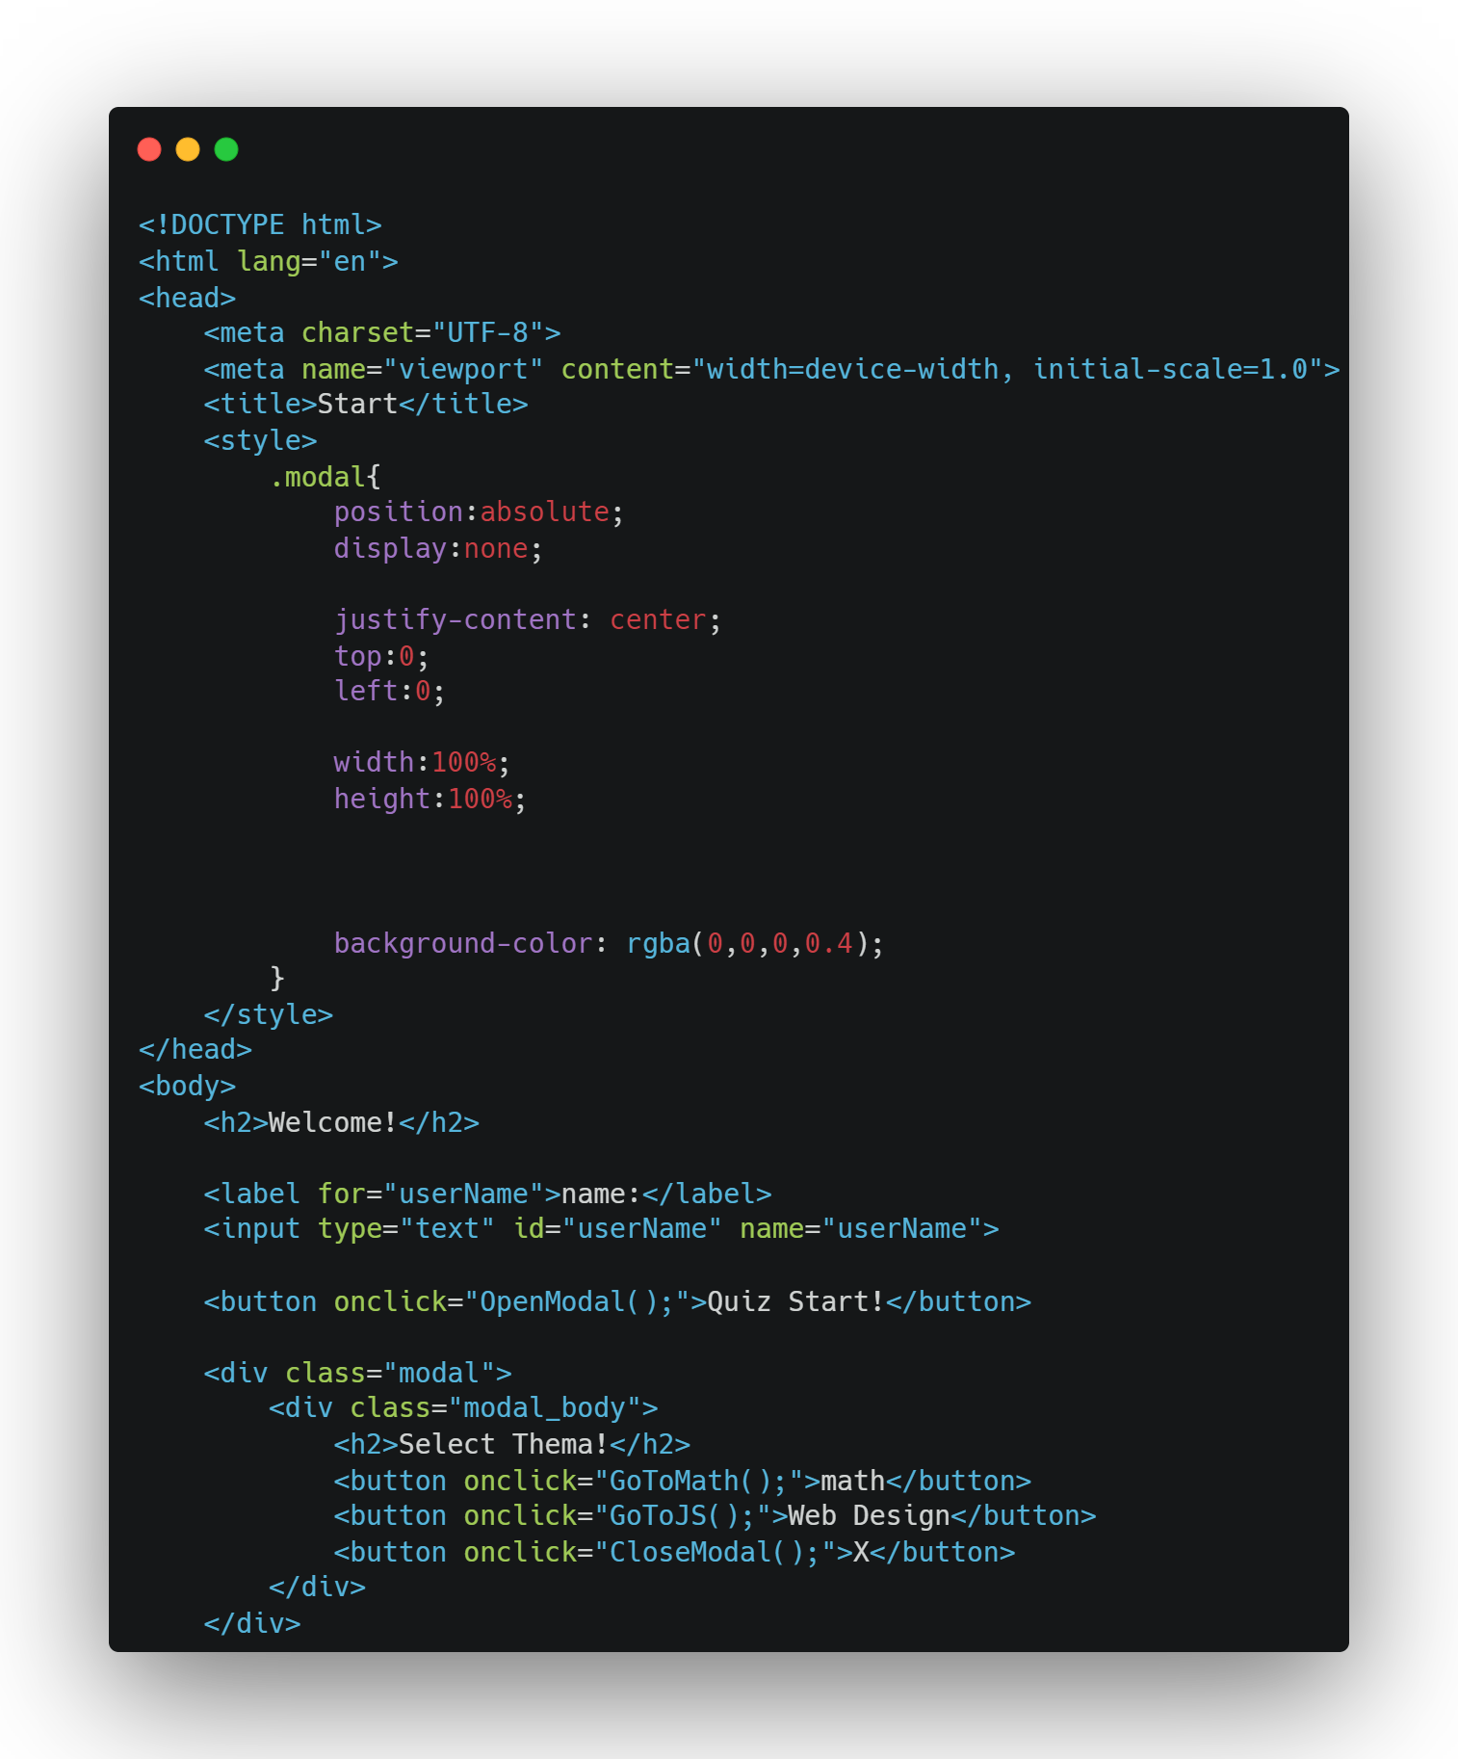
start.html

Slide 5
Modal
web page element that displays in front of and
deactivates all other page content

Slide 6
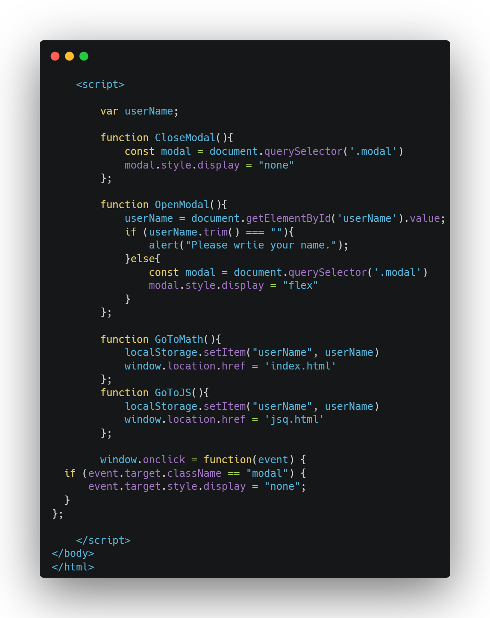
start.html

Slide 7
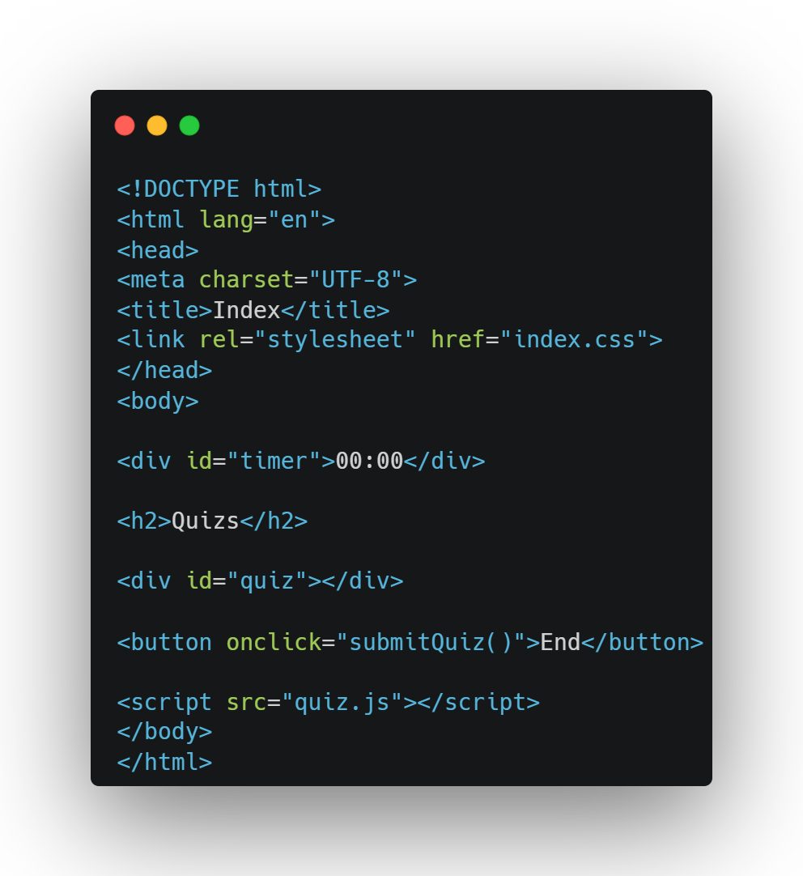
index.html

Slide 8
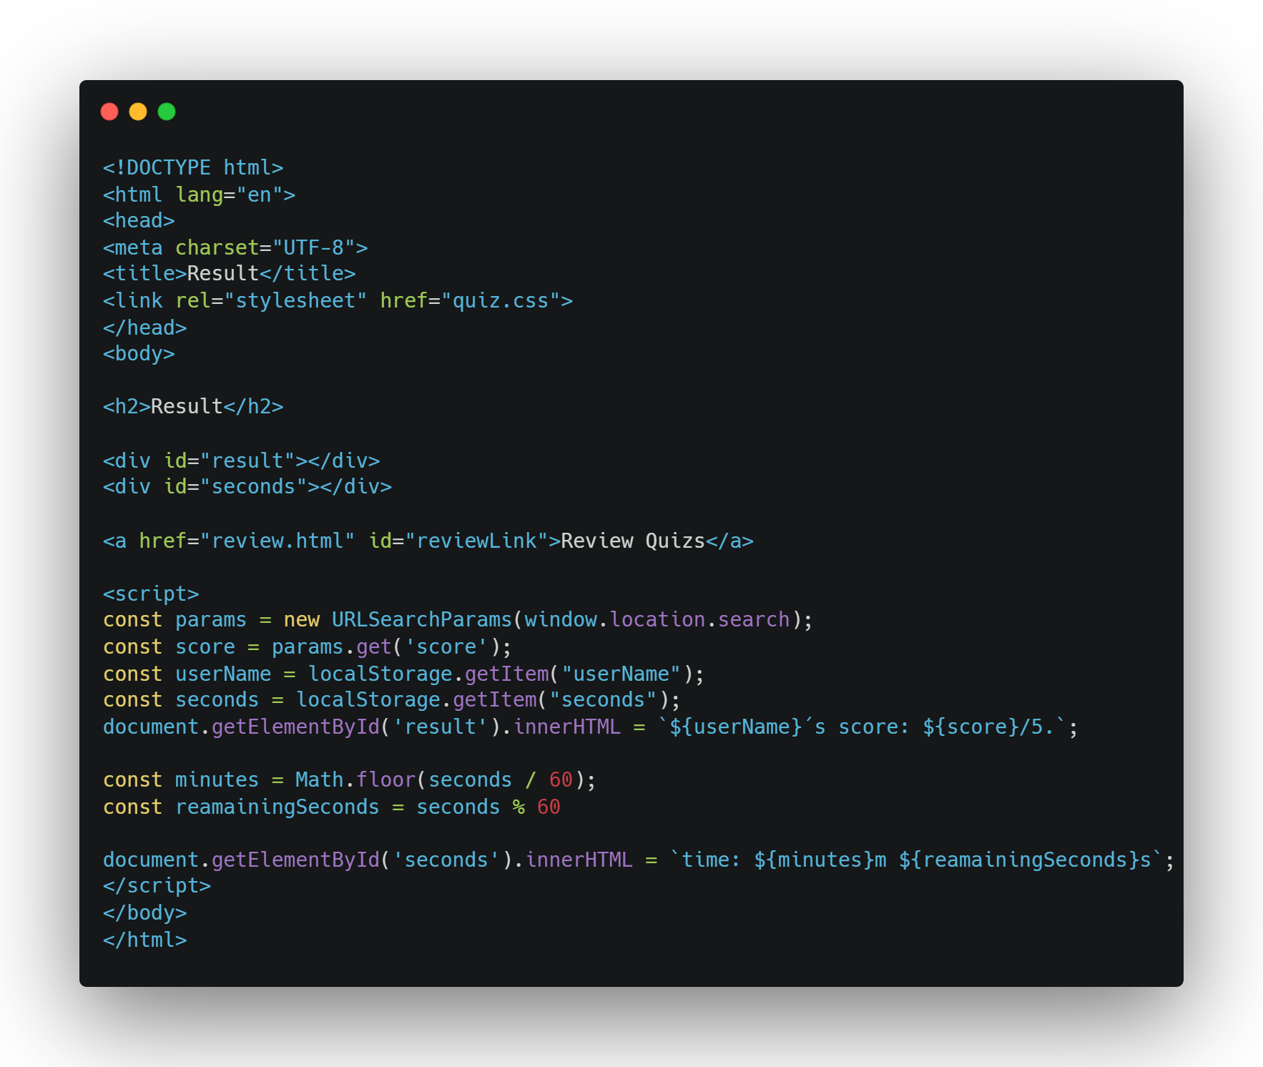
result.html

Slide 9
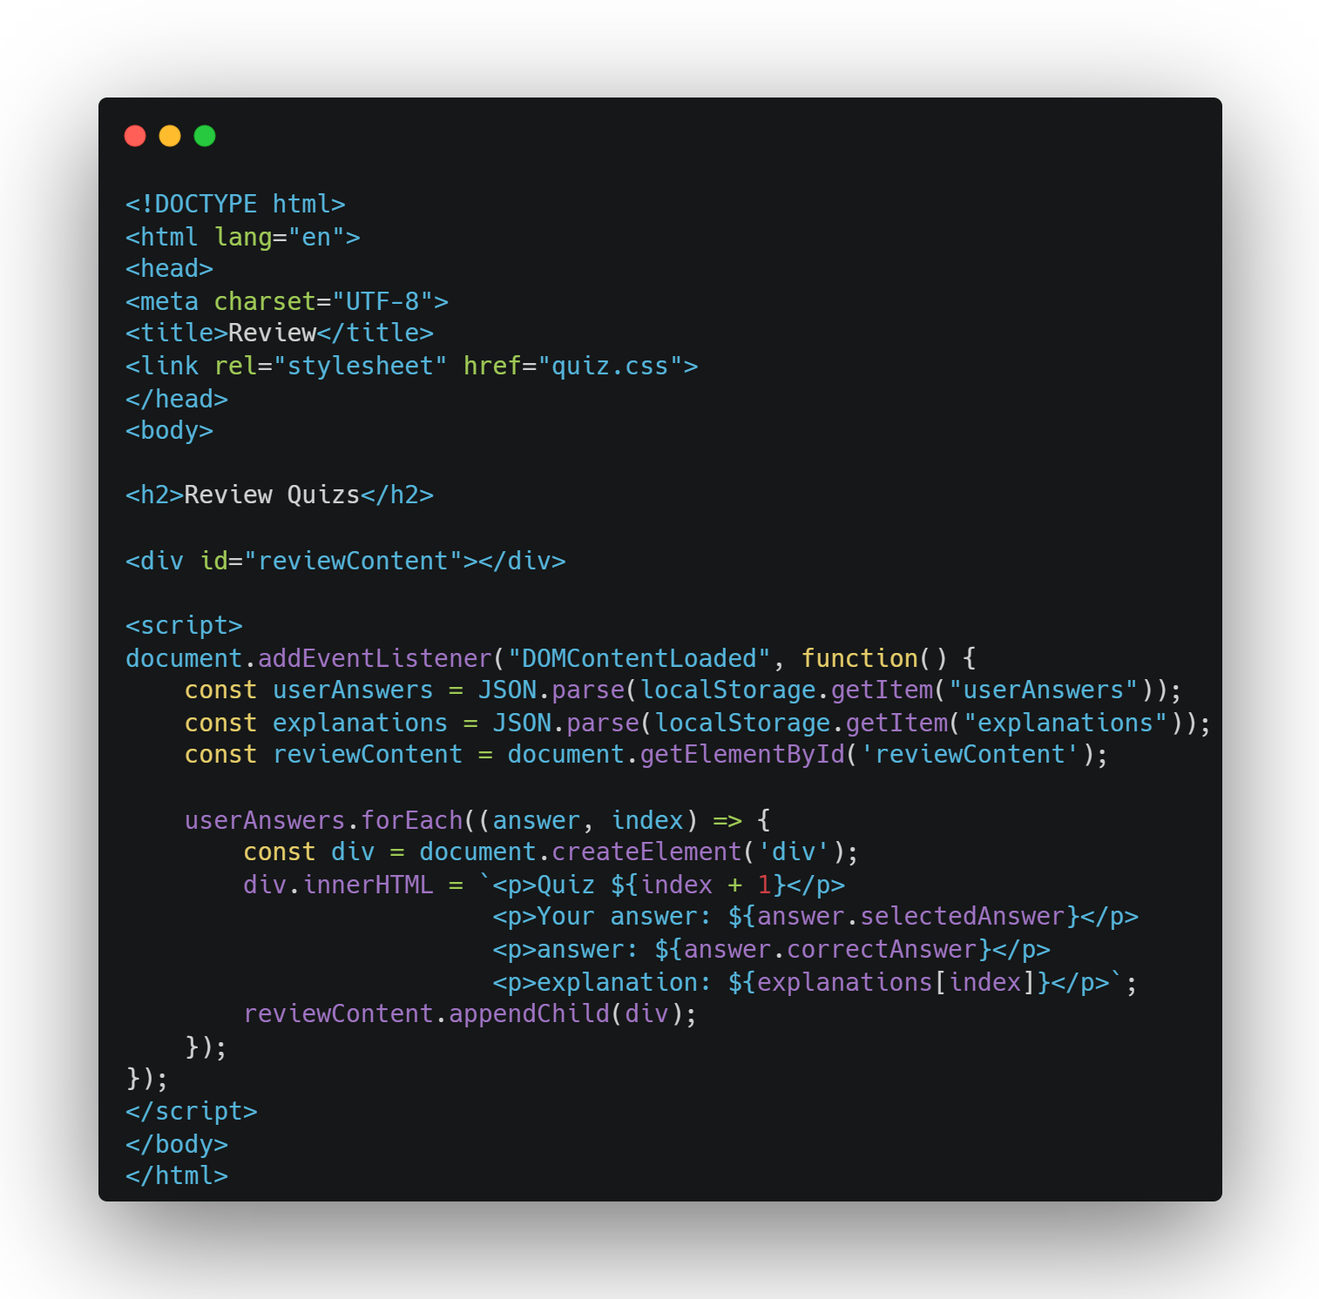
review.html

Slide 10
Quiz Time

