Slide 1

SDLC & Software Development Methodologies
eleks-2018
Yurii Dmytriv

Slide 2
Agenda:
What is SDLC
Stages of SDLC
Software development methodologies:
Agile
Waterfall
Spiral

Slide 3
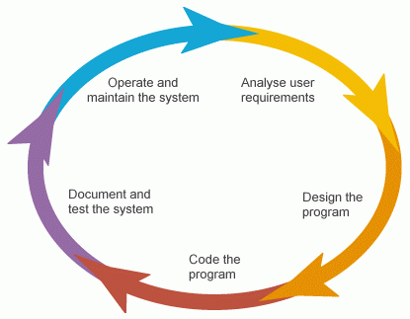
Software Development Life Cycle
A software development life cycle is essentially a series of steps, or phases, that provide a model for the development and lifecycle management of an application.

Slide 4
Stages of SDLC
Planning
Defining problems, goals and resources
Searching for alternative solutions
Learn how to make your product better than your competitors

Slide 5
System analysis
Documentation requirements of the customer - SRS (Software Requirement Specification)
Defininig if the project is organizationally, economically, socially, technologically feasible
SRS - document which consists of all the product requirements to be designed and developed during the project life cycle.

Slide 6
System design
This phase defines the system elements, components, security level, modules, architecture, interfaces, data types ...
How the system will look and function
Create SDS (System Design Document)

Slide 7
Developing the product
“Let’s create what we want.”

Slide 8
Testing the product
“Did we get what we want?”
Searching for defects and deficiencies
Fixing issues until the product meets the original specifications

Slide 9
Deployment and Maintenance
Delivery to customers
Deployment on customers side
Maintenance and update

Slide 10
Some of software developmet methodologies
Agile
Waterfall
Spiral

Slide 11
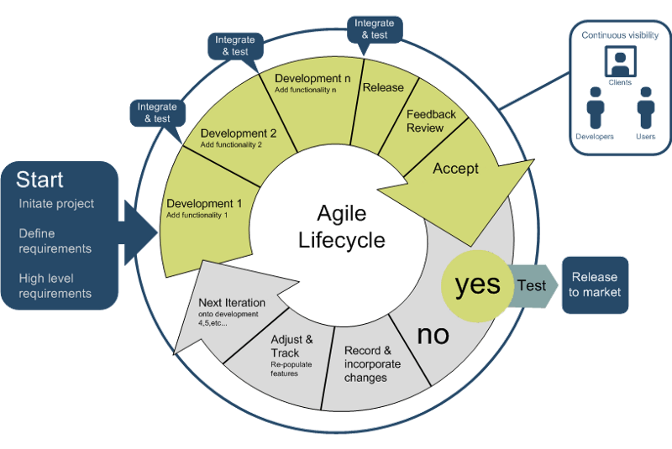
Agile

Slide 12
Agile model believes that every project needs to be handled differently and the existing methods need to be tailored to best suit the project requirements. In Agile, the tasks are divided to time boxes (small time frames) to deliver specific features for a release.
Agile methods:
Scrum
Kanban
Extreme Programming (XP)
Crystal
Dynamic Systems Development Method (DSDM)
Feature-Driven Development (FDD)

Slide 13
Agile values:
Individuals and Interactions over processes and tools
Working Software over comprehensive documentation
Customer Collaboration over contract negotiation
Responding to Change over following a plan

Slide 14
Agile software development principles:
Development is divided into short cycles (sprint) – 1-4 weeks
At the end of each sprint, the customer receives an application (or part of it) that can be used in business;
The development team cooperates with the customer
Changes in the project are welcomed and quickly included in the work.

Slide 15
Advantages:
Promotes teamwork and cross training
Functionality can be developed rapidly and demonstrated
Resource requirements are minimum
Suitable for fixed or changing requirements
Delivers early partial working solutions
Minimal rules, documentation easily employed
Easy to manage
Gives flexibility to developers
Disadvantages:
Not suitable for handling complex dependencies
Depends heavily on customer interaction, so if customer is not clear, team can be driven in the wrong direction
Transfer of technology to new team members may be quite challenging due to lack of documentation

Slide 16
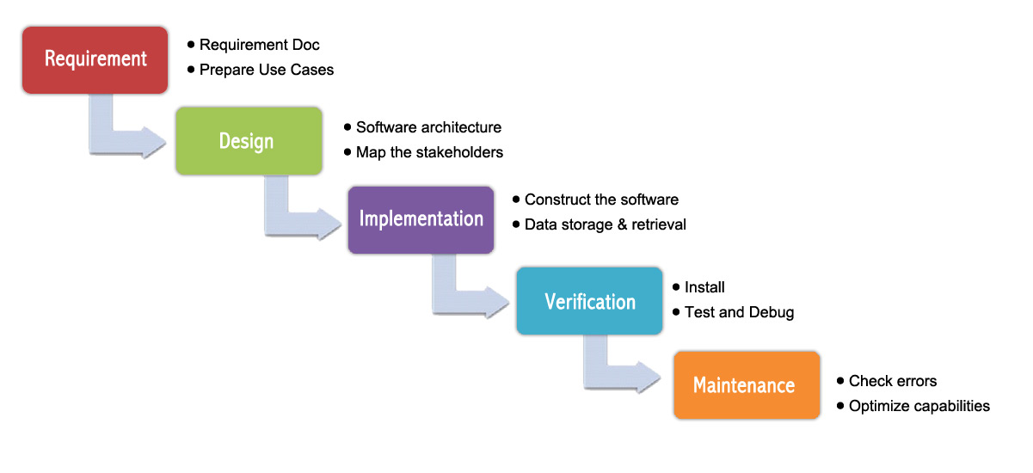
Waterfall

Slide 17
The Waterfall model is a sequential development approach, in which development is seen as flowing steadily downwards (like a waterfall) through several phases:
analysis
software requirements specificationSoftware design
software implementation
testing
integration (if there are multiple subsystems)
deployment (or Installation)
Maintenance
Transition from one phase to another is possible only after the successful completion of the previous stage

Slide 18
Advantages:
Easy to understand and functional
Simple enough to handle as model is rigid
Saves significant amount of time
Allows for easy testing and analysis
It allows for departmentalization and managerial control
Disadvantages:
Nonadaptive Design Constraints
Ignores Mid-Process User/Client Feedback
Delayed Testing Period

Slide 19
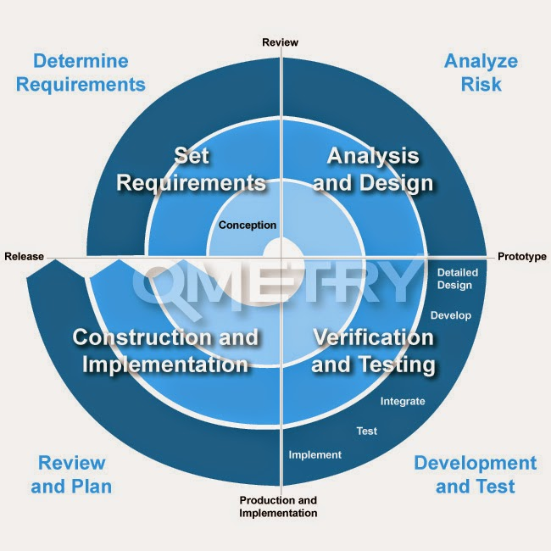
Spiral

Slide 20
The spiral model has four phases:
Planning
Risk Analysis
Engineering
Evaluation
This model suits to large-scale complex systems. Spiral is generally chosen over the waterfall approach for large, expensive, and complicated projects.

Slide 21
Advantages:
Risk factors are considerably reduced
Excellent for large and complex projects
Allows for additional functionality later
Suitable for highly risky projects with varied business needs
Disadvantages:
Expensive model in software development
Failure in risk analysis phase may damage the whole project
Not appropriate for low-risk projects

