Slide 1

ITIL fundamentals
by Vitalii Boldin
eleks.com

Slide 2
Agenda
What is ITIL/ITSM?
ITIL overview, basic structure
What is DevOps
DevOps role within ITIL

Slide 3
ITSM Definition
IT Service Management is a general term that describes a strategic approach for designing, delivering, managing and improving the way information technology (IT) is used within an organization. The goal of every IT Service Management framework is to ensure that the right processes, people and technology are in place so that the organization can meet its business goals.

Slide 4
ITSM Frameworks
COBIT
Microsoft Operations Framework
Six Sigma
ISO 20000
TOGAF
ITIL

Slide 5
ITIL Definition
ITIL (Information Technology Infrastructure Library) - a framework that provides best practices for aligning IT with business needs. The most widely used framework for IT process management is ITIL v3, which has five parts: Strategy, Design, Transition, Operations and Continual Service Improvement. Ongoing development for ITIL has been vested in Axelos, a joint-venture company created by the U.K. Cabinet Office and Capita PLC. As of this writing, the most widely used framework for ITSM is ITIL v3. ITIL was created because there was a need for ITSM best practice in the late 1980’s and it has since become the de facto framework used by many organizations across the world. The framework has five parts: Strategy, Design, Transition, Operations and Continual Service Improvement

Slide 6
ITIL Subjects
Customer
Service Provider
User

Slide 7
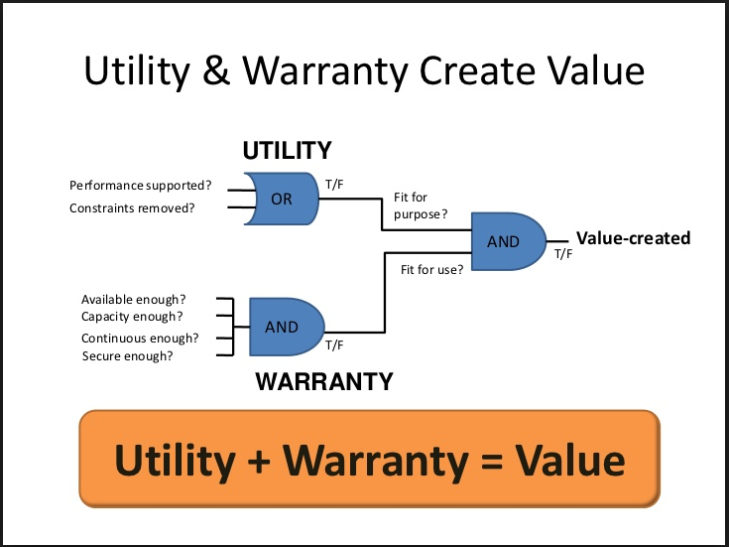
ITIL Service Value

Slide 8
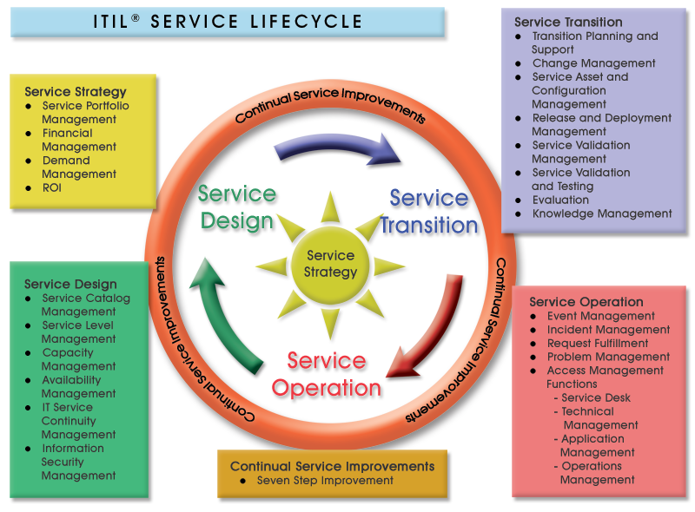
ITIL Service lifecycle

Slide 9
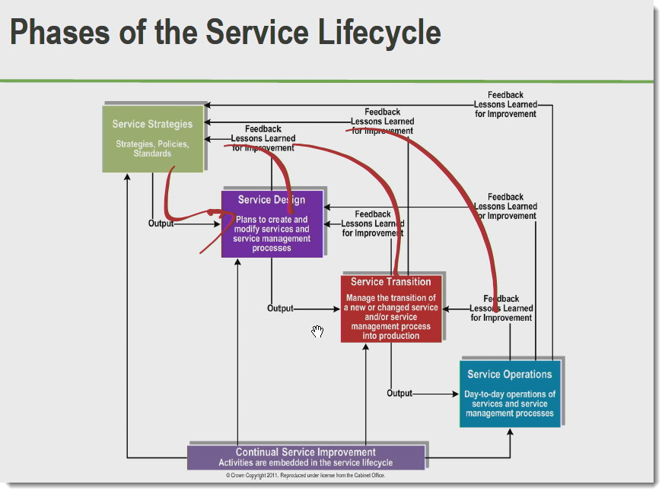

Slide 10
ITIL agreement levels
Service Level Agreement (SLA) is a formal, negotiated contract that outlines service level expectations and clarifies responsibilities between the Service Desk and its Customers (End users).
Operational Level Agreement (OLA) is an internally negotiated document that identifies the service level expectations between the Service Desk and the Technical Support Teams.
Underpinning Contract (UC) enables the Service Desk to monitor and maintain control of requests that are forwarded to external service and support providers.

Slide 11
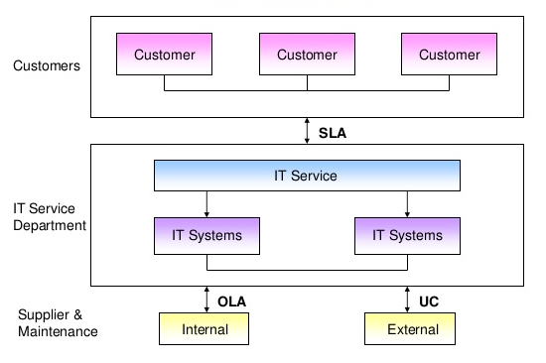
Agreements representation

Slide 12
SLA structure
1. Agreement overview
2. Goals & Objectives
3. Stakeholders
4. Periodic review
5. Service Agreement
5.1 Service Scope
5.2 Service Requirements
5.3 Service Provider Requirements
5.4 Service Assumptions
6. Service Management
6.1 Service Availability
6.2 Service Requests

Slide 13
Disaster Recovery Plan
A disaster recovery plan (DRP) is a documented process or set of procedures to recover and protect a business IT infrastructure in the event of a disaster. Such a plan, ordinarily documented in written form, specifies procedures an organization is to follow in the event of a disaster. It is "a comprehensive statement of consistent actions to be taken before, during and after a disaster". The disaster could be natural, environmental or man-made. Man-made disasters could be intentional (for example, an act of a terrorist) or unintentional (that is, accidental, such as the breakage of a man-made dam).

Slide 14
DRP key points
Disaster Recovery-as-a-Service is a hot topic in cloud, and in business, right now. And, for good reason. The technology that powers disaster recovery has never been more efficient, affordable and capable than it is today.
Disaster recovery vs Business Continuity
DR/BC term might give a false impression that DR and BC are the same, in fact they are different, thought linked
There are many, many businesses that fail after a disaster without a BC plan. DR will get your hardware, software and apps back up and running, but without a business continuity plan to keep your company going during the recovery process, you might not have a reason to recover those items.

Slide 15
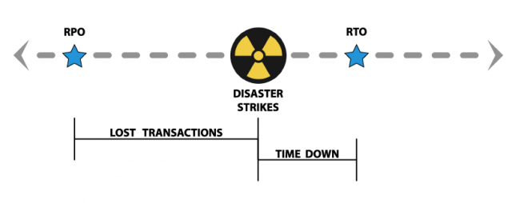
RTO vs RPO vs PTO
Recovery Point Objective (RPO) refers to the the point in time in the past to which you will recover.
Recovery Time Objective (RTO) refers to the point in time in future in which you will be up and running again
Paid time Off (PTO) is what you take the day after you’ve successfully recovered from your disaster and your business is up and running at full speed ahead.

Slide 16
Problems and incidents
What is an incident?
Based on the definition provided, an incident is something that needs to be resolved immediately. This can either be through a permanent fix, a workaround or a temporary fix. An example of an incident would be a server crash which causes a disruption in the business process. If a server is used only during office hours, a crash after office hours is, strictly speaking based on the definition, not yet an incident since the no service was affected. It becomes an incident only when the outage extends to the hours of use.
What is problem?
Problems however are not incidents. An incident can raise a problem, specially if there is a high possibility that the incident might happen again. In the case of a server crash after office hours, the crash is a problem. This is a high priority problem because if this problem is not resolved, this will become an incident.

Slide 17
More widely used terms
KPI - an extensive collection of ITIL key performance indicators (ITIL KPIs) supports the introduction of a comprehensive framework for process control. This includes regular quality assessments of the IT Service Management processes. ITIL key performance indicators (ITIL KPIs) are used to assess if the processes of an IT organization - the ITIL processes - are running according to expectations..
CSF - a management term for an element that is necessary for an organization or project to achieve its mission. It is a critical factor or activity required for ensuring the success of a company or an organization. The term was initially used in the world of data analysis and business analysis. For example, a CSF for a successful Information Technology project is user involvement.
Service Desk - is a communications center that provides a single point of contact (SPOC) between a company and its customers, employees and business partners. The purpose of a service desk is to ensure that users receive appropriate help in a timely manner.

Slide 18
What is DevOps?
The DevOps approach to software development requires frequent, incremental changes to code versions, which means frequent deployment and testing regimens. Although DevOps engineers rarely code from scratch, they must understand the basics of software development languages and be familiar with the development tools used to create new code or update existing code. A DevOps engineer will work with development staff to tackle the coding and scripting needed to connect elements of code, such as libraries or software development kits (SDKs), and integrate other components such as SQL data management or messaging tools that are needed to run the software release on operating systems and production infrastructure.

Slide 19
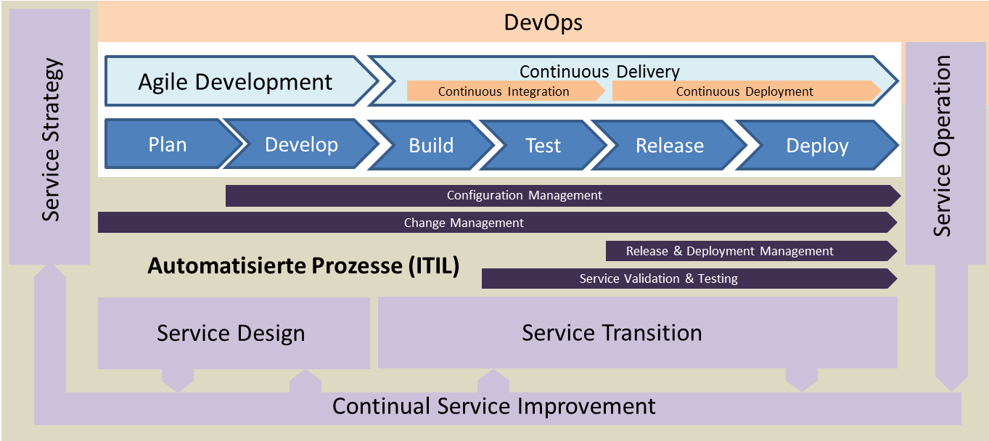
DevOps and ITIL

Slide 20

Questions time
Notes:
Опиши де і як краще використовувати такий стиль

Slide 21
Inspired by Technology.
Driven by Value.
Find us at eleks.com
Have a question? Write to eleksinfo@eleks.com

