Slide 1

Software Development Life Cycle (SDLC)
eleks.com

Slide 2
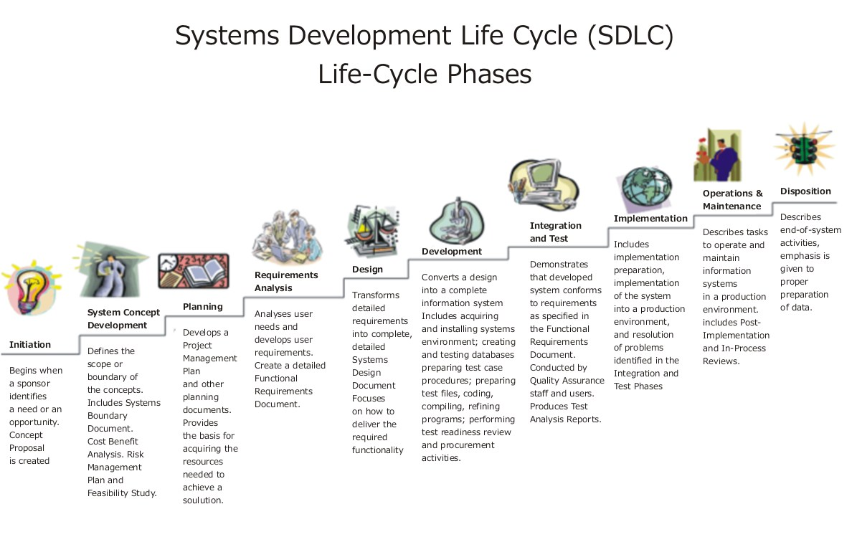

Slide 3
SDLC MODELS
To help understand and implement the SDLC phases various SDLC models have been created by software development experts, universities, and standards organizations

Slide 4
Reasons for Using SDLC Models
Provides basis for project planning,
estimating & scheduling
Provides framework for standard set of
terminologies, activities & deliverables
Provides mechanism for project tracking &
control
Increases visibility of project progress to all
stakeholders

Slide 5
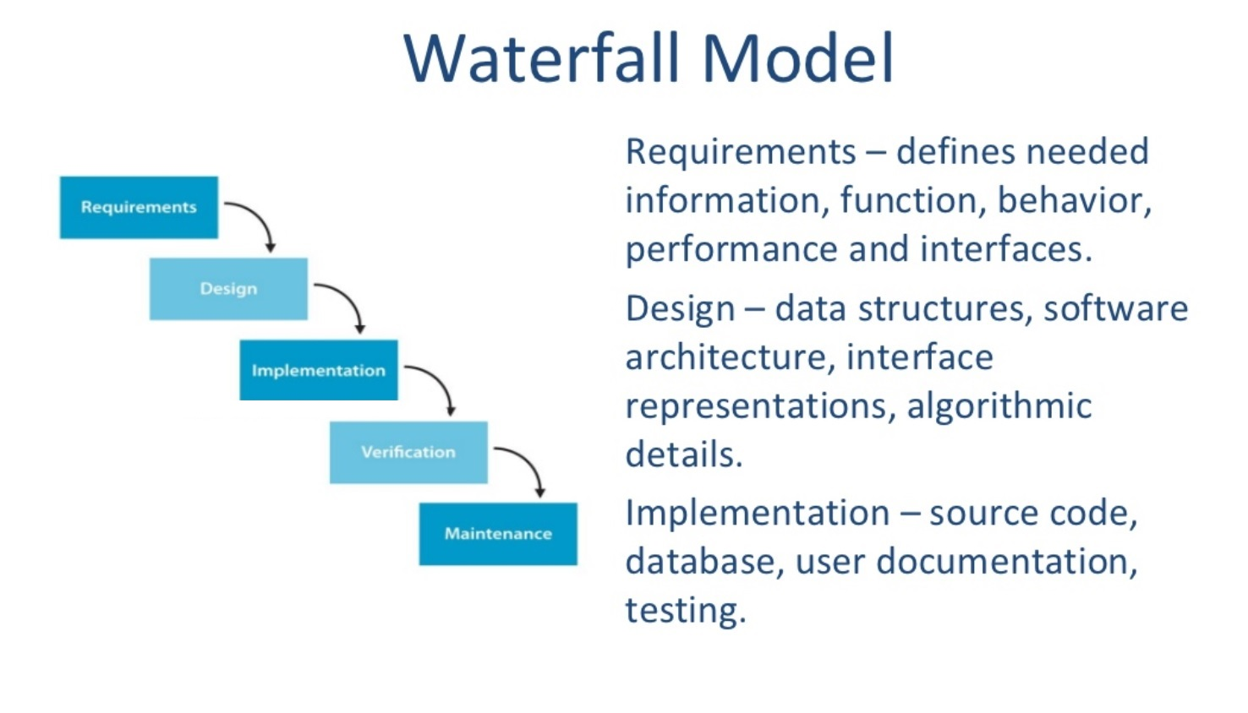
Waterfall Model

Slide 6
Waterfall Strengths
Easy to understand, easy to use
Provides structure to inexperienced staff
Milestones are well understood
Sets requirements stability
Good for management control (plan, staff, track)
Works well when quality is more important than cost or schedule

Slide 7
Waterfall Deficiencies
Idealised, does not match reality well.
Doesn’t reflect iterative nature of exploratory development.
Unrealistic to expect accurate requirements so early in project
Software is delivered late in project, delays discovery of serious errors.
Difficult to integrate risk management
Difficult and expensive to make changes
to documents, ”swimming upstream”.
Significant administrative overhead,
costly for small teams and projects.

Slide 8
When to use the Waterfall Model
Requirements are very well known
Product definition is stable
Technology is understood
New version of an existing product
Porting an existing product to a new platform.

Slide 9
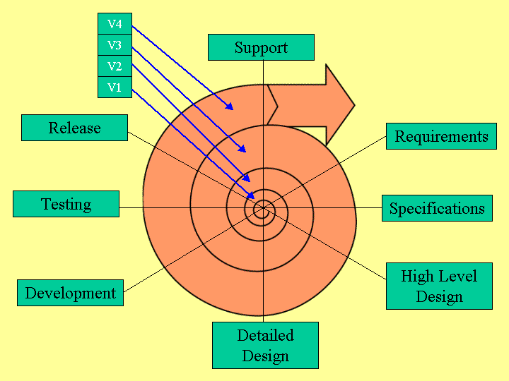
Spiral Model
Adds risk analysis, and RAD prototyping to the waterfall model
Each cycle involves the same sequence of steps as the waterfall process model

Slide 10
Spiral Model Strengths
Provides early indication of insurmountable risks, without much cost
Users see the system early because of rapid prototyping tools
Critical high-risk functions are developed first
The design does not have to be perfect
Users can be closely tied to all lifecycle steps
Early and frequent feedback from users
Cumulative costs assessed frequently

Slide 11
Spiral Model Weaknesses
Time spent for evaluating risks too large for small or low-risk projects
Time spent planning, resetting objectives, doing risk analysis and prototyping may be excessive
The model is complex
Risk assessment expertise is required
Spiral may continue indefinitely
Developers must be reassigned during non-development phase activities
May be hard to define objective, verifiable milestones that indicate readiness to proceed through the next iteration

Slide 12
When to use Spiral Model
When creation of a prototype is appropriate
When costs and risk evaluation is important
For medium to high-risk projects
Long-term project commitment unwise because of potential changes to economic priorities
Users are unsure of their needs
Requirements are complex
New product line
Significant changes are expected (research and exploration)

Slide 13
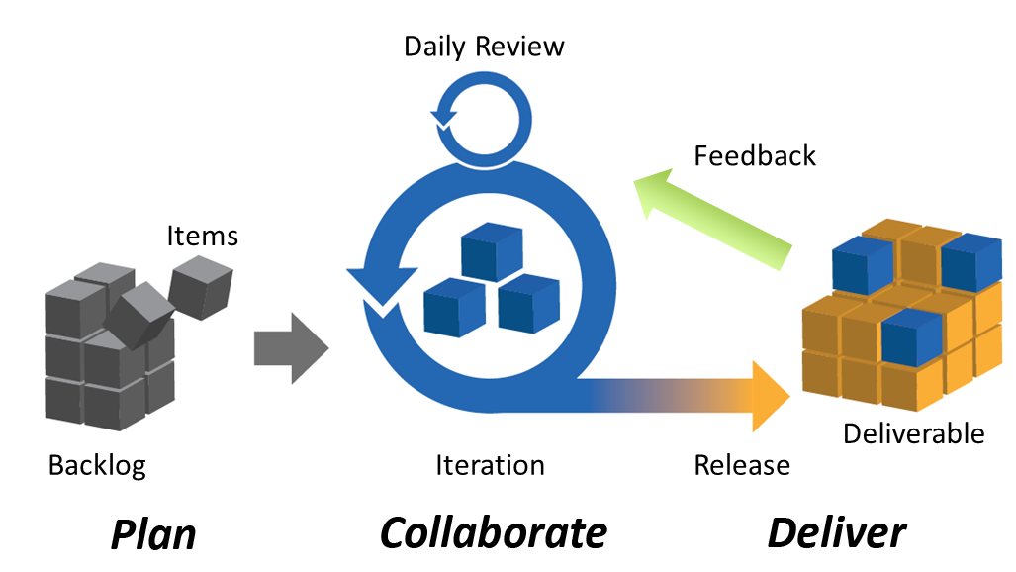
Agile Model
Speed up or bypass one or more life cycle phases
Usually less formal and reduced scope
Used for time-critical applications
Used in organizations that employ disciplined methods

Slide 14
Agile Methods
Adaptive Software Development (ASD)
Feature Driven Development (FDD)
Crystal Clear
Dynamic Software Development Method (DSDM)
Rapid Application Development (RAD)
Scrum
Extreme Programming (XP)
Rational Unify Process (RUP)

Slide 15
Agile Model Strengths
Deliver a working product faster than
conventional linear development model
Customer feedback at every stage ensures that the end deliverable satisfies their expectations
No guesswork between the development team and the customer, as there is face to face communication and continuous inputs from the client

Slide 16
Agile Model Weaknesses
For larger projects, it is difficult to judge the efforts and the time required for the project in the SDLC.
Since the requirements are ever changing, there is hardly any emphasis, which is laid on designing and documentation. Therefore, chances of the project going off the track easily are much more

Slide 17
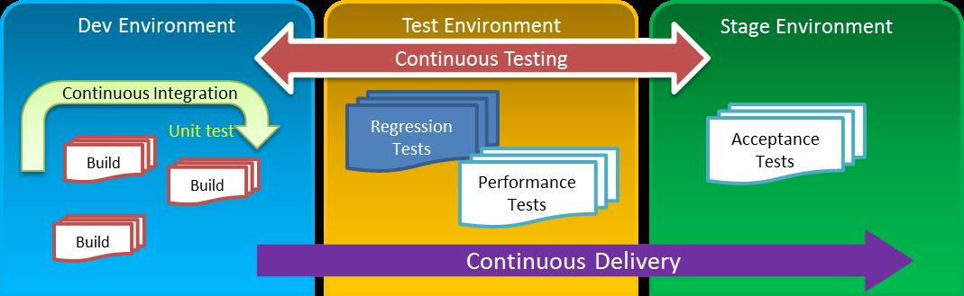
Software environments organization

