Slide 1
SDLC

Slide 2
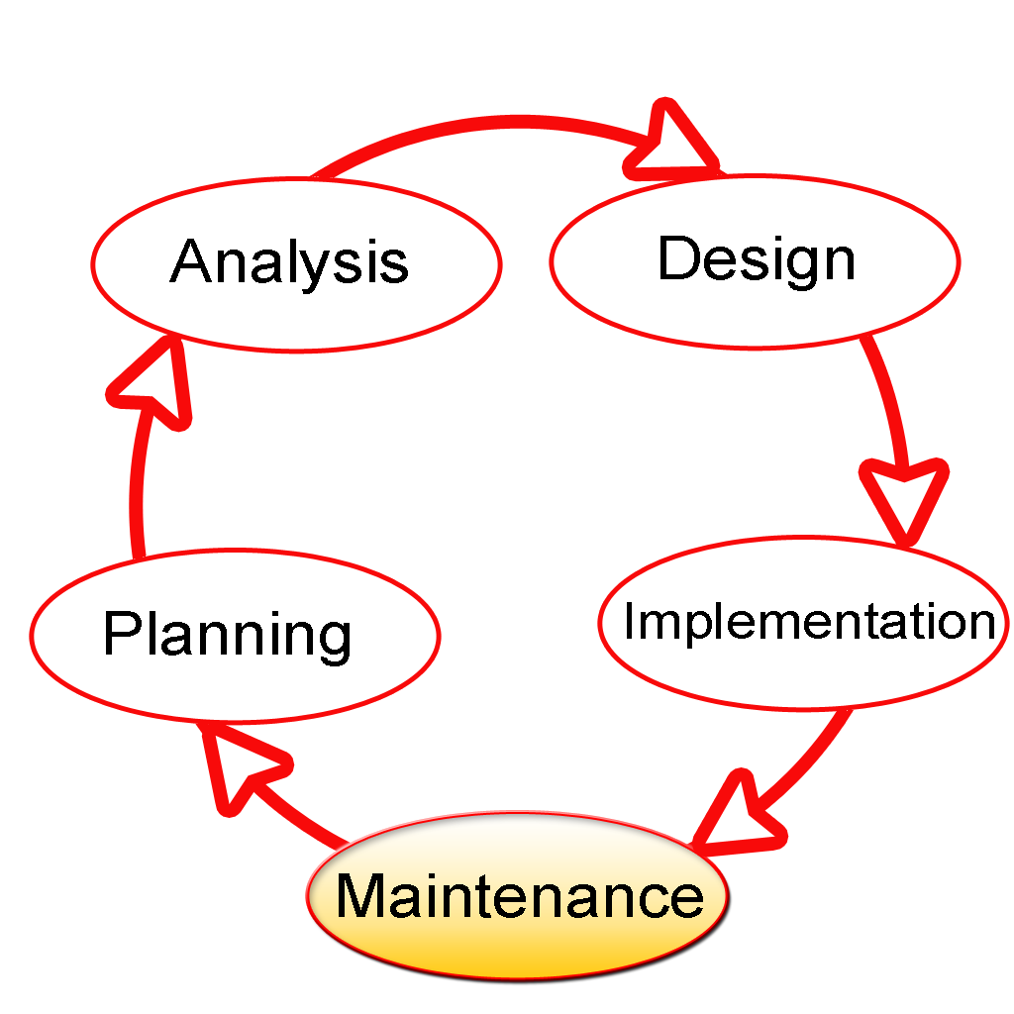
SDLC
A process for planning, creating, testing, and deploying an information system

Slide 3
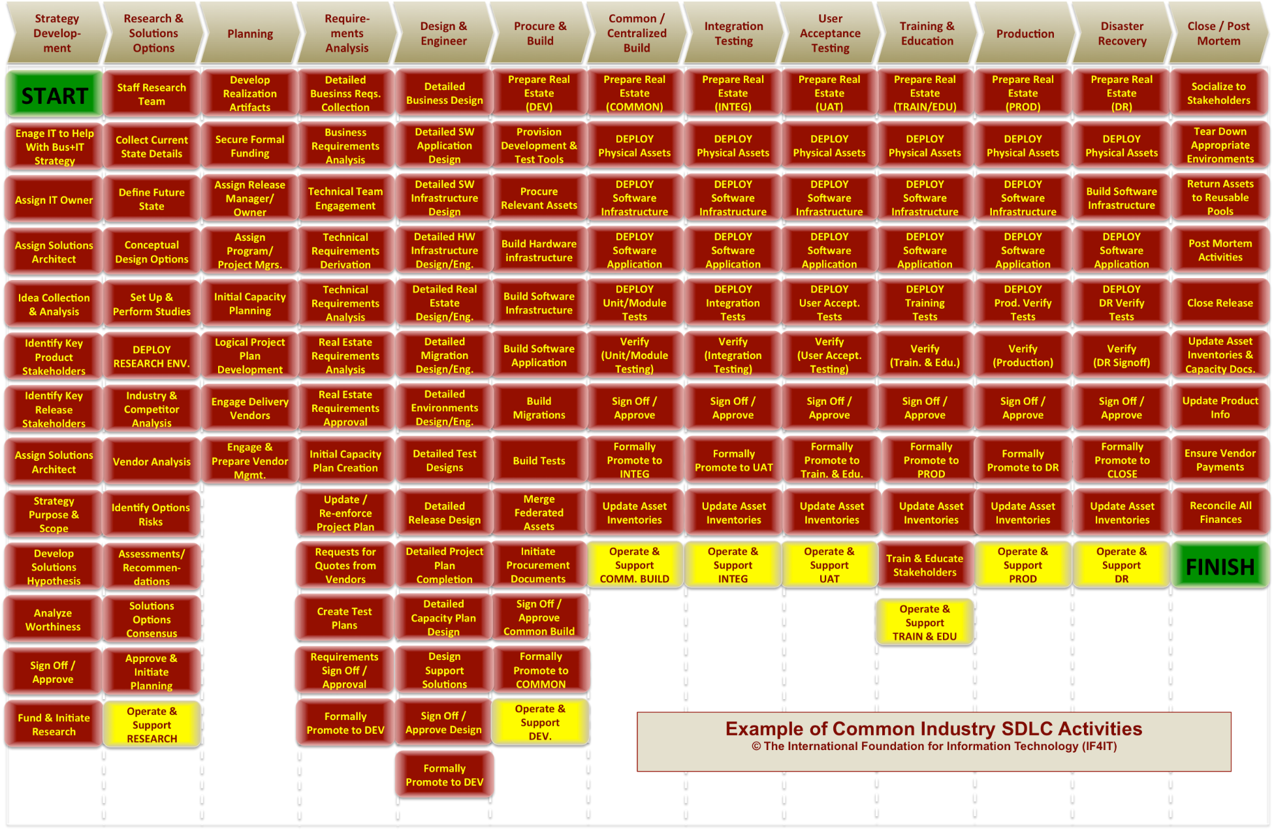
SDLC

Slide 4
SDLC Objectives
SDLC has three primary objectives:
Ensure the delivery of high quality systems
Provide strong management control
Maximize productivity

Slide 5
Stage 1: Planning
Inputs from the customer
Requirement Analysis
Plan the basic project approach

Slide 6
Stage 2: Defining
Clearly define and document the product requirements
Get them approved from the customer
Create ‘SRS’ – Software Requirement Specification document

Slide 7
Stage 3: Designing
Define how the system will be implemented
Designing the product architecture
Create ‘DDS’ – Design Document Specification

Slide 8
Stage 4: Implementation
Developing, Building, Deploying
Development starts and the product is built
CI/CD and DevOps

Slide 9
Stage 5: Testing
Product quality control
Product compliance with the claimed requirements
Fixing errors in the bug control system
Bug fixes by developers

Slide 10
Stage 6: Maintenance
Support for a finished product
Help a Customer
Bug-fix
Satisfy changing needs
Enhance performance
Fix potential problems

Slide 11
Software Development Methodology

Slide 12
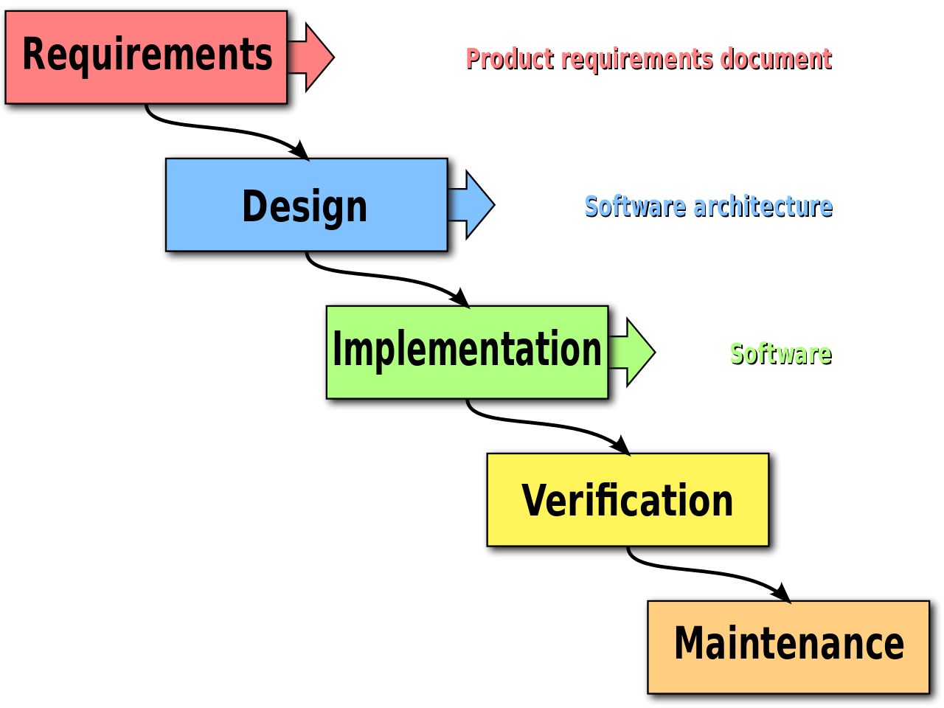
Waterfall
The final version of the product is known in advance
Strength
Accurate planning of time and costs
Transparency of processes for the customer
Weakness
Inflexible
The need to approve the full amount of requirements for the system at the first stage
If there is a need to make changes to the requirements later - return to the first stage and re-do all the work done

Slide 13
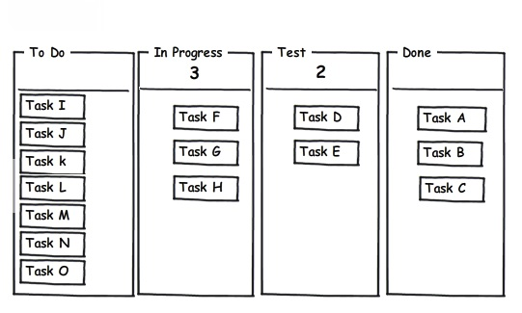
Kanban
Reducing the number of parallel tasks greatly reduces the execution time of each individual task
A limited number of tasks in “In Progress”
No timetable for implementation
Best methodology for DevOps stream

Slide 14
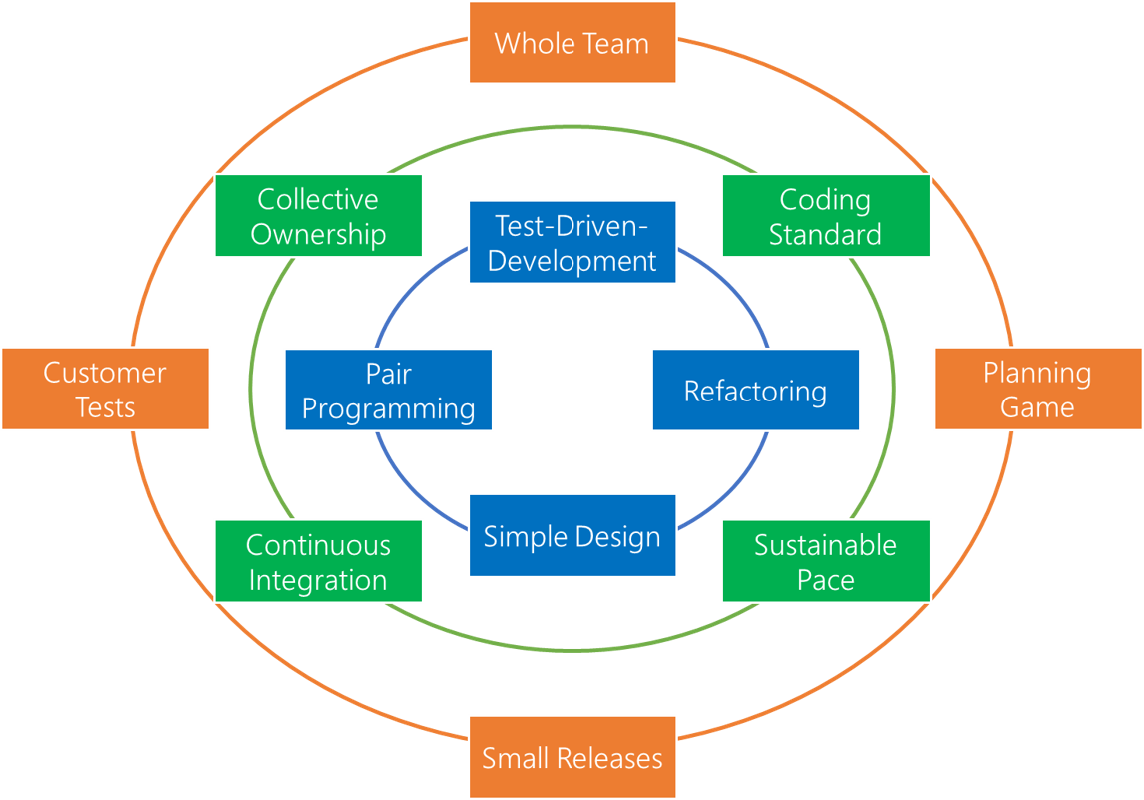
XP

Slide 15
XP: Test-driven development
requirements are turned into very specific test cases, then the software is improved to pass the new tests, only
this is opposed to software development that allows software to be added that is not proven to meet requirements

Slide 16
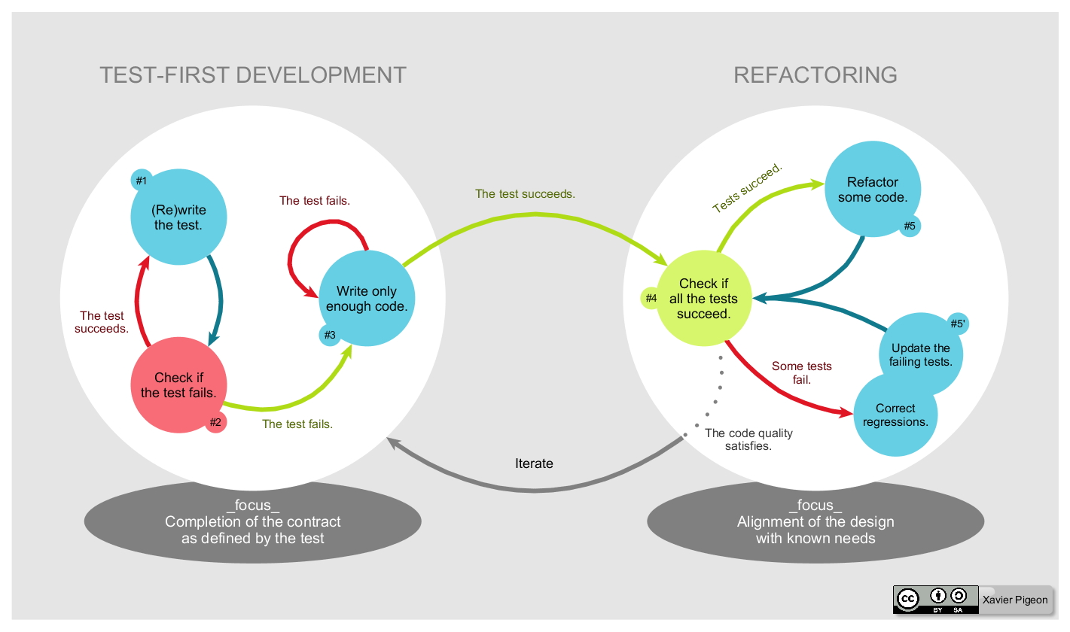
XP: Test-driven development

Slide 17
XP: Refactoring
process of restructuring existing code—changing the factoring—without changing its external behavior
improves nonfunctional attributes of the software
usually motivated by noticing a code smell

Slide 18
XP: Simple Design
"simple is best" approach to software design
Whenever a new piece of code is written, the author should ask themselves 'is there a simpler way to introduce the same functionality?'. If the answer is yes, the simpler course should be chosen.

Slide 19
XP: Pair Programming
two programmers work together at one workstation
one, the driver, writes code while the other, the observer or navigator, reviews each line of code as it is typed in
the two programmers switch roles frequently

Slide 20
Last slide
Question
There will be “Thank you”. Maybe.

