Slide 1

Notes:
Speaker notes: - Good afternoon everyone. I am Dominic, a final-year PhD student in the Kao Group. - Over the next 20 minutes, I will talk through work asking whether Scotland's COVID-19 genome data can help identify genomic signatures of superspreading. - By superspreading, I mean situations where one person, one setting, or one local network contributes a disproportionate amount of onward transmission. - These events shaped the COVID-19 pandemic, but they are difficult to identify directly from genome data alone. - The central challenge is resolution: SARS-CoV-2 has relatively low genetic diversity over short time scales, so the question is not whether genomes can prove an event occurred, but whether they can flag patterns worth investigating.

Slide 2
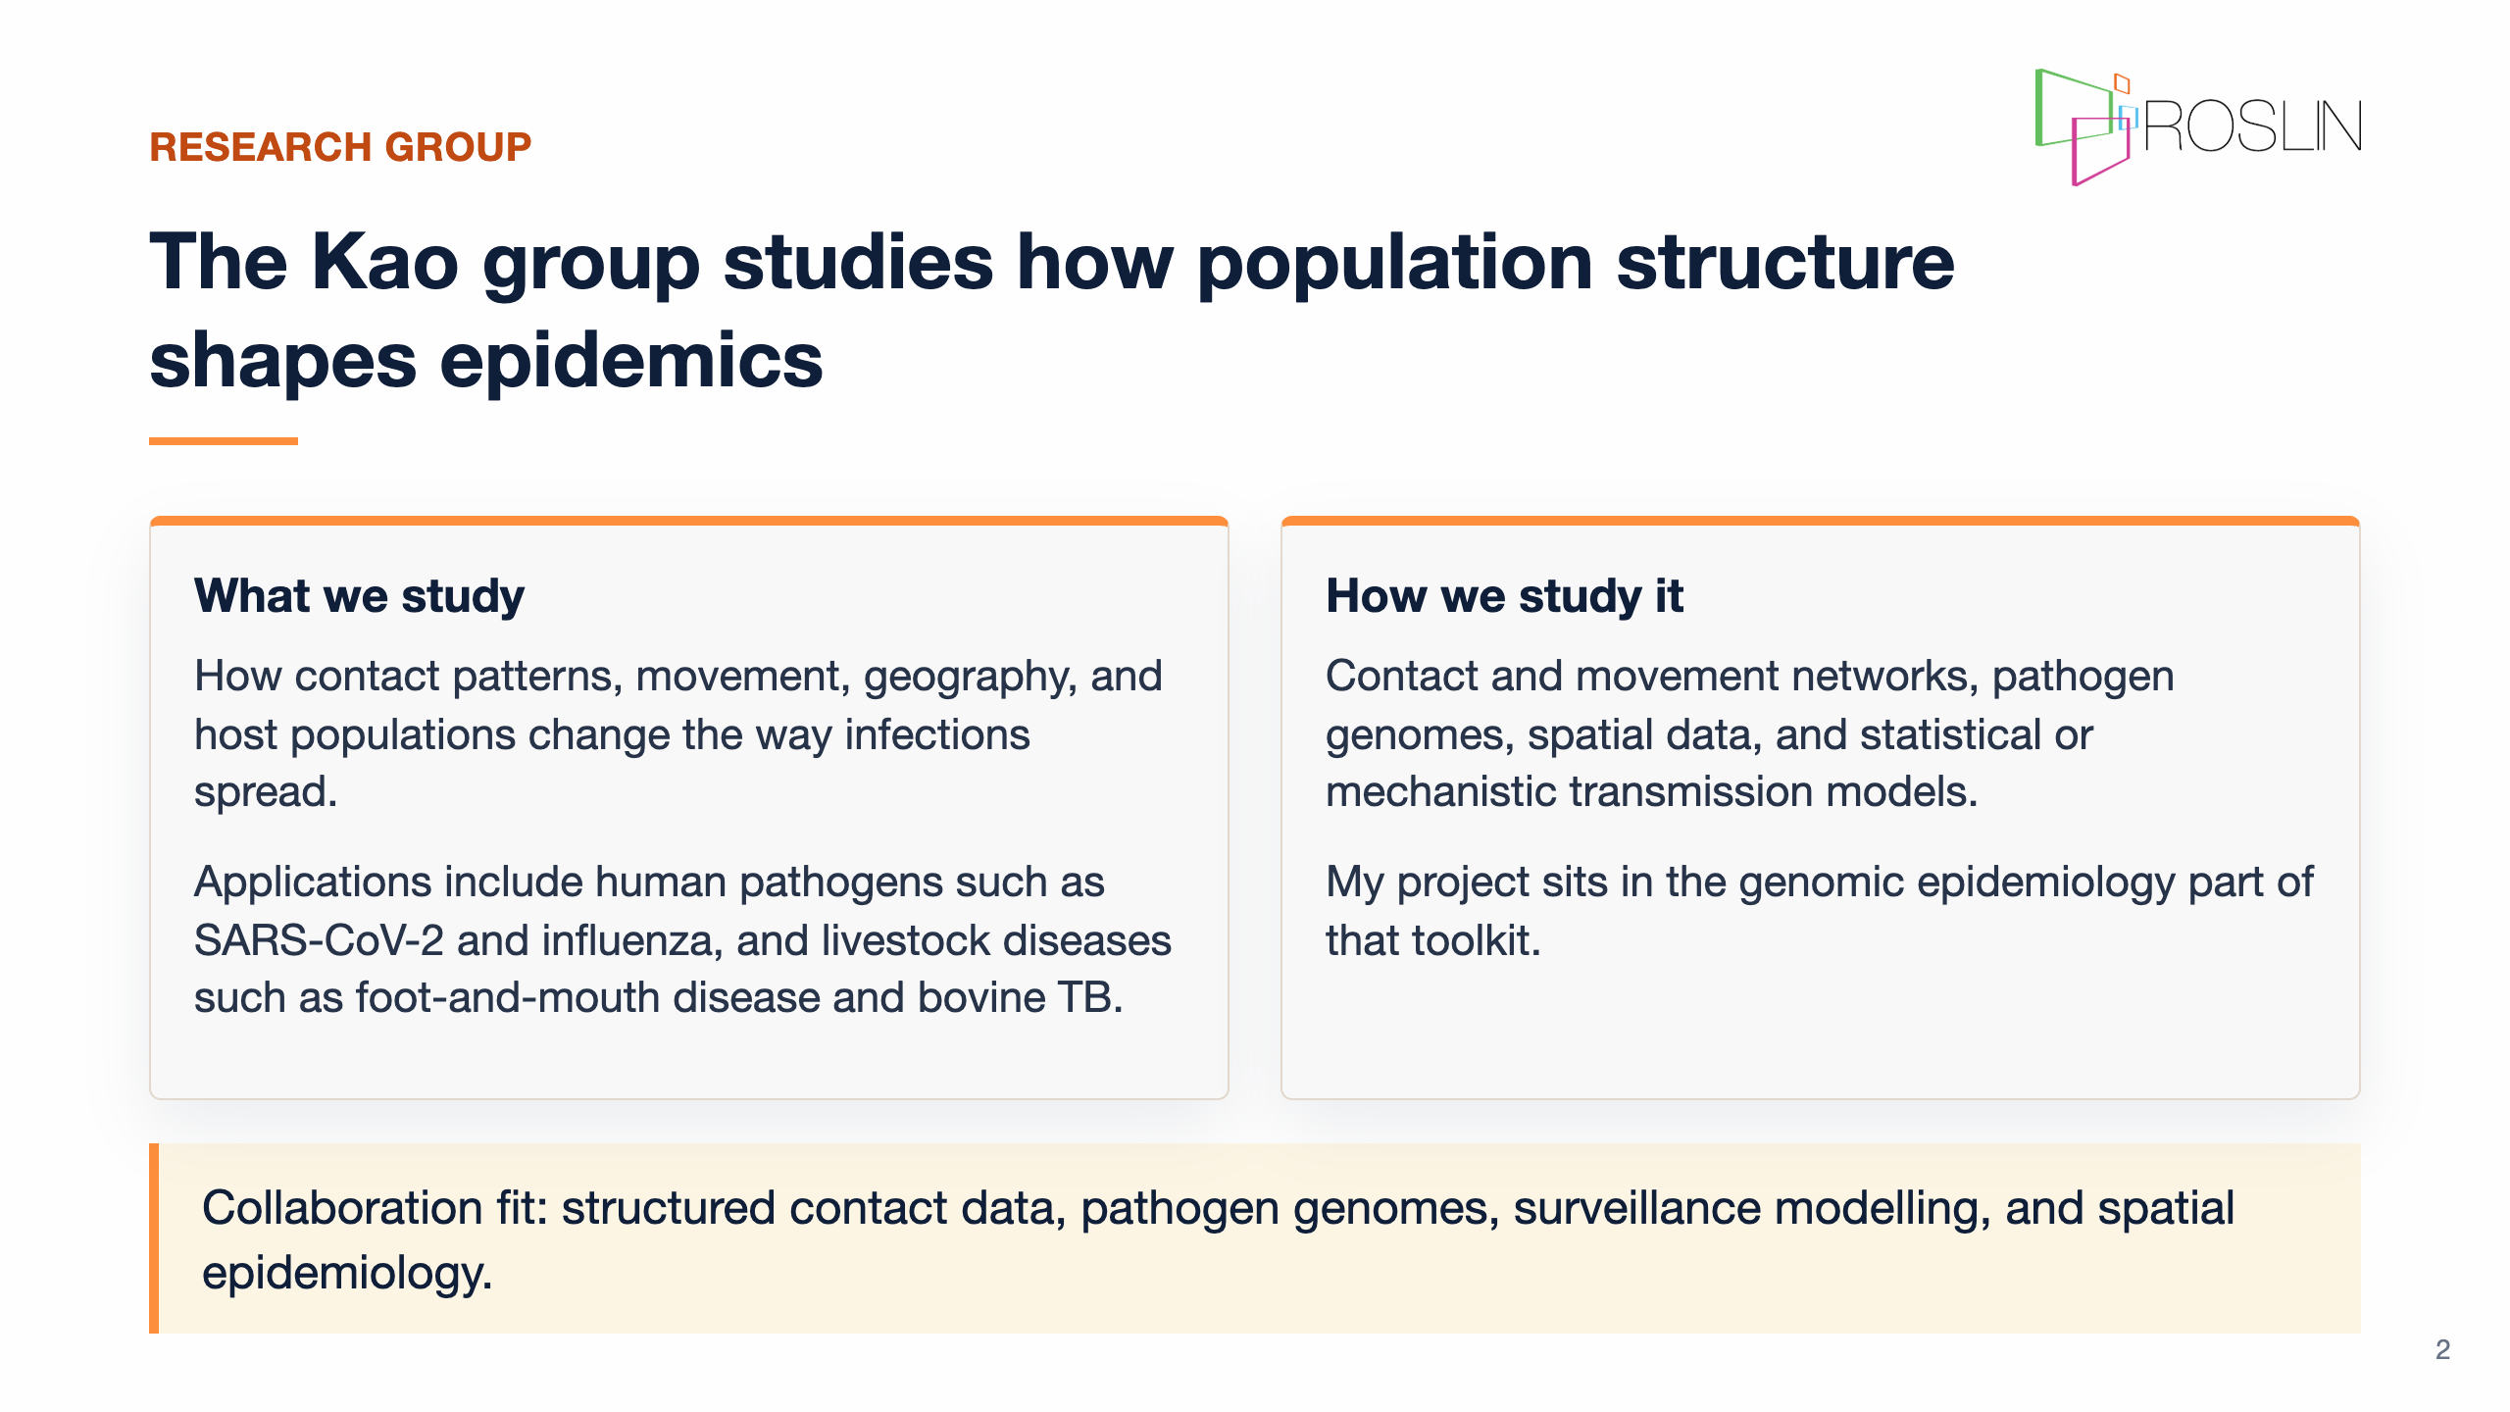
Notes:
Speaker notes: - To place the project in context, the Kao Group studies how population structure shapes disease spread. - Population structure means the patterns that determine who can infect whom: contacts between people, animal movements between farms, geography, and how connected communities are over time. - The group works across human and animal pathogens, including SARS-CoV-2, influenza, foot-and-mouth disease, and bovine TB. - The biology differs, but the core questions often overlap: how does structure change transmission, and how can surveillance data reveal that structure? - My project sits in the genomic epidemiology part of that toolkit, using virus genomes as one source of evidence about how transmission unfolded. - If your work connects to contact data, movement records, pathogen sequences, spatial epidemiology, or surveillance modelling, I would be very happy to talk afterwards.

Slide 3
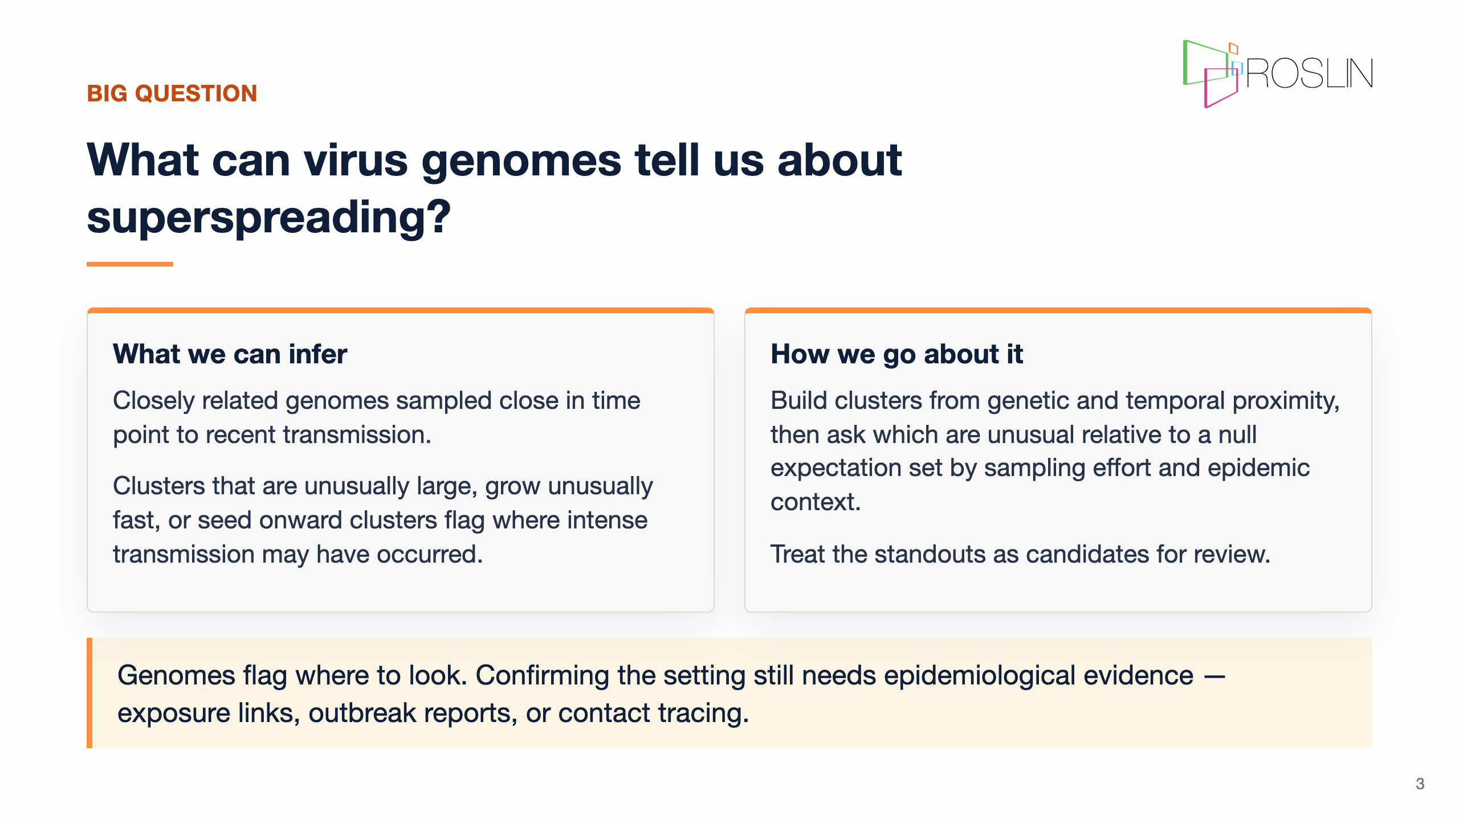
Notes:
Speaker notes: - The main question is what virus genomes can tell us about superspreading, and where that inference stops. - A confirmed superspreading event requires epidemiological evidence: a setting, exposure links, and ideally supporting outbreak or contact tracing data. - I do not have those links directly, but I do have a very large set of virus genomes. - Closely related genomes sampled close together in time point to recent transmission. - Clusters that are unusually large, grow unusually quickly, or seed onward clusters are therefore useful signals to flag. - The methodological challenge is making those flags rigorous: defining clusters, choosing an appropriate null comparison, and accounting for uneven sampling and changing epidemic context. - I will use the word "candidate" deliberately throughout: it means a genomic signal worth reviewing, not a confirmed superspreading event.

Slide 4
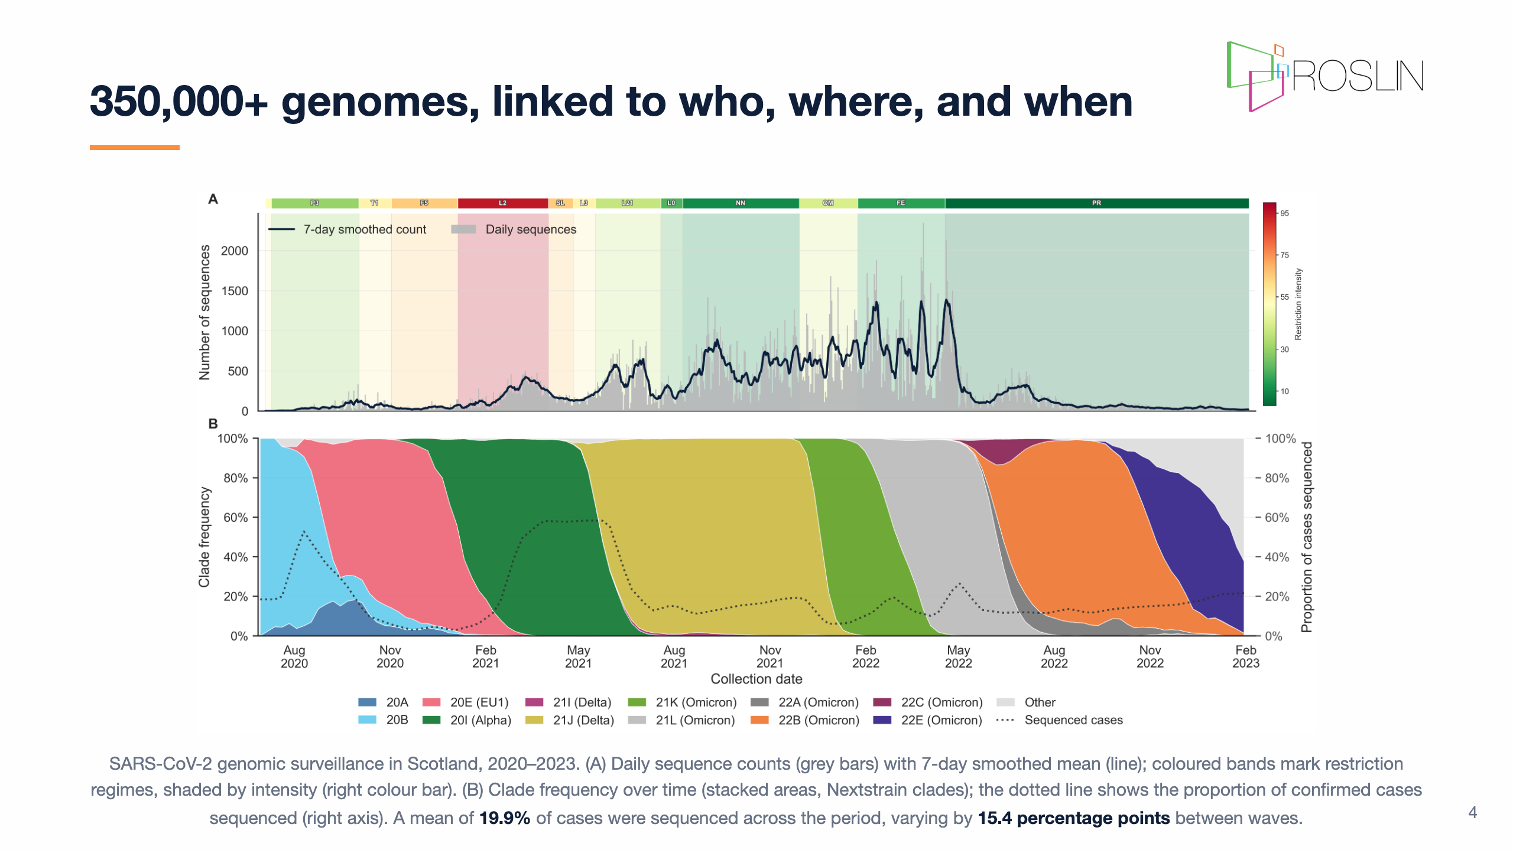
Notes:
## Genomic epidemiology of SARS-CoV-2 in Scotland Speaker notes: - This work uses a rich national surveillance resource from Public Health Scotland and COG-UK. - Between 2020 and 2023, more than 350,000 Scottish SARS-CoV-2 genomes were generated, spanning the major variant waves and restriction regimes. - The volume matters, but the linked metadata are just as important. - Each sequence can be connected to collection date, geography, age, sex, area-level deprivation, and vaccination history. - That allows the analysis to ask not only whether a cluster is unusual, but who is involved, where it appears, and what policy and variant context it sits within. - The key caveat is that sequencing intensity changed through time, so any screen for unusual clusters must be calibrated against uneven sampling effort.

Slide 5
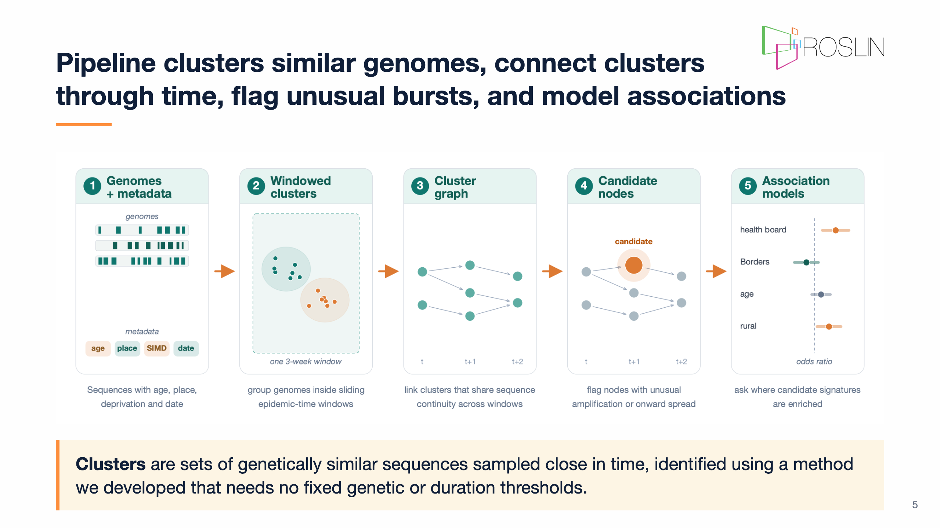
Notes:
Speaker notes: - This is the methods slide I want people to remember. - First, I split the epidemic into overlapping time windows and cluster together very similar genomes within each window. - Second, I connect related clusters across neighbouring windows, so I can follow how a viral lineage appears to move through the sampled data. - Third, I ask which clusters look unusual compared with other clusters observed at the same time. - The important idea is simple: connect genome clusters through time, then look for unusual bursts in size, novelty, or onward spread.

Slide 6
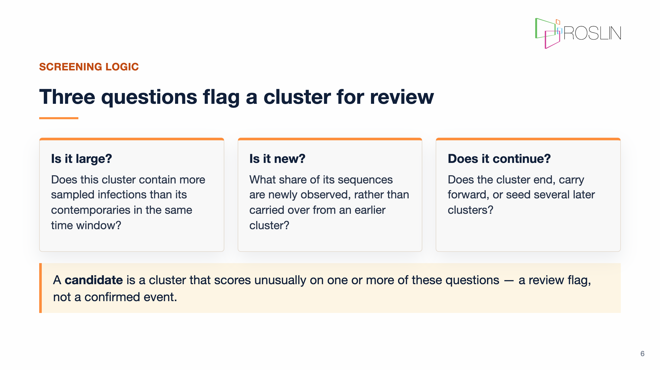
Notes:
Speaker notes: - The screen does not try to prove why a cluster grew. - Instead, it asks three practical questions, each compared against clusters from the same time window. - First: is it large? Does it contain more sampled infections than other clusters from the same period? - Second: is it new? What share of its sequences are newly observed, rather than carried over from an earlier cluster? - Third: does it continue? Does the signal end, carry forward, or seed several later clusters? - Clusters need at least six sequences to enter the screen; below that, the comparisons are not reliable enough. - A cluster that scores unusually on one or more of these questions becomes a candidate for review. - Again, candidate means review flag, not confirmed event.

Slide 7
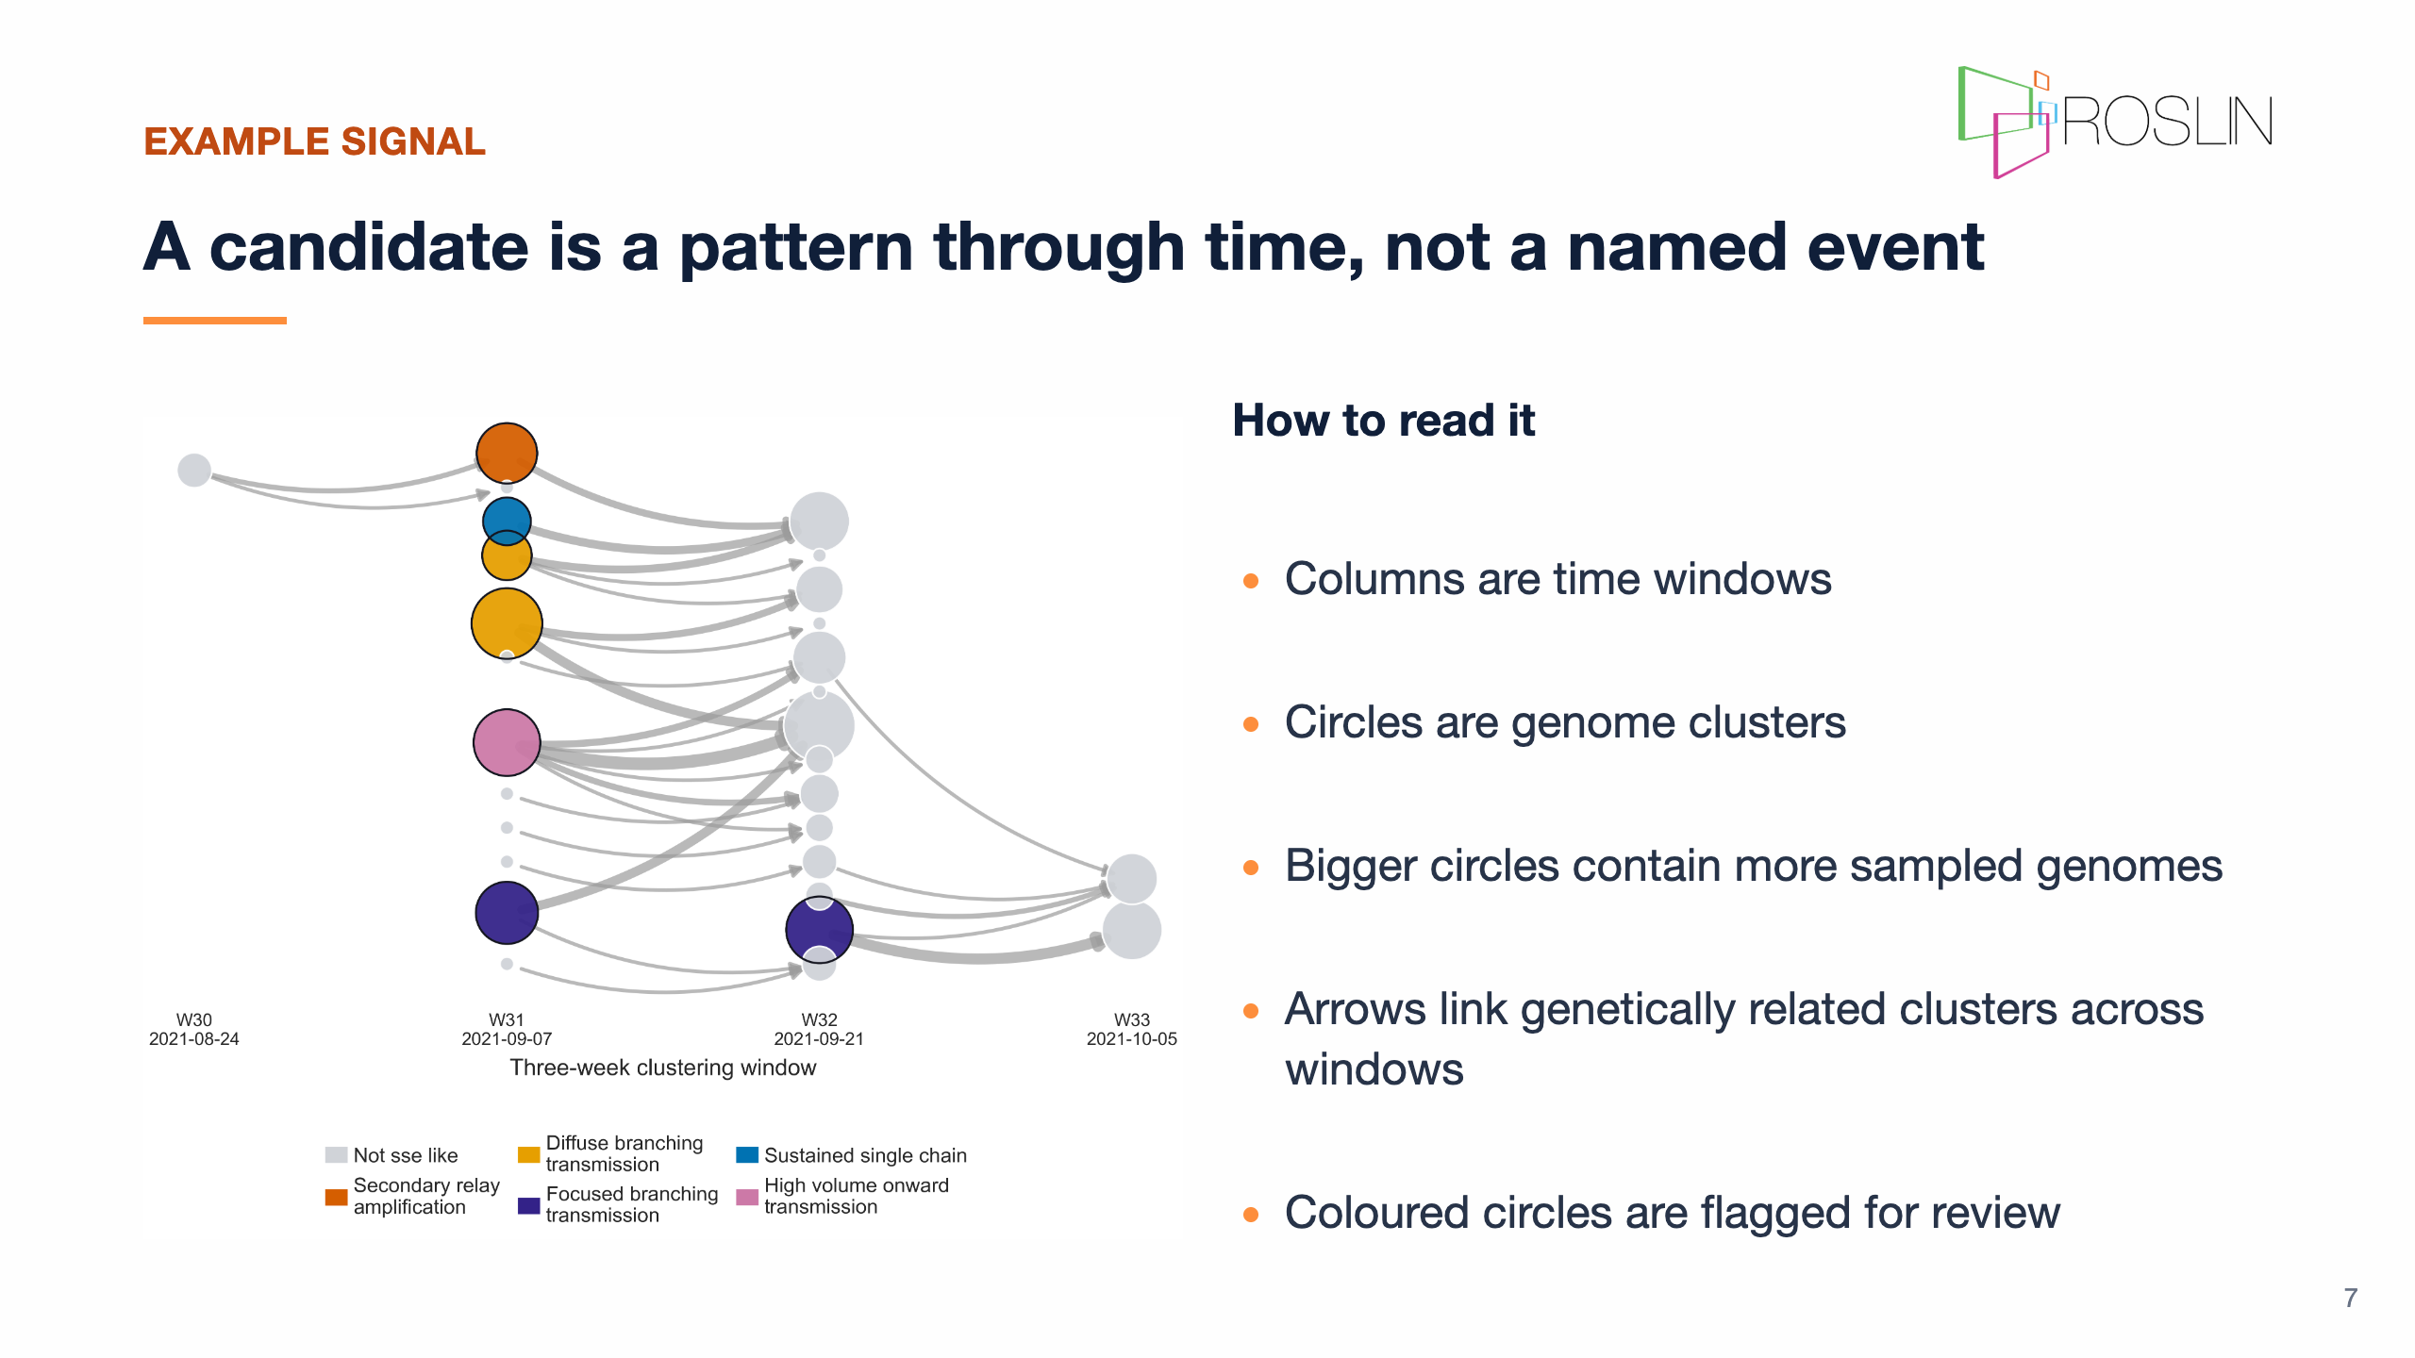
Notes:
Speaker notes: - This is what one flagged pattern looks like. - The coloured circles are clusters flagged by the screen using the three questions from the previous slide. - They may be unusually large, unusually new, or positioned where the lineage branches forward into several later clusters. - The important point is what this figure is not: it is not a map of a known outbreak setting, and it is not a named event. - It is the temporal shape of a viral lineage in sampled genome data. - That is enough structure to say this part of the record deserves a closer look, but not enough to explain what happened on its own.

Slide 8
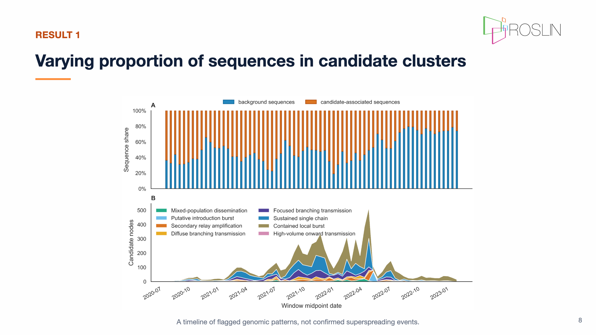
Notes:
Speaker notes: - When the screen is applied across the full surveillance period, the flagged patterns are not evenly distributed through time. - Some periods contain more unusual genome clusters than others, and the type of signal also changes. - I would be cautious about over-interpreting individual peaks. - Variant replacement, testing policy, sequencing intensity, and restrictions all affect what becomes visible in the genome data. - The useful message is that the screen gives us a structured way to identify unusual parts of the epidemic record at national scale. - The next step is to ask whether candidate membership is associated with socio-demographic or geographic factors.

Slide 9
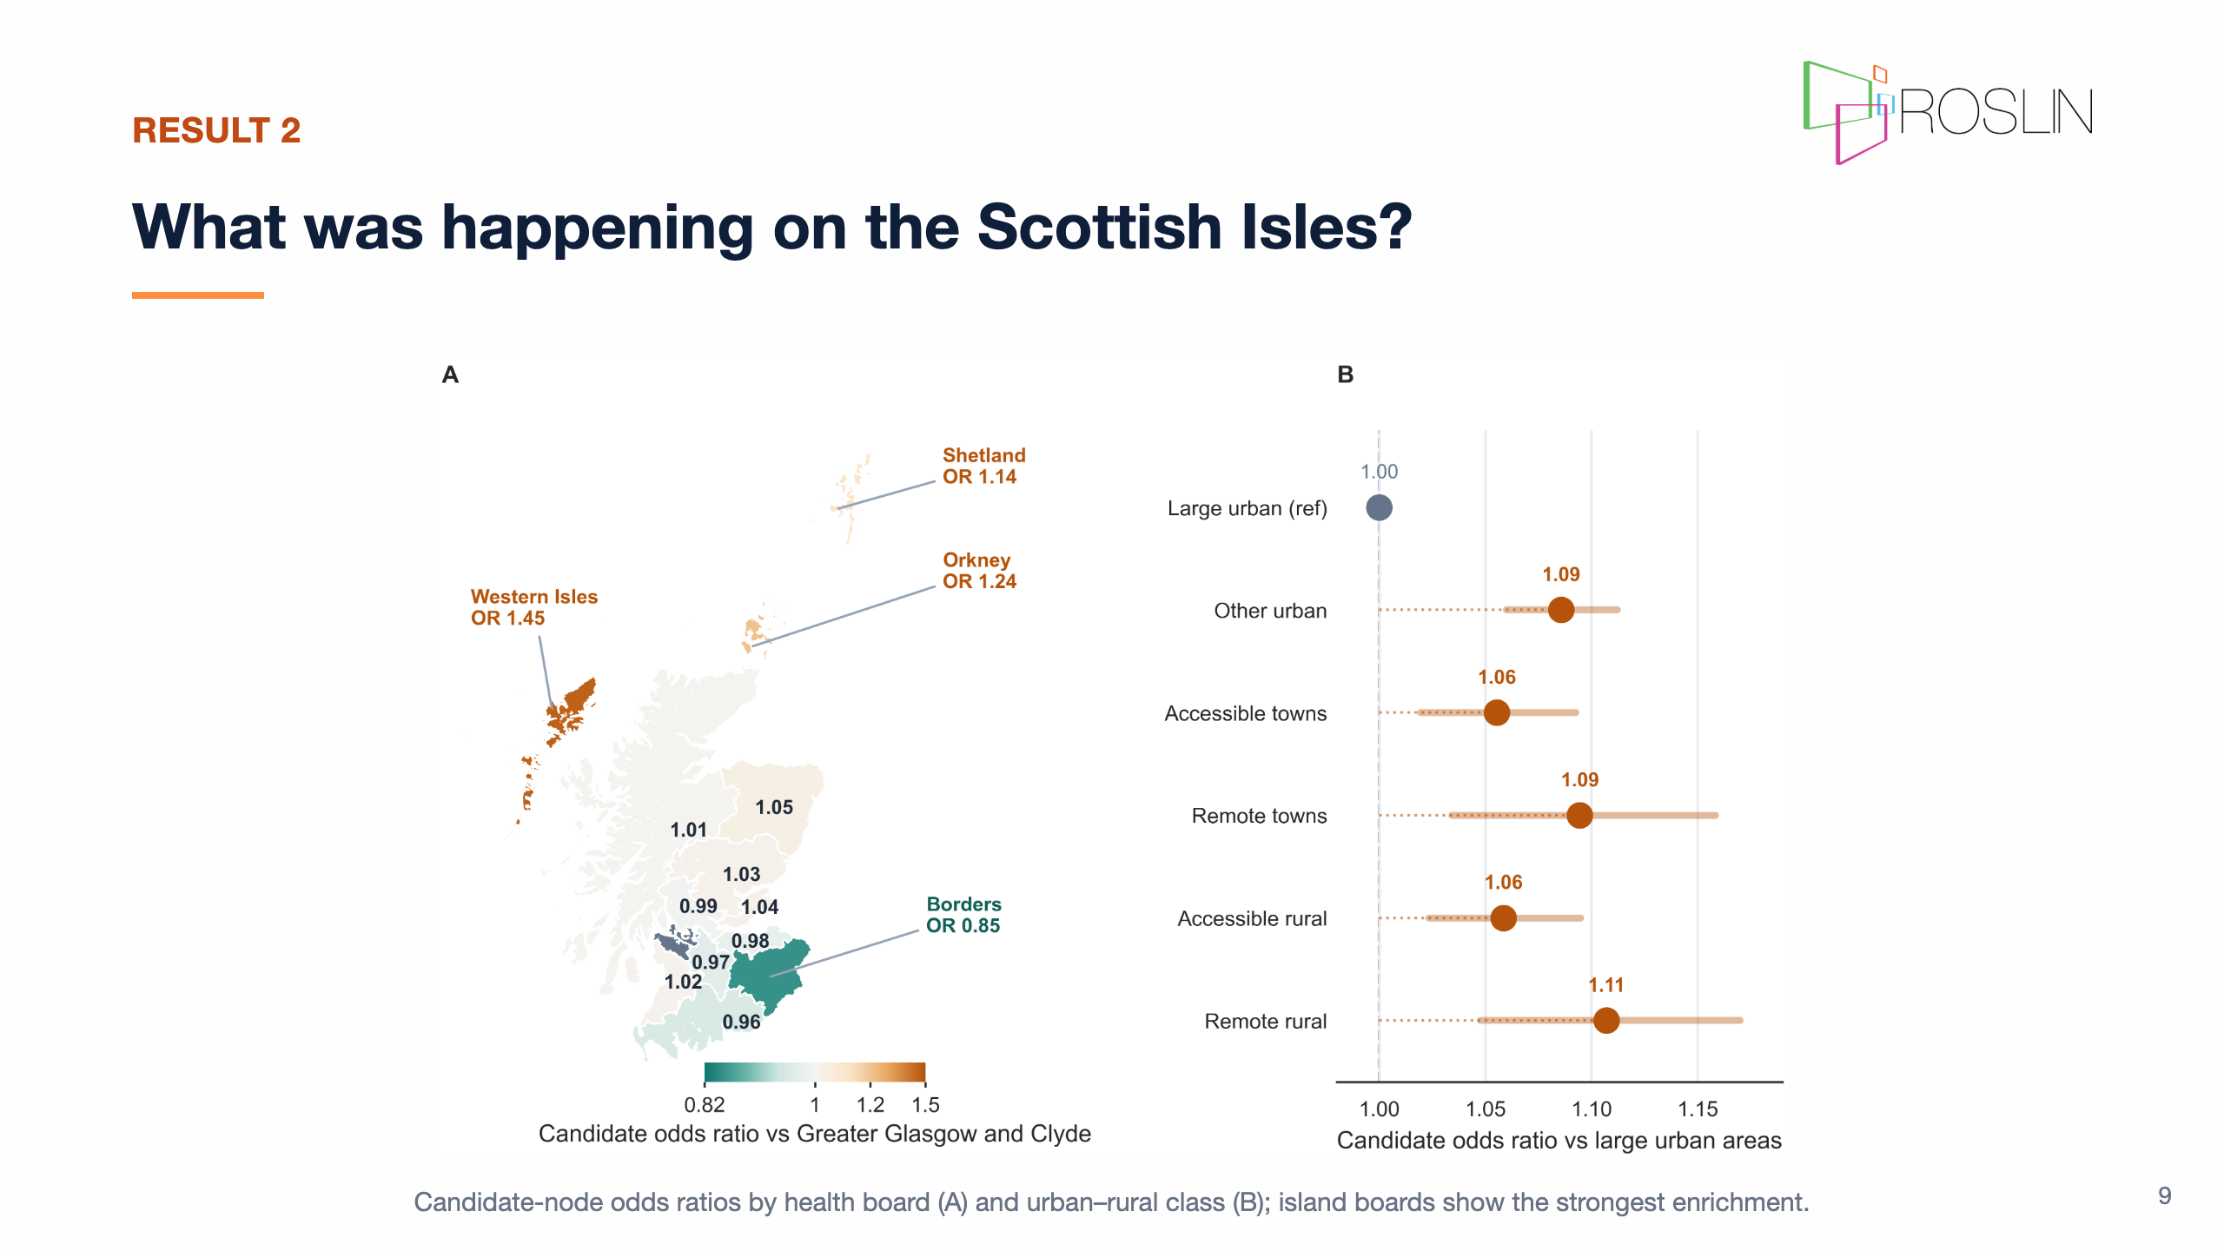
Notes:
Speaker notes: - Here I am showing results from a logistic regression model. - One model uses health board as the main predictor, and the other uses urban-rural class; both adjust for epidemic time windows, and clades. - The strongest place signal appears in the Scottish islands. - In Panel A, the odds ratios compare each health board with Greater Glasgow and Clyde, asking how much more or less likely sequences from that board are to sit in a flagged cluster. - The island boards stand out most: Western Isles at 1.45, Orkney at 1.24, and Shetland at 1.14. - Panel B shows a more modest urban-rural gradient, with remote rural areas and remote towns elevated by around 9-11% compared with large urban areas. - So what was happening there? From these data alone, we cannot say. - The signal could reflect true transmission dynamics in small, well-connected communities after an introduction. - It could also reflect surveillance practice, introduction timing relative to local viral diversity, travel and connectivity patterns not captured in the model, or uncertainty from small island-board populations. - This is exactly the kind of result the screen is designed to surface: a geographically specific, falsifiable question for external validation, not a conclusion by itself.

Slide 10
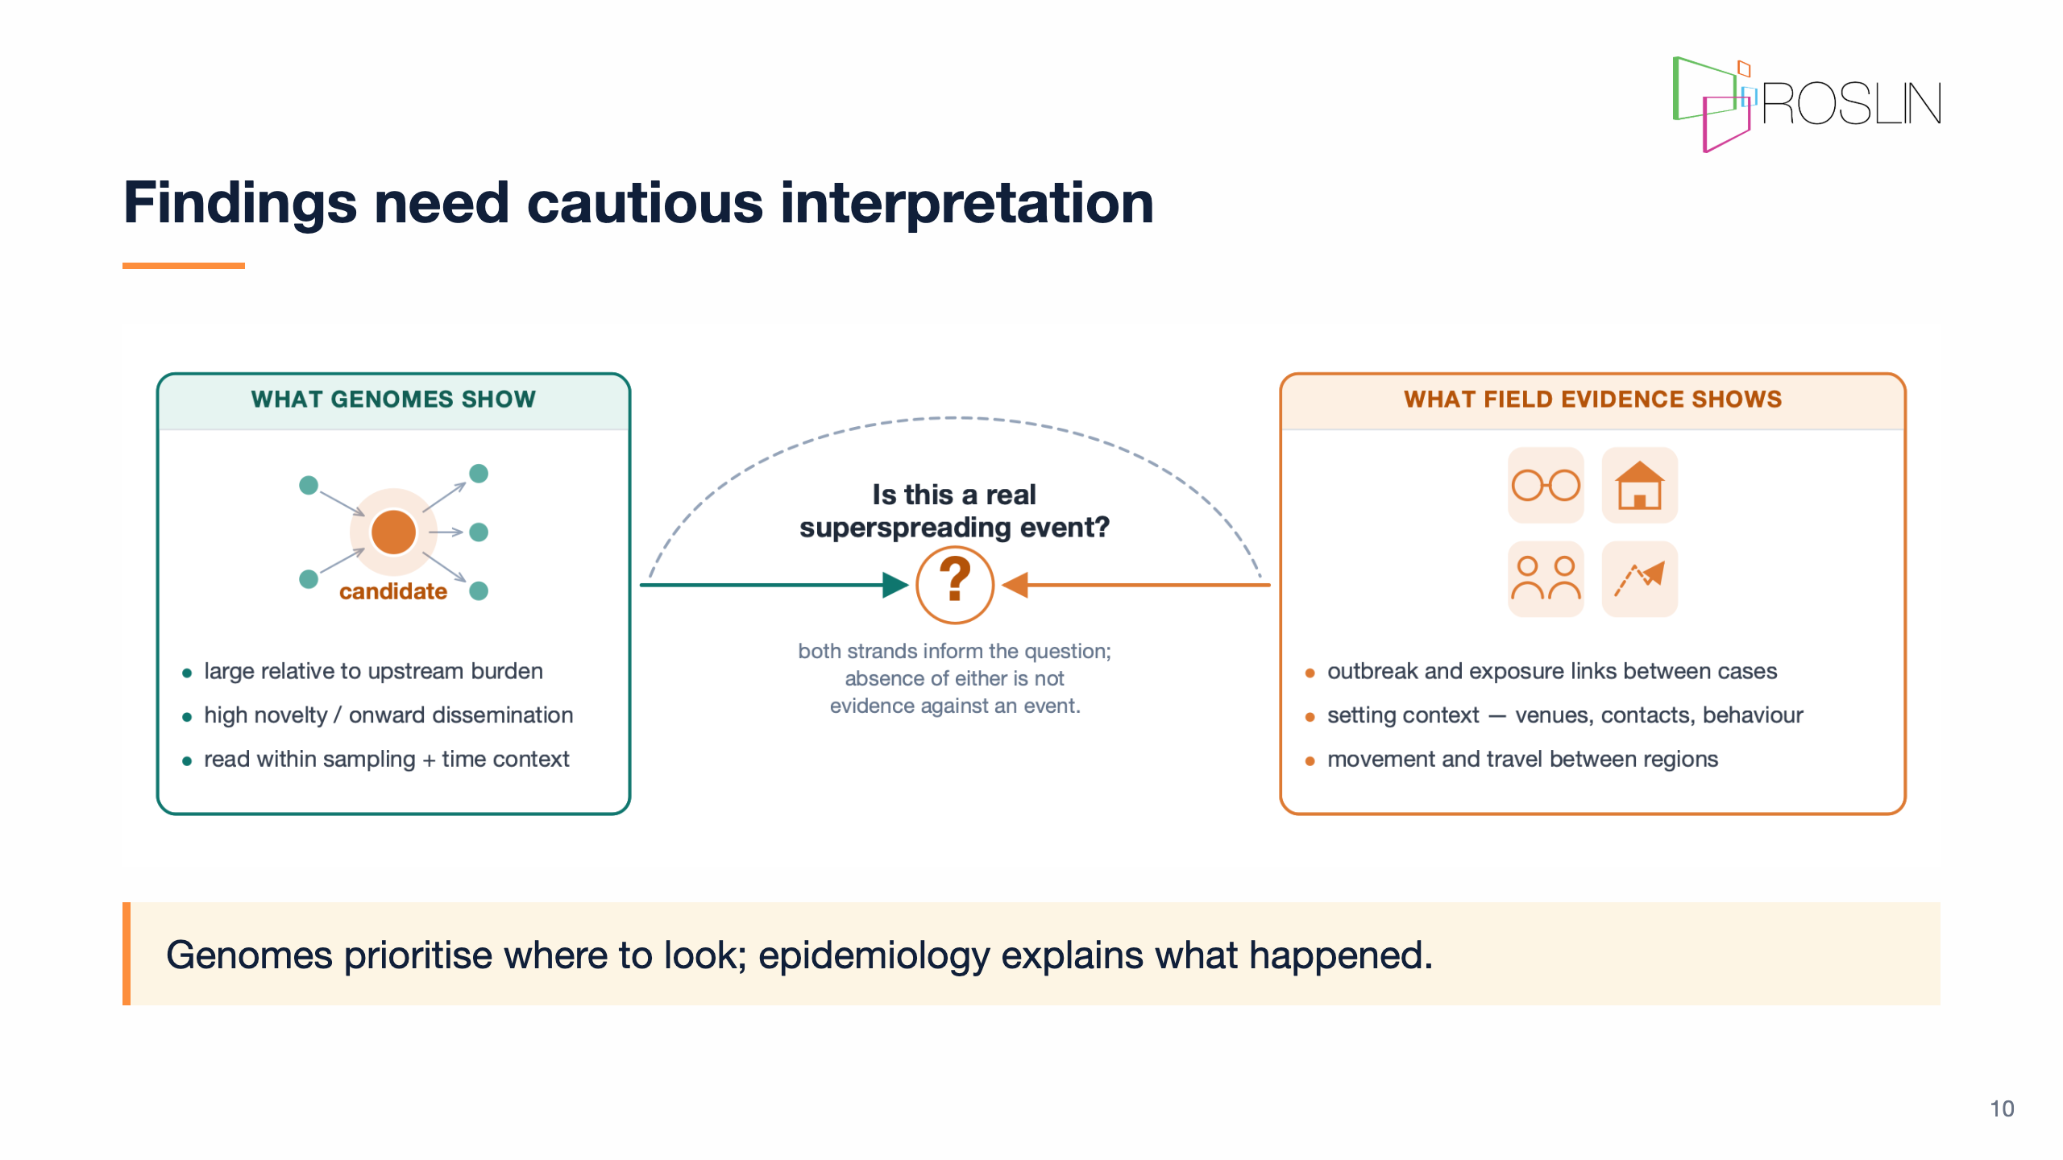
Notes:
Speaker notes: - This is the conceptual point I want to leave you with. - The genomic screen can scan years of surveillance data and produce a prioritised review list at national scale. - That is something manual review cannot do consistently across hundreds of thousands of genomes. - What the screen cannot do is confirm what happened or why. - Confirmation requires evidence outside the genomes: setting information, outbreak investigations, contact tracing, and travel or mobility data. - Genomics and epidemiology are complementary, not competing. - The ideal workflow links them, with genomic flags triggering targeted epidemiological follow-up.

Slide 11
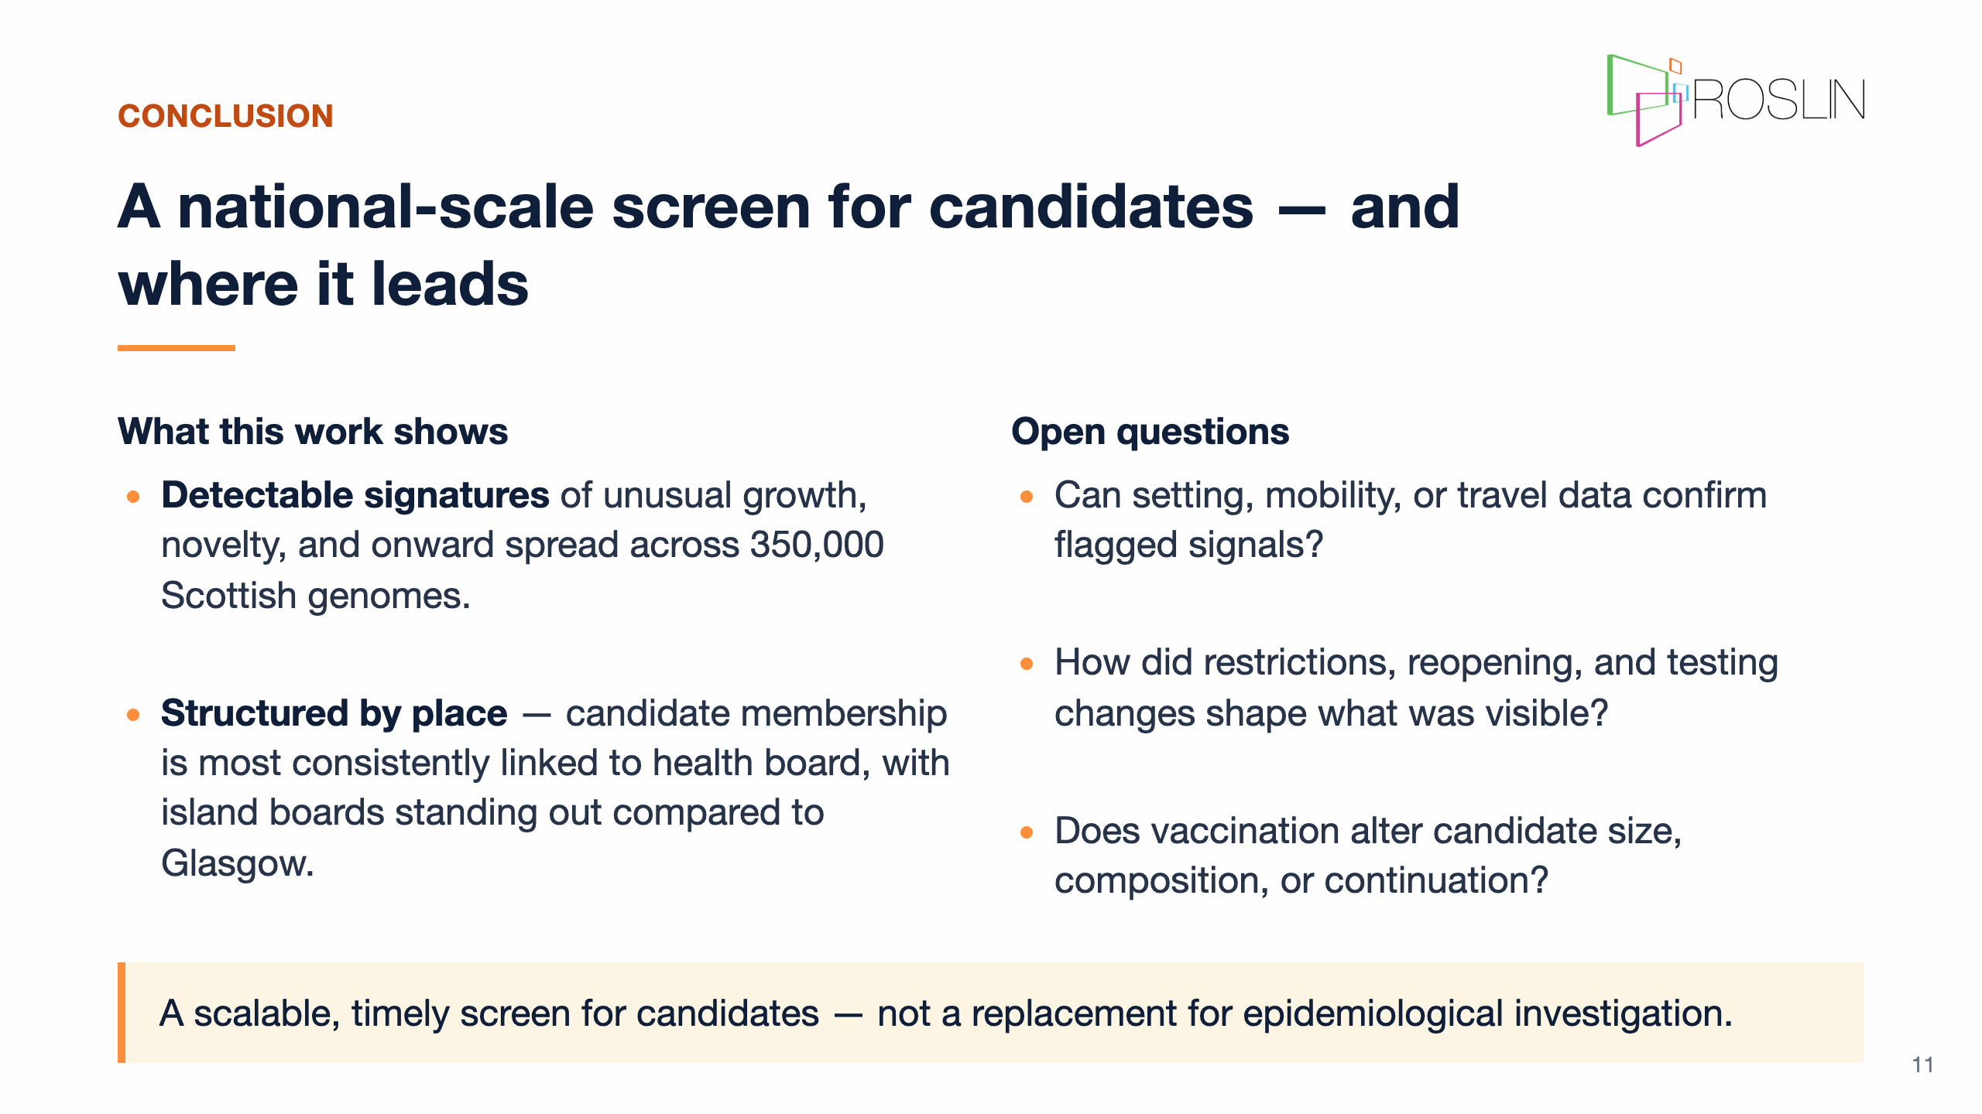
Notes:
Speaker notes: - To bring it together, the main contribution is a scalable retrospective screen for candidate superspreading-like signatures in Scotland's pandemic genome data. - The method clusters genomes across overlapping time windows and links those clusters into a transition graph. - That makes it possible to identify nodes with unusual amplification, novelty, or onward spread at a scale manual review cannot match. - The clearest population-level finding is that candidate membership is structured by place. - The association is strongest and most consistent by health board, with island boards standing out, and more modest by urban-rural class. - The open questions are where I would most welcome input. - External validation is the biggest one: can setting, mobility, travel, or outbreak data confirm what the screen flags? - The policy layer also matters, because restrictions and testing changes shaped which clusters were visible in the data. - Vaccination effects on cluster composition and continuation are still largely unexplored in this framework. - A final question is generalisability: could this approach transfer to influenza or other respiratory pathogens as genomic surveillance expands? - If any of these questions overlap with your work, please come and talk to me.

Slide 12

Notes:
Speaker notes: - Thank you very much for listening. - I am very grateful to Rowland Kao and Chris Banks for supervision and feedback. - Thank you to the Kao Group for discussion around the network and modelling framing. - Thank you also to Public Health Scotland and COG-UK for the surveillance data infrastructure, and to Wellcome for funding. - I would especially welcome questions or conversations about validation, interpretation of the place signal, and whether similar approaches could be useful for other respiratory pathogens.

