Slide 1
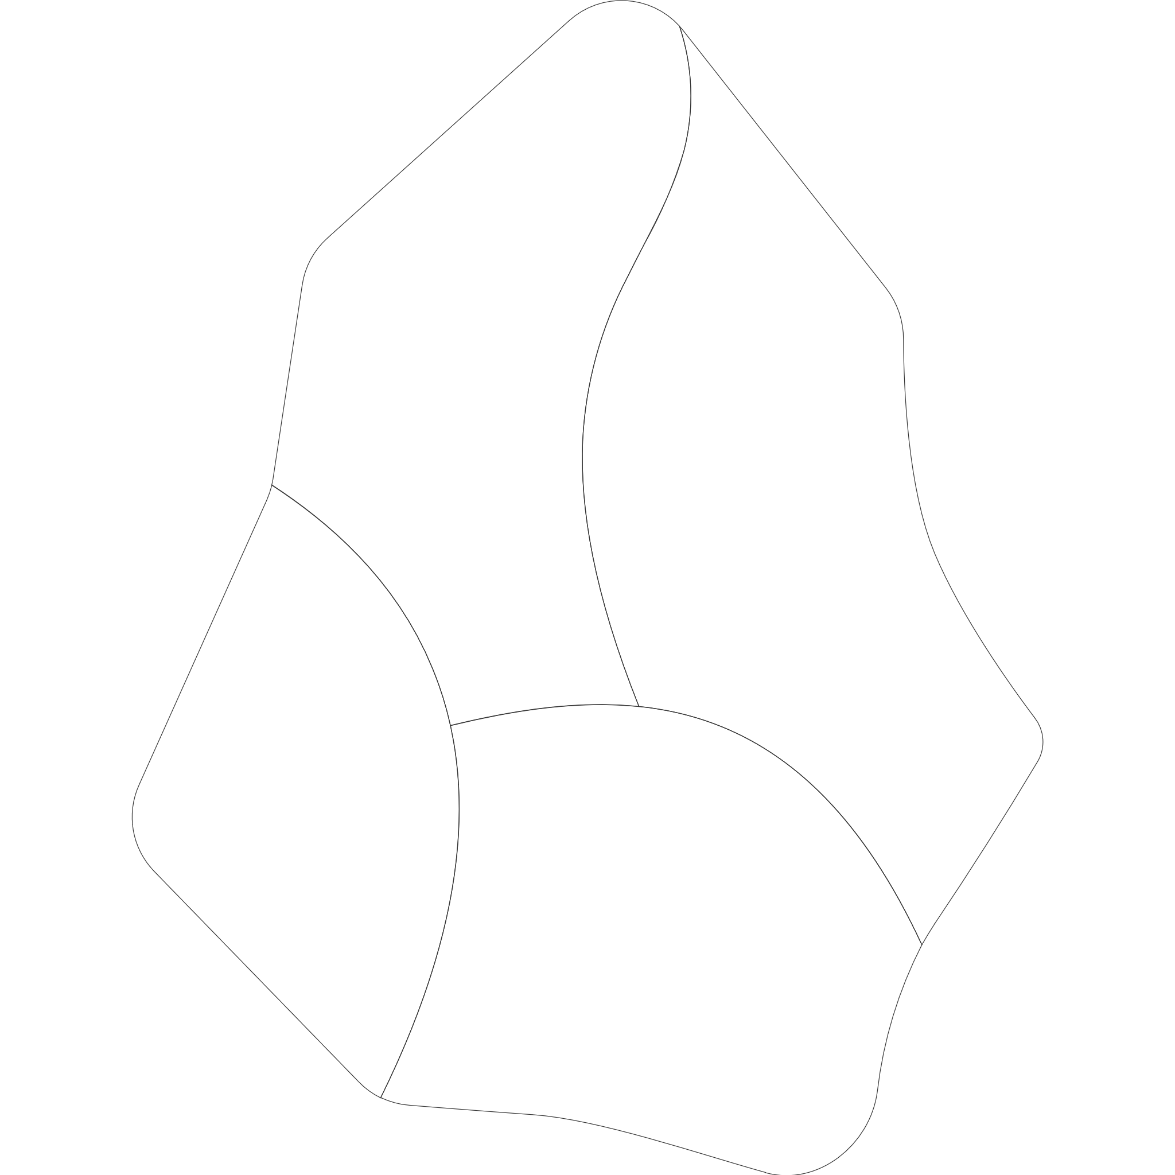





OBSIDIAN-VUE-SAMPLE-PLUGIN
Obsidian
TypeScript
Vue
ESbuild

Slide 2
