Slide 1

ME 607 $−$ Introduction to composite materials
Term Project:
Complete and partial degradation of laminate under mechanical and hygro-thermal loading
Group no: 1
Sabyasachi Kashyap (244103429)
Dushyant Pratap Singh (244103101)
Vikas Prajapati (244103107)
Partha Pratim Borah (246103104)

Slide 2





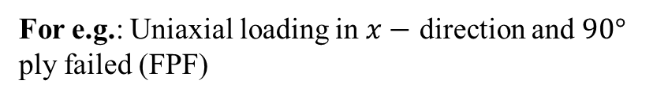

Complete and partial degradation of composites
Complete Degradation
Assumes that once a failure criterion is met, the material properties at the failed point reduce to zero instantly.
Partial Degradation
Only the failed material stiffness components reduced others remains intact.
For e.g.: Uniaxial loading in $x−$ direction and $90°$ ply failed (FPF)
$${[Q]}_{k}=f(E_{1},E_{2}{,θ}_{12},G_{12},θ)$$
For e.g.: Based on the failure mode:
Longitudinal: $E_{1}=0$,
Transverse: $E_{2}=0$, $G_{12}=0$
Shear: $G_{12}=0$
$$\left[Q_{90}\right]=0$$
Solve for
$$\left[\begin{matrix}N \\ M\end{matrix}\right]=\left[\begin{matrix}A & B \\ B & D\end{matrix}\right]\left[\begin{matrix}∈^{°} \\ K\end{matrix}\right]$$

Slide 3

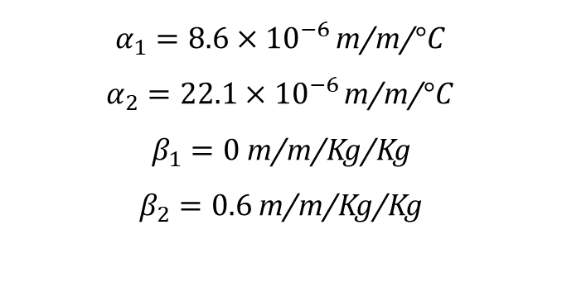


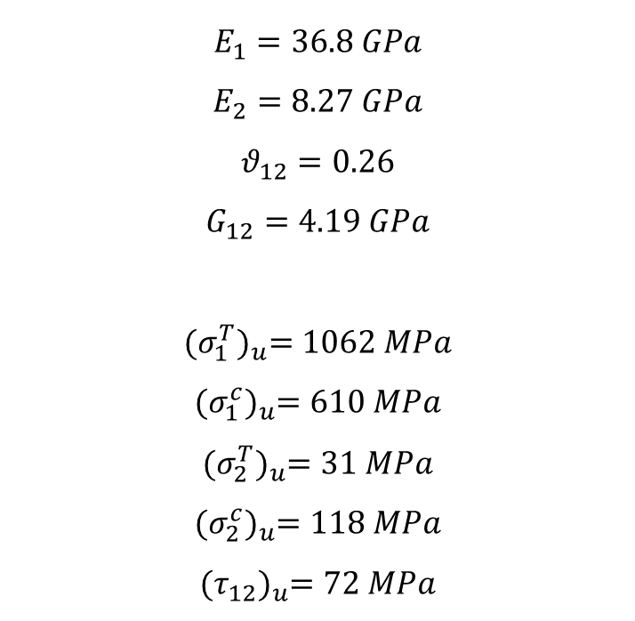



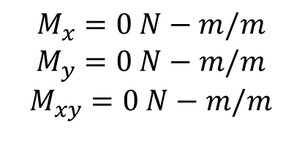


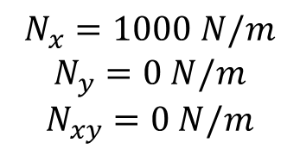


Glass epoxy laminate properties:
Hygrothermal properties:
Mechanical loading:
$$E_{1}=36.8 GPa$$
$$E_{2}=8.27 GPa$$
$$θ_{12}=0.26$$
$$G_{12}=4.19 GPa$$
$${(σ_{1}^{T})}_{u}=1062 MPa$$
$${(σ_{1}^{c})}_{u}=610 MPa$$
$${(σ_{2}^{T})}_{u}=31 MPa$$
$${(σ_{2}^{c})}_{u}=118 MPa$$
$${(τ_{12})}_{u}=72 MPa$$
$α_{1}=8.6×{10}^{−6 }$m/m/$°C$
$α_{2}=22.1×{10}^{−6 }$m/m/$°C$
$β_{1}=0$ m/m/Kg/Kg
$β_{2}=0.6$ m/m/Kg/Kg
$$N_{x}=1000 N/m$$
$$N_{y}=0 N/m$$
$$N_{xy}=0 N/m$$
$$M_{x}=0 N−m/m$$
$$M_{y}=0 N−m/m$$
$$M_{xy}=0 N−m/m$$
$$N_{x}$$
$$N_{x}$$
$$0°$$
$$45°$$
$$−45°$$
$$90°$$
$$90°$$
$$−45°$$
$$45°$$
$$0°$$
Fig: Glass epoxy laminate ${\text{[0/}\text{±}\text{45/90]}}_{s}$

Slide 4
Complete Degradation

Slide 5

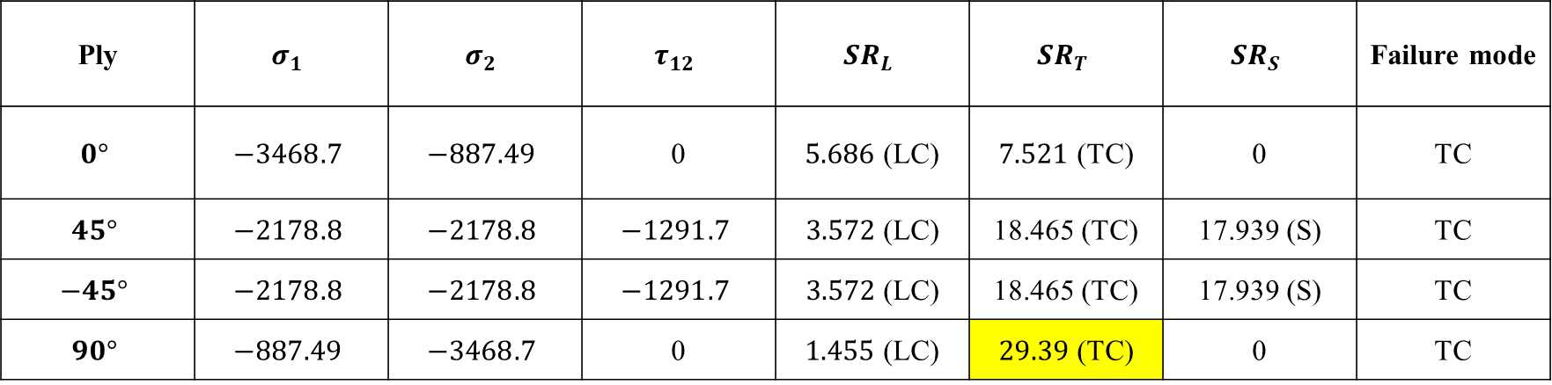
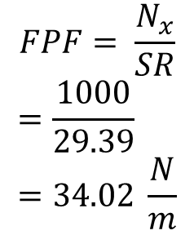

Complete degradation of laminate
Iteration 1
Ply | $$σ_{1}$$ | $$σ_{2}$$ | $$τ_{12}$$ | $${SR}_{L}$$ | $${SR}_{T}$$ | $${SR}_{S}$$ | Failure mode
$$0°$$ | $$−3468.7$$ | $$−887.49$$ | 0 | $5.686$ (LC) | $7.521$ (TC) | 0 | TC
$$45°$$ | $$−2178.8$$ | $$−2178.8$$ | $$−1291.7$$ | $3.572$(LC) | 18.465 (TC) | 17.939 (S) | TC
$$−45°$$ | $$−2178.8$$ | $$−2178.8$$ | $$−1291.7$$ | $3.572$(LC) | 18.465 (TC) | 17.939 (S) | TC
$$90°$$ | $$−887.49$$ | $$−3468.7$$ | 0 | $1.455$ (LC) | $29.39$ (TC) | 0 | TC
Ply layer 4 will fail $\left(90°\right)$
$$\left[Q_{90}\right]=0$$
$$FPF= \frac{N_{x}}{SR}$$
$$=\frac{1000}{29.39}=34.02 \frac{N}{m}$$

Slide 6

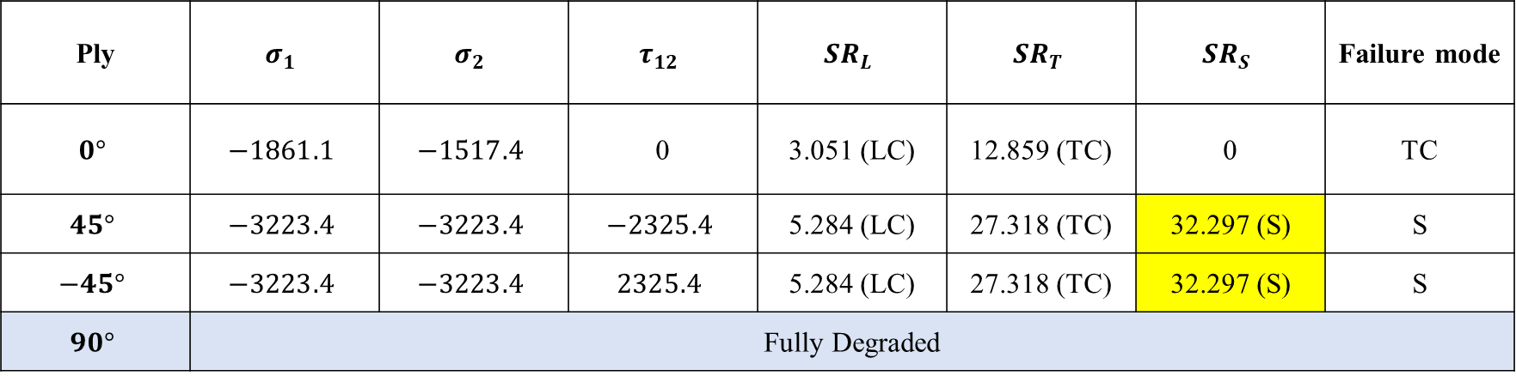
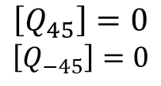
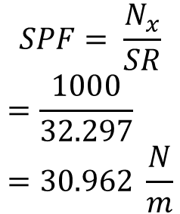
Complete degradation of laminate
Iteration 2
Ply | $$σ_{1}$$ | $$σ_{2}$$ | $$τ_{12}$$ | $${SR}_{L}$$ | $${SR}_{T}$$ | $${SR}_{S}$$ | Failure mode
$$0°$$ | $$−1861.1$$ | $$−1517.4$$ | 0 | 3.051 (LC) | 12.859 (TC) | 0 | TC
$$45°$$ | $$−3223.4$$ | $$−3223.4$$ | $$−2325.4$$ | 5.284 (LC) | 27.318 (TC) | 32.297 (S) | S
$$−45°$$ | $$−3223.4$$ | $$−3223.4$$ | $$2325.4$$ | 5.284 (LC) | 27.318 (TC) | 32.297 (S) | S
$$90°$$ | Fully Degraded
Ply layer 2 $\left(45°\right)$& layer 3 $\left(−45°\right)$will fail
$$\left[Q_{45}\right]=0$$
$$\left[Q_{−45}\right]=0$$
$$SPF= \frac{N_{x}}{SR}$$
$$=\frac{1000}{32.297}=30.962 \frac{N}{m}$$

Slide 7

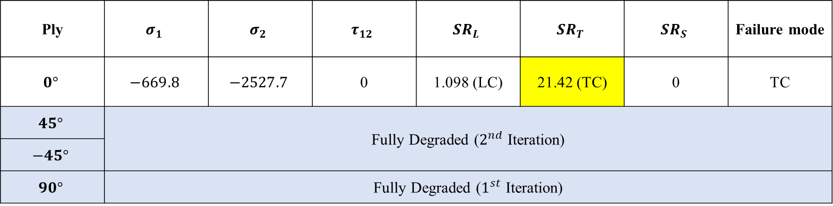

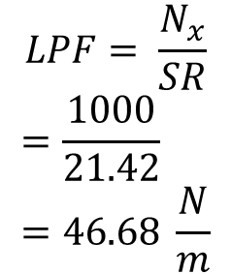
Complete degradation of laminate
Iteration 3
Ply | $$σ_{1}$$ | $$σ_{2}$$ | $$τ_{12}$$ | $${SR}_{L}$$ | $${SR}_{T}$$ | $${SR}_{S}$$ | Failure mode
$$0°$$ | $$−669.8$$ | $$−2527.7$$ | 0 | 1.098 (LC) | 21.42 (TC) | 0 | TC
$$45°$$ | Fully Degraded ($2^{nd}$ Iteration)
$$−45°$$
$$90°$$ | Fully Degraded ($1^{st}$ Iteration)
Ply layer 1 $\left(0°\right)$will fail
$$\left[Q_{0}\right]=0$$
$$LPF= \frac{N_{x}}{SR}$$
$$=\frac{1000}{21.42}=46.68 \frac{N}{m}$$

Slide 8
Partial Degradation

Slide 9
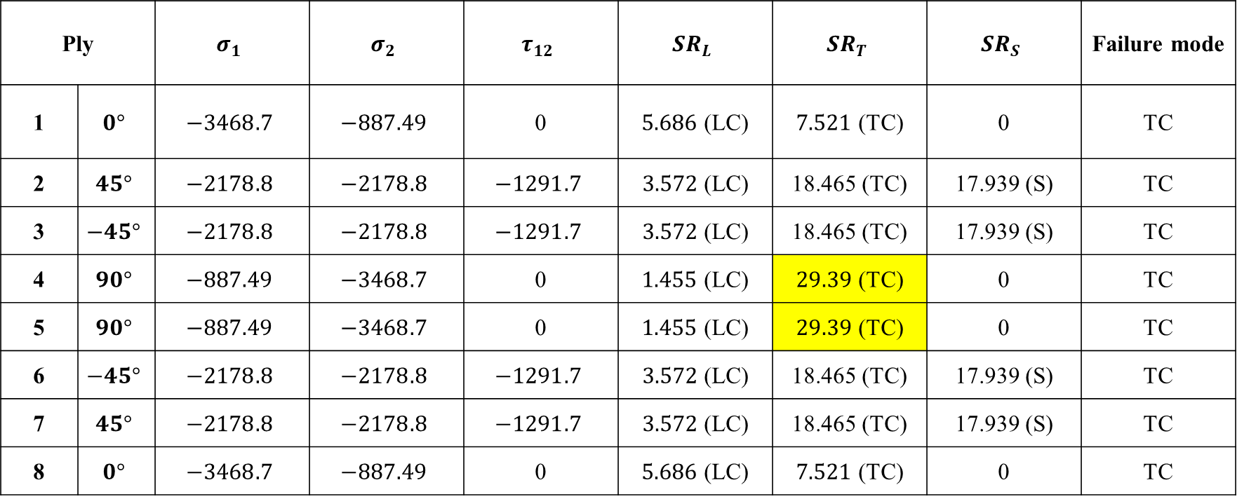
Partial degradation of laminate
Iteration 1
Ply |  | $$σ_{1}$$ | $$σ_{2}$$ | $$τ_{12}$$ | $${SR}_{L}$$ | $${SR}_{T}$$ | $${SR}_{S}$$ | Failure mode
1 | $$0°$$ | $$−3468.7$$ | $$−887.49$$ | 0 | $5.686$ (LC) | $7.521$ (TC) | 0 | TC
2 | $$45°$$ | $$−2178.8$$ | $$−2178.8$$ | $$−1291.7$$ | $3.572$(LC) | 18.465 (TC) | 17.939 (S) | TC
3 | $$−45°$$ | $$−2178.8$$ | $$−2178.8$$ | $$−1291.7$$ | $3.572$(LC) | 18.465 (TC) | 17.939 (S) | TC
4 | $$90°$$ | $$−887.49$$ | $$−3468.7$$ | 0 | $1.455$ (LC) | $29.39$ (TC) | 0 | TC
5 | $$90°$$ | $$−887.49$$ | $$−3468.7$$ | 0 | $1.455$ (LC) | $29.39$ (TC) | 0 | TC
6 | $$−45°$$ | $$−2178.8$$ | $$−2178.8$$ | $$−1291.7$$ | $3.572$(LC) | 18.465 (TC) | 17.939 (S) | TC
7 | $$45°$$ | $$−2178.8$$ | $$−2178.8$$ | $$−1291.7$$ | $3.572$(LC) | 18.465 (TC) | 17.939 (S) | TC
8 | $$0°$$ | $$−3468.7$$ | $$−887.49$$ | 0 | $5.686$ (LC) | $7.521$ (TC) | 0 | TC

Slide 10
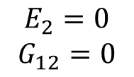

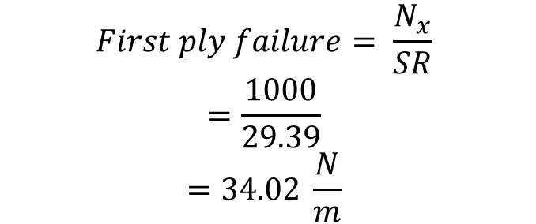
Iteration 1: cont…
Ply layer 4 $\left(90°\right)$and 5 $\left(90°\right)$will fail
$$E_{2}=0$$
$$G_{12}=0$$
$$First ply failure= \frac{N_{x}}{SR}$$
$$=\frac{1000}{29.39}$$
$$=34.02 \frac{N}{m}$$

Slide 11
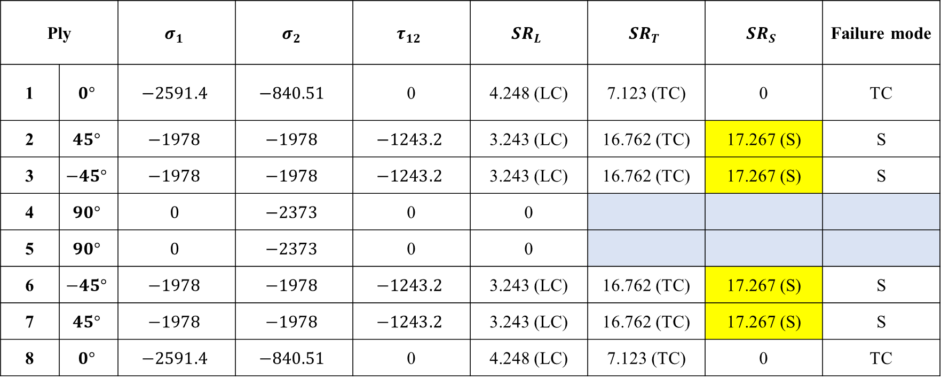
Partial degradation of laminate
Iteration 2
Ply |  | $$σ_{1}$$ | $$σ_{2}$$ | $$τ_{12}$$ | $${SR}_{L}$$ | $${SR}_{T}$$ | $${SR}_{S}$$ | Failure mode
1 | $$0°$$ | $$−2591.4$$ | $$−840.51$$ | 0 | 4.248 (LC) | 7.123 (TC) | 0 | TC
2 | $$45°$$ | $$−1978$$ | $$−1978$$ | $$−1243.2$$ | 3.243 (LC) | 16.762 (TC) | 17.267 (S) | S
3 | $$−45°$$ | $$−1978$$ | $$−1978$$ | $$−1243.2$$ | 3.243 (LC) | 16.762 (TC) | 17.267 (S) | S
4 | $$90°$$ | $$0$$ | $$−2373$$ | 0 | 0
5 | $$90°$$ | $$0$$ | $$−2373$$ | 0 | 0
6 | $$−45°$$ | $$−1978$$ | $$−1978$$ | $$−1243.2$$ | 3.243 (LC) | 16.762 (TC) | 17.267 (S) | S
7 | $$45°$$ | $$−1978$$ | $$−1978$$ | $$−1243.2$$ | 3.243 (LC) | 16.762 (TC) | 17.267 (S) | S
8 | $$0°$$ | $$−2591.4$$ | $$−840.51$$ | 0 | 4.248 (LC) | 7.123 (TC) | 0 | TC

Slide 12

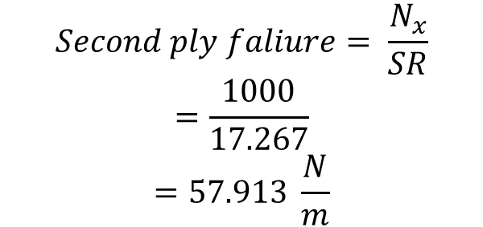
Iteration 2: cont…
Ply layer 2 & 7 $\left(45°\right)$ and ply layer 3 & 6$(−45°)$ will fail
$$G_{12}=0$$
$$Second ply faliure= \frac{N_{x}}{SR}$$
$$=\frac{1000}{17.267}$$
$$=57.913 \frac{N}{m}$$

Slide 13
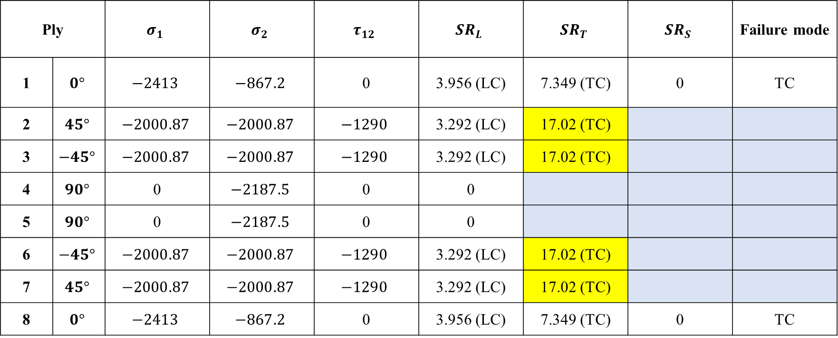
Partial degradation of laminate
Iteration 3
Ply |  | $$σ_{1}$$ | $$σ_{2}$$ | $$τ_{12}$$ | $${SR}_{L}$$ | $${SR}_{T}$$ | $${SR}_{S}$$ | Failure mode
1 | $$0°$$ | $$−2413$$ | $$−867.2$$ | 0 | 3.956 (LC) | 7.349 (TC) | 0 | TC
2 | $$45°$$ | $$−2000.87$$ | $$−2000.87$$ | $$−1290$$ | 3.292 (LC) | 17.02 (TC)
3 | $$−45°$$ | $$−2000.87$$ | $$−2000.87$$ | $$−1290$$ | 3.292 (LC) | 17.02 (TC)
4 | $$90°$$ | 0 | $$−2187.5$$ | 0 | 0
5 | $$90°$$ | 0 | $$−2187.5$$ | 0 | 0
6 | $$−45°$$ | $$−2000.87$$ | $$−2000.87$$ | $$−1290$$ | 3.292 (LC) | 17.02 (TC)
7 | $$45°$$ | $$−2000.87$$ | $$−2000.87$$ | $$−1290$$ | 3.292 (LC) | 17.02 (TC)
8 | $$0°$$ | $$−2413$$ | $$−867.2$$ | 0 | 3.956 (LC) | 7.349 (TC) | 0 | TC

Slide 14
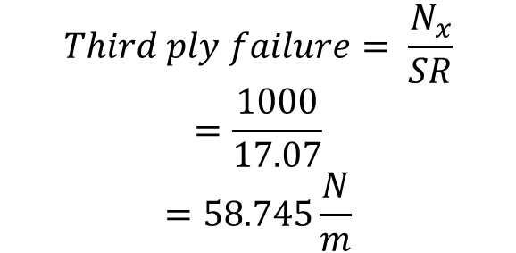
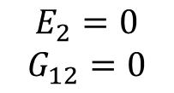
Iteration 3: cont…
Ply layer 2 & 7 $\left(45°\right)$ and ply layer 3 & 6$(−45°)$ will fail
$$E_{2}=0$$
$$G_{12}=0$$
$$Third ply failure= \frac{N_{x}}{SR}$$
$$=\frac{1000}{17.07}$$
$$=58.745\frac{N}{m}$$

Slide 15
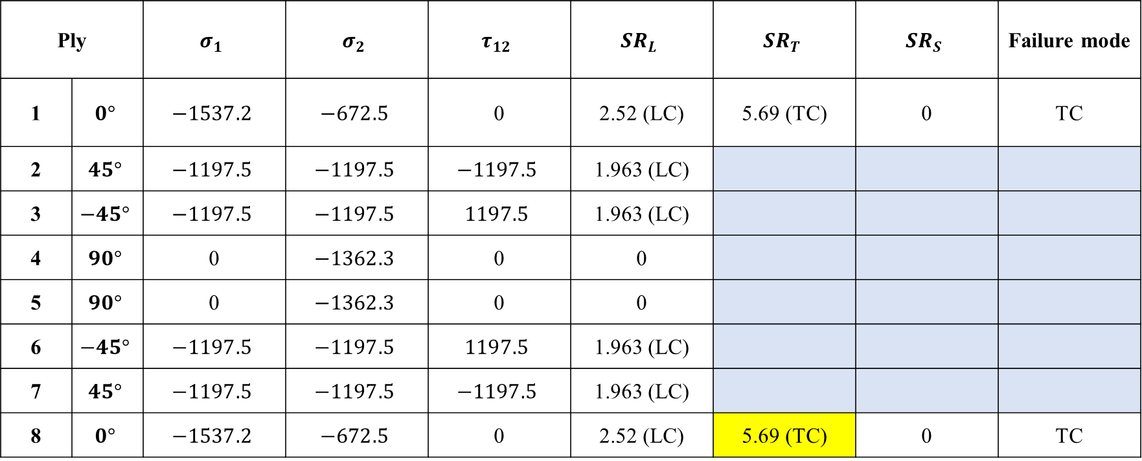
Partial degradation of laminate
Iteration 4
Ply |  | $$σ_{1}$$ | $$σ_{2}$$ | $$τ_{12}$$ | $${SR}_{L}$$ | $${SR}_{T}$$ | $${SR}_{S}$$ | Failure mode
1 | $$0°$$ | $$−1537.2$$ | $$−672.5$$ | 0 | 2.52 (LC) | 5.69 (TC) | 0 | TC
2 | $$45°$$ | $$−1197.5$$ | $$−1197.5$$ | $$−1197.5$$ | 1.963 (LC)
3 | $$−45°$$ | $$−1197.5$$ | $$−1197.5$$ | $$1197.5$$ | 1.963 (LC)
4 | $$90°$$ | 0 | $$−1362.3$$ | 0 | 0
5 | $$90°$$ | 0 | $$−1362.3$$ | 0 | 0
6 | $$−45°$$ | $$−1197.5$$ | $$−1197.5$$ | $$1197.5$$ | 1.963 (LC)
7 | $$45°$$ | $$−1197.5$$ | $$−1197.5$$ | $$−1197.5$$ | 1.963 (LC)
8 | $$0°$$ | $$−1537.2$$ | $$−672.5$$ | 0 | 2.52 (LC) | 5.69 (TC) | 0 | TC

Slide 16
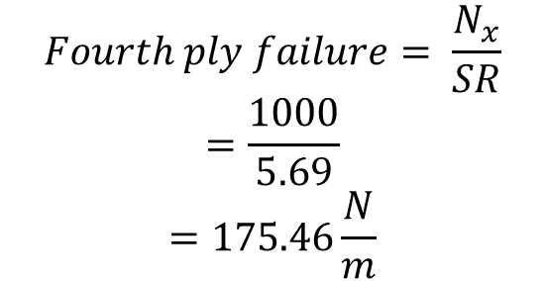

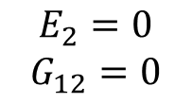
Iteration 4: cont…
Ply layer 8 $\left(0°\right)$ will fail
$$E_{2}=0$$
$$G_{12}=0$$
$$Fourth ply failure= \frac{N_{x}}{SR}$$
$$=\frac{1000}{5.69}$$
$$=175.46\frac{N}{m}$$

Slide 17
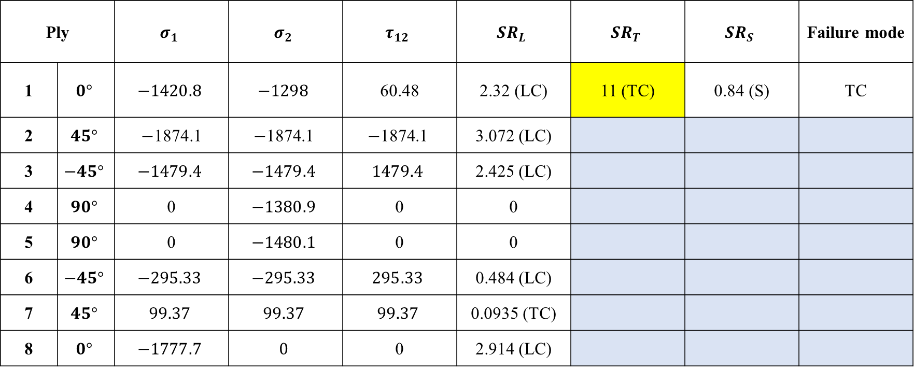
Partial degradation of laminate
Iteration 5
Ply |  | $$σ_{1}$$ | $$σ_{2}$$ | $$τ_{12}$$ | $${SR}_{L}$$ | $${SR}_{T}$$ | $${SR}_{S}$$ | Failure mode
1 | $$0°$$ | $$−1420.8$$ | $$−1298$$ | 60.48 | 2.32 (LC) | 11 (TC) | 0.84 (S) | TC
2 | $$45°$$ | $−$1874.1 | $$−\text{1874.1}$$ | $$−\text{1874.1}$$ | 3.072 (LC)
3 | $$−45°$$ | $$−1479.4$$ | $$−1479.4$$ | $$1479.4$$ | 2.425 (LC)
4 | $$90°$$ | 0 | $$−1380.9$$ | 0 | 0
5 | $$90°$$ | 0 | $$−1480.1$$ | 0 | 0
6 | $$−45°$$ | $$−295.33$$ | $$−295.33$$ | $$295.33$$ | 0.484 (LC)
7 | $$45°$$ | $$99.37$$ | $$99.37$$ | $$99.37$$ | 0.0935 (TC)
8 | $$0°$$ | $$−1777.7$$ | $$0$$ | 0 | 2.914 (LC)

Slide 18
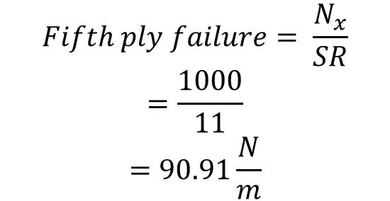

Iteration 5: cont…
Ply layer 1 $\left(0°\right)$ will fail
$$E_{2}=0$$
$$G_{12}=0$$
$$Fifth ply failure= \frac{N_{x}}{SR}$$
$$=\frac{1000}{11}$$
$$=90.91\frac{N}{m}$$

Slide 19
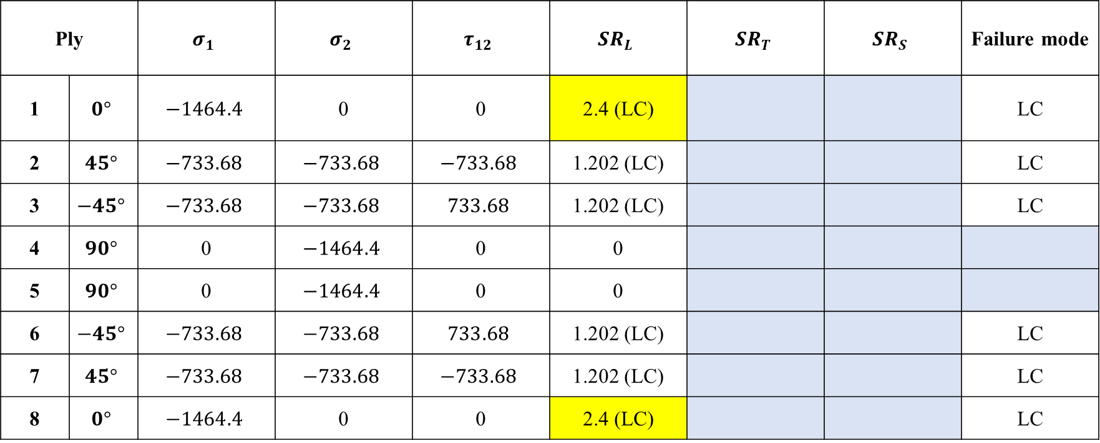
Partial degradation of laminate
Iteration 6
Ply |  | $$σ_{1}$$ | $$σ_{2}$$ | $$τ_{12}$$ | $${SR}_{L}$$ | $${SR}_{T}$$ | $${SR}_{S}$$ | Failure mode
1 | $$0°$$ | $$−1464.4$$ | 0 | 0 | 2.4 (LC) |  |  | LC
2 | $$45°$$ | $$−733.68$$ | $$−733.68$$ | $$−733.68$$ | 1.202 (LC) |  |  | LC
3 | $$−45°$$ | $$−733.68$$ | $$−733.68$$ | $$733.68$$ | 1.202 (LC) |  |  | LC
4 | $$90°$$ | 0 | $$−1464.4$$ | 0 | 0
5 | $$90°$$ | 0 | $$−1464.4$$ | 0 | 0
6 | $$−45°$$ | $$−733.68$$ | $$−733.68$$ | $$733.68$$ | 1.202 (LC) |  |  | LC
7 | $$45°$$ | $$−733.68$$ | $$−733.68$$ | $$−733.68$$ | 1.202 (LC) |  |  | LC
8 | $$0°$$ | $$−1464.4$$ | 0 | 0 | 2.4 (LC) |  |  | LC

Slide 20
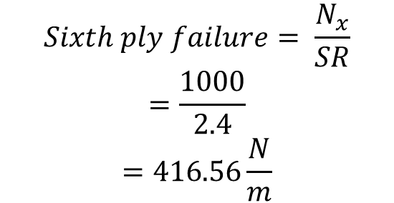


Iteration 6: cont…
Ply layer 1 and 8 both $\left(0°\right)$ will fail
$$E_{1}=0$$
$$Sixth ply failure= \frac{N_{x}}{SR}$$
$$=\frac{1000}{2.4}$$
$$=416.56\frac{N}{m}$$

Slide 21
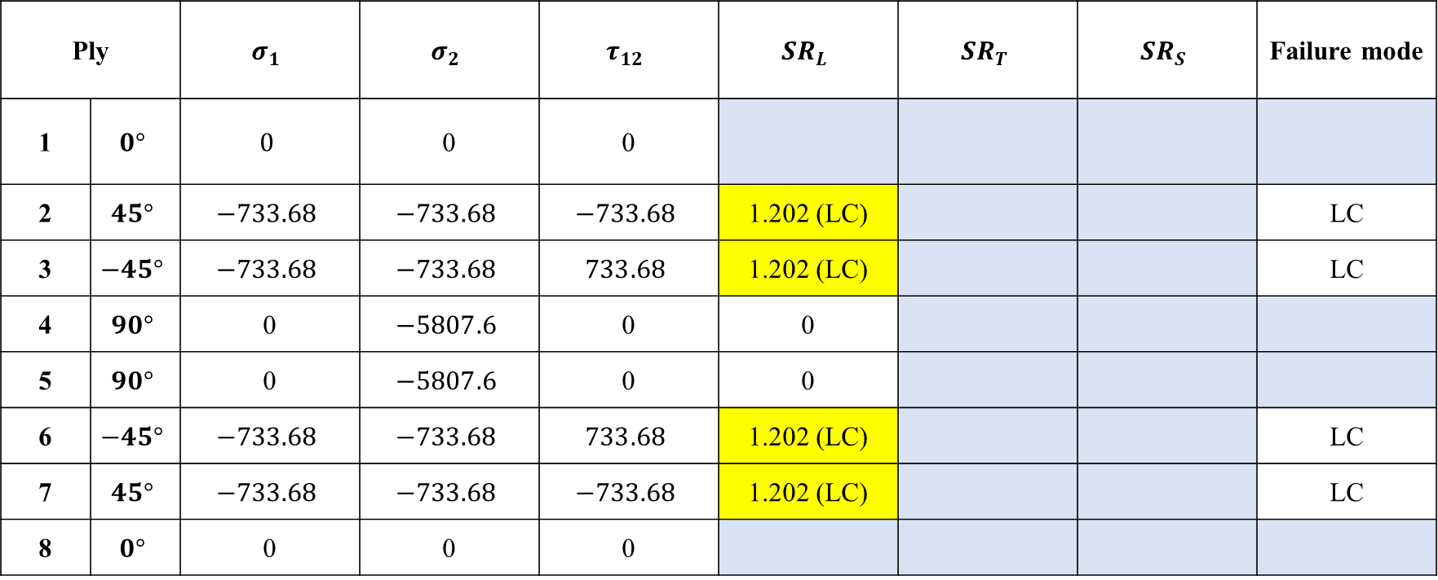
Partial degradation of laminate
Iteration 7
Ply |  | $$σ_{1}$$ | $$σ_{2}$$ | $$τ_{12}$$ | $${SR}_{L}$$ | $${SR}_{T}$$ | $${SR}_{S}$$ | Failure mode
1 | $$0°$$ | $$0$$ | 0 | 0
2 | $$45°$$ | $$−733.68$$ | $$−733.68$$ | $$−733.68$$ | 1.202 (LC) |  |  | LC
3 | $$−45°$$ | $$−733.68$$ | $$−733.68$$ | $$733.68$$ | 1.202 (LC) |  |  | LC
4 | $$90°$$ | 0 | $$−5807.6$$ | 0 | 0
5 | $$90°$$ | 0 | $$−5807.6$$ | 0 | 0
6 | $$−45°$$ | $$−733.68$$ | $$−733.68$$ | $$733.68$$ | 1.202 (LC) |  |  | LC
7 | $$45°$$ | $$−733.68$$ | $$−733.68$$ | $$−733.68$$ | 1.202 (LC) |  |  | LC
8 | $$0°$$ | 0 | 0 | 0

Slide 22
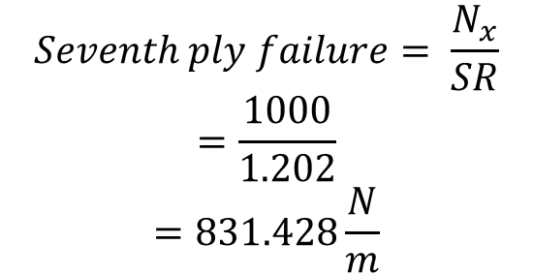
Iteration 7: cont…
Ply layer 1 and 8 both $\left(0°\right)$ will fail
$$E_{1}=0$$
$$Seventh ply failure= \frac{N_{x}}{SR}$$
$$=\frac{1000}{1.202}$$
$$=831.428\frac{N}{m}$$

Slide 23
Thank you

